Slide 1
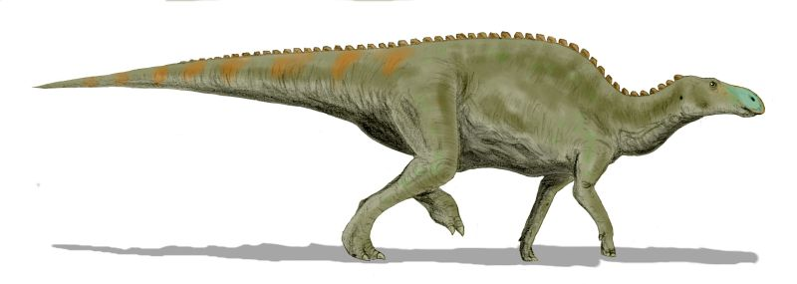
41th Annual Greater Indianapolis
Gem, Mineral and Fossil Show
September 8 – 9 – 10, 2017
Hancock County 4-H Fairgrounds, Greenfield, Indiana
Friday: 10:00 a.m. – 7:00 p.m.
Saturday: 10:00 a.m. – 7:00 p.m.
Sunday: 10:00 a.m. – 4:00 p.m.
Dealers and Swappers in
Fossils, Minerals, Gems and Jewelry and Lapidary Equipment…
MIDWEST
FEDERATION
PLUS
Silent Auctions, Door Prizes and Much, Much More!
Kids Activities, Demonstrations, Educational Displays and Programs for All
Special Fossil Exhibits by:
The Children’s Museum of Indianapolis
GREAT FOOD!
FREE ADMISSION!
RV PARKING!
Meeting on Saturday: Indiana Society of Paleontology at 2:00 p.m.
Sponsored by:
3 AREAS OF DEALERS AND SWAPPERS!
Interstate 70
Mackenzie Rd
Hwy 9
620 N. Apple Greenfield, IN
Apple St.
US 40
N
Cheryl Hamilton, 3507 Luewan Dr., Indianapolis, IN 46235, 317+897-6639, clhamilton1951@gmail.com

