Slide 1
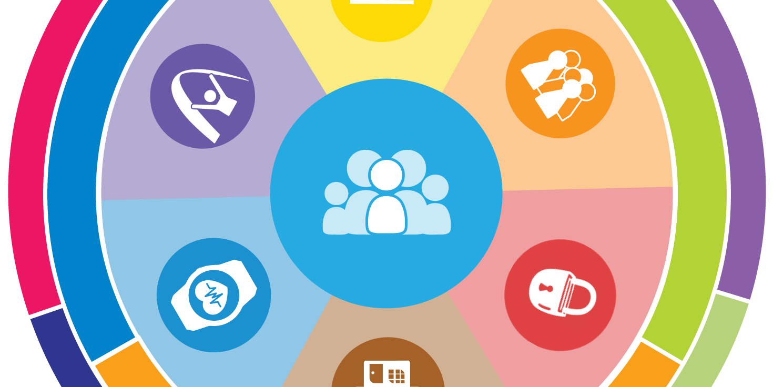
Envisioning a Good Life for All
Nancy Richey
Lifesharing Conference
October 18, 2016
Notes:
ALL people should be able and encouraged to have a good life, an everyday life.

Slide 2
A vision of a good life
Having a vision sets the dream, the positive expectation for the future.
But without a vision, there is no expectation of what the future might look like.
Notes:
Having a vision or an expectation of what an everyday life would look like is the critical starting place for creating it and moving toward it at all life stages.

Slide 3
In the next 90 minutes:
National Community of Practice
Concept of “ALL”
Foundational beliefs of the LifeCourse Framework
LifeCourse tools (with exercises)
Pennsylvania’s Community of Practice

Slide 4
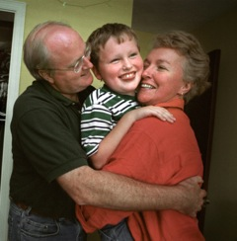
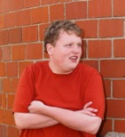
Notes:
We all exist within the context of family.
Think about your own family, and how much your family has shaped who you are and how you live your life.

Slide 5
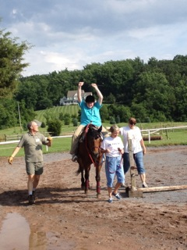
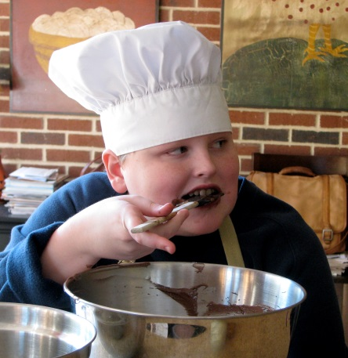
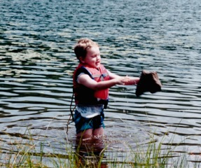
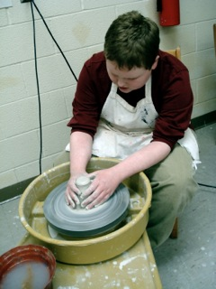
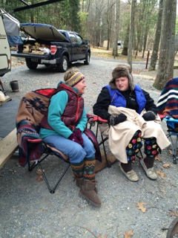
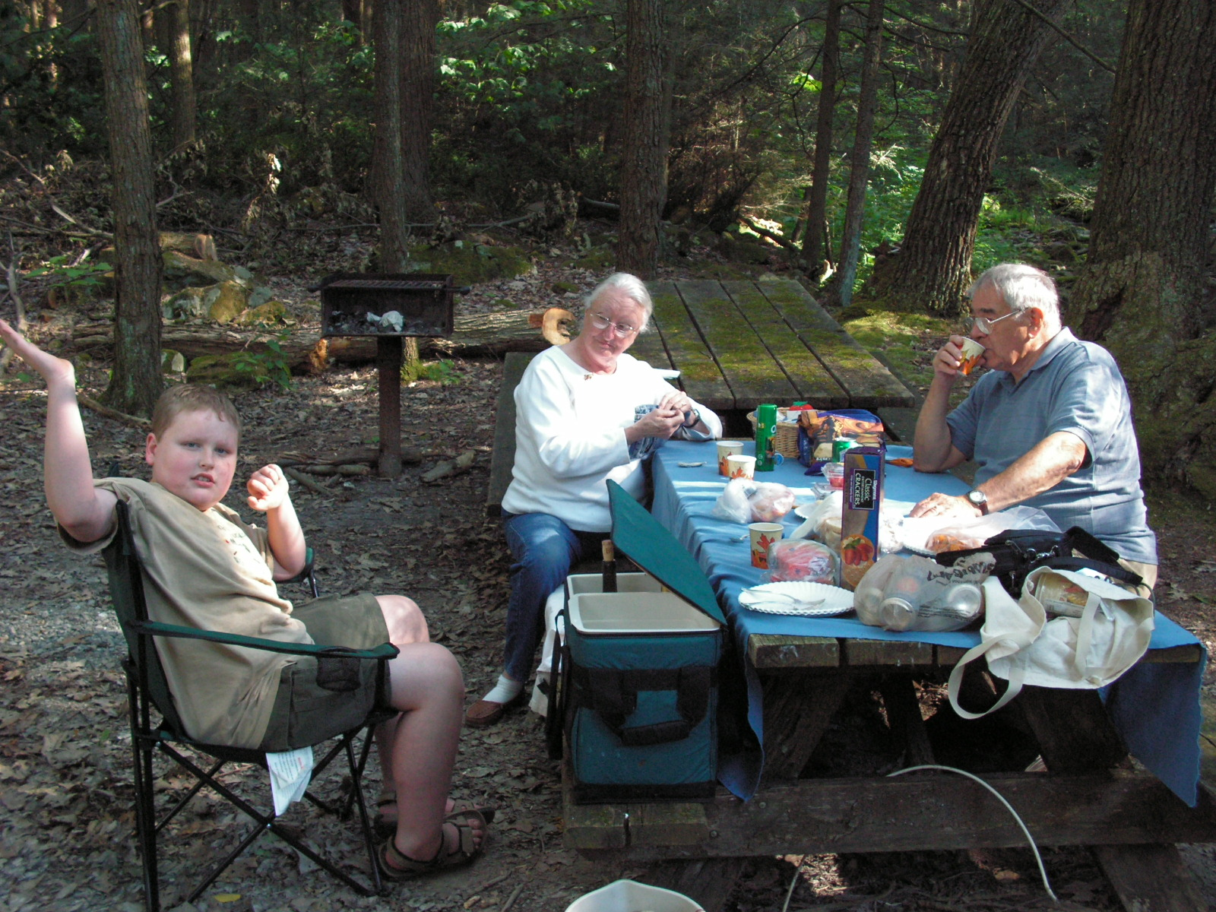
Notes:
And all of us also are shaped within the context of our life experiences.
We focus on outcomes so much that we sometimes forget the importance and impact of experiences – be they good or not so good.
How can we even think about outcomes without first thinking of the experiences that will lead to them, learning experiences, making mistakes, experiencing new things, success, changing directions, etc?
Think about yourself and the experiences you’ve had that have shaped who you are today.

Slide 6
The most powerful force in changing transition outcomes for young people with significant disabilities is not ultimately found in the transition plans we craft, the educational services we offer, the instruction we provide, or the systems we build, but rather in the expectations and aspirations individual parents hold for their
sons and daughters. All of these other efforts are no doubt essential, but absent families equipped with a clear and compelling vision for a “good life” after high school, we are missing something utterly essential.
- Erik Carter
“What Matters Most: Research on Elevating Parent Expectations”

Slide 7
What do we know?
Expectations are formed early and over time.
Expectations shape experiences.
Experiences also shape expectations.
Expectations are influenced by opportunities and supports.
Notes:
Erik Carter’s research

Slide 8
Where should we go?
We must connect families with ordinary examples of what is possible.
We must invest in expectations.
We must catch and communicate a collective vision.
Finally, professionals must let parent expectations challenge their own.
Notes:
Erik Carter’s challenge to professionals who work in the field of supporting people with disabilities:
“There is a tension here we must release. Professionals are sometimes reluctant to encourage parents to “hope large” because it ultimately will require us to do things differently, demand us to invest differently. We must be willing to let families show us what is possible when their vision exceeds our own. Indeed this is how the world has always moved forward fastest. “ ~ Erik Carter

Slide 9
EXERCISE!
Notes:
In small groups at your tables, choose a note taker and someone who will report out. Discuss the things that define the vision of a “good life”. Think about yourselves and your families, and this is not disability specific. Think in terms of your personal perspectives. On the single large sheet called the Trajectory, write these things in the box at the top right, “Vision for a Good Life.”
(allow about 10 minutes)
Report out, asking each table to not repeat things that were already said by another table.
When done, talk about how all people, including all people with disabilities, should be able and encouraged to dream and vision in the same exact way.
And let’s talk about the other box, “what we don’t want”. And this time thinking about people with disabilities, what are some things you might imagine a person with disabilities and his/her family would write in that box?? Have people name things in the big group, not as a small group exercise, to save time.
We’ll come back to this tool shortly, so keep it nearby. And please leave the big sheets on the tables at the end of the session so we can collect and compile your ideas.

Slide 10
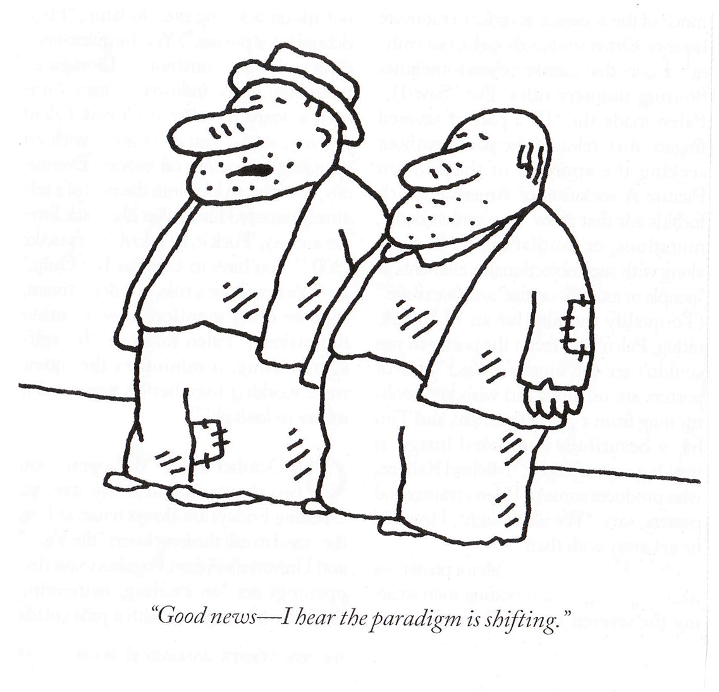
Notes:
We are in the midst of a paradigm shift. Another way of thinking about these changes is “reframing”. Reframing means thinking and talking about things in a new way.
Across the country, our culture is embracing the belief that all people have the right to live, love, work, play, and worship in their communities.
And of course, the CMS Final Rule is all about change, about reframing the way we view people and their lives, and how we support them to have good lives like all the rest of us.
This change in our culture requires that we reframe our conversations at every intersection of life and with all people.
In our work in supporting people to have a vision for a good life and how to achieve it, this reframing involves helping people to see things in new ways, easily access the information they need through the lifestages, connect with others who have similar experiences and situations, and draw together all of the supports needed to reach for that vision.

Slide 11

WINGSPREAD REPORT, 2011
RECOMMENDATION 1:
Design the structure and functions of state service systems to include a focus on supporting families reflective of the fact that most people with I/DD are living with their families in the community.
Notes:
This paradigm shift got a big shot of momentum in 2011.
A group of diverse national and state family support leaders and stakeholders (including Nancy Thaler and several others from PA) met during a three-day intensive conference held on March 6-8, 2011 at the Johnson Foundation’s Wingspread Conference Center in Racine, Wisconsin. The purpose of the conference was to generate recommendations for a National Agenda on Family Support for families of people with intellectual and developmental disabilities (I/DD).
This was the first and primary recommendation.

Slide 12
Wingspread report, 2011
Identify strategies for collaboration and support with local and statewide family-focused organizations or networks that can assist in the development, implementation and evaluation of strategies for supporting families.
Establish mechanisms to maintain ongoing dialogue with families, services system representatives and other key stakeholders involved in supporting families.
Notes:
Other recommendations (paraphrased/shortened below):
Collaborate with and support local and statewide family organizations in developing strategies
Maintain ongoing dialogue with families and all stakeholders

Slide 13
Wingspread report, 2011
Increase opportunities for self/family directed service options.
Build the capacity of supports coordinators to support and plan with people with autism or intellectual disability within the family unit.
Notes:
Increase self direction options
Enable SCs to do the work they came into the field to do!

Slide 14
Wingspread report, 2011
Identify and fund strategies for assisting individuals with I/DD and their families to navigate both disability and community services and supports, including informal or natural supports.
Provide training to all stakeholders on supporting persons with I/DD within their natural homes and communities, accessing community services along with disability supports as needed.
Notes:
Support families to navigate both the service system and the community-based systems and organizations
Provide training to all on these values of supporting people differently

Slide 15
type of change that is needed
Transitional Change
Transformation Change
“Retooling” the system and its practices to fit the new model
Mergers, consolidations, reorganizations, revising systematic payment structures,
creating new services, processes, systems and products to replace the traditional one
Fundamental reordering of thinking, beliefs, culture, relationships, and behavior
Turns assumptions inside out and disrupts familiar rituals and structures
Rejects command and control relationships in favor of co-creative partnerships
Creating Blue Space, Hanns Meissner, 2013
Notes:
Transitional Change has been our approach for years to tweak our institutional-based DNA.
Transformational Change means we start with a new DNA that is community-based and that encourages a life like everyone else.
The LifeCourse Framework is the way we can achieve Transformational Change
But, we do not want to imply or make families perceive that they did wrong in the context of decisions they made; they had few choices when they made them. And the narratives they were given actually discouraged envisioning possibilities that were different than those limited choices.

Slide 16
the national community of practice
Grant from AIDD in 2012
5 states plus Missouri as mentor state
5 year initiative, now in 4th year
Expansion to 12 more states started July 1, 2016
PA accepted in February to join national Community of Practice
What joining means for PA
Notes:
As a result of the recommendations of the Wingspread Conference, the idea of a national community of practice arose, supported by a grant from AIDD to NASDDDS.
Project Goal of the CoP:
To build capacity through a community of practice across and within States to create policies, practices and systems to better assist and support families that include a person with I/DD across the lifespan.
Expected Project Outcomes:
State and national consensus on a national framework and agenda for improving support for families with members with I/DD.
Enhanced national and state policies, practices, and sustainable systems that result in improved supports to families.
Enhanced capacity of states to replicate and sustain exemplary practices to support families and systems.

Slide 17
12 more states joining as of 7/1/16
Notes:
Original six states: CT, WA, OK, TN, D.C., and MO
New states: PA, MD, MA, KS, KY, OH, OR, DE, AL, SD, MI, HI

Slide 18
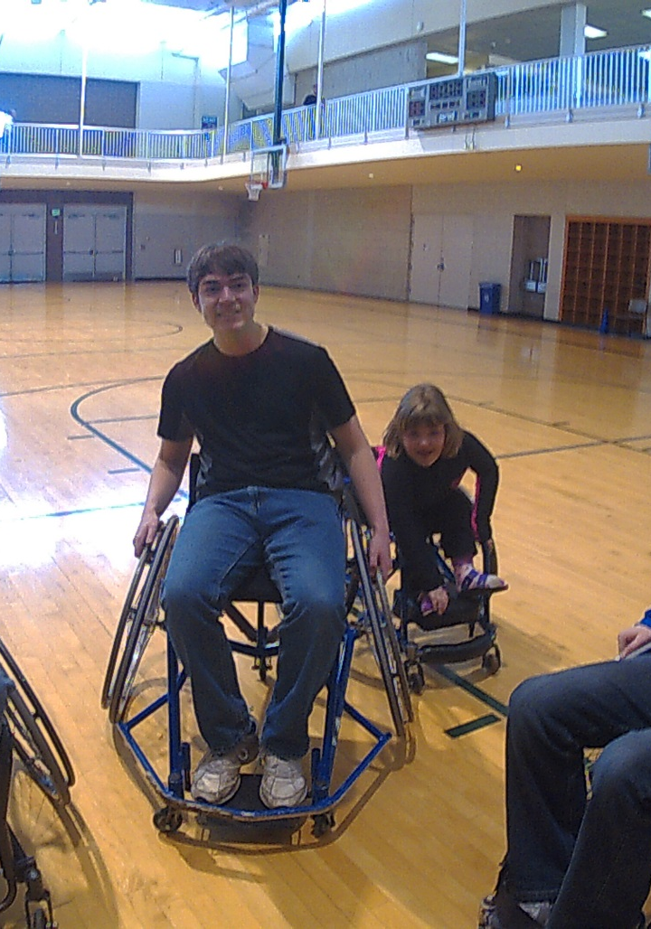
Foundational Beliefs

Slide 19
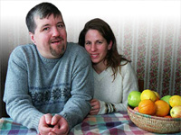
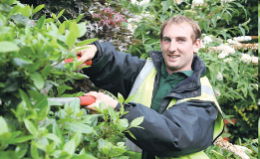
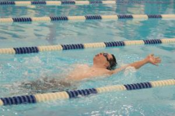
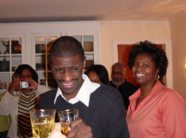
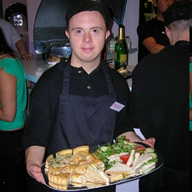
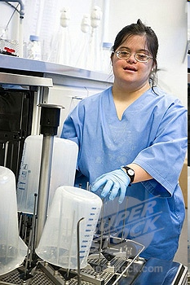
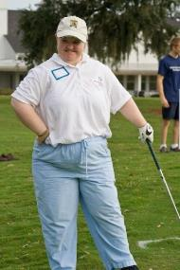
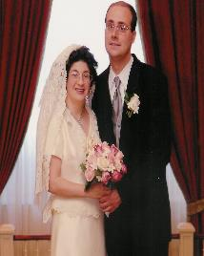
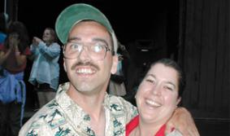
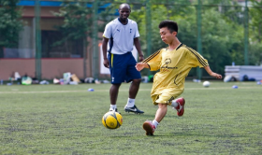
Core Belief:
All people and their families should be able to live, love, work, play
and pursue their dreams and aspirations in their communities.
Notes:
In the past, conversations about supporting people with disabilities and their families mainly revolved around those who were known to the system. We know that number is small in relation to the actual number, and so want to make sure all families have access to and choices about the supports they need.
All people are considered in our vision, values, policies and practices for supporting people with intellectual and developmental disabilities.
This does not mention disabilities. It is based on the values that all of us should have these opportunities.

Slide 20


1 and 4 Persons with I/DD
Receive Formal State DD Services
25%
100%
75%
4.7 Million people with developmental disabilities
National % Receiving State DD Services
** Based on national definition of developmental disability with a prevalence rate of 1.49%
Notes:
ALL individuals and their families, whether they are known to the DD system and/or receive formal services or not, are considered in our vision, values, policies and practices for supporting people with I/DD.

Slide 21
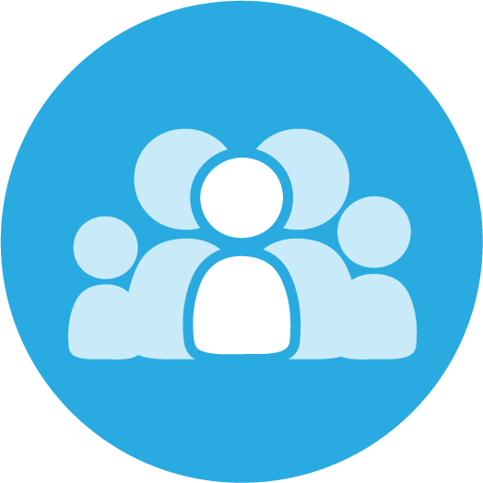
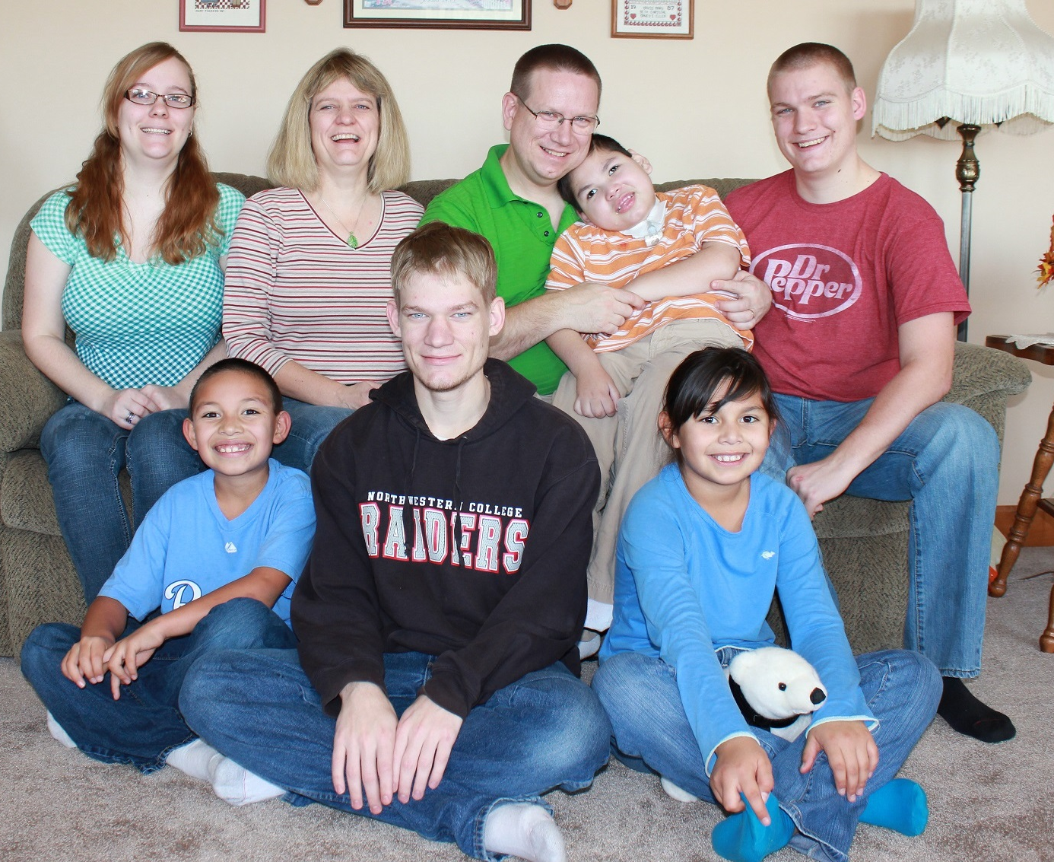
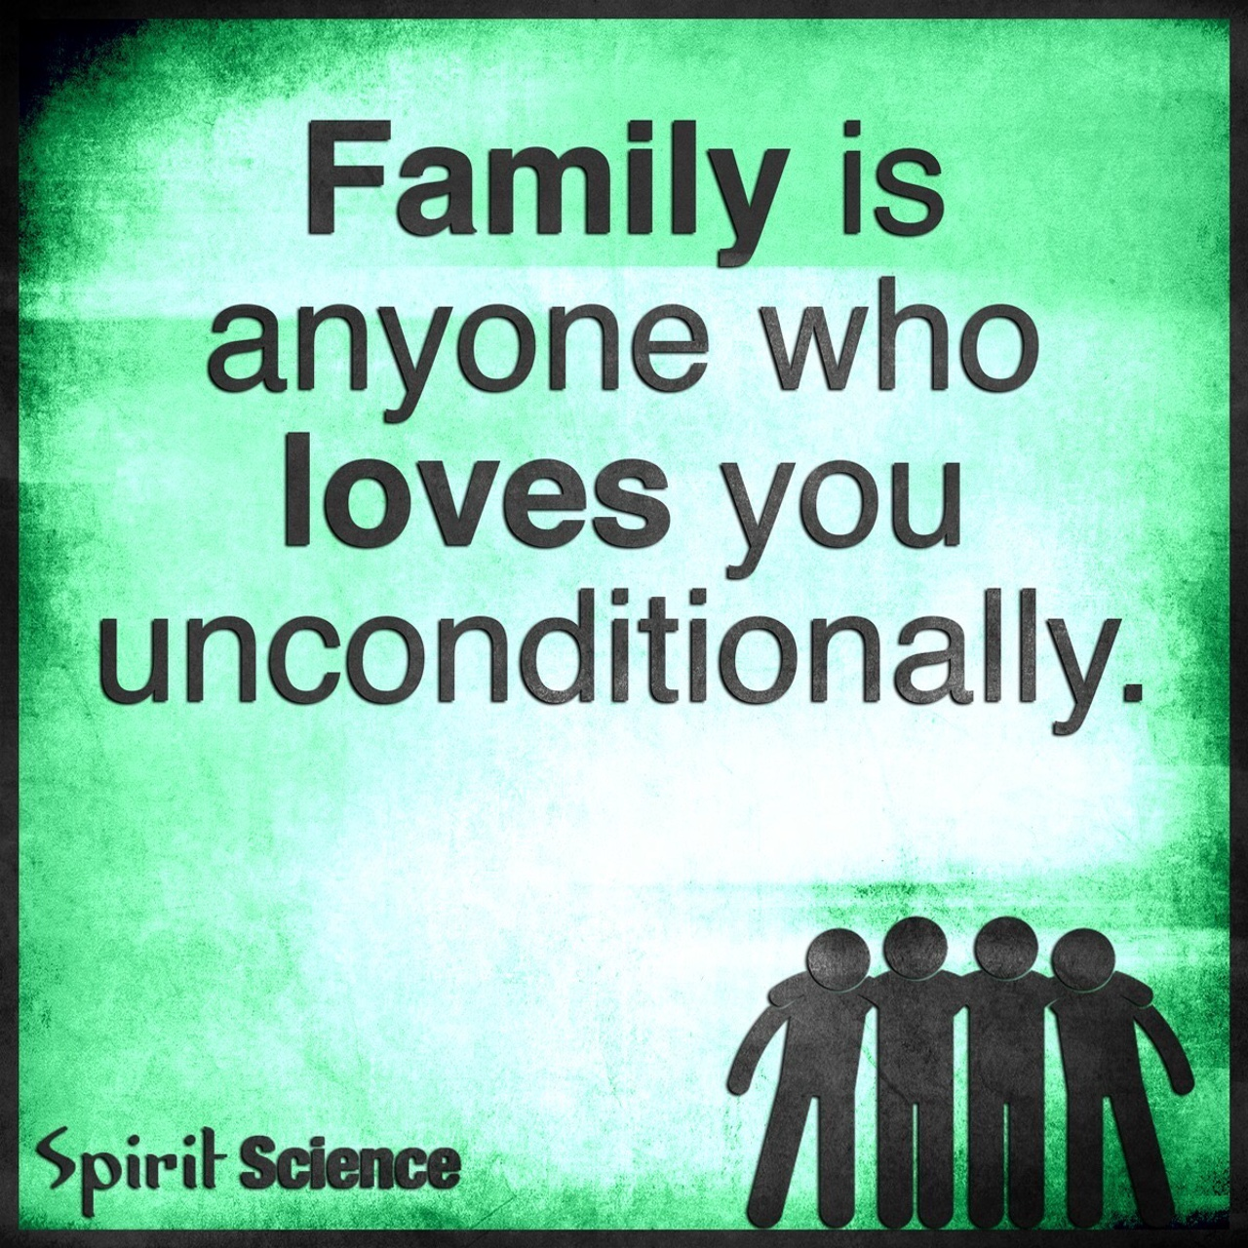
All of us exist within the context of family
Family is defined by the individual
Individuals and their family may need supports that adjust as roles and needs of all members change
Not dependent upon where the person lives
Notes:
This makes sense to all of us when we are talking about children. But we often stop talking about family when the person we support is an adult.
And “family” may look very different – not just our blood relatives, but the people one chooses to consider like family.
People exist and have reciprocal roles within a family system, which adjust as the individual family members change and age; individuals and families need supports that address all facets of life and adjust as roles and needs of all family members change as they age through the life stages.

Slide 22

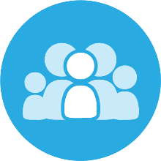
lifecourse framework basics
A Good Life for All
      The individual will achieve self-determination, interdependence, productivity, integration, and inclusion in all facets of community life
      Families will be supported in ways that maximize their capacity, strengths, and unique abilities to best nurture, love, and support all family members to achieve their goals
Notes:
And a good life based upon eligibility and capacity is not the key to fulfilled lives. It takes much more.

Slide 23
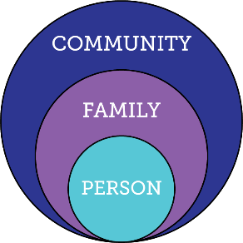
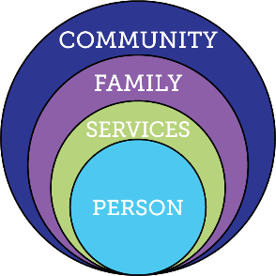
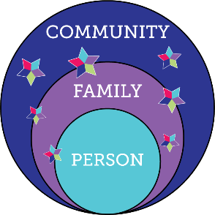
Services and Supports are Evolving
Everyone exists within the context of family and community
Integrated Services and Supports within context of person, family and community
Traditional
Disability Services
Notes:
Over time, in focusing on the individual, we forgot about the important role of family. In fact, In not-so-recent history, a whole generation of adults with disabilities were cut off from having family in their life, and families and their generations were cut off from real relationships with their loved ones.
That traditional model not only created a layer between a person and the family, but also cut off the possibility and opportunity for family to even BE supportive of a life like everyone else.
Our system and often our attitudes still harbor an institution-based DNA. We need a new community-based DNA where people can have real lives.
We sometimes tend to focus on intervention and forget about the importance of life experiences.

Slide 24


Reciprocal Roles Between all Family Members
Caring About | Affection & Self-Esteem
 | Repository of knowledge
 | Lifetime commitment
Caring For | Provider of day-to-day care
 | Material/Financial
 | Facilitator of inclusion and membership
 | Advocate for support
*Adapted from Bigby & Fyffe (2012), Dally (1988), Turnbull et all (2011)
Notes:
We tend to focus on the “caring for” role, and forget how important the “caring about” is. Imagine if we ourselves felt only “cared for” in times of need, not also “cared about” every day of our lives? Extended family has a very important role in this area.

Slide 25
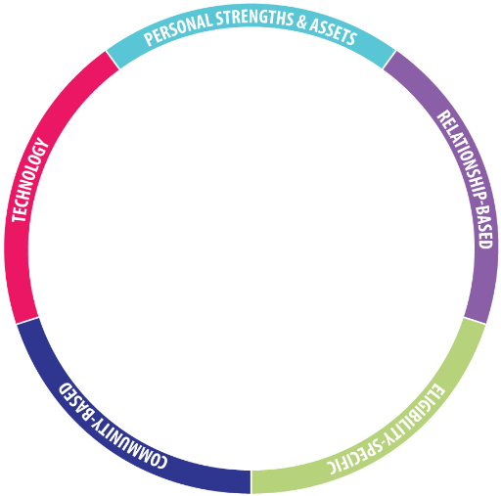
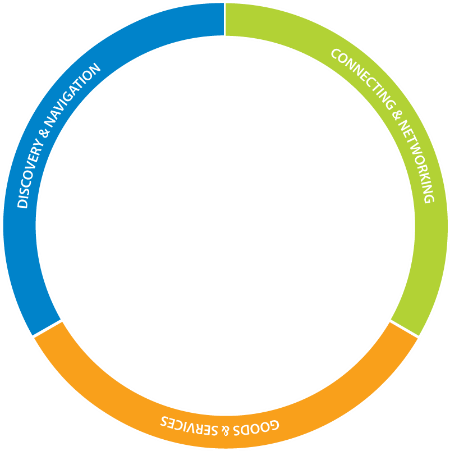
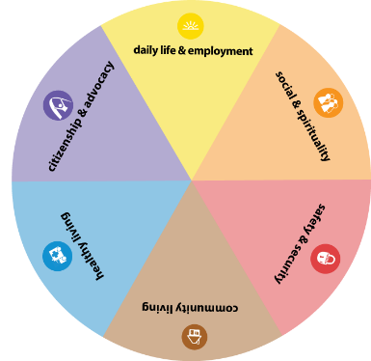
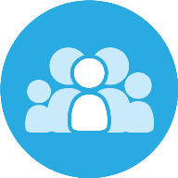

What is the LifeCourse Framework?
Notes:
LifeCourse Framework reframes the way we think about all people.
The Framework was created:
BY FAMILIES to help families and people of all abilities and all ages to develop a vision for a good life,
to think about what they need to know and do,
to identify how to find or develop supports,
and to discover what it takes to live the lives they want to live.
to focus on their current situation and stage of life
and also to look ahead to think about life experiences that will help move them toward an inclusive, productive life in the future.

Slide 26
The LifeCourse Tools
Trajectory Toward a Good Life
Life Domains: Outcomes and Possibilities
Three Buckets of Support
Integrated Supports Star

Slide 27
These tools are:
  Conversation starters
  Problem solvers
  Visioning about the future
  Empowering ownership of a vision
  Can be used by anyone in any setting
  Focused on all stages of the lifespan

Slide 28
Vision for a
Good Life
The future is not something we enter. The future is something that we create. And creating that future requires us to make choices and decisions that begin with a dream.
    -Leonard L. Sweet
Notes:
Individuals and families focus on life experiences that point the trajectory toward a good quality of life. Based on current support structures that focus on self-determination, community living, social capital and economic sufficiency, the emphasis is on planning for life outcomes, not just services alone.

Slide 29

THREE BUCKETS
Goods &
Services
(Day-to-day supports at home, work, and in the community)
Discovery & Navigation
(Information and Training)
Connecting & Networking
(Talking to someone who has “been there”)
Notes:
Supports address all facets of life and adjust as roles and needs of all family members change.
Three strategies for supporting individuals and their families:
discovery and navigation: having the information and tools you need at every lifestage;
connecting and networking: making connections with peers and resources to help you navigate, not feel alone, and become strong;
Goods, supports and services: the tangible items you buy and use and the public and private organizations in your community that you access for support -- not all of which are eligibility-based.
Families need all three buckets! We must listen to what they need – I need information. I feel alone. I need help with day-to-day support.
DISCOVERY & NAVIGATION
Information and Training
Information on disability
Knowledge about best practices and values
Encourage and empower to create a vision of a good life
Skills to navigate and access supports, both natural and formal, in the community
Ability to advocate for services and policy change
CONNECTING & NETWORKING
Emotional Support of Peers
Family-to-family support
Self-advocacy organizations
Family organizations
Sibling groups
Disability support groups
Professional Counseling
Non-disability community support
Neighbors, friends, family
GOODS & SERVICES
Supports Coordination
Habilitation Services
Personal Care
Employment Services
Supports Brokers
Behavioral Supports
Benefits Counseling
Assistive Technologies
Home Modifications
Cash Subsidies
Long-term Planning
Respite

Slide 30
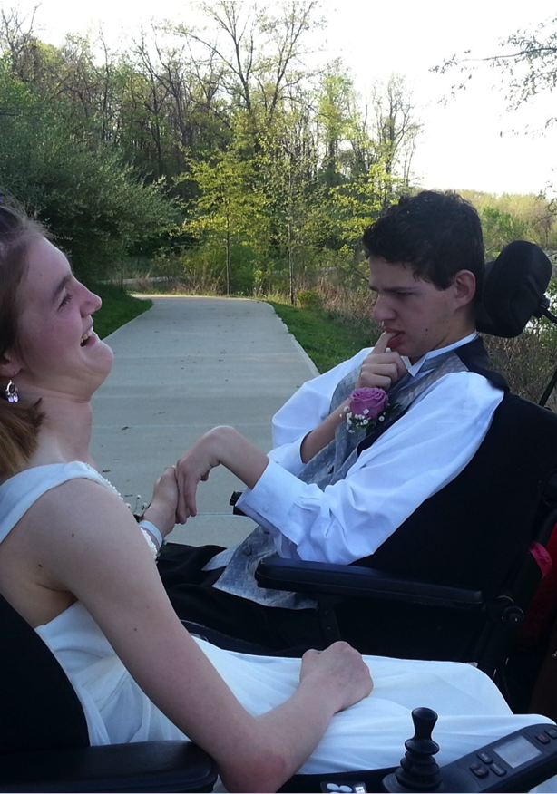
Life Trajectory:
Experiences and Life Stages

Slide 31







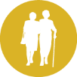
Life Stages and Trajectory
Toward the Good Life
What would that good life look like?
What do we know we don’t want to see happen?
Notes:
Aim for a target, a clear picture of what a good life would look like for people.
People can focus on a specific life stage, with an awareness of how prior, current and future life stages and experiences impact and influence life trajectory.
What happens to us early in our lives has a significant impact on our quality of life and well-being in the future. It is important to help people have positive, healthy experiences, adequate support, and ample opportunities to learn and make mistakes so that they can have better outcomes later in life.
Sometimes people can’t see what a good life would look like, but can see what they don’t want. It’s ok to start with identifying what they don’t want.
At every life stage, we can easily discern if what is happening is leading toward the vision or not. This tool helps families to adjust experiences so that the day-to-day life does point toward the vision.
EXERCISE:
On that same big trajectory worksheet, draw a vertical line between the arrows. Divide the group if you want into different ages, like 8, 13, 18, 30, etc.
Have the tables list on the sheet the things that typical people of that age would be doing in their day-to-day lives or during that lifestage.
Report out from each table.
And then, point out that we should be encouraging ALL people to consider those typical experiences and the importance of them as elements of the trajectory. And the opportunities to redirect if the arrow goes the wrong way!

Slide 32
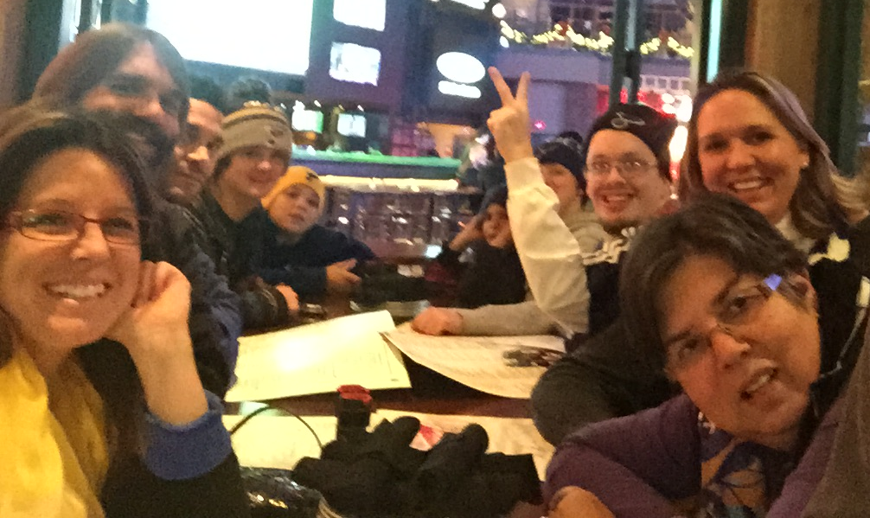
Trajectory Isn’t Always Straight
Getting back on track
Incidents shouldn’t become life sentences
Notes:
Eric’s “firestarter” story.

Slide 33




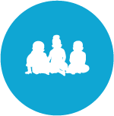

Life Experiences and
Life Transitions
Enjoying friends and family
Volunteering
Getting a home
Chores and allowance
Finding a job
Learning to say “no”
Making Mistakes
Scouts, 4H, faith groups
My parents have passed away, what do I do?
Playing sports or an instrument
Birthday parties with friends
Parents Turn 65
Medicare & SSDI
Transition planning
Living Adult Life
Turning 18. Leaving school at 18 or 21
Leaving Early Childhood/ enter school
Getting New Diagnosis
“Anticipatory Guidance for Life Experiences”
Notes:
In our field, we sometimes get caught in only thinking about systems, services, interventions, therapies, etc. and so overlook experiences, day to day experiences that lead toward the vision, and the experiences that other people of the same age are having.
For example, employment outcomes don’t happen because of OVR – they happen because of experiences, certainly perhaps supported by OVR. Experiences and relationships.
As professionals, we must think about this concept of anticipatory guidance: What is your vision? And what needs to happen along the lifespan that will follow the trajectory to that good life?
We need to put ourselves in the shoes of the person we support and see their life through the lens of that age group.

Slide 34
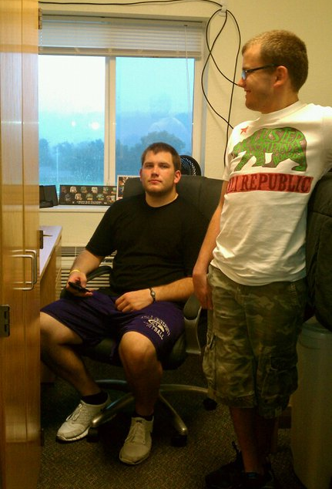
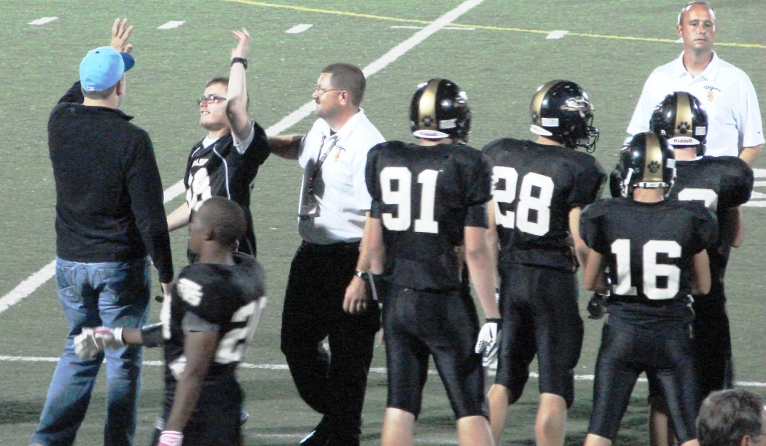
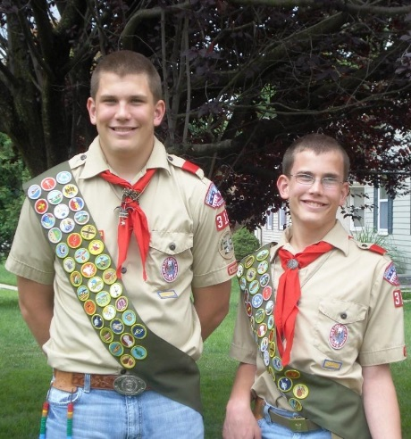
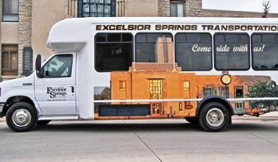
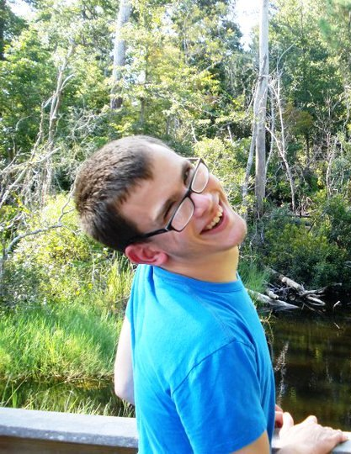

Life Domains:
Life Experiences and Life Possibilities
Notes:
The life domains are the ways that ALL of us live our lives, the ways we describe ourselves when we meet new people, the categories of what is important in all of our lives.

Slide 35





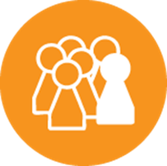
Achieving Outcomes for
Connected Life Domains
Healthy Living
(medical, behavioral, nutrition, wellness, affordable care)
Daily Life and Employment
(school/education, employment, volunteering, routines, life skills)
Safety and Security
(emergencies, well-being, legal rights & issues, guardianship options & alternatives )
Community Living
(housing, living options, home adaptations and modifications, community access, transportation)
Citizenship and Advocacy
(valued roles, making choices, setting goals, responsibility, leadership, peer support)
Social and Spirituality
(friends, relationships, leisure activities, personal networks, faith community)
Notes:
As we encourage people to develop a vision and explore guidance in the day-to-day experiences along the lifespan, it is also important to consider each of the domains and what is happening in all areas of a person’s life. We tend to get focused on just one at a time when we think of supporting people with disabilities. But a good life is a well-rounded life that considers all domains.
People lead whole lives made up of specific integrated life domains that are important to a good quality of life.

Slide 36

INTEGRATED SUPPORTS
Personal strengths & assets
A USEFUL TOOL FOR:
Problem-solving
Identifying strengths
Exploring options
Seeing opportunities
Technology
Relationship based
Community based
Eligibility Specific
Notes:
People utilize an array of integrated supports to achieve the envisioned everyday life, including those that are publicly or privately funded and based on eligibility, community supports that are available to anyone, relationship based supports, technology, and that take into account the assets and strengths of the person and the family.
Individuals and families are satisfactorily involved in policy-making so that they influence planning, policy, implementation, evaluation and revision of the practices that affect them. Individuals and families design and direct the supports they receive to the extent possible with sufficient public funding allocated in ways that are fair to all individuals and families.
This tool is the integrated supports star. With the person in the center, each point of the star represents the supports, opportunities, and strengths that are unique to the individual.
Whereas conversations about supporting people with disabilities and their families have typically revolved around the supports offered by the disability service system, this approach demonstrates (for families as well as organizations and policymakers) that we ALL access a variety of supports to make it through our daily lives.
Filling in information about the person and family in each of these five areas is very useful in problem-solving, identifying strengths, exploring options, and coming up with new opportunities.
EXERCISE:
Divide the room in half. Have one half write “my morning routine” (from waking up until arriving at work/school) in the white star and the other half “my evening routine” (from leaving work/school to going to bed). Now as a group, list in each of the five parts of the star the people, strengths, community resources, eligibility-based, and technological things that help us with that daily routine.
Report out from groups, again, not repeating was another group has already said.

Slide 37
EXERCISE!

Slide 38

What is Pennsylvania’s strategy?

Slide 39
Coordinated by Vision for Equality
Curricula to be developed jointly with ODP
Content for families will be centered around envisioning a good life, using lifespan tools, and seeing supports and services in a new way
Family Advisors across the state will help families to connect with each other, support mentoring relationships, and help to identify community resources.
The PA
Family Network

Slide 40
Person-Centered Thinking Trainers
Family members across the state were selected and are engaged now in becoming fully-credential PCT Trainers

Slide 41
Self-Advocates United as One
Launching with a plan to support self-advocate training and mentoring across the state, and will work in parallel efforts with PA Family Network

Slide 42
An initiative of the Sibling Leadership Network in partnership with Temple University through a grant from the PA Developmental Disabilities Council
20 “Sibling Ambassadors” now creating networks of siblings across PA
Many opportunities to partner with the PA Family Network and SAU1
The PA
Sibling Support
Network

Slide 43
Regional Collaboratives
Counties, SCOs, ASERT and ODP staff (ID and autism, regional and central office staff), self-advocates and families, providers, as well as community partners working together to build commitment, strength and new approaches in local areas to better support real lives.

Slide 44
Putting the Lifecourse Framework Together!

Slide 45

www.supportstofamilies.org www.lifecoursetools.com
Thank you!
Nancy Richey
717-783-1003
c-nrichey@pa.gov

