Slide 1
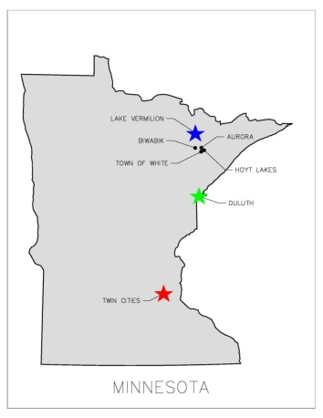
EAST MESABI JOINT WATER SYSTEM A JOINT VENTURE BETWEEN THE CITy OF AURORA & TOWN OF WHITE
REQUEST
A $8.6 million request for State Funding in 2018 for final design,
land acquisition, and to build a new water treatment facility &
infrastructure system serving the East Range as a
consolidated municipal distribution system.
POTENTIAL
Ensures the ability to provide essential services to citizens of the
City of Aurora, the Town of White (which includes Scenic Acres),
and allows for future economic development and expansion
extending to the cities of Biwabik and Hoyt Lakes in the future.
PROJECT HISTORY
Aurora plant built in 1953 now serving both Township & City residents
In 1997, Township extended water lines to Highway 135 with intention of providing water to Scenic Acres
Planning began in 2011 for a Joint Water Facility on the East Range
Preliminary studies have been completed identifying cost estimates, the water source, and modeling of the system
State bonding requests were submitted in 2012 and 2016 with no funding allocated
CONSOLIDATION OF ESSENTIAL SERVICES
East Range Joint Powers Board established in 1984 among Cities of Aurora, Biwabik, Hoyt Lakes, and the Town of White to provide economic development & governance
East Range has consolidated as many essential services as possible for economic and financial impact (police, ambulance, EMT, recreation, equipment/major purchases, comprehensive planning and shared staff)
IMPACT
Provides water services, from a more stable source, to better serve our citizens
Allows a more cost effective service while meeting current and future environmental concerns
Supports collaboration, improves efficiencies, meets compliance standards not currently being met, and addresses emergency/safety concerns
New system could provide service to 3100+ homes covering a 186 square miles radius
Provides an opportunity for growth and expansion for Economic Development and/or Residential Growth in over 295 acres of undeveloped property

