Slide 1
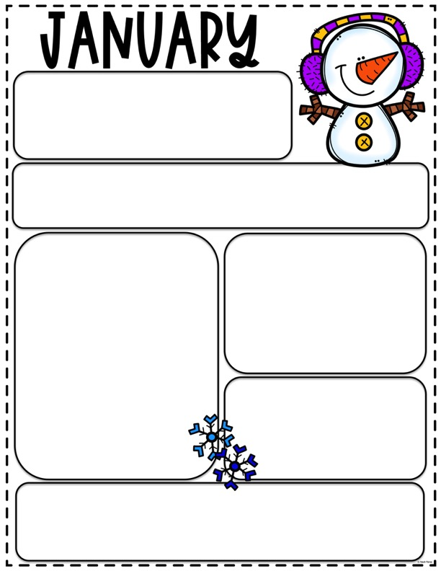
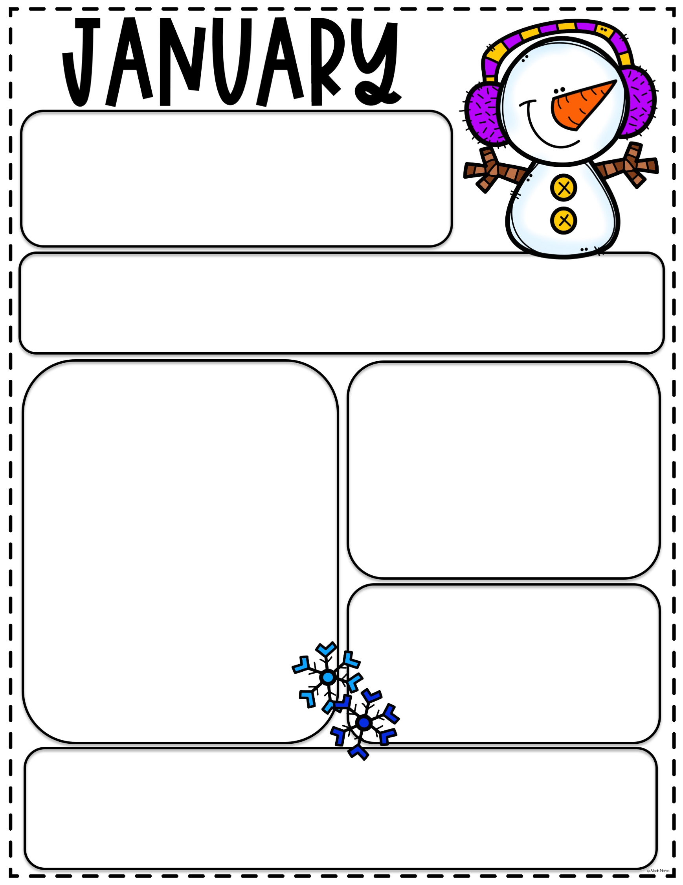
SCHOOL HOLIDAY
We will be closed
Monday, January 20^{th,} for the observation of
Martin Luther King Jr. Day
REMINDER
Please put your child's name on all jackets, water bottles and lunch boxes
What We Are Learning
Big School
Universe
I-Care Rules
Land & Water
Continents
Little School
Winter
Polar Animals
BEARS
Letter Review
H, P, B, N, F, S, D, J
Illness
If your child had a fever please keep
them home until the fever has been
gone for 24 hours with out the aide
of medication. Also if your child needs
to take medication during the day
please fill out a medication form and
we will be happy to give them their medication while they are at school.
PLEASE
Remember to sign your child in and out everyday of attendance. This licensing
regulation.
Thank you
BOOK ORDERS
Please order on line at
www.scholastic.com/bookclubs
And use class code: ny986 at check out.

