Slide 1
Testing: Data Requirements and Other Information
TN Data & Attendance Supervisors Conference – September 2017

Slide 2
Agenda
Assessment Overview
Processing Changes
Assessment Process Details
SIS
EIS Transfers
Data Review
Test Orders
Test Registration
Course Codes
Teacher Student Connection
Closing

Slide 3
TN Comprehensive Assessment Program
TCAP
TNReady
Students in grade 3-8: ELA, Math, Science, SS
High School EOC: ELA, Math, Science, SS
Other TN Assessments
Alternate assessments for students in grades 3-11 with the most significant cognitive disabilities (ELA, Math, Science, SS)
Grade 2 optional assessment suite
ELL Assessments

Slide 4
2017-18 Assessment Windows
* Subpart 1 of ELA and USH must be completed in the 1st week

Slide 5
Reminder: Phasing into Online Assessments
School Year | Operational Testing | Field Testing
2016-17 | Online testing was optional for high schools | Field testing for all grades and subjects was administered via paper and pencil
2017-18 | Online testing is required for high schools Online testing is optional for grades 5–8 | Field testing for grades 5–12 in all subjects will be administered online only Field testing for grades 3 and 4 will be administered via paper and pencil only
2018-19 and beyond | Online testing is required for grades 5–12 Online testing is optional for grades 3 and 4; there will continue to be a paper option for these grades. | Field testing for grades 5–12 in all subjects will be administered online only Field testing for grades 3 and 4 will be administered via paper and pencil only
Please contact Cliff.Lloyd@tn.gov for more information.
5
Notes:
Cliff
Districts had the option to opt into online testing for high school students last year
24 districts opted in, and administration went smoothly
In the 2017-18 school year, all high school students will be required to take TNReady online, and we will expand the option for students in grades 5-8
Next year (2018-19), all students will take TNReady online—but there will always be an option for our youngest students in grades 3 and 4 to take TNReady on paper

Slide 6
Ready for TNReady
High school students must test online this year—and that includes fall block.
In the Commissioner’s Update for Directors, we have been sharing a technology readiness guide to check for online preparedness.
The Ready for TNReady check for online readiness was developed through lessons learned in a successful 2016-17 online test administration and includes three categories of readiness: device readiness, infrastructure readiness, and operational readiness. The Ready for TNReady overview can be found here.
You must complete this check for readiness and submit it to TDOE.
Please contact Cliff.Lloyd@tn.gov for more information.
6
Notes:
Cliff

Slide 7
Assessment Processing Changes

Slide 8
Changes to Pre-ID and SDDV Process
We must continuously improve our processes to ensure a smooth administration and reduce delays for score turnaround—from raw scores to family reports.
Several data entry process changes, including Pre-ID and SDDV, will be implemented this year so that we have more accurate information earlier about students who are taking TNReady and other TCAP assessments.
Assessment will be driven by data in EIS.
Enrollment, scheduling, demographic, and class roster must entered in district SIS and transferred to EIS.
EdTools will not be used to clean-up demographic information or complete assessment ordering.
Notes:
Cliff

Slide 9
New Streamlined Process for Assessment
Fully Enrolled Students in SIS
Nightly Data Transfer to EIS
New Tool for Data Review of EIS Demo Stats
Automatic Ordering of Student Tests
Automatic Rostering in Teacher Student Connection
Ongoing SIS Updates and EIS Data Transfer

Slide 10
More Time, Better Data, Faster Processing!
OLD PROCESS | NEW PROCESS
Pre-ID data pulled once – in October and January – for test ordering | Continuous EIS data transfer through two days before admin window opens (in November and April) for online test ordering in Nextera
Demographic data clean-up 2-3 weeks after testing window closed and SDDV complete | Demographic data review and updates for 2 – 3 months - from first EIS data transfer through the last day of the testing window
Teacher Student Connection open only after testing window closed | Teacher Student Connection (TSC) open and available for editing from first EIS data transfer through last day of testing window
Duplicate data entry in both EdTools and SIS | Single data entry in SIS with data transfer to EIS, Nextera, and TSC
No reconciliation between EdTools and EIS resulting in data conflicts and errors | Visibility Tool ensures accuracy of data for assessment, accountability, and other reporting/finance functions

Slide 11
Reset

Slide 12
Reset of Expectations for Assessment Process Updates via EIS Enrollment
Districts will only be able to test students (paper or online) who have been fully enrolled in the SIS.
The teacher of record must be defined in the SIS at enrollment through complete scheduling. Districts update roster in teacher student connection (TSC) only when multiple teachers have instructional responsibility.
Districts will complete student claiming via TSC in EdTools any time between transfer of enrollment data to EIS and the last day of the administration window.
Notes:
Cliff

Slide 13
Reset of Expectations for Assessment Process Updates via EIS Enrollment
RI (reports of test irregularities) inputs by districts will be made in the Nextera application.
Districts will review their student demographic data using the Visibility Tool and the Nextera interface as read-only (no editing). Changes to demographic data can only be made through the district SIS by last day of testing window.
Notes:
Cliff
After this side, turn it over to Casey Haugner Wrenn, assistant commissioner of college, career, and technical education

Slide 14
Reset of Expectations for Assessment Process Updates via EIS Enrollment
Online tests are linked to SIS enrollment data, so there is no need to place “orders.” For grades 5–8, the ability to opt in to online will be made in Nextera.
Paper order counts will be based on SIS enrollment data, and districts may only edit paper order counts to indicate special formats (e.g., Braille).
There is no longer a need to maintain testing calendars in EdTools.
Notes:
Cliff
After this side, turn it over to Casey Haugner Wrenn, assistant commissioner of college, career, and technical education

Slide 15
Fall EOC Timeline
September
Ongoing student enrollment updates in SIS
Additional staffing for EIS Helpdesk to support assessment processing change
December
Ongoing student demographic updates in SIS
December 15 – Last day for demographic updates in SIS for fall admin. TSC closes. Fall block admin window closes.
October
November
October 16 – Data Visibility Tool opens for data review for all grades/subjects. TSC opens for all grades/subjects
Ongoing student enrollment updates in SIS
Ongoing student enrollment updates in SIS
November 22 – Final EIS data transfer for fall block testing
December 13 – Last day for late student enrollment in SIS
November 27 – Fall block admin window opens

Slide 16
First things first: SIS Enrollment

Slide 17
It All Goes Back to the SIS…
Visibility Tool
Data Review
Nextera
Order Entry
EdTools
Teacher Student Connection (TSC)
Test Administration
Reports of Irregularity (RIs)
Demographic Statistics
SIS
EIS

Slide 18
Key to Success – SIS Vigilance
Districts must ensure that complete and accurate student enrollment data is entered into their district SIS in a timely manner.
Doing this will make assessment administration much easier both for the district and for the schools.

Slide 19
Dad Lecture #57

Slide 20
Platform Functions
Function | SIS | Visibility Tool | Nextera | EdTools
Enrolling and Scheduling Students | X
Updating Student Demographics | X
Updating Schedules/Class Rosters | X
Reviewing Demographic Information |  | X | X
Test Ordering and Registration |  |  | X
Reports of Irregularity (RIs) |  |  | X
Recording Accommodations |  |  | X
Teacher Student Connection (TSC) |  |  |  | X

Slide 21
EIS Transfers to Nextera

Slide 22
From SIS to EIS
Student data is changed in SIS
District produces extract from SIS
District uploads extract to EIS

Slide 23
EIS Transfers to Nextera
Assessment data transfers from SIS to EIS will occur every evening.
Information updated in a district SIS by 4 pm CST will show up in the Visibility Tool the next day.
Information updated in a district SIS by 4 pm CST will show up in Nextera Admin and in EdTools TSC no later than two days after data transfer.
All assessment data transfers occur when the district produces an extract and submits it to EIS.

Slide 24
EIS Transfer for Provisioning Nextera
The last EIS assessment pull to provision Nextera with currently enrolled students and class rosters will be two business days before the testing window opens.
For Fall EOC, this will be Wednesday, November 22, 2017.

Slide 25
Final EIS Transfer for Demographic Data
The final EIS assessment transfer to generate demographic data for the Comprehensive Data File (CDF) and assessment reporting will be the last day of the testing window.
For Fall block EOC: Friday, December 15, 2017.
For Spring block and traditional: Friday, May 4, 2018.
Districts must be sure all demographic changes are corrected by the last day of the testing window. No changes will be accepted after the window closes.
Remember: districts can start reviewing and updating student demographic data from the first EIS data transfer if issues are found in the Visibility Tool.

Slide 26
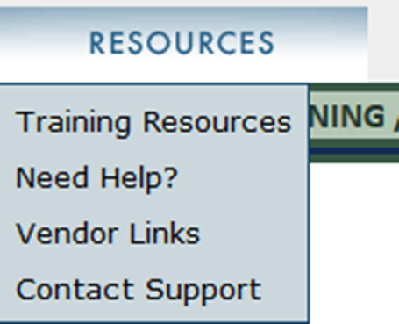
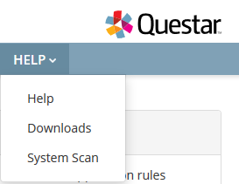
Assessment Course Codes Document
The 2017-18 assessment course codes document is posted on EdTools under the Resources tab.
It will also be posted under the Help tab on the Nextera Admin portal.

Slide 27
Demographic Data Review

Slide 28
Data Review will occur in new Visibility Tool
SIS
EIS
Visibility Tool
District Review

Slide 29
Data Review Cycle
SIS
EIS
Visibility Tool
District Review
Overnight processing of SIS data updates transferred to EIS
Enter student enrollment and demographic data
Check Visibility Tool to confirm expected changes
Visibility Tool will reflect changes to on the same day they show up in EIS (from the prior day of updates to the SIS)
Check SIS data if unexpected values
Contact EIS Helpdesk if data appears incorrect in EIS
EIS data is then uploaded to Visibility Tool

Slide 30
Demographic Data
Districts will be able to view student demographic data in the Visibility Tool and the Nextera Admin platform.
Both of these are read only.
Any and all changes to demographic data must be made through the district SIS.

Slide 31
Visibility Tool
The Visibility Tool developed by the TDOE technology team will give districts a clear and timely picture of information uploaded from their SIS to EIS.
Features include
Information about high priority groups
Students not enrolled in at least one assessment course code
Students enrolled in retired assessment course codes
Assessment classes with no Teacher of Record (TOR)
Detailed information about the EIS pull fields
At district, school and grade levels

Slide 32
Visibility Tool – User Access
The Visibility Tool will be accessed through either:
Your Single Sign On
Your regular EIS login
You’ll be able to request access online via a simple form.
We will communicate more details about user access through the Commissioner’s Update in early October.

Slide 33
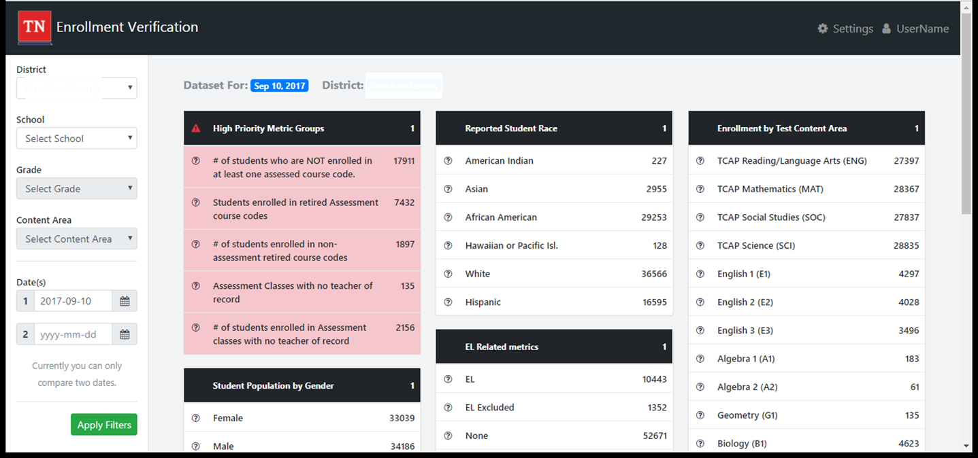
Visibility Tool - District

Slide 34
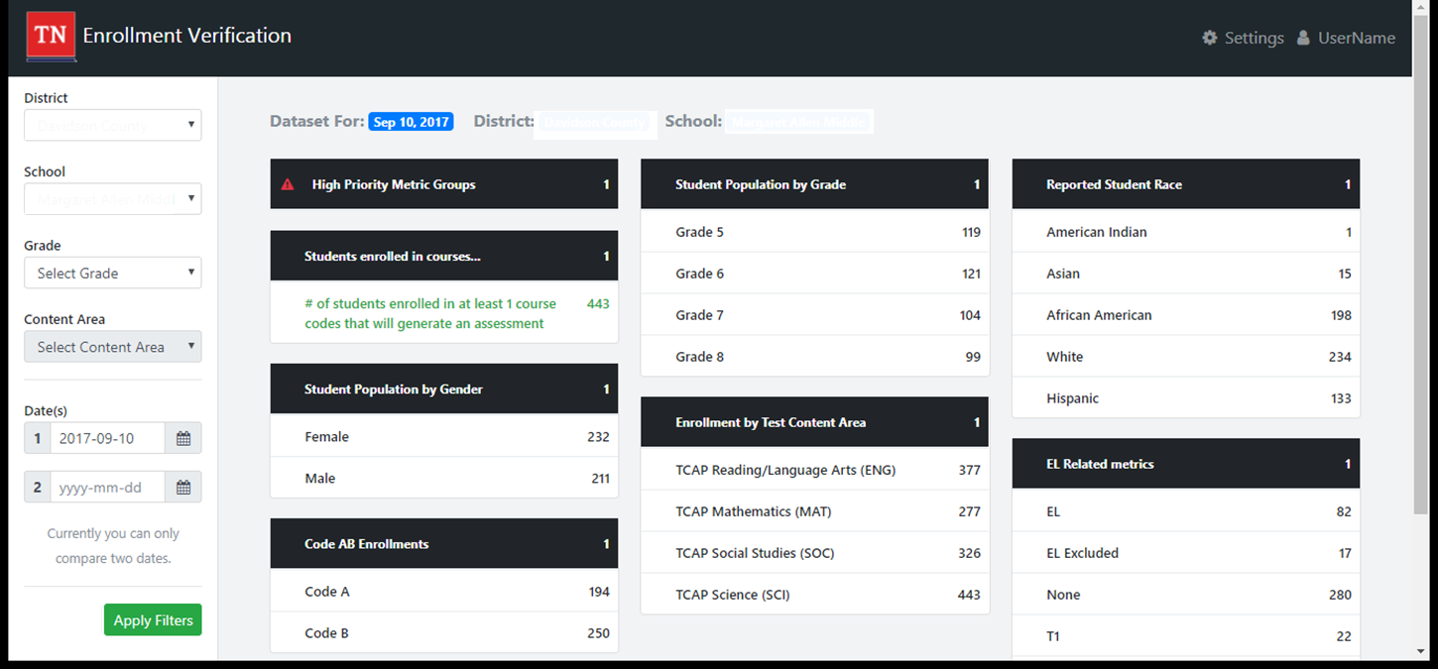
Visibility Tool - School

Slide 35
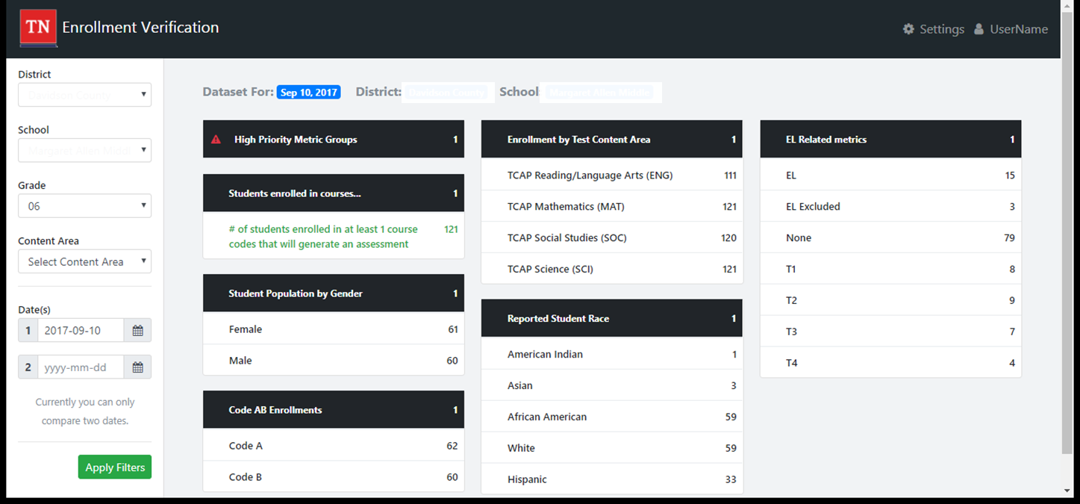
Visibility Tool – Grade

Slide 36
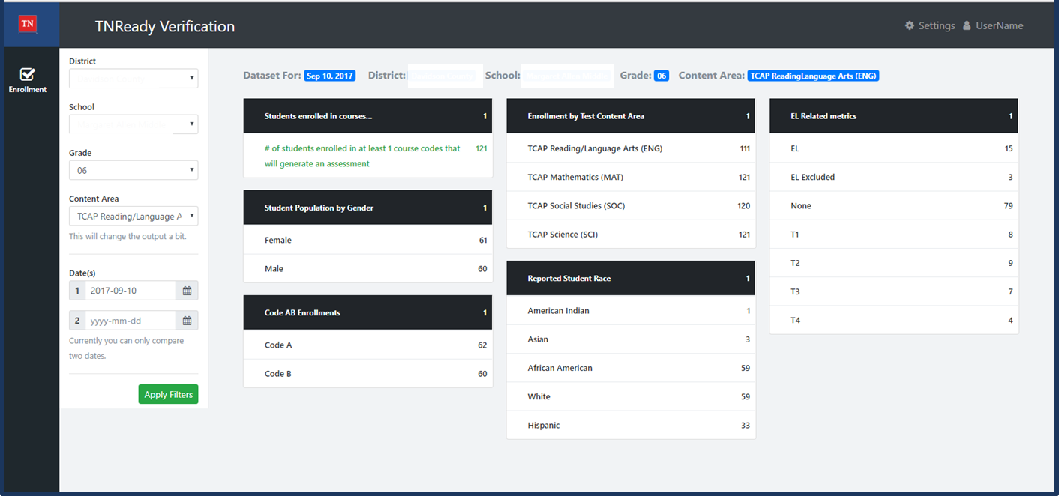
Visibility Tool –Grade & Content Area

Slide 37
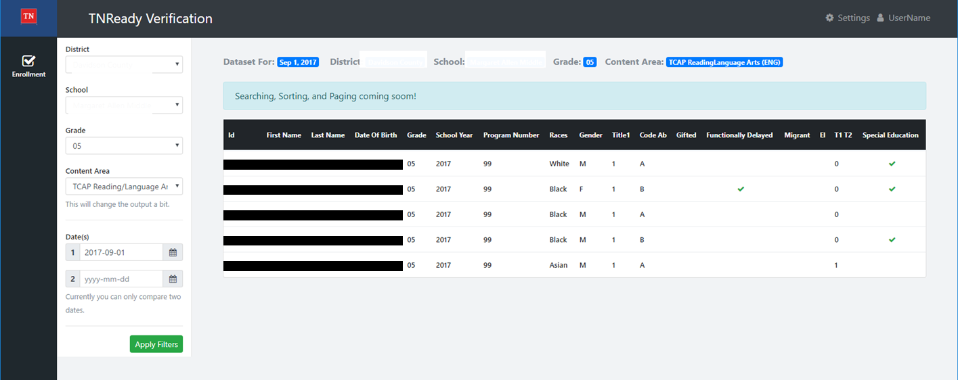
Visibility Tool - Students

Slide 38
Visibility Tool
The technology team is here at the conference today & tomorrow to answer questions about EIS and the Visibility Tool.

Slide 39
Test Orders

Slide 40
Test Orders – Online
Online test orders are linked specifically to SIS enrollment data.
Online testing is the default decision for all EOC testing.
Online testing is optional for grades 5-8 in Spring 2018. The decision to opt-in to online will be recorded in Nextera.
The deadline to opt-in to online will be early in Spring semester.

Slide 41
Test Orders – Automatic Provisioning
Districts will not be able to register currently enrolled students for online testing who are not correctly scheduled in courses in the district SIS and uploaded to EIS.
Test orders are automatically generated based on student scheduling in the SIS.
Districts will be able to manually add students to Nextera who enroll after the testing window opens.
Districts may manually order accommodated formats.
Braille
Large Print (spring admin only)

Slide 42
Test Registration

Slide 43
Test Registration
Districts must formally enroll students in order to generate a test registration.
Formal enrollment is defined as; “A state Student ID has been issued to the district SIS by the EIS data system,” and, therefore, a record of that student exists in both the district SIS and in EIS.
Students must meet the business rules for the assessment pull in order to appear in Nextera and EdTools.

Slide 44
Business Rules for the EIS Enrollment
For a student record to result in a test registration, the student must have:
Enrollment in a school
Instructional Grade record for that enrollment
Student Class Assignment (course code) for that enrollment
Class Section (local class number) for the Student Class Assignment
Teacher identified as the teacher of record for the class section (Master Teacher record)
Valid Teacher License number for the teacher of record

Slide 45
Test Registration
Districts will no longer be able perform “on the fly” test registration for online tests by entering the student directly into Nextera for those who were not correctly enrolled through the SIS and accurately transferred to EIS.
For paper tests, printing orders and pre-slugged answer documents (Spring) will only be generated for students formally enrolled in the SIS and viewable in EIS.
Exceptions:
Students who enroll after the administration window opens for online testing may be manually entered in Nextera
For Spring, additional paper tests overage will be printed for administration to students who enroll after pre-slugged answer documents are finalized

Slide 46
EIS Pull for Provisioning Nextera
The last EIS assessment enrollment file transfer to provision Nextera with students and class rosters will be the week before the testing window opens.
For Fall EOC, this will be Wednesday, November 22, 2017.

Slide 47
New Students
New students enrolling in the district from out of state (home school, private school, another state) must be entered into the SIS as soon as possible in order to properly register them for the appropriate assessments.

Slide 48
Registering New Students During Testing
If a new student is enrolled after November 22, they will be manually entered into Nextera by the district testing coordinator.
Students can only be entered in this manner during the operational testing window.
These students will first be entered into the SIS with complete demographics.
EIS will assign them an USID.
The district testing coordinator will enter them into Nextera using the assigned USID.
Any new student must be formally enrolled in the SIS by COB Wednesday, December 13, two days before the fall testing window closes.

Slide 49
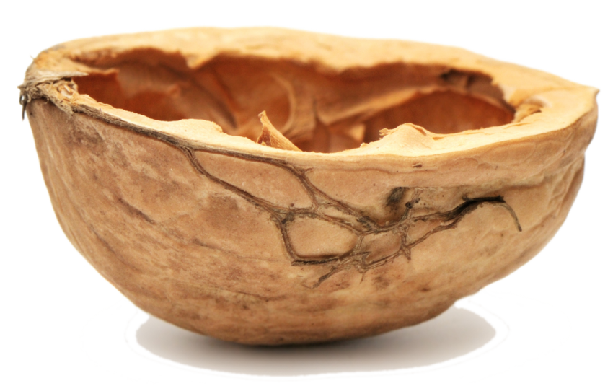
In a Nutshell…
Student scheduling data must be correct in the SIS in order to generate orders and test registration for assessments.
Correct scheduling must reflect the correct course code to trigger the assessment process.

Slide 50
Course Codes, of course…

Slide 51
Course Codes – EOC
ACTIVE CODES - EOC | Regular | SPED | The “A” course codes are for the first section of yearlong courses and will not be pulled.
Algebra I | 0842 (7th & 8th)
 | 3102
 | 31024 (B - spring course) |  | 31023 (A - test as B in spring)
 |  | 31026 (B) | 31025 (A - test as B in spring)
Geometry | 0843 (7th & 8th)
 | 3108
 | 31084 (B spring course) |  | 31083 (A - test as B in spring)
 |  | 31086 (B) | 31085 (A - test as B in spring)
Algebra II | 3103
 |  | 31034 (B) | 31033 (A - test as B in spring)
Integrated Math I | 0832 (7th & 8th)
 | 3117
 | 31324 (B spring course) |  | 31323 (A - test as B in spring)
 |  | 31326 (B) | 31325 (A - test as B in spring)
Integrated Math II | 0833 (7th & 8th)
 | 3118
 | 31334 (B spring course) |  | 31333 (A - test as B in spring)
 |  | 31336 (B) | 31335 (A - test as B in spring)
Integrated Math III | 3119
 |  | 31344 (B) | 31343 (A - test as B in spring)

Slide 52
Course Codes – EOC
ACTIVE CODES - EOC | Regular | SPED | The “A” course codes are for the first section of yearlong courses and will not be pulled.
English I | 3001
English II | 3002
English III | 3003
USHistory | 3416 |  | (AP US History - 3440 - not tested)
Biology I | 3210
 | 32104 (B - spring course) |  | 32103 (A - test as B in spring)
 |  | 32106 (B ) | 32105 (A - test as B in spring)
Chemistry I | 3221
 | 32214 (B - spring course) |  | 32213 (A - test as B in spring)

Slide 53
Course Codes – EOC (Cambridge)
Cambridge IGSCE
Course Name | Course Code | Required EOC
IGCSE Mathematics I | 4135 | Integrated Math I
IGCSE Mathematics II | 4136 | Integrated Math II
IGCSE Additional Mathematics III | 4137 | Integrated Math III
IGCSE English Language | 4222 | English I
IGCSE English Literature | 4226 | English II
IGCSE Biology | 4145 | Biology
IGCSE Chemistry | 4146 | Chemistry

Slide 54
Course Codes – Grades 3-8
ACTIVE CODES - GRADES 3-8 | English Language Arts | Math | Science | Social Studies
Grade 3 - Reg (content specific) | 0301 | 0306 | 0307 | 0319
Grade 4 - Reg (content specific) | 0401 | 0406 | 0407 | 0419
Grade 5 - Reg (content specific) | 0501 | 0506 | 0507 | 0519
Grade 6 - Reg (content specific) | 0601 | 0606 | 0607 | 0619
Grade 7 - Reg (content specific) | 0701 | 0706 | 0707 | 0712
Grade 8 - Reg (content specific) | 0801 | 0806 | 0807 | 0814

Slide 55
Course Codes – Grade 2
ACTIVE CODES - GRADE 2 | English Language Arts | Math
2nd grade | 0201 | 0206
2nd grade ALT | 50201 | 50206

Slide 56
Course Codes – MSAA and TCAP Alt
ACTIVE CODES - GRADES 3-8 | English Language Arts | Math | Science | Social Studies
Grade 3 - Alternate Assessment | 50301 | 50306 | 50307 | 50319
Grade 4 - Alternate Assessment | 50401 | 50406 | 50407 | 50419
Grade 5 - Alternate Assessment | 50501 | 50506 | 50507 | 50519
Grade 6 - Alternate Assessment | 50601 | 50606 | 50607 | 50619
Grade 7 - Alternate Assessment | 50701 | 50706 | 50707 | 50712
Grade 8 - Alternate Assessment | 50801 | 50806 | 50807 | 50814
Alternate Assessment: Algebra I | 53102
Alternate Assessment: Biology I | 53210
Alternate Assessment: English II | 53002

Slide 57
Retired Codes
The 2017-18 assessment course codes document also contains lists of retired codes for Grade 2, Grades 3-8 and End of Course.

Slide 58
Teacher Student Connection

Slide 59
Teacher Student Connection
Teacher Student Connection (TSC) editing will remain in EdTools.
Districts will be able to perform claiming (TSC) any time between submission of their enrollment data to EIS (starting October 16) and the last day of the administration window.
Districts will no longer have to wait until after testing to commence TSC.

Slide 60
Teacher Student Connection
The first EIS pull that will populate the Visibility Tool will open for districts on October 16.
Data in the tool will reflect all EIS transfers from the SIS through the prior week.
Districts will have through the last day of testing window (December 15) to update student demographic information in SIS.
TSC will open in EdTools on October 16.
Districts will have through the last day of the testing window to complete TSC for fall block (December 15).

Slide 61
Teacher Student Connection
Teacher of Record must be defined in the district SIS through complete scheduling.
Districts should only use teacher student claiming (TSC) in EdTools to update roster information in circumstances where multiple teachers taught a specific class as co-teachers or based on personnel changes throughout the school year.
Otherwise, TSC will reflect the same field values and information as in prior years (instructional responsibility and instructional availability)

Slide 62
The End of a New Beginning…

Slide 63
New Streamlined Process for Assessment
Fully Enrolled Students in SIS
Nightly Data Transfer to EIS
New Tool for Data Review of EIS Demo Stats
Automatic Ordering of Student Tests
Automatic Rostering in Teacher Student Connection
Ongoing SIS Updates and EIS Data Transfer

Slide 64
More Time, Better Data, Faster Processing!
OLD PROCESS | NEW PROCESS
Pre-ID data pulled once – in October and January – for test ordering | Continuous EIS data transfer through two days before admin window opens (in November and April) for online test ordering in Nextera
Demographic data clean-up 2-3 weeks after testing window closed and SDDV complete | Demographic data review and updates for 2 – 3 months - from first EIS data transfer through the last day of the testing window
Teacher Student Connection open only after testing window closed | Teacher Student Connection (TSC) open and available for editing from first EIS data transfer through last day of testing window
Duplicate data entry in both EdTools and SIS | Single data entry in SIS with data transfer to EIS, Nextera, and TSC
No reconciliation between EdTools and EIS resulting in data conflicts and errors | Visibility Tool ensures accuracy of data for assessment, accountability, and other reporting/finance functions

Slide 65
Making Assessment Simpler
Accurate data in the SIS
Easier Administration
TSC Open Before Testing

Slide 66
Data Review Cycle
SIS
EIS
Visibility Tool
District Review
Allow overnight processing of data updates to SIS to transfer to EIS
Enter student enrollment and demographic data
Check Visibility Tool to confirm expected changes
Visibility Tool will reflect changes to EIS (from SIS) on the same day
Check SIS data if unexpected values
Contact EIS Helpdesk if data appears incorrect in EIS

Slide 67
Platform Functions
Function | SIS | Visibility Tool | Nextera | EdTools
Enrolling and Scheduling Students | X
Updating Student Demographics | X
Updating Schedules/Class Rosters | X
Reviewing Demographic Information |  | X | X
Test Ordering and Registration |  |  | X
Reports of Irregularity (RIs) |  |  | X
Recording Accommodations |  |  | X
Teacher Student Connection (TSC) |  |  |  | X

Slide 68
Key to Success – SIS Vigilance
Districts must ensure that complete and accurate student enrollment data is entered into their district SIS in a timely manner.
Doing this will make assessment administration much easier both for the district and for the schools.

Slide 69
Fall EOC Timeline
September
Ongoing student enrollment updates in SIS
Additional staffing for EIS Helpdesk to support assessment processing change
December
Ongoing student demographic updates in SIS
December 15 – Last day for demographic updates in SIS for fall admin. TSC closes. Fall block admin window closes.
October
November
October 16 – Data Visibility Tool opens for data review for all grades/subjects. TSC opens for all grades/subjects
Ongoing student enrollment updates in SIS
Ongoing Student Enrollment updates in SIS
November 22 – Final EIS data transfer for fall block testing
December 13 – Last day for late student enrollment in SIS
November 27 – Fall block admin window opens

Slide 70
Questions?
Email: TNEd.Assessment@tn.gov
www.TNReady.gov

