Slide 1
Countdown to Boyne 9-12 Jan. 2015
ALL TRIP PARTICIPANTS PLEASE READ BELOW. See map on next page.
Hope Hotel, 10823 Chidlaw Road, Wright-Patterson AFB, OH. Located just outside Wright-Patterson AFB, Gate 12A. From I-675 Northbound, take exit 17 onto Rt. 844 and stay in left lane of exit ramp, bear left to stay on 844 passing underneath I-675, pass exit for Wright State and take next exit onto Rt. 444, turn left at light at end of exit ramp onto Rt. 444, turn left at next light towards WPAFB Gate 12 A. Take immediate right towards Richard Holbrook Conference Center and Hope Hotel. Park along the fence at the far right side of the parking lot. ALLOW EXTRA TIME TO GET THERE IF YOU’VE NEVER BEEN TO HOPE HOTEL.
Bus will depart the Hope Hotel at 2 p.m. sharp on 9 January. Please be there NLT 1:30 to load the bus. Bring food/dinner for the bus ride up to Michigan. Bus does not stop for a dinner break. The bus will have beer, wine, soda, water, and some snacks. There is adequate luggage space under the bus but please limit luggage to ski equipment, one suitcase per person, and a small cooler if desired. Bring DVDs or CDs for the bus.
Do not forget swim suit, flip flops, and plastic drinking vessel for the hot tub. BYOB for hot tub beverage and other use. The resort has bathrobes in the rooms so no need to bring one. We have 46 people on our 56 passenger bus, and we need room for beverages, so please limit your bus carry-on to essential items. Also, handy to have drink holder to hang on the bus windows. Weekend itinerary will be provided on the bus. SEE YOU ALL THERE. THINK SNOW!!!
Call the Trip Leader: Del Thomas, 937-231-8566 if you get lost or are running late ☹

Slide 2
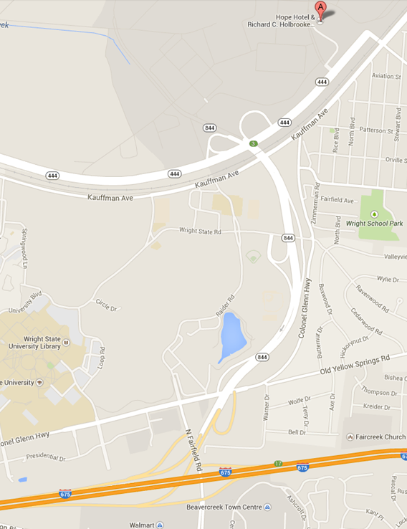
North
Fairborn
To Rt. 4
Wright State
Exit
South

