Slide 1
APPR for 2016-2017
Central Square School District and CSTA

Slide 2
Changes to State law (3012-d)
State provided growth scores for grades 3-8 will be used for advisory purposes only through June 2019
Teachers in grades 3-8 will receive both a transition rating and a composite rating
The composite rating cannot be used for purposes of employment decisions
Notes:
Currently in the transition period
Any state provided growth score will be excluded from the scores and ratings used to calculate the transition score and rating, and back-up SLO’s that use the 3-8 ELA or math scores cannot be used either. NYS Regents data and Science 8 is allowable.
Teachers who no longer have a growth score will have a new transition rating out of a total of 80 points instead of 100. This is mandated by NYS.

Slide 3
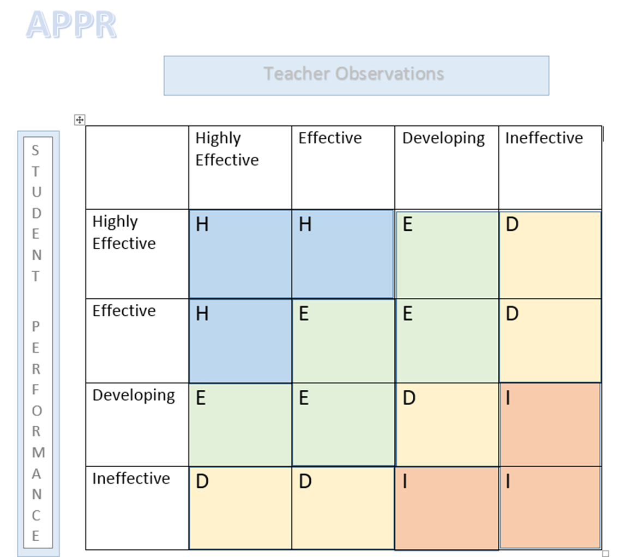
Teacher Observations
Notes:
50/50

Slide 4


Observation Process

Slide 5
STAR – Growth Score
K-8 teachers will have their score derived using STAR.
Why?
Quick
Historically proven to be favorable (14-18 points/20)
The risk of using two assessments is too great
Notes:
When it is used as a building score it spreads out the risk from any one class having a bad testing day. It is an assessment we can use K-12 that is quick and we have data that shows it has histoically given us a decent number of points.
the state now mandates that if you use a second assessment and the student scores from that assessment qualify the teacher as ineffective, that the entire transition rating would be ineffective regardless of how well the teacher rated in their observation or assessment.

Slide 6
Student Performance
New HEDI band:
Old HEDI band: no longer in use
HIGHLY EFFECTIVE |  |  | EFFECTIVE |  |  |  |  |  |  |  |  | DEVELOPING |  |  |  |  |  | INEFFECTIVE
20 | 19 | 18 | 17 | 16 | 15 | 14 | 13 | 12 | 11 | 10 | 9 | 8 | 7 | 6 | 5 | 4 | 3 | 2 | 1 | 0
87 – 100 | 74-86 | 61 – 73 | 58 – 60 | 55 – 57 | 53 – 54 | 51 – 52 | 49 – 50 | 47 – 48 | 45 – 46 | 43 – 44 | 41 – 42 | 37 – 40 | 33 – 36 | 30 – 32 | 27 – 29 | 24 – 26 | 21 – 23 | 14 – 20 | 7 – 13 | 0 - 6
Notes:
Review the graph –
Point out the change in ranges for effective etc.
STAR was based on these new ranges last year and our STAR ranges

Slide 7
Changes to note:
Timeline has been altered
Every attempt will be made to have your Reflection and Observation aligned at least 24 hours prior to your post-observation
If a teacher isn’t in receipt of the scores ahead of time he/she may choose to reschedule the post-observation

Slide 9
Streamlined NYSUT rubric
Observable evidence:
  1.2, 1.3, 1.6
  2.1, 2.2,2.4, 2.5
  6.2, 6.4,
  7.1, 7.2, 7.3
Only one indicator needs to be observed for Standards 1, 2, 6 and 7.
Only one indicator needs to be observed for each element in Standards 3, 4 and 5.
5.4 and 5.5 will no longer be scored.
Notes:
The APPR committee worked to narrow the focus of the rubric. While still evaluating all standards, they will be focused on those elements and indicators that will be able to be observed during the lesson or can be linked to observed parts of the lesson.
For the 2015-2016 school year, we have streamlined Standards 1, 2, 5, 6 and 7. Standards 3, 4 and 5 will still be measured in the observation. Targeted indicators in Standards 1, 2, 6 and 7 will be discussed in post-conference dialog

Slide 10
Standards
Elements
Indicators
Notes:
Only one indicator needs to be observed for Standards 1, 2, 6 and 7.
Only one indicator needs to be observed for each element in Standards 3, 4 and 5.
5.4 and 5.5 will no longer be scor

Slide 11
Standard 3
Element 3.6
One indicator or the other
Notes:
For standard 3, you only need one indicator in each element to be scored.

Slide 12

Questions ?

