Slide 1
Lesson 2: Theory
Robert Wonser
Introduction to Sociology

Slide 2
How Do Sociologists Understand Society?
We use various theories to help explain the social world.
According to sociologists, a theory is an abstract proposition that both explains the social world and makes predictions about future events.
Theories can and do change over time because theories seek to explain society, which itself also changes over time.

Slide 3
Thinking Sociologically about Sociology
What was going on (that is, what did the social context look like) in sociology’s formative years?
Major trends:
  Urbanization and rapid social change
  The Enlightenment
  The Industrial Revolution

Slide 4
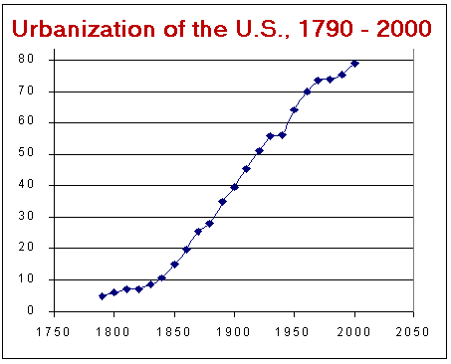
Urbanization
First US Census in 1790: 5% urban.
Largest city: NYC at fewer than 50,000.
Only rose to 11% urban by 1840.
Notes:
http://srufaculty.sru.edu/james.hughes/100/100-6/d-6-10.htm

Slide 5
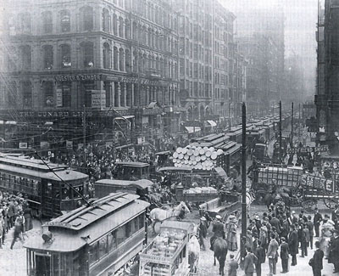
Urbanization brought new social arrangements
  Simmel’s ‘stranger’ - physically close but psychologically far away

Slide 6

The Enlightenment
How did a shift towards the individual and away from group affect society and social interactions?

Slide 7

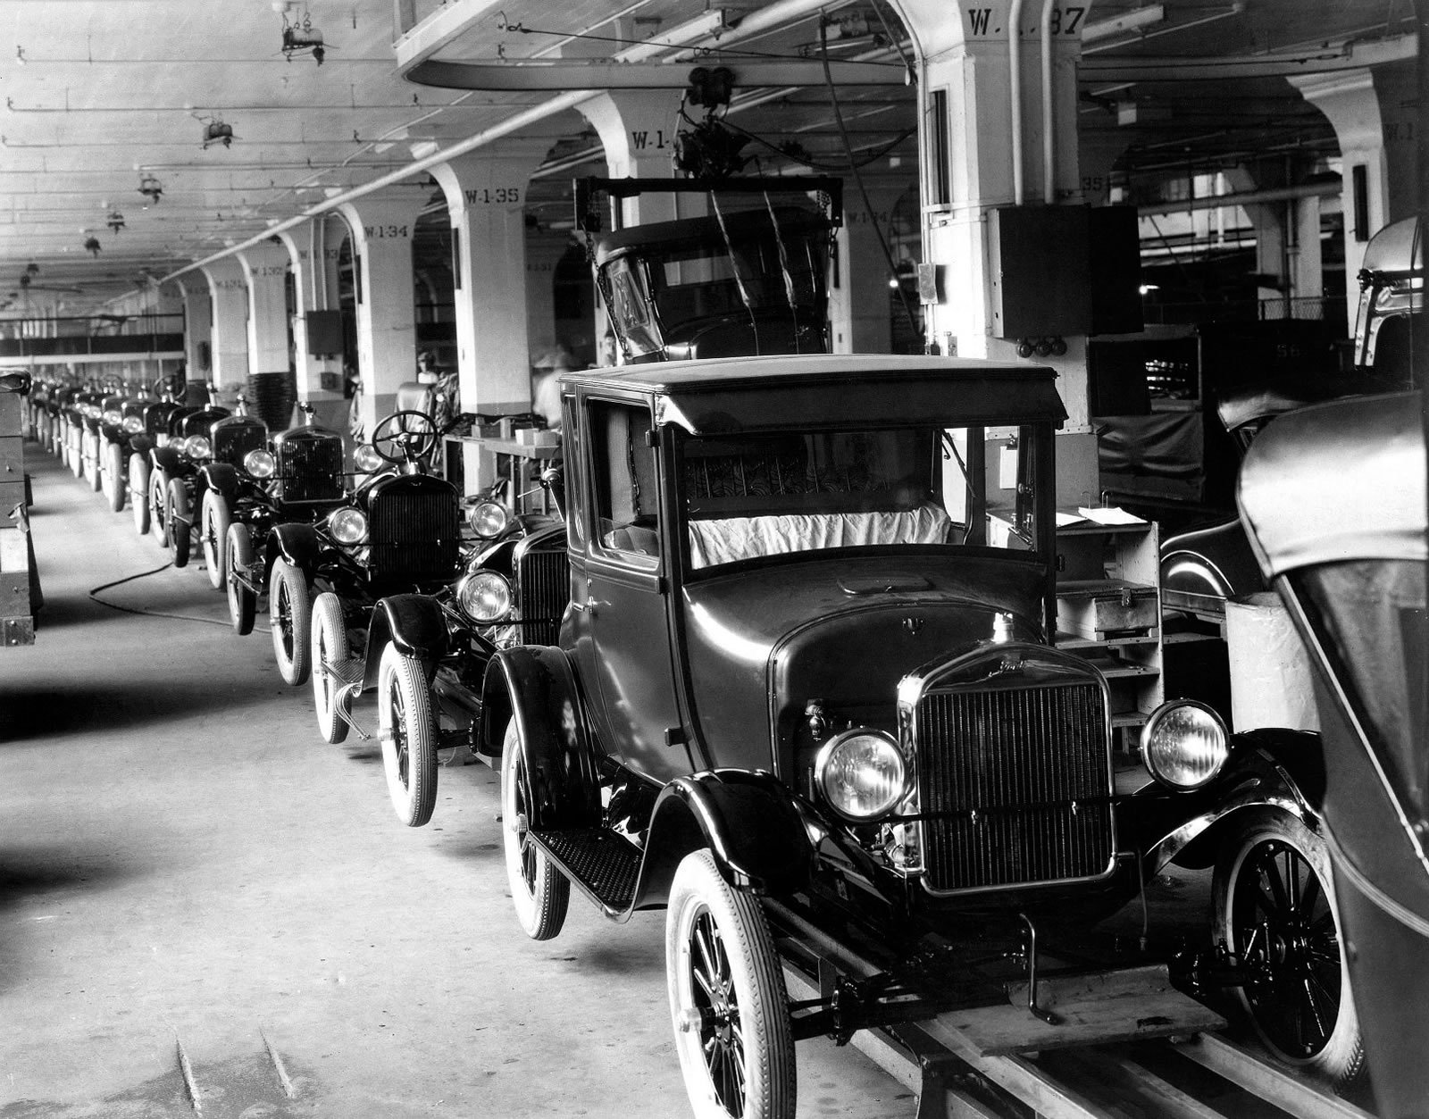
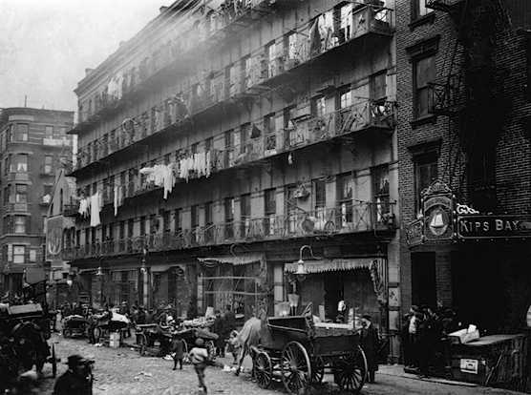
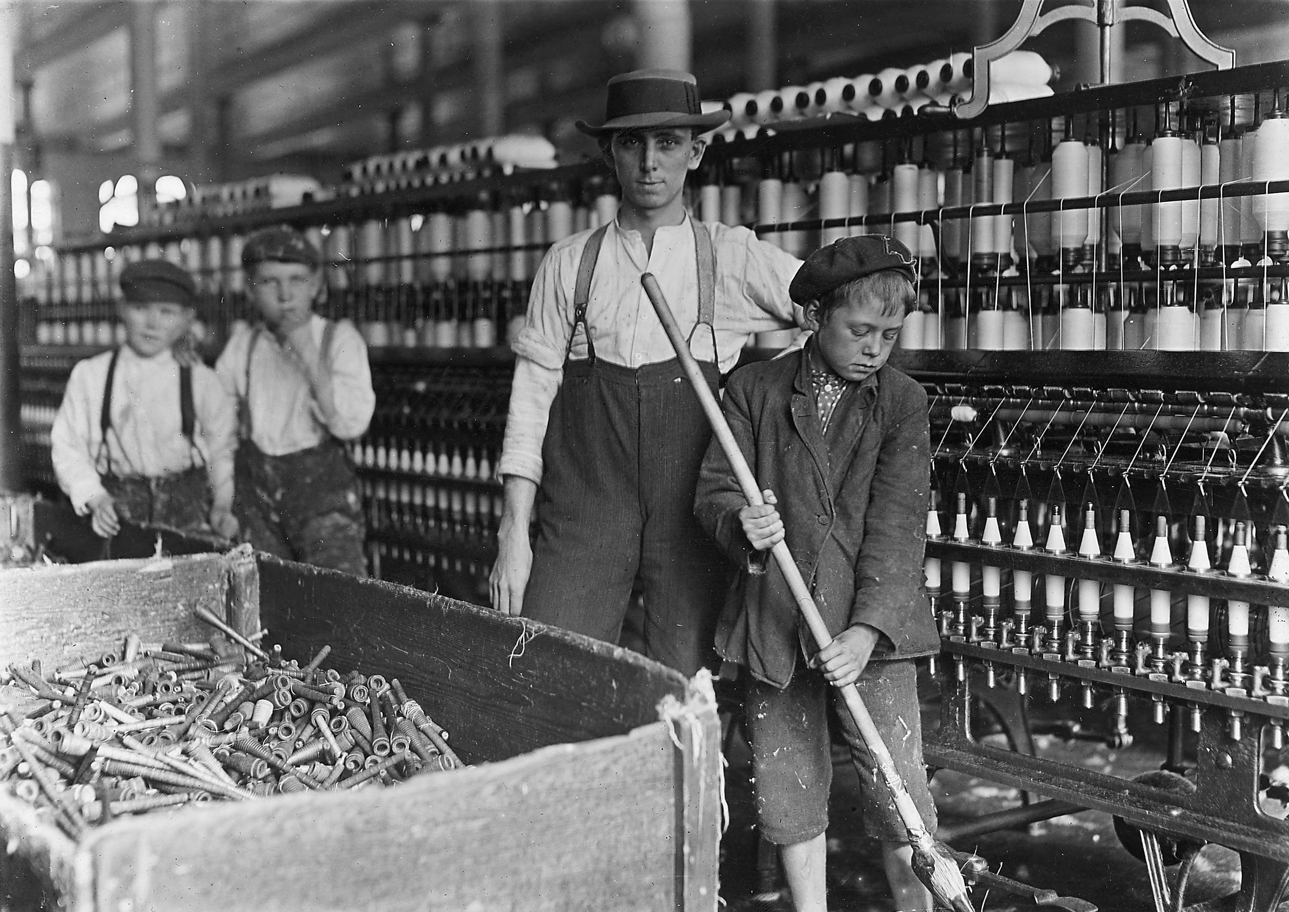
The Industrial Revolution
How did factory life change society?

Slide 8
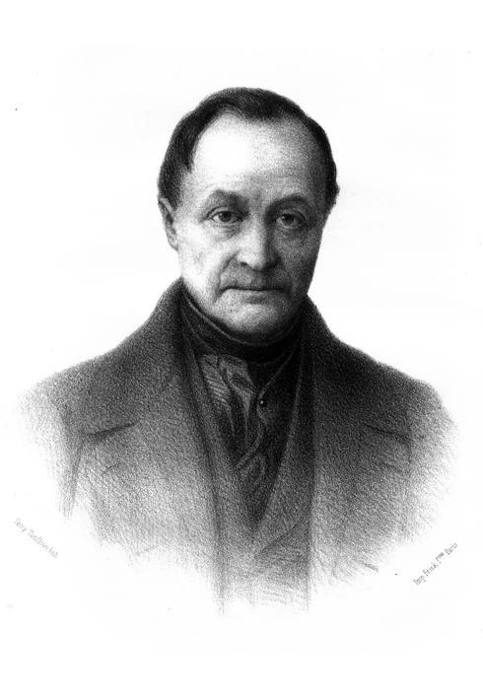
Auguste Comte
Coined the term “sociology”
Defined sociology as a positivistic science
helped to establish sociology as an intellectual tradition in France
“law of three stages” – theological, metaphysical, positivistic

Slide 9
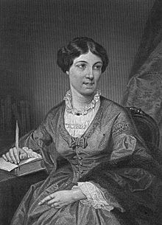
Harriet Martineau
Harriet Martineau was an English journalist and political economist.
She traveled to the United States and studied American society, which she believed was flawed and hypocritical because of the existence of slavery and the fact that both women and blacks were denied equal rights.

Slide 10
Entrenched Sexism in Science
Despite these impressive works, her most important contribution may have been her English translation of Comte’s Introduction to Positive Philosophy.
Why would this be the case for her?

Slide 11
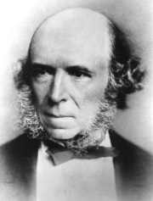
Herbert Spencer
Herbert Spencer was the first great English-speaking sociologist.
Spencer was an advocate of the idea of evolution, even before Darwin made it famous and coined the phrase “survival of the fittest.”
He believed that societies, like living organisms, evolve through time by adapting to their changing environment. His philosophy is often referred to as “social Darwinism.”

Slide 12
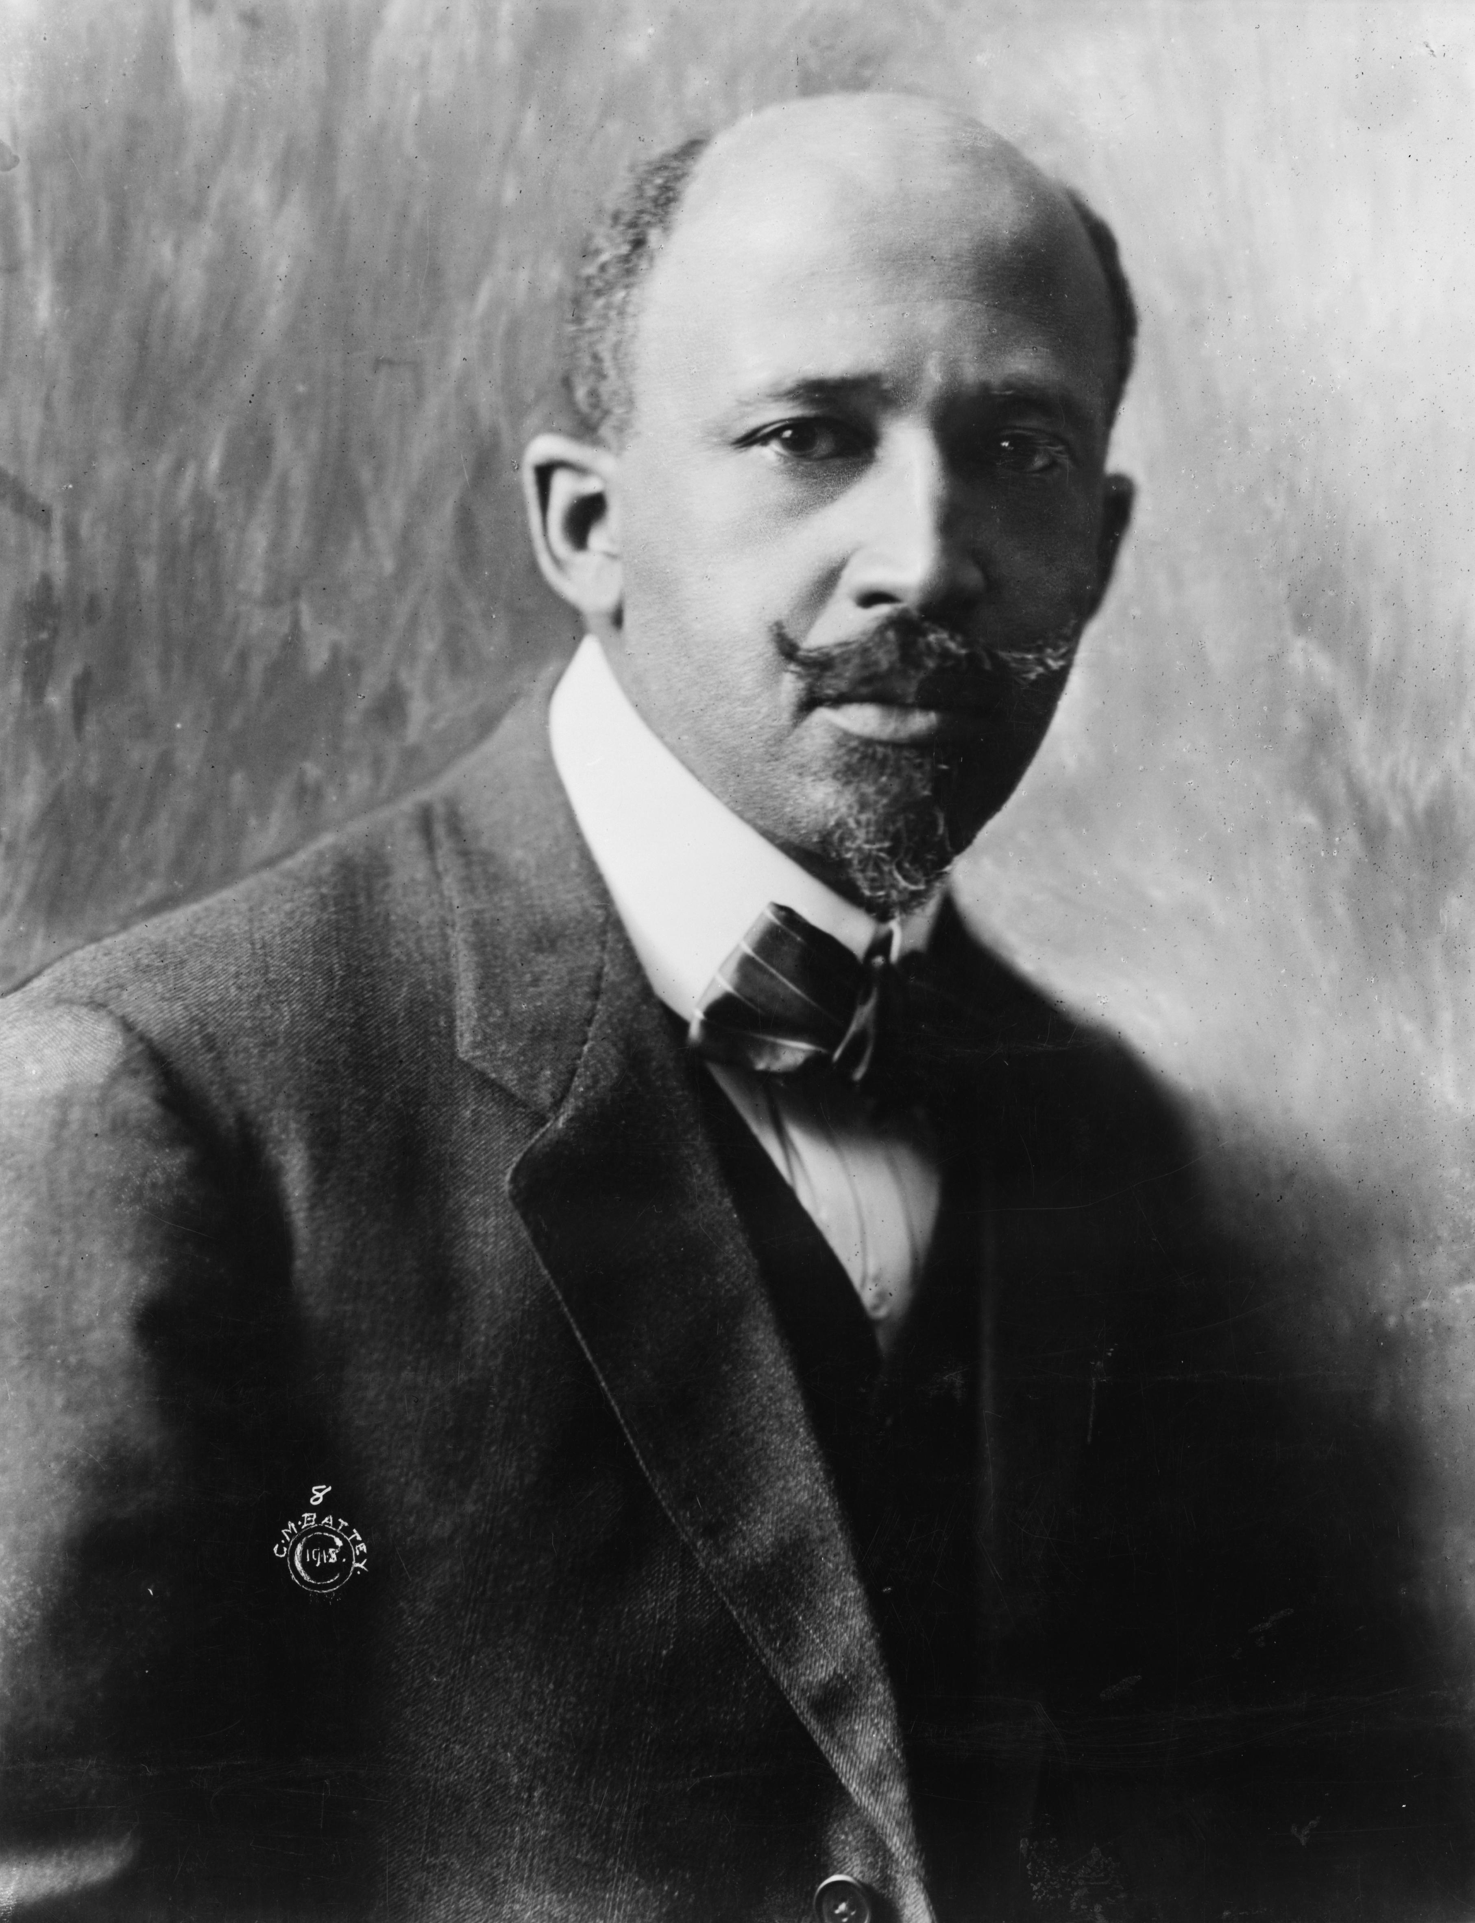
W.E.B. DuBois
The Veil and Double Consciousness
African Americans were simultaneously outsiders and insiders, outsiders within.
Both inside and outside the dominant white society (separated by the Veil).
Gives them unique and enhanced insight into society as a whole (standpoint theory) and it produces an enormous tension that manifests itself in pathologies within the black community.

Slide 13
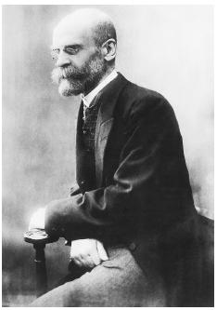

Emile Durkheim
What holds society together?
Two types of social bonds: mechanical and organic
He believed that agrarian, pre-modern societies were held together by mechanical solidarity, a type of social bond where shared traditions and beliefs created a sense of social cohesion.
  Ex: The Amish

Slide 14
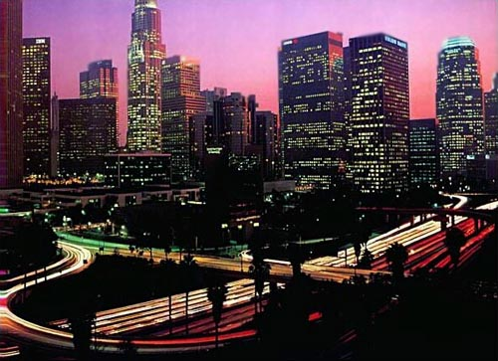
Durkheim
On the other hand, industrial societies were held together by organic solidarity, a type of social bond based on a division of labor that created interdependence and individual rights.
Ex: modern cities

Slide 15
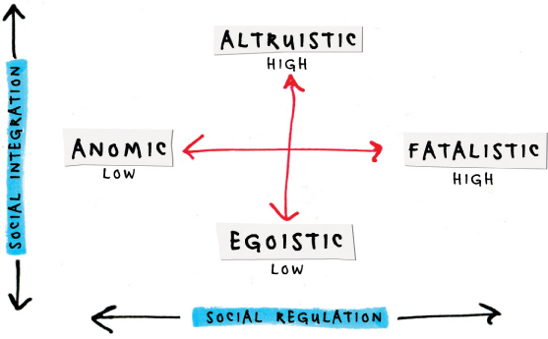
Suicide
In another study, Durkheim found that the more firmly connected people are to others, the less likely they are to commit suicide; thus demonstrating that even suicide is impacted by social forces.

Slide 16
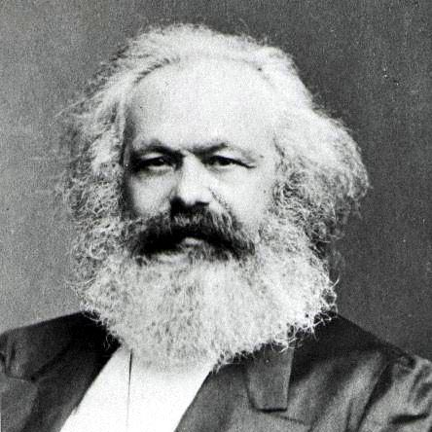
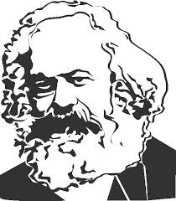

Karl Marx
Karl Marx was a German philosopher and political activist whose contribution to sociology can be found in conflict theory.
Interested in Capitalism, the economic system that is based on the private for-profit operation of industry.

Slide 17
A Theory of Conflict
Marx was describing how capitalism works.
Marx believed that capitalism was creating class conflict and social inequality between the bourgeoisie, who owned the means of production (money, factories, natural resources, land), and the proletariat, who were the workers.

Slide 18
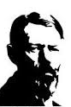
Max Weber
Also interested in the shift from traditional society to the modern industrial society.
  Particularly religion and rationalization.
He was particularly concerned with the process of rationalization, the application of economic logic to all human activity, due to the development of bureaucracies throughout society.

Slide 19
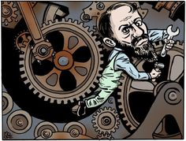
Iron Cage of Rationality
Too much rationalization → iron cage of rationality
Cloak to iron cage

Slide 20




Disenchantment
He believed that contemporary life was filled with disenchantment, the inevitable result of the dehumanizing features of bureaucracies that dominated modern societies.

Slide 21

European Sociology
The early sociologists were European men.
This influenced their outlook and theories.

Slide 22
Functionalism
Structural Functionalism or simply functionalism begins with the assumption that society is a unified whole that functions because of the contributions of its separate structures.
Its origins can be traced to the ideas of Comte, Spencer, and Durkheim.
  Parsons and Merton in US

Slide 23
Conflict Theory
Conflict Theory sees social conflict as the basis of society and social change, and emphasizes a materialist view of society, a critical view of the status quo, and a dynamic model of historical change, emerged from the writings of Marx.
Power imbalances and class based analyses.

Slide 24
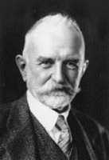
Symbolic Interactionism
Symbols + interaction
Symbolic Interactionism sees interaction and meaning as central to society and assumes that meanings are not inherent but are created through interaction.
Interaction of meaningful symbols.
It is America’s unique contribution to sociology and has proved to be the most influential perspective of the twentieth century.
Comes from George Herbert Mead, Charles Horton Cooley and Herbert Blumer

Slide 25

Three tenets of Symbolic Interactionism
Symbolic Interactionism, the process by which things are socially constructed:
1)Human beings act toward ideas, concepts and values on the basis of the meaning that those things have for them.
2) These meanings are the products of social interaction in human society.
3) These meanings are modified and filtered through an interpretive process that each individual uses in dealing with outward signs

Slide 26










Symbolic Interactionism: An example
Are these the same? Do they have the same meaning? What do you think of when you see each?

Slide 27
New Theoretical Perspectives
Feminist Theory looks at gender inequalities in society and the way that gender structures the social world.
Standpoint Theory where we exist in the social world affects how we see and understand the world.
Queer theory is a paradigm that proposes that categories of sexual identity are social constructs, and that no sexual category is fundamentally either deviant or normal.

Slide 28

More New Theories
Postmodern Theory is a paradigm that suggests that social reality is diverse, pluralistic, and constantly in flux.
  Critical of accounts of Truth – especially traditional science
Intersectionality is a concept often used in critical theories to describe the ways in which oppressive institutions (racism, sexism, homophobia, transphobia, ableism, xenophobia, classism, etc.) are interconnected and cannot be examined separately from one another.

Slide 29
Some Important Realizations
Theories are explanations for events (that is behaviors, people, attitudes, etc.).
Theme connecting many classical theorists work: modernization, society (social bonds) and capitalism.

Slide 30
Lesson Quiz
The purpose of sociological theory is:
  to prove sociological hypotheses.
  to demonstrate that human behavior can be seen in predictable absolutes.
  to show that sociology has more to offer that psychology.
  to help people understand the world around us.

Slide 31
Lesson Quiz
2. Which of the following is NOT true about social theory?
  Social theories are completely consistent over time.
  Social theories are also known as perspectives.
  Social theories will change over time because society changes over time.
  Social theories attempt to explain human behavior.

Slide 32
Lesson Quiz
3. According to Karl Marx, _______ is the source of all social change.
  a. conflict
  b. solidarity
  c. politics
  d. anomie

Slide 33
Lesson Quiz
4. Which of the following is a paradigm that begins with the assumption that society is a unified whole that functions because of the contributions of its separate structures?
  a. Conflict Theory
  b. Labeling Theory
  c. Structural Functionalism
  d. Symbolic Interactionism

Slide 34
Lesson Quiz
5. What theory looks at gender inequalities in society and the way that gender structures the social world?
  a. Conflict Theory
  b. Psychoanalytic Theory
  c. Critical Theory
  d. Feminist Theory

