Slide 1
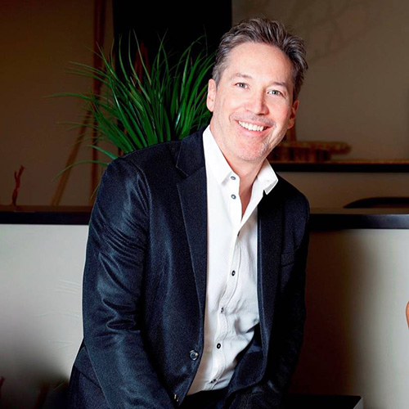
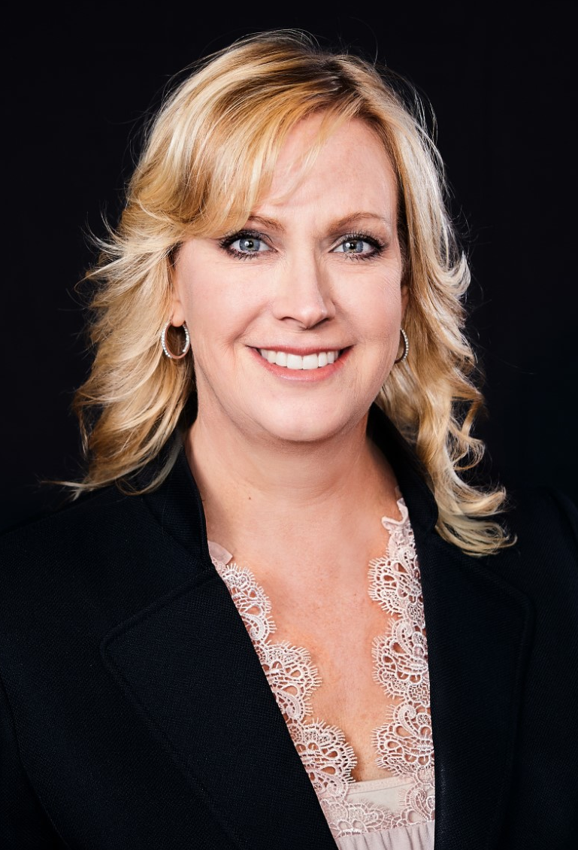
Christian Fournier, DMD
Dr. Fournier has been speaking for Align since 2009. He is actually treating all his patients with clear aligners. As a Diamond solo Provider, he is also a coach of YourOrthoCoach.com and a speaker for the Aligner Intensive Fellowship. He is speaking across North America on Clear aligners and has been using lingual attachments for better aesthetics since 2008. He has won the Case Shootout at the Invisalign Summit in 2018.
Dr. Fournier’s creativity and ingenuity will inspire you. The combination of his imagination and experience have created incredible smiles that will make you rethink how you design your current treatment plans. You will find this presentation both useful and extremely enjoyable.
7 hours of
continuing education!
VAO/VAOF
FIRST EVER!
Virtual Meeting
September 11
8:30-4:00
Link coming soon.
Cindi James
Cindi James is the director of training at Peniche and Associates. She has coached orthodontic offices throughout the country on how to improve all aspects of their practice. Cindi is enthusiastic and educated, with more than 30 years of orthodontic experience and has a degree in Business Marketing. She has expertise in the areas of treatment coordinating, marketing, office management, and clinical assisting.
Cindi has lectured internationally including at the AAO, and you will find this lecture imperative as she guides you through the new patient process from a post-quarantine perspective. It will guide you towards staying current and competitive with the new systems developed, both during these unusual times and into the future.

