Slide 1
Hayner Library Upper Alton Seminar Closing Poem
“TREASURES”
The Pride of the Upper Alton Mother
by poet Marilyn Trainor
recited by Mary M. Mathis

Slide 2
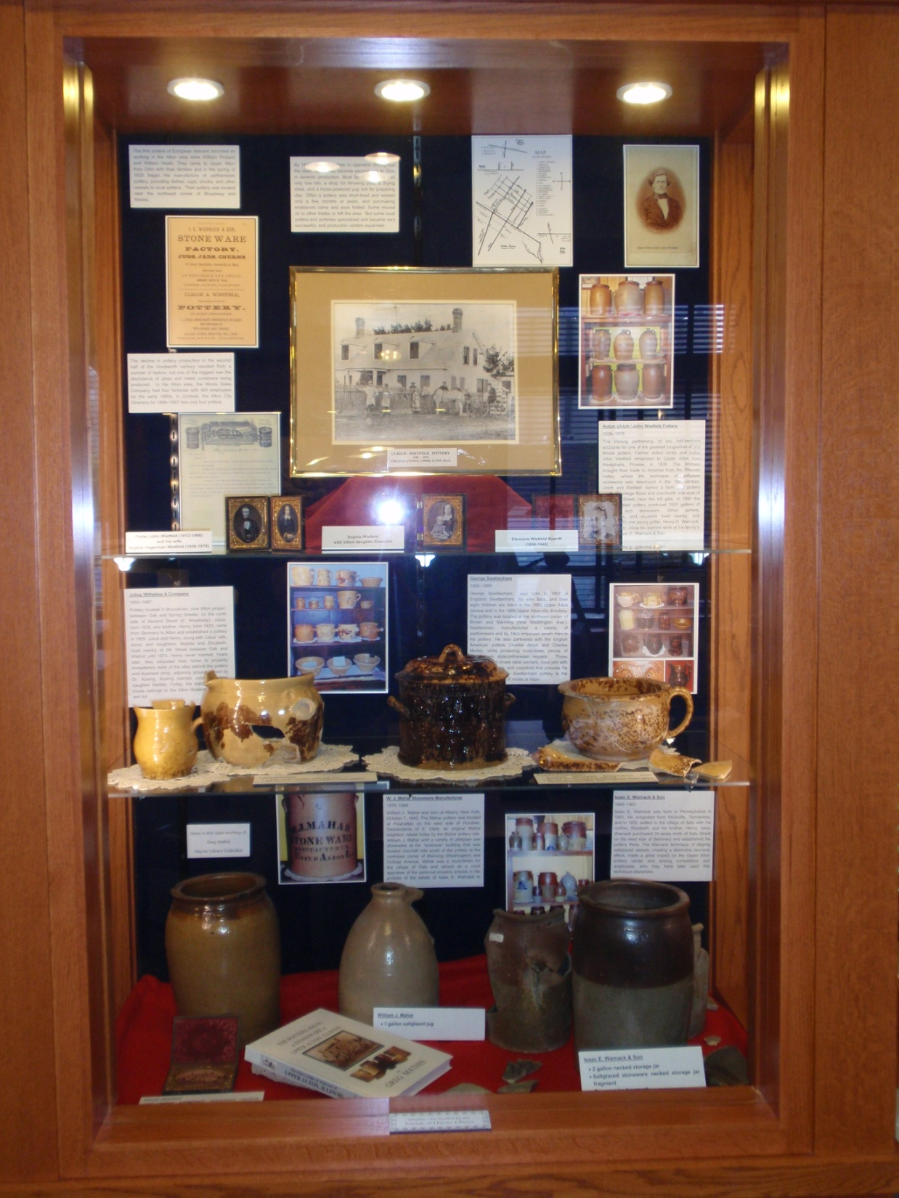
Notes:
THANK YOU LACY AND THE HAYNER GENEALOGY AND LOCAL HISTORY LIBRARY……… FOR THE GREAT DISPLAY.

Slide 3
The Pride of the Upper Alton Mother
TREASURES
by
Marilyn Trainor
Recited by
Mary M. Mathis
272
Notes:
I CLOSE …….with an excellent poem written in 1996 by an Illinois poet, Marilyn Trainor. It was recited twenty years ago at the Alton Museum of History and Art, December 1996.

Slide 4
Notes:
END

Slide 5
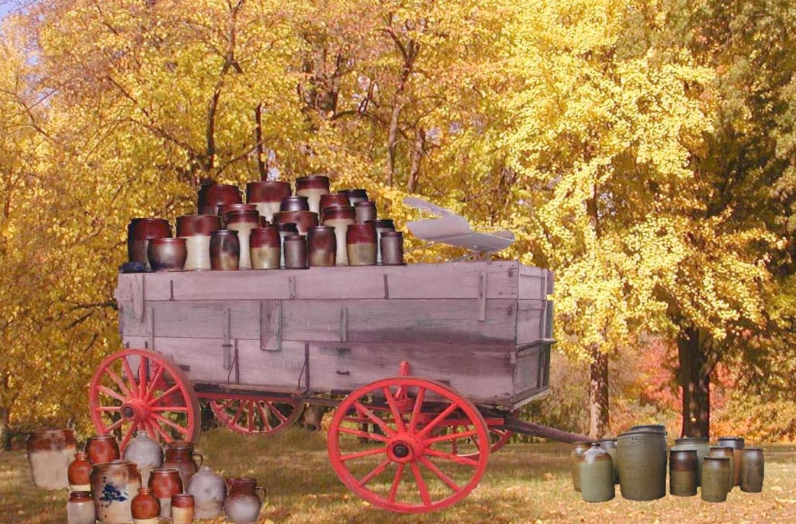
Notes:
FOR the researcher, the collector, and the student of Upper Alton, Madison County, Illinois.
This DREAM PICTURE might well have been a common seen in the village of Salu around 1860.
Thanks Everyone for your time today. HAPPY HOLIDAYS !!!!!

