Slide 1
English Learner, Immigrant and Migrant Data 2016 Fall Tennessee Data and Attendance Supervisor Conference September 15, 2016 Trish Kelly Executive Director, Data Governance & EDFacts-CSPR Coordinator Trish.Kelly@tn.gov (615) 770-1059
9-14-16

Slide 2
Session Overview
Review federal reporting requirements for English learners and immigrant and migrant students
Examine English learner, immigrant and migrant data in EIS
Explore how to use EIS Research Queries to check your data
Review name and registration practices
Share resources and contacts
Answer your questions

Slide 3
Federal Reporting: EL and Immigrant
Students Whose First Language Is not English
English Language Background (L, W, 1, 2, 3, 4, F, N)
Language
Grade, Sex, Race-Ethnicity, Disability Status
Achievement and English Language Proficiency Test Results
ESL Teachers
Immigrant
Date First Enrolled in US School
Country of Birth, Language
Grade, Sex

Slide 4
Federal Reporting: Migrant
Migrant
Age/Grade (PreK, K-12, Out of School Youth)
Sex, Race-Ethnicity, Disability Status, English Language Background
Achievement Test Results and English Language Proficiency Assessments (if applicable)
Program Type (instructional or support services)
Period (regular school year, summer or winter session)
Qualifying Arrival Date (QAD)

Slide 5
EIS: Principal Data Source
EIS: Tennessee Department of Education’s (TDOE) operational database.
Primary data source for federal reporting requirements
Updated nightly from most districts with data transmitted from LEA student information systems (SIS) and other databases that contain student, teacher, school and district data
Contact your IT team to determine your district’s upload schedule

Slide 6
Reviewing Data in EIS
Log into EIS production as a district or school user.
Select the Research Queries option.
Choose a research query (e.g, Migrant Student List).
Enter year as the “fall” part of the school year.
Use 2015 for 2015-16
Use 2016 for 2016-17
In the School box, select All Schools for a district report
Choose other filters (e.g., grade, gender, race-ethnicity).
Select View Report (right side of the page).
To download the data to csv or Excel format, select the file icon (to the right of Find | Next).

Slide 7
English Language Background (ELB)
English Language Background classification:
2015-16: L, W, 1, 2, F, N, E
2016-17: L, W, 1, 2, 3, 4, F, N, E
If an English language background is not entered, most SIS packages will automatically enter English (E).
English language background cannot be English for English learners and non-English background students.

Slide 8
State Reporting and Funding
The following four classifications are most important:
English Learner (L) – first language is not English and qualifies for direct ESL services
Waived Direct ESL services (W) – An EL student who declined direct ESL services in order to receive ESL services in a regular classroom
Transitional Year 1 (T1 or 1) – first transition year from ESL
Transitional Year 2 (T2 or 2) – second transition year from ESL

Slide 9
2015-16 Changes in ELB Classifications
Removed from the Collection: Completed ESL Program in High School (G)
Definition Revised: Former EL Student (F) – former EL status attained upon completion of the second transitional year.

Slide 10
2016-17 Changes in ELB Classifications
Added to the Collection:
Transitional Year 3 (T3 or 3) - third transition year from ESL
Transitional Year 4 (T4 or 4) - fourth transition year from ESL
Definition Revised:
Former EL Student (F) – former EL status attained upon completion of the fourth transitional year.

Slide 11
Other ELB Classifications
Non-English Language Background (NELB or N) - first language is not English and the student NEVER qualified for ESL services.
NELBs are screened for English language proficiency because a language other than English appears on the Home Language Survey (HLS).)
English Native (E) – native English speaker
For more: See the CPM Data Manual and the EIS Data Dictionary’s Appendix, E, English Language Background (ELB)

Slide 12
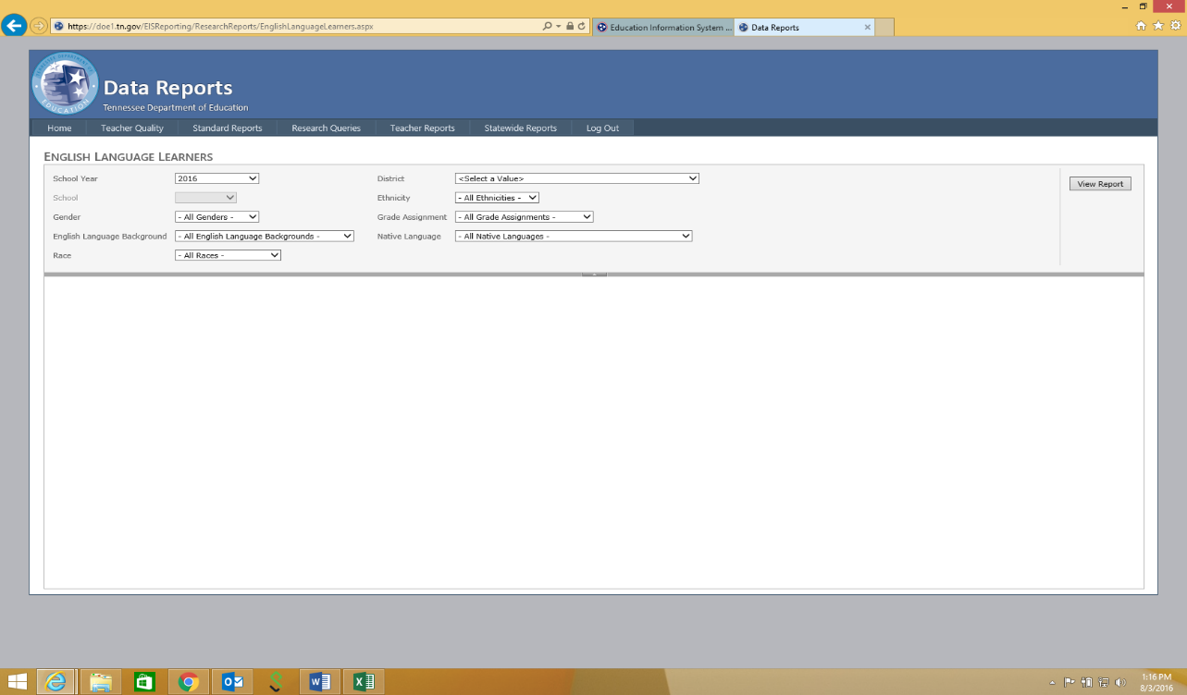
English Language Learners Research Query
Select Research Queries / English Language Learners (ELL)
Choose an English language background classification
2015-16: L, W, 1, 2, F, N, E
2016-17: L, W, 1, 2, 3, 4, F, N, E

Slide 13
ELL Research Query Results
Native Language
L,W,1, 2, 3, 4, F, N – Native Language is NEVER English
E - Native Language is ALWAYS English
Birth Country
Complete for all students
Date 1st Enrolled/Eligible for ESL
Complete for L,W,1, 2, 3, 4, F
Sch # | Last Name | State ID | ELB | Native Language | Birth Country | Date 1st Enrolled ESL
11 | XXX | XXXX | L | SOM | Somalia | 8/6/2013
40 | XXX | XXXX | W | JAP | Japan | 8/3/2014
36 | XXX | XXXX | 1 | SPA | Mexico | 8/10/2010
100 | XXX | XXXX | 2 | SPA | United States | 8/6/2009
36 | XXX | XXXX | F | SPA | Mexico | 8/1/2008
40 | XXX | XXXX | N | SPA | United States
100 | XXX | XXXX | E | ENG | United States

Slide 14
Immigrant Data
The immigrant flag is Yes for students who were NOT born in
one of the fifty US states,
the District of Columbia or
Puerto Rico.
Once a student is identified as NOT born in the US as defined above, the immigrant flag remains Yes permanently.

Slide 15
Immigrant Research Query
Select Research Queries / Immigrant Students.
Select Yes to produce a list of immigrant students
Other data required for federal reporting
Date First Entered US School -Identifies students who have been in a US school for three or fewer years
Country of Birth - Can NEVER be US for an immigrant student
Sch # | Last Name | State ID | DOB | Sex | Grade | Immigrant | Date 1st Entered US School | Birth Country
5 | XXXXX | XXXXX | XX | F | 9 | Y | 8/8/2015 | Laos
5 | XXXXX | XXXXX | XX | F | 2 | Y | 8/8/2011 | Somalia
10 | XXXXX | XXXXX | XX | M | 5 | Y | 8/8/2009 | Mexico

Slide 16
Migrant
2016-17: The process for determining the migrant student list will likely change in 2016-17
A new contractor begins working with districts and TDOE in October
Goal: A simpler, more district-centered process
2015-16: Follow the steps below to review your 2015-16 migrant data.

Slide 17
Migrant Student List Research Query
2015-16: To review your data, Select Research Queries / Migrant Student List.
The qualifying arrival date (QAD) (right most column) determines migrant status.
The QAD is determined when the state issues a Certificate of Eligibility (COE) that certifies a student as migrant.
Students exhaust eligibility for migrant services 36 months after the QAD (although services continue through the completion of the term).
Students eligible for even one day of the program year, which runs September 1 through August 31, are included in migrant counts.
2016-17: The process for determining the migrant student list will likely change
A new contractor begins working with districts and TDOE in October
Goal: a simpler, more district-centered process

Slide 18
Migrant Student List Query Results
Students who qualified/qualify as migrant in:
SY 2015-16: had QAD dates of 9/2/2012 or later
SY 2016-17: have QAD dates of 9/2/2013 or later.
The query lists students with a QAD in any year.
Download the data.
Sort by QAD to determine the students who qualify as migrant in your district.
Sch # | Last Name | State ID | DOB | Sex | Grade | QAD Date
25 | XXXXX | XXXXX | XXX | F | 5 | 5/8/2010
25 | XXXXX | XXXXX | XXX | M | 5 | 1/30/2013
25 | XXXXX | XXXXX | XXX | M | 2 | 2/15/2014
90 | XXXXX | XXXXX | XXX | M | 12 | 3/12/2007

Slide 19
Inconsistent Names and Dates of Birth
Name/date of birth inconsistences make it difficult to match EL, immigrant and migrant student data across different sources.
EIS – MSIX Example
Only 1 of 44 migrant students in EIS and the federal MSIX database with last names that began with “A” matched by last name, first name and date of birth.
But 33 matched manually after factoring in minor differences in names and dates of birth.
Problem 1: There are too many students to use a manual approach.
Problem 2: A manual approach involves discretion that reduces data quality.
Review name and registration practices in your district.

Slide 20
Names and Registration Practices
Prepare for a positive and welcoming experience.
Identify official documents (e.g, birth certificate, immigration document) and request that the family bring them to registration.
Enroll each student using the name as it appears on the official document provided by the family at registration.
Discuss the importance of a using a consistent student name with the family (same names, order, spelling).
If different forms of the student’s name exist, write down the name entered at registration and explain that the same spelling must be used in all transactions with the school system.
Verify date of birth and explain the importance of using a consistent date of birth.

Slide 21
Two Last Names
If the name includes two last names, enter both in the last name cell on your data entry screen:
Maria Isabel Rojas Villanueva
First Name: Maria Middle Name: Isabel
Last Name: Rojas Villanueva

Slide 22
Hyphen in Name
If the name includes a hyphen, include it:
Enrique Jose Ruiz-Martinez
First Name: Enrique Middle Name: Jose
Last Name: Ruiz-Martinez

Slide 23
Spaces in Name
If the name includes spaces, include them:
Abdul Rahman Al Alawi
First Name: Abdul Middle Name: Rahman
Last Name: Al Alawi
If your student information system does not accept hyphens and/or spaces, the vendor should change its coding to accommodate TDOE requirements.

Slide 24
No Last Name: Use Father’s If Available
If the official document does not list a last name for the student, please use the father’s last name if available.
If the birth certificate lists:
First Name: Elena Middle Name: Angelica
Last Name:_________
Father’s Last Name: Allende
Mother’s Last Name: Alvarez
Enter the name as: Elena Angelica Allende

Slide 25
No Last / No Father’s Name: Use Mother’s
If the student’s last name and the father’s last name are not listed on the document, please use the mother’s last name.
If the birth certificate lists:
First Name: Khai Middle Name: Van
Last Name:_________
Father’s Last Name: ___________
Mother’s Last Name: Nguyen
Enter the name as: Khai Van Nguyen

Slide 26
Resources and Contacts
Resources
EIS Data Dictionary and Appendices (http://www.tn.gov/education/topic/education-information-system-eis)
Consolidated Planning & Monitoring (CPM) Data Manual (ePlan / 2016 LEA Document Library / CPM Data)
Contacts
EIS Help Desk (eis.help@tn.gov)
Jan Lanier, Title III and Migrant Director (Jan.Lanier@tn.gov)
Trish Kelly, CPM Data Steward (Trish.Kelly@tn.gov)

Slide 27
Questions

