Slide 1
Civil Liberties & Civil Rights
US Politics

Slide 2
Civil Liberties & Civil Rights
Definition/Distinction
1st Amendment Issues
Rights of the Accused & Criminal Justice
Civil Rights

Slide 3
Definition
Civil Liberties | Civil Rights

Slide 4
Definition
Civil Liberties -- Rights that need protection from the government
Civil Rights -- Rights that need protection by the government

Slide 5
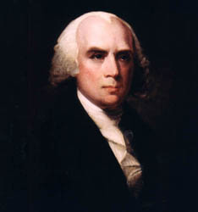
Definition
Judicial Review
Marbury v. Madison (1803)
Incorporation Theory
Gitlow v. New York (1925)

Slide 6
Definition
Judicial Review: power of the Supreme Court to determine the meaning of the constitution
Incorporation Theory: applying the protections of the Bill of Rights to the actions of state governments via the 14th Amendment

Slide 7
1st Amendment Issues
First Amendment rights include:
Religious Freedom
Free Speech
Free Press
Free Assembly

Slide 8
1st Amendment Issues
Religious Freedom has 2 components
Anti-establishment
Free Exercise

Slide 9
Religious Freedom
Anti-Establishment clause
1971 - Lemon v. Kurtzman
Aid must be secular in intent
Its primary effect can neither enhance nor inhibit religion
Government must avoid “excessive entanglement” with religion

Slide 10
Religious Freedom
Is aid -- tax dollars -- to church related schools permissible?
Courts have ruled that it is ok for tax dollars to be spent on: school lunch, transportation, speech/hearing support, standardized tests, computer purchases and internet access, vouchers; subject to Lemon test restrictions

Slide 11
Religious Freedom
School Prayer?
Mandatory?
Daily bible readings?
Moment of silent prayer?
Moment of silence for non-religious reasons?
No. Engel v. Vitale (1962)
No. Abington School District v. Schempp (1963)
No. Wallace v. Jaffree (1985)
Yes. Brown v. Gwinnett County S.D. (1997)

Slide 12
Religious Freedom
Prayer outside of school
Permissible to have religious leaders not affiliated with school at “official” school events?
Permissible to have student led prayer at official school events?
No (Lee v. Weisman [1992])
Yes. Santa Fe Independent S.D. v. Doe (2000) student led prayer okay, but can’t use PA system

Slide 13
Religious Freedom
Permissible to have school functions (e.g., graduation) in a church, with religious icons on display?
To be determined; case from Tennessee working its way through the courts now

Slide 14
Religious Freedom
Display of Ten Commandments?
Depends. Stone v. Graham (1980) -- display of Ten Commandments is permissible, but cannot be required or mandated by the state*
McCreary County v. ACLU (2005) -- cannot mandate display of 10 commandments in courtrooms
*Permissible if part of other document display and not given special “pride of place” treatment (Van Orden v. Perry [2005])

Slide 15
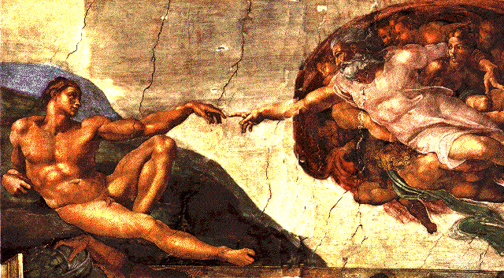
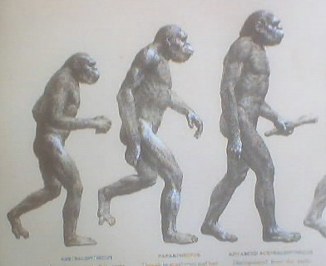
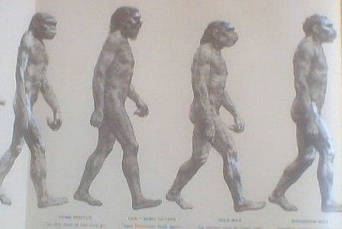
Religious Freedom
Evolution vs. Creationism
Edwards v. Aguillard (1987) -- states cannot mandate teaching of biblical creationism

Slide 16
Religious Freedom
Kitzmiller et. al. vs Dover Area School District (2005)
State cannot mandate teaching of “Intelligent Design” in the science curriculum

Slide 17
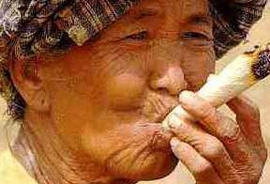
Religious Freedom
Free Exercise
Distinction between belief and practice
Courts have upheld state intervention in religious practices
Drug Use permissible?
No. Oregon v. Smith (1990)
Yes. Gonzales v O Centro Espirita Benficiente Unaio do Vegetal (2006)

Slide 18
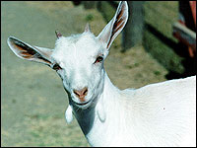
Religious Freedom
Free Exercise
Is animal sacrifice permissible?
Yes.
Church of the Lukumi Babalu Aye v. City of Hialeah (1993)

Slide 19
Religious Freedom
Free Exercise
Distinction between belief and practice
Exemptions for religious groups for various regulatory requirements:
faith healing
immunization exemption
reporting infectious disease exemption
child neglect exemption
licensing exemption
People vs. Cole, 219 N.Y. 98, 113 N.E. 790 (1916)
People vs. Vogelgesang, 221 N.Y. Reports 290 (1917). N.Y. Court of Appeals.

Slide 20
Freedom of Expression
Free speech provisions
Permitted Restrictions
Schenck v. United States (1919) - “clear and present danger”
Gitlow v. New York (1925) - “bad tendency”
Brandenburg v. Ohio (1969) - “incitement to imminent lawlessness”

Slide 21
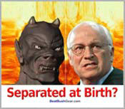
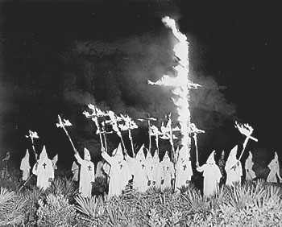
Freedom of Expression
“Beyond the Pale” unprotected speech
Obscenity
Fighting Words
Heckler’s Veto
Hate Speech
Slander
Advocate illegal activities

Slide 22
Freedom of Expression
Is this protected speech?
No. Morse v. Frederick (2007). Students could be suspended for unfurling banner held to advocate the use of illegal drugs

Slide 23
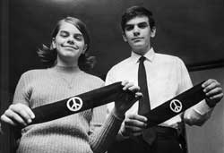
Other Speech Rights
“Symbolic” Speech and the First Amendment... protected or not?
Yes
Tinker v. Des Moines School District (1969)

Slide 24
Other Speech Rights
Symbolic Speech
Is Flag burning protected?
Yes Texas v. Johnson (1989)
flag burning as part of a peaceful protest is protected by the First Amendment*
*It’s also the official way of disposing of old flags.

Slide 25
Freedom of the Press
In general, same protections as speech with some permissible restrictions
national security
censorship permissible if protects national security

Slide 26
Freedom of the Press
“fair trial” issues
protect witnesses
protect accused

Slide 27
Freedom of the Press
Print vs Non-print media
Print has greater protection
Non-print, distinction between finite and non-finite transmission mode
Broadcast vs cable/satellite
More restriction on broadcast
Licensing and rules

Slide 28
Freedom of the Press
“Beyond the Pale” unprotected press
Libel
Knowingly publish with reckless disregard for the truth statements known to be false and injurious to person’s character, reputation

Slide 29
Freedom of the Press
Pornography/Obscentiy
Roth v. United States (1957)
Miller v. California (1973)

Slide 30
Freedom of the Press
Miller v California (1973)
Average Person finds it violates contemporary community standards
Work taken as a whole appeals to a prurient interest in sex
Work depicts patently offensive sexual conduct
Work lacks serious redeeming literary, artistic, political, or scientific merit

Slide 31
Freedom to Assemble
Balance right to free association with right for public order
Permissible for localities to require permits in order to protest

Slide 32
Second Amendment
One of the few remaining amendments in the Bill of Rights that has not been incorporated
In District of Columbia v. Heller (2008) court ruled for the first time that gun ownership is an individual rather than a collective right.

Slide 33
Third Amendment
This amendment prohibits the federal government from commandeering private homes for the military in peacetime without consent of the owner.
In time of war, however, it can happen with appropriate legislation.

Slide 34
Rights of the Accused
Founders were concerned with crime, but their concerns were different from ours
Wanted to find ways to protect individuals from overambitious state activities
Variety of provisions built into the Bill of Rights to make it more difficult for states to deprive people of their liberty

Slide 35
Rights of the Accused
Pretrial Rights
4th Amendment protections
no unreasonable search & seizure
police need warrant to search
5th Amendment protections
no self-incrimination
grand jury indictment

Slide 36
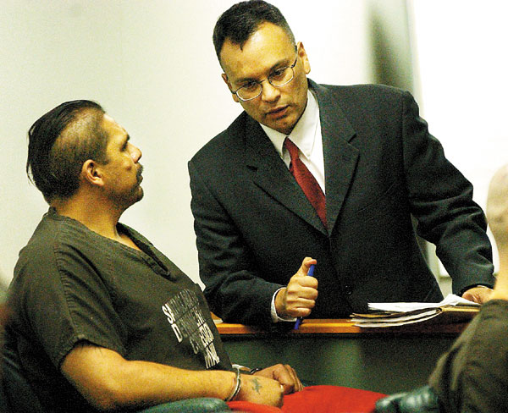
Rights of the Accused
Trial Rights
habeas corpus -- accused must be brought before judge and be publicly informed of charges (Art. 1, sec. 9, clause i)
right to counsel (6th Amendment)
right to confront witnesses (6th Amendment)

Slide 37
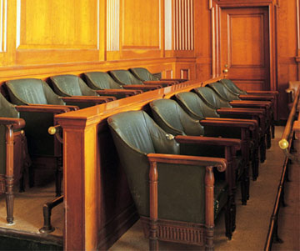
Rights of the Accused
Trial Rights (continued)
due process provisions (6th Amendment)
speedy and public trial
jury of peers
presumption of innocence
trial conducted in jurisdiction where crime is alleged to have occured

Slide 38
Rights of the Accused
Post Trial Rights
no double jeopardy (5th Amendment)
no cruel and unusual punishment (8th Amendment

Slide 39
Rights of the Accused
Key additions/amendations to basic rights
Gideon v. Wainwright (1963) -- right to counsel even if can’t afford an attorney; state must provide one

Slide 41
Rights of the Accused
Mapp v. Ohio (1961) -- exclusionary rule; illegally obtained evidence is inadmissable at trial. "all evidence obtained by searches and seizures in violation of the Constitution is, by [the Fourth Amendment], inadmissible in a state court."

Slide 42
Rights of the Accused
Exceptions to Exclusionary Rule
“Plain sight”:
evidence not on a warrant but in “plain sight” of the police is admissable in court
Alternative means:
If police can demonstrate they would inevitably have found the evidence legally anyway, even though it was illegally obtained originally, the evidence is admissable
“Good faith”:
if police believe they are conducting a “reasonable” search, and a subsequent court rules that the search was in fact unreasonable, the evidence is admissable

Slide 43
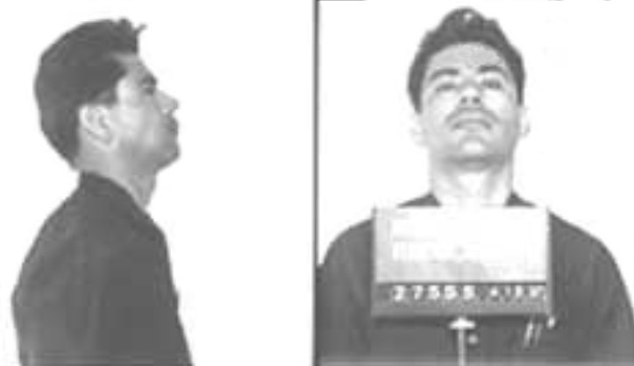
Rights of the Accused
Miranda v. Arizona (1966) -- police must inform accused of rights prior to taking into custody

Slide 44
Rights of the Accused
Exceptions to Miranda:
“Public Safety”
Conviction possible if other evidence at trial would have been enough to convict, even if confession was coerced or suspect was not read Miranda rights
Ambiguity
Suspects must clearly state that they would like to speak to counsel or exercise other provisions of their Miranda rights

Slide 45
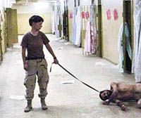
Rights of the Accused
Exceptions:
War on Terror and enemy combatants
Bush Administration argues that terrorists taken into custody are outside both international law (Geneva Conventions regarding Prisoners of War) and US civil law

Slide 46
Death Penalty
Death penalty and the 8th Amendent
“cruel and unusual” refers to punishment that is excessive (punishment did not fit the crime) and needlessly inflicts suffering on the convict
Furman v. Georgia (1972)
Death penalty unconstitutional because its use was random and arbitrary

Slide 47
Death Penalty
Gregg v. Georgia (1976)
States adopt, and court approves a “two step” process for capital cases
Ring vs Arizona (2002)
Only juries, not judges, can impose the death penalty
Death Row statistics from the Bureau of Justice Statistics

Slide 48
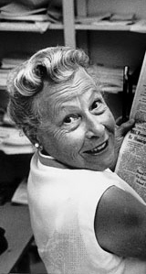
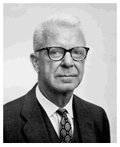
Other Rights
Privacy Rights
Privacy not mentioned specifically in the Constitution or the Bill of Rights
Griswold v. Connnecticut (1965)
Privacy located in the 1st, 3rd, 4th, 5th, 9th amendments

Slide 49
Other Rights
Privacy and the USA Patriot Act
allows government officials to secretly search a suspected terrorist house with special warrant
allows government to monitor internet, phone conversation, banking, and book purchases with special warrant
allows government to open mail with special warrant

Slide 50
Privacy and the Patriot Act
FBI must present evidence why warrant is necessary, but judge has no authority to reject warrant
Individuals targeted by these investigations are forbidden to discuss investigation, including the facts of its existence, with anyone

