Slide 1
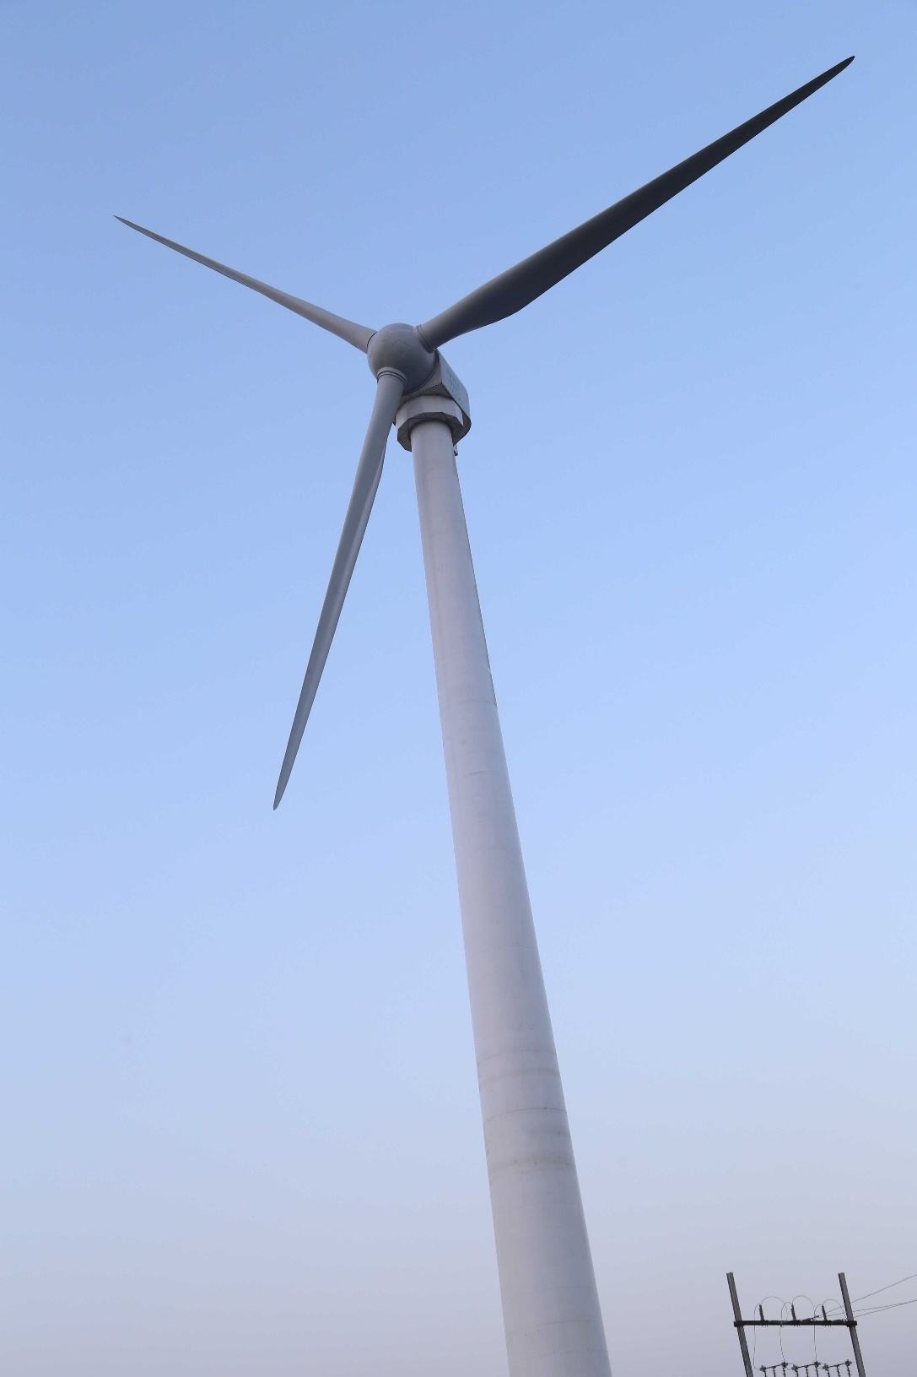
XYRON
TECHNOLOGIES
EX-55 1 MW Direct Drive Wind Turbine
Permanent Magnet Synchronous Generator
Complies with
Germanischer Lloyd Industrial Services GmbH "Guideline for the Certification of Wind Turbines", Edition 2010 Certified by TUV Nord Germany
Ideal wind turbine for Islands, small projects, storage projects, developing countries.
WTG at Test Station Ratlam(M.P)

Slide 2
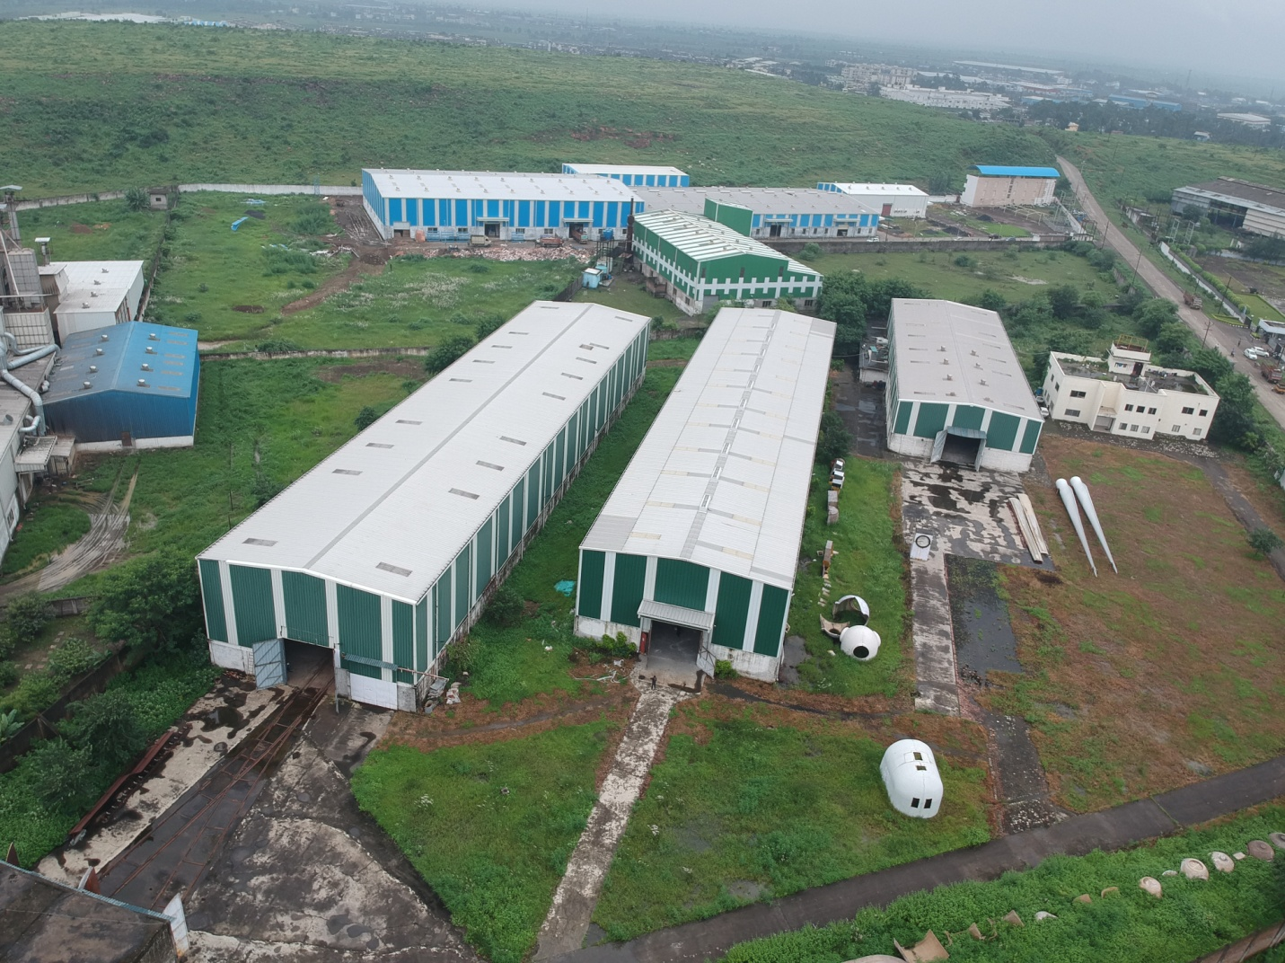
Xyron Technologies Ltd
D-23 New Industrial Area
Phase-II, Mandideep,
Bhopal, India

Slide 3
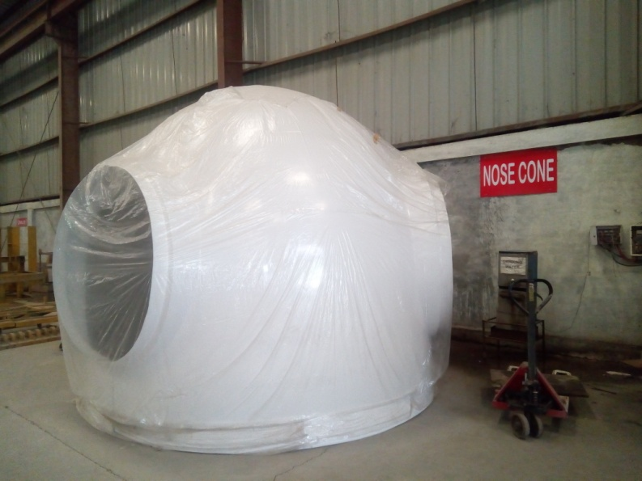
Fiber Reinforced plastic (FRP) technology covers a wide range of products. In Wind , FRP is used to manufacture variety of parts. These are Blades, Nacelle, Nose cone etc.
Xyron has in depth knowledge of design and development.
Xyron’s FRP Technology is based on epoxy and glass fiber. It involves latest manufacturing method called Vacuum Assisted Resin Infusion Method (VARIM).
FRP Components
Epoxy and Glass fiber based technology is the latest technology that makes the blades lighter, stronger and having longer life.

Slide 4
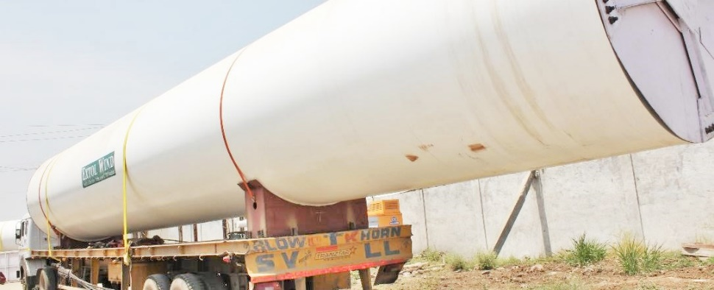
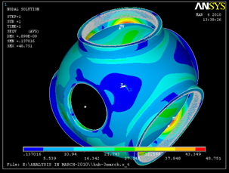
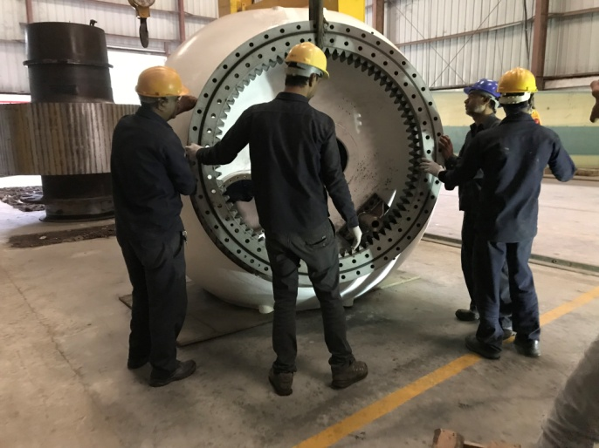
Mechanical Design and manufacturing capabilities
A wind turbine has many mechanical components. Major components are Hub, Mainframe,
Shaft and Tower. These components are made from Casting, Forging or fabrication and
need precision machining. Nacelle is also made in house by Xyron.
Xyron has design and manufacturing facility for precision manufacturing of any component
and verification of design.

Slide 5
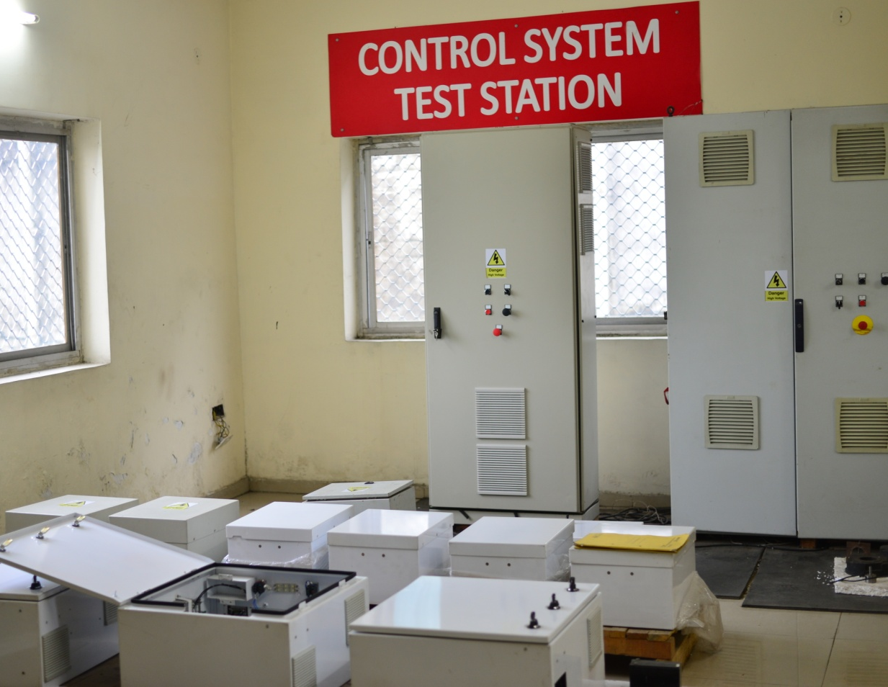
Control System Technology Capability
Wind Turbines are installed at remote locations and operate 24 x 7 under challenging weather conditions.
Wind Turbines are equipped with advanced control and safety system to autonomously operate according to wind conditions and weather conditions.
Xyron has end to end control system capability on advanced pitch control technology and main controller. This gives us in depth knowledge of safety and components. Each component functions, specification, testing and replacements can be done by Xyron.

Slide 6
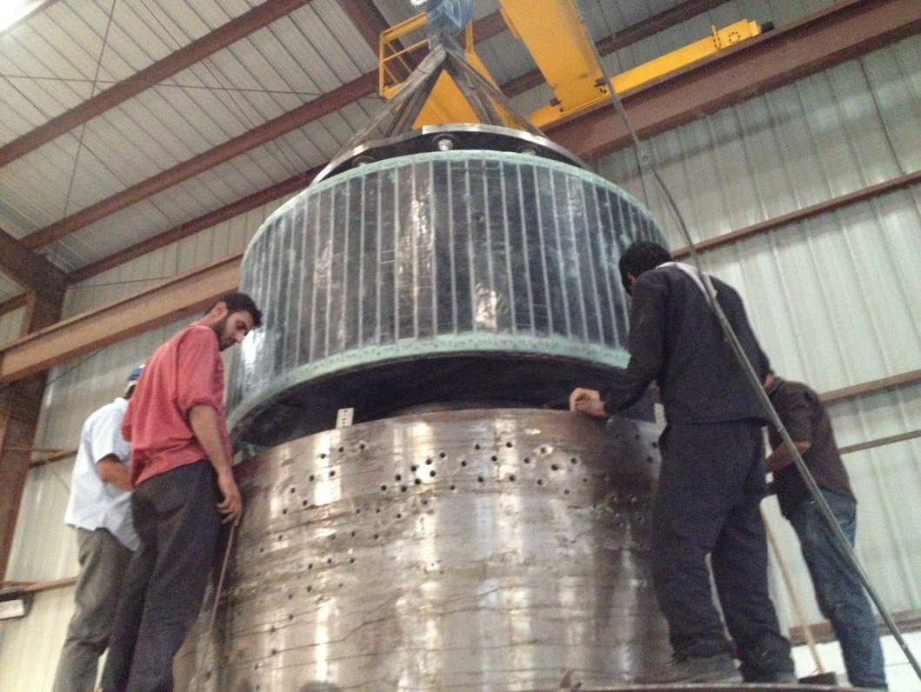
PMSG Technology Capability
Permanent Magnet Synchronous Generator (PMSG) are a unique type of efficient generators that use permanent magnets instead of copper windings in the rotor. This eliminates the need for excitation current, slip rings, thus leading to savings over the life time.
Xyron is one of the few companies worldwide, which have it’s own design and manufacturing of PMSG Generators.
Xyorn also has a back to back test bench to test each generator to full power.

Slide 7
Vendor Network
Xyron work’s with the best of the international suppliers.
This ensures that component performance is maintained during the lifetime of wind turbine.
For more information see ; EX-55 Specifications - 2021.pdf
Visit www.xyronindia.com or youtube : https://www.youtube.com/watch?v=Yj08tiConGk

