Slide 1
New
Additions to the Pioneer Gardens
2015 Premium Plug Program
August 28, 2014
Pionee r Gardens, Inc 2015

Slide 2
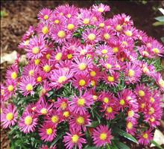
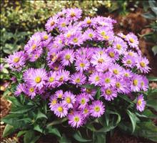
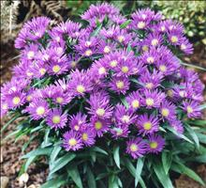
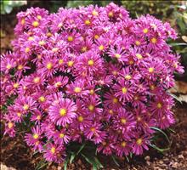
Aster Island Series
Bahama’s
Barbados
Samoa
 |  | 72’s | Rty | Available | Order
Bahama’s |  | 0.68 | 0.04 | Apr - June
Barbados |  | 0.68 | 0.04 | Apr - June
Samoa |  | 0.68 | 0.04 | Apr - June
Tonga |  | 0.68 | 0.04 | Apr - June
Tonga
Pioneer Gardens, Inc. 2015

Slide 3
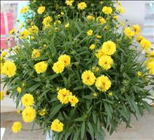
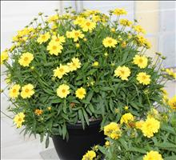
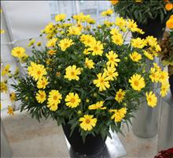
Coreopsis Leading Lady Series
Charlize
Lauren
Sophia
 |  | 72’s | Rty | Available | Order
Charlize |  | 0.68 | 0.25 | Aug-Feb
Lauren |  | 0.68 | 0.25 | Aug-Feb
Sophia |  | 0.68 | 0.25 | Aug-Feb
Pioneer Gardens, Inc. 2015

Slide 4
Dianthus Kahori
 |  | 72’s | Rty | Available | Order
Dianthus Kahori |  | 0.78 | 0.05 | July-Oct
Pioneer Gardens, Inc. 2015

Slide 5
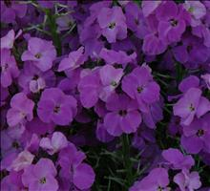
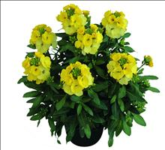
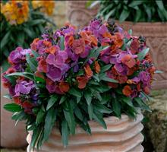
Erysimum Winter Series
Joy Improved
Joy Light
Orchid
 |  | 72’s | Rty | Available | Order
Joy Improved |  | 0.68 | 0.08 | Oct-Mar
Joy Light |  | 0.68 | 0.08 | Oct-Mar
Orchid |  | 0.68 | 0.08 | Oct-Mar
Rouge |  | 0.68 | 0.08 | Oct-Mar
Sorbet Improved |  | 0.68 | 0.08 | Oct-Mar
Sun |  | 0.68 | 0.08 | Oct-Mar
Pioneer Gardens, Inc. 2015

Slide 6
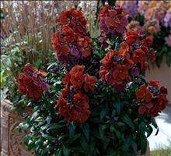
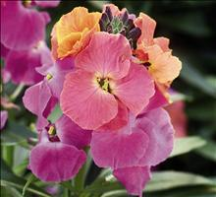
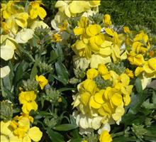
Erysimum Winter Series
Rouge
Sorbet Improved
Sun
 |  | 72’s | Rty | Available | Order
Joy Improved |  | 0.68 | 0.08 | Oct-Mar
Joy Light |  | 0.68 | 0.08 | Oct-Mar
Orchid |  | 0.68 | 0.08 | Oct-Mar
Rouge |  | 0.68 | 0.08 | Oct-Mar
Sorbet Improved |  | 0.68 | 0.08 | Oct-Mar
Sun |  | 0.68 | 0.08 | Oct-Mar
Pioneer Gardens, Inc. 2015

Slide 7
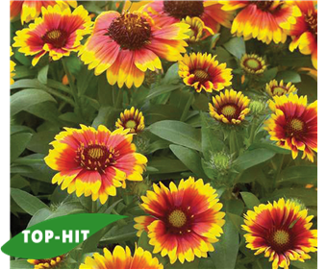
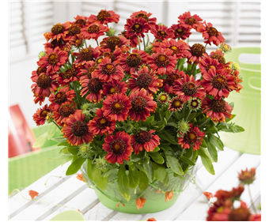
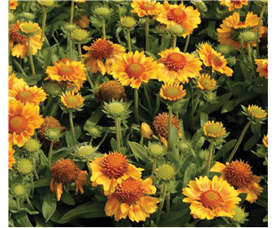
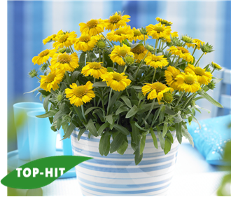
Gaillardia Gallo Series
Dark Bicolor
Bright Red
Peach
 |  | 72’s | Rty | Available | Order
Bright Red |  | 0.78 | 0.08 | Jan-May
Dark Bicolor |  | 0.78 | 0.08 | Jan-May
Peach |  | 0.78 | 0.08 | Jan-May
Yellow Improved |  | 0.78 | 0.08 | Jan-May
Yello w Improved
Pioneer Gardens, Inc. 2015

Slide 8
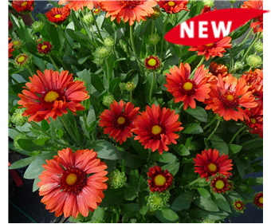
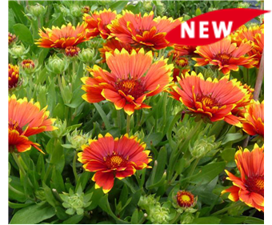
Gaillardia Sunset Series
Celebration
Cutie
Flash
 |  | 72’s | Rty | Available | Order
Celebration |  | 0.78 | 0.16 | Jan-May
Cutie |  | 0.78 | 0.16 | Jan-May
Flash |  | 0.78 | 0.16 | Jan-May
Snappy |  | 0.78 | 0.16 | Jan-May
Snappy
Pioneer Gardens, Inc. 2015

Slide 9
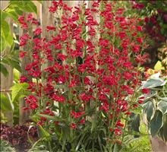
Penstemon Riding Hood Series
 |  | 72’s | Rty | Available | Order
Blue |  | 0.68 | 0.15 | Aug-Apr
Delft Blue |  | 0.68 | 0.15 | Aug-Apr
Hot Pink |  | 0.68 | 0.15 | Aug-Apr
Lavender |  | 0.68 | 0.15 | Aug-Apr
Marble Cream |  | 0.68 | 0.15 | Aug-Apr
Purple |  | 0.68 | 0.15 | Aug-Apr
Red |  | 0.68 | 0.15 | Aug-Apr
Red
Pioneer Gardens, Inc. 2015

Slide 10
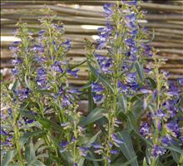
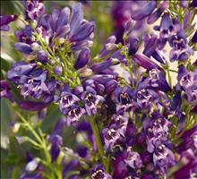
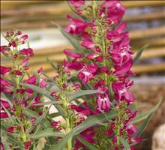
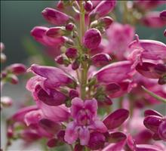
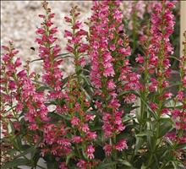
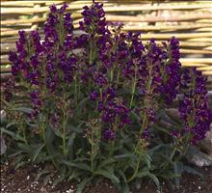
Penstemon Riding Hood Series
Blue
Delft Blue
Hot Pink
Lavender
Marble Cream
Purple
Pioneer Gardens, Inc. 2015

Slide 11
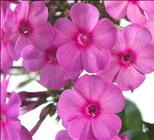
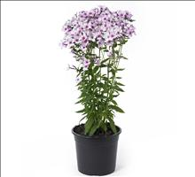
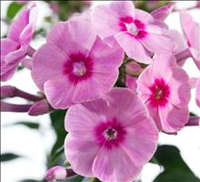
Phlox Early Series
Dark Pink
Light Pink
Pink Dark Eye
 |  | 72’s | Rty | Available | Order
Dark Pink |  | 0.68 | 0.04 | Aug-Sep
Light Pink |  | 0.68 | 0.04 | Aug-Sep
Pink Dark Eye |  | 0.68 | 0.04 | Aug-Sep
Purple |  | 0.68 | 0.04 | Aug-Sep
Red |  | 0.68 | 0.04 | Aug-Sep
White |  | 0.68 | 0.04 | Aug-Sep
Pioneer Gardens, Inc. 2015

Slide 12
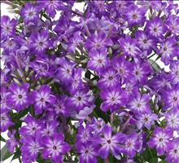
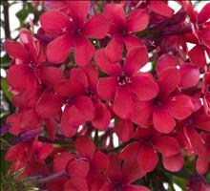
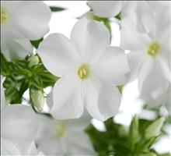
Phlox Early Series
Purple
Red
White
 |  | 72’s | Rty | Available | Order
Dark Pink |  | 0.68 | 0.04 | Aug-Sep
Light Pink |  | 0.68 | 0.04 | Aug-Sep
Pink Dark Eye |  | 0.68 | 0.04 | Aug-Sep
Purple |  | 0.68 | 0.04 | Aug-Sep
Red |  | 0.68 | 0.04 | Aug-Sep
White |  | 0.68 | 0.04 | Aug-Sep
Pioneer Gardens, Inc. 2015

Slide 13
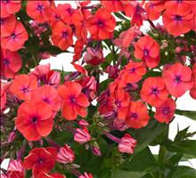
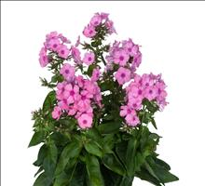
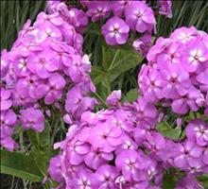
Phlox Flame Series
Coral
Light Pink
Lilac
 |  | 72’s | Rty | Available | Order
Coral |  | 0.78 | 0.15 | Aug-Sep
Light Pink |  | 0.78 | 0.15 | Aug-Sep
Lilac |  | 0.78 | 0.15 | Aug-Sep
Pink |  | 0.78 | 0.15 | Aug-Sep
Purple |  | 0.78 | 0.15 | Aug-Sep
White |  | 0.78 | 0.15 | Aug-Sep
Pioneer Gardens, Inc. 2015

Slide 14
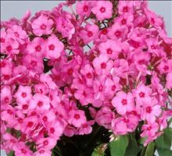
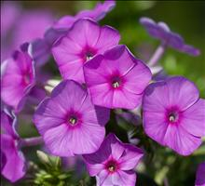
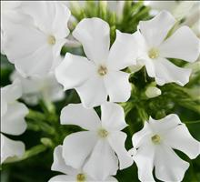
Phlox Flame Series
Pink
Purple
White
 |  | 72’s | Rty | Available | Order
Coral |  | 0.78 | 0.15 | Aug-Sep
Light Pink |  | 0.78 | 0.15 | Aug-Sep
Lilac |  | 0.78 | 0.15 | Aug-Sep
Pink |  | 0.78 | 0.15 | Aug-Sep
Purple |  | 0.78 | 0.15 | Aug-Sep
White |  | 0.78 | 0.15 | Aug-Sep
Pioneer Gardens, Inc. 2015

Slide 15
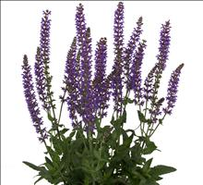
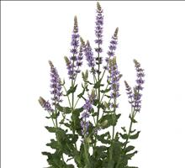
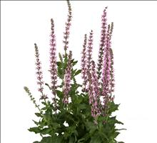
Salvia Salute Series
Deep Blue
Ice Blue
Pink
 |  | 72’s | Rty | Available | Order
Deep Blue |  | 0.68 | 0.08 | Aug-Oct
Ice Blue |  | 0.68 | 0.08 | Aug-Oct
Pink |  | 0.68 | 0.08 | Aug-Oct
Pioneer Gardens, Inc. 2015

Slide 16
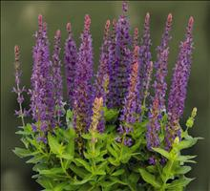
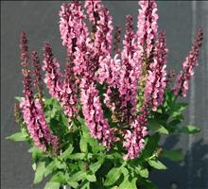
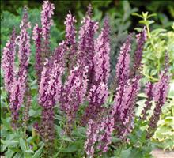
Salvia Sensation Series
Deep Blue
Deep Rose
Pink
 |  | 72’s | Rty | Available | Order
Deep Blue |  | 0.68 | 0.08 | Aug-Feb
Deep Rose |  | 0.68 | 0.08 | Aug-Feb
Pink |  | 0.68 | 0.08 | Aug-Feb
Pioneer Gardens, Inc. 2015

