Slide 1
Highly functioning Boards of Health
October 18, 2015

Slide 2
Learning Objectives
Define Local Boards of Health (LBOH)
Identify the basic role of LBOH
Highlight the core characteristics of effective board governance
Understand how creating a culture of Population health can help health outcomes
(I have no conflicts to disclose)
Notes:
Scutch – As Chair of the KPHI governing board, I want to thank you for coming to visit us today. The Kentucky Population Health Institute was incorporated on 11/26/2012 as an emerging institute in the then 33-member National Network of Public Health Institutes (NNPHI). A grant from NNPHI and provision of a mentor from the Georgia Health Policy Institute helped guide the formation of our institute, which was accepted, into formal membership in NNPHI on November 10, 2014. So we are new, largely unknown but building a foundation to be the organization that folks turn to in KY for unbiased information on policy. The team with us here today includes, Georgia Heise and Cynthia Lamberth, Co-directors representing the practice and academic partnership. Randy Gooch is our fiscal agent from Jessamine County Health Department, and April Harris heads up our accreditation efforts. You will hear from each of them briefly before we open things up for your questions.
Randy – As the fiscal Agent Jessamine county handles all the financial elements of this grant and prepared the report for the first 6 months. We curently have consumed % of the budget and expect to spend down the remaining before grant end.

Slide 3
BASIC ROLE OF LOCAL BOARDS OF HEALTH
The local board of health serves as the steward of the health department-- its mission, its programming, and its integrity.
Local health departments typically are the only governmental units with statutory responsibility for the health of the community it serves
The US public health system includes federal, state, and local agencies with varying levels of policy-making and decision-making authority; some have mainly advisory responsibilities.
The role and responsibilities of all public health boards are becoming more complex and challenging.

Slide 4
8 CORE CHARACTERISTICS OF EFFECTIVE LBOH
The local health department director, the board chair, and the board as a whole understand their responsibilities and authority, and share strong commitment to constructive collaboration.
The health department director’s support and leadership is essential in order to have an effective board.
Building and maintaining an excellent health department director-board chair relationship also is vitally important.
Constructive collaboration requires on-going communications, respect, and trust.
Prybil, Lawrence, PhD, 2013

Slide 5
The board and health department director insist on ensuring the organization has a board-approved strategic plan that includes:
A crisp and meaningful mission statement.
A compelling vision for the organization’s future.
A clearly-stated set of core values that are understood & respected by key stakeholders and drive organizational decision-making.
Strategic goals that are linked directly to the department’s mission and vision together with annual, operating objectives and metrics that facilitate objective assessment of progress toward them.
Prybil, Lawrence, PhD, 2013

Slide 6
The board composition includes a diverse mix of highly-competent members --- including health professionals and respected leaders in other sectors -- dedicated to the health of the community and are prepared to devote the necessary time and energy to their board duties.
Competence without dedication is insufficient.
Today’s environment demands a more diverse and robust mix of competencies and perspectives to foster health mission and programs.
Intentional, proactive efforts are required to assemble and maintain a proper mix of talent particularly when the authority to make board appointments and re-appointments is vested in some other governmental body or official.
Prybil, Lawrence, PhD, 2013

Slide 7
A carefully-constructed board committee structure with clear definitions of each committee’s duties and authority (a “charter”) together with board-approved annual priorities and crisp accountability for progress in addressing them.
Well-organized and well-led committees enhance the board’s performance.
Board chairs and health department directors need to invest staff time & energy in supporting board committees; it will pay off.
Ineffective committees waste time and create more problems than they solve.
Prybil, Lawrence, PhD, 2013

Slide 8
Setting board priorities and allocating time & energy with careful deliberation.
Members’ time and energy are the board’s most valuable assets; they must be employed wisely.
Effective boards receive good, timely information (not “data”) in a compact format coupled with well-constructed agendas that focus on key issues that warrant board deliberation; e.g., ways that the community’s health needs are changing and the impact on health department programs and priorities.
Requiring board members to sit and listen to long reports is too common and very wasteful.
Effective boards harbor time for strategic thinking about matters of long-range importance to the organization and the communities it serves.
Prybil, Lawrence, PhD, 2013

Slide 9
Clearly-stated objectives in critical areas such as community health status, the quality of departmental services, and departmental financial performance together with evidence-based metrics that allow board and management leadership to accurately monitor actual performance in relation to established standards.
Effective boards insist on clear targets and excellent metrics; they are results-oriented and expect prompt action when performance does not meet the targets.
Effective boards govern -- not manage -- the organization. They understand the difference, and ensure that highly-capable management and professional leaders are in place.
Effective boards demand first rate information (not just “data”) in a timely manner, whether it is “good news” or not.
Prybil, Lawrence, PhD, 2013

Slide 10
Sustained commitment to a real “board development program” that drives the board toward continuous self assessment and improvement in performing its governance duties.
On-going assessment of the board’s needs for talent; proactive efforts to collaborate with the governmental body and/or officials who have the authority to name board appointments; top-notch orientation & continuing education for all members; and serious, action-oriented evaluation of the board’s performance are among the basic components of a real “board development program.
All boards in every sector of society have plenty of room to carry-out these functions better.
Prybil, Lawrence, PhD, 2013

Slide 11
A healthy board culture characterized by a strong focus on governance priorities, constructive dialog among the members and management leaders, and enlivened decision-making processes.
Robust engagement, shared commitment to high standards, mutual trust, and willingness to take action are among the features that characterize effective boards in all sectors of society.
The boards of high-performing organizations -- both in the private and public sectors -- tend to have a healthy, proactive board culture.
Prybil, Lawrence, PhD, 2013

Slide 12
Poorly defined targets for organizational performance |  | Well-established measures, clear targets, and concerted attention to clinical and financial performance in relation to them
Passive and reactive governance style |  | Highly interested and engaged board
Fuzzy priorities for the board’s work |  | Sharp focus on well-defined governance priorities
Spotty attendance with low energy level |  | High attendance and enthusiasm
Lots of listening and little discourse |  | Active & consistent engagement in dialog involving board members and staff
Challenges and disagreements are squelched |  | Constructive dissent and debate are welcomed
Decision-making is pro forma |  | Decision-making is enlivened
Board “self-evaluation” is superficial and done sporadically |  | Board evaluation is done seriously and results in real changes

Slide 13
The Kentucky Population Health Institute
Why?
Vision: Optimal health and quality of life for all Kentucky communities (communities being broadly defined beyond geography)
How?
Mission: Bridging partnerships and alliances for improved health and quality of life (connectivity, collaboration, commitment, facilitating, engaging)
Use a systems approach to policy decisions
What?
Legislative education
Evaluation
Peer consultation on accreditation
Technical assistance
Notes:
Cynthia – We held strategic planning sessions and agreed on the following. The why behind our work is our vision: optimal health… and our vision bridging partnerships….

Slide 14
Approach to our Work
Notes:
Cynthia - How we go about this work is important and these guiding principles were developed and refined by our own strategic planning process.

Slide 15
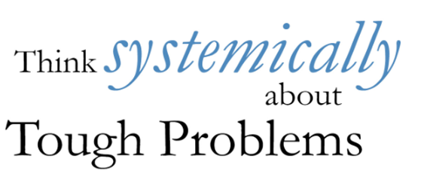
Approach to our Work

Slide 16
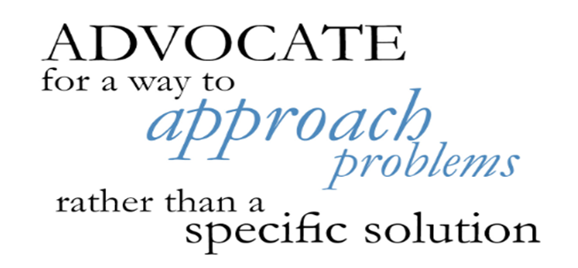
Approach to our Work

Slide 17
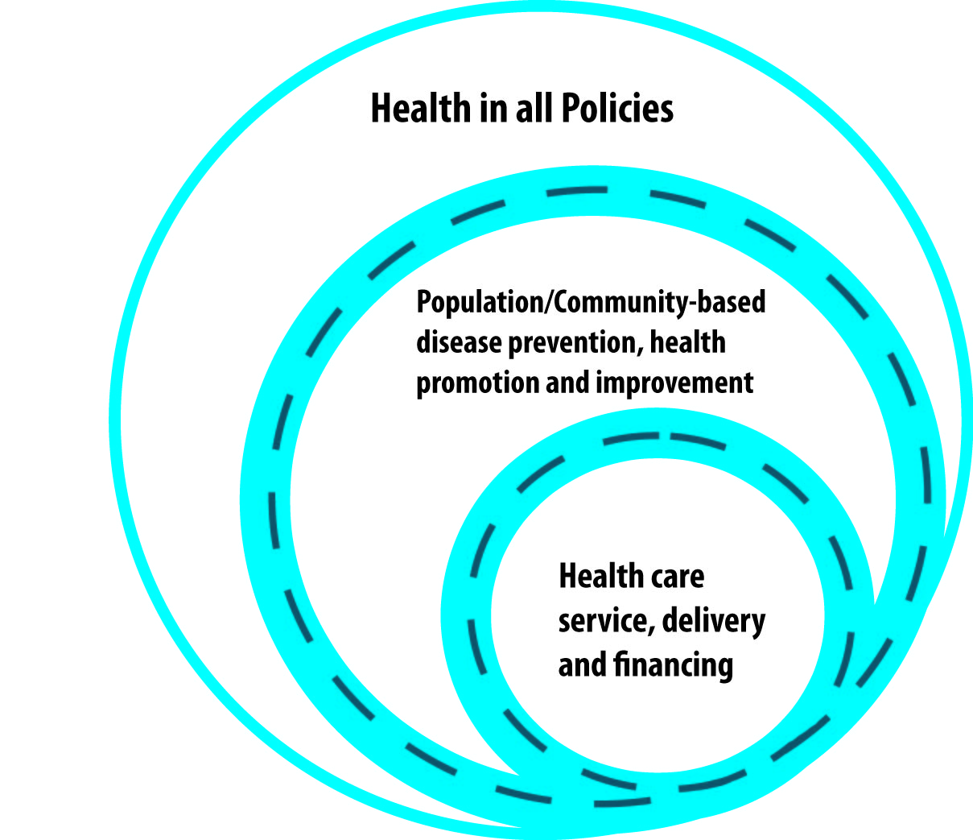
Increasing visibility in policy dialogue
Focus: Increasing the visibility and influence of public health approaches in policy dialogue including creating a culture of health and health in all policies (HIAP) approach.

Slide 18
Cynthia Lamberth, MPH, CPH
Co-director, KPHI
140 Consumer Lane PO Box 4056
Frankfort, KY 40604
Cynthia.Lamberth@kypophealth.org

