Slide 1
District Technology Service Desk
Melissa Teat, Customer Product Manager, April 4, 2019

Slide 2
Our Vision

Slide 3
Our Priorities

Slide 4
District Technology Service Desk
The Service Desk is staffed with six agents.
Items that we support include:
EIS
Application Access
EdFi
Single Sign On
TNReady
Visibility Tool
ImpactTN
SDE Directory
EIS Training For New District Supervisors
SkillSets Online Training

Slide 5
District Technology Service Desk
The TDOE Office of District Technology provides an online IT training through an LMS known as SkillSets Online Training.
The trainings are self-administered.
A number of ‘library cards’ have been purchased.
District supervisors may request to use a ‘library card’ for two week time slots.
No cost to districts.
Email dt.support@tn.gov for assistance.

Slide 6
District Technology Service Desk

Slide 7
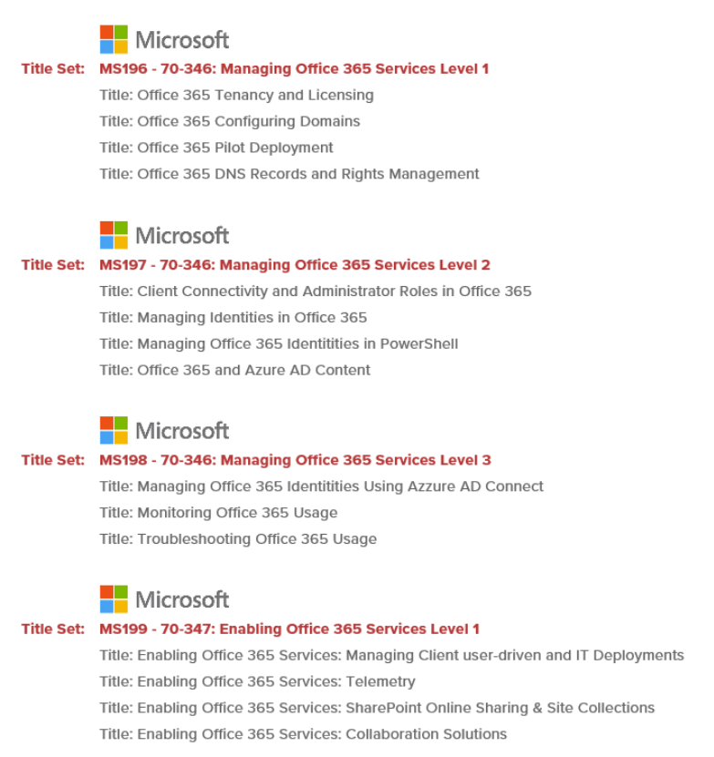
District Technology Service Desk

Slide 8
District Technology Service Desk
District Technology Request Portal is our ticketing system. Register today!
There are currently over 250 registered district contacts in the ticket system.
Since implementation in July 2017, over 25,000 tickets have been resolved.
The resolved ticket count since July 2018 is 13, 592.

Slide 9
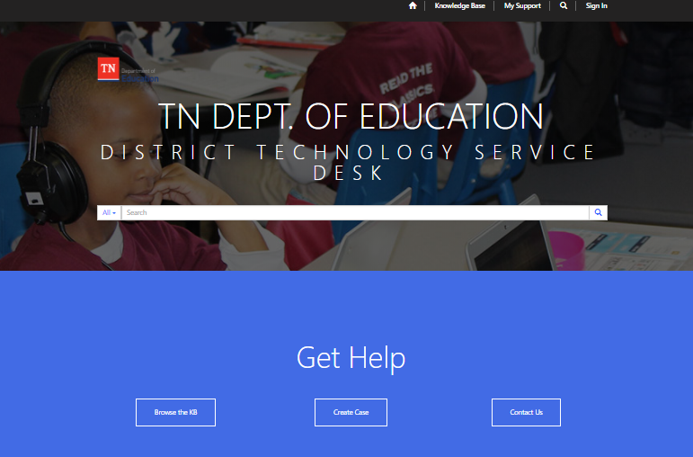
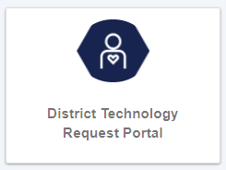
District Technology Service Desk
The Portal can be accessed using TDOE Single Sign-On, Orion.

Slide 10
Updates & Reminders
Review and update EIS contact information when a staff change is made by sending the request to dt.support@tn.gov . Don’t forget to include requests for removal and addition of department list serves.
The Contact List can be found on the EIS Website.
https://www.tn.gov/education/lea-operations/education-information-system-eis.html

Slide 11
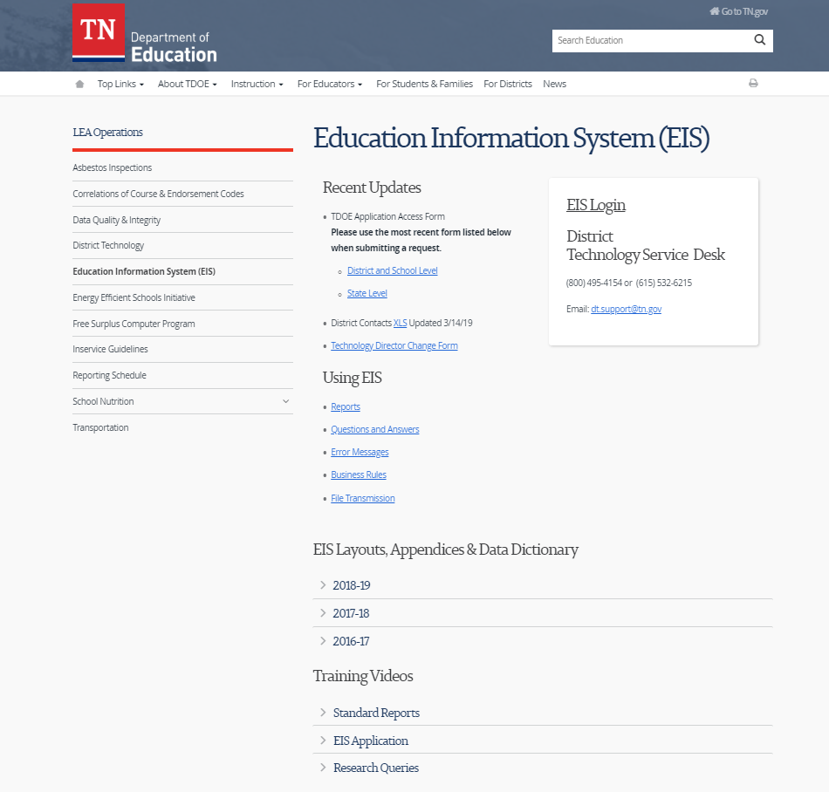
Updates & Reminders
The EIS website contains important information.

Slide 12
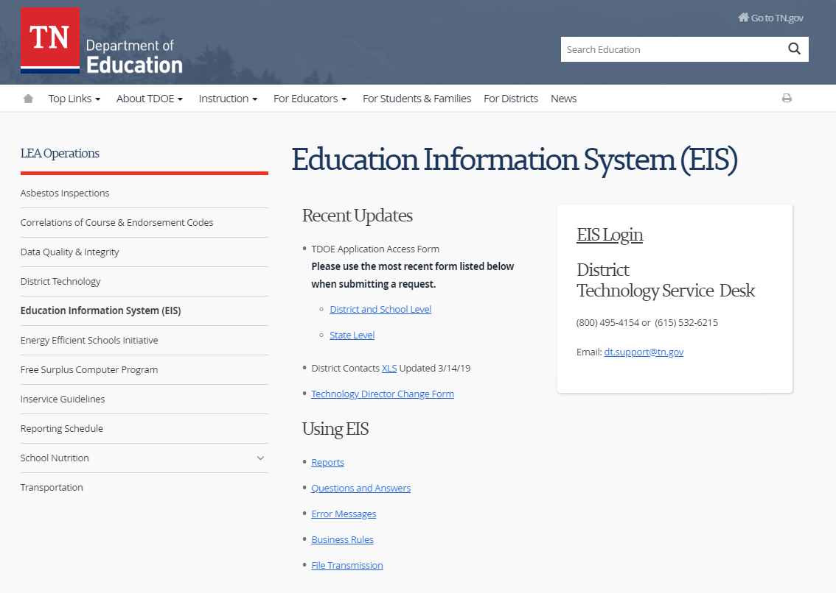
Updates & Reminders
The TDOE Application Access Form can be found on the EIS Website.

Slide 13
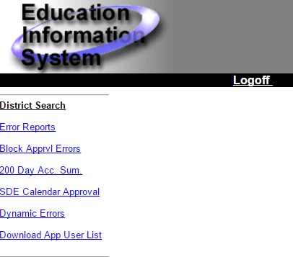
Updates & Reminders
District supervisors with DST_AA user role should periodically review the App User List in EIS Production, and make changes as needed.

Slide 14
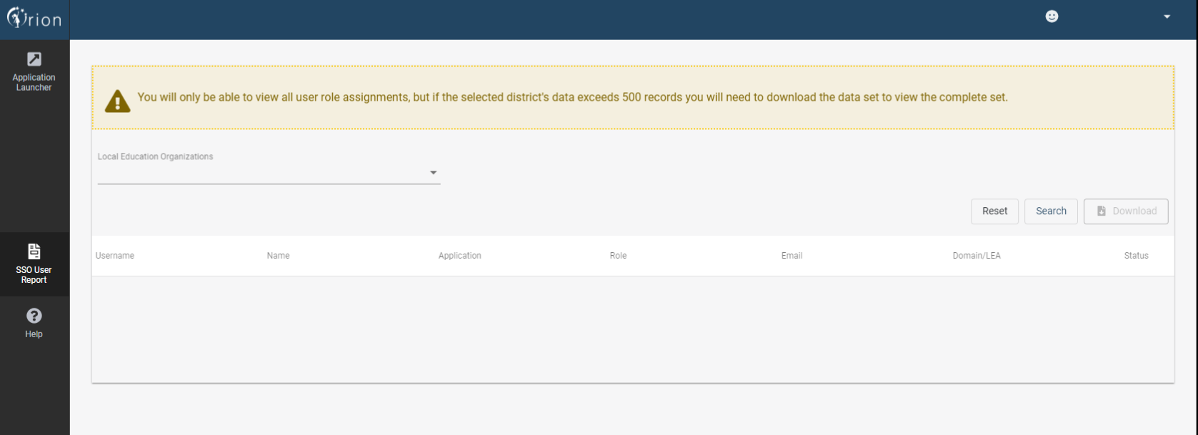
Updates & Reminders
The SSO User Report will be assigned for users that have an EIS Production security role of DST_AA (District EIS Approval ADM).

Slide 15
Updates & Reminders
With the single sign on (SSO), Orion, 2.0 launch, all users will receive a tile called TDOE.

Slide 16
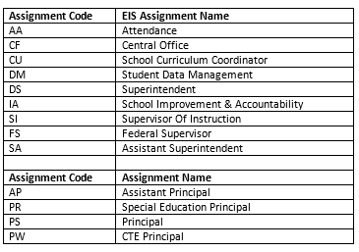
Updates & Reminders
Suggested EIS & EdFi staff assignments for ePlan users include:

Slide 17
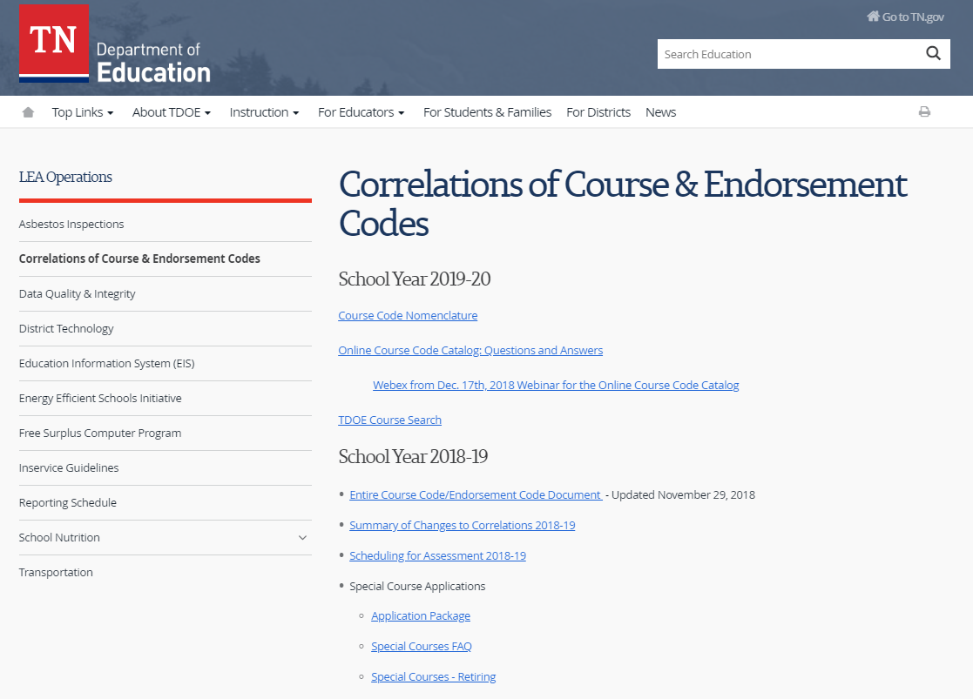
Updates & Reminders
Please review the 2019-20 TDOE Course Search.

Slide 18
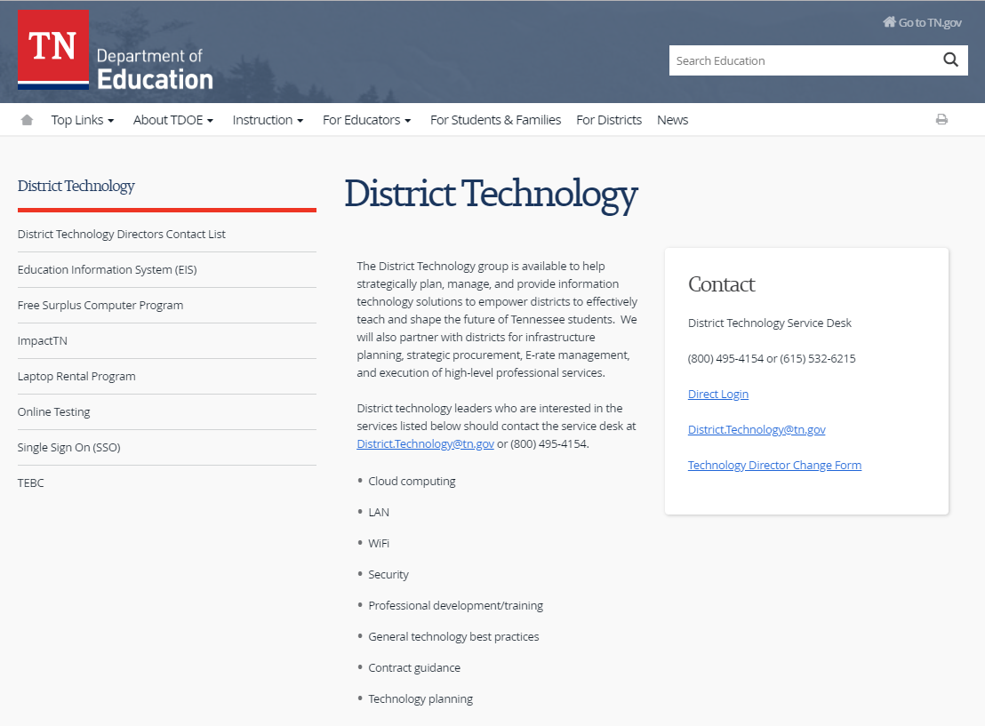
Updates & Reminders
The District Technology website contains important information.

Slide 19
Updates & Reminders
Student Enrollment Count

Slide 20
Updates & Reminders
Staff Count

Slide 21
EIS Changes 2019-20
Extract 15, District Bus
Add 2 new fields to:
1.) Number of “safety complaints” made about the bus (4 digit integers)
2.) Does the bus have electronic stability control system (Y or N- alpha value)
Add additional fuel types:
1.) ELEC (electric)
2.) LNG (liquid natural gas)

Slide 22
EIS Changes 2019-20
Extract 30, Class Section AND Extract 80 Student Final Grade
EIS is required to be changed to accept the new course code structure.
Please note: TDOE Course Master should not be deleted to validate prior year course submission/state reporting.

Slide 23
EIS Changes 2019-20
Extract 50, Student Withdrawal
Stop collecting withdrawal code 9 (transferred to mental health or drug rehabilitation facility).

Slide 24
EIS Changes 2019-20
Extract 62, Staff Current Assignment
Add:
6E- Grade 6 Other Teacher
7E- Grade 7 Other Teacher
8E- Grade 8 Other Teacher
8S- Grades 6-8 STEM Teacher
GI- Intellectually Gifted
HG- Grades 9-12 Other Teacher
HS- Grades 9-12 STEM Teacher
Remove:
VO- CTE Supervisor

Slide 25
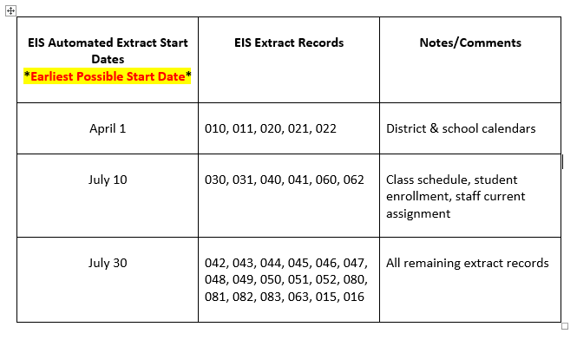
EIS 2019-20 Extract Submission Schedule
Calendar extracts for the new school year must be turned on April 1st (EARLIEST possible submission start date) in order for your districts to meet the mid-May reporting deadline for district calendars.
For the automated submission of the remaining extracts, please use the staggered schedule below. All student information system vendors should turn on extracts for all districts operating in the Statewide Information System in the sequence outlined below.

Slide 26
Melissa Teat Customer Product Manager Melissa.Teat@tn.gov (800) 495-4154

