Slide 1


Upgrade your Career Fair: Have a Career Conference!
Sonya Addison-Stewart, Academy Coordinator
Tana Lee, Director of Career and Technical Education
Heidi Guerry, CTE Program Coordinator

Slide 2

Berkeley County School District
Vision and Mission Statements
Vision
Empower all students
for success.
Notes:
Explain how the vision relates to our special project Career Conference formerly Teen Summer Job Expo. Think outside of the box in providing opportunities for students

Slide 3
Berkeley County School District
Mission Statements
Mission
In partnership with our community, ignite in every student a passion for world-class knowledge and skills through dynamic instruction and personalized educational opportunities.
Notes:
Again relate mission statement to this project.

Slide 4
Berkeley County School District
Quick Facts
Enrollment
  33,962
Schools
  44 (New High School opening August 2017)
Teachers
  2,070
It’s estimated that enrollment will increase by 1,000 students annually and that 20 to 23 new schools will be necessary to manage growth by 2035.
Notes:
Discuss location (near Charleston), size of county, diversity of schools in county (rural schools, suburban, etc.). Discuss growth of county and the number of industries that are moving to the tri-county area (manufacturing, IT, increase in health related professions – high demand in our region).

Slide 5
Office of Career and
Technical Education
Tana Lee
Director
Sonya Addison-Stewart
Academy Coordinator
Heidi Guerry
CTE Program Coordinator
Frances Haselden
Administrative Assistant/Bookkeeper
Notes:
Explain our roles, programs in schools to give an idea of our district and office.

Slide 6

Career Conference Evolution
Teen Summer Job Expo
Career Conference
Notes:
Discuss how the Career Conference started as a Teen Summer Job Expo for students in BCSD. Started in 2015 as a way to promote summer opportunities for students. Discuss how it initially started in 2014 with a community organization (Cane Bay Exchange Club as simplified program (panel) to give students basic knowledge about job skills. It was converted to a more broad base program in 2015 with the partnership of the Office of Career and Technical Education

Slide 7



PROFILE OF SC GRADUATE
World Class Knowledge
Rigorous standards in language arts and math for career and college readiness
Multiple languages, science, technology, engineering, mathematics (STEM), arts and social sciences
World Class Skills
Creativity and innovation
Critical thinking and problem solving
Collaboration and teamwork
Communication, information, media and technology
Knowing how to learn
Life and Career Characteristics
Integrity
Self-direction
Global perspective
Perseverance
Work ethic
Interpersonal skills
Notes:
Explain that this is the focus of what we do. Explain how the Teen Summer Job Expo falls into play with this.

Slide 8
Teen Summer Job Expo - 2015
Held on March 14, 2015 at Cane Bay High School
Coordinated with Exchange Club of Cane Bay
Focused on summer jobs for teens
Students attended 2 sessions prior to speaking to potential summer employers in a career fair format.
Notes:
Discussed the date – Spring – too late for summer jobs.
Discuss Meetings held with Cane Bay Exchange Club
Discuss sample of sessions - Sample is on the next slide.

Slide 9
Teen Summer Job Expo – 2015
Sample Schedule - Sessions
Teen Summer Job Expo
Business/Organization Contact Name | Session I 8:30 - 8:55 | Session II 9:00 - 9:25 | Session III 9:30 - 9:55 | Session IV 10:00 - 10:25 | Session V 10:30 - 10:55 | Session VI 11:00 - 11:30 | Room Number
Berkeley County School District Holly Landry | How to Apply Online BCSD Jobs | How to Apply Online BCSD Jobs | How to Apply Online BCSD Jobs | BREAK | How to Apply Online BCSD Jobs | How to Apply Online BCSD Jobs | 402 Lab
Palmetto Community ActionPartnership Jennifer Brown | Dress To Impress | Dress To Impress | Dress To Impress | Dress To Impress | BREAK | Dress To Impress | 400
Life Learning Academy Charlenia Snider | Positive Work Ethics | Positive Work Ethics | BREAK | Positive Work Ethics | Positive Work Ethics | Positive Work Ethics | 401
Berkeley County DSS Jeanna Watson | Ready for Work? | Ready for Work? | Ready for Work? | Ready for Work? | Ready for Work? | BREAK | 405
Palmetto Youth Connections Amanda Wagner | Social Media | Social Media | Social Media | BREAK | Social Media | Social Media | 406
Palmetto Youth Connections Inger Sheppard | Interviewing Skills | Interviewing Skills | Interviewing Skills | Interviewing Skills | BREAK | Interviewing Skills | 407
O'Shea Law Firm Ian O'Shea | Career Information on being a Lawyer or Paralegal | Career Information on being a Lawyer or Paralegal | BREAK | Career Information on being a Lawyer or Paralegal | Career Information on being a Lawyer or Paralegal | Career Information on being a Lawyer or Paralegal | 409
SC Works Ellen Ward | Barriers to Employment | Essential Interviewing Skills | Demo SC Works | Essential Interviewing Skills | Demo SC Works | BREAK | 410

Slide 10
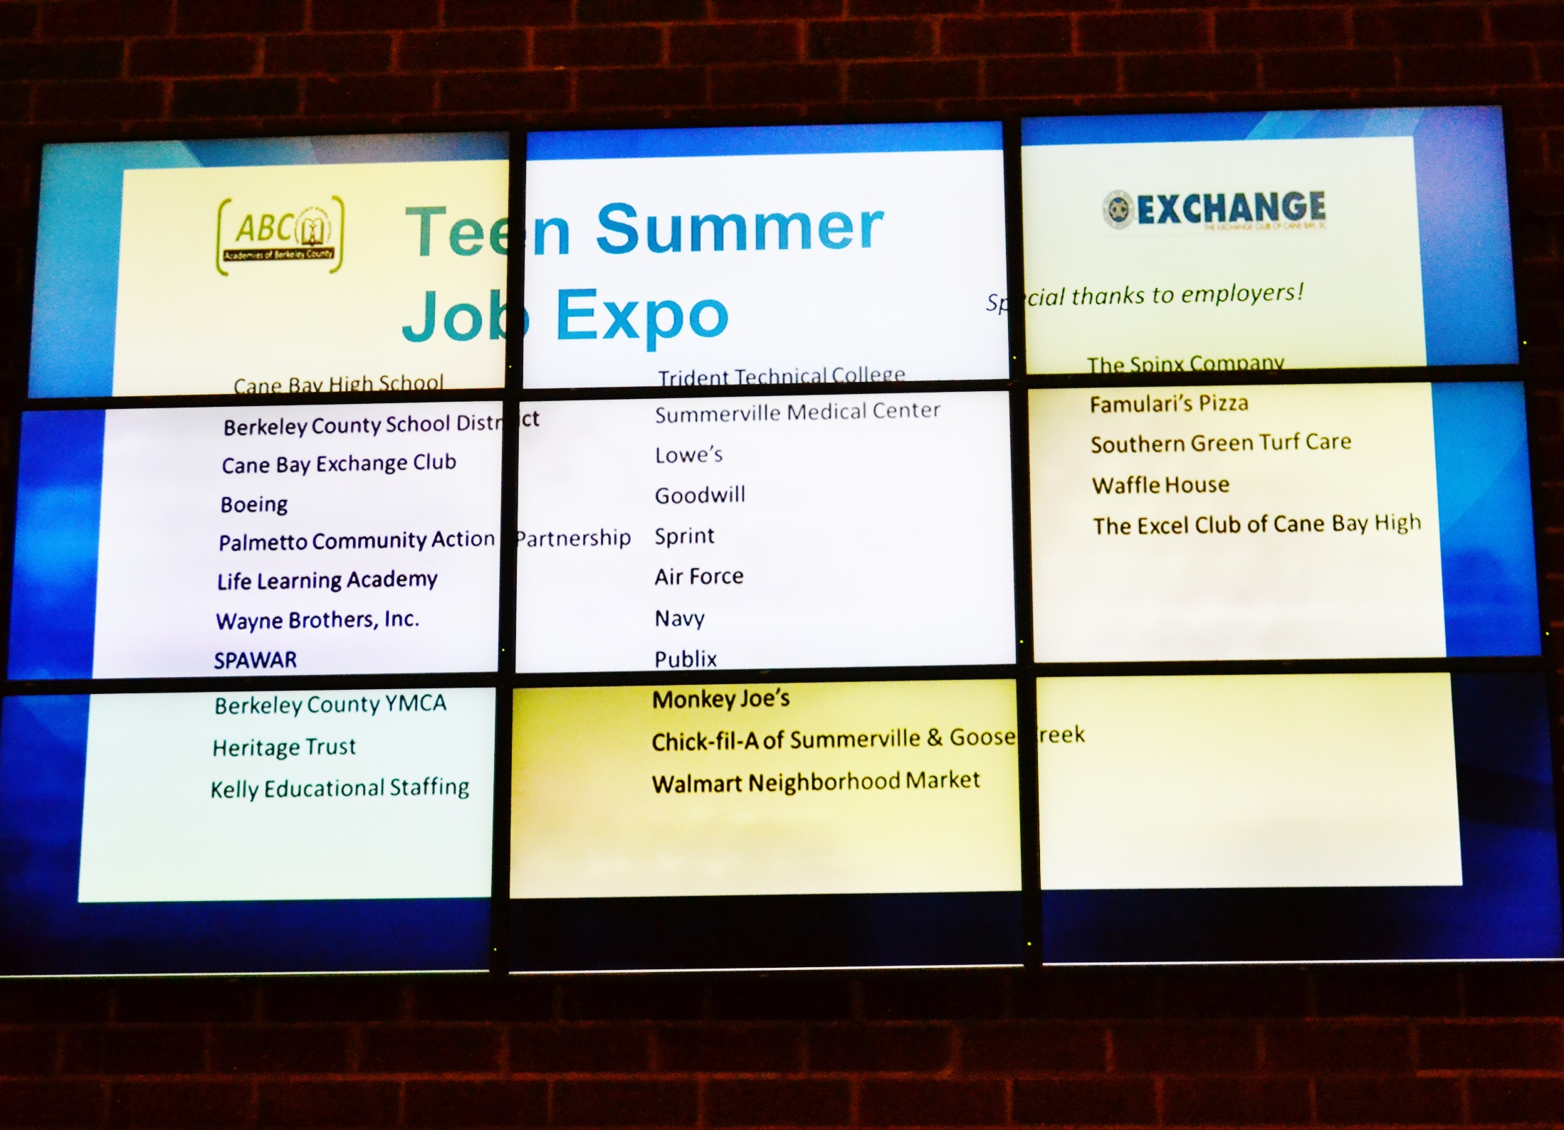
Teen Summer Job Expo - 2015
Over 480 student participants
19 Presenters
95 - 25 minute sessions

Slide 11
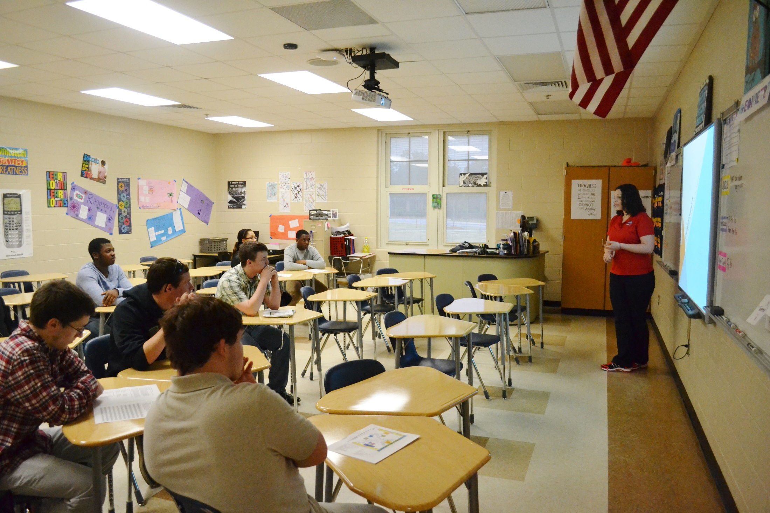
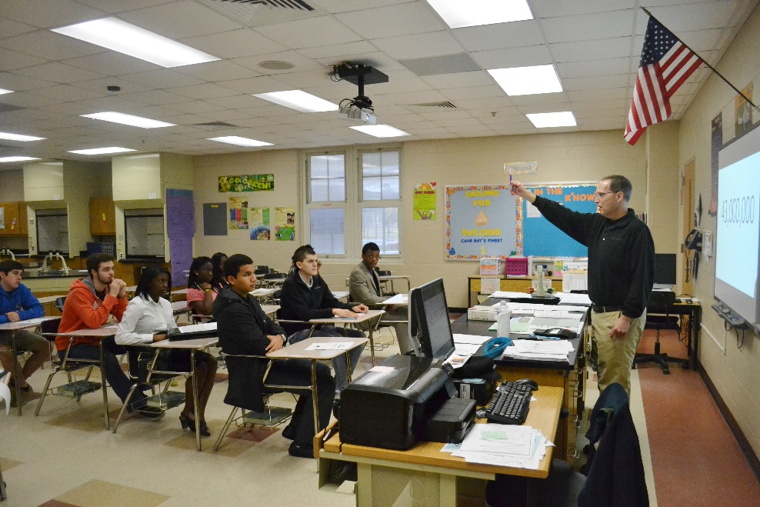
Teen Summer Job Expo - 2015
Employability Workshop
Employability Workshop

Slide 12
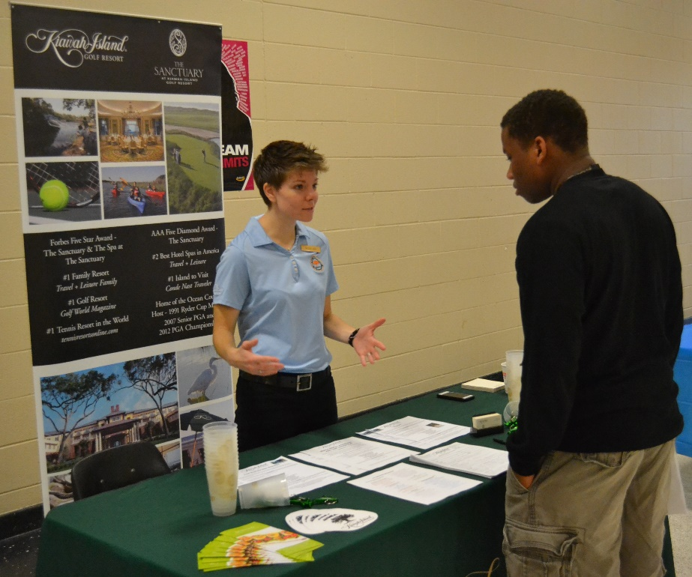
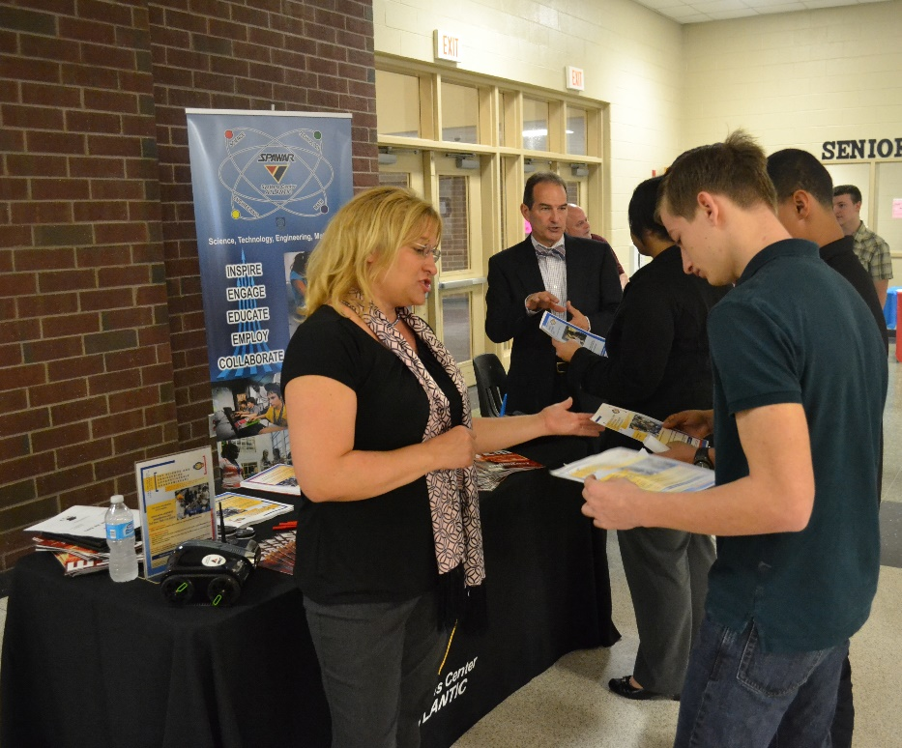
Teen Summer Job Expo - 2015
Employer’s Table
Employer’s Table

Slide 13
Teen Summer Job Expo – 2015 Observations/Feedback
Date was too late for summer jobs
Pre-Registration for Students
Parent Sessions
Bags to hold materials/Notepad for notes
Student Volunteers during set up
Notes:
Had online registration during this first year, but realized that students could pre-register. That would give us an idea of how many students would potentially attend.
Many parents were sitting around while students participated in sessions. Industry professional discussed the idea of doing a parent session.
Industry professionals were giving out handouts. Students needed pen and paper to take notes.
Had volunteers during the day of, but decided to have volunteers during set up to get service hours.

Slide 14
Teen Summer Job Expo - 2016
Held on February 20, 2016 at Cane Bay High School
Coordinated with Exchange Club of Cane Bay
Focused on summer jobs for teens
Students attended 2 sessions prior to speaking to potential summer employers in a career fair format.
Notes:
Date was moved up earlier, but it still did not help for some major youth employers in our area (Wannamaker Park/Santee Cooper)
Discuss Meetings held with Cane Bay Exchange Club
Discuss sample of sessions - Sample is on the next slide.

Slide 15
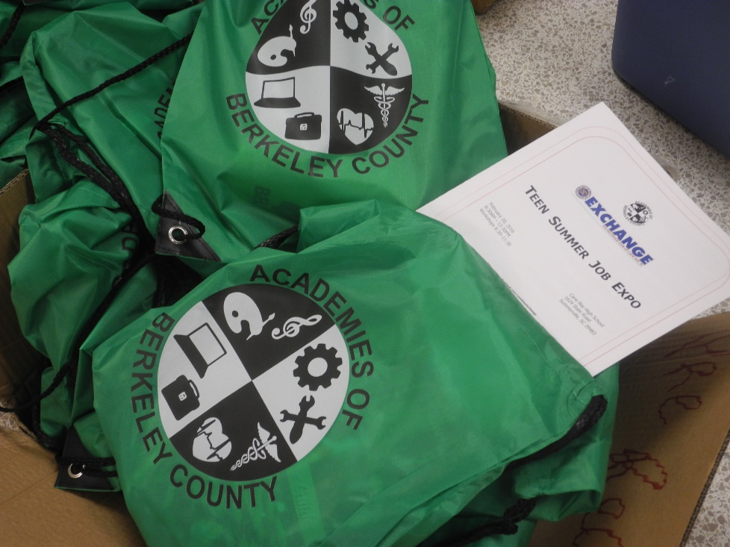
Teen Summer Job Expo - 2016
Over 200 student participants
21 Presenters
105 - 25 minute sessions

Slide 16
Teen Summer Job Expo – 2016
Sample Schedule - Sessions
Teen Summer Job Expo-2016
Business/Organization Contact Name | Session I 8:30 - 8:55 | Session II 9:00 - 9:25 | Session III 9:30 - 9:55 | Session IV 10:00 - 10:25 | Session V 10:30 - 10:55 | Session VI 11:00 - 11:30 | Room Number
Palmetto Youth Connections Jessical Galati | Essential Interviewing Skills & Networking | Essential Interviewing Skills & Networking | Essential Interviewing Skills & Networking | BREAK | Essential Interviewing Skills & Networking | Essential Interviewing Skills & Networking | 402 Lab
Palmetto Community ActionPartnership Jennifer Brown | What is your Statement? (Dress for Success) | What is your Statement? (Dress for Success) | What is your Statement? (Dress for Success) | What is your Statement? (Dress for Success) | BREAK | What is your Statement? (Dress for Success) | 400
Life Learning Academy Charlenia Snider | Professional Work Ethics | Professional Work Ethics | BREAK | Professional Work Ethics | Professional Work Ethics | Professional Work Ethics | 401
A.M.P Advocating for Minor Programs Beverly Dickey-Daniel | Job Readiness | Job Readiness | Job Readiness | Job Readiness | Job Readiness | BREAK | 405
Centura College Victoria Felder | Emotional Intelligence | Emotional Intelligence | Emotional Intelligence | BREAK | Emotional Intelligence | Emotional Intelligence | 406
Trident Technical College Patricia Gramling | Youth Apprenticeshp Programs | Youth Apprenticeshp Programs | Youth Apprenticeshp Programs | Youth Apprenticeshp Programs | BREAK | Youth Apprenticeshp Programs | 407
Staring Block Career Services Ellen Steverson | Social Media Impact on Employability | Social Media Impact on Employability | BREAK | Social Media Impact on Employability | Social Media Impact on Employability | Social Media Impact on Employability
Berkeley County Middle College Sherri Scoggins | Parent Session | Parent Session | Parent Session |  |  |  | Media Center
Heritage Trust Federal Credit Union Angela Gordon |  |  |  | Parent Session | Parent Session | Parent Session | Media Center
Notes:
Point out different presentations
Note the Parent Sessions at the bottom of the table that spanned the entire time. One presentation done by Guidance professional, one done by one of our partners (information from an industry perspective). Talked to parents about how to dress their child for interviews, etc.

Slide 17
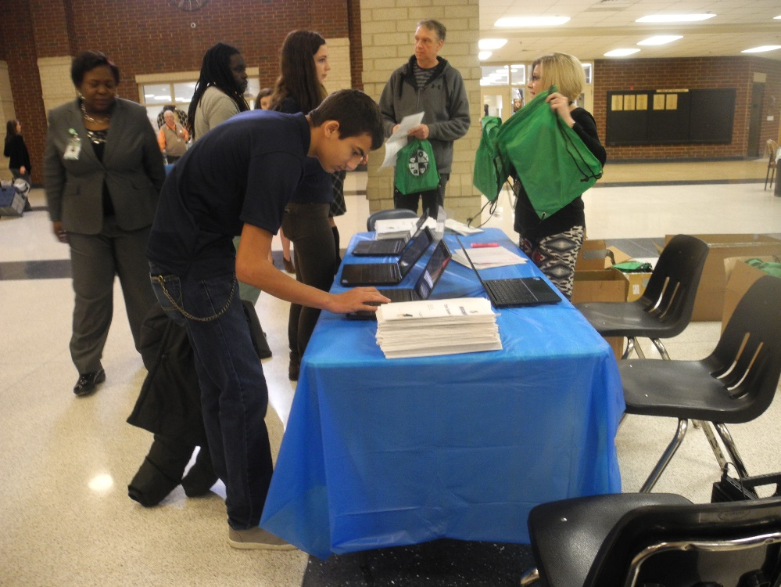
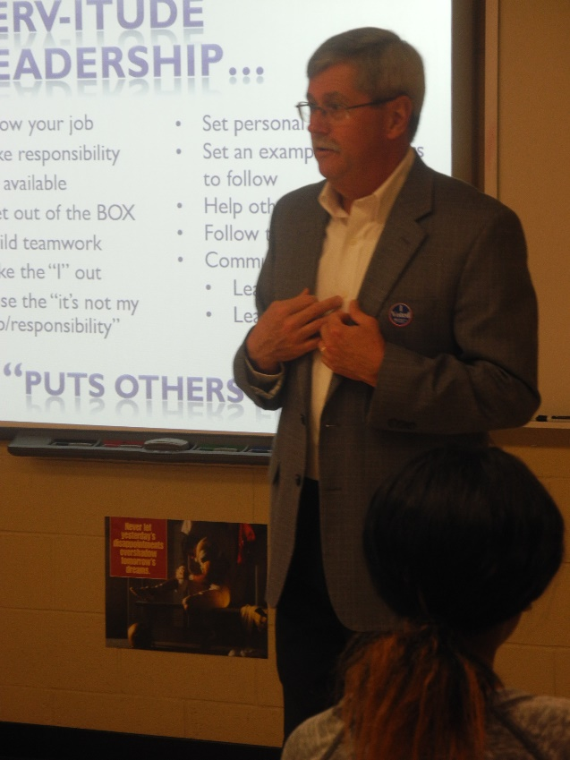
Teen Summer Job Expo - 2016
Registration
Employability Workshop

Slide 18
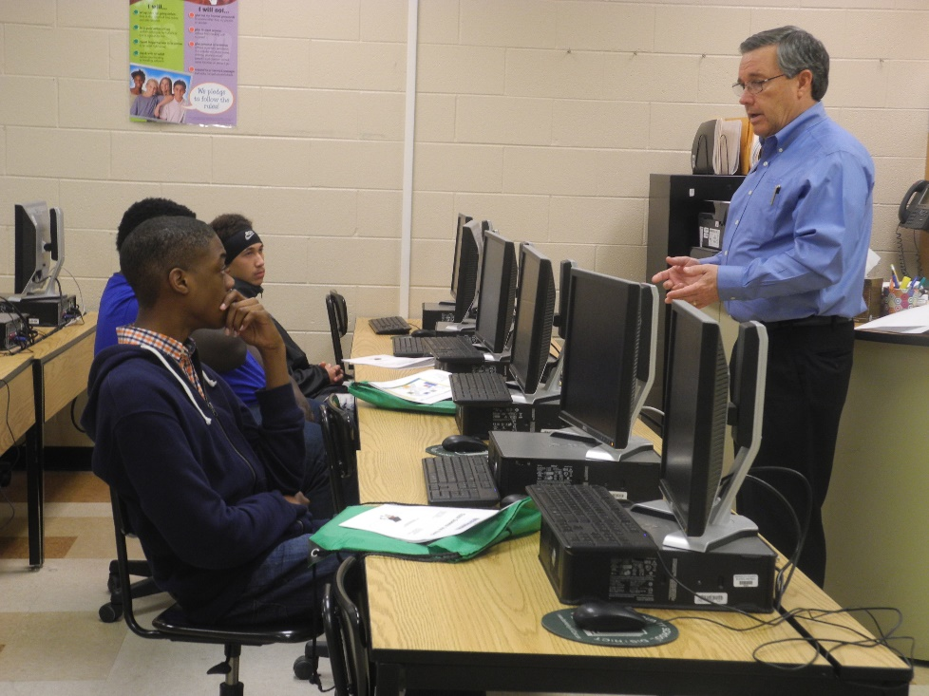
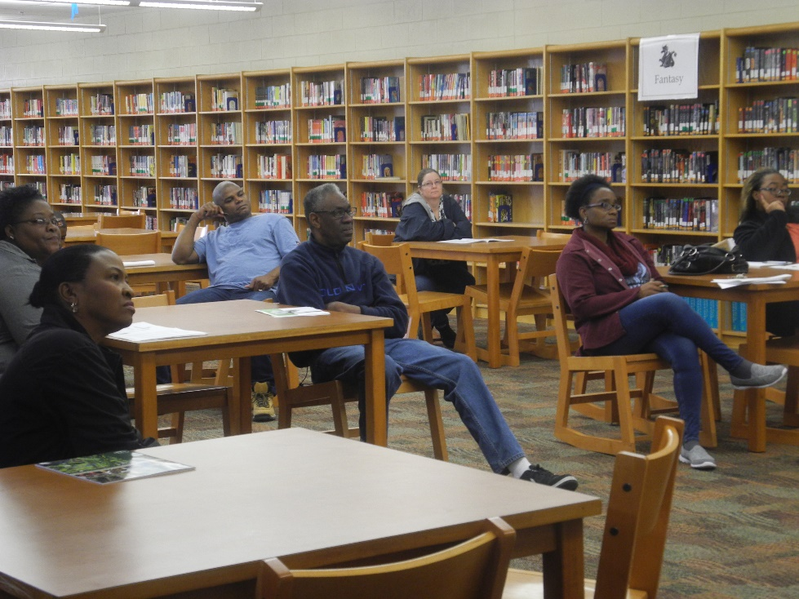
Teen Summer Job Expo - 2016
Employability Workshop
Parent Session

Slide 19
Teen Summer Job Expo - 2016
Observations/Feedback
Date was still too late for summer jobs
Location Change needed
Session times too short
Possible Use of Conference App
Notes:
Date still too late for major youth employers – Wannamaker Park and Santee Cooper
Location Change – Wanted to ensure that students/parents across the district understood that this was a district initiative. Trying to rotate the event among schools.
Attempted the use of a conference. Not there yet.

Slide 20
Career Conference - 2017
Held on January 7, 2017 at Stratford High School
Partnered with two of our Academy Partners (utility companies) - Santee Cooper and Berkeley Electric Cooperative
Changed focus from summer jobs to careers
Same format as past expos
Notes:
Discuss that we moved the date up even earlier this year due to prior feedback. However, it SNOWED this day. However, we were still able to get about 150 students in the very bad weather.
Discuss the partnering with Santee Cooper and Berkeley Electric Cooperative – no financial partnerships. Name recognition. Show bags and the logos that were added.
Changed the focus to move beyond summer jobs – all opportunities: apprenticeships, summer jobs, internships, future career opportunities past high school, etc.

Slide 21
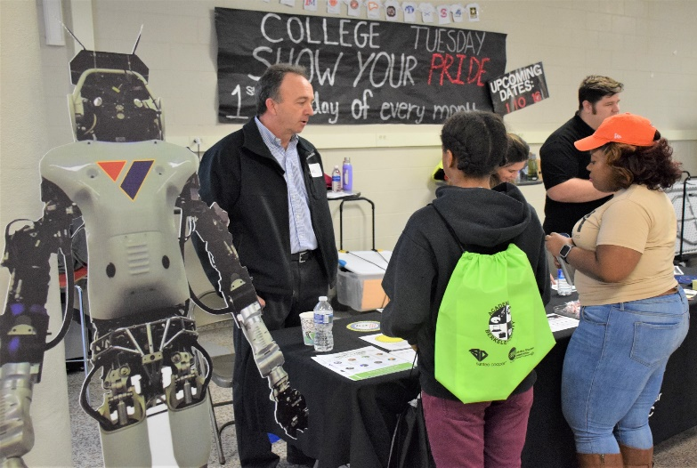
Career Conference 2017
  Over 150 student participants
  24 Employer tables
  31 Presenters
    79 – 30 minute sessions

Slide 22
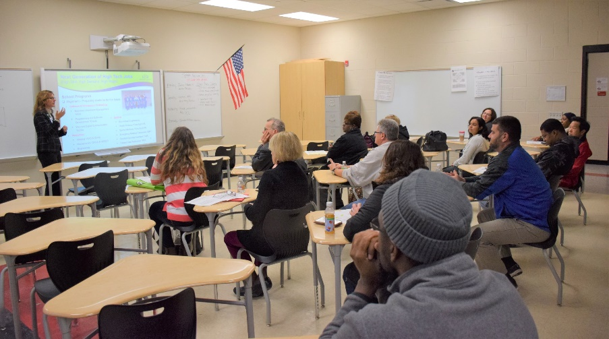
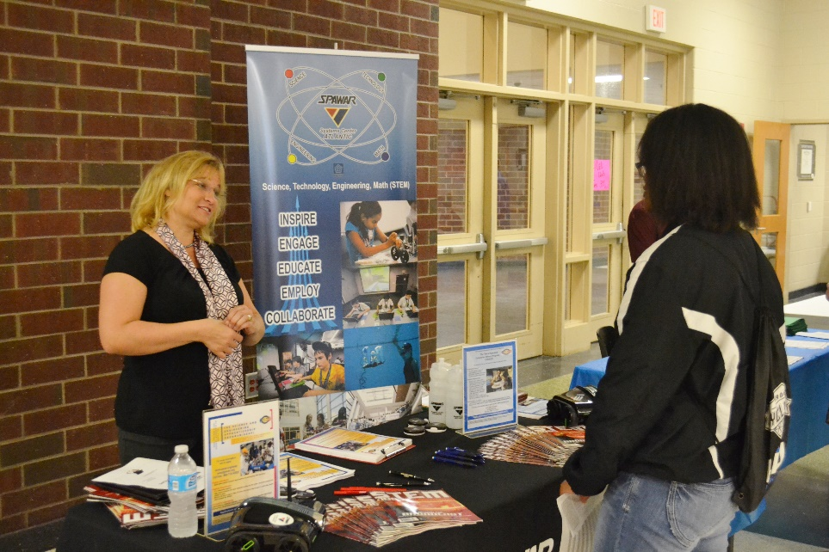
Career Conference 2017
Parent Session
Employer’s Table

Slide 23
Career Conference – 2017
Sample Schedule - Sessions
BCSD Career Conference-2017
Business/Organization Contact Name | Session I 8:30 - 8:55 | Session II 9:00 - 9:25 | Session III 9:30 - 9:55 | Session IV 10:00 - 10:25 | Session V 10:30 - 10:55 | Session VI 11:00 - 11:30 | Room Number
Lowe's Courtney Mathis | Interviewing Skills | Interviewing Skills | Interviewing Skills | BREAK | Interviewing Skills | Interviewing Skills | 203
Berkeley Prosperity Center Bryan Sharper | Money Management | Money Management | Money Management | Money Management | BREAK | Money Management | 211
Santee Cooper Credit Union Michelle Jones | Resume Writing | Resume Writing | BREAK | Resume Writing | Resume Writing | Resume Writing | 225
Dale Carnegie Liz McCool | Networking 101 | Networking 101 | Networking 101 | Networking 101 | Networking 101 | BREAK | 227
Hendrick Automotive Group Brad Davis | Skill Sets Needed for Employment | Skill Sets Needed for Employment | Skill Sets Needed for Employment | BREAK | Skill Sets Needed for Employment | Skill Sets Needed for Employment | 229
Knights Companies Rhonda Vidal | Employability Skills | Employability Skills | Employability Skills | Employability Skills | BREAK | Employability Skills | 231
Berkeley Electric Cooperative Sharon Rosa | Interviewing Skills | Interviewing Skills | BREAK | Interviewing Skills | Interviewing Skills | Interviewing Skills | 233
SPAWAR Byas Glover | How to Be Good at Life | How to Be Good at Life | How to Be Good at Life | How to Be Good at Life | How to Be Good at Life | BREAK | 235
Santee Cooper Geno Porter | Positive Work Ethic | Positive Work Ethic | Positive Work Ethic | BREAK | Positive Work Ethic | Positive Work Ethic | 232
Santee Cooper Mike Johnson | Professional Conduct | Professional Conduct | Professional Conduct | Professional Conduct | BREAK | Professional Conduct | 234
Landmark 21 Consulting Jordan Graffis | Interviewing/Resume Writing | Interviewing/Resume Writing | Interviewing/Resume Writing | Parent Session (Preparing your Child for Future Careers) | Parent Session (Preparing your Child for Future Careers) | BREAK | 201
Career and Technical Education Berkeley County School District Tana Lee | Parent Session | Parent Session | Parent Session |  |  | Parent Session | 807
Notes:
Point out different presentations
Note the Parent Sessions at the bottom of the table that spanned the entire time. One presentation done by Guidance professional, one done by one of our partners (information from an industry perspective). Talked to parents about how to dress their child for interviews, etc.

Slide 24
Career Conference 2017
Feedback/Observations
  Increase length of sessions
  Possibility of doing panel discussions with former students
  Possibility of hosting during the school day
Notes:
Used an online follow-up survey for employer participants. The information above is from them.

Slide 25

Planning Tips
Select an appropriate date and location based on school/district calendars and needs of industry (hiring dates)
Select community partner(s)
Identify format
Send out Save the Date announcements

Slide 26
Planning Tips
Send out emails/letters requesting participation
Flyers/Emails/Social Media to announce event
Consider ordering any promotional items
Partner with schools to provide support
  Culinary Arts to prepare hospitality room with breakfast, snacks, and lunch
  Students in organizations that need service hours to assist with set up and during the Conference (Beta, NHS, FBLA, DECA, Skills USA, Student Government, JROTC)

Slide 27
Planning Tips
  Have an administrator on the day of the event to provide support (use of PA system, access, etc.)
  Use technology (Chromebook, iPads) for registration.

Slide 28
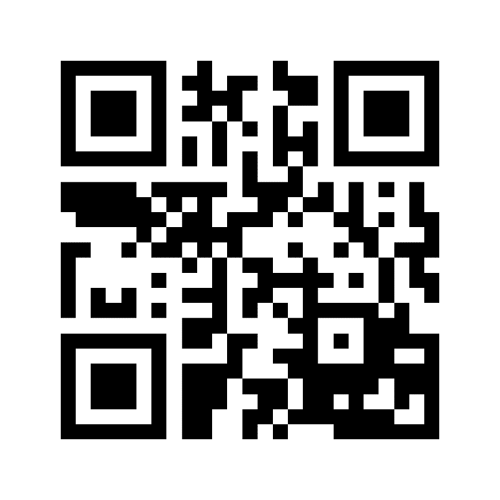
Planning Tips
To access the presentation, files, etc. use the following:
https://goo.gl/YrvEQ4

Slide 29
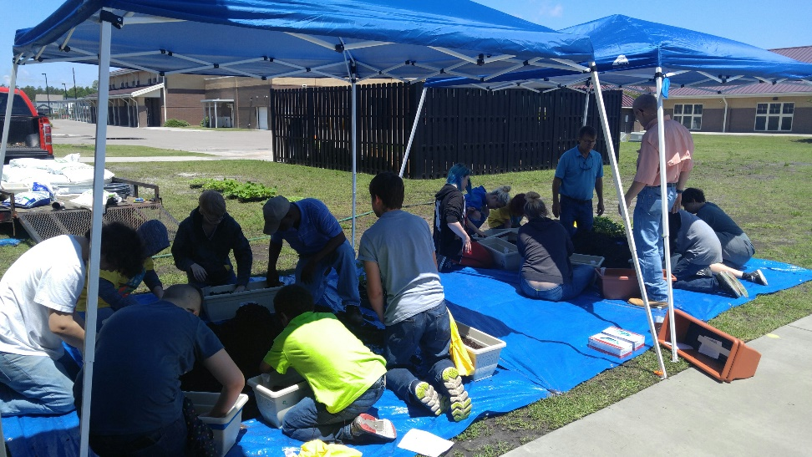

Other Special Projects
Middle School CTE Camp (LowCountry Lifestyles)
#CodeNation Computer Science Middle School Camp

Slide 30

Questions/Answers

Slide 31


For More Information
Sonya Addison-Stewart, Academy Coordinator
stewarts@bcsdschools.net
843-899-8308
@Academies_BCSD
Academies of Berkeley County School District
Tana Lee, Director of Career and Technical Education
leetana@bcsdschools.net
843-899-8670
@tanalee12
Heidi Guerry, CTE Program Coordinator
guerryh@bcsdschools.net
843-899-8670
@Heidi_Guerry

