Slide 1
Tennessee’s Response to COVID-19
September 2021
Lisa Piercey, MD, MBA, FAAP

Slide 2
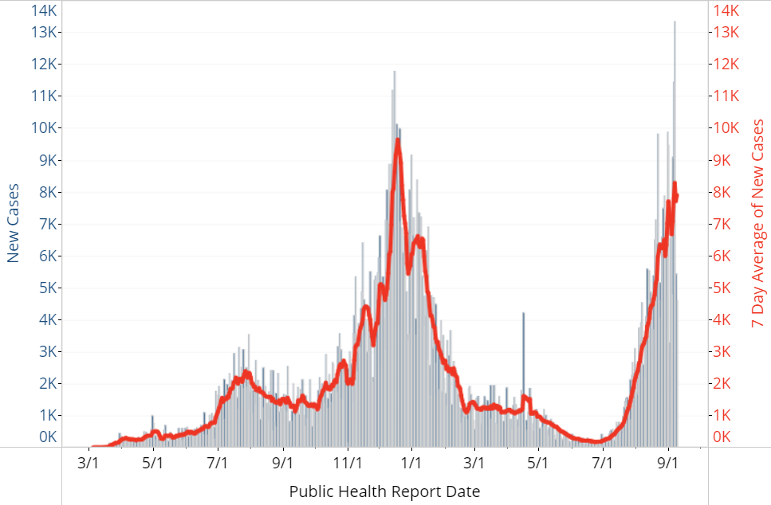
TN’s COVID Epi Curve
Total Cases: 1,119,545
Total Hospitalizations: 31,514
Total Deaths: 13,897
Data as of Sep 9, 2021

Slide 3
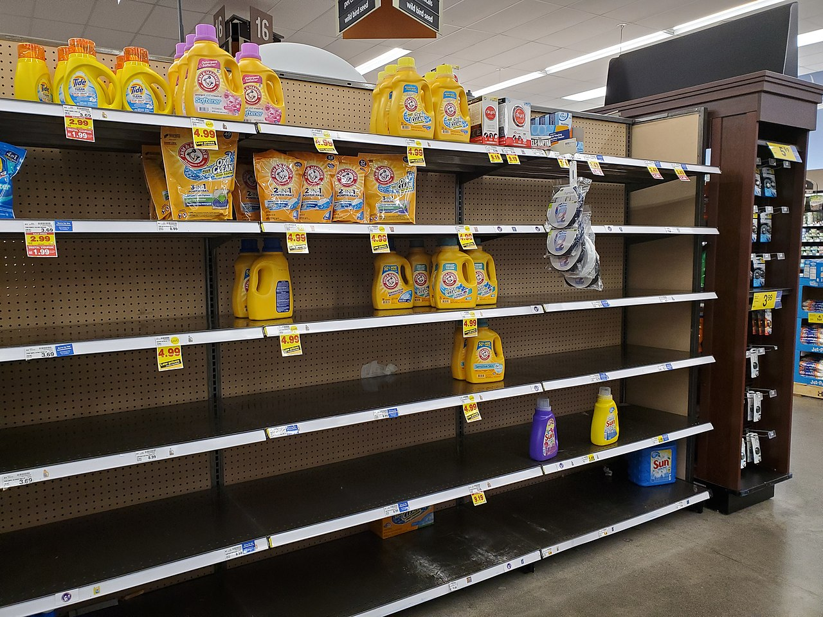
Remember 2020?
By BlueShirtz - Own work, CC BY-SA 4.0, https://commons.wikimedia.org/w/index.php?curid=88742198

Slide 4
Tennessee Responded
Alternative Care Sites
Testing for Everyone
TN Pledge
Regulatory Flexibility
Long-Term Care Support
National Guard
Hospitals
Addressing Disparities
Kids Back to School
Quick Vaccine Rollout

Slide 5
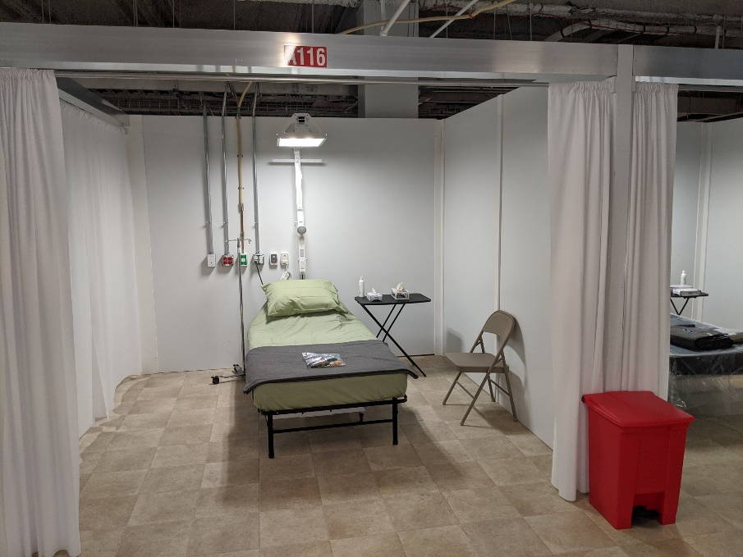
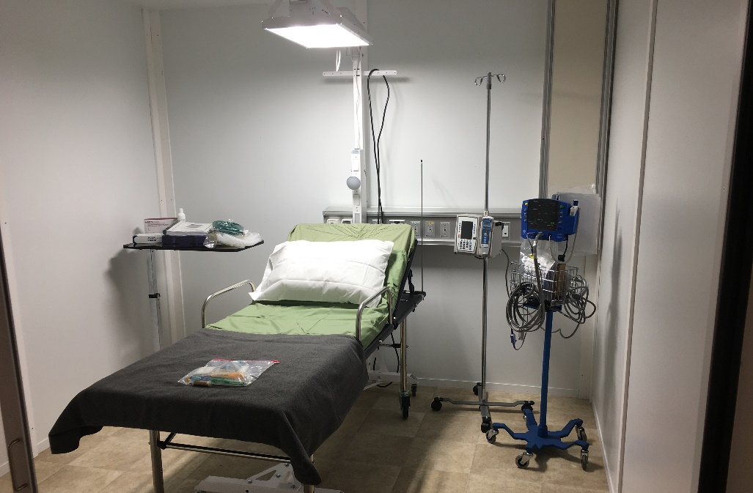
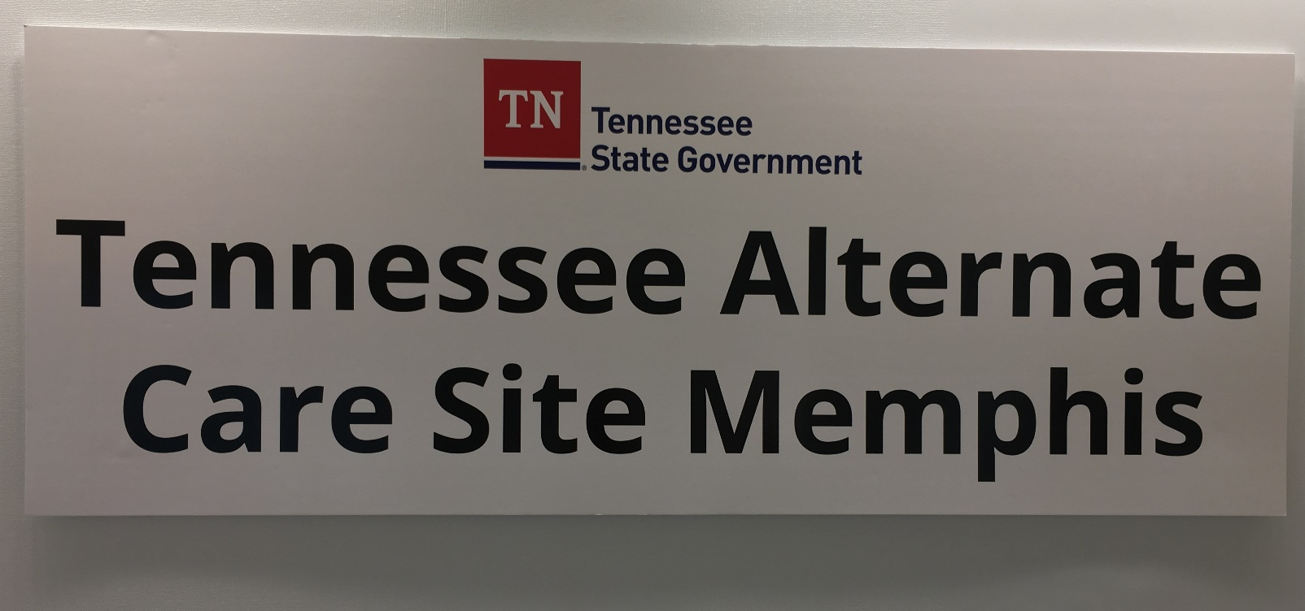
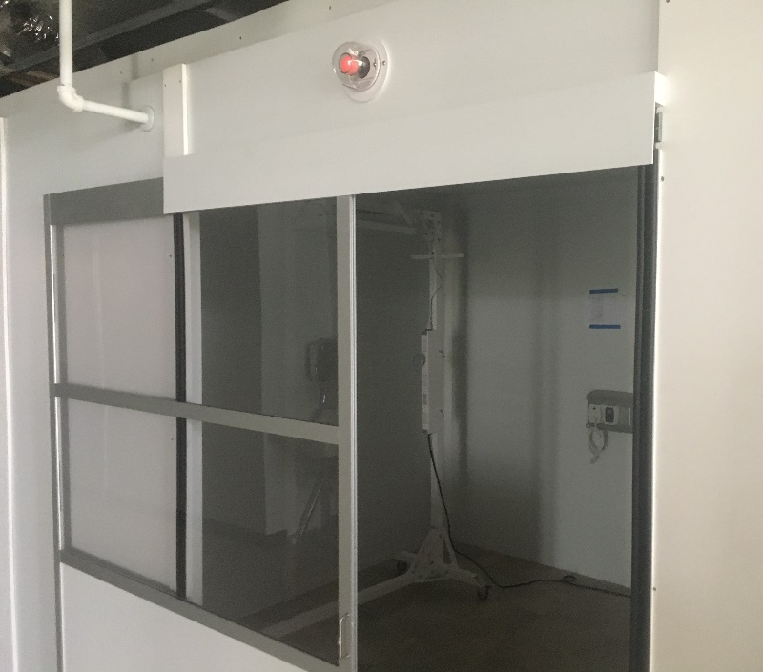
Alternative Care Sites

Slide 6
Testing for Everyone

Slide 7
TN Pledge

Slide 8
Regulatory Flexibility

Slide 9
Long-Term Care Support

Slide 10
National Guard

Slide 11
Hospitals
Source: Erlanger Health, CC BY-SA 4.0

Slide 12
Addressing Disparities

Slide 13
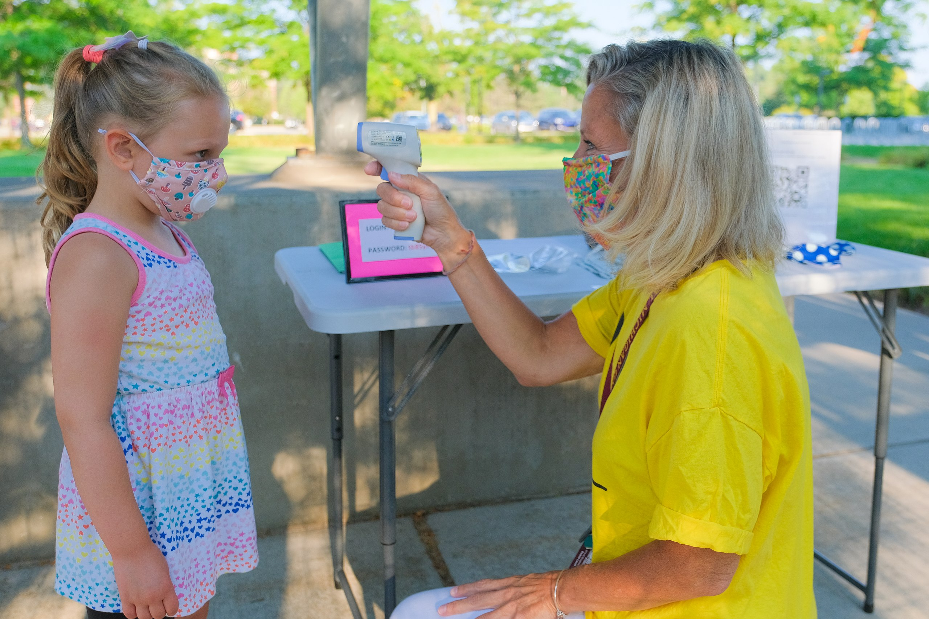
Back to School

Slide 14
Quick Vaccine Rollout

Slide 15
THANK YOU

