Slide 1
Engaging Your Community
“Love your Neighbor As Yourself!”

Slide 2
First Baptist Church of Teachey Mission and Vison Statements
These three statements guide our service and engagement !
Motto: “Reaching for God…Growing in Love…Changing the World!”
Mission Statement: Equipping the Saints to serve through sound teaching, preaching, and mission outreach.
Vision: To be the gap-fillers in the lives of our members and the community by serving, providing resources, and being a light to show the way.

Slide 3
The Role of Church & Believers!
Church- (Ekklesia)- the community of believers in Jesus Christ . Both the local community and all believers together.
In the New Testament, no building (synagogue, temple, tabernacle) was ever called a “church.”
Matthew 16:18- Jesus declared “I will build my church.” He is the head, and we are the body.
Ministry is the responsibility of everyone in the church, each bringing and using their gifts with the aid of the Holy Spirit.
This is how the church blesses and fulfills its mission to “Go and announce to them that the Kingdom of Heaven is near. Heal the sick, raise the dead, cure those with leprosy, and cast out demons. Give as freely as you have received!” Matthew 10:7-8 NLT

Slide 4
The Fellowship of the Believers Acts 2:42-47 ICB
They learned.
They shared.
They practiced Table Fellowship.
They prayed together.
They stayed together.
They sold their belongings and gave it to those people who needed it.
They praised God. The People Liked Them. People were saved. The Lord added to the number of believers.

Slide 5
Engaging Your Community Follow Jesus’ lead!
How did Jesus do ministry?
He saw, noticed, observed!
When Jesus saw him lying there and knew he had been there a long time. He said to him, “Do you wish to get well?” (John 5:6)
Seeing the people, He felt compassion for them because they were distressed and dispirited. (Matthew 9:36)
And when the Lord saw her, he had compassion on her and said to her, “Do Not weep.” Luke 7:13 (Widow of Nain)
Jesus saw…We must see, notice, observe as we drive into and out of church!

Slide 6
Strong Communities!
We need our church’s neighborhood to flourish just as we want our church to flourish.
We can strengthen and improve the well being of our neighbors.
Just as we believe members are planted in our churches, I believe our churches are planted in neighborhoods.
We need to notice our neighbors!
Drive thru the neighborhood…what do you see?
Children playing in the yard? {Ministry Opportunity}
Overgrown grass?
House in disrepair?
What can the church do about what you see?

Slide 7
What do your Neighbors Need?
Why don’t you ask them?
Create a simple survey to find out!
English and Spanish if that is who is in your neighborhood.
Ask your members to share of needs they know about?

Slide 8
Need To Be met!
Seniors need help with home care and maintenance?
Handy people in the church?
Hospitality Ministry Meal prep?

Slide 9
Need to be met Continued?
Are people hungry? How many? Family? Several Families?
Can the need be met by a food pantry or is it greater?
Is there another church organization providing this service in the community?
Can you partner with them?

Slide 10
Need Continued
Family Help
Children Need School Help?
Parents need support/mentors?
Can you offer a family evening program a few times a week?
Classes for parents? Tutoring for kids?
Meal for the family?

Slide 11
Serve according To your church’s gifts and abilities
Keep it simple!
01
Focus on basic needs!
02
Give yourself enough time to plan and advertise.
03

Slide 12
Community Service is Magnetic
People want to serve; they just need opportunity.
It will draw attention from those outside of the church.
It will give members of other churches an opportunity to serve.
It blesses your members!
It builds discipleship and empowers your members.
It improves the lives of your neighbors.
It introduces Jesus without ever saying His name.

Slide 13
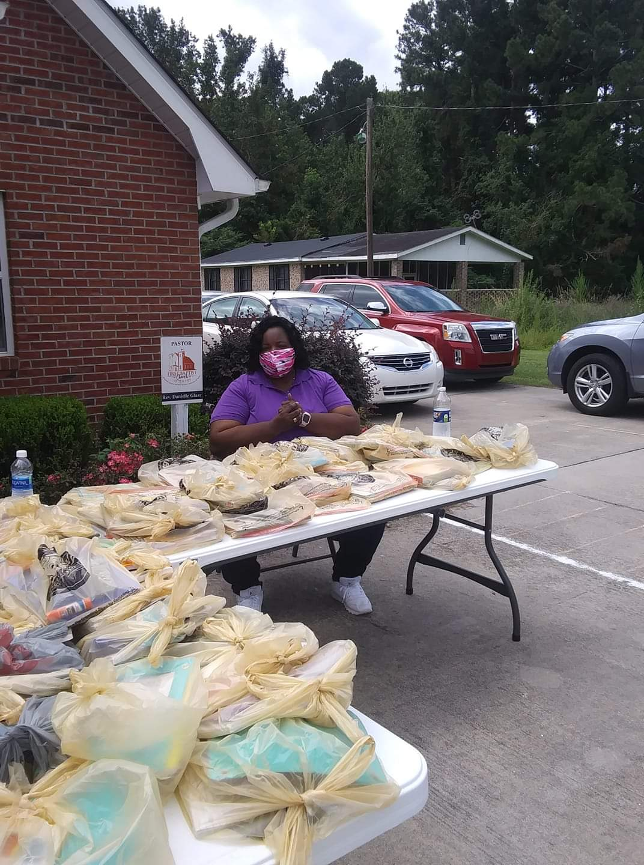
First Baptist Church of Teachey’s Outreach projects 2020
Back to School Supplies and Book Give Away
Several Covid Testing

Slide 14
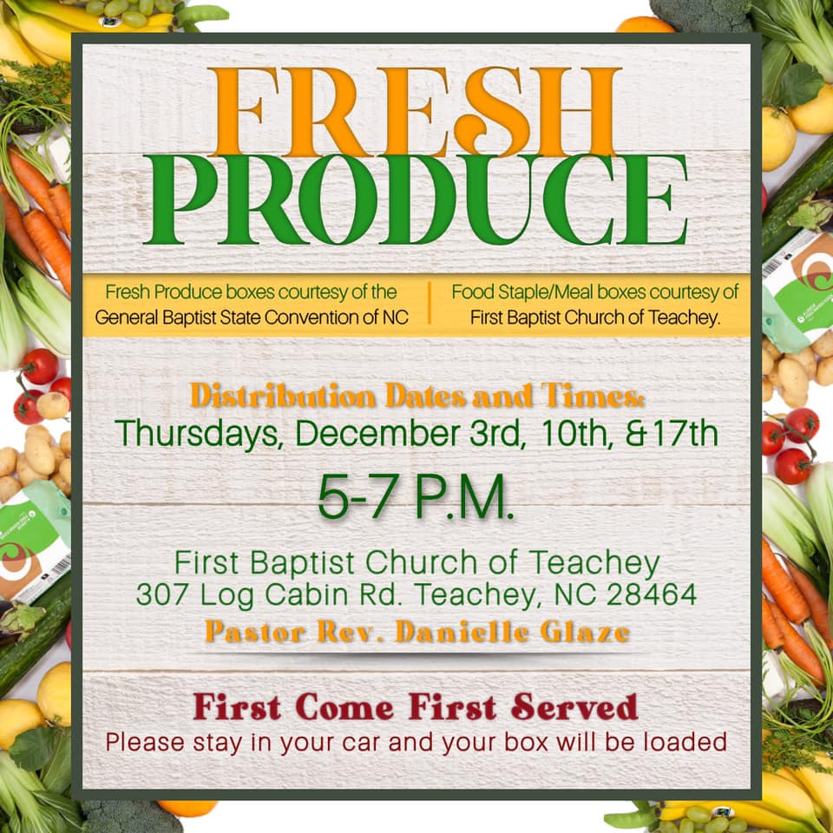
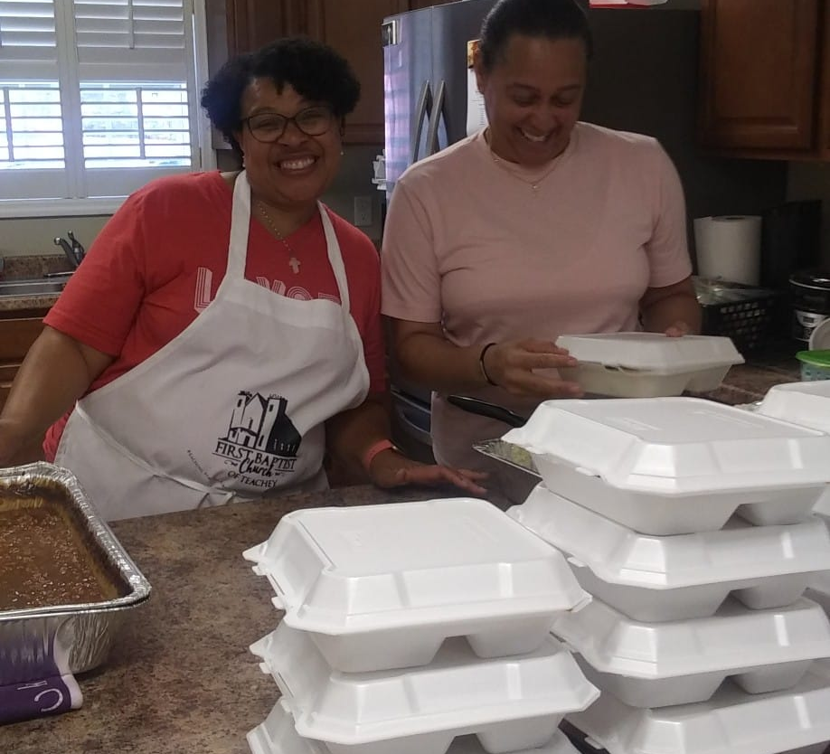
Community Outreach- Filling gaps of Basic Needs
For I was hungry, and you fed me. I was thirsty, and you gave me a drink. Matthew 25:35
Notes:
We partnered with GBSC to distribute fresh produce as well as staples to 100 families for 3 weeks. In addition, we prepared meals for school cafeteria workers, and seniors in the community.

Slide 15
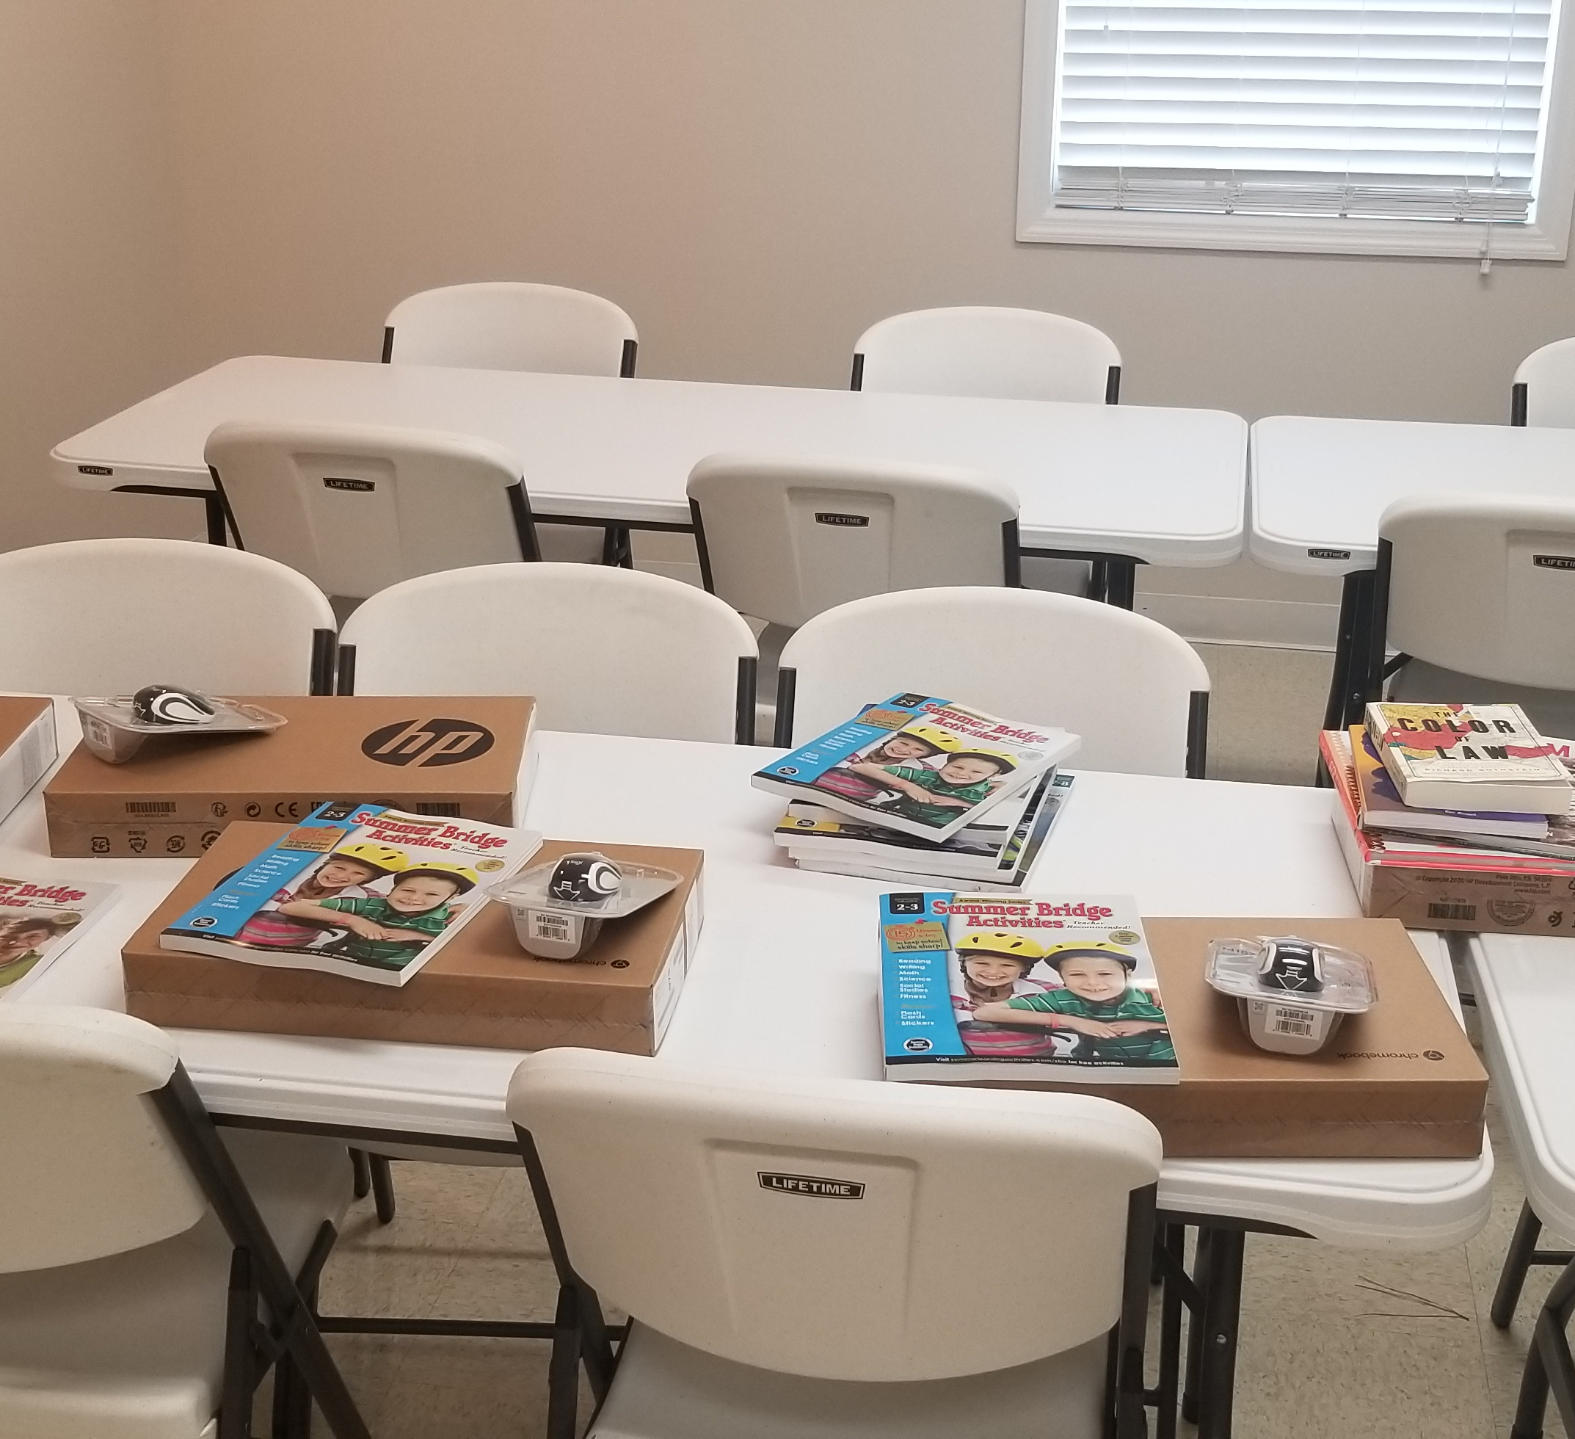
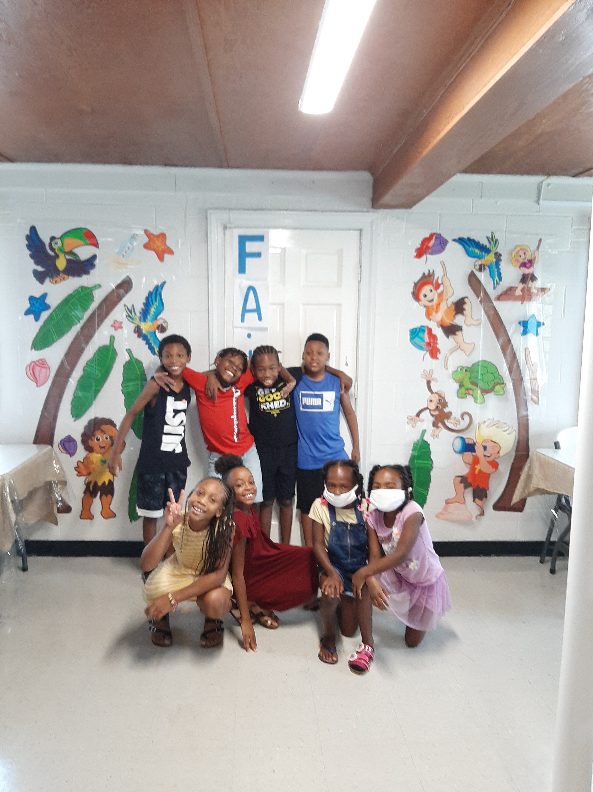
Preparing our Youth for Success
Tutoring, Computers, Summer Enrichment, School Supplies
Notes:
We distributed 175 bags of school supplies, 300 books for the community. We purchase laptops and summer enrichment workbooks for our youth members so they could successfully engage in school and retain skills over the summer. The Pastor did in person tutoring for 4 months, twice a week for 4 weeks each for our youth and then shifted to virtual tutoring and continues to give each child one on one tutoring twice a week. She also did a mini vans for our youngest youth to give them some sense of normalcy.

Slide 16
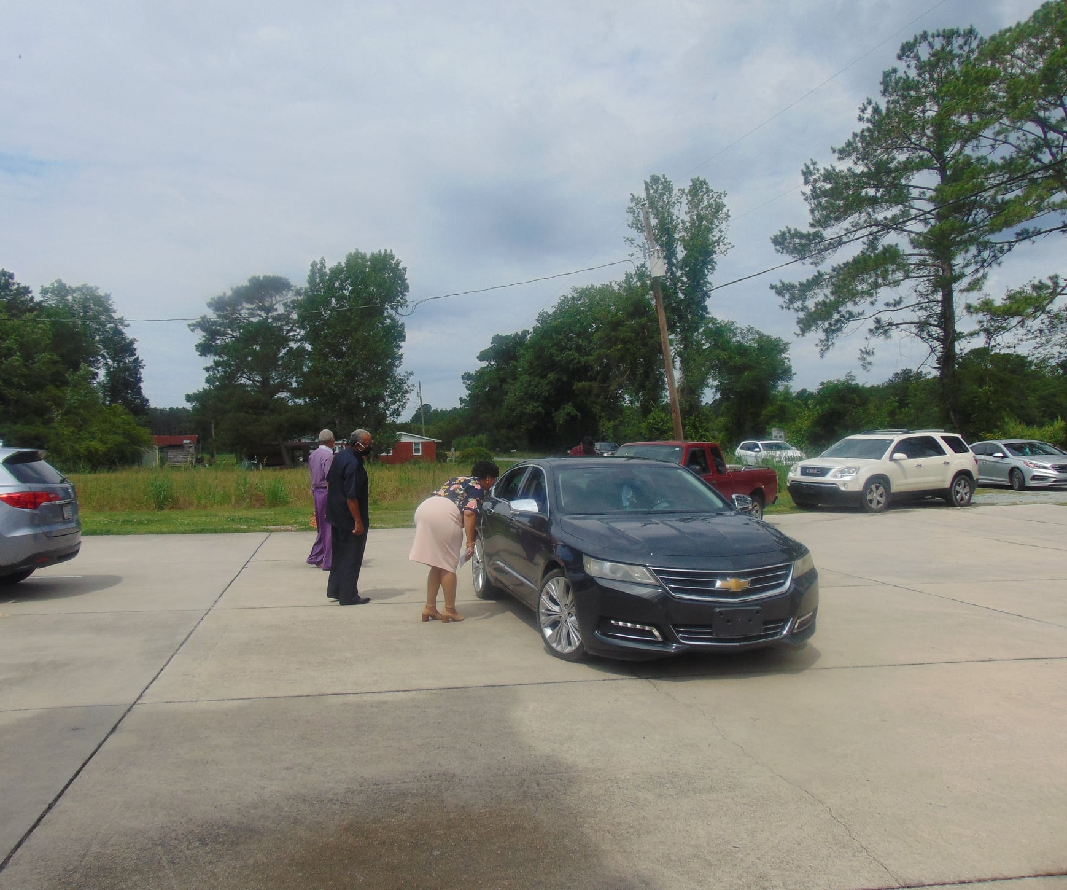
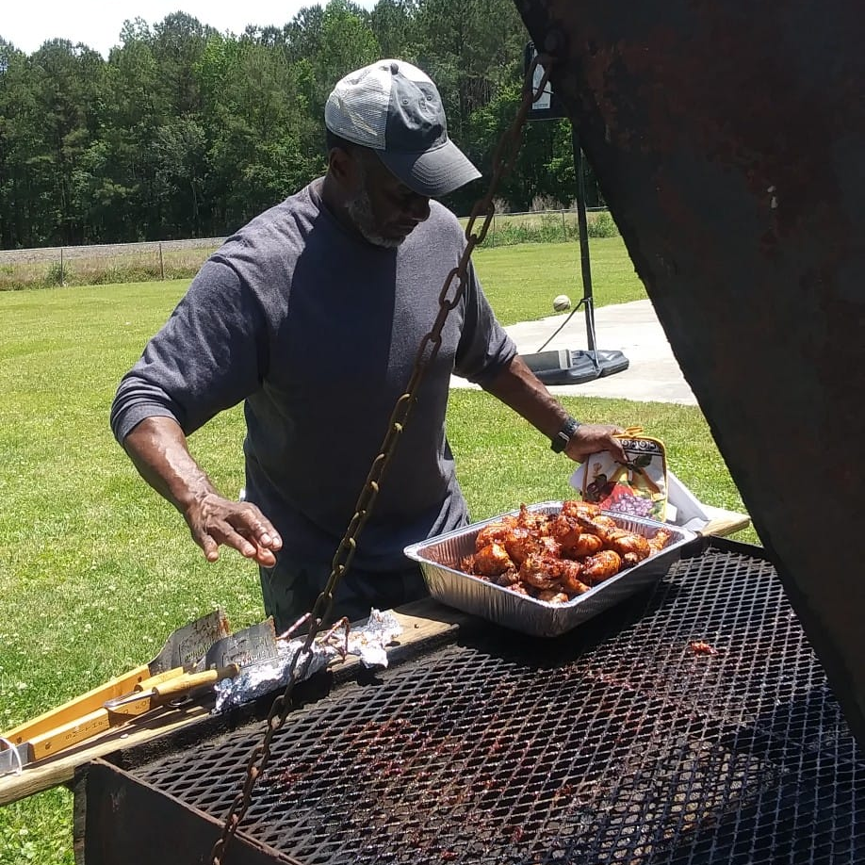
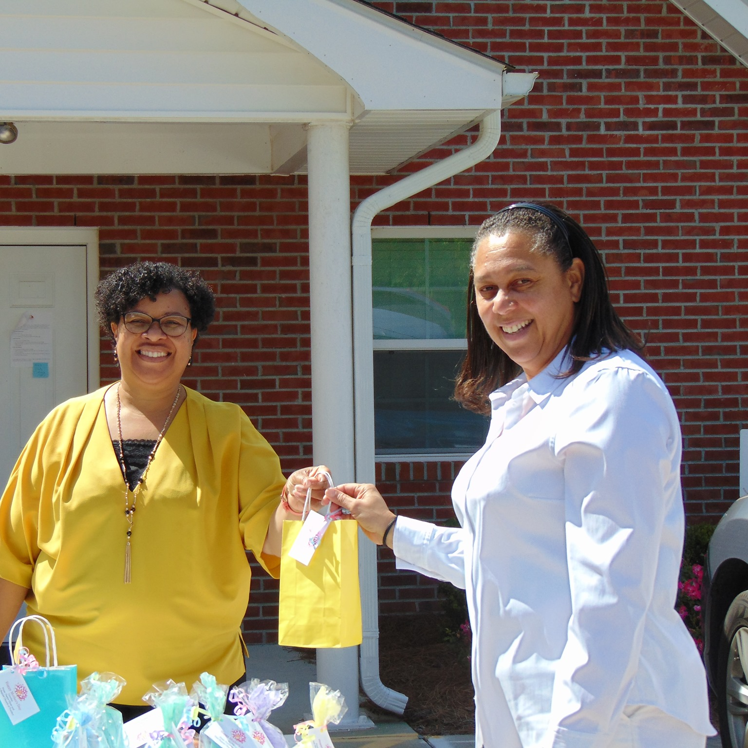
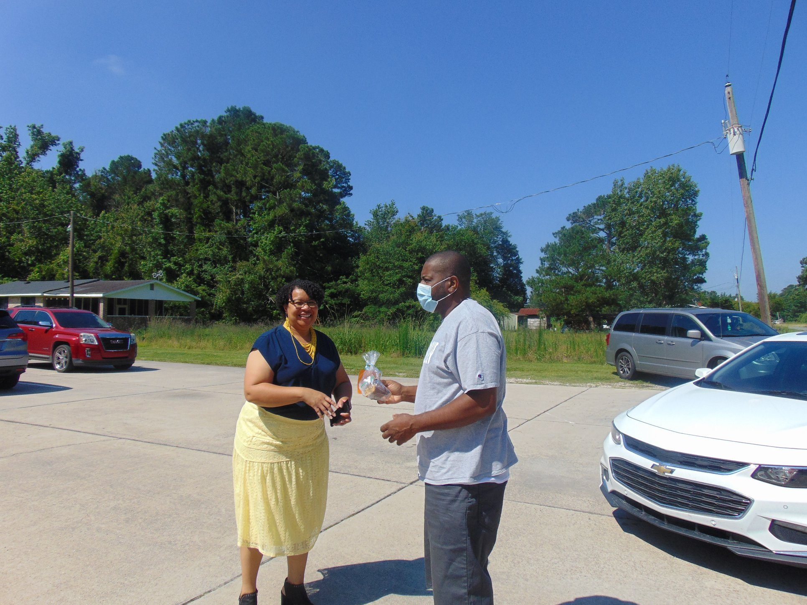
Congregational Connections
Notes:
To keep our church family connected we offered cookout to go drive thru meals for the family. Drive thru Mother’s Day and Father’s Day gifts as well as Christmas drive through for hot dogs,cocoa, treat bags, and craft kits.

Slide 17
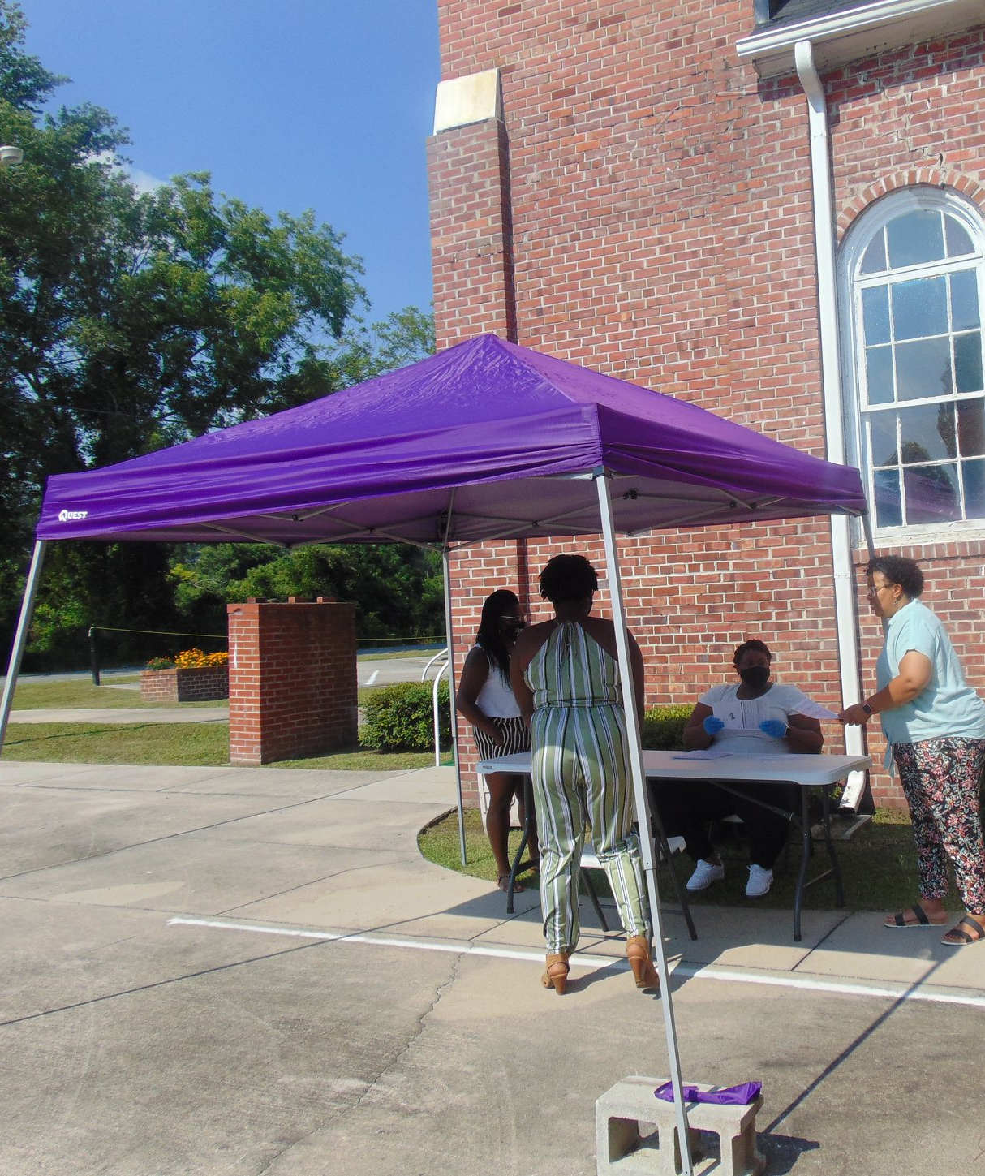
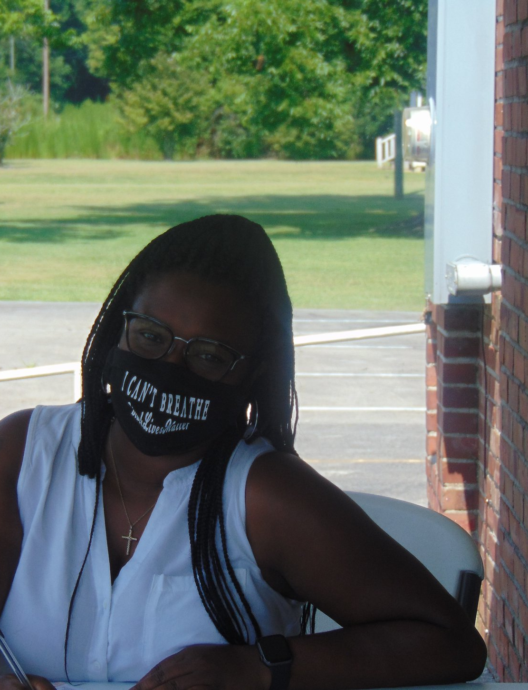
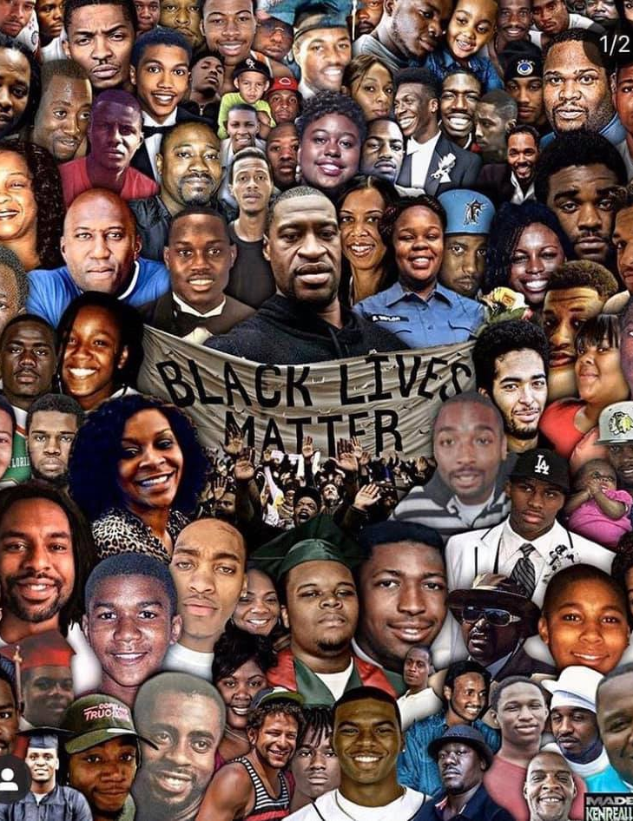
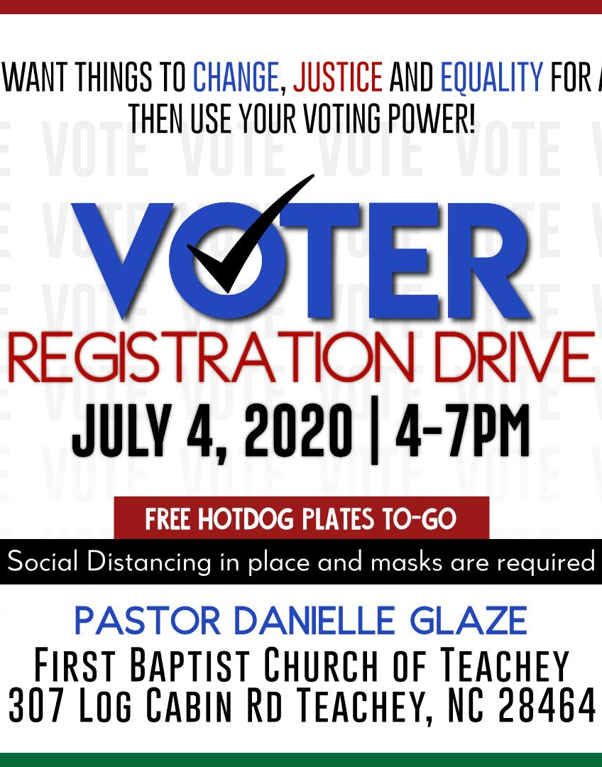
We fought for Social Justice
He has told you, O man, what is good; and what does the Lord require of you but to do justice, and to love kindness, and to walk humbly with your God?
Notes:
We fought for social justice and worked for the oppressed by hosting 4 Voter registration drives as well as. Ensue completion.

Slide 18
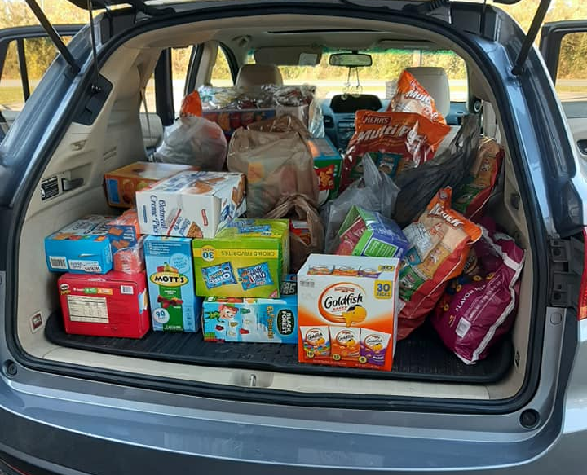
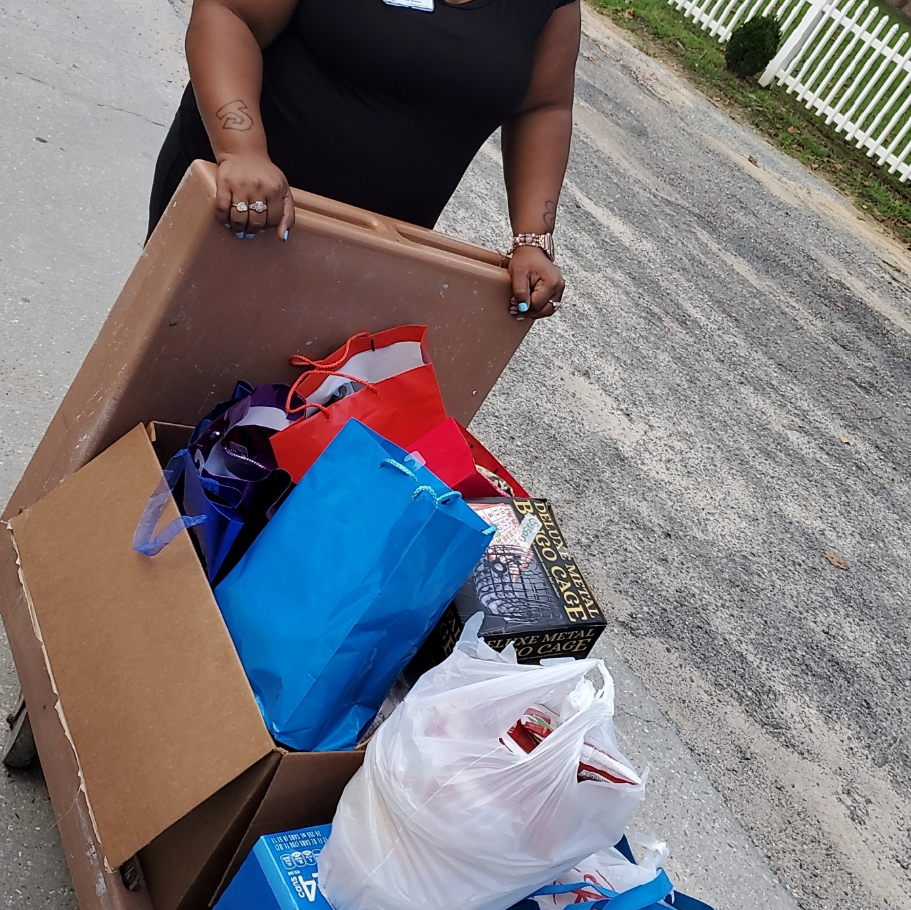
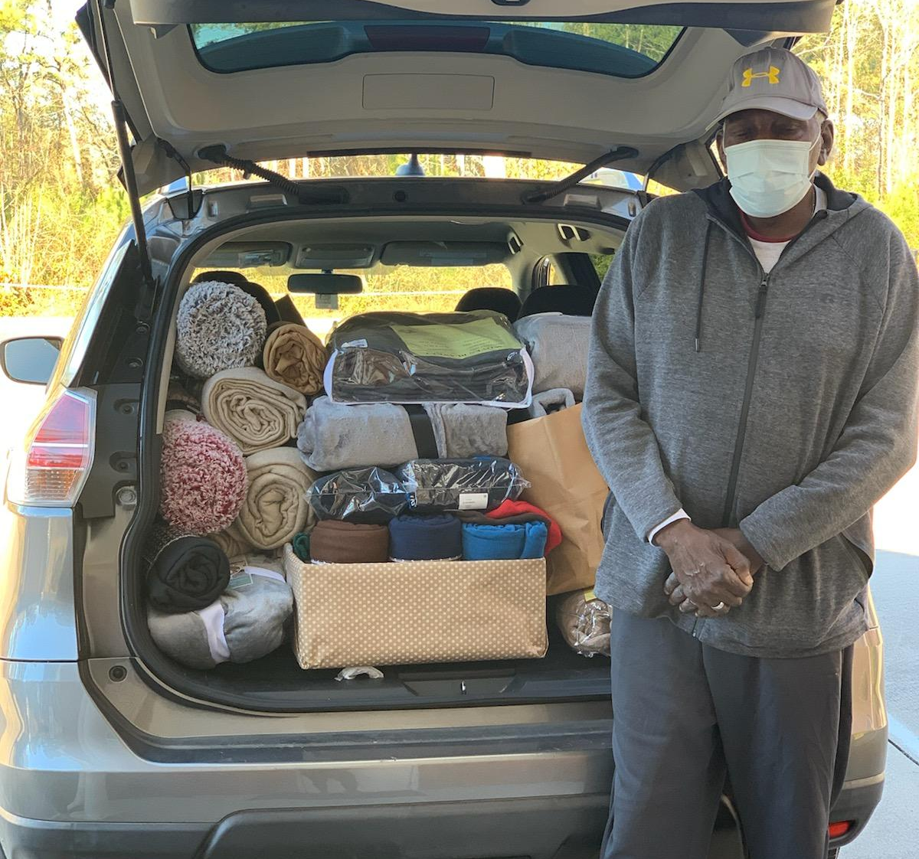
Missional Outreach
For I was hungry, and you fed me. I was thirsty, and you gave me a drink. I was a stranger, and you invited me into your home.
Notes:
We continued to try to fill the gap for the hungry by donating snacks for over 200 elementary children at Rose Hill Magnolia Elementary school. We collected blankets, socks, hats, and mitt snacks for the homeless in Raleigh. They were given to two shelters. We also adopted the Warsaw Nursing and Rehab facility and created gift bags of their favorite things and wrote encouraging cards,

Slide 19
Ministry on Purpose! 2021 Focus
February Outreach:
Taking advantage of February’s “Love” focus as well as “Black History Month”
How can we show the love of Christ and value the lives of those who are considered “less than” in this country?
“You Are Loved!” outreach project. Bombing neighbors' porches with Love Bags!
Everyone can participate-donations, bagging, dropping off!
We bless people to show them they are loved, they matter, we noticed!

Slide 20
Long-term Community Engagement
Friday Night’s Out-provide a meal, tutoring, crafts, dance classes, basketball. to give the children a safe place to get out in the community. After football season.
Adult Literacy Classes-to equip those in the community who need this most valuable skill.
After-School Program-tutoring, snacks, etc.
Boy’s Mentoring Group-basic automotive, carpentry, fishing,
Health and Nutrition Classes- to serve the whole person.

Slide 21
Steps to engaging Your Church’s Community!
Pay attention! Take a walk or ride!
1
Ask questions.
2
Make a plan to meet basic needs.
3
Empower and include your members.
4
Eliminate bureaucracy!
5
Seek to develop partner-ships.
6
Love your neighbors as yourselves!
7
God will send the increase!
8
Which of your projects can become long-term to keep meeting needs?

