Slide 1
Salvation History Throughout the Bible
Craig Vincent Mitchell, PhD
Eric Mitchell, PhD

Slide 2
The Chiastic Structure of Salvation History in the Bible
Creation (Genesis 1+2)
  Cosmic Rebellion (Genesis 3-11)
    Abraham’ Seed: Israel (Genesis 12- Malachi)
      Jesus Christ: Messiah, Son of God
    Abraham’s Seed: The Church (Acts 1- Revelation 6)
  Cosmic Rebellion 2 (Revelation 6-20)
Re- Creation (Revelation 21-22)

Slide 3
Creation
Psalms 89: 5-16
6- No one in the skies or any of the heavenly beings compares to the Lord
7- YHWH is feared in the council of the holy ones and awesome above all
8- YHWH is almighty
11-12- the YHWH created everything
14- Justice and righteousness are established by YHWH.
YHWH
Sons of God
Lower level Angels

Slide 4
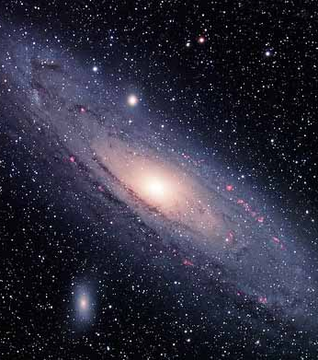
Creation
Genesis 1-2: Stars
In the OT, the terms ‘stars’ and ‘hosts (or armies) of heaven’ were virtually interchangeable.
Ps 147:4, YHWH “counts the number of the stars He gives to all of them their names.”
Isaiah 40:26, the term ‘hosts’ is used interchangeably for the stars.

Slide 5
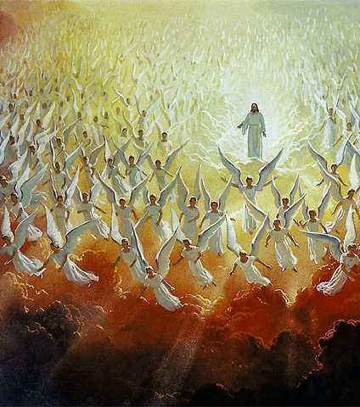
Creation:
Genesis 1-2: Angels
YHWH is sometimes presented as a divine warrior, who arrays the ranks of the heavenly armies (or hosts) before him.
Judges 5: 20 shows that the stars can be seen as YHWH’s army in the Song of Deborah.

Slide 6
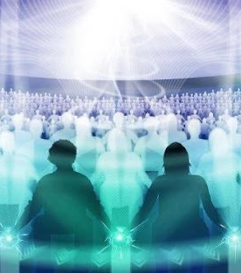
Creation:
The Divine Council
Genesis 1:14-19 YHWH and His council prescribe the dominion of the heavens to the sun, moon and the stars. In Gen 1:26, YHWH and His angelic council prescribe the dominion of man as “the whole earth.”
Job 38:7 explains that the morning stars sang together and all the sons of God shouted for joy at the creation of the world.
YHWH calls together His angelic court in Job 1-2 and also in 1 Kings 22 and reveals His control over rulers and history

Slide 7
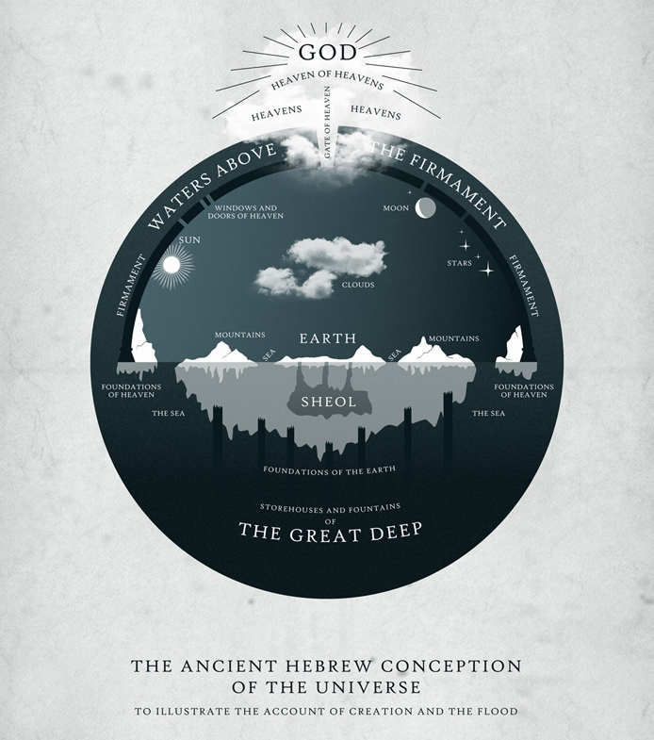
Creation:
Genesis 1-2: YHWH’s Temple
The cosmic temple has three domains, each with their corresponding hosts.
1. The heavens above are inhabited the sun, moon, and stars.
2. The seas below (also a part of “the heavens,” i.e. waters above, waters below) inhabited by the sea monsters.
3. The greatest of these is the earth, which is the center. This is the domain of man, the “image of God.”

Slide 8
Creation:
The Created Order
YHWH created everything to reflect His justice and righteousness.
YHWH gave dominion to the angels to govern different aspects of the created order to the angels. They were supposed to govern with justice and righteousness.
YHWH made man a little lower than the angels (Psalms 8:4-8).
YHWH made the earth for the man, because man was made after the image of YHWH.
Righteousness As World Order
Angels over the natural order
Angels over the social order

Slide 9
The Transition from Creation to Rebellion
Creation
(Genesis 1-2)
The Fall of Creation
(Genesis 3)
Creation Order
  Man (Adam)
  Woman (named by Adam)
  Animals (named by Adam)
Man has communion with God
Man lives in a paradise
Man has access to the tree of life
The Fall is a reversal of the creation order
  Animal (the serpent)
  Woman (Renamed Eve)
  Man (Adam)
Man is separated from God
Man is removed from paradise
Death enters the world

Slide 10
God’s Righteousness is Achieved by
Acts of Salvation
Acts of Wrath
YHWH sacrifices for them
YHWH clothes them
There is a prophecy about Christ to destroy the serpent (Genesis 3:15, the protoevangelium).
YHWH removes them from the garden so that they will not eat of the tree of life in their sinful state
The serpent is now more cursed than any animal and loses his legs. It must now must crawl on his belly.
The woman fives child birth in great pain and her marriage relationship is difficult struggle of leadership.
The man must now toil and sweat to produce food by tilling the soil.

Slide 11
The Cosmic Rebellion
Genesis 3-11
The Serpent
And the Fall of Creation
The Angels
And the Flood
Nimrod and the Tower of Babel

Slide 12
The Cosmic Rebellion
Genesis 3-11
Genesis 3:1-14, this is an attack on the image of God from below. The serpent is a sea creature that left his proper domain, the sea. The serpent enters the domain of man, where the image of God dwells. The serpent begins his attack through the woman. The serpent’s action results in man’s expulsion from the garden.
Genesis 6:1-4, this is an attack on the image of God from above. The angels left their proper domain, the heavens. Then they entered the domain of man. The angels attacked through marrying women. Their offspring were giants (the men of renown or of name) Their actions result in the flood. These angels are bound in everlasting chains of darkness (2 Peter 2:4, Jude 6-7).
Genesis 11:1-9, this is the most sinful part of the rebellion. It is an attack by man (the image of God). Man attempts to make a name for himself. Man left his proper domain and tried to enter the domain of God. The result of Nimrod’s action is that man is scattered over the face of the earth.

Slide 13
Cosmic Rebellion:
Genesis 10 (The Nations)
In Genesis 10 there is a genealogy of Noah and his sons. Each son’s descendants become nations.
Japheth, Ham and Shem’s descendants have their own clans, languages, lands and nations.
Paul explains that YHWH did this so that men might seek Him (Acts 17: 25-27).
Noah
Japheth
Ham
Shem

Slide 14
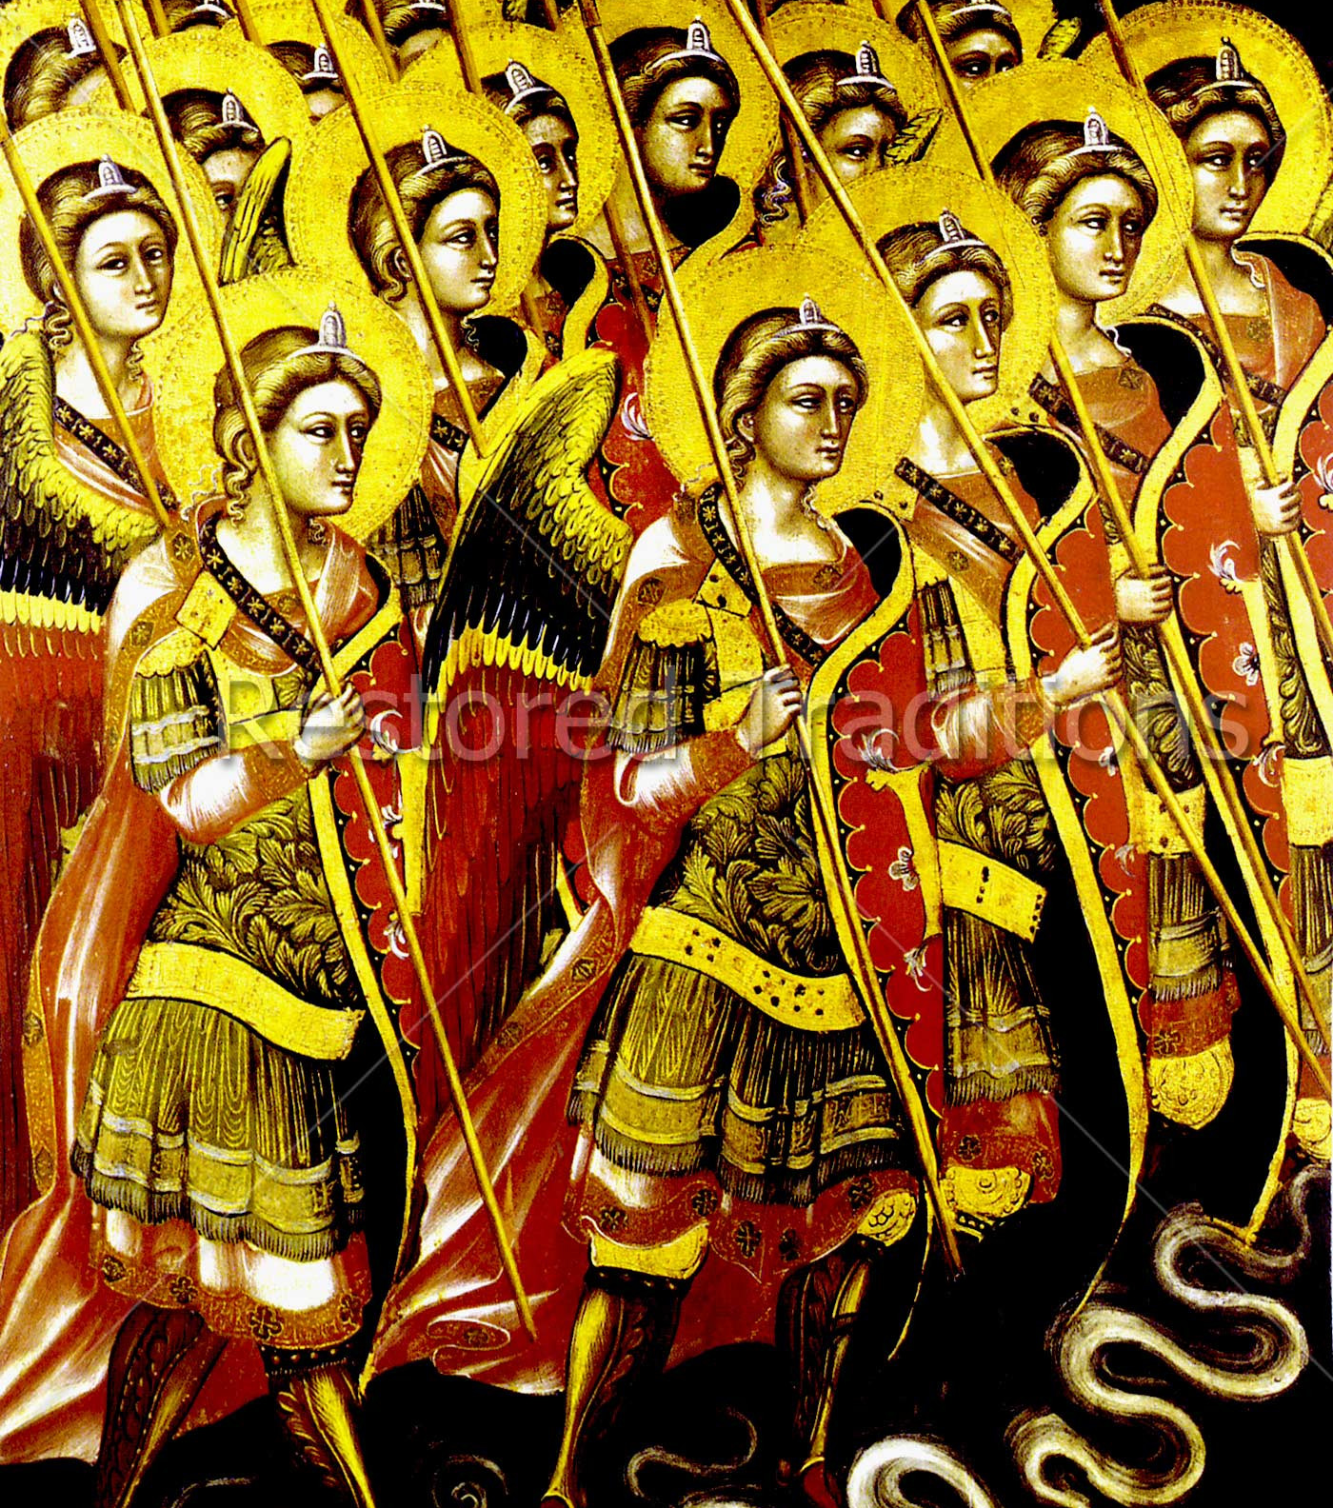
Cosmic Rebellion
Deuteronomy 32: 8-9: Cosmo- Political Order
Deuteronomy 32: 8, YHWH “separates” the “sons of Adam” according to the number of the sons of God
Gen 10: 32 explains that after the tower of Babel came the list of the seventy nations.
These nations separated on the earth after YHWH confused their language.
Notes:
According to ???, The seventy celestial sons of Elyon were appointed their positions as the “fathers” of the nations.

Slide 15
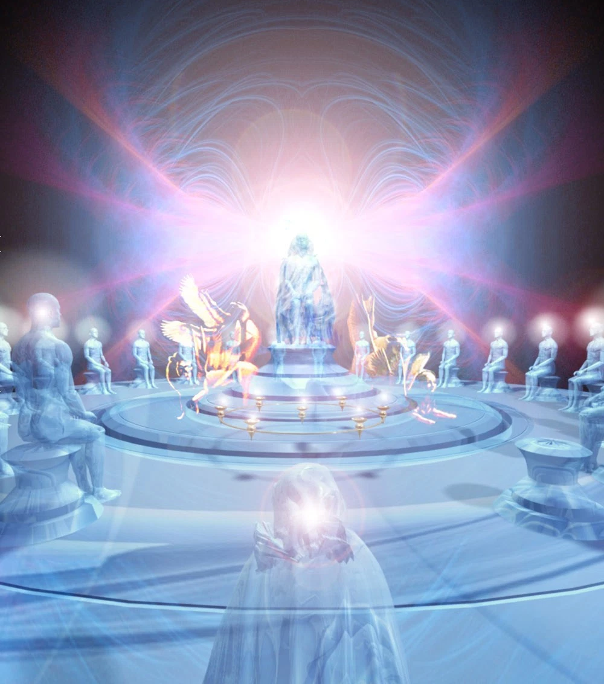
Cosmic Rebellion
Psalm 82: Cosmo- Political Order
Here is a heavenly trial scene where YHWH takes His place in the midst of the divine council.
These angels hold dominion over nations/peoples and have ruled unjustly, neglecting their people, and as a result YHWH’s intended order is in disarray.
YHWH then passes judgment over the celestial council. YHWH will evict them from their positions at a time of His choosing.

Slide 16
Transition from Rebellion to Abraham and His Seed
Nimrod The Hunter
(Genesis 11:1-9)
Abraham
(Genesis 12-)
Nimrod said to men, “Let us make a name for ourselves” (11: 4).
Nimrod defied YHWH’s command to “go and fill the whole earth.” Instead he commanded everyone to stay together
The people are scattered and allotted to the angels
YHWH said to Abraham, “I will make you a great name.”
Abraham obeyed YHWH’s call leave everything and to go to a place that “I will cause you to see.”
Abraham and his seed are allotted to YHWH as his inheritance.

Slide 17
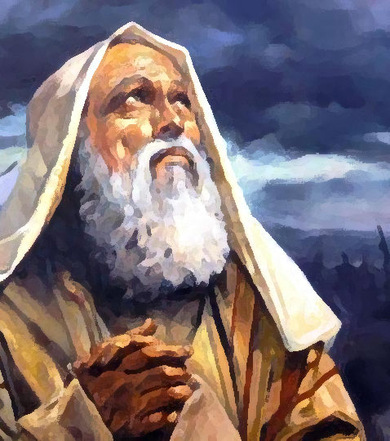
Abraham’s Seed: Israel
YHWH intends to restore the cosmic order through the seed of Abram. His descendants are no longer under the dominion of the “sons of God.”
Genesis 12: 1-7, YHWH tells Abram to leave everything and go to a promised land. He will become the father of many nations.
This is to fulfill his prophecy about Christ in Genesis 3: 15. This is an Act of Salvation.

Slide 18
Abraham’s Seed: Israel
Genesis 15:5 promises that Abraham’s seed will be like the stars. This includes both quantity and quality.
Genesis 22:16-18 the promise continues through Isaac.
Jacob has 12 sons representing the 12 quadrants of the heavens.
Genesis 37:5-11, Joseph’s dream about his celestial family relates to the promise in Genesis 15:5.
Abraham
Isaac
Jacob (Israel)

Slide 19
Abraham’s Seed: Israel
Divine Council Meetings
The Cosmic Mountain
Mount Sinai
Psalms 82 mirrors ideas found in the ancient near east. They believed that the divine council met on a cosmic mountain.
YHWH meets with angelic powers over the 70 nations.
Genesis 10:19 is a table of 70 nations. The angels are allotted to each of these nations.
Exodus 24: 1-11 occurs after the defeat of Egypt. It is the middle of the Pentateuch.
YHWH meets with Moses Aaron, Nadab and Abihu with the 70 elders of Israel.
The 70 elders function like the stars of the angelic council.

Slide 20
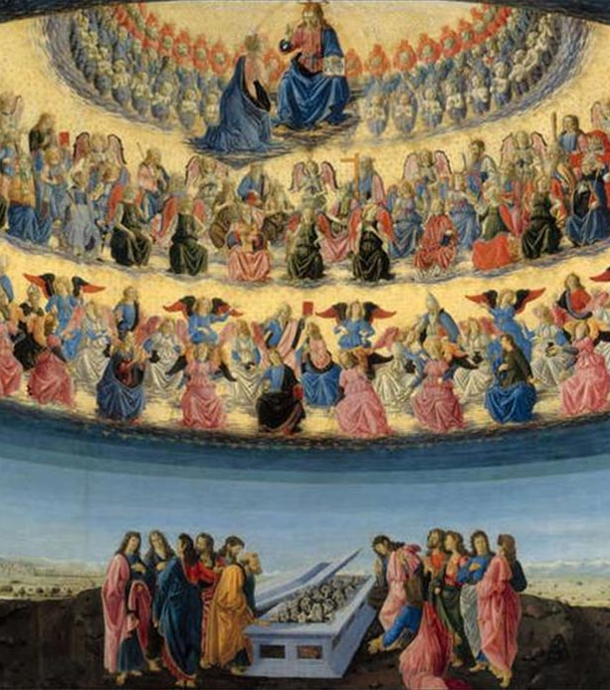
Creation
Deuteronomy 4:19-20, The Angelic Court
The “hosts of heaven” have been “allotted” or “assigned to” all the nations under heaven. This “allotment” expresses the celestial bodies’ dominion over their respective nations.
Israel was “allotted” to YHWH as his inheritance when He took them out of Egypt.

Slide 21
Abraham’s Seed: Israel
Numbers 24:17 is a prophecy of Balaam that a star will come out of Jacob and a scepter shall rise out of Israel.
Judah is the tribe of the kings. David is YHWH’s choice for king. He rules Israel from Jerusalem.
Jeremiah 33:19-22 repeats the promise in Gen 15:5. This time it refers to David’s seed.
The 12 Tribes of Israel
Judah,
Line of the kings
King David, and his line

Slide 22
Transition from Abraham’s Seed to Jesus Christ
I-II Chronicles
Last book in Hebrew Bible
Matthew
First book in the NT
Begins with a genealogy
Tells the stories of the kings of Israel
Ends with a commission for the Hebrews to return to Jerusalem
The commission was given by King Cyrus of Persia, who was prophesied (Isaiah 45)
Begins with a genealogy
Tells the story of the King of Israel
Ends with a Great Commission to reach the whole world
The Great Commission was given by King Jesus who was prophesied about throughout the OT.

Slide 23
Jesus Christ: Matthew
The Order of Melchizedek
Son of David (King)
Second Moses (Priest)
Genealogy from Abraham to Joseph (Matthew 1:1-17)
From the tribe of Judah
Of the line of King David
Came preaching the good news of the Kingdom of Heaven (Matthew 4:23 -25)
Called “King of the Jews” at the crucifixion (Matthew 27: 37)
Called out of Egypt (Matthew 2: 13-15)
There are five great discourses (as in the five books of the Pentateuch)
In the Sermon on the Mount (chapters 5-7) Jesus goes up the mountain. He gives sermon with 10 commandments. He then comes down the mountain (Chapter 8:1).
Fulfills Deuteronomy 18:15.

Slide 24
Jesus Christ
In the Gospels
Mark
John
Mark was the writer for Peter. He was not an eye-witness of Jesus, nor a disciple.
Mark presents and defends Jesus’ universal call to discipleship.
Mark tells of Jesus’ coming to bring salvation, as well as triumphing over sin and Satan.
Jesus is the promised Messiah (Greek- Christ) and Son of God.
By believing in Jesus, people can have eternal life (John 20: 30-31).
Jesus is the new temple and center of worship for God’s people.

Slide 25

Jesus Christ:
The Birth of Jesus
Numbers 24:17 is a prophecy of Balaam about a star coming out of Jacob and a scepter out of Israel.
Matthew 2:2 wise men from the east saw the star and came to worship the king.
Matthew 2:9 the star rested over where the child was.
Luke 2:9 an angel of the Lord appears.
Luke 2:13 a multitude of the heavenly host praises God.

Slide 26
Transition from
Jesus Christ to the Church
Luke
Acts
Written by Luke to Theophilus
Luke tells the story of Jesus Christ from his birth to the resurrection
Luke explains how Israel’s rejection of Jesus and the Gentiles entrance into the kingdom of God are in accord with the divine plan,
He also explains what Jesus taught about the end times
Written by Luke to Theophilus.
Acts is written as a selective history of the early church following the resurrection of Christ.
Acts tells how Jesus Christ leaves in a cloud.
Acts introduces the Apostle Paul.

Slide 27
Abraham’s Seed:
The Church
Romans 4:11-12 relates YHWH’s promise to Abraham for all who have faith in Jesus Christ.
Romans 11:11 explains that Gentiles are grafted into the tree of Abraham’s seed.
Ephesians 3:1-6 Gentiles are fellow heirs through Christ
Galatians 3:6-9, 26-29 those who belong to Christ are descendants of Abraham.
Galatians 4:28-31 says that like Isaac, we are Abraham’s children of promise
The Davidic line of Kings
Jesus Christ
The Church

Slide 28
Abraham’s Seed: The Church
The Kingdom: Already
The Kingdom: Not Yet
The local church is an embassy of the kingdom of God to the community in which it is located
Believers are ambassadors for Christ
It is the job of every believer to share the good news of the kingdom with those who do not know Christ.
A worldwide kingdom
The capital city is Jerusalem
It will last 1000 years
The nations will be at peace
It will be ruled with perfect justice and righteousness

Slide 29
Transition from the Church to Cosmic Rebellion
The Church
Israel
Many believers are martyred by the Anti- Christ with the breaking of the fifth seal (Revelation 6: 9-11).
The sixth seal is broken and the sign of the Son of Man is in the sky (Rev 6:12- 17).
The Church is raptured out of the Great Tribulation (Revelation 7: 9-17).
The Anti Christ commits the Abomination of Desolation (Daniel 12:11) and attacks Israel.
The sixth seal is broken and then the 144,000 are sealed with the mark of God (Revelation 7: 1- 8).
The 144,000 meet with the Lamb on Mount Zion (Rev 14:1-5).
Daniel 12: 2-3 shows that in a time of great tribulation, the faithful of Israel will be like the stars.

Slide 30
Cosmic Rebellion 2:
Revelations 6-20
The Tribulation
Period
The Millennial Kingdom
The Final Rebellion

Slide 31
Cosmic Rebellion 2:
The Gang of Three
The First Rebellion
The Second Rebellion
The Serpent (Genesis 3:1) deceives man through the woman. This results in the “Fall of creation.”
The Angels, or sons of God, took the daughters of men as wives (Genesis 6: 2). This results in the flood.
Nimrod the Hunter leads mankind into rebellion against YHWH, in the land of Shinar (Genesis 10: 9- 11; 11: 1-9). This results in confusion of language and the scattering of men into nations.
The Dragon (the serpent of old, Revelation 12: 9) fights with the archangel Michael and is thrown out of heaven to the earth. The Dragon then attacks the woman and her offspring.
The Angels are thrown down to earth (Revelation 12: 4- 9).
The Anti- Christ is, the “Man of Sin” (2 Thess. 3: 3-12), and the Beast (Revelation 2: 2; 13:1-10). He leads the nations to rebel against YHWH.

Slide 32
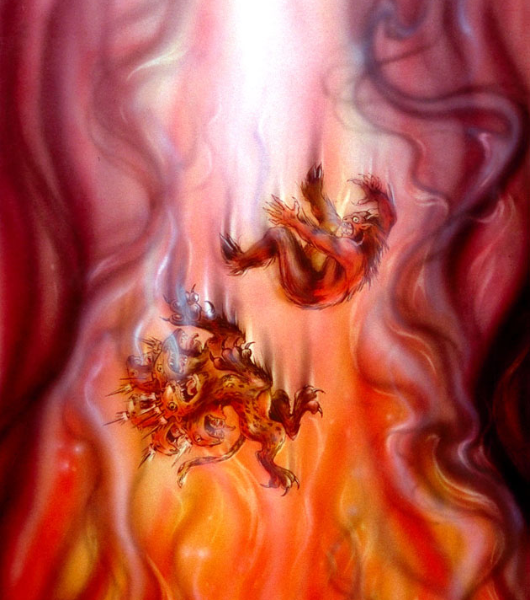
Cosmic Rebellion 2:
The Beast the False Prophet and the Harlot
Revelation 13: 1-10, the Beast receives his power from the Dragon. He blasphemes YHWH and rules on earth for 42 months.
Revelation 13: 11-18, the False Prophet makes the inhabitants of the earth worship the Beast.
Revelation 17: 1-18 , the Harlot is a false religious system that is destroyed by the Beast.
Revelation 19: 20, the Beast and the False Prophet were cast alive into the lake of fire.

Slide 33
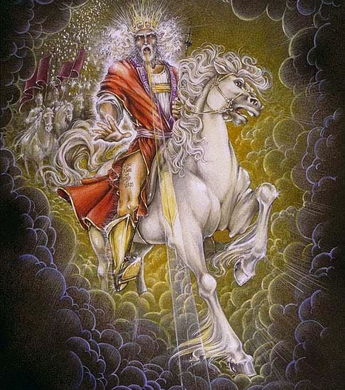
Cosmic Rebellion 2:
The Return of Christ
Psalm 82:8 is a plea for the rule of YHWH, “Arise, O God, judge the earth; for you shall inherit all the nations!”
Revelation 11:15, “The kingdom of the world has become the kingdom of our Lord and of his Christ, and he shall reign forever and ever.”
Revelation 19:11-21 The victorious return of Jesus Christ

Slide 34
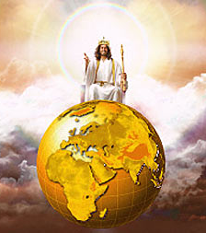
Cosmic Rebellion 2:
The Millennial Reign
Revelation 20: 4-6
Jesus Christ rules the whole world from Jerusalem.
The nations are no longer deceived
Christ rules 1000 years with perfect justice and righteousness
Those who were martyred participate in the first resurrection

Slide 35
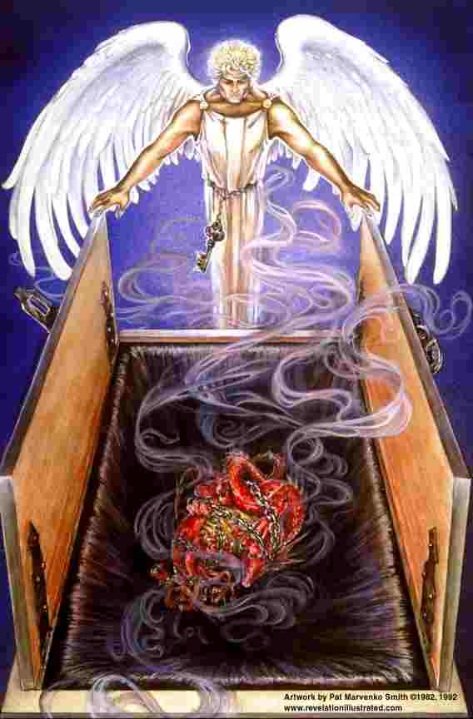
The Cosmic Rebellion 2:
The Final Rebellion
Revelation 20: 1-3, the dragon is chained for 1000 years.
Revelation 20: 7-10, the dragon is released.
The dragon deceives the nations. They rebel against King Jesus. This shows that man is so sinful, that he will rebel no matter how perfect things are.
The rebels surround Jerusalem and Jesus sends fire from heaven. The rebels are destroyed.
Time comes to and end

Slide 36
Transition from the Cosmic Rebellion to the Re- Creation
Great White Throne of Judgment
The Bema Seat of Judgment
Revelation 20: 11-15
Romans 9: 21-22, unbelievers are resurrected as vessels of wrath for destruction
Judgment for all unbelievers and all are found guilty and thrown into the lake of fire for eternity
Death and Hell are also cast into the lake of fire.
This is God’s righteousness achieved through His wrath
Time comes to an end and eternity begins
2 Corinthians 5: 10, we must all appear before the judgment seat of Christ
Romans 9: 23, believers are resurrected as vessels of mercy.
All are judged righteous because of the atoning work of Jesus Christ
Believers go on to eternal life.
This is God’s righteousness achieved through His salvation
Time comes to an end and eternity begins

Slide 37
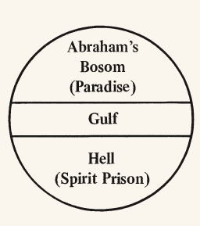
Transition from the
Cosmic Rebellion to the Re- Creation
Jesus died and descended into Sheol to preach the Gospel to the captives in Paradise, as well as to the "spirits in prison/fallen angels (1 Peter 3:18-22).
At His resurrection, Jesus led the faithful "held captive” by death/hades" out the Gates of Hell (Matthew 16:18; Ephesians 4:8-10; Psalms 68:18)

Slide 38
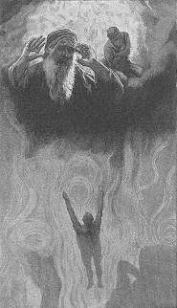
Re- Creation:
The Condemned
Isaiah 66: 22-24. The redeemed will be able to see the bodies of those who rebelled.
Believers Martyred during the Tribulation (Rev 6:9) will stand on the Sea of Glass. They can do this because over these the "second death/lake of fire" has no power (Rev 20:4-6). This may be an image of victory. They will stand on the lake of fire above the all who are in torment below.
This is everlasting torment. Mark 9 :43-48, Revelation 14:11; 20:14-15; 21:8.

Slide 39

Re- Creation:
Resurrection Bodies
God’s promise to Abraham in Genesis 15: 5 is fulfilled.
Psalms 8: 4-5 explains that man is a little lower than the angels.
Daniel 12: 2-3, the wise will shine and be like the stars forever and ever.
Matthew 22: 30 asserts that we will be like the angels
I Corinthians 15: 35-41 asserts that we will have celestial bodies.
1 John 3: 2 asserts that we will be like Christ.
Romans 9: 23, YHWH does this to show the riches of His mercy.

Slide 40
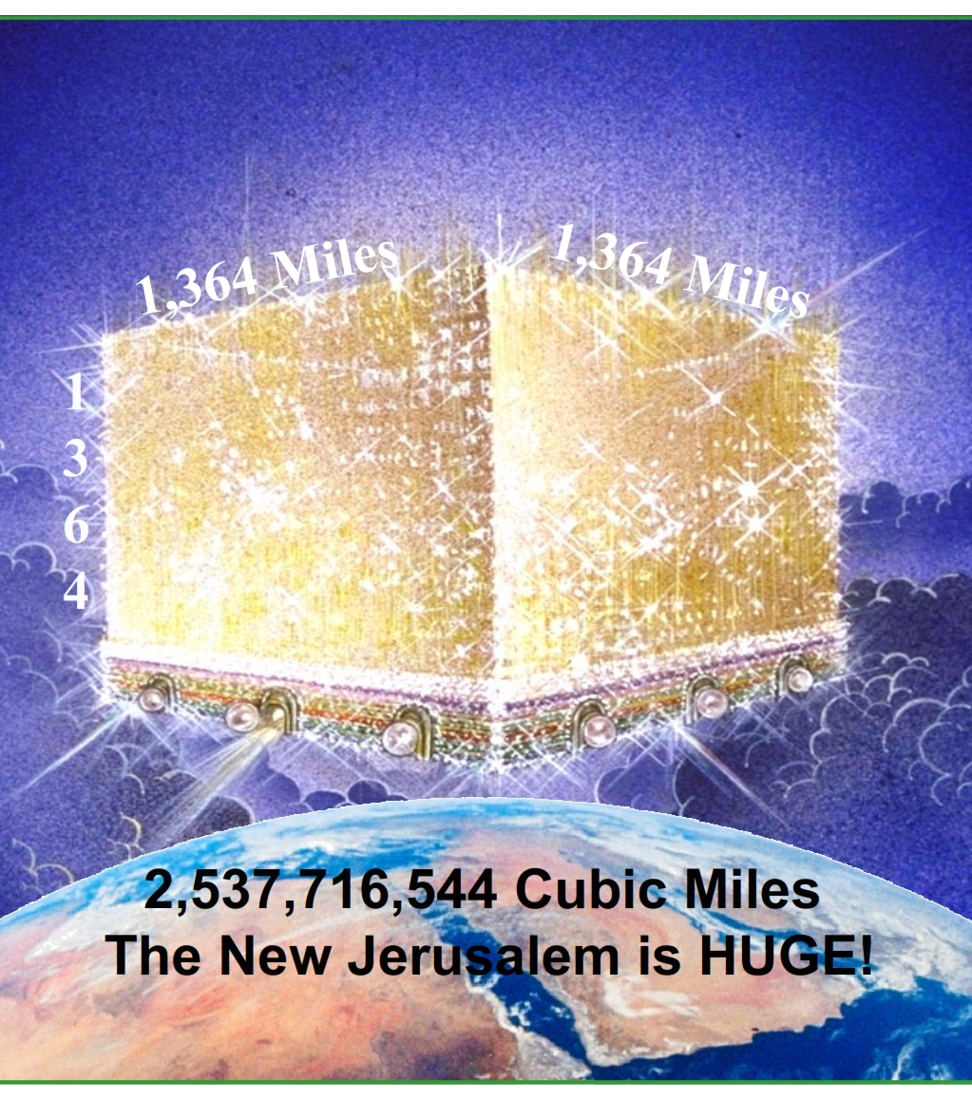
Re- Creation:
A New Heaven and Earth
Revelation 21: There is a New Heaven and a New Earth. There is no sea (disorder).
The New Jerusalem will be a cube that will come out of the heavens to the earth
It will have streets of gold and twelve foundations, each made from a different gem stone
It will have twelve gates that never close.

Slide 41
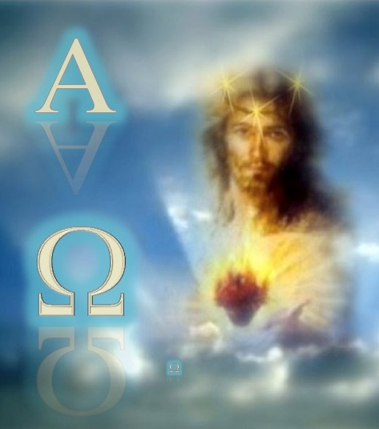
Re- Creation:
A New Heaven and Earth
Revelations 21- 22 mirrors Genesis 1-2.
  Man is living in a paradise
  Man has communion with God
  Man has access to the tree of life
Jesus, the Bright and Morning Star (Numbers 24: 17, Revelation 2:28) says “Come!”

