Slide 1
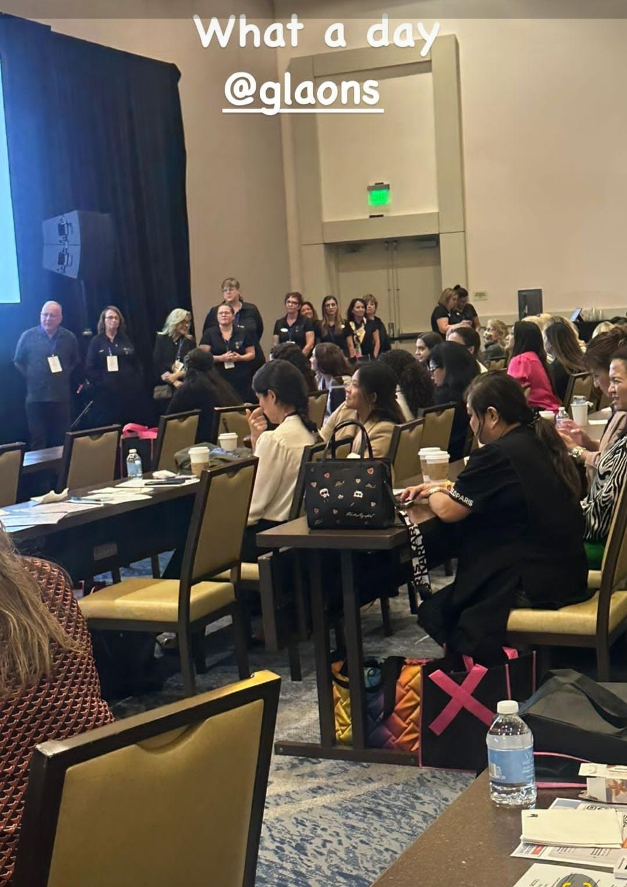
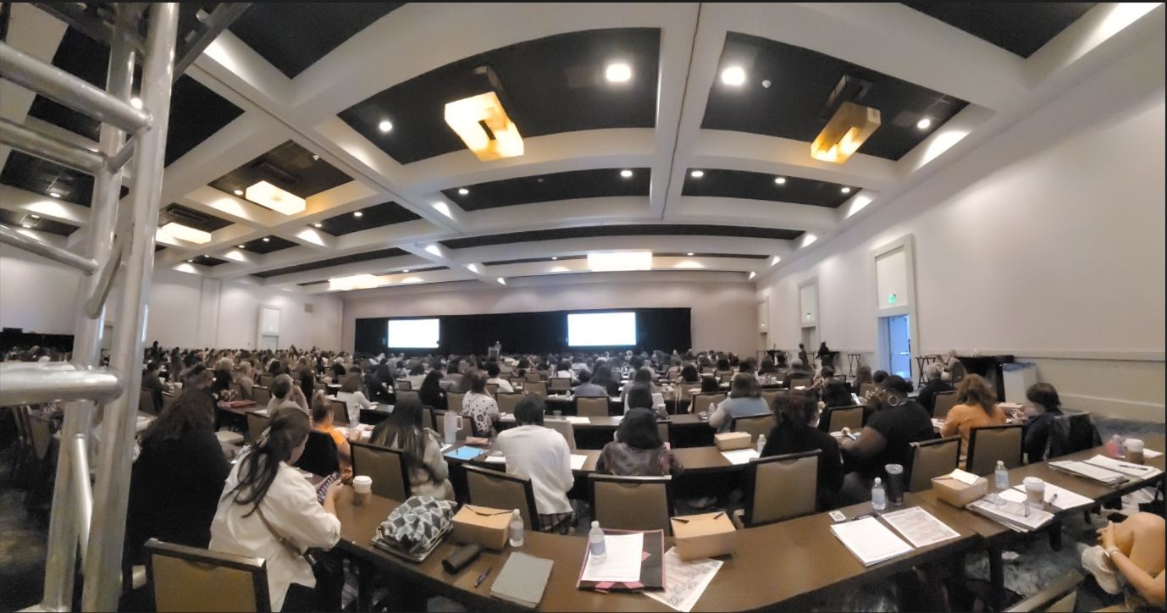
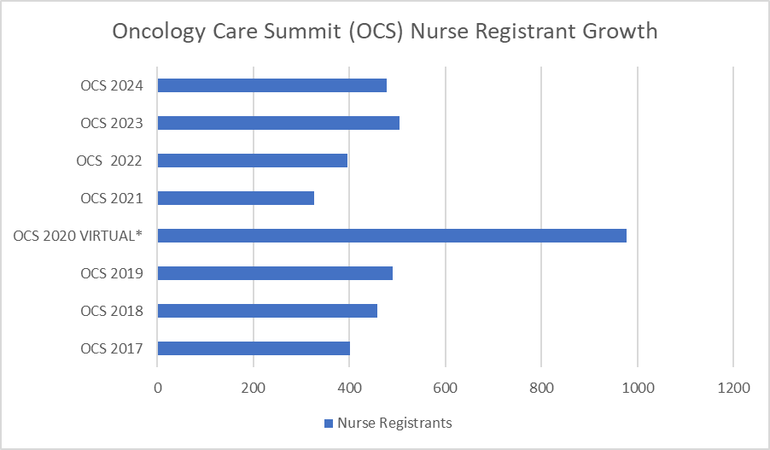
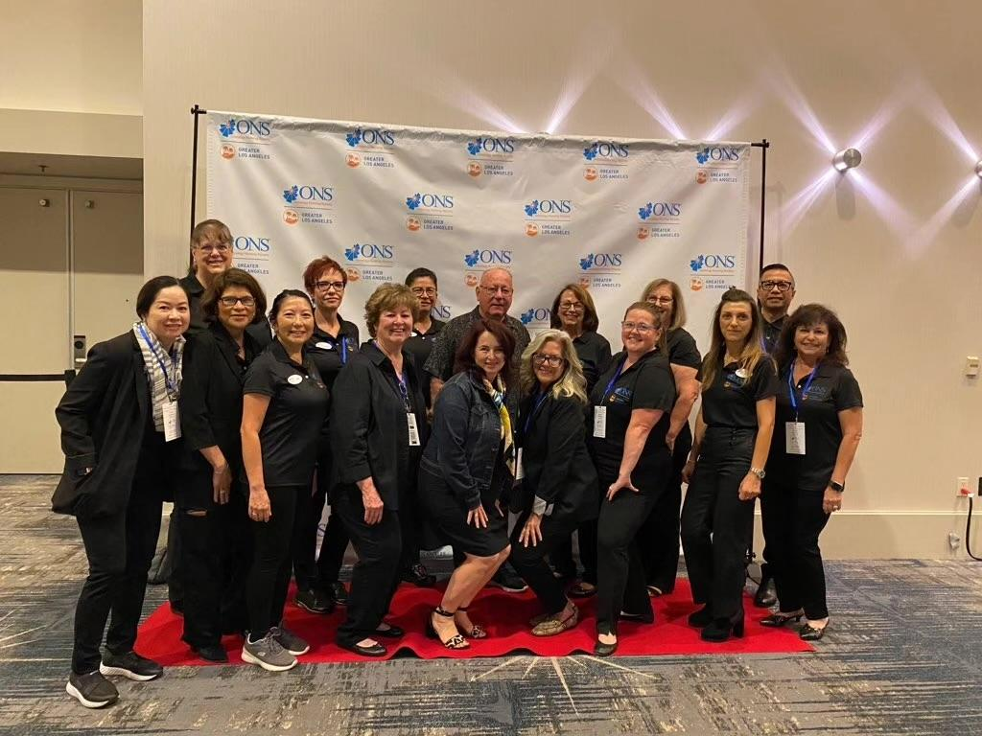
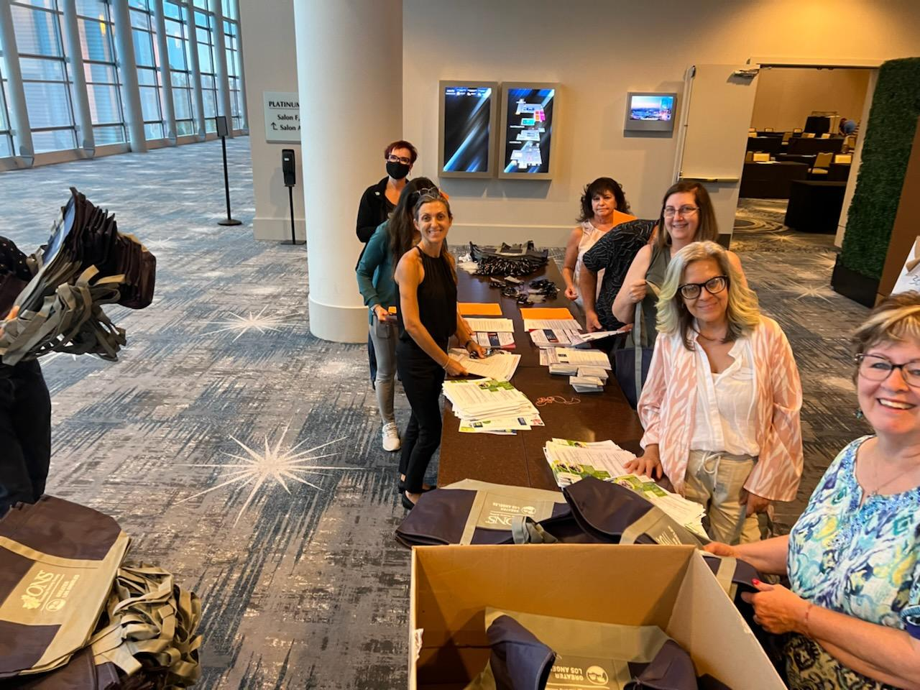
Meeting Our Mission,
Developing a Premier Oncology Nursing Learning Event
Timothy Freitas, MS, PhD, RN; Cynthia Dasaad, MSN, RN, OCN; Nancy Loporchio, BSN, RN, OCN;
Deborah Lorick, MSN/MHA, RN, CMSRN, OCN; Marie Christine Seitz, MSN, DNP, RN, NP, AOCN, BMT-CN;
Gilanie De Castro, MSN, RN, OCN, NE-BC, CNML; Sylvia Estrada, DNP, WHNP-BC, AGN-BC, CBCN;
https://www.youtube.com/watch?v=2YcrGtZ5vYo
Background and Significance
Excellence in Oncology Nursing
Transform Cancer Care
Fuel Passion for Learning
Bootcamp With Fun & Prizes
The Premier Oncology Nursing Conference on the West Coast
Interventions
Leverage industry relationships
Involve oncology institutions
Collaborate with educational content & delivery sponsors
- Scholarships for all nurses
Discussion
8 years of phenomenal success
Gold to Platinum to Diamond
Consistency of Quality
Outsourcing wisely
Convenient Venue
2026 = 10th Anniversary
Options for the Future:
- Continue to Grow?
- Virtual Component?
- Boutique Learning Event?
- Model for Other Chapters
- Venue and Cost Considerations
Evaluation
500+ Nurse attendees
High number of repeat attendees
Top ratings on OCS evaluations
High level of exhibitor satisfaction
Team Debriefing
Regional reach
Purpose
World Class Education
Learning Resource Center
Networking
Low to No Cost for Nurses
10 CEUs
Orchestrating Success In Oncology Nursing
Acknowledgements
The GLAONS OCS team.
www.oncologycaresummit.com

