Slide 1
District Technology Service Desk Updates
Melissa Teat, Help Desk Manager, September 26, 2019

Slide 2
District Technology Service Desk
The Service Desk is staffed with six agents.
Items that we support include:
EIS
Application Access
EdFi
Single Sign On
TCAP Visibility Tool
ImpactTN
SDE Directory
EIS Training For New District Supervisors
SkillSets Online Training
Monitor tned.assessment@tn.gov Inbox

Slide 3
District Technology Service Desk
The help desk hours of operation are:
Monday – Friday
6:30 a.m CST – 4:30 p.m. CST

Slide 4
Updates & Reminders: SkillSets Online Training
The TDOE Office of District Technology provides an online IT training through an LMS known as SkillSets Online Training.
The trainings are self-administered.
A number of ‘library cards’ have been purchased.
District supervisors may request to use a ‘library card’ for two week time slots.
No cost to districts.
Email dt.support@tn.gov for assistance.

Slide 5
Updates & Reminders: SkillSets Online Training

Slide 6
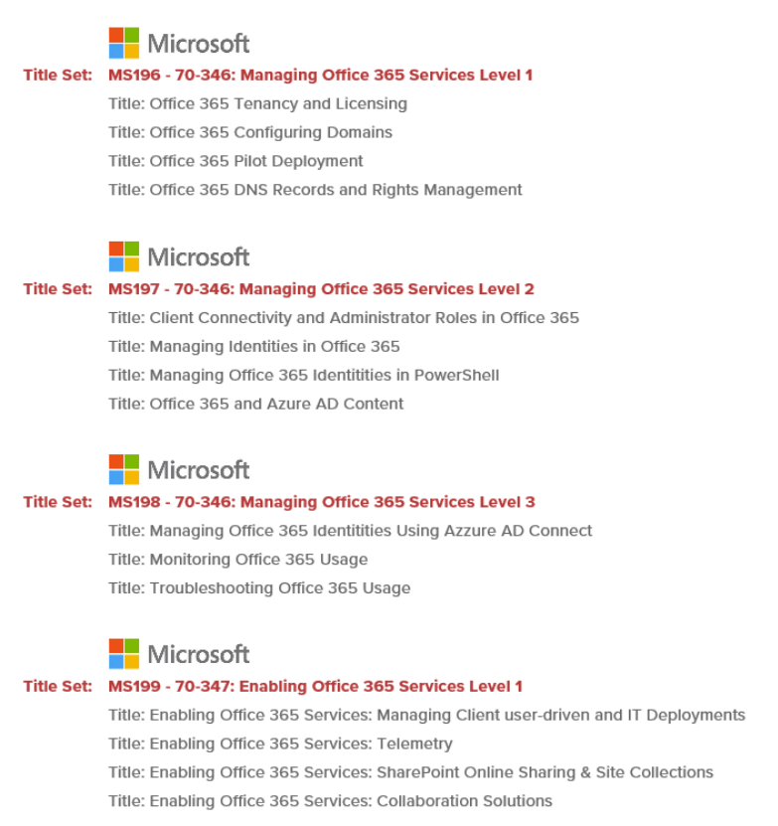
Updates & Reminders: SkillSets Online Training

Slide 7
Updates & Reminders: Ticketing System
District Technology Request Portal is our ticketing system. Register today!
There are currently 279 registered district contacts in the ticket system.
Since implementation in July 2017, over 38,270 tickets have been resolved.
The resolved ticket count since July 2019 is over 5,600.

Slide 8
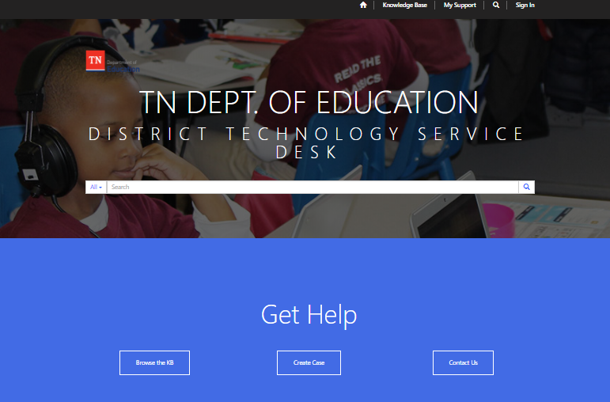
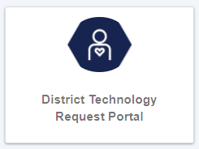
Updates & Reminders: Ticketing System
The Portal can be accessed using TDOE Single Sign-On, Orion.

Slide 9
Updates & Reminders: District Contact Information
Review and update EIS contact information when a staff change is made by sending the request to dt.support@tn.gov . Don’t forget to include requests for removal and addition of department list servs.
The Contact List can be found on the EIS Website.
https://www.tn.gov/education/lea-operations/education-information-system-eis.html

Slide 10
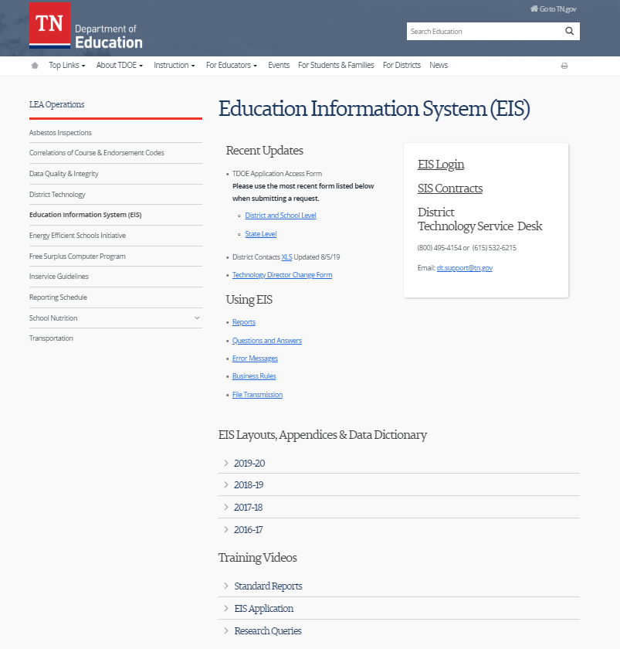
Updates & Reminders: EIS Website
The EIS website contains important information.

Slide 11
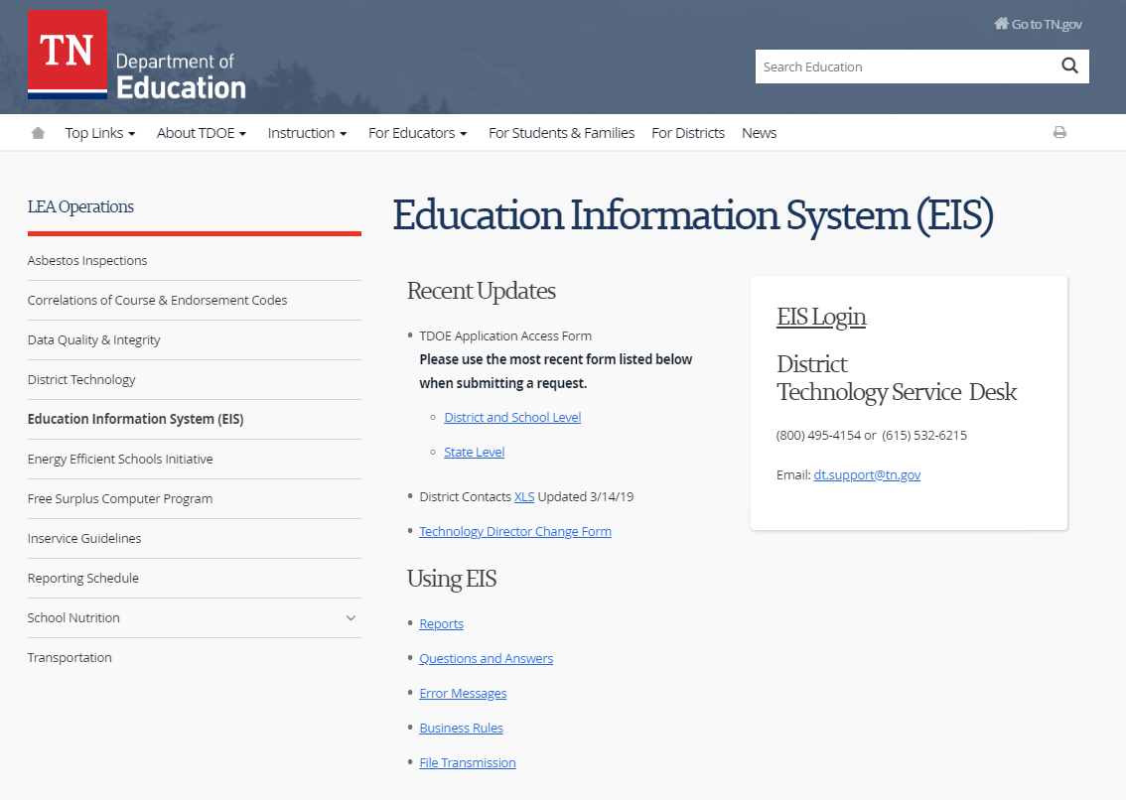
Updates & Reminders: Application Access Forms
The TDOE Application Access Form can be found on the EIS Website.

Slide 12
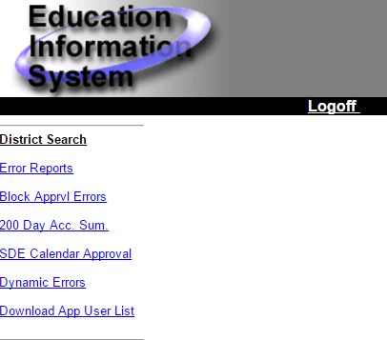
Updates & Reminders: Application User List
District supervisors with DST_AA user role should periodically review the App User List in EIS Production, and make changes as needed.

Slide 13
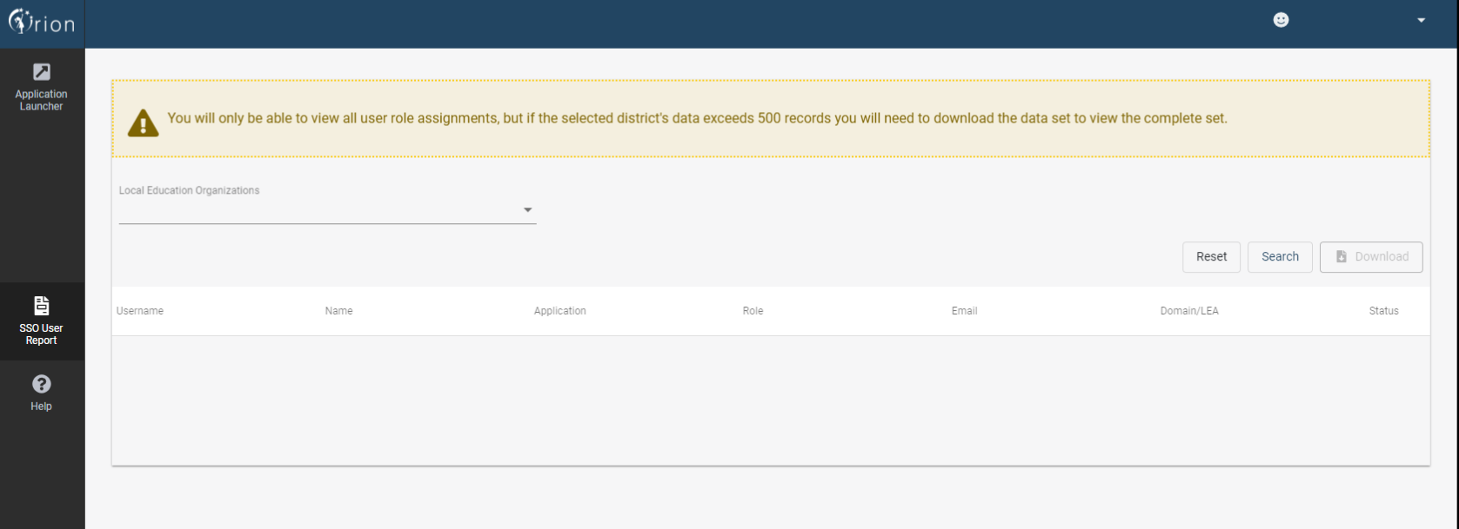
Updates & Reminders: Single Sign-On User Report
The SSO User Report will be assigned for users that have an EIS Production security role of DST_AA (District EIS Approval ADM).

Slide 14
Updates & Reminders: Single Sign-On User Report
The Login Detected column was recently added to the SSO User Report. This column will be beneficial to district supervisors as they work locally to confirm that staff members log-in at least one time to their SSO, Orion, account.

Slide 15
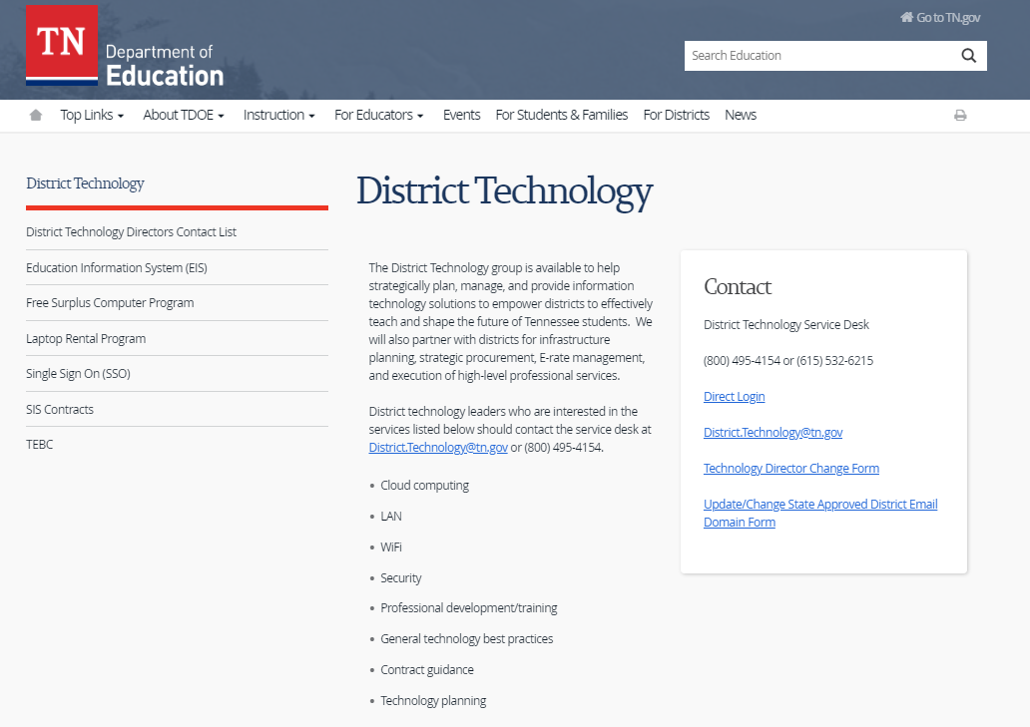
Updates & Reminders: District Technology Website
The District Technology website contains important information.

Slide 16
Updates & Reminders: EIS Metrics
Student Enrollment Count

Slide 17
Updates & Reminders: EIS Metrics
Staff Count

Slide 18
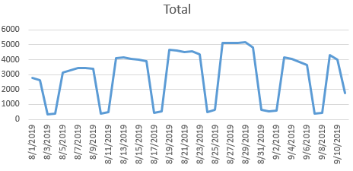
Updates & Reminders: Single Sign-On Metrics
Orion User Log-ins
Grand Total = 122,282

Slide 19
Updates & Reminders: List Serv Messages
SSO Provisioning With EIS Staff Data Message (8/27/2019)
EDUID Refresh Message (8/30/2019)
SSN Request Update Message (9/9/2019)

Slide 20
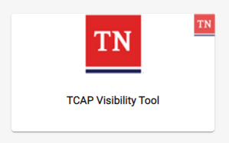
Updates & Reminders: TCAP Visibility Tool
2019-20 Assessment Application:
The TCAP Visibility Tool can be accessed using a single sign-on (SSO), Orion account.

Slide 21
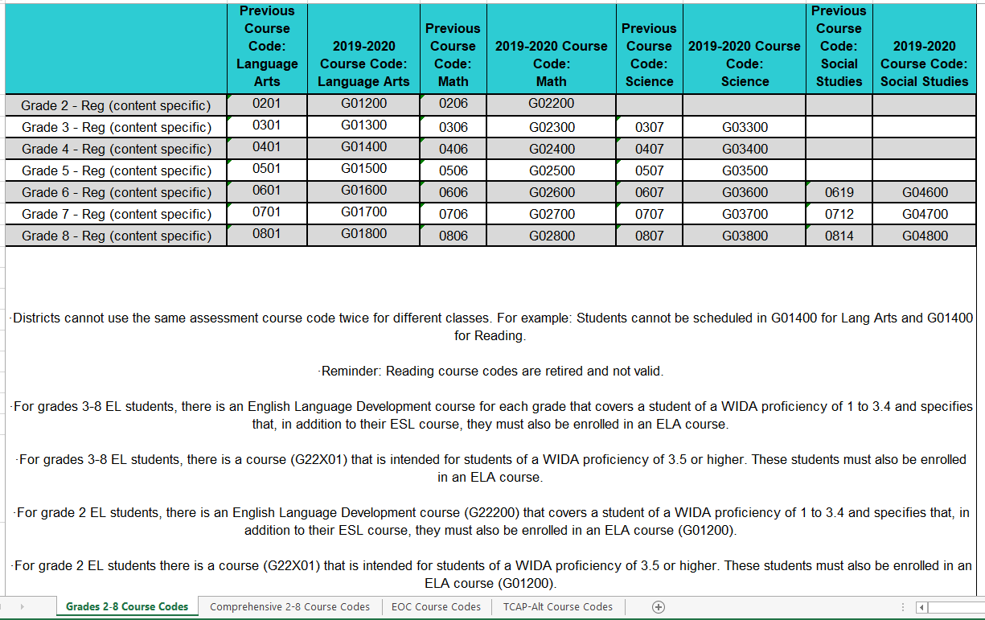
Updates & Reminders: Assessment Information
Refer to the Assessment Course Codes Workbook 2019-20 Final document when reviewing assessment data.

Slide 22
Updates & Reminders: Regional User Group (RUG) Leaders
There are 18 RUG Leaders across the state that regularly hold meetings and/or share information.
RUG Leader Name | District | Region
Teresa Simcox | Elizabethton | First TN
Greg Sturgill | Hawkins | First TN
James Atkins | Grainger | East TN
Guy Respess | Knox | East TN
April Hale | Dekalb | Upper Cumberland
Katrina Haley | Warren | Upper Cumberland
Linda Comerford | Athens City | Southeast
Michael Kahrs | Cleveland City | Southeast
Randy Brison | Dickson | Mid Cumberland
Cheryl Collins | Sumner | Mid Cumberland
Tom Delbridge | Rutherford | Mid Cumberland
Lewis Walling | Robertson | Mid Cumberland
Becky Coleman | Hickman | South Central
Terise' Rhodes | Bedford | South Central
Dianne Anderson | McKenzie SSD | Northwest
Steve Nunley | Dyersburg | Northwest
Cathy Korth | Madison | Southwest
Wendy Mills | Hardeman | Southwest

Slide 23
Melissa Teat Help Desk Manager Melissa.Teat@tn.gov (800) 495-4154

