Slide 1
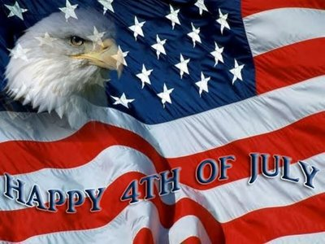
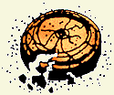
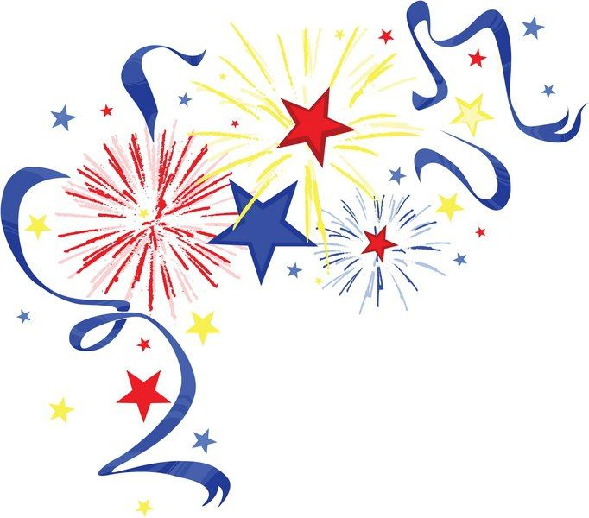
Flying Saucer Trap Club
Since 1956
Lovelock, NV
Trapshooting Range located at 1550 Airport Rd. Lovelock, NV.
FSTC’s Annual 4th of July Shoot
Saturday July 4th
Registration – 9:00 am
Shoot Starts at 10:00 am
Three Events (Singles-50, Handicap-50, Doubles-25 pairs)
$30.00/Event
Buckle Awards for:
Men’s (HOA)
Men’s and Women’s (HAA)
Men’s and Women’s High Score Singles, Handicap and Doubles
High Score Veteran’s Singles, Handicap and Doubles
Night Fun Shoot!
A Night Fun Shoot will be held immediately following the fireworks display. Come out and enjoy the fireworks and then have some fun shooting under the lights.
Flying Saucer Trap Club Membership
Yearly membership fee is $25.00
Members receive discounts on practice targets and shells

