Slide 1
Registering Your Team for the State Tournament
Florida Odyssey of the Mind

Slide 2
Things You Will Need
Login Information for the Member Area (Membership Number, Membership Zip Code)
Login Information for the Team Login (was sent in the email to you when you first registered the team for the Regional Tournament)
Name, Address, Cell Phone, Email of your Volunteer Worker
Confirmation from your Regional Director that your team has been Advanced to the State Tournament in the registration system

Slide 3
Deadlines for Registration
Region | Regional Tournament Date | State Tournament Registration Deadline | State Tournament Payment Deadline
Buccaneer Bay | March 2, 2019 | March 9, 2019 | March 16, 2019
Emerald Coast | February 23, 2019 | March 2, 2019 | March 9, 2019
Gulf Coast | February 23, 2019 | March 2, 2019 | March 9, 2019
Magic Center | March 2, 2019 | March 9, 2019 | March 16, 2019
Manatee | March 2, 2019 | March 9, 2019 | March 16, 2019
Nature Coast | February 16, 2019 | February 23, 2019 | March 2, 2019
Palms | March 9, 2019 | March 16, 2019 | ASAP
Space Coast | March 2, 2019 | March 9, 2019 | March 16, 2019
Sun | March 2, 2019 | March 9, 2019 | March 16, 2019
Tropical | March 2, 2019 | March 9, 2019 | March 16, 2019

Slide 4
Steps to Registering for State Tournament
Register the Team
Double Check all information
Register the Team Volunteer
Pay the Registration Fee
Pay by Check, made out to FLOMA
Send all checks to FLOMA, c/o Matt Whaley, 1356 Smiling Fish Lane, St Augustine, FL 32080
Pay by PayPal
Link to pay is in Registration email you receive after finishing the Team Registration.
Link can also be found in the Member Area of the website.
If you have multiple teams moving to the State Tournament, a Pay All button will appear in the Member area once all teams and workers are registered.
$3/team fee added to the $50.
Teams must be Registered no later than 1 week after Regional Tournament AND paid for no later than 2 weeks after Regional Tournament.
Failure to do EITHER will result in a $20 late fee.

Slide 5
Registering the Team

Slide 6
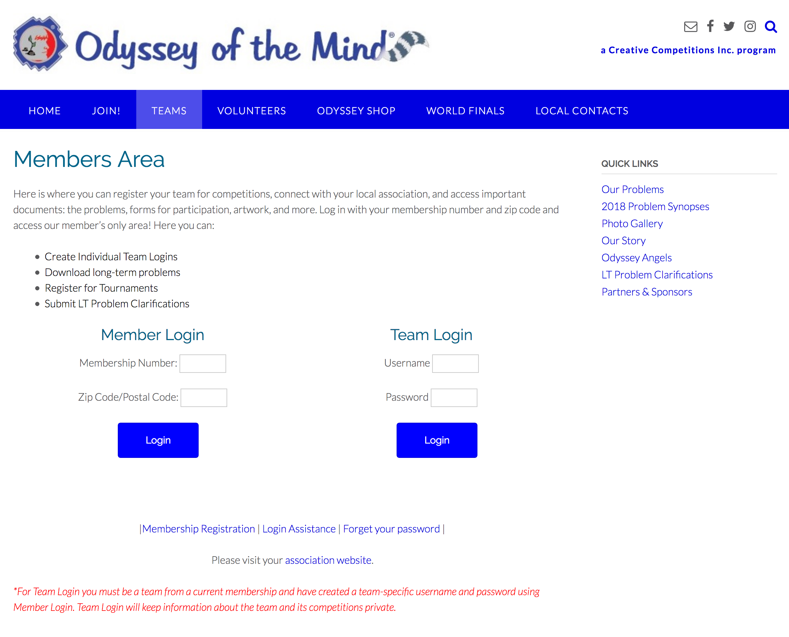
Go to the National Site (www.odysseyofthemind.com)
Go to the Teams and then choose Member Area.
Under Member Login put in the team Membership Number & Zip Code associated with the Membership.
Click Login

Slide 7
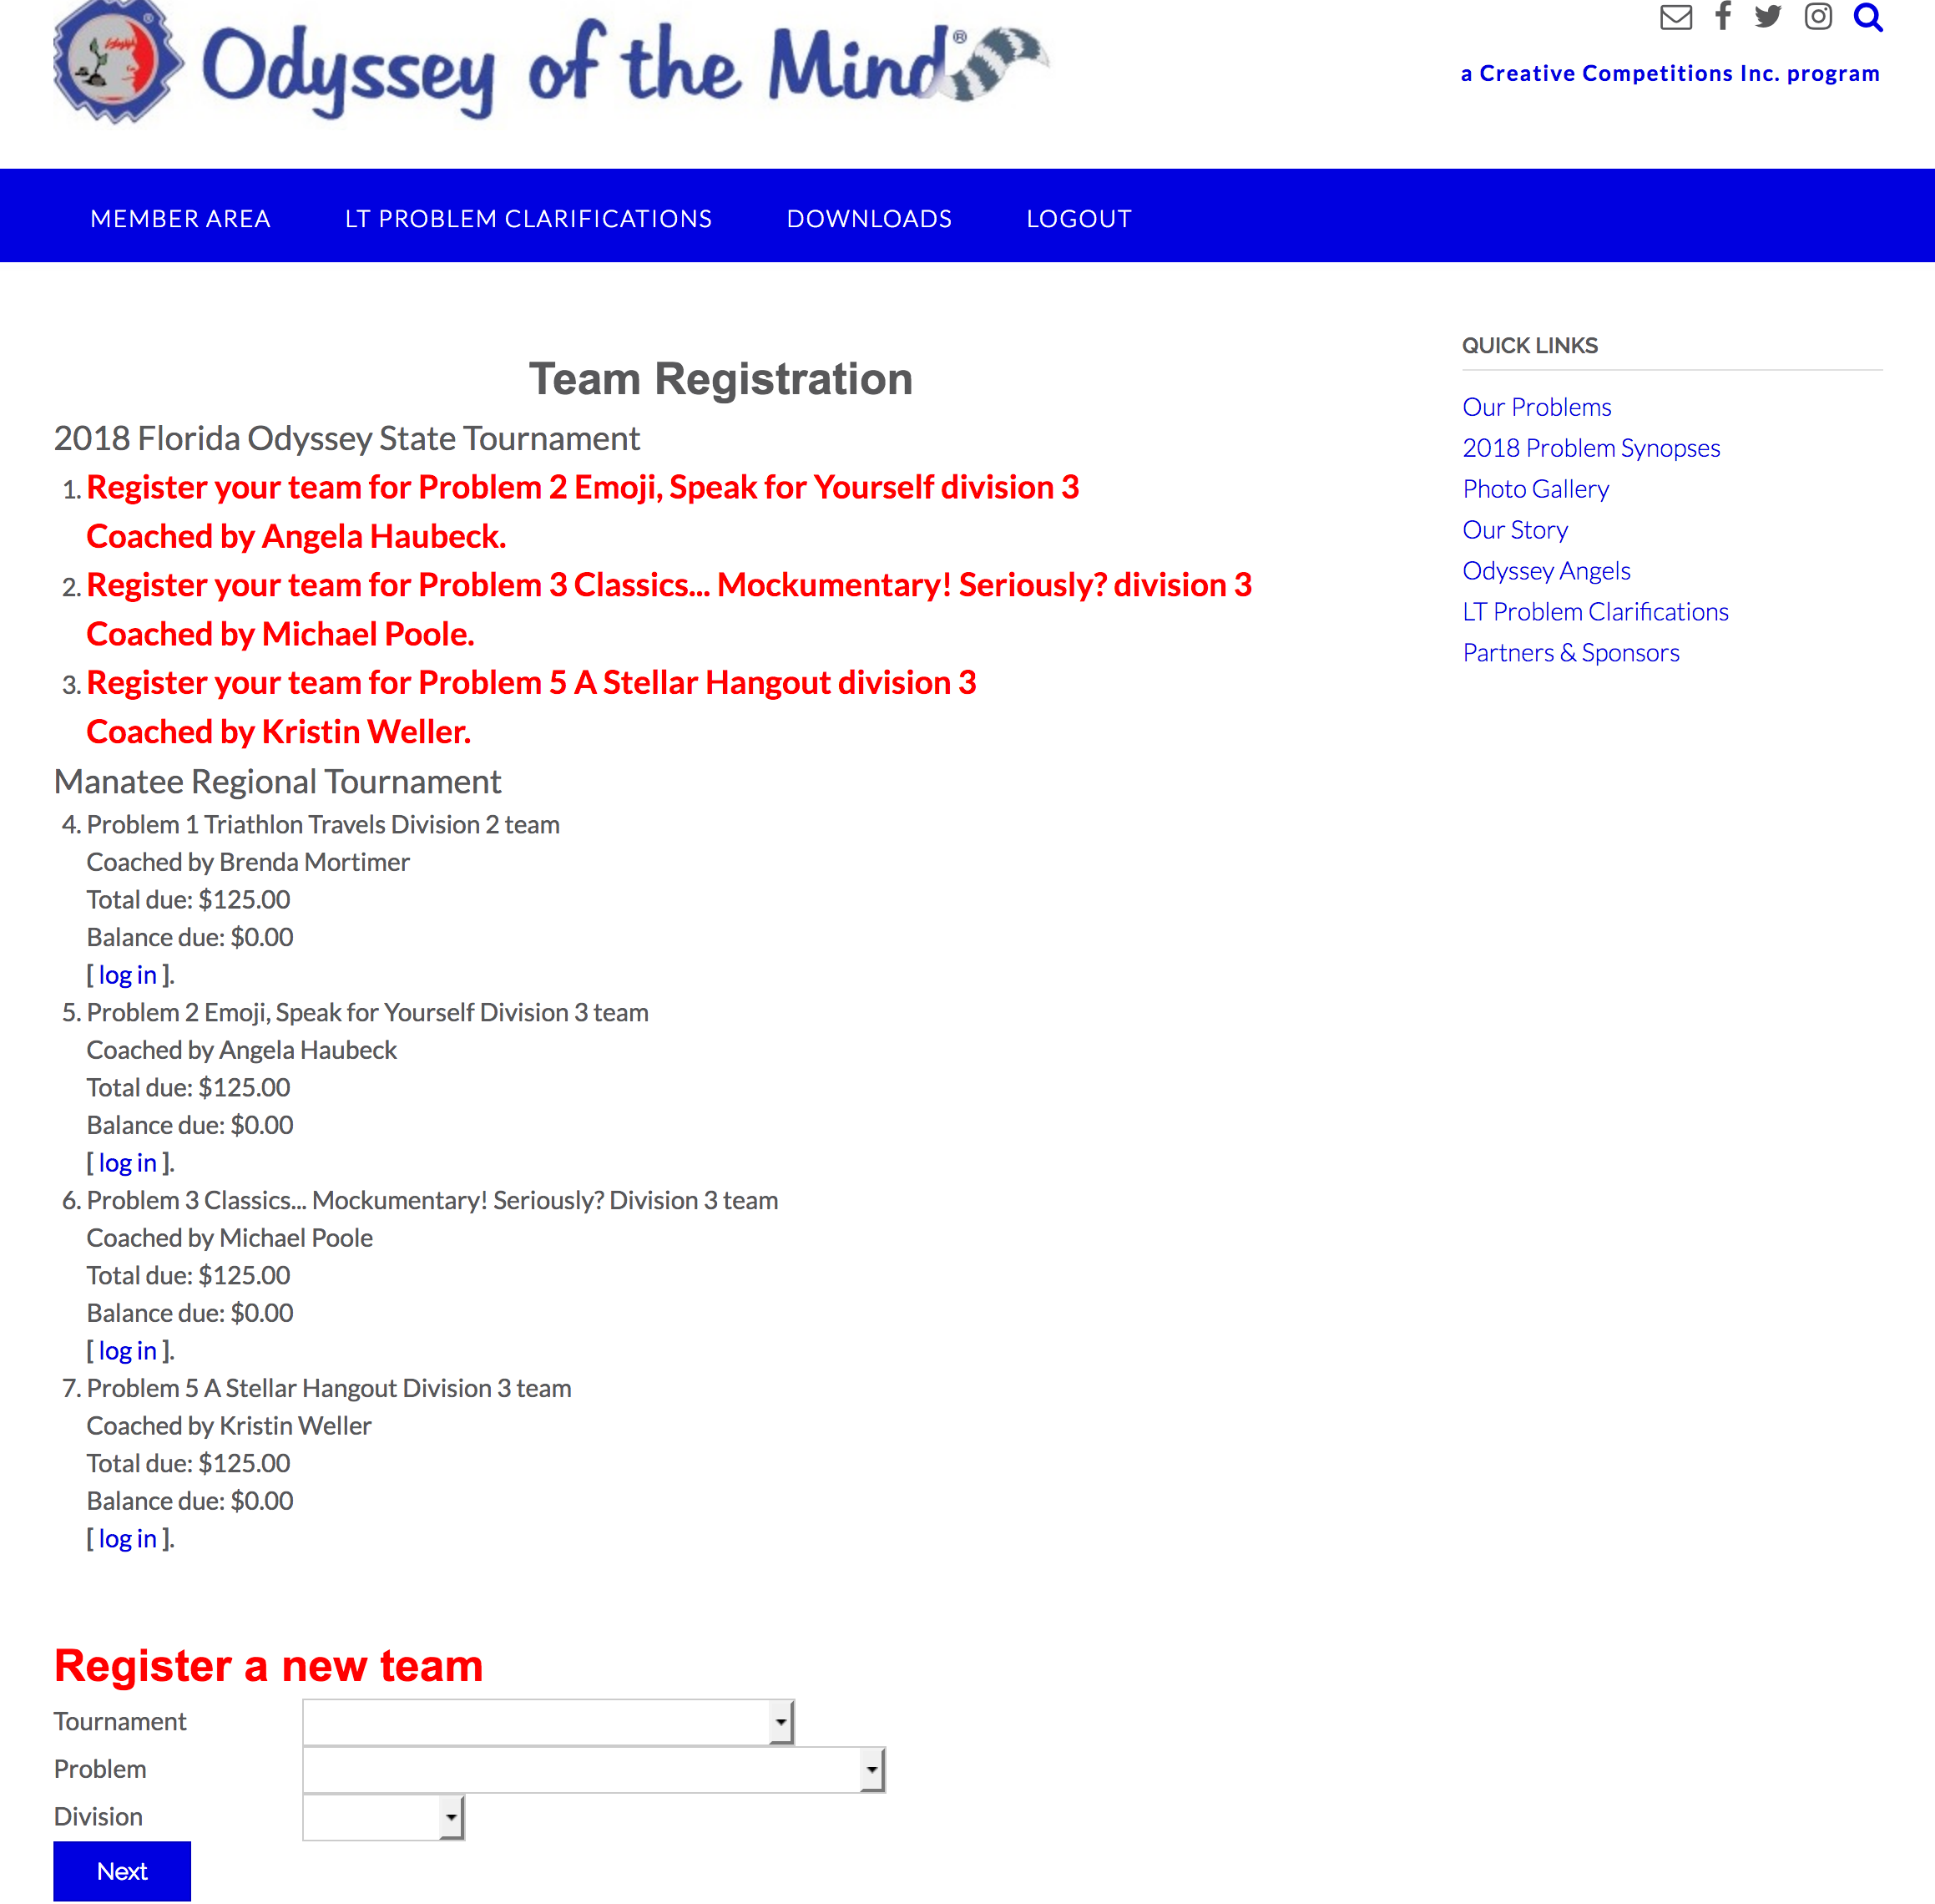
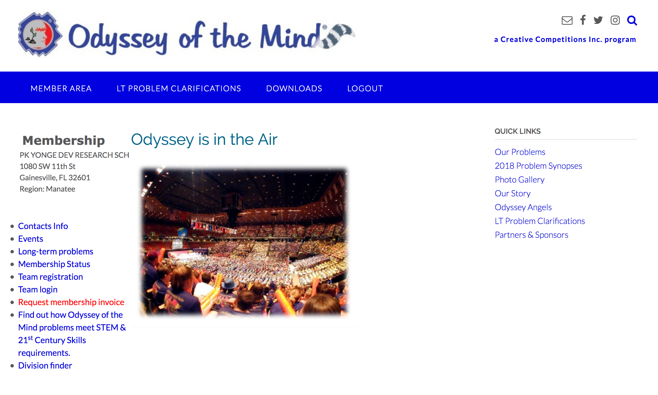
Make sure the information under Membership is for your teams membership!
Select Team Registration from the list of options on the left.
Click on the team, under 2018 Florida Odyssey State Tournament, that you are representing.
DO NOT Register a New Team

Slide 8
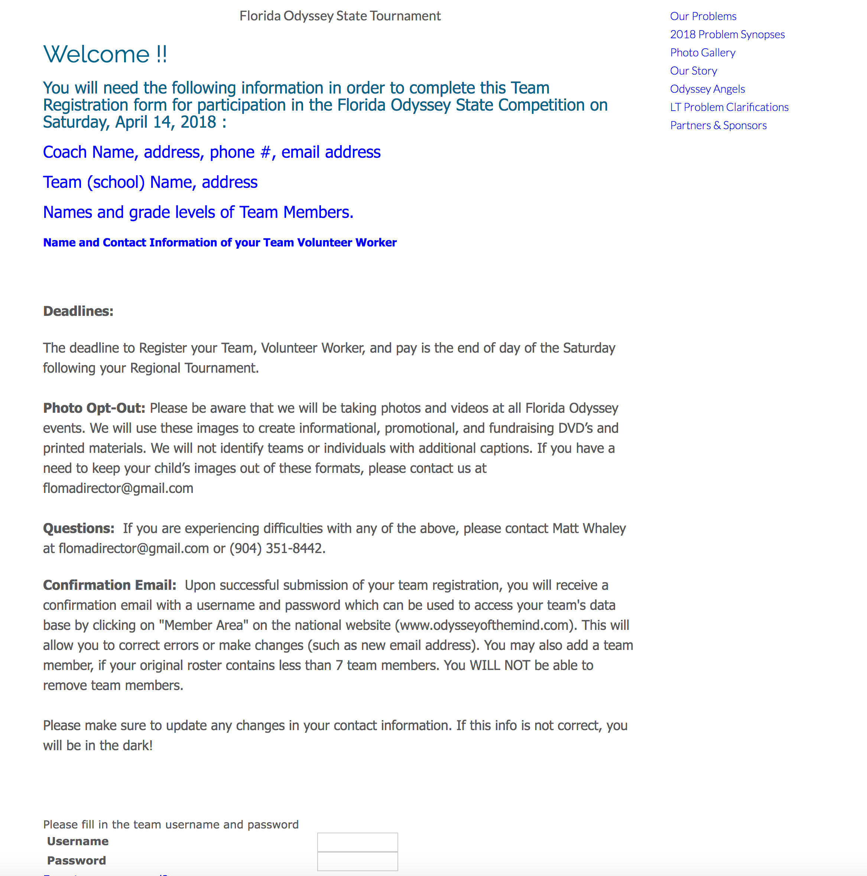
Read through the information on the State Team Registration Welcome Screen
Using your Team Login information login at the bottom of the page.
Username and Password are located in the email you received when you initially registered your teams for the Regional Tournaments.
If you have forgotten your login information, your Regional Director has access to resend you the email.

Slide 9
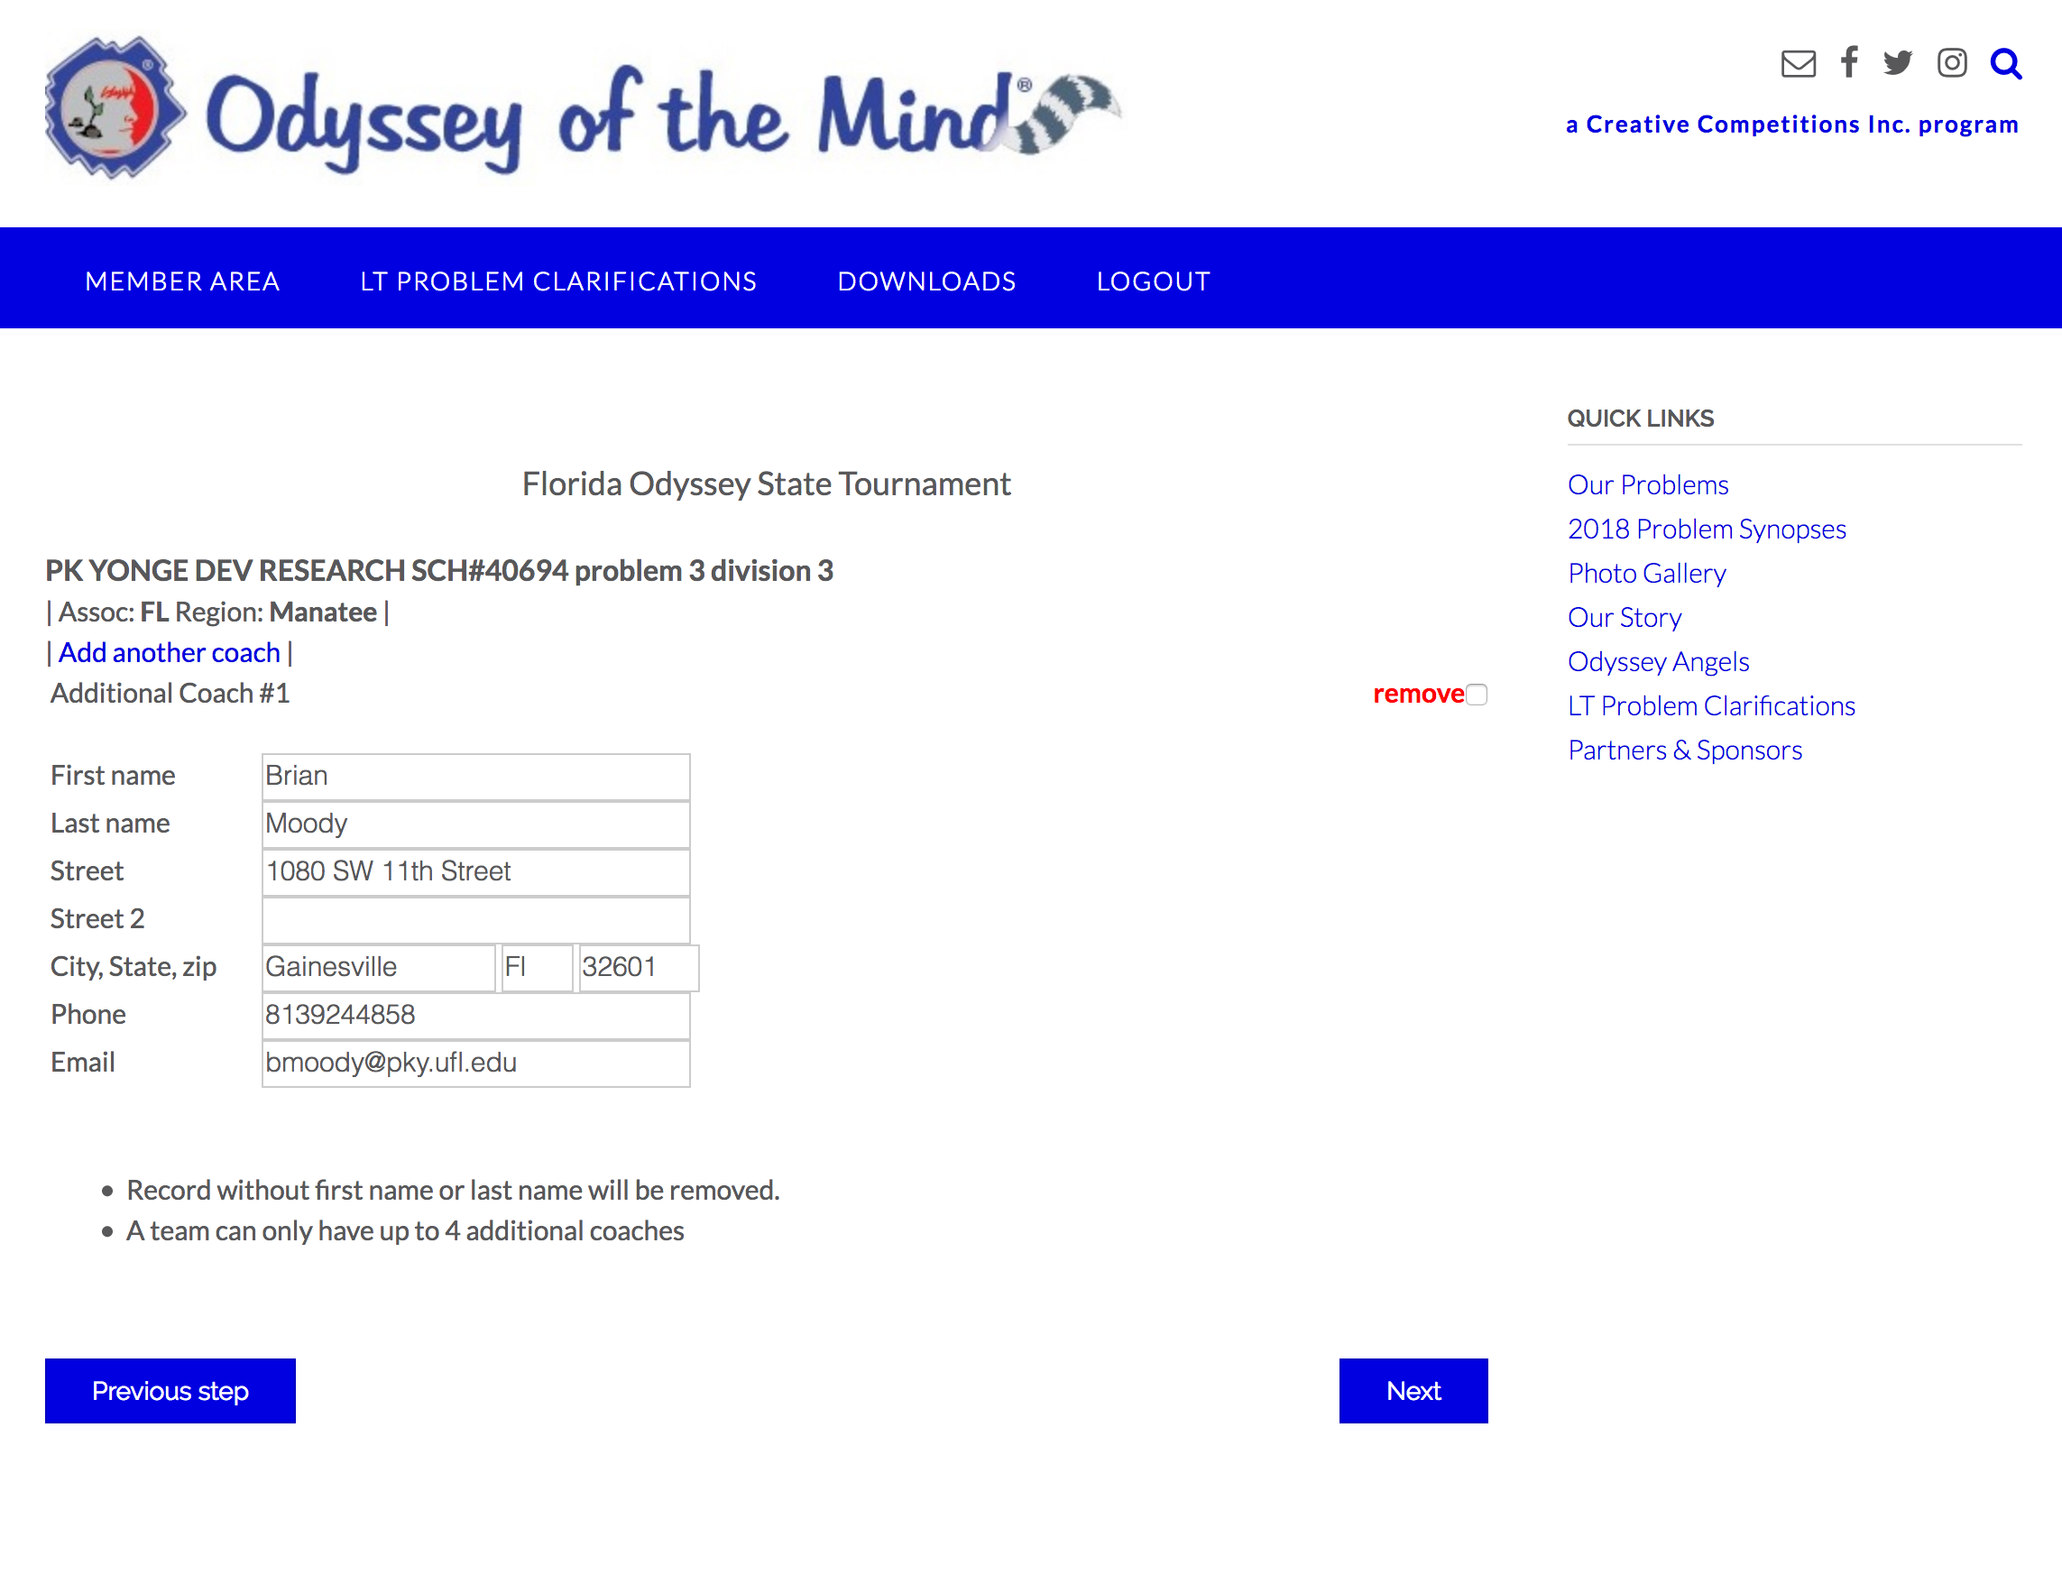
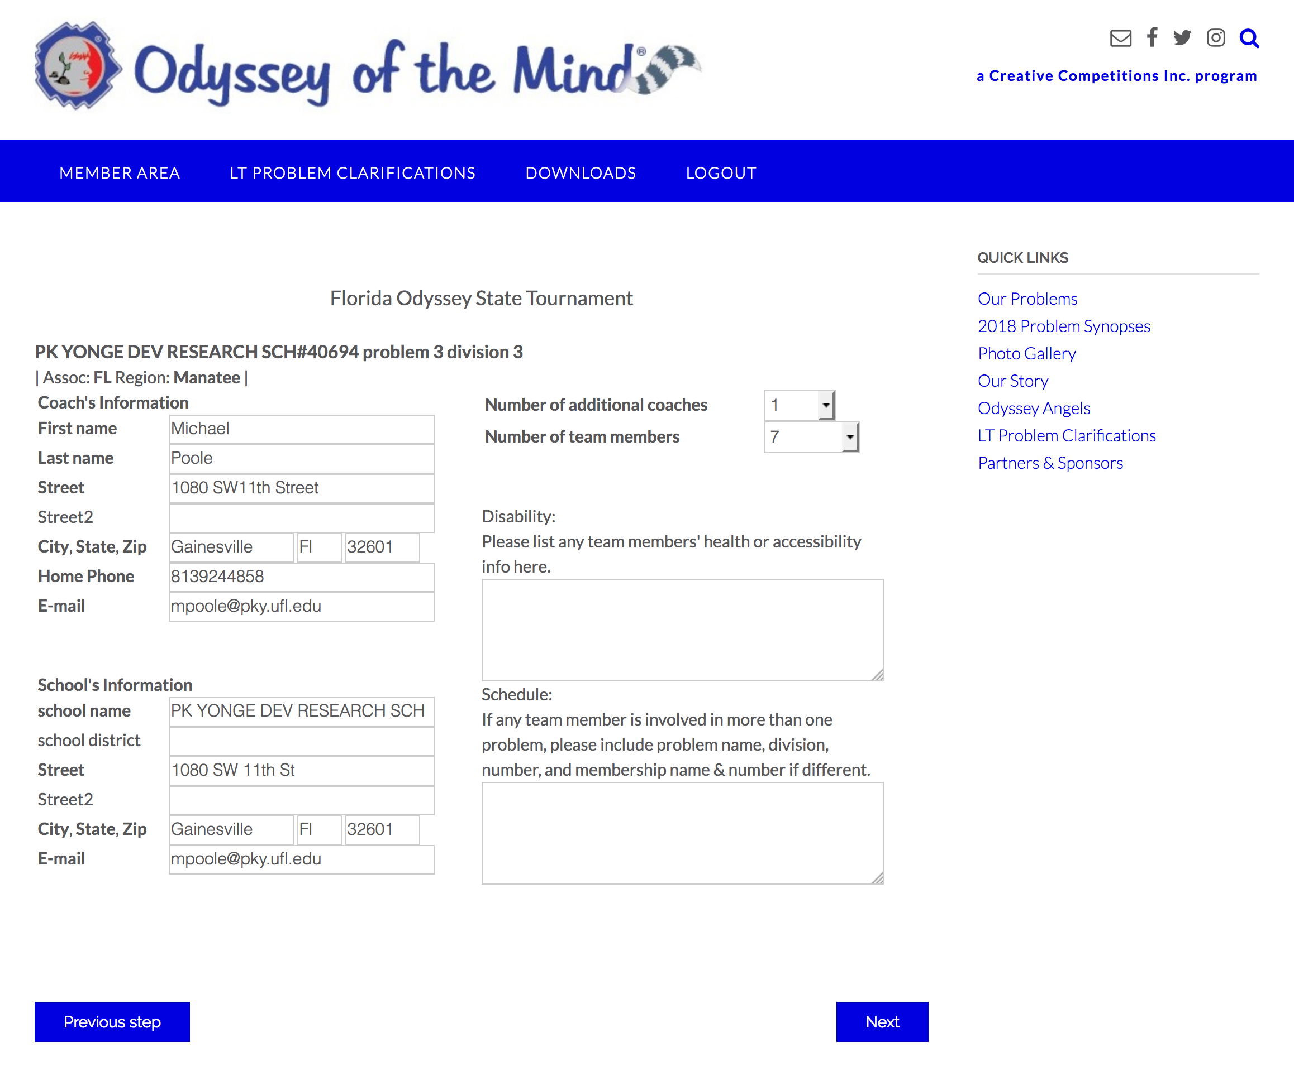
Make sure all the information on this page is still accurate
Make sure to add any Scheduling conflicts to the box on the Right
Click NEXT
NOTE: We try our best to accommodate all schedule conflicts but it is never guaranteed.
If the team has a 2nd coach please check that information.
Click NEXT

Slide 10
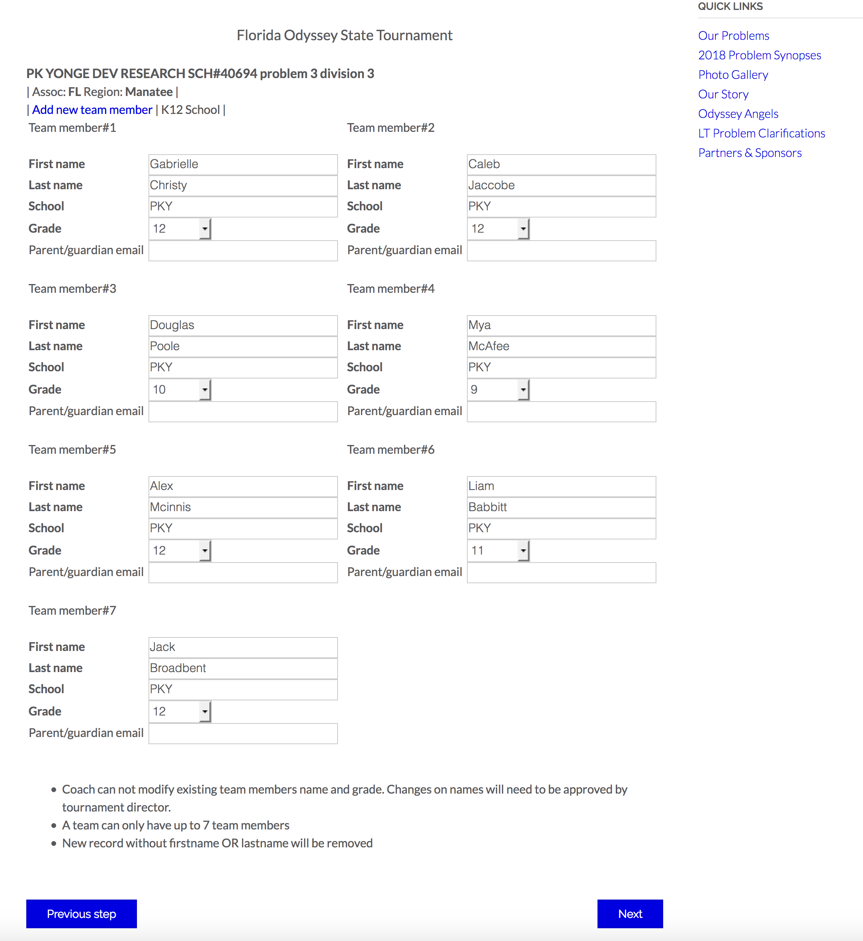
Check all Team Information on this page.
Note that a coach cannot change any of this information without approval from the Tournament Director
Click NEXT

Slide 11
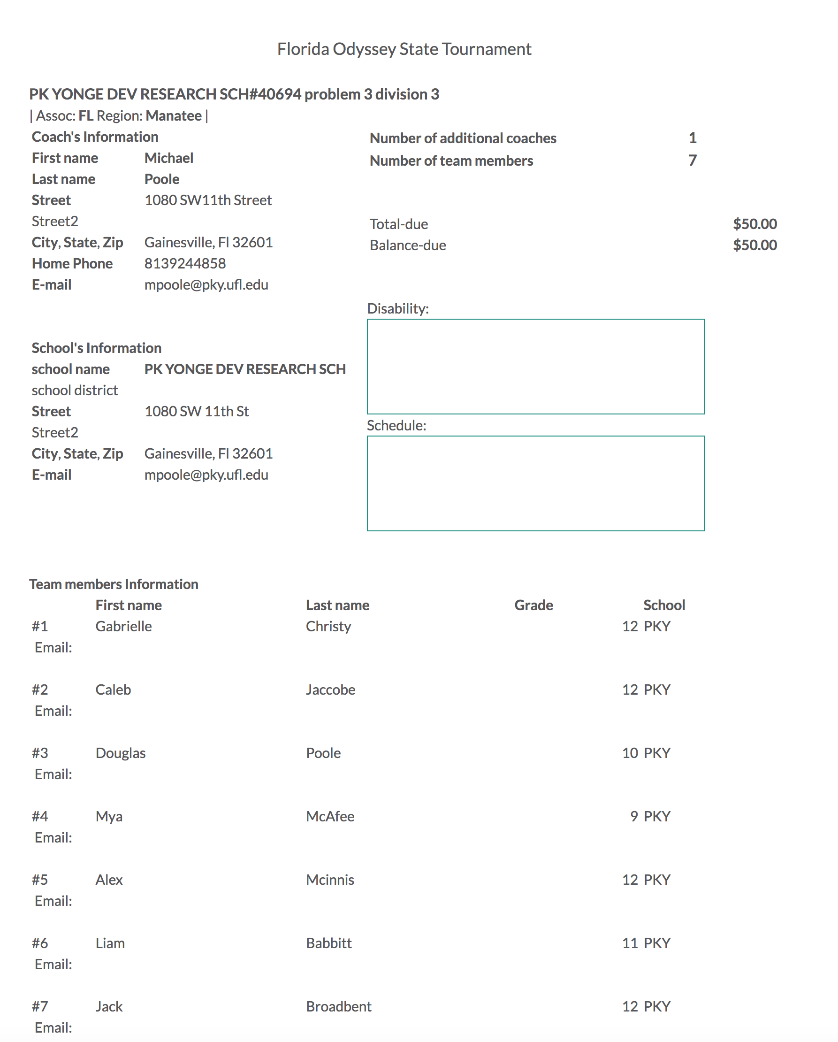
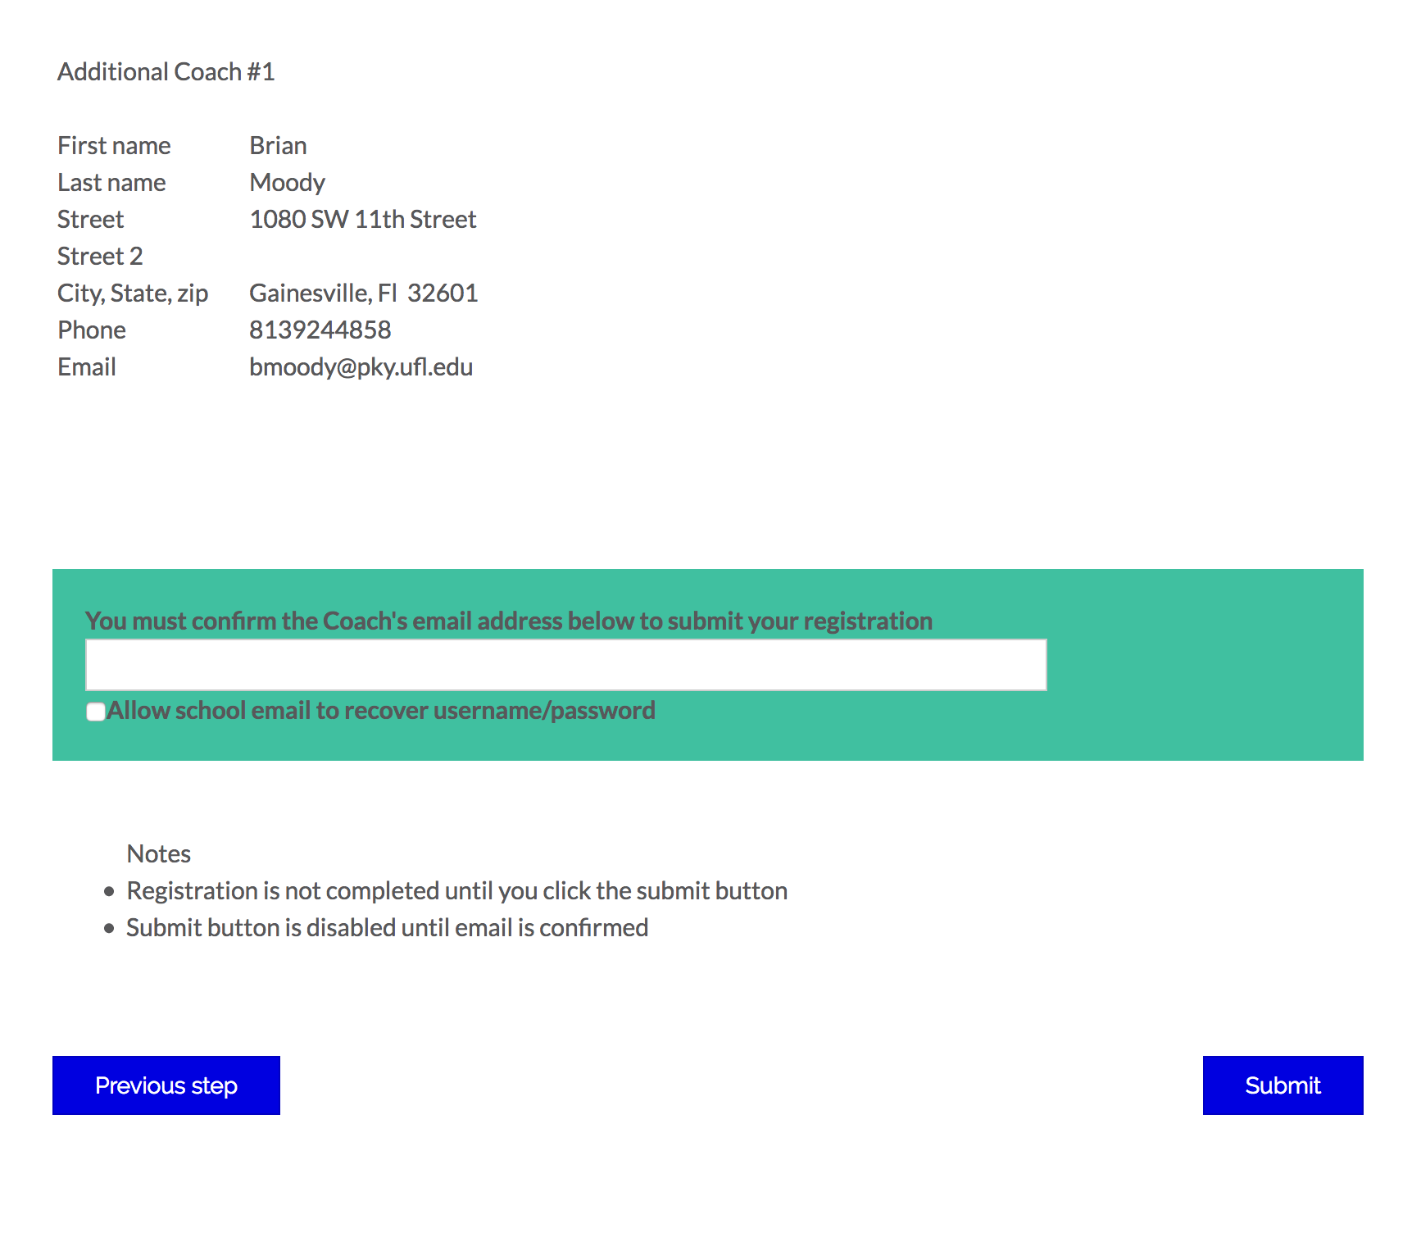
Final Confirmation Page (Top Half)
Final Confirmation Page (Bottom Half)
Enter the matching email address for the main coach.
Click SUBMIT
You will receive a confirmation email

Slide 12
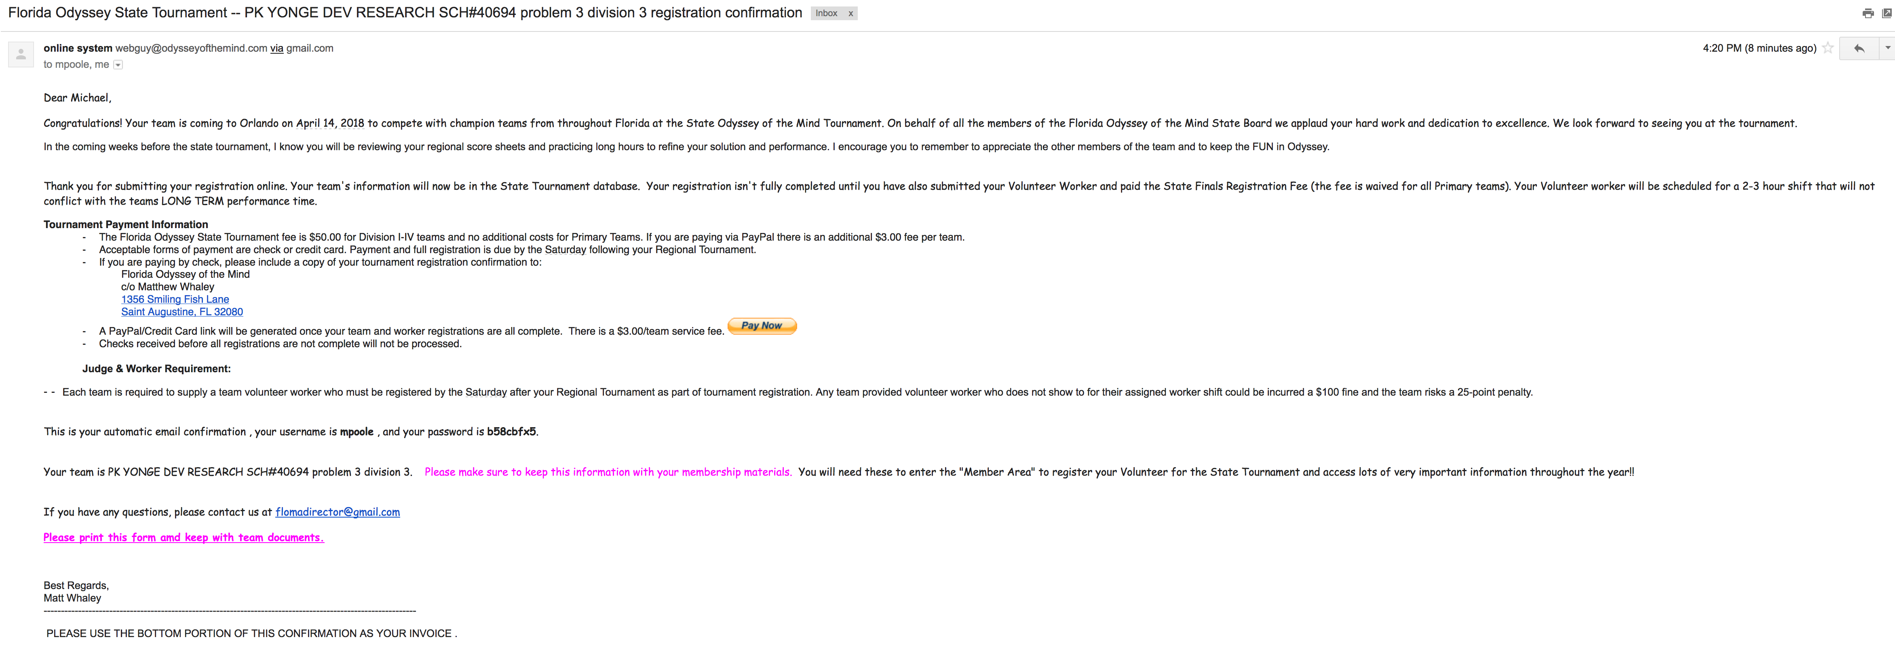
Confirmation Email (Top Half)

Slide 13
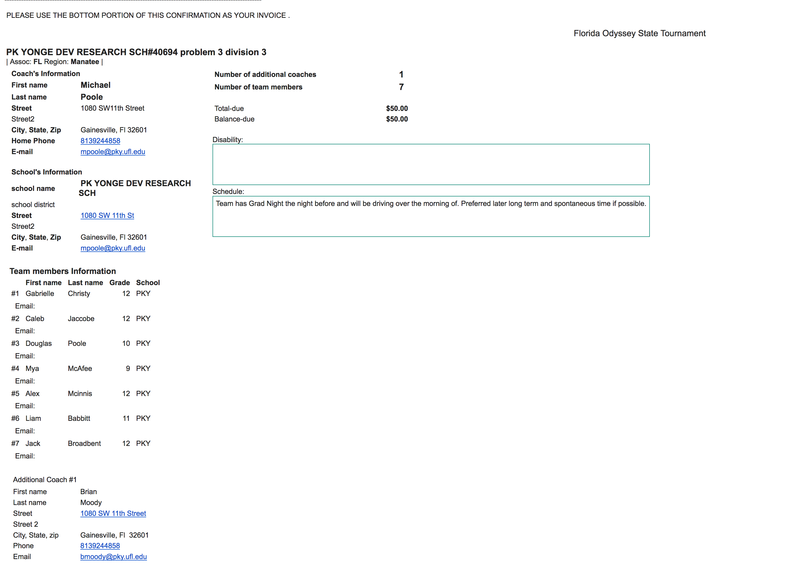
Confirmation Email (Bottom Half)
Use the bottom portion as your Invoice for your Bookkeepers
Note that paying by PayPal will add a $3/team fee

Slide 14
Registering the Volunteer Worker

Slide 15
Go to the National Site (www.odysseyofthemind.com)
Go to the Teams and then choose Member Area.
Under Member Login put in the team Membership Number & Zip Code associated with the Membership.
Click Login

Slide 16
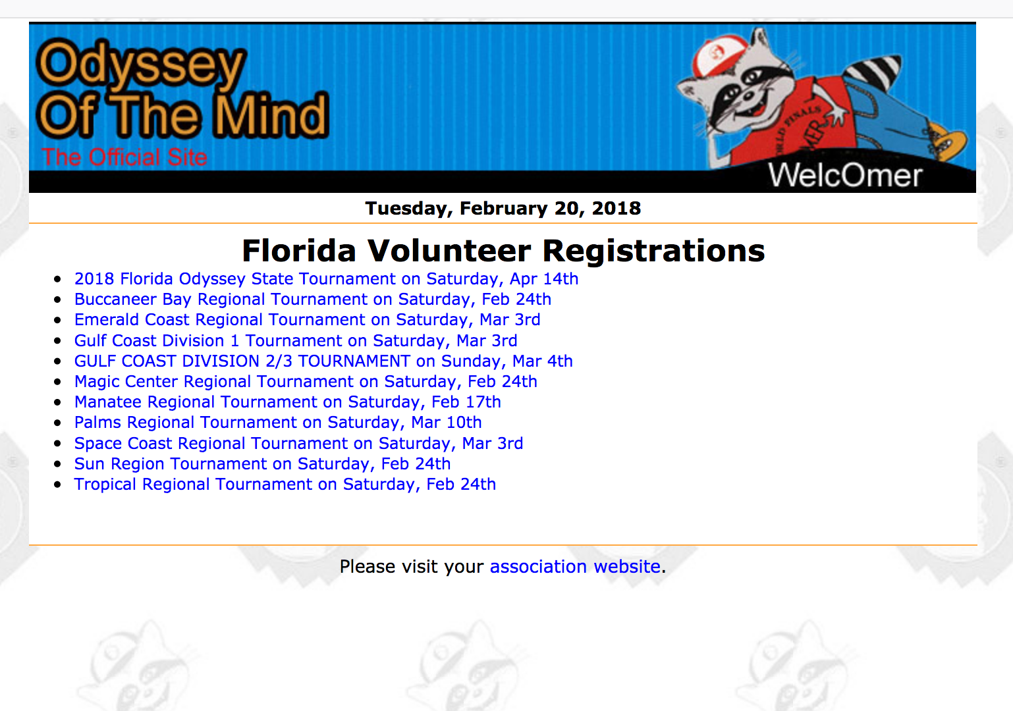
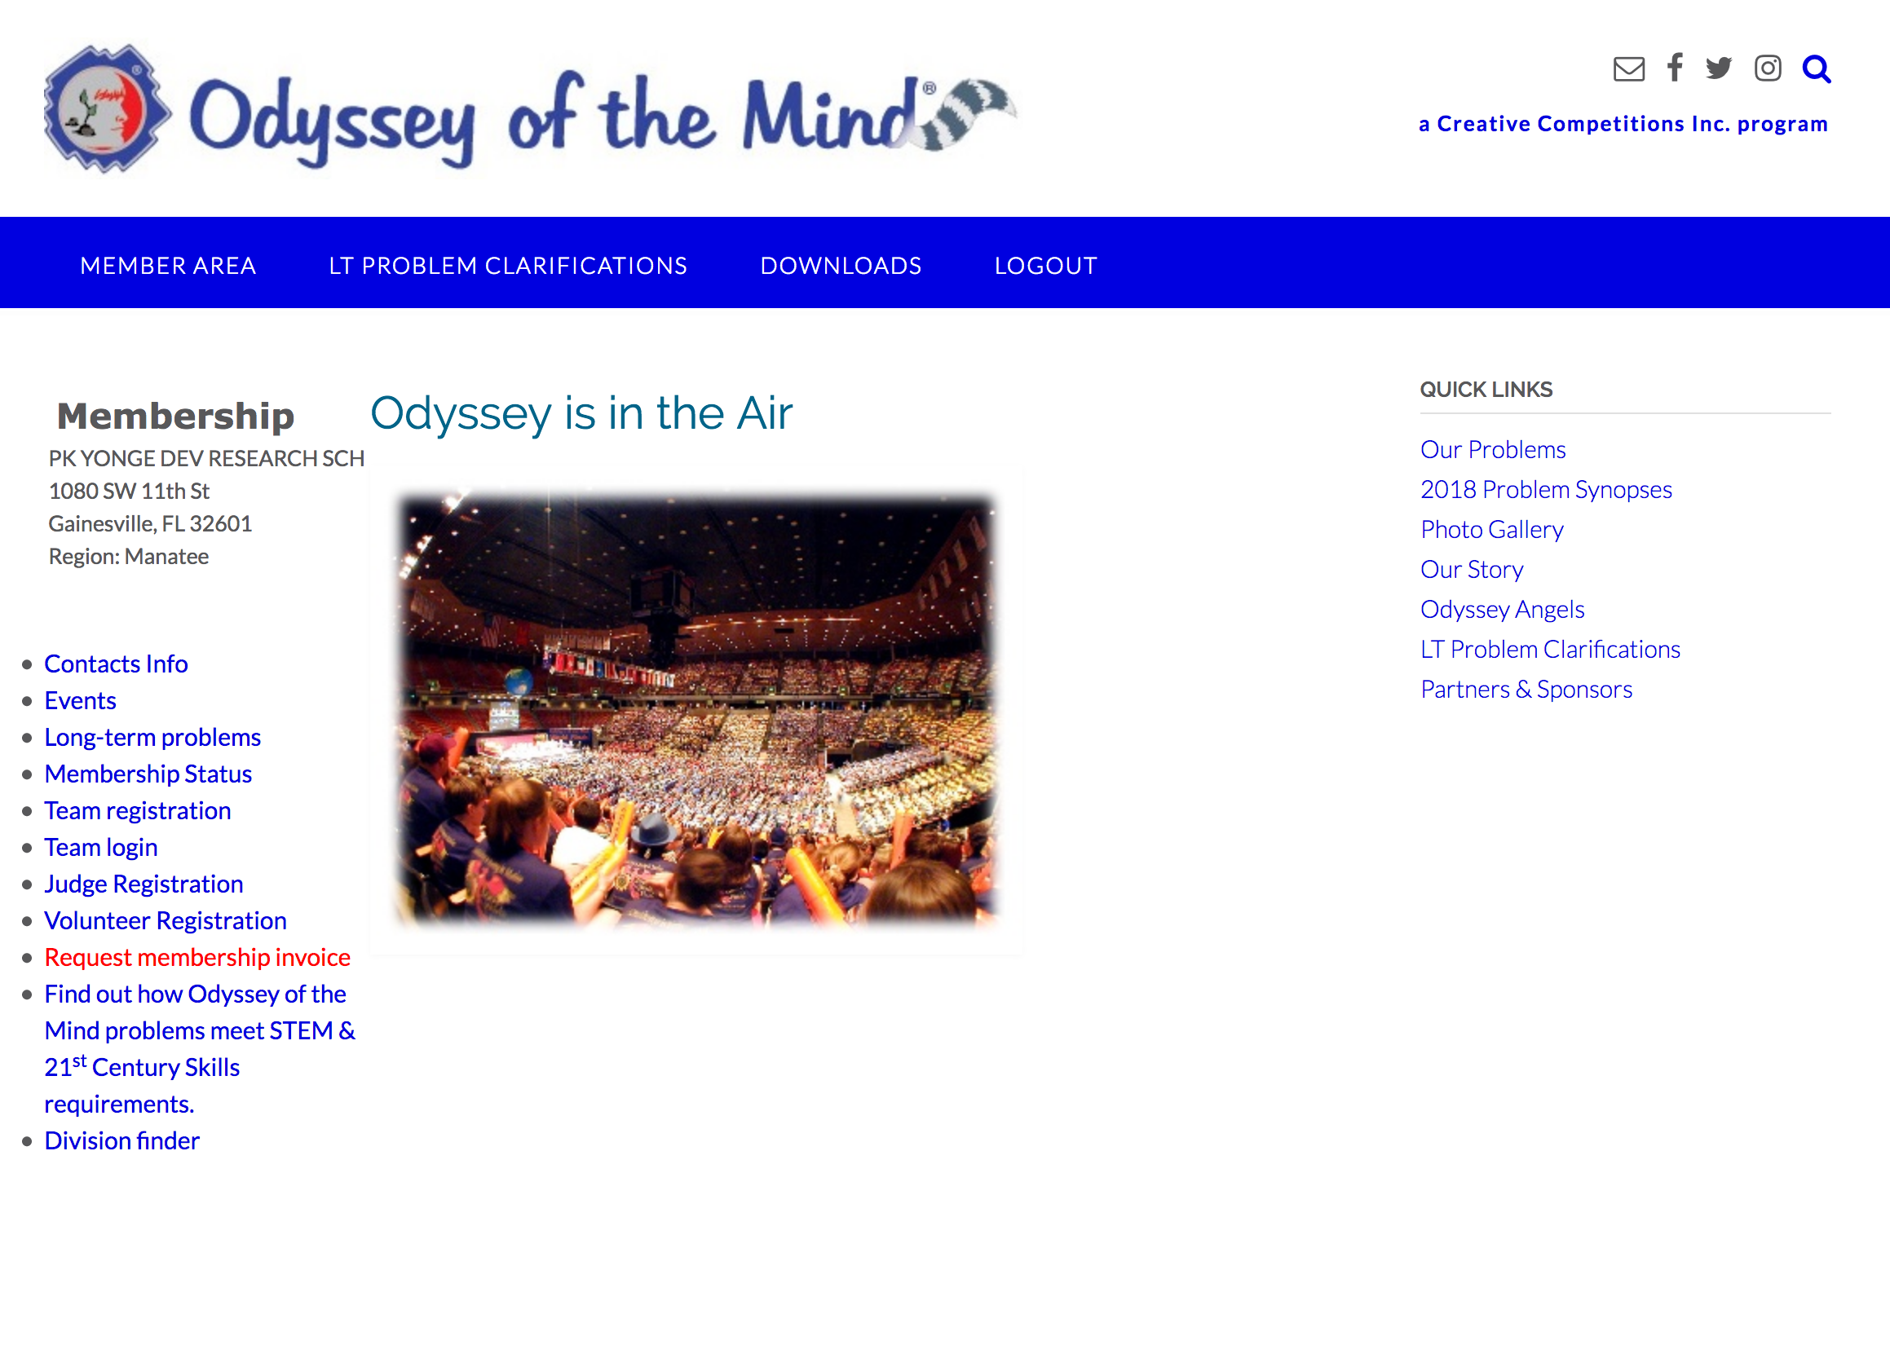
Choose Volunteer Registration from the left hand column
Choose “2018 Florida Odyssey State Tournament on Saturday, April 14^{th”}.

Slide 17
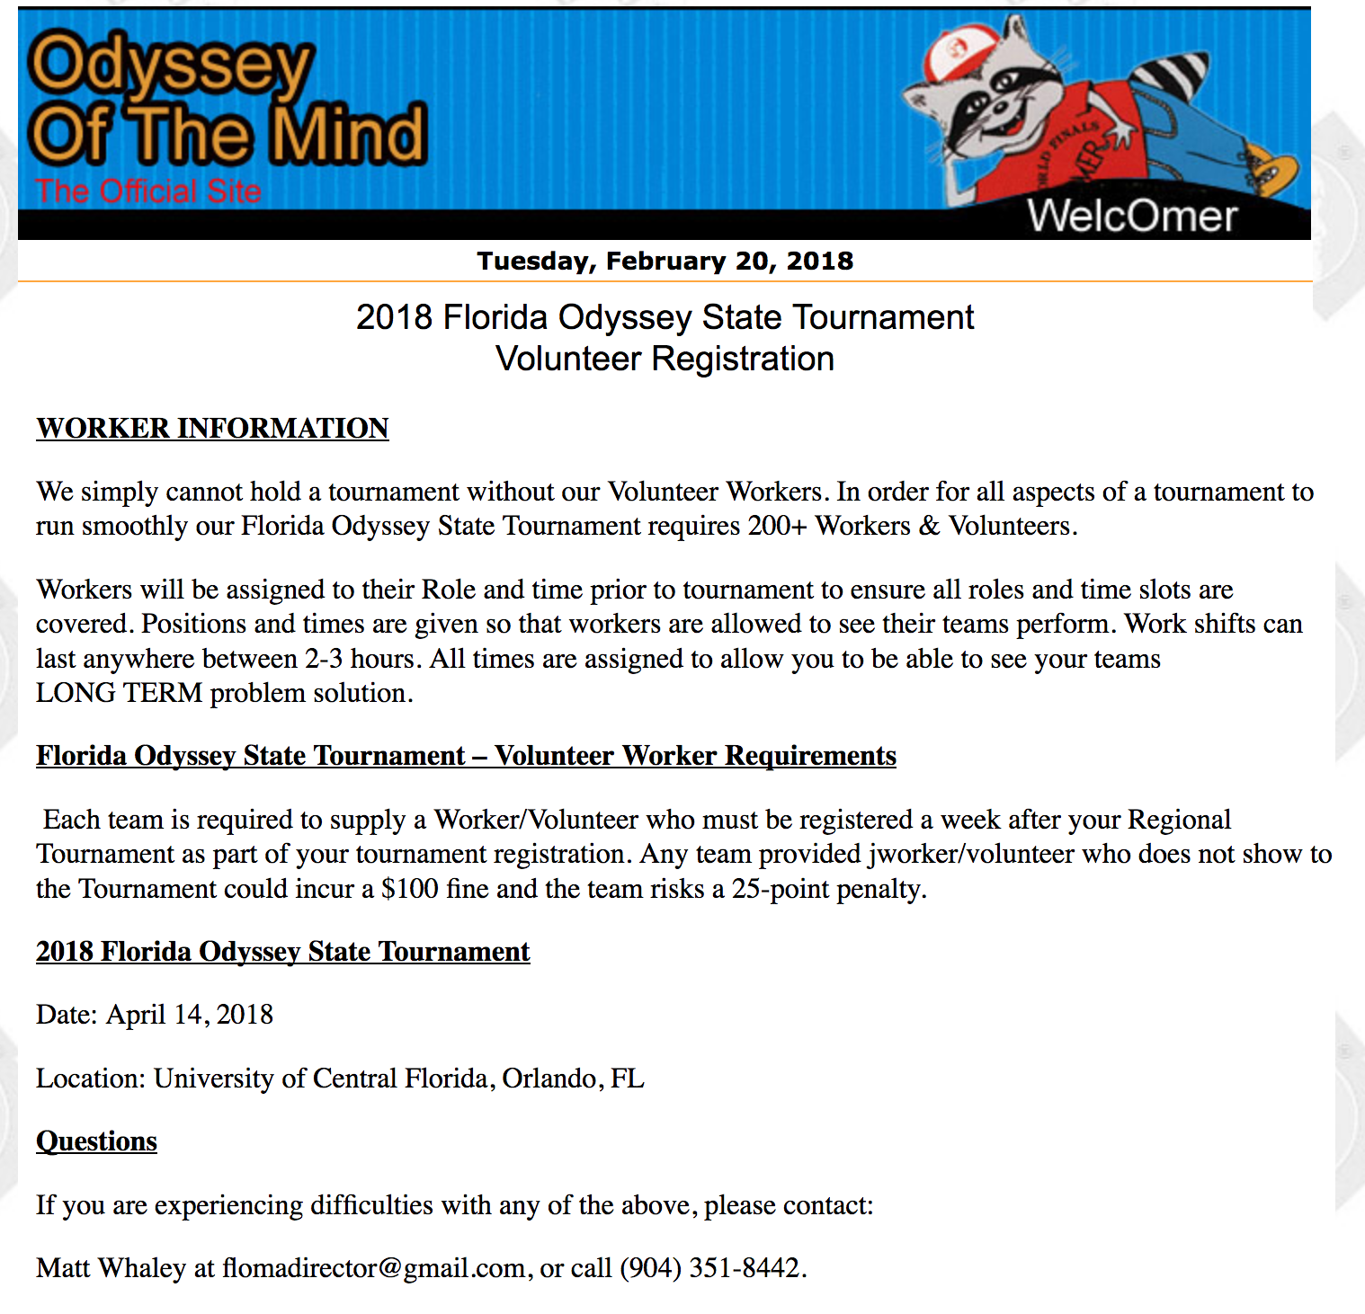
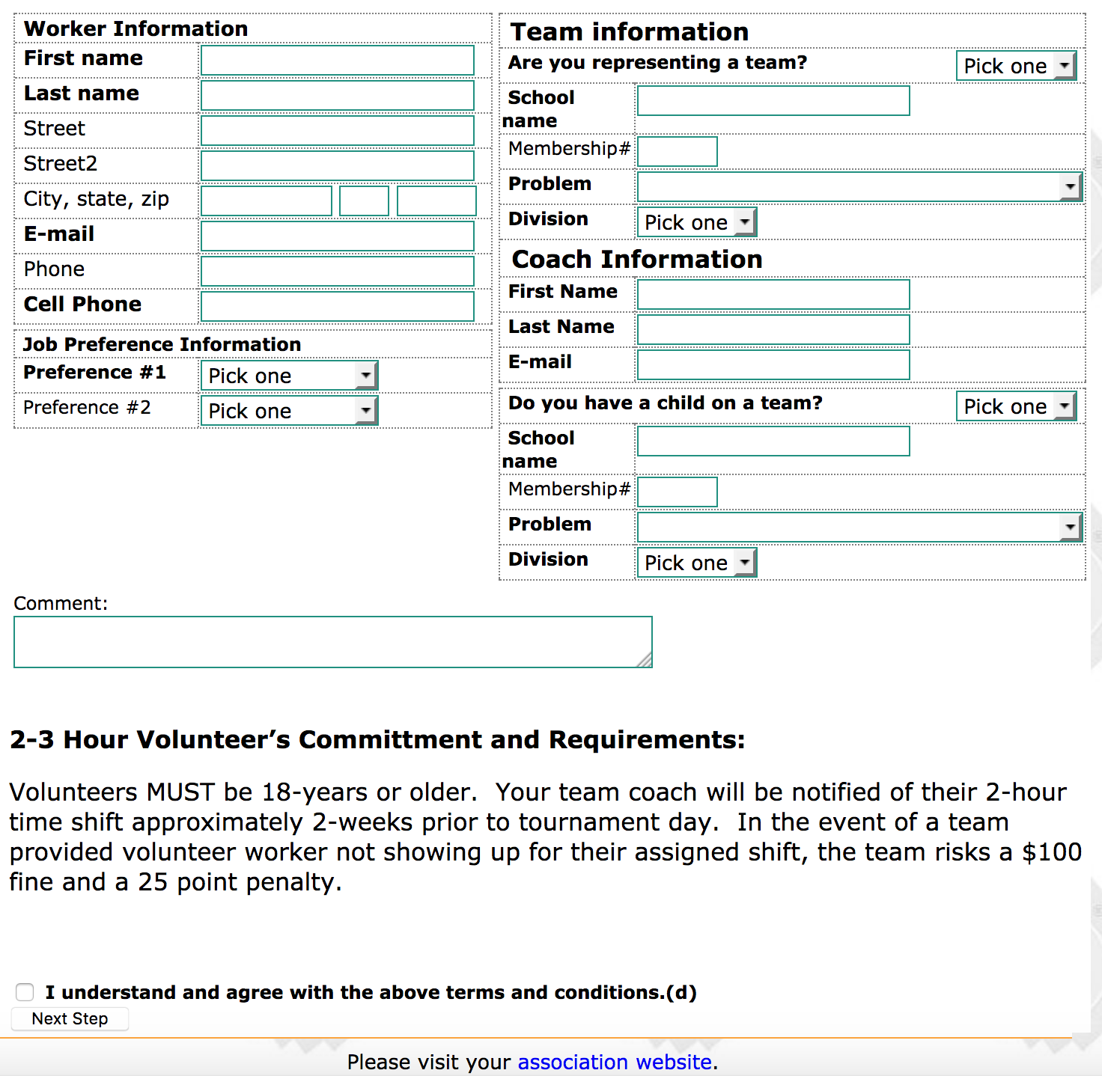
Registration Form (Top Half)
Registration Form (Bottom Half)
Check the Box & Click Next Step

Slide 18
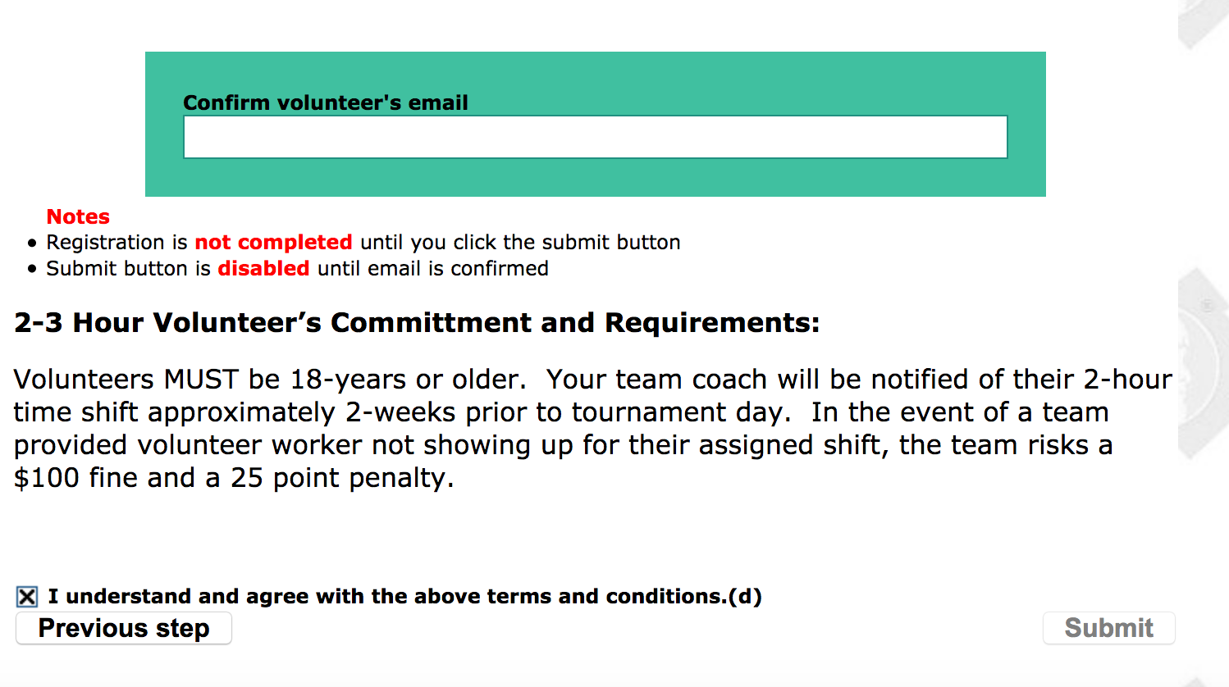
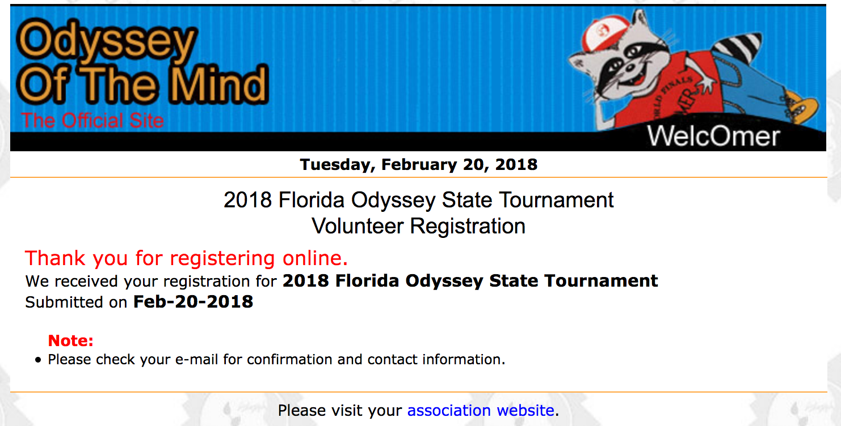
Confirm the Volunteer’s Email
Click Submit
Your Volunteer Worker Registration is done!

Slide 19
Paying For Your Registration

Slide 20
Paying By Check
Checks must be made out to FLOMA
Send ALL checks to:
FLOMA, c/o Matt Whaley, 1356 Smiling Fish Lane, St Augustine, FL 32080

Slide 21
Paying by Credit Card (Single Team)
Option 1: Click on the PayPal link in the confirmation email that was sent to you

Slide 22
Paying by Credit Card (Single Team)
Option 2: Login to the Member Area to access the Pay Now button

Slide 23
Paying by Credit Card (Multiple Teams)
If your membership has multiple teams moving on to the State Tournament you can pay for all with a single transaction.
Login to the Member Area.
Once all teams are registered you will see a button to “Pay All”
There is still a $3/team fee for using PayPal

Slide 24
If You Have Questions
Contact your Gulf Coast Odyssey Regional Director
FREDA ABERCROMBIE
fabercro@pasco.k12.fl.us
813-924-0850
Contact your Association Director
Matt Whaley
flomadirector@gmail.com
(904) 351-8442

