Slide 1
What is your Leadership Style?

Slide 2
What is Your Leadership Style?
A key component to being a leader is to understand how you lead. Leadership is the action of leading a group of people or an organization

Slide 3
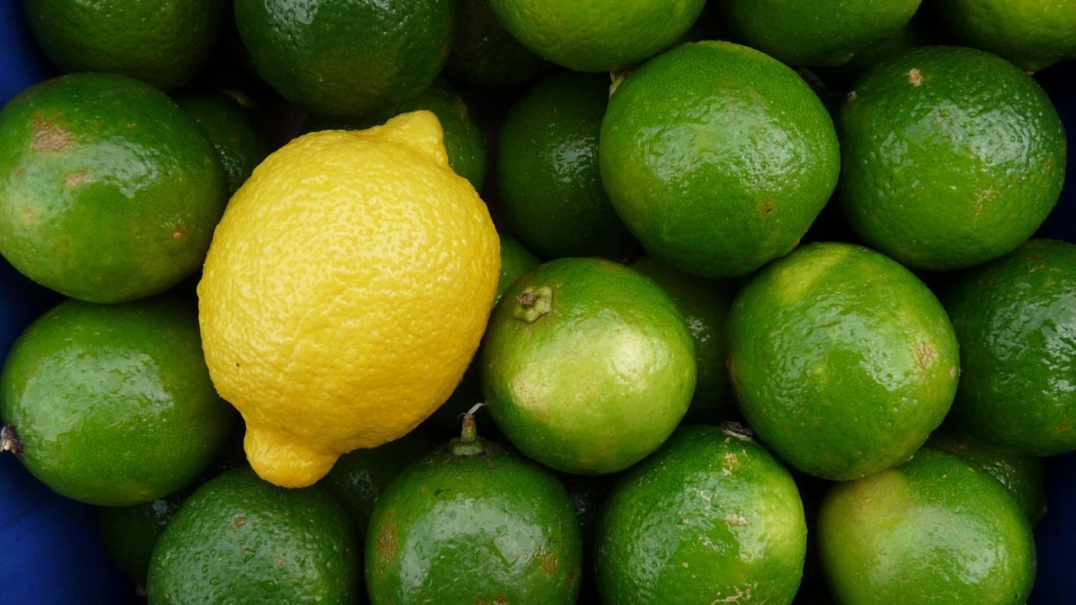
All do not lead the same way
There is no cookie cutter approach to how one leads. There are some unique attributes that most leaders have but how you lead also depends on where you are in an organization.

Slide 4
So What Styles do Successful Leaders Display?
The Predictable Success Company says that most successful leaders fall into one of four categories. Follow the link below and see where you fall in the different Leadership Styles:
http://predictablesuccess.info/quiz/quiz.php?id=4

Slide 5
What is Your leadership style?
Are you a charismatic big-thinker who quickly becomes bored by minutia and is driven by a need to create? Most Visionaries possess similar traits: big-thinkers turned on by ideas, they’re easily bored with minutia and are consumed by the need to create and to achieve. Visionaries are often (although not always) charismatic. Engaging communicators, able to motivate people to bring their best in every endeavor, they inspire deep loyalty in others, and frequently a small, tight team or ‘posse’ will develop around them, a group of committed individuals who share the Visionary’s…well, vision – and who want to help see it realized.
Notes:
(pg. 8)
“How many of you were visionaries?”

Slide 6
What is Your leadership style?
Operators are the practically-minded folks that get stuff done. Operators work well alongside Visionaries, and in a sense, they’re mutually dependent – a Visionary needs an Operator to translate his or her vision into day-to-day tasks – and then to get those tasks completed. An Operator, on the other hand, looks to the Visionary for the big picture, for motivation and inspiration in the tough times, and for the flexibility and lateral thinking to change the enterprise’s direction if things aren’t working out. Because of their task-oriented disposition, Operators are often hard to spot in an office environment. Easily bored by meetings and unimpressed with simply putting in ‘face time’, Operators don’t like to sit around idly, and can usually be found in jobs that keep them on the move.
Notes:
(pg. 8)
“How many of you are operators?”

Slide 7
What is Your leadership style?
Processors have an innate desire to bring order to any situation – they focus not only on what they’ve been asked to do, but also on the underlying systems and processes that will make doing it more consistent and repeatable – and if those systems and processes don’t yet exist, they’ll begin by designing and implementing them. Processors bring a crucial skill-set to any group or team – they manage risk, provide consistency and grind out the detail in a way that the Visionary and Operator aren’t pre-disposed to do.
Notes:
(pg. 8)
“How many of you are processors?”

Slide 8
What is Your leadership style?
The Synergist brings a primary focus on what is best for the enterprise as a whole, and they choreograph and harmonize team or group interactions to produce high-quality decisions. Adding the Synergist style to a VOP (Visionary–Operator–Processor) group releases it from the gravitational pull of gridlock and compromise, and transforms it into a high-performance team. Unlike the Visionary, Operator and Processor styles, which are natural and innate to all of us, the Synergist style is primarily a learned style – meaning anyone can learn to be a Synergist.
Notes:
(pg. 8)
“How many of you are synergists?”

Slide 9
It is not only about you but also those you lead and partner with
We all want a leader who has some predictability about themselves. Once you understand your style and your team understands your style you can see if the team has all of the necessary pieces to be successful. No football team would have quarterback at every position nor have a center at every position.
Understanding who you are and how you lead is important. However, knowing who you need to compliment you in your leadership style is just as important.

Slide 10
https://bbv2m-brothersbrooksvision2missionllc

