Slide 1

A Warm Welcome to the
Belbroughton and Fairfield
Annual Parish Meeting

Slide 2
Agenda
1. Apologies
2. Minutes of the 2018 Annual Meeting
3. Annual Reports.
Parish Council Chairman
Parish Council Committees
County and District Councillors Reports
4. Footpath Wardens - Paul & Lynne Hardcastle
5. Open forum

Slide 3
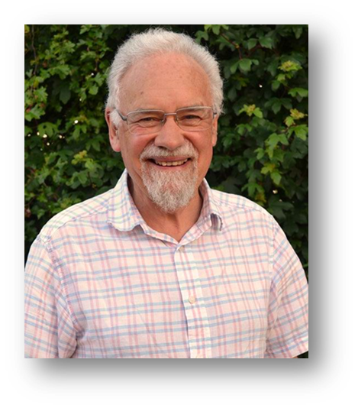
Review
P.C. Chairman Cllr. James Bradley
  Lots of Effort, Some Achievement
  2018/19 – 2019/20
  New Council
  Fairfield Cllr. Opportunities

Slide 4

Parish Action Plan
Cllr. James Bradley
  Priorities:
  a Traffic
  b Green Spaces
  c The Green Belbroughton
  d Neighbourhood Planning

Slide 5
Parish Action Plan
Cllr. James Bradley
  So Frustrating.. Meanwhile…..
  Little Bell Hall Pool
  Smartwater
  c. Tidy Parish
  d. Planning
  Communication
  Finances

Slide 6
Finance Committee
The Council expects to report a surplus:-
£5k from ordinary income (The Precept) plus,
£31k from your Parish Council’s assets.
Numbers are subject to both the internal and external audits which take place during May.
In June the detailed accounts will be published on our website belbroughtonandfairfield-pc.info with paper copies being available upon request.

Slide 7
‘Ordinary’ and ‘Other ‘ Income
Precepted Income £65,000
Other Income
Lengthsman Scheme £2,688
Rentals £15,096
Cash Investments interest £3,995
Bel. Village Green Agreement £21,800
Ward members grants £2,740
Total - £111,319

Slide 8
Major Expenditure items
Clerk salary (incl.N.I. &Pension) £25,033
Grass Cutting & Green Spaces £7,206
Belne Brook, Belbroughton site £5,500
Footway Lighting £5,349
Lengthsman £4,520
Dog bins £3,145
Tree work £3.940

Slide 9
Maintenance Grants Paid
Belbroughton Parochial Church Council £3,200
Belbroughton Recreation Centre £1,155
Fairfield Village Hall £730
Belbroughton Church Hall £730

Slide 10
2018/19 Grants Approved
Capital Grants:
* Belbroughton Rec. Centre improvements £3,900
* Belbroughton Cricket Club – secure storage £550
Parish Projects:
* Smartwater kits for the Fairfield Ward £3,560
* Footpath Diversion £1,739
* Belbroughton history Society repaint library
phone box.
Minor Grants:
* Fairfield Community Association £350
* Bingo club £200

Slide 11
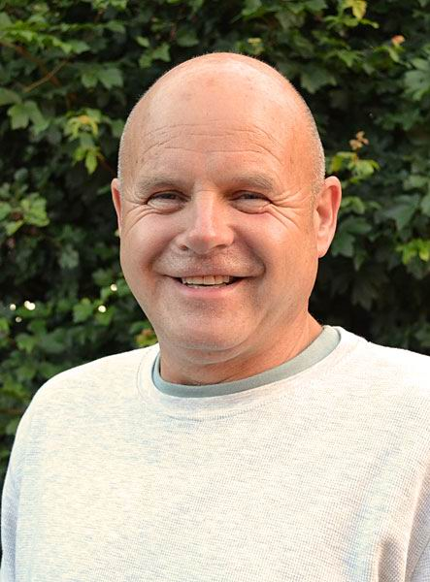
Agricultural Holdings Comm.
The Council owns 85 acres of arable
farmland in Wildmoor & Stoneybridge.
Let under 13 tenancies at £90 /acre and is
used for various arable cropping types.
The income is used to fund the Capital & Minor Grants and Parish Projects.
Council inspects the holdings during the year to ensure they are well maintained which has again proved to be the case.
As well as providing a regular income the land is a significant area of ‘Green Belt’ in the Council’s ownership and control.

Slide 12
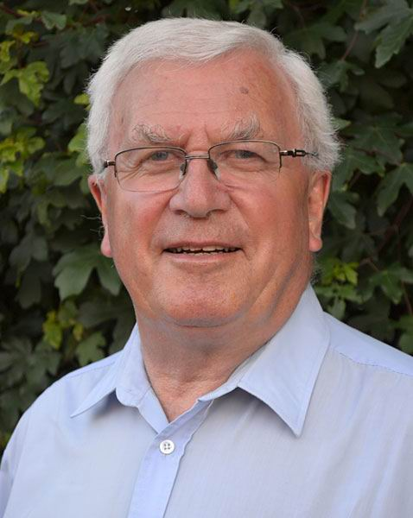
Planning Committee Chairman
Cllr. Chris Scurrell
28 planning applications were considered
Recommendations made to the
District Council :
13 No Objection
10 No Objection but with conditions
5 Objected to

Slide 13

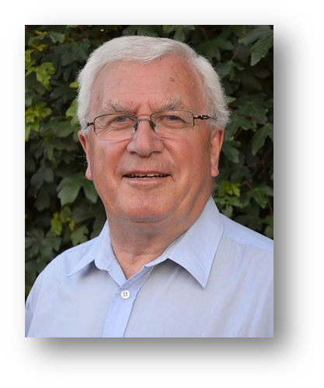
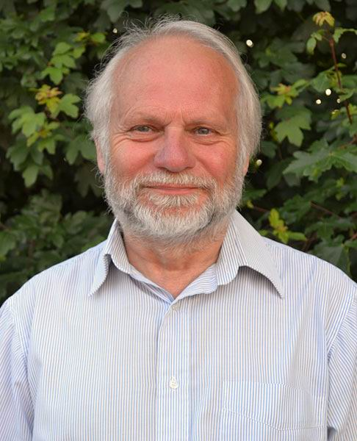
And So Farewell !

Slide 14
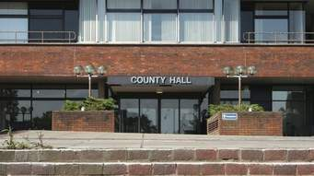
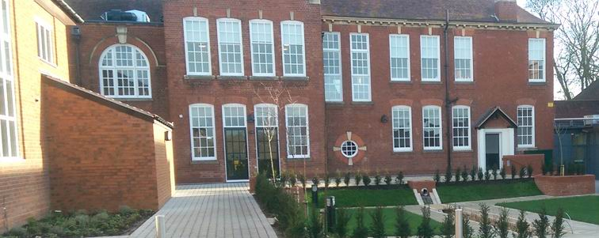
County and District Councillors
County Councillor Karen May
District Councillor Margaret Sherrey

Slide 15
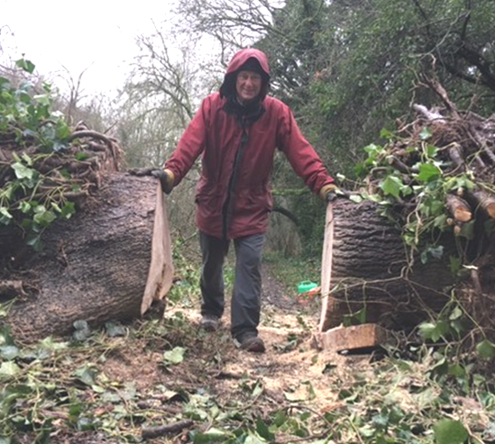
Parish Footpath Warden Report
Paul Hardcastle

Slide 16
The Open Forum
Question time on any matters of interest to residents and an opportunity for other organisations promote themselves to the parish community.
Please tell us your name and which village you are resident in.

Slide 17
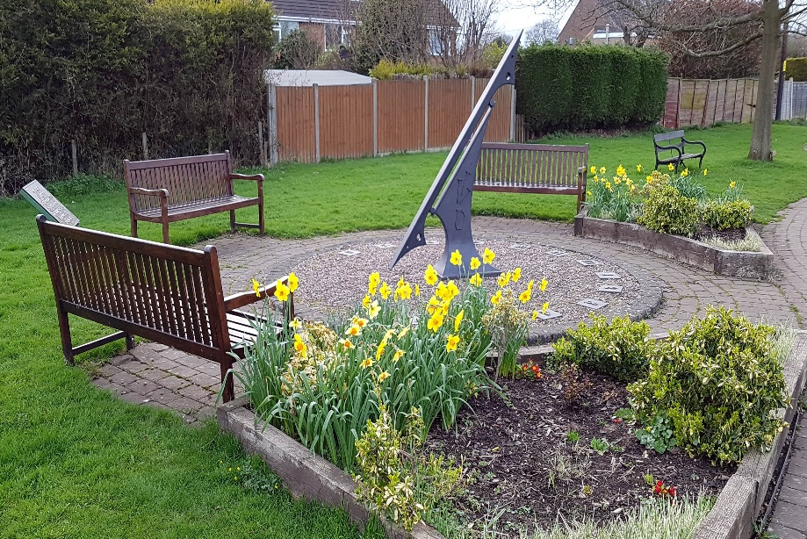
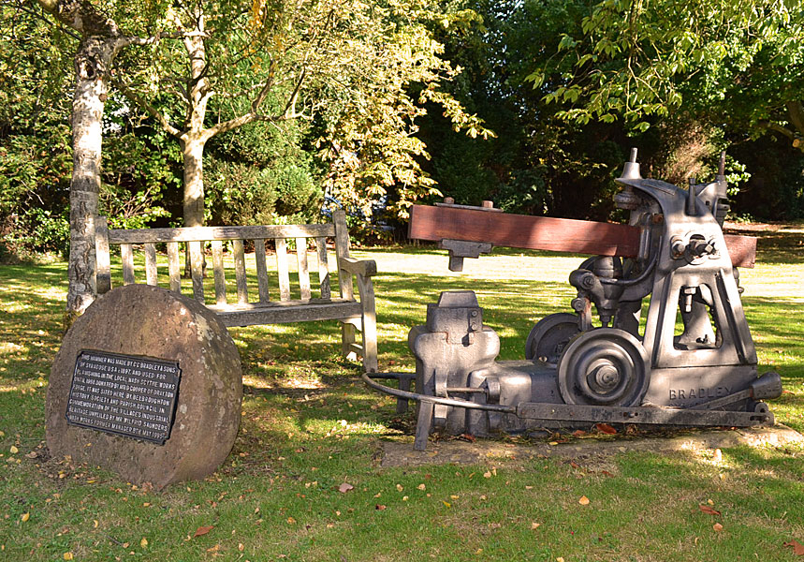
Thank you for coming to your
Annual Parish Meeting

