Slide 1
Parish Path Warden Report
30th April 2018

Slide 2
Strimming / Maintenance
ST Resilience Project
Improvements
Brookfield Farm Path
2018-19 Plans

Slide 3
Strimming / Maintenance
Reduced personal time
WCC Strimming Programme
Landowner improvements
Winter ground conditions
Fallen tree removals

Slide 4
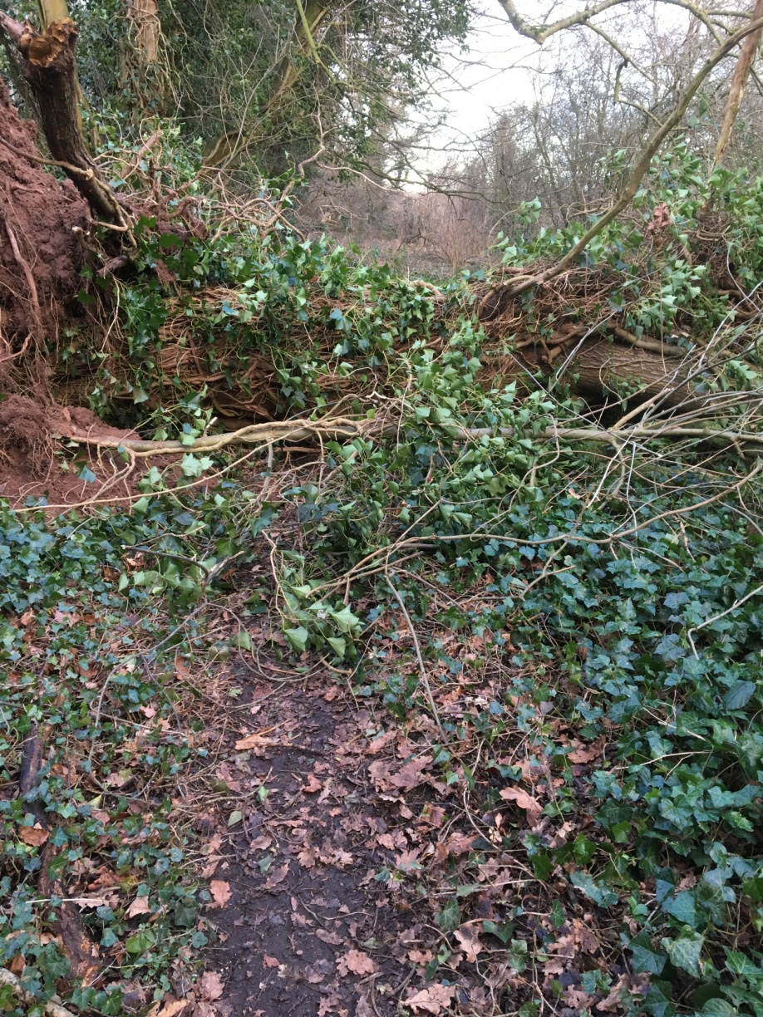
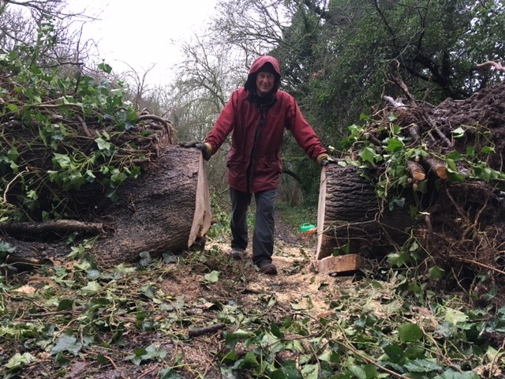
A cold snowy Sunday

Slide 5
Improvements
PH 5 new waymarker posts
4 replacement stile stepovers
WCC 3 replacement ditch crossings
Widening and cutting back on bridle
path Moorfields Farm to Drayton
Steps near Drayton path bridge
LO/WCC New Gate near New Barn

Slide 6
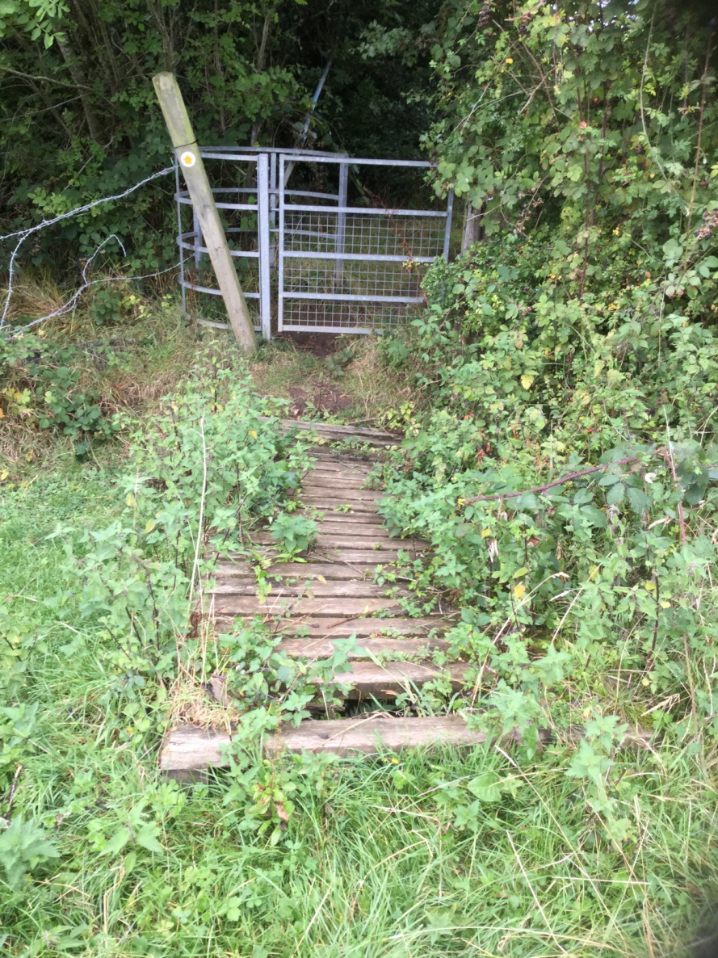
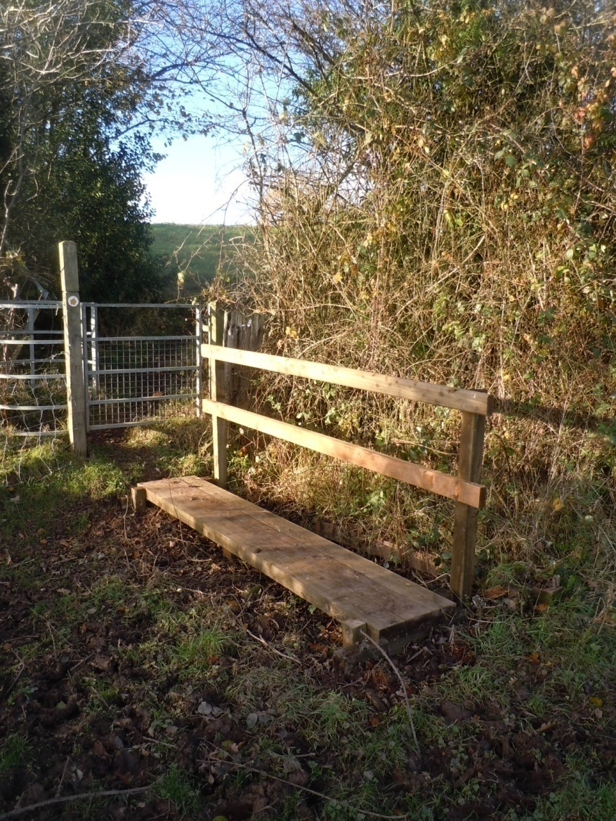
Ditch Crossing – Royal Content

Slide 7
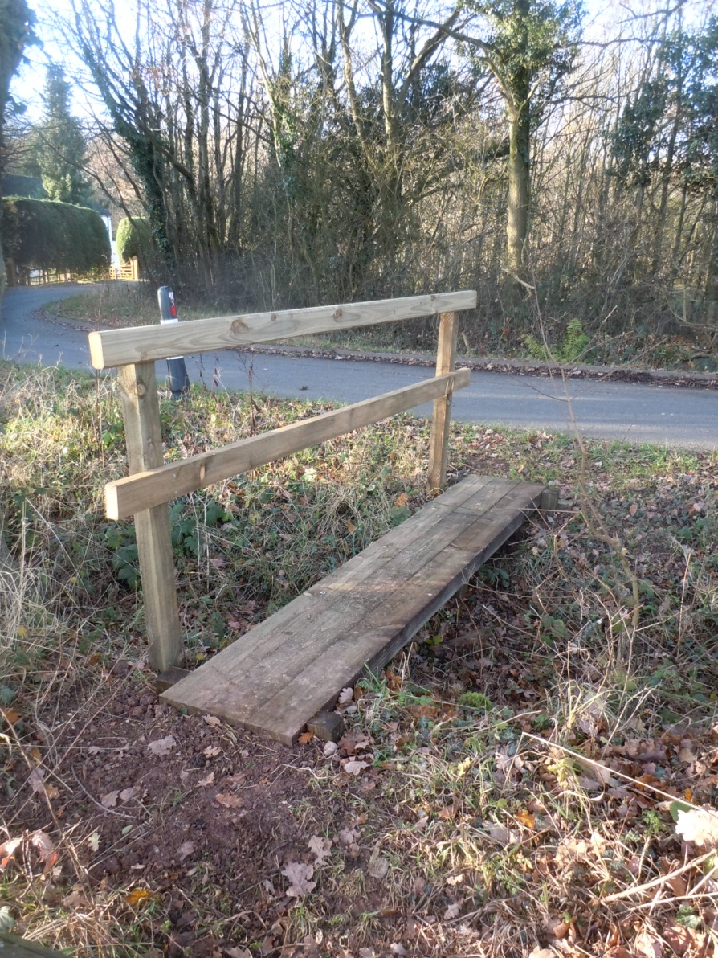
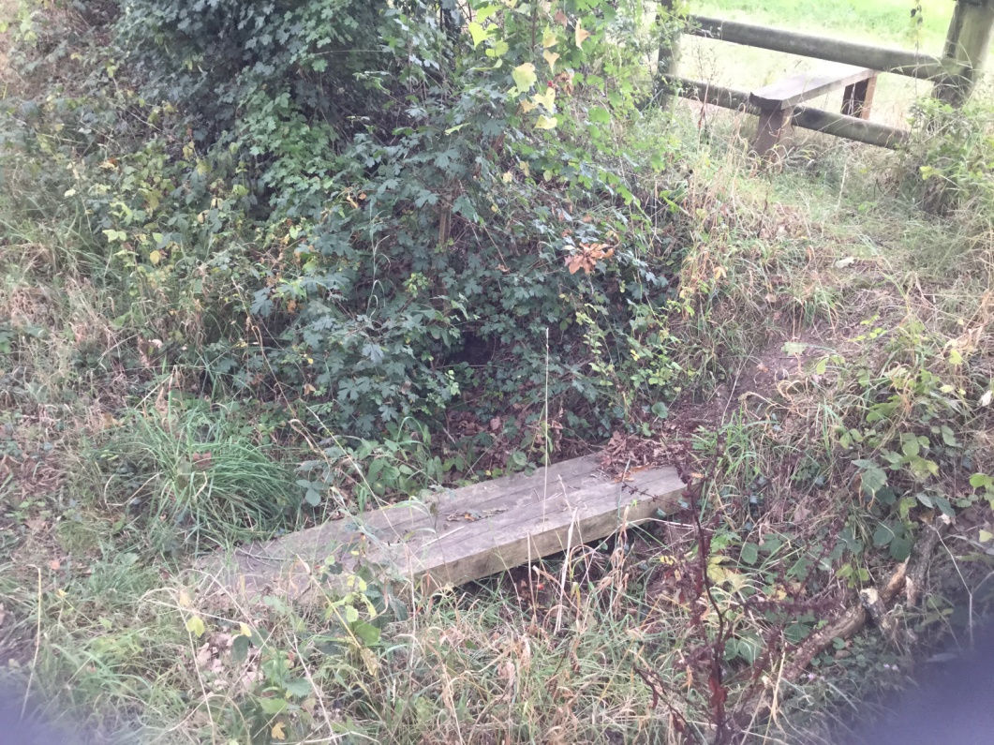
Ditch Crossing – Dodford Road

Slide 8
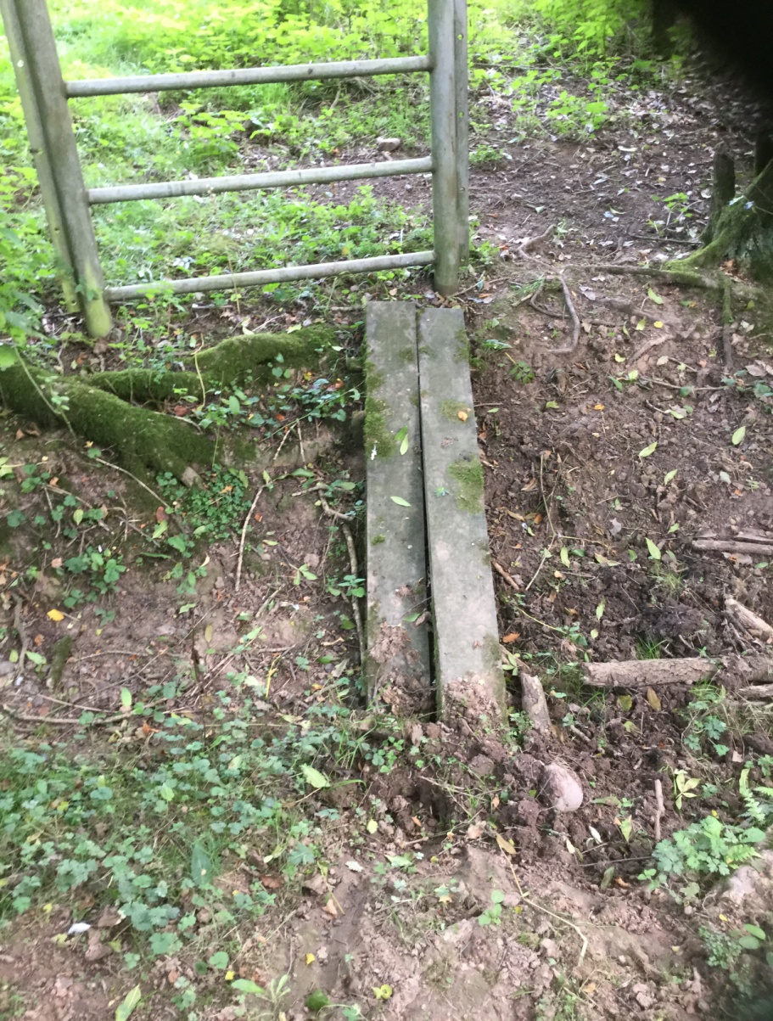
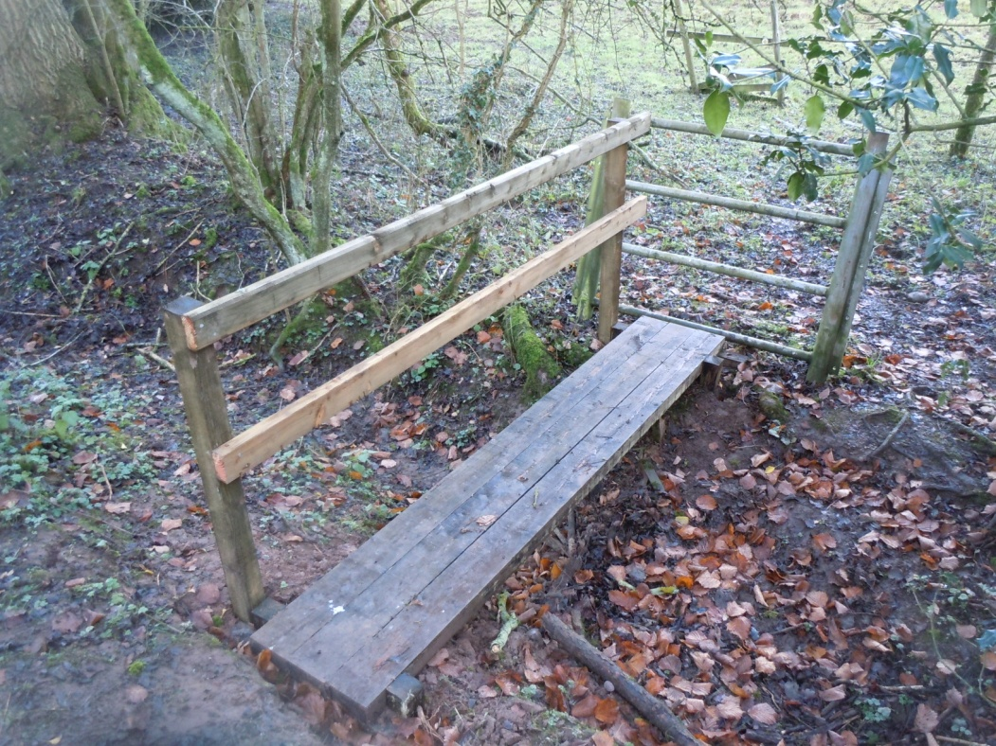
Ditch Crossing – Nr Hockley Brook Lane

Slide 9
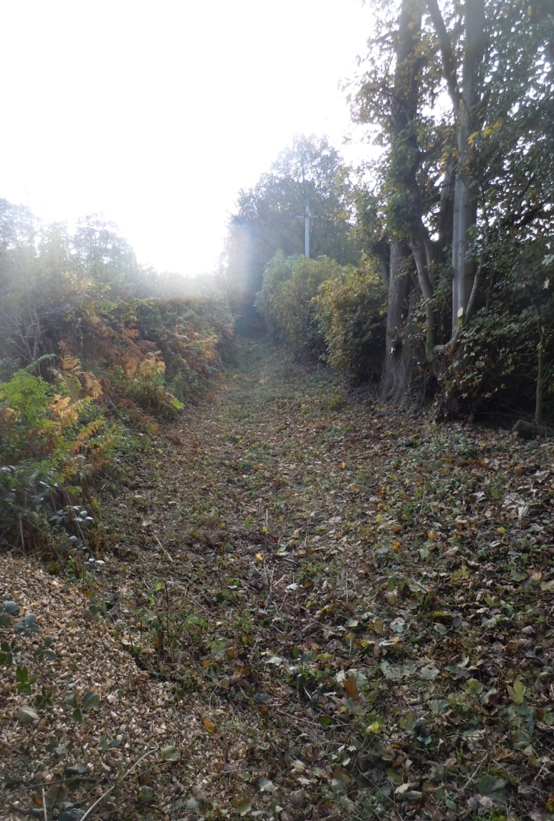
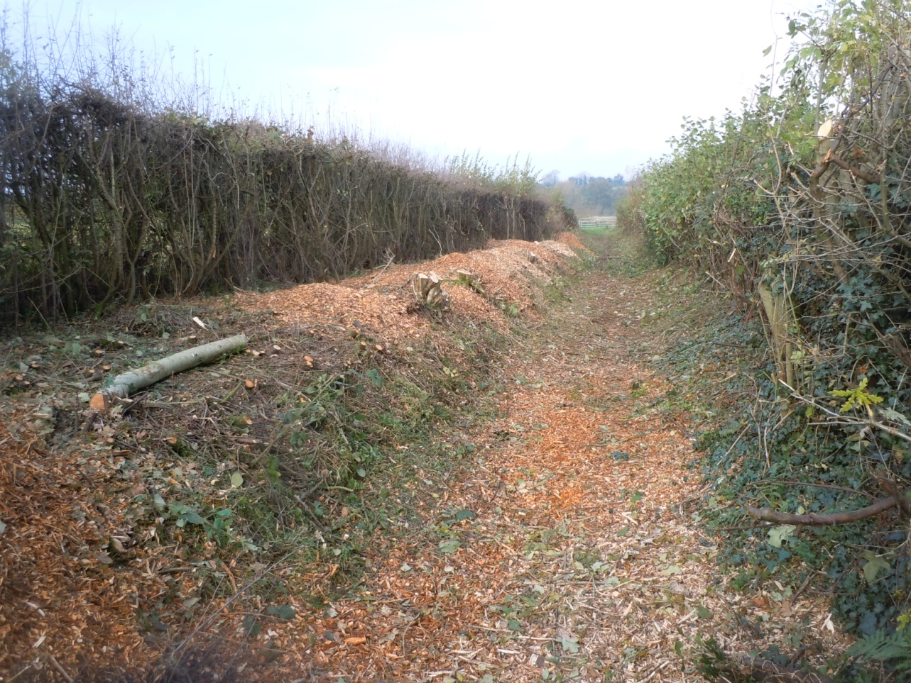
Moorfields Farm to Drayton

Slide 10
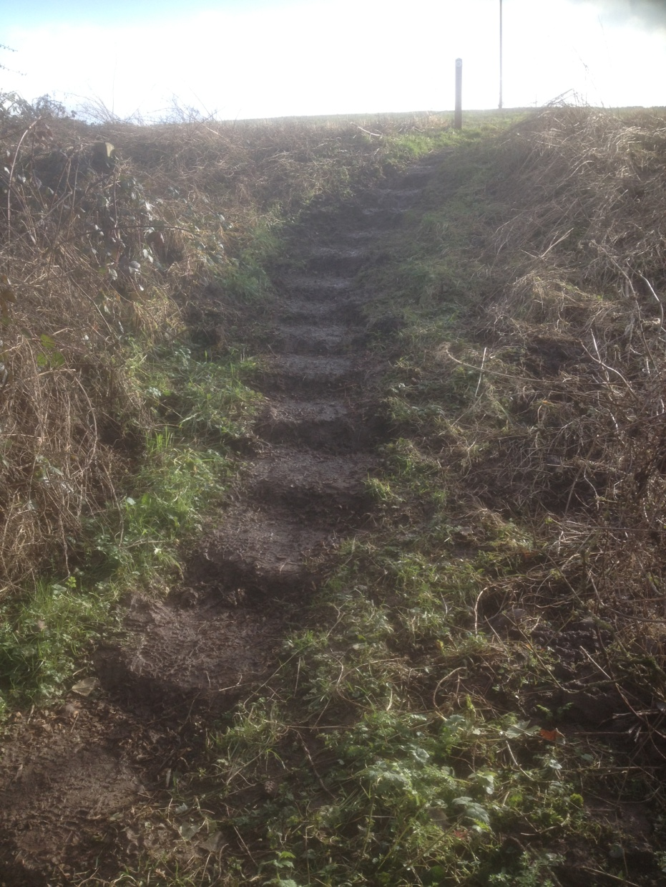
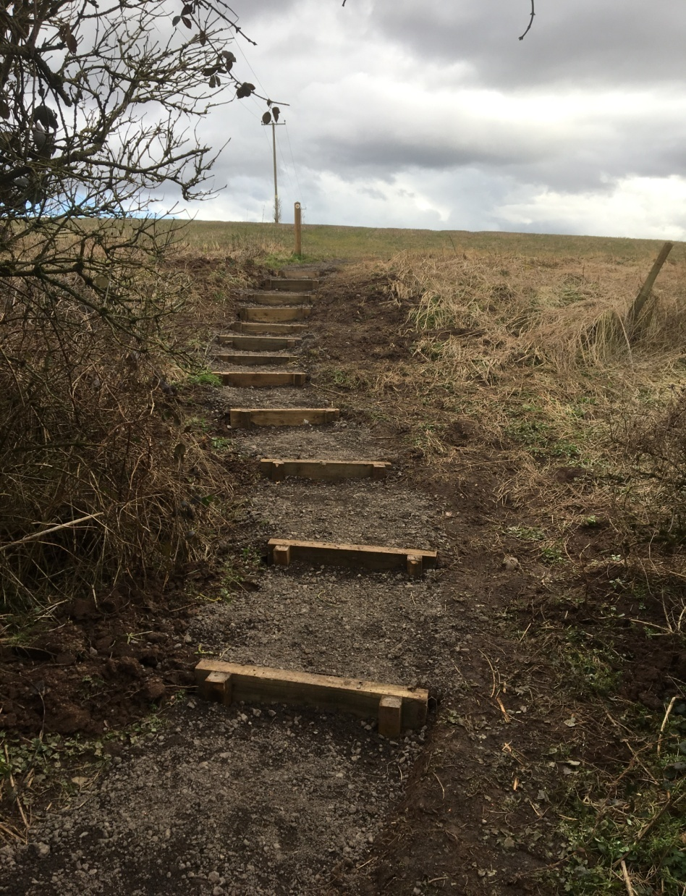
New Steps by Drayton path bridge

Slide 11
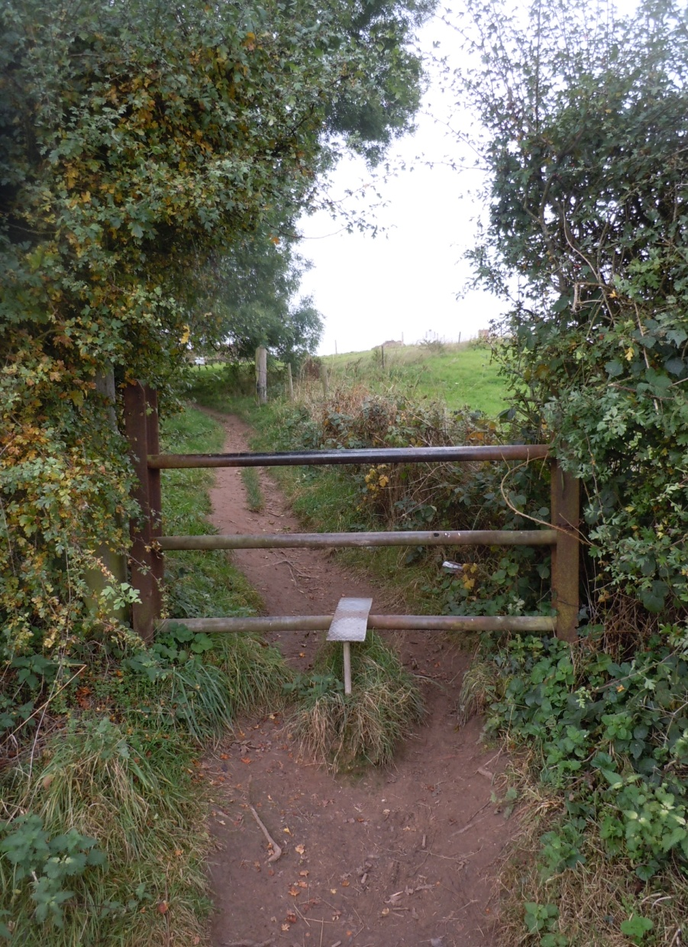
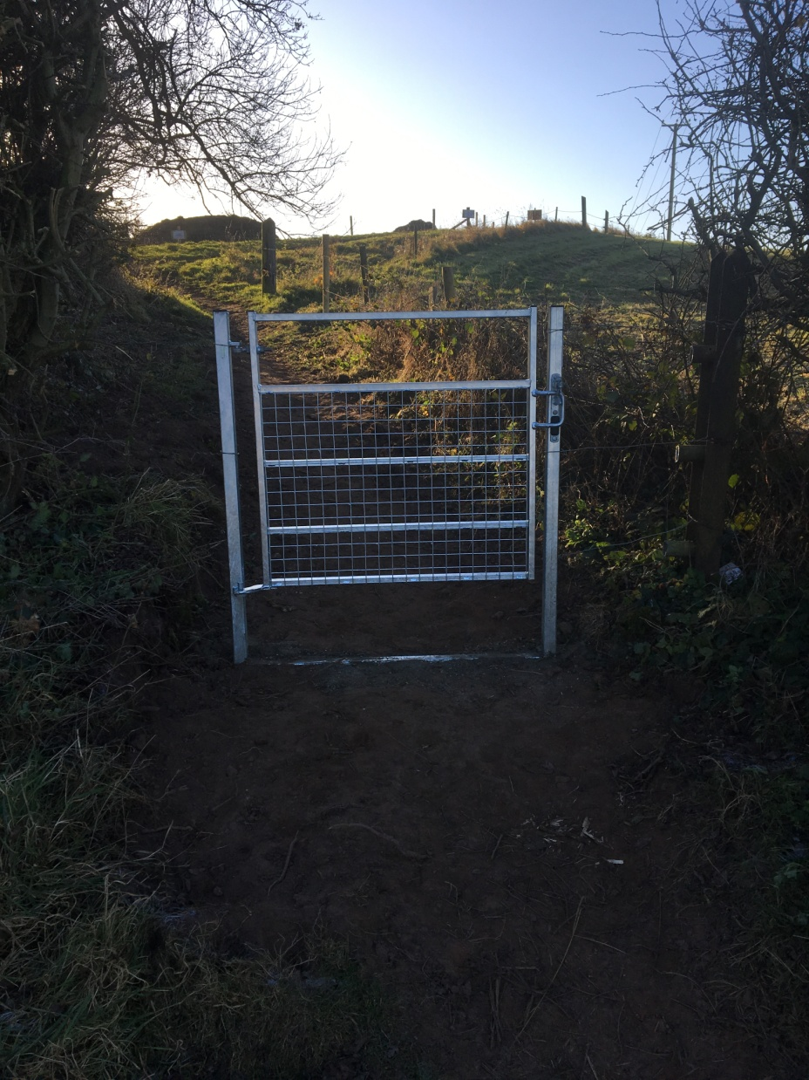
New Gate

Slide 12
ST Resilience Project
All paths have remained open
Pipeline installed through footpath crossovers
Awaiting surface re-instatement

Slide 13
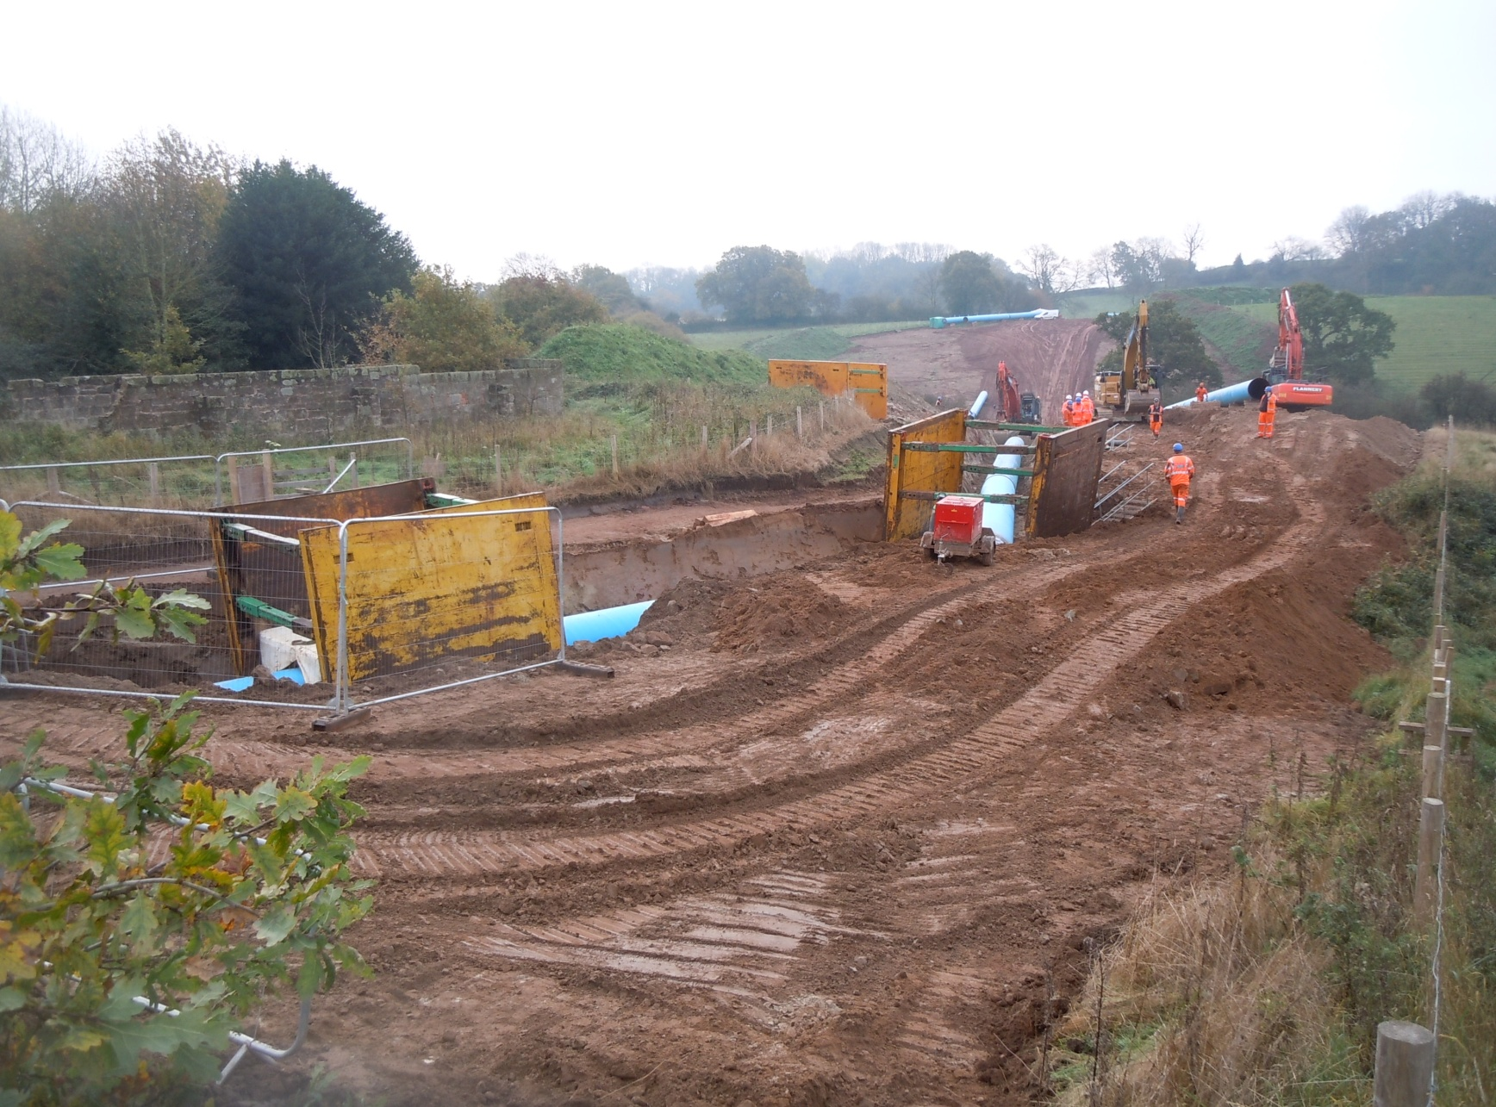
Pipeline at New Barn

Slide 14
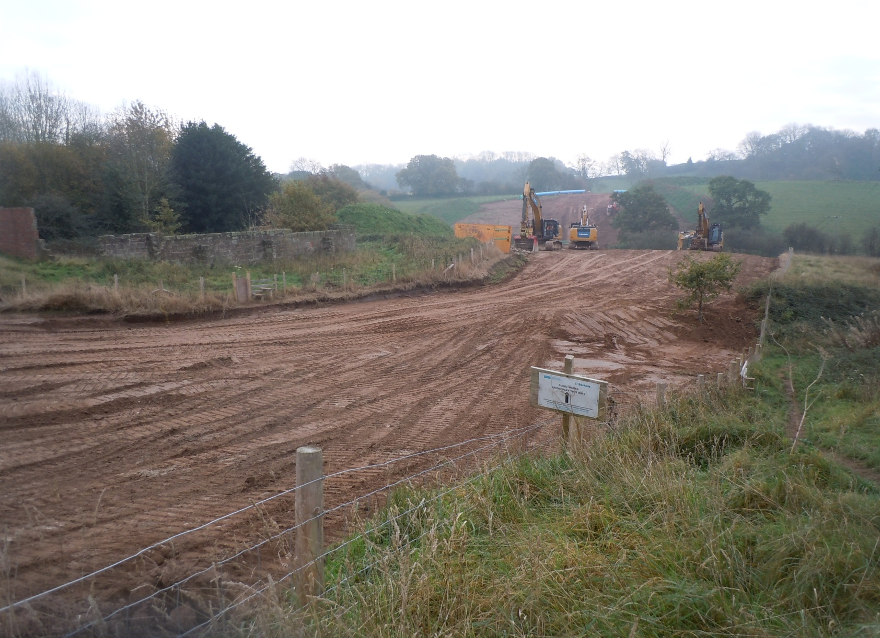
Pipeline at New Barn

Slide 15
New Path – Brookfield Farm
Current path
dangerous stile on to main road
“unpleasant” surface through farm area
New path
eliminates main road access
by-passes farm area
links to existing path system to create circulars
Application now passed all objection stages
Gates etc to be installed before final sign off

Slide 16
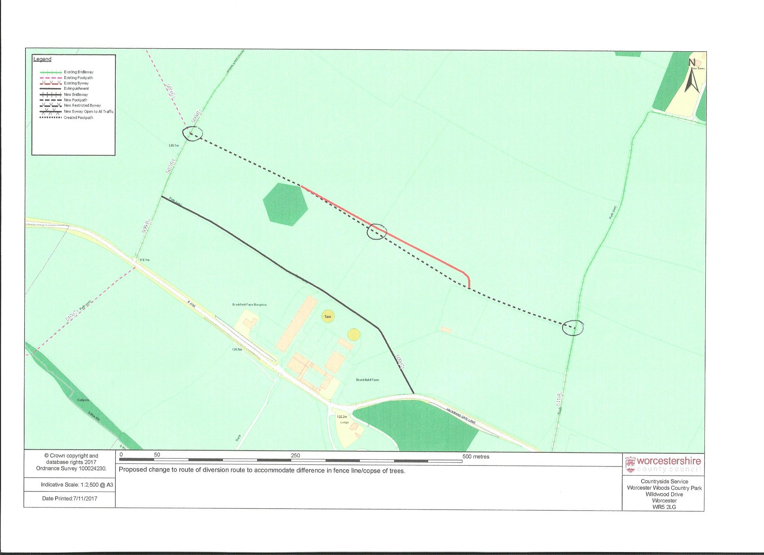
New Path – Brookfield Farm

Slide 17
2018 – 19 Plans
Continue WCC strimming programme
Continued general maintenance
Completion and opening of new path
Drainage work on Drayton path
Review possible surface works around Parish

Slide 18
Finally
Any problems or improvement suggestions
Lynne and Paul Hardcastle
01562 730511

