Slide 1

What to do if your
Lost In The Woods
A Learning Program From the Search & Rescue Foundation
www.searchandrescuefoundation.org

Slide 2
Lost in the Woods

Slide 3






Two Rules of Survival
Stay Warm!
Stay Dry!

Slide 4
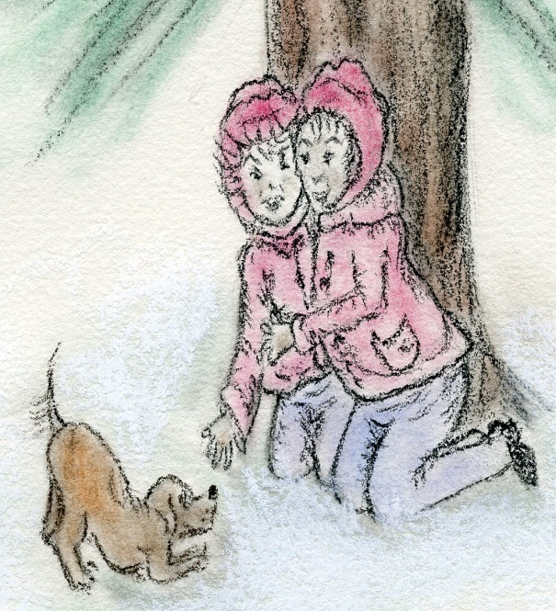

Stay Together-
Do Not Separate
If with a friend or pet!

Slide 5





Stay in one place or area!
Do not Wander!

Slide 6

Carry A Small Map
&
Compass!

Slide 7

Bring a Noisemaker!
Save Your Voice!

Slide 8
Take Some Tools!

Slide 9
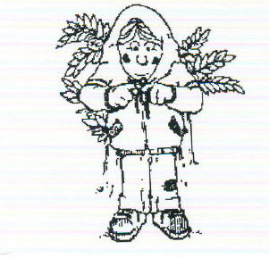

Keep Warm!
INSULATE!

Slide 10

Hug a Friend!!!
Even Navy Seals Hug to Stay Warm!

Slide 11
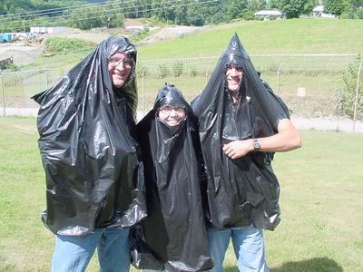
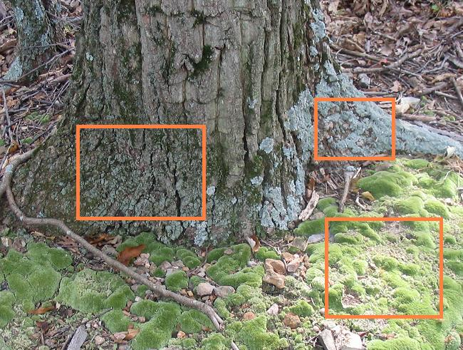

You can use insulation to create a thermal barrier to Keep you warm!
Insulation can be anything!
A plastic bag!
Leaves!
Moss!
Layers of clothes

Slide 12



You can make clothes from a plastic bag!

Slide 13
80% of your body heat is lost through top of the head and back of the neck!
  Put a plastic bag under your hat to provide -INSULATION!

Slide 14



Find a cozy waiting place…….
Not a hiding place!

Slide 15
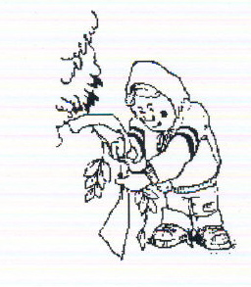

Tie A bright rag to a tree!
Use Bright Colors to Signal!

Slide 16




Make yourself into a Snow Angel!
Look Bigger For Searchers!

Slide 17



The eye sees motion!
If You hear or see rescuers signal and make noise!

Slide 18
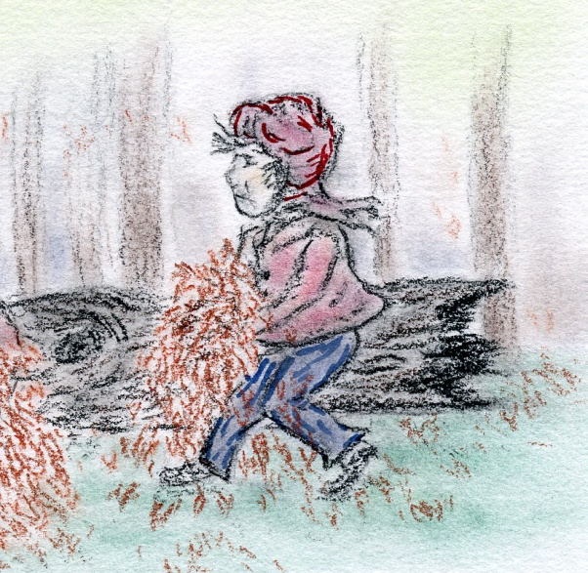
The ground will lower your body Temperature
Do not lie on the bare ground!
Insulation

Slide 19




Do not eat anything you are not
sure of!

Slide 20





Stay away from large rivers and lakes!

Slide 21
Things to Bring
Compass
Whistle
Flashlight
Pocket Tool
Plastic Bag
Food

Slide 22


