Slide 1
MCL “REPORT of OFFICER INSTALLATION” / ROI
MCL MIDWEST DIVISION MEETING / April 16–17, 2021
PROCEDURES
REPORT OF OFFICER INSTALLATION (ROI)

Slide 2
MCL “REPORT of OFFICER INSTALLATION” / ROI
MCL NATIONAL PROCEDURES
1
Section 855. Election of Officers. Each Department / Detachment shall hold an annual election and installation of officers between September 1 and June 30th. The “Report of Installation” form must be received by the National Headquarters by July 31st of each year. Any time throughout the year and there was a change in any Officer’s position, that new officer must be sworn in accordance with Administrative Procedures and a new “Report of Installation” form must be submitted. THE “REPORT OF INSTALLATION” SHOULD BE SUBMITTED TO THE DEPARTMENT ADJUTANT/PAYMASTER WHO WILL FORWARD A COPY TO DIVISION AND HEADQUARTERS / / JD FOSTER jfoster@mcleague.org
Section 920. Detachment Officers. Each Department / Detachment shall:
a. Elect a Commandant, a Senior Vice Commandant, a Junior Vice Commandant, and a Judge Advocate each year; and
b. Elect or appoint an Adjutant, Paymaster (or Adjutant/Paymaster), Chaplain, Sergeant-at-Arms and a Marine for Life liaison. Marine for Life liaison is a new position that has been added to the “Report of Installation” form. IF NO M4L LIAISON APPOINTED THE COMMANDANT ASSUMES THE TITLE AND RESPONSIBILITIES AND IS LISTED ON THE ROI REPORT.
2

Slide 3
MCL “REPORT of OFFICER INSTALLATION” / ROI
MCL NATIONAL PROCEDURES
3
Section 925 / Officer Changes
(7) INSTALLATION AND REPORT OF INSTALLATION REPORT Submission. Upon appointing a member to any new position on the Detachment staff, the Department Commandant, Detachment Commandant, or any Past Commandant, in the case of a newly appointed Commandant, will swear in the officer to the new position and submit the revised “Report of Installation” form as specified in the National Administrative Procedures.
THE “REPORT OF INSTALLATION” SHOULD BE SUBMITTED TO THE DEPARTMENT ADJUTANT/PAYMASTER WHO WILL RETAIN A COPY AND FORWARD A COPY TO DIVISION COMMANDANT AND HEADQUARTERS.
NEW PROCEDURE – SIGNATURE
IF THE COMPLETED ROI IS EMAILED TO THE DEPARTMENT ADJUTANT or ADJUTANT/PAYMASTER BY THE DETACHMENT COMMANDANT OR DETACHMENT PAYMASTER THIS WILL SERVE AS A LEGAL SIGNED DOCUMENT, NO OTHER SIGNATURES REQUIRED. SAME PROCEDURES FOR DEPARTMENT ROI.

Slide 4
MCL “REPORT of OFFICER INSTALLATION” / ROI
WHAT IS A PROFILE ID?
NEW
A PROFILE ID IS A UNIQUE IDENTIFIER CODE FOR EACH MCL MEMBER & DETACHMENT IN THE MCL INFORMATION SYSTEM DATABASE.
THE PROFILE ID WILL NOW APPEAR ON ALL REPORTS GENERATED FROM THE MCL INFORMATION SYSTEM.
THE DETACHMENT ROSTER CAN NOW BE GENERATED & PRINTED FOR DETACHMENTS AT THE DEPARTMENT LEVEL.

Slide 5
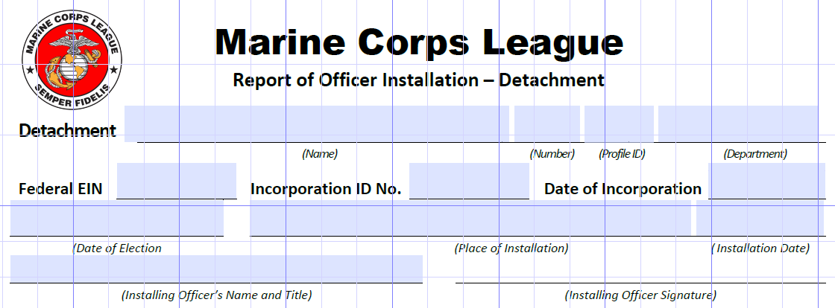
MCL “REPORT of OFFICER INSTALLATION” / ROI
Don’t communicate to be understood. Communicate so you can not be misunderstood.
NOTE; THERE IS A DEPARTMENT FORM AND A DETACHMENT FORM TO DOWNLOAD
DOWNLOAD FROM THE MCL LIBRARY EACH TIME TO MAKE SURE YOU ARE USING THE CURRENT VERSION OF THE FORM

Slide 6
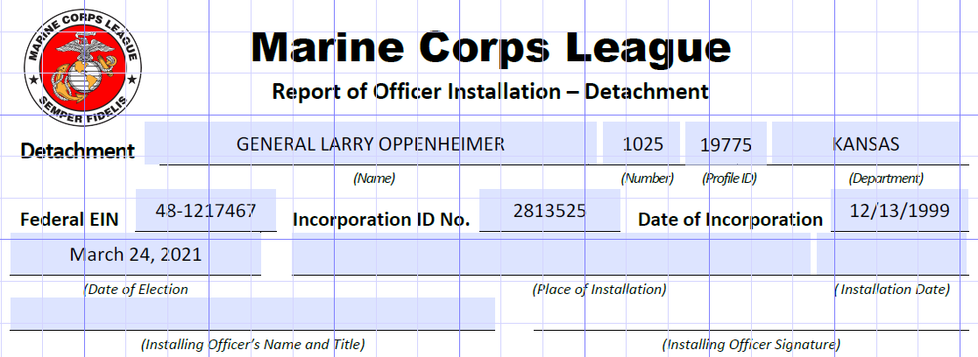
MCL “REPORT of OFFICER INSTALLATION” / ROI
Don’t communicate to be understood. Communicate so you can not be misunderstood.
EIN / FEDERAL EMPLOYEE IDENTIFICATION NUMBER – USED TO FILE YOUR YEARLY 990 FEDERAL PAPERWORK
INCORPORATION ID NUMBER / THIS IS YOUR STATE IDENTIFICATION NUMBER ASSIGNED WHEN INCORPORATED
DATE OF INCORPORATION / THE DATE YOUR STATE ASSIGINED YOU THE INCORPORATION ID NUMBER
PROFILE ID / UNIQUE IDENTIFIER IN THE MCL DATABASE FOR EACH DETACHMENT
THESE NUMBERS NEVER CHANGE UNLESS YOU HAD A PROBLEM IN THE PAST / UNIQUE TO YOUR CORPORATION

Slide 7
MCL “REPORT of OFFICER INSTALLATION” / ROI
SECRETARY OF STATE RECORDS – THESE ARE LEGAL DOCUMENTS OF THE DETACHMENT CORPORATION
IF OFFICERS HAVE CHANGED FROM CURRENT OFFICERS ON FILE WITH YOUR SECRETARY OF STATE SEND IN A CORRECTED DOCUMENT FOR TAX RECORD ON FILE.
SECRETARY OF STATE WEB ADDRESSES
IOWA – https://sos.iowa.gov/search/business/search.aspx
KANSAS – https://www.kansas.gov/bess/flow/main?execution=e1s4
MINNESOTA - https://mblsportal.sos.state.mn.us/Business/Search
MISSOURI - https://bsd.sos.mo.gov/search
NEBRASKA – https://www.nebraska.gov/sos/corp/corpsearch.cgi?nav=search
NORT DAKOTA – https://firststop.sos.nd.gov/search/business
SOUTH DAKOTA – https://sosenterprise.sd.gov/BusinessServices/Business/FilingSearch.aspx
FEDERAL EIN NON-FOR-PROFIT ORGANIZATION WEB ADDRESS
Federal EIN Organization Search: https://apps.irs.gov/app/eos/

Slide 8
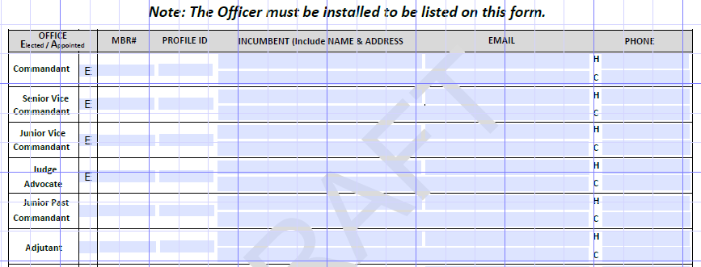
MCL “REPORT of OFFICER INSTALLATION” / ROI
Don’t communicate to be understood. Communicate so you can not be misunderstood.
FILL FORM OUT COMPLETELY / ALL BOXES
ELECTED OFFICERS SHALL INCLUDE; Commandant, Sr. Vice Commandant, Jr. Vice Commandant, Judge Advocate
All other officers can be E lected or A ppointed depending on your By-laws / Procedures
NOTE: EACH MCL MEMBER HAS THEIR OWN UNIQUE PROFILE ID IDENTIFER NUMBER IN THE DATABASE
MEMBER MUST BE PRESENT TO BE INSTALLED
NOTE: THIS DATA WILL BE ENTERED INTO THE MCL INFORMATION SYSTEM

Slide 9
MCL “REPORT of OFFICER INSTALLATION” / ROI
FILL FORM OUT COMPLETELY
NOTE: THIS DATA WILL BE ENTERED INTO THE MCL INFORMATION SYSTEM AS SUBMITTED
IF THE COMPLETED ROI IS EMAILED TO THE DEPARTMENT ADJUTANT/PAYMASTER BY THE DETACHMENT COMMANDANT OR DETACHMENT PAYMASTER THIS WILL SERVE AS A LEGAL SIGNED DOCUMENT, NO OTHER SIGNATURES REQUIRED. SAME PROCEDURES FOR DEPARTMENT ROI.

Slide 10
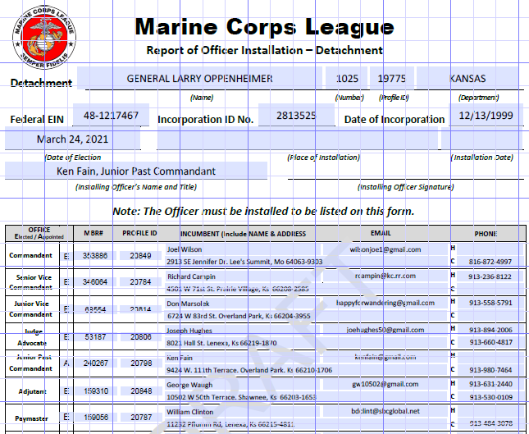
MCL “REPORT of OFFICER INSTALLATION” / ROI
NEW
M4L APPOINTED POSITION
COMMANDANT IS DEFAULT PERSON IF NO OTHER MEMBER APPOINTED

Slide 11
MCL “REPORT of OFFICER INSTALLATION” / ROI
MCL MIDWEST DIVISION MEETING / April 16–17, 2021
TRAINING WEBSITE
www.mcleaguekansas.com/midwest.html

