Slide 1
Article 10
Plastic Bag Reduction in Business Establishments

Slide 2
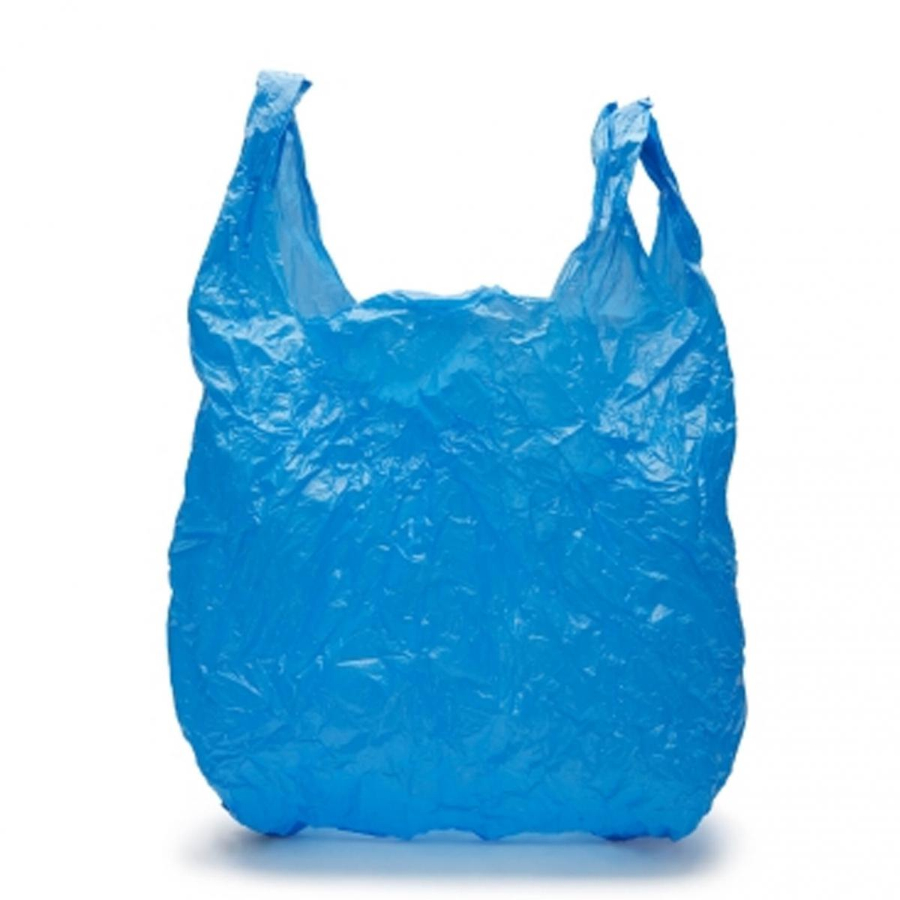
What’s The Problem ?
TOO MANY SINGLE USE BAGS
NOT RECYCLED
POLLUTE OUR ENVIRONMENT
HARMFUL TO ANIMAL LIFE

Slide 3
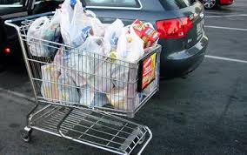
How Many is Too Many?
100 billion plastic bags are used in the U.S. every year
Most discarded after one use
On average, 15 plastic bags per trip to the grocery store
Notes:
According to The Wall Street Journal, the U.S. goes through 100 billion plastic shopping bags annually.
According to a Mass Food Association survey, in 2012 the average supermarket in Massachusetts dispensed over two and one half million disposable bags – 2,682,643.
The average family shopper returns home with 15 bags per trip to the grocery store, and by some estimates, each plastic shopping bag is in use for an average of 12 minutes and approximately 90% are discarded after one use.

Slide 4
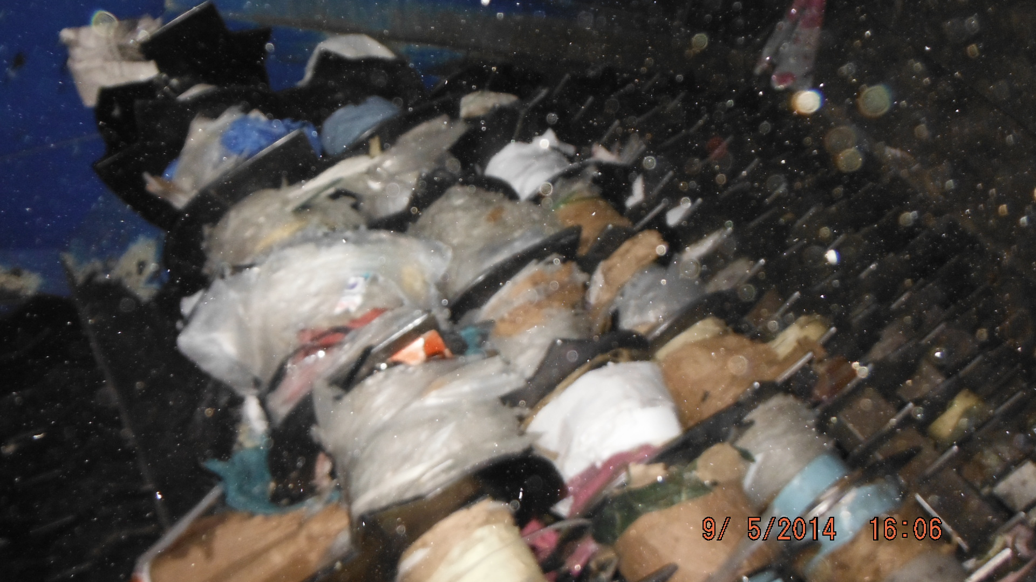
Infrequently Recycled
and Disposed of Improperly
Low rates of voluntary recycling
Costs more to recycle a plastic bag than to make a new one
Not appropriate for municipal curb-side recycling
Clog and damage the mechanisms of recycling machinery
Notes:
Years of efforts to educate the public and encourage recycling have failed to increase recycling rates for plastic bags, which are estimated to be between 3-10% nationwide.
Recycling is not particularly cost-effective - it actually costs more to recycle a bag than make a new one.
Plastic bags also can’t be recycled in our municipal curbside recycling bins. Those that are disposed of improperly get entangled every day in recycling machinery, causing ongoing labor and repair costs for these facilities.

Slide 5
Pollute our Environment
On land, bags take 500 to 1000 years to decompose
Light weight – windblown debris can easily reach far- away woods and waterways
In landfills, release CO2 which promotes the leaking of other gases including methane
Contaminate terrestrial, freshwater and marine habitats
Notes:
On land, plastic bags take 500 to 1000 years to decompose
Light weight – windblown debris can easily reach far- away woods and waterways
In landfills – release CO2 which promotes the leaking of other gases including methane
Contaminate a wide range of natural terrestrial, freshwater and marine habitats

Slide 6
Pollute our Environment
Litter our roadsides
Pollute our streams and woods
Clog storm drains
Notes:
Plastic Bags are the 3rd largest source of litter on U.S. Coasts, surpassed only by cigarette butts & bottle caps. Plastic bags clogs storm drains, litter roadsides and get caught in trees.
You can see them all around town, once you stop to look…

Slide 7
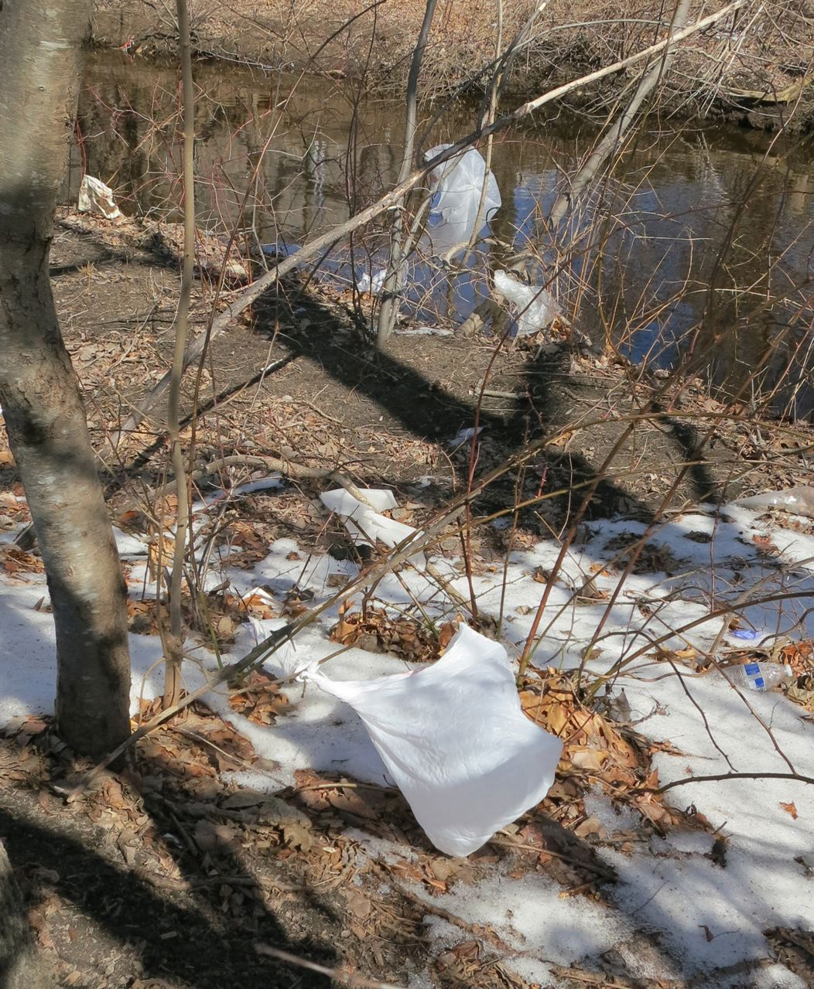
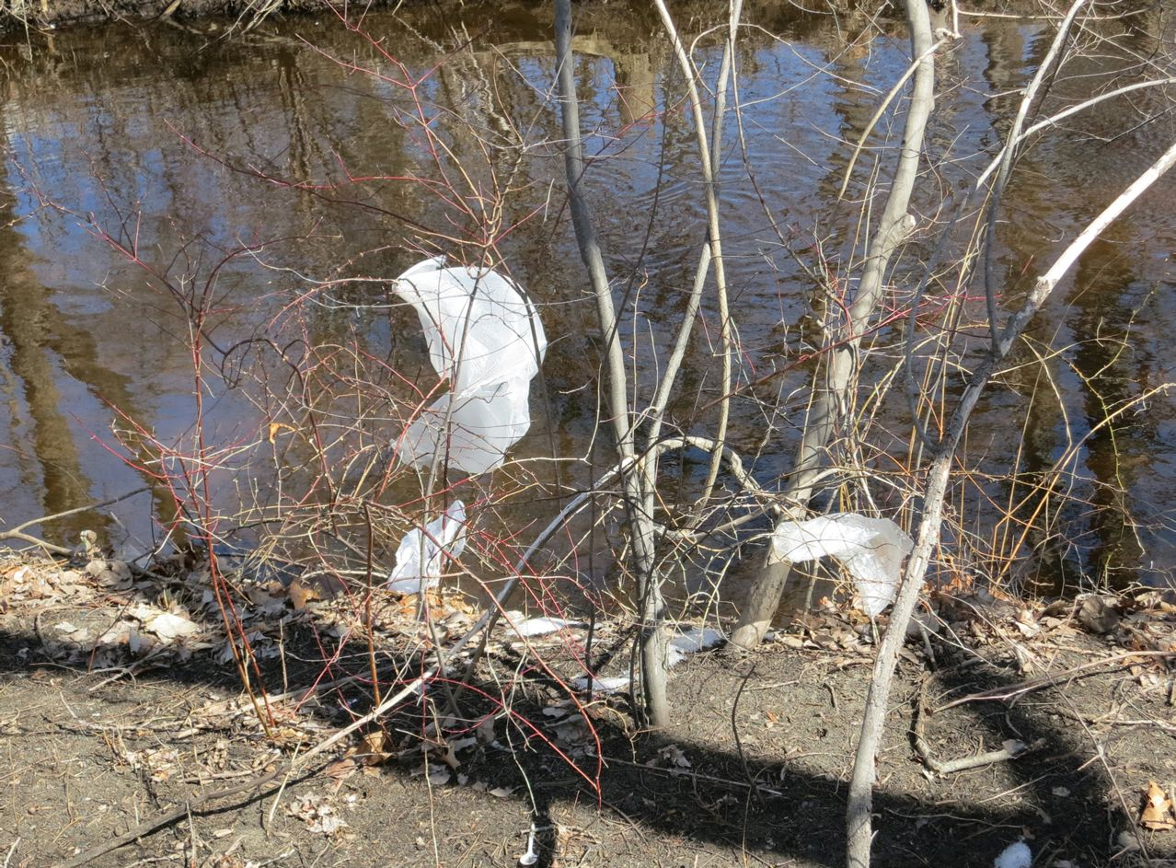
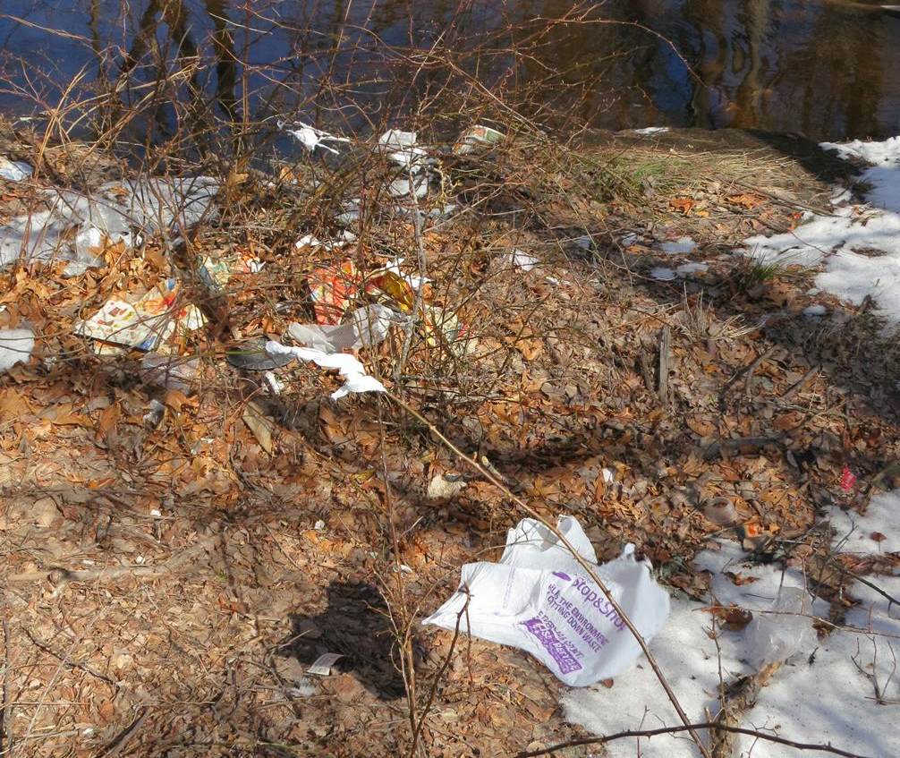
Notes:
Here are some recent views from local woods and waterways right here in town…

Slide 8
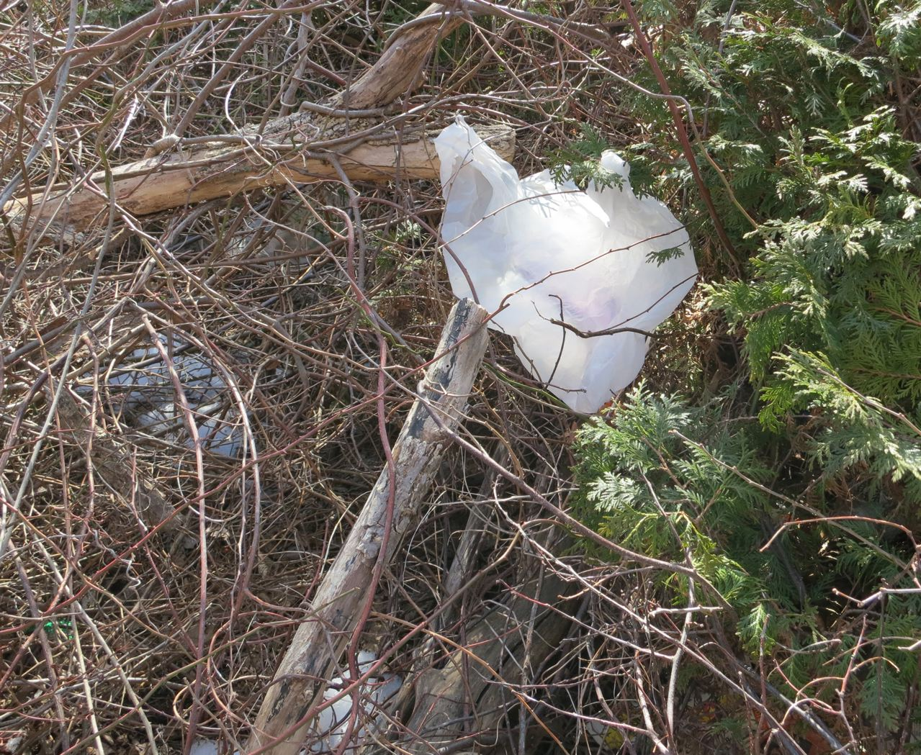

Slide 9
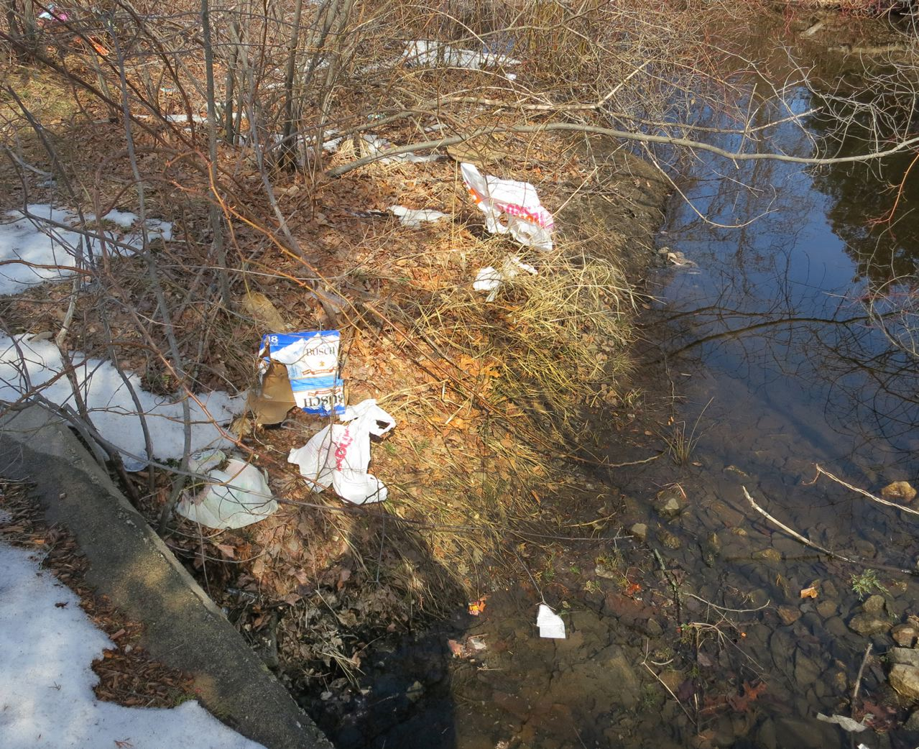

Slide 10
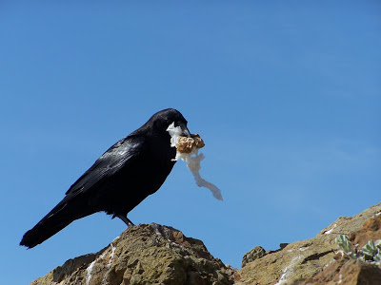
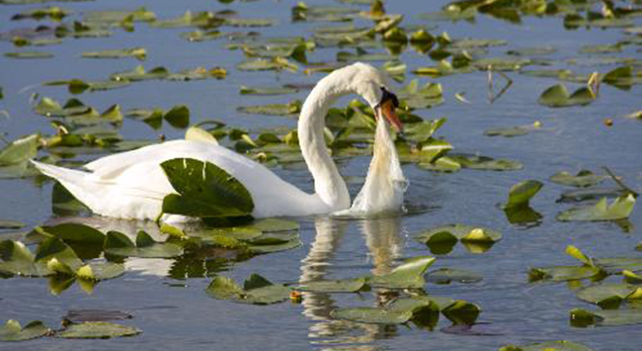
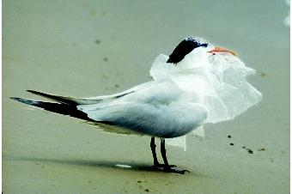
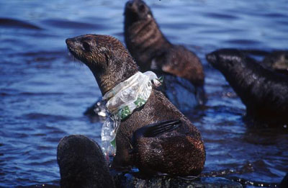
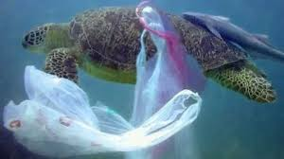
Harm Birds and Aquatic Wildlife
Notes:
The harm plastic bags do to the environment is well known. Researchers in Australia estimate that ALL of the worlds sea birds have plastic in their systems, and plastic bags are estimated to cause over 100,000 sea turtle and other marine animal deaths every year.

Slide 11
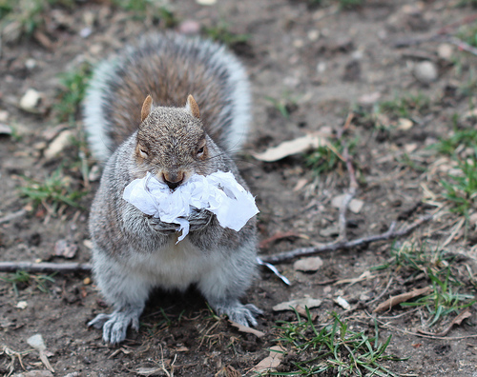
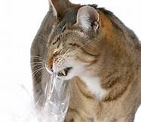
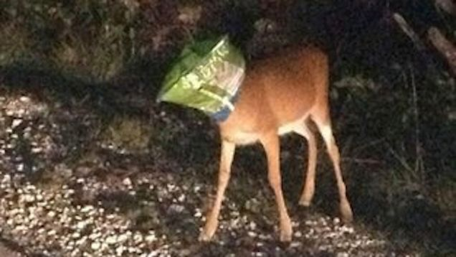
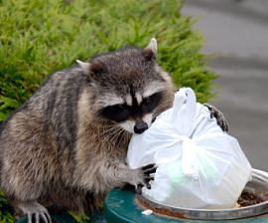
Harm Terrestrial Wildlife
and Pets
Notes:
Terrestrial wildlife, farm animals, and pets are also harmed by plastic bags. When plastic bags accumulate in animals’ stomachs, intestinal blockages can lead to starvation and death.

Slide 12
Microplastics and Human Health
Tiny pieces (microplastics) enter waterways and flow into the ocean
Absorb and concentrate pollutants present in the water
Pollutants bioaccumulate in small marine life when they mistake microplastics for food, and move up the aquatic food chain
Extent of possible harm to human health is being researched by EPA
Source: Environmental Health Perspectives • vol. 123, no. 2 • Feb. 2015
Notes:
There is also reason to be concerned about the accumulation of plastics in our seafood. When plastics break up into tiny pieces, they wash away into our waterways and ultimately reach the ocean, where they absorb pollutants already present in the water.
These pollutants bioaccumulate in marine animals when they mistake plastic for plankton, and move up the food chain to the fish that we eventually eat.
EPA chemist Richard Engler concluded, “While current research cannot quantify the amount, plastic in the ocean does appear to contribute to [persistent, bioaccumulative, and toxic substances] in the human diet.”1

Slide 13
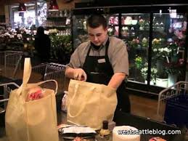
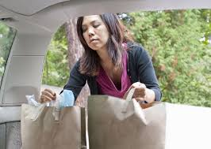
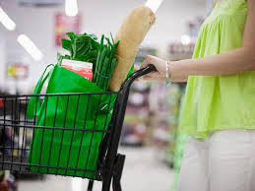
What’s The Solution ?
Source Reduction
Notes:
So what is the solution? We’re not obviously going to go back to a pre-plastic era, and of course there are uses of plastic that are very beneficial. But single-use plastic bags are not one of them.
And while there are many types of plastic pollution in our environment, plastic bags are among the most needless and egregious. Their environmental impact and the scale of their waste far outweighs their convenience.
The purpose of the bylaw amendment before us tonight is to do what we can to improve this situation by reducing the numbers of plastic bags at their source.

Slide 14
Article 10 Bylaw Amendment
Eliminates thin-film plastic checkout bags at all retail and grocery stores in Bedford starting on October 1st 2017
Notes:
Article 10 proposes the elimination of thin-film plastic checkout bags at all retail and grocery stores in Bedford starting on October 1st 2017.

Slide 15
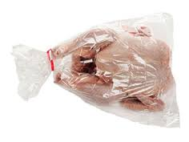
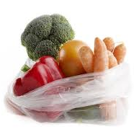
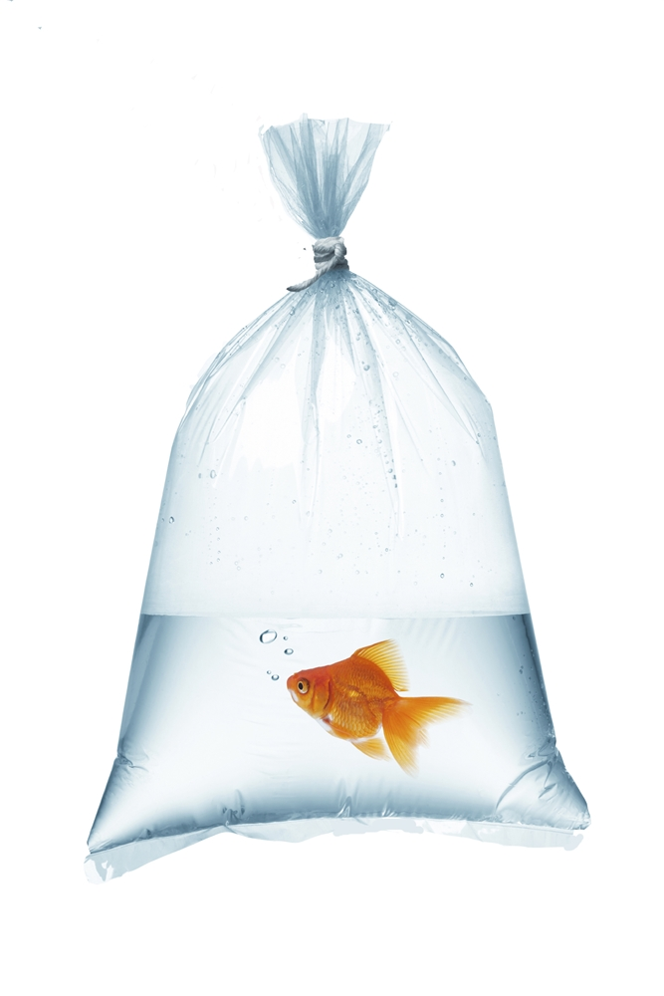
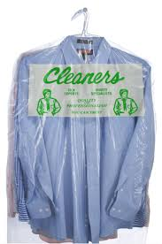
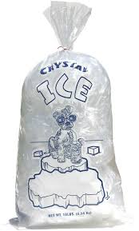
Bags that would still be allowed
Notes:
Bags for newspapers, dry cleaning, produce, meat, and bulk items would still be allowed. Products that come packaged in plastic will not be affected.

Slide 16
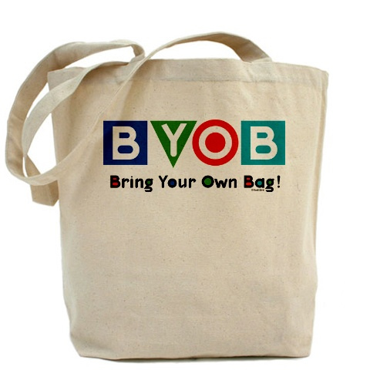
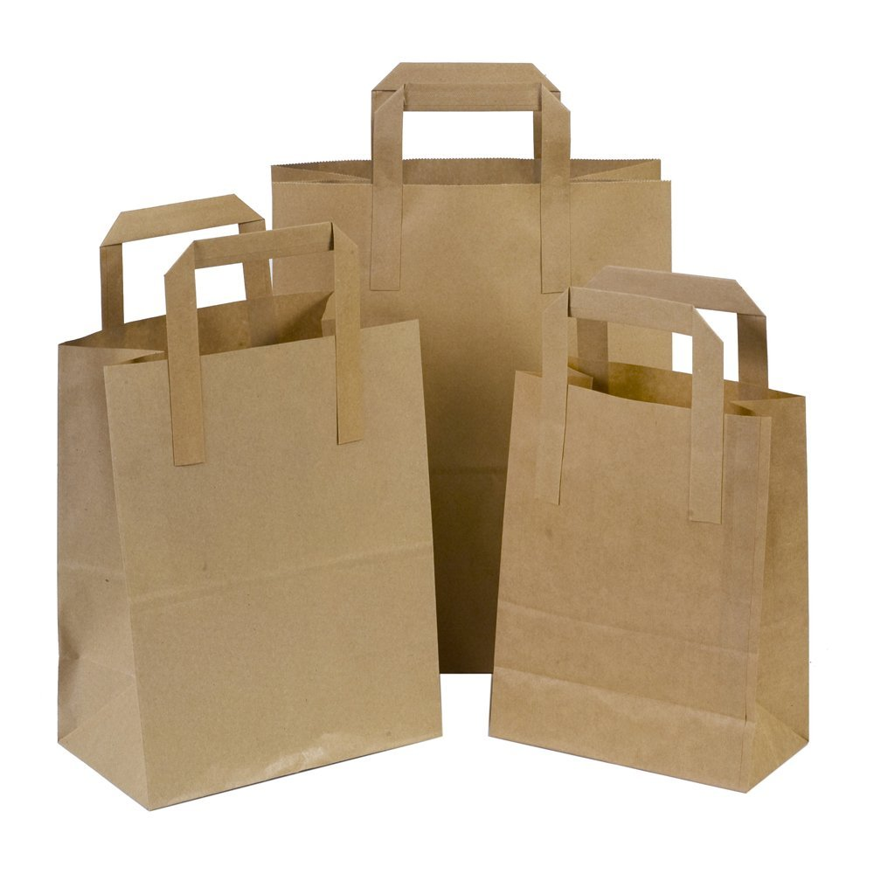
Many alternatives
Notes:
There are many alternatives to single-use plastic bags available, and under our proposed bylaw, businesses may provide thicker plastic bags that can be reused multiple times, or they may choose to follow the lead of Trader Joe’s and Whole Foods and only provide paper.
Customers are also encouraged to bring their own bags, whether canvass, paper or recycled plastic – and if having a light-weight bag with handles is important to you, there are nylon bags, such as the red one on the left of this slide, and this one I brought to show you tonight, which folds up conveniently into this little pouch, that are essentially identical in size and shape to the single-use plastic bags, but much sturdier and infinitely reusable.

Slide 17
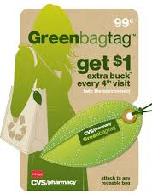
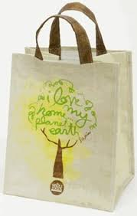
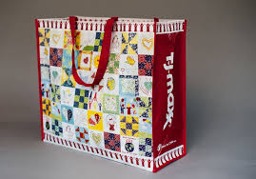
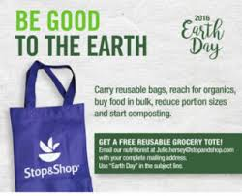
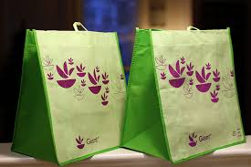
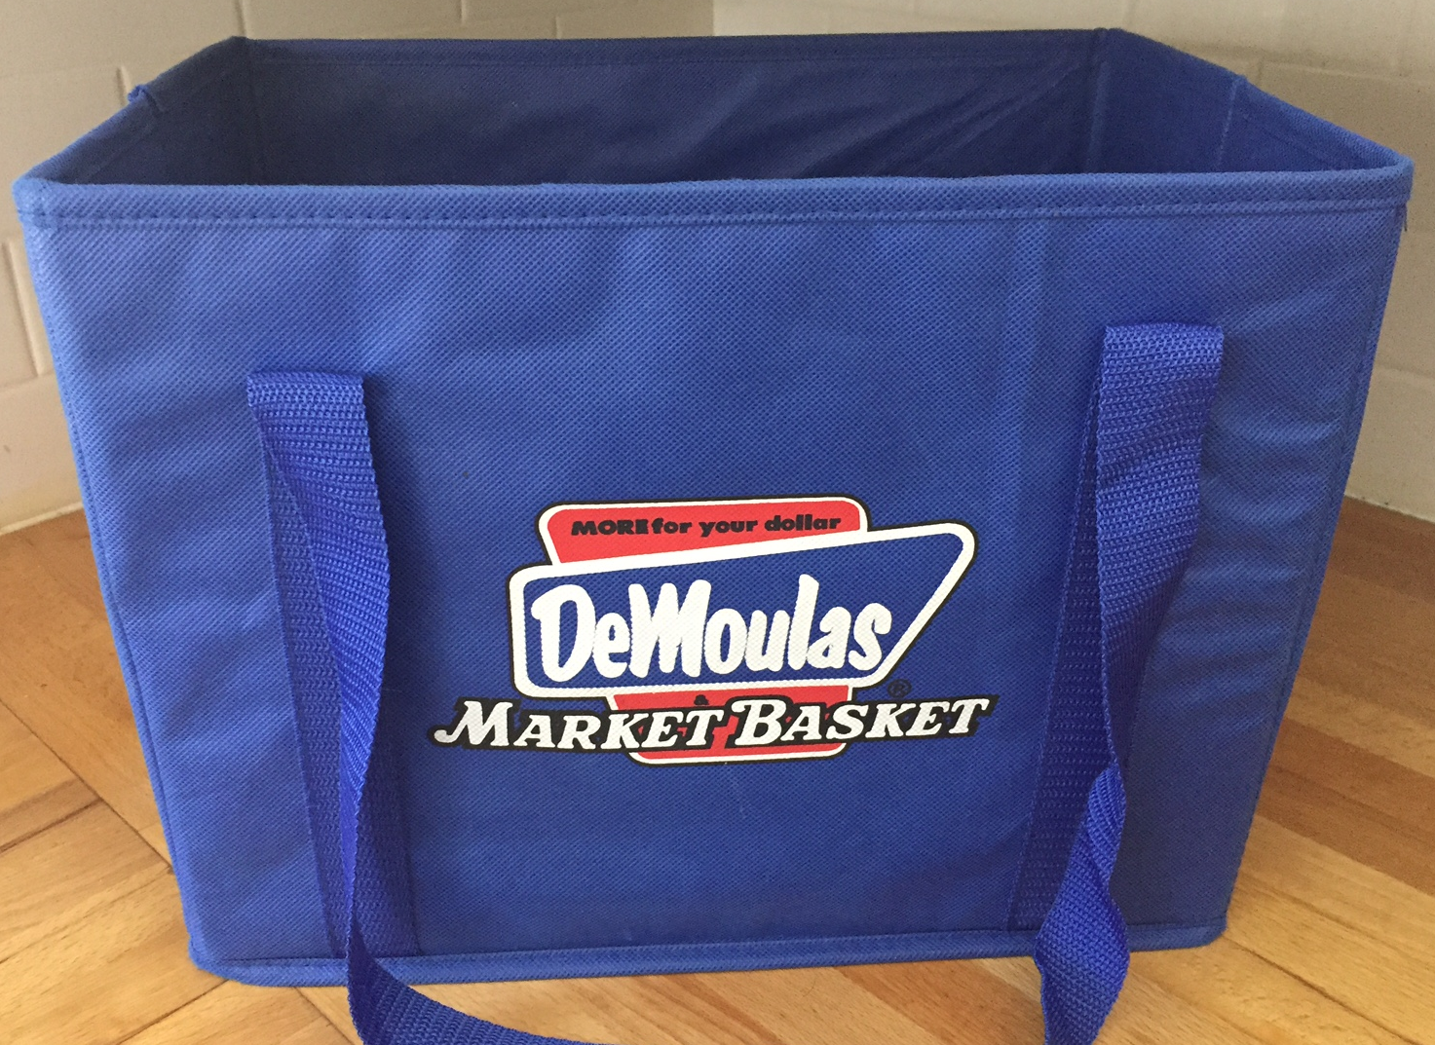
Options widely promoted by retailers
Notes:
A whole range of retailers and grocery stores already make available to shoppers a variety of bag and basket options, and often promote these reusable items with incentives, rebates and bag giveaways.
Here’s an assortment from local stores: CVS, TJ Maxx, Whole Foods, Stop and Shop, Market Basket and Trader Joe’s.

Slide 18
43 Massachusetts Cities and Towns with Bans + 9 Proposed
Adams
Amherst
Aquinnah
Barnstable
Bedford
Boston
Bourne
Bridgewater
Brookline
Cambridge
Chatham
Chilmark
Concord
Dennis
Duxbury
Edgartown
Falmouth
Framingham
Franklin
Great Barrington
Hamilton
Harwich
Ipswich
Lee
Lenox
Lincoln
Manchester-by-the- Sea
Marblehead
Mashpee
Nantucket
Natick
Newburyport
Newton
Northampton
Pittsfield
Provincetown
Plymouth
Salem
Sandwich
Shrewsbury
Springfield
Somerville
Tisbury
Truro
Watertown
Wayland
Wellesley
Wellfleet
Weston
West Tisbury
Williamstown
Yarmouth
PASSED
PROPOSED
Notes:
Plastic bag bans are becoming much more mainstream, around the country, around the world, and right here in Massachusetts.
Here is a list of the 43 Massachusetts cities and towns that have already passed these sorts of regulations, plus 9 more that are in the process of considering them.
This puts our efforts, which might seem insignificant considering our small size, into the context of a larger movement to address plastic bag pollution at a local and state level.

Slide 19
Selectmen Recommend Approval of Article 10
Notes:
Single use plastic bags have become so ubiquitous, it seems like we cannot live without them. But with a little will, we can take steps to reduce their use.
Article 10 gives Bedford the chance to address this problem locally and join with over 50 other Massachusetts cities and towns in decreasing the amount of plastic pollution in our lives.
It’s not going to fix everything, but it is an important step in the right direction.
The Selectmen unanimously recommend approval of Article 10.

