Slide 1
Early Detection of COVID Pneumonia and Pulmonary Embolism via Manifestation of Ground Glass Opacity
Keerthana Srinivasan, Apanjit Sahi, Sagar Matharu, Aamna Siddiqui, Sofia Bhalwani, Sourabh Vellala, Arvinder Uppal, MD, Harpal Mangat, MD
Presented Christian Medical Association National Conference 2021

Slide 2
Introduction

Slide 3
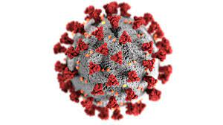
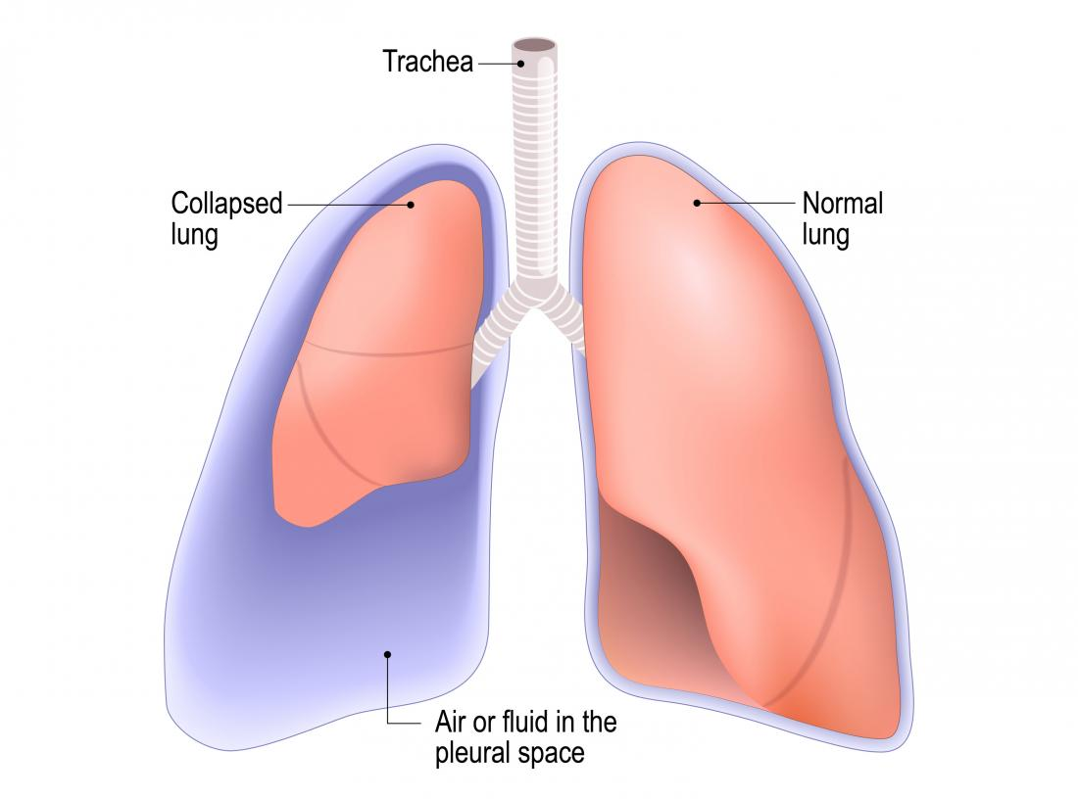
COVID and Acute Respiratory Distress Syndrome
COVID
ARDS
Low oxygen in blood
8-10 days after onset of infection
Cytokine Storm
Hyaluronic Acid deposition + ARDS
Ground Glass Opacity (GGO)
Shortness of Breath
Pneumonia
Sepsis (later stages)

Slide 4
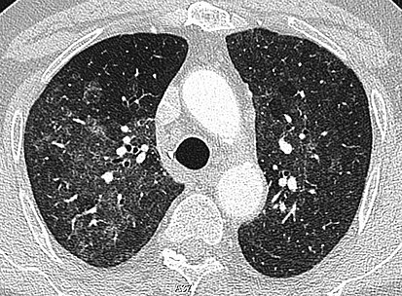
Ground Glass Opacities: an indication for Pulmonary Embolism
GGOs are Hazy ”grey areas” that can show up in diseased lungs
Studies have shown correlation between presence of pulmonary emboli (PE) and GGO
GGO can provide an early detection of PE

Slide 5
Case Presentation and Discussion

Slide 6
Methods
24 patients Covid Positive lab result
Shortness of Breath
Patients were advised to get 128 slice CT
4 Patients had GGO and PE

Slide 7
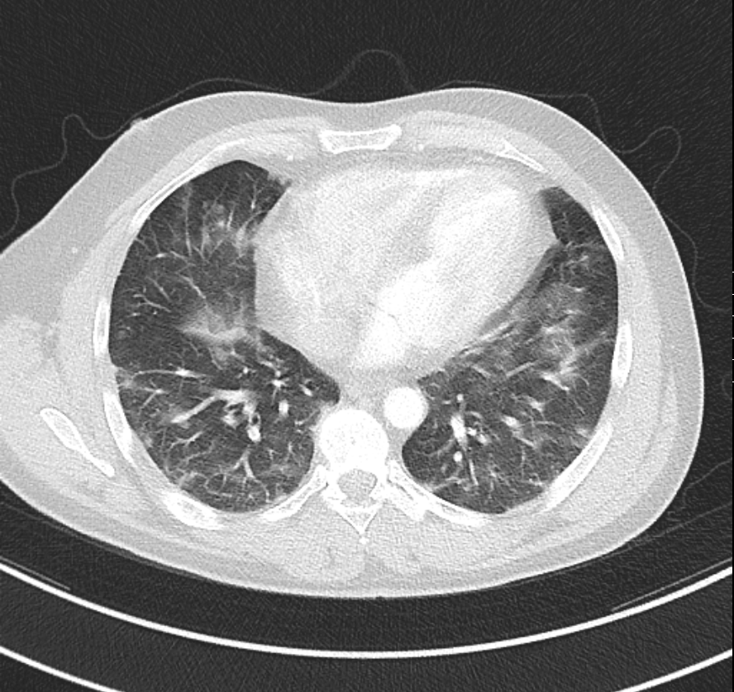
Patient 1
46 y/o Male, Positive for COVID 12/13
Patient had shortness of breath, 128 slice CT was ordered
CT revealed severe GGO and PE
Patient was admitted to Howard County Hospital for anticoagulation (PE treatment)

Slide 8
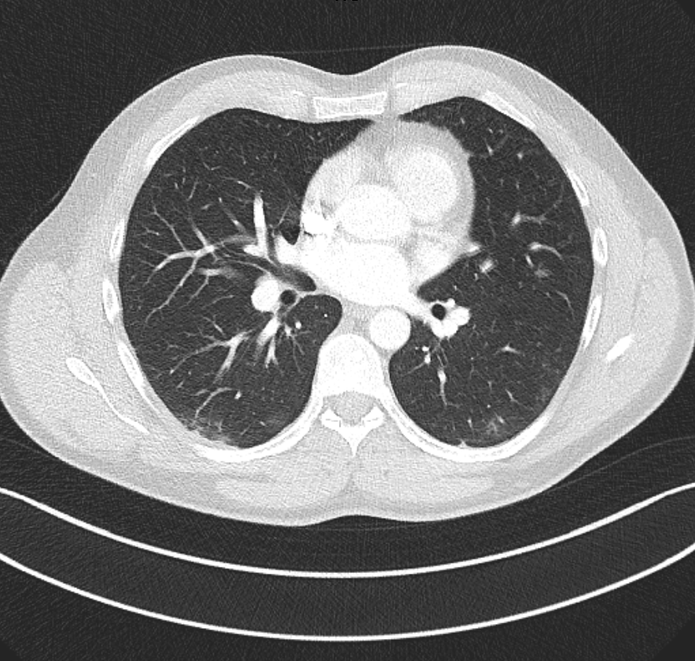
Patient 2
41 y/o male, positive for COVID 5/13, presented with dizziness, loss of smell and taste, dry cough
Patient went to ER on May 30th with Chest pain, d-dimer and chest x-ray were negative for PE
Patient received 128 slice CT that revealed PE and GGO
Patient was advised to return to the ER to treat PE

Slide 9
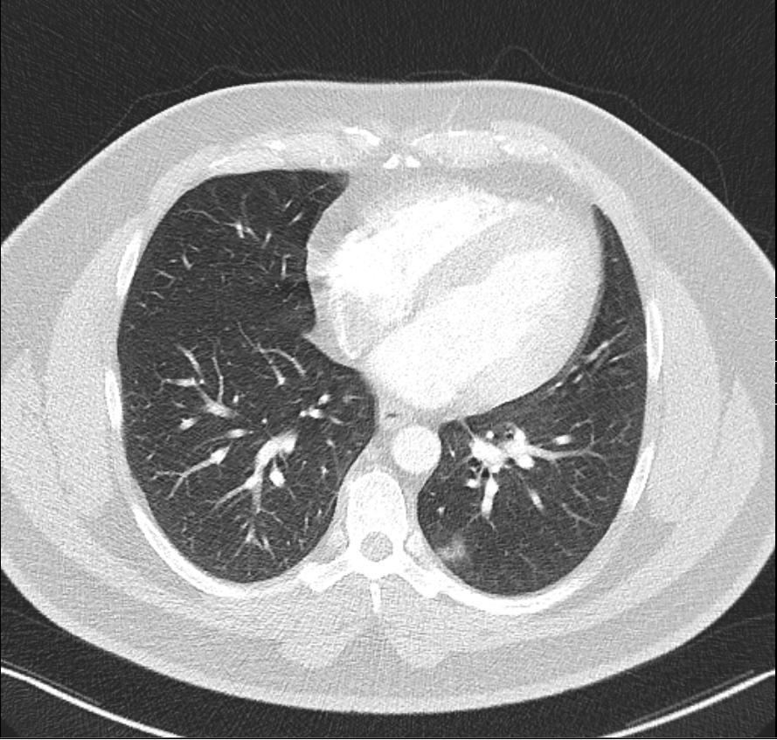
Patient 3
44 y/o male, positive for COVID 12/28
Patient presented with shortness of breath and had Bamlanivimab infusion at the hospital
CT revealed GGO and PE
Patient was treated at home with Eliquis 5 mg, 2x daily for 7 days and Prednisone, 20 mg, 3 tablets 2x daily for 5 days

Slide 10
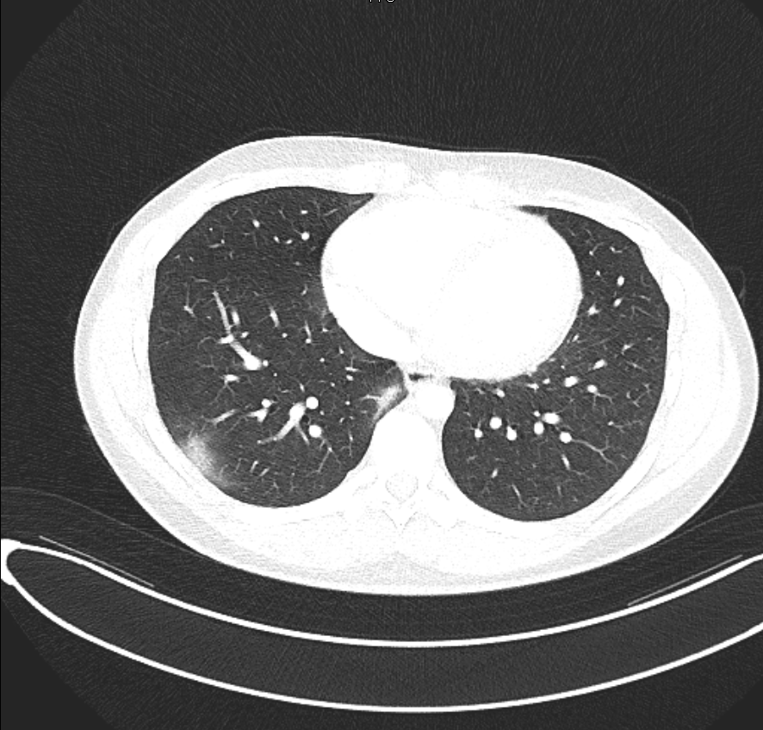
Patient 4
23 y/o male, positive for COVID 10/19, presented with fever and dry cough
CT revealed GGO and PE
Patient advised to go to ER for treatment of PE

Slide 11
Discussion
128 slice CT enables early detection of PE before the emergency room (d-dimer or chest x-ray)
Goal
Preserve Lung Function
Early detection of PE allows for at home treatment
6 mg prednisolone is standard; however, 60 mg is better to control cytokine storm with eliquis and IV ceftriaxone

Slide 12
References
Battista G, Sassi C, Zompatori M, Palmarini D, Canini R. Ground-glass opacity: interpretation of high resolution CT findings. Radiol Med. 2003 Nov-Dec;106(5-6):425-42; quiz 443-4. English, Italian. PMID: 14735009.
Ontong P, Prachayasittikul V. Unraveled roles of hyaluronan in severe COVID-19. EXCLI J. 2021;20:117-125. Published 2021 Jan 15. doi:10.17179/excli2020-3215
Andonegui-Elguera S, Taniguchi-Ponciano K, Gonzalez-Bonilla CR, et al. Molecular Alterations Prompted by SARS-CoV-2 Infection: Induction of Hyaluronan, Glycosaminoglycan and Mucopolysaccharide Metabolism. Archives of Medical Research. https://www.sciencedirect.com/science/article/abs/pii/S0188440920307050?via%3Dihub. Published June 18, 2020. Accessed April 22, 2021.
Thoma P, Rondelet B, Mélot C, Tack D, Naeije R, Gevenois PA. Acute Pulmonary Embolism: Relationships between Ground-Glass Opacification at Thin-Section CT and Hemodynamics in Pigs. Radiology. 2009;250(3):721-729. doi:10.1148/radiol.2503081134

