Slide 1
Understanding
Academic Conferences
Rob Mayes
University of North Texas

Slide 2
What Are Academic Conferences?
Gathering of Members for the advancement of the discipline and knowledge base.
Sponsored by Associations

Slide 3
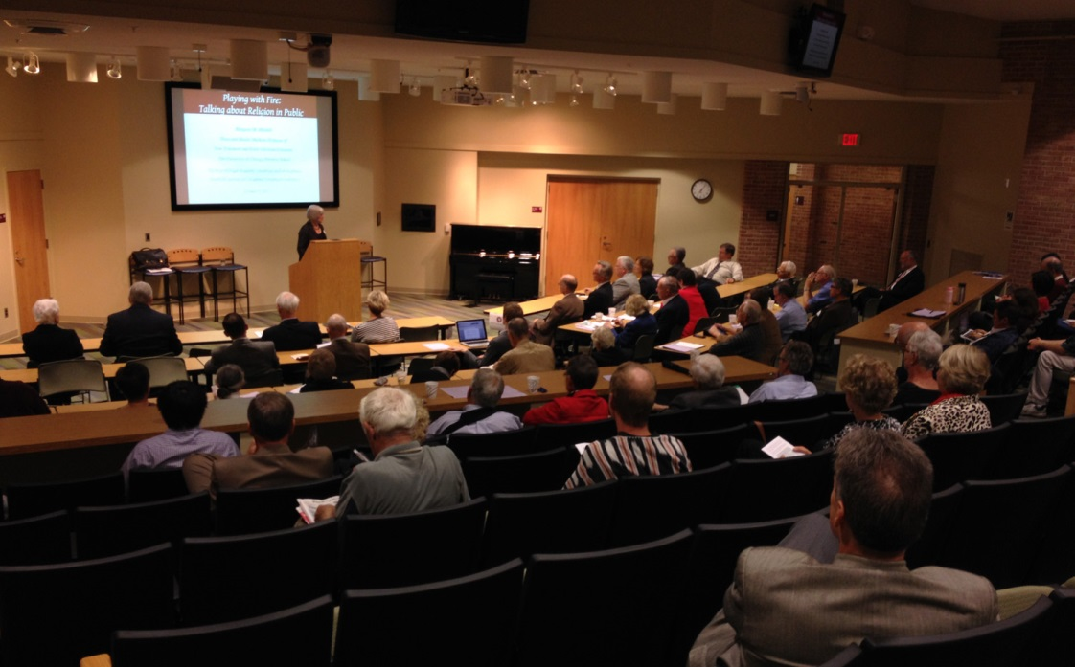
What Are Academic Conferences?
http://www.gvsu.edu/interfaith/west-michigan-academic-consortium-conference-134.htm

Slide 4
Why Academic Conferences?
Meeting Profession’s Leaders Experts
Networking with Other people.
Sharing of Research Interests
Broadening of One’s Interests

Slide 5
Conference Agenda Items
Keynote Speaker(s)
Sessions
Board Meetings/Elections
Dinners
Fire-Side Chats (Keynote Speaker & Students)
Presentations / Panels / Round Tables
Poster Displays
Conferencing Closing

Slide 6

Panel Participants
http://www.salford.ac.uk/__data/assets/image/0017/208016/varieties/lightbox.jpg

Slide 7
Academic Research Participation
Find a Relevant Conference
Submit a Poster or Article (Presentation)
Register for Conference
  Membership Fees
  Conference Fees
Make Travel Accommodation
  Transportation
  Hotel

Slide 8
Consider Expenses….
Passport Acquisition
Immunizations
Airport Parking
Airfare / Shipping
Bus or Taxies or Car Rentals
Meals-Drinks
Hotel / Motel

Slide 9
Also Consider THIS!
Laptops or Tablet Computers
Presentation Software
Cabling Computer to Projector
  HDMI
  VGA
Projectors are usually
provided
Supplies

Slide 10
Also Consider THIS!
Medical Care
  In Case of Emergency call…….
  Special Diets
  Insurance Cards
  Ability to Pay
  Prescriptions & Medications
  Physician contacts
  Allergies

