Slide 1
Elections Cycle
Summary

Slide 2
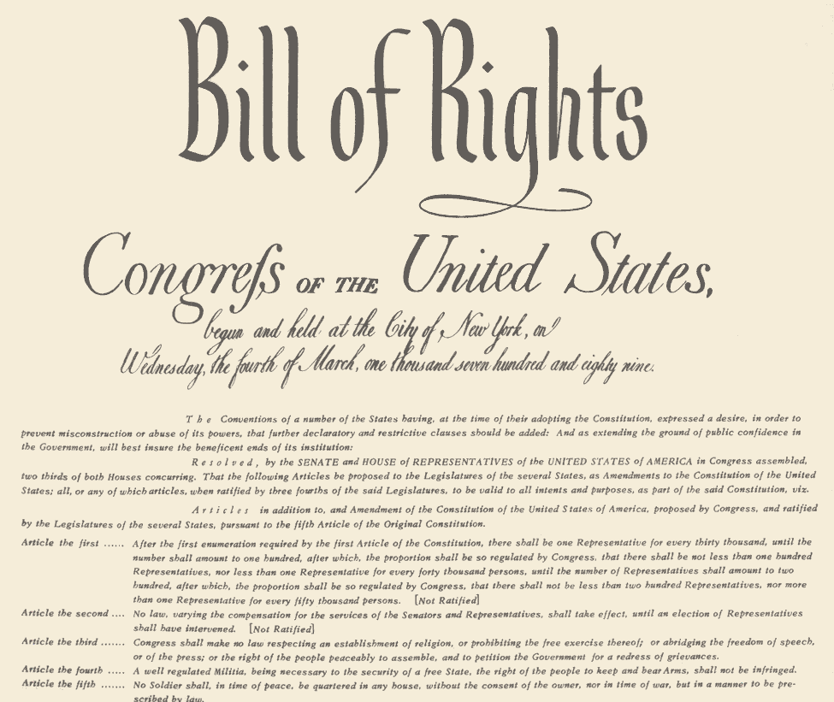
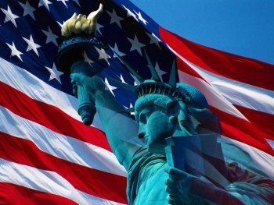
political culture: set of shared values and beliefs about the nation, such as liberty and freedom, the Constitution, Bill of Rights, political equality, and private property rights; does NOT CHANGE

Slide 3
Political ideology is a set of beliefs about life, culture, government, and society. It changes over time.
Liberals are active in helping individuals and communities promote health, justice, and equal opportunity.
Conservatives believe the role of the government in society should be limited and that individuals should be responsible for their own well-being.
Since the 1970s, most Americans consider themselves political moderates.

Slide 4
mass media: means of communication such as TV, radio, newspaper, Internet, blogging, etc.
Some people believe that the media is the fourth branch of the government that the Founders anticipated would speak the truth and keep our democracy on track.
Remember: Media focus
determines what the public
thinks about.

Slide 5
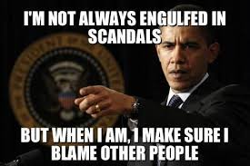
Investigative journalism leads to scandals.

Slide 6
Narrowcasting (stations target narrow audiences) has replaced broadcasting to “broad” audiences.
Cable News
Young adults are LEAST likely to use newspapers and broadcast media and are MORE likely to use narrowcast media.

Slide 7
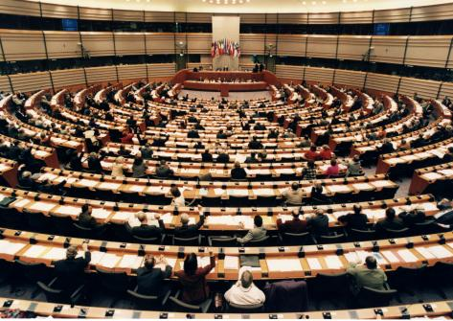
Interest Groups
Organization of people with similar policy goals entering the political process to INFLUENCE PUBLIC POLICY
They address single issues and don’t try to appeal to everyone. While political parties are “party generalists,” interest groups are “party specialists.”

Slide 8
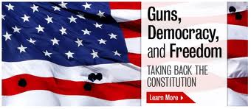
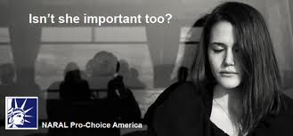

Slide 9
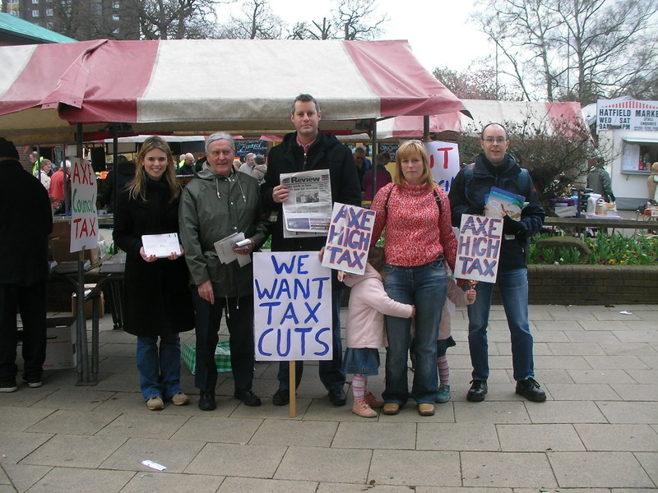
Tactics of Interest Groups
Lobbying
Electioneering/PACs
Litigation
Grassroots campaign
Local level
Going public

Slide 10
How Reform Changed Elections
hard money: is regulated by FEC; requires filing paperwork (PACs); can give $2,000/year per candidate per election (local, state, national)
soft money: is unregulated; allows 527 groups; can give $25,000 to national party, $10,000 to state/local; allows unlimited spending for advertisements, fundraisers, campaigns

Slide 11
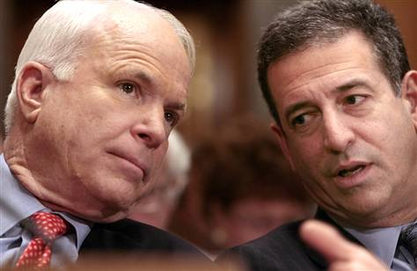
Loopholes to Campaign Finance Reform
soft money: campaign money donated to PARTIES rather than candidates; has few contributions or limitations on it (unregulated money to parties)
It was banned at the national level by the McCain-Feingold Act in 2002, but other loopholes were found.
At right: McCain and Feingold, who sponsored bill on campaign reform

Slide 12
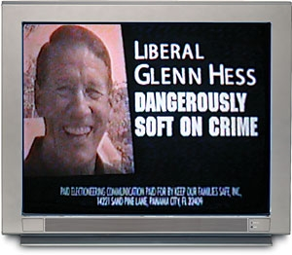
One Loophole: 527 Groups
They were named after federal tax code protected by freedom of speech.
They spend money on our “liberty,” and citizens give their views using media. You could write a check for any amount to a 527 group!

Slide 13
Buckley v. Valeo (1976): Individuals can contribute as much of their own money to their own campaign as they want.
Citizens United v. FEC (2010): This ruling held that the First Amendment prohibits the government from placing limits on spending for political purposes by corporations or unions. Money cannot go directly to the candidate or political parties in the race for federal office, but it can go toward advertising and other electioneering communications.
Candidates must approve ads (McCain-Feingold Act): “I am Barack Obama, and I approved this ad.”

Slide 14
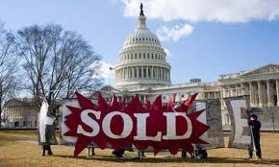
In 1976, The Supreme Court ruled candidates could spend as much as they wanted on their own campaign, and corporations could give money to campaigns if they were not directly related to the candidate, resulting in a great increase in PAC spending (Buckley v. Valeo).
Again in 1996 AND in 2010, the Supreme Court ruled that spending in support of federal candidates was a form of free speech and thus such spending could not be limited (Citizens United v. FEC).

Slide 15
The Supreme Court’s decision in Citizens United v. Federal Election Commission (5-4) made a HUGE impact on elections and was NOT popular with the Obama Administration.
The court’s January 2010 decision freed corporations and unions and allowed them to spend whatever they like for and against candidates. This ruling wiped out laws in 24 states banning such spending. Only Montana still wages a lonely court battle to maintain the ban.
The Citizens United ruling did away with 527 groups and initiated the rise of super PACs who could spend as much money as they wanted up to the day of the election.

Slide 16
Recap: Interest Groups
Party “specialists”—that is, they specialize in their topic area—give Congress expert advice.
Their entire goal is to INFLUENCE PUBLIC POLICY that will help their interest group’s goals.
They have the money, the membership, and the influence and use it all to get what they want.
Is it no wonder that people think that Washington can be bought?

Slide 17
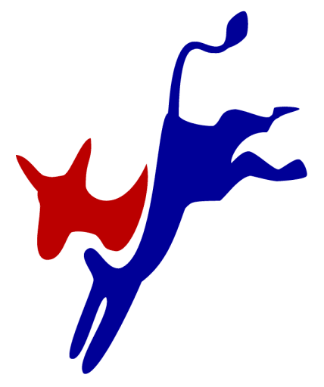
Democratic Party
It is more liberal and was the minority party until the Great Depression, after which it remained the majority party for the next 50 years.
National government is very active.
It appeals to the working class, union workers, minorities, and disadvantaged groups in society.
It has a history of protecting Social Security and Medicare, improving schools, protecting the environment, and helping the poor.
It supports government spending on social programs.

Slide 18
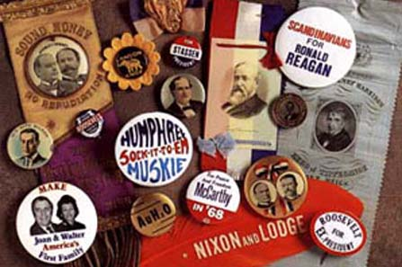
Political Parties
Linkage institutions are the structures within a society that connect the people to the government.
These institutions include
political parties, interest groups, and media.
Inputs from the public
Outputs from policy makers

Slide 19
Caucus and Primary Elections
Delegates who get to the national conventions are selected in presidential primaries and caucus in which voters in a state go to the polls and vote for a candidate or for delegates pledged to a candidate.
**front-loading: states like to hold caucuses and primaries early in the calendar year to capitalize on media attention

Slide 20
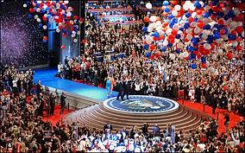
National conventions: Democrats are in August.
Republicans are in September.
Delegates from each party’s convention nominates a presidential and vice presidential candidate to represent their party in the general election.

Slide 21
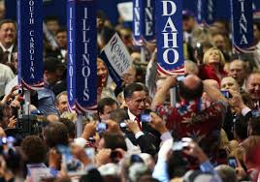
The main purpose is to unify party members.
Party’s platform (statement of its goals and policies for the next four years)
Nomination of candidates for president/vice president.

Slide 22
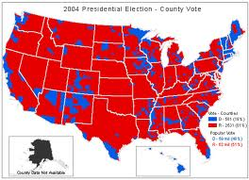
General Election
Presidential Election Day is every four years on the Tuesday following the first Monday in November.
In the winner-take-all system, the presidential candidate who wins the most popular votes in a state receives the state’s electors.
There are two exceptions: Maine and Nebraska.
Electoral votes = # of H of R members + # of Senators

Slide 23
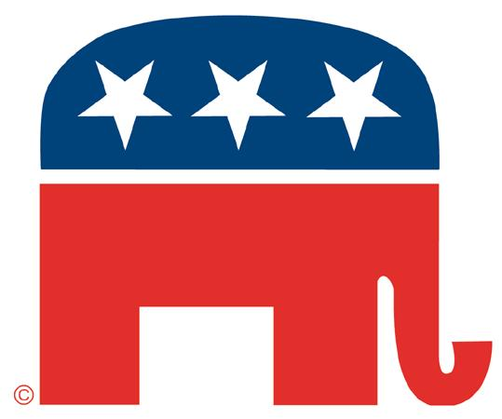
Republican Party
Is more conservative; was born on the eve of the Civil War
Believes the role of government in society should be limited
Appeals to voters that are college graduates, upper-income families, professionals, or businesspersons
Feels that the government should be involved in fewer social programs
Is more likely to emphasize national defense, foreign affairs, balancing the budget, handling crime and drug problems

Slide 24
The Last Battle: The Electoral College
We elect the president of the United States using the Electoral College? What is it? Why does the US have it?
In 1787, at the Constitutional Convention, the Founders were debating how to decide on choosing the president.
If Congress elected the president, it would mean the president would be controlled by the legislature.
Direct democracy (everyone votes) would not work (too much room for error or corruption); nor would having the state legislatures decide (fear that federal authority would be compromised in exchange for votes).

Slide 25
The Compromise
The Electoral College (Article II, Section 1) was a compromise on two important issues: The first was how much power the people should have and the second was how much power states should have.
The power went NOT to the people (the Founders thought they could not be trusted with such an important decision). The power went to the STATES and the “college of electors” to pick the best person for the job.

Slide 26
How States Get Electoral Votes
A census is taken each decade (every ten years) to determine the population of each state. POPULATION IS POWER!
The larger states have more members in the House.
State senators (two) and representatives (based on population) give each state their number of electors. (Iowa has six.) The candidate with the most popular votes is given all the state electoral votes (with the exception of Maine and Nebraska).
There are 538 electors total.

Slide 27
Profiles of Voters
Regular voters
Higher than average education level**
Middle aged
Higher than average income**
Married people
Women more than men
White people and minorities with high education and income
Government employees
Regular nonvoters
Not formal citizens
Not met residency requirements
Not registered to vote
Young people** (lowest voter turnout)
Unmarried people
Minority groups

