Slide 1
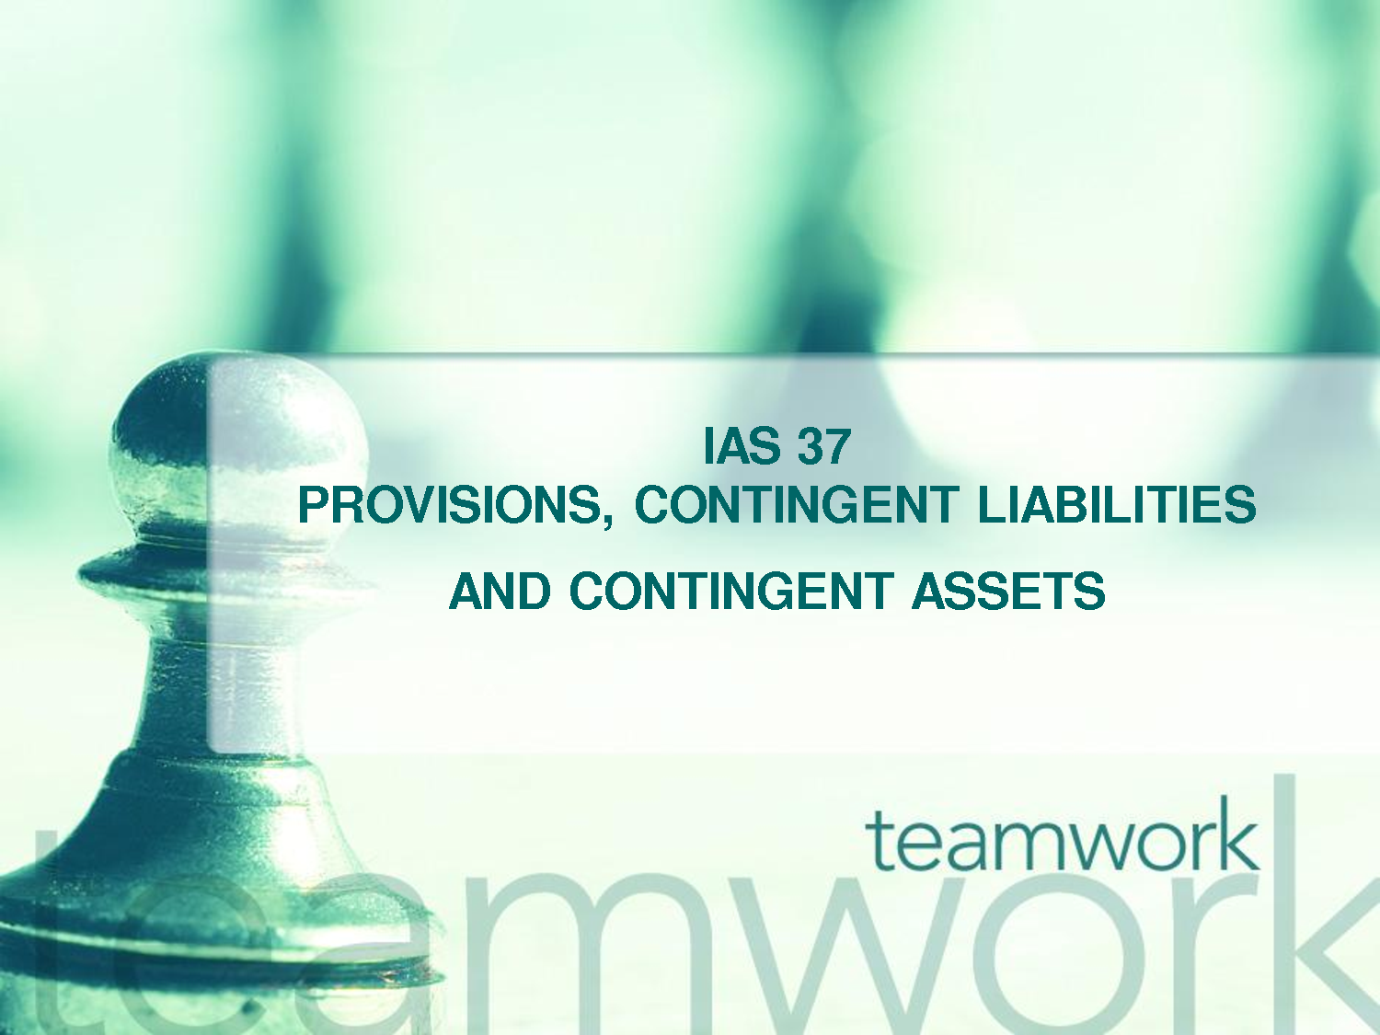
Prepared by Joshua Horne. 2015

Slide 2

What is a Liability?

Slide 3
What is a Liability?
IAS 37
‘A present obligation arising from past events, the settlement of which is expected to result in an outflow of resources embodying economic benefits’

Slide 4
What is a Provision?

Slide 5
What is a Provision?
IAS 37
‘A liability of uncertain timing or amount’

Slide 6
Difference between Liability and Provision?

Slide 7
Difference between Liability and Provision?
IAS 37
Uncertainty

Slide 8
Why is IAS 37 needed?
IAS 37
Stops possibility of Creative accounting

Slide 9
Why is IAS 37 needed?
IAS 37
Stops possibility of Creative accounting
Why is this a problem?

Slide 10
Recognising a Provision

Slide 11
Recognising a Provision
IAS 37
IAS 37 states that a provision should be recognised when:
An entity has a present obligation as a result of a past event
It is probable that an outflow of resources will be required to settle the obligation
A reliable estimate can be made of the obligation

Slide 12
Obligation
IAS 37
If there is an obligation for the transferring of benefits, entity cannot avoid making payment.
*Legal
*Constructive

Slide 13
PG 217 – Task 6
TEXT

Slide 14
How to measure?

Slide 15
How to measure?
IAS 37
The amount recognised should be the best estimate.
Risks, uncertainties and future events should be taken into account.
Should be reviewed at the end of reporting period and adjusted if needs be.
A provision should only be used for expenditures that were originally recognised.

Slide 16
Contingent Liabilities

Slide 17
Why Contingent?
IAS 37
Entity is uncertain on the obligation

Slide 18
Contingent Liabilites
IAS 37
IAS 37 states that a contingent liability does not meet the recognition criteria but should disclose unless remote
A contingent liability is a potential liability...it depends on a future event occurring or not occurring.

Slide 19
Contingent Assets

Slide 20
Contingent Assets
IAS 37
Same scenario as Contingent Liabilities
Like with liability, should not be recognised

Slide 21
Disclosure
IAS 37
For each class of provision
The carrying amount at the beginning and end of the period
Additional provisions made in the period
Amounts used during the period
Unused amounts reversed during the period
* Also disclose brief description of obligation and expected timing of economic benefit transfer. An indication of the uncertainty is also needed*

Slide 22
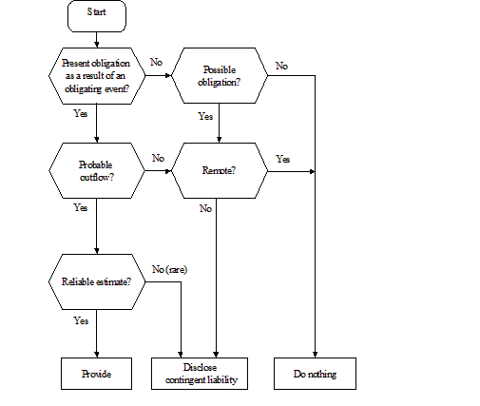
Decision Tree

Slide 23
Question Style – Example
Question Bank, PG 79 TASK 3.11

