Slide 1
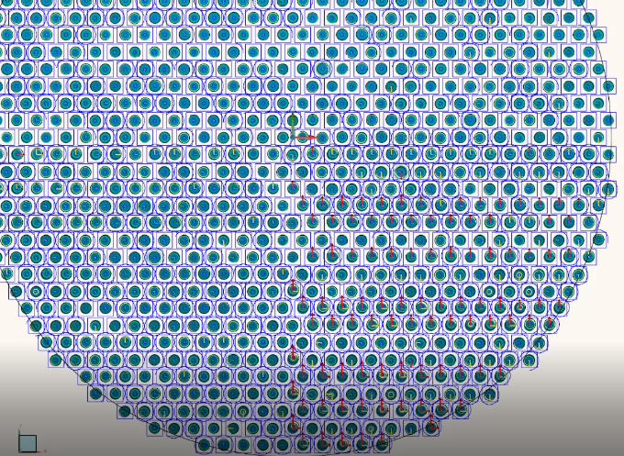
Sample visual report

Slide 2
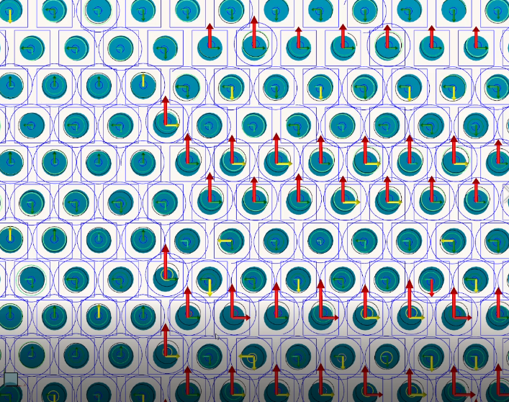
Sample visual report zoom in

Slide 3
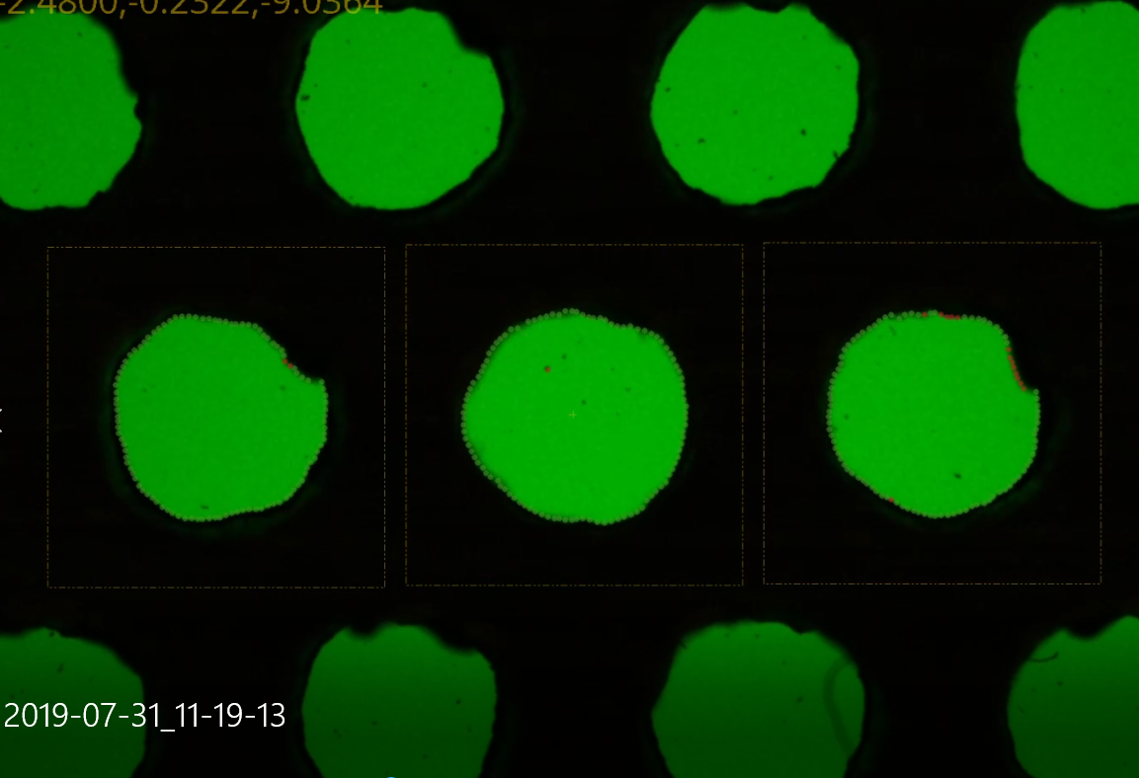
Field of view capture

Slide 4
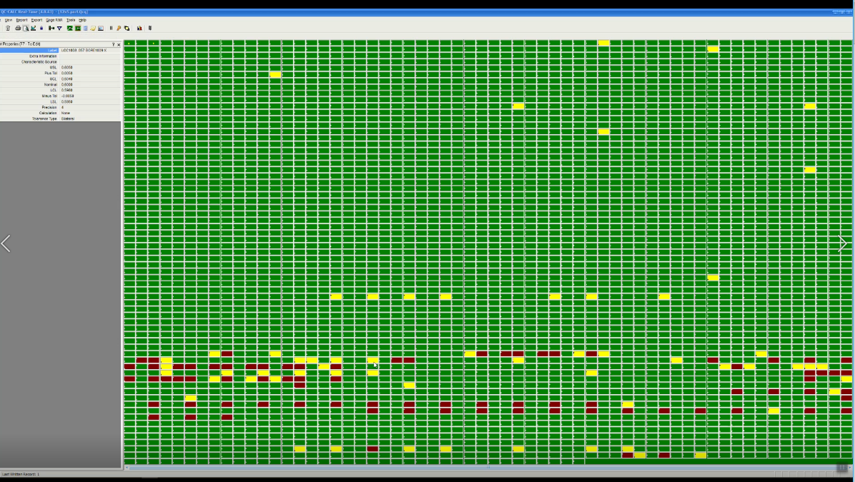
Sample full piece, each box is a measured dimension

