Slide 1
Five Components of Effective Mathematics Instruction

Slide 2
Contact Information
Sarah Powell, Ph.D
The University of Texas at Austin
srpowell@austin.utexas.edu
@sarahpowellphd
119

Slide 3
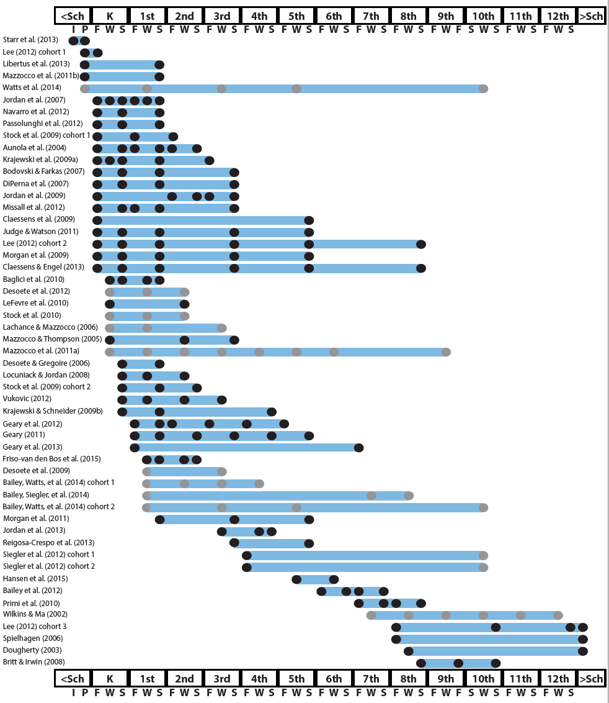
http://www.greatertexasfoundation.org/trajectories-of-mathematics-performance/

Slide 4
Broad math in preK predicted K broad math
Mathematics in preschool predicts later mathematics
http://www.greatertexasfoundation.org/trajectories-of-mathematics-performance/
Broad math in preK predicted grade 10 broad math

Slide 5
Counting in K predicted grade 1 broad math
Mathematics in kindergarten predicts later mathematics
http://www.greatertexasfoundation.org/trajectories-of-mathematics-performance/
Broad math in K predicted grade 8 broad math
K math accurately predicted math performance below 10th percentile in grades 2 and 3 with 84% correct classification

Slide 6
Mathematics in elementary school
predicts later mathematics
Addition influenced arithmetic with increasing importance from grades 1 to 5
http://www.greatertexasfoundation.org/trajectories-of-mathematics-performance/
Grade 1 arithmetic predicted arithmetic at grades 2, 3, and 4
Grade 1 broad math predicted broad math at grades 3, 5, and 10

Slide 7
Mathematics in middle school
predicts later mathematics
Counting and comparison in grades 2 or 4 predicted broad math 1 year later
http://www.greatertexasfoundation.org/trajectories-of-mathematics-performance/
Fractions at 10-12 years old predicted broad math 5 years later
Broad math in grade 7 predicted broad math in grade 8

Slide 8
Broad math in grade 8 predicted completion of 4-year college degree
Mathematics in
high school
predicts later outcomes
http://www.greatertexasfoundation.org/trajectories-of-mathematics-performance/
Students who took algebra in grades 8 took more advanced math courses and enrolled in 4-year colleges more often than students who took algebra in grade 9
Numeracy measured in adolescence impacted hourly earnings 7 to 15 years later

Slide 9
Mathematics in preschool predicts later mathematics
Mathematics in kindergarten predicts later mathematics
http://www.greatertexasfoundation.org/trajectories-of-mathematics-performance/
Mathematics in elementary school
predicts later mathematics
Mathematics in middle school
predicts later mathematics
Mathematics in
high school
predicts later outcomes

Slide 10
How would you convince your school of the need for providing services to at-risk students?
How would you convince caregivers of the need to provide services for their children?

Slide 11
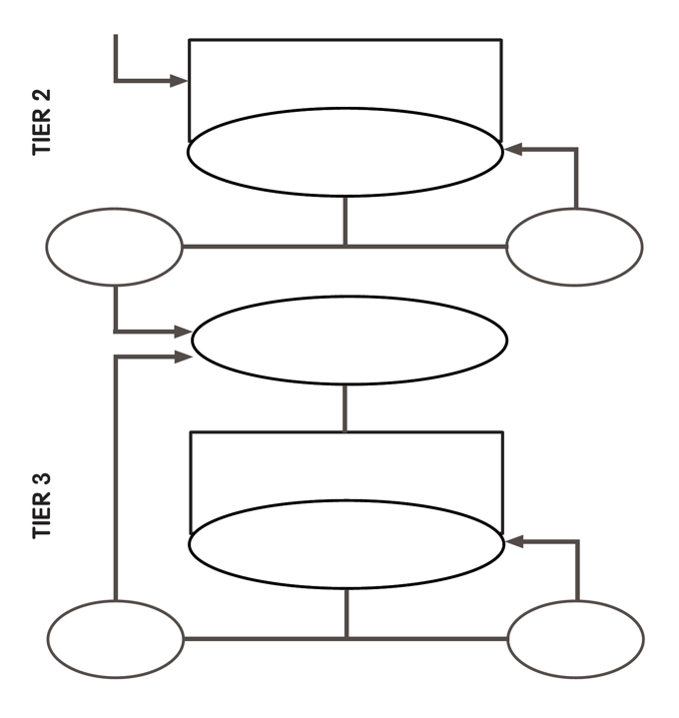

Slide 12
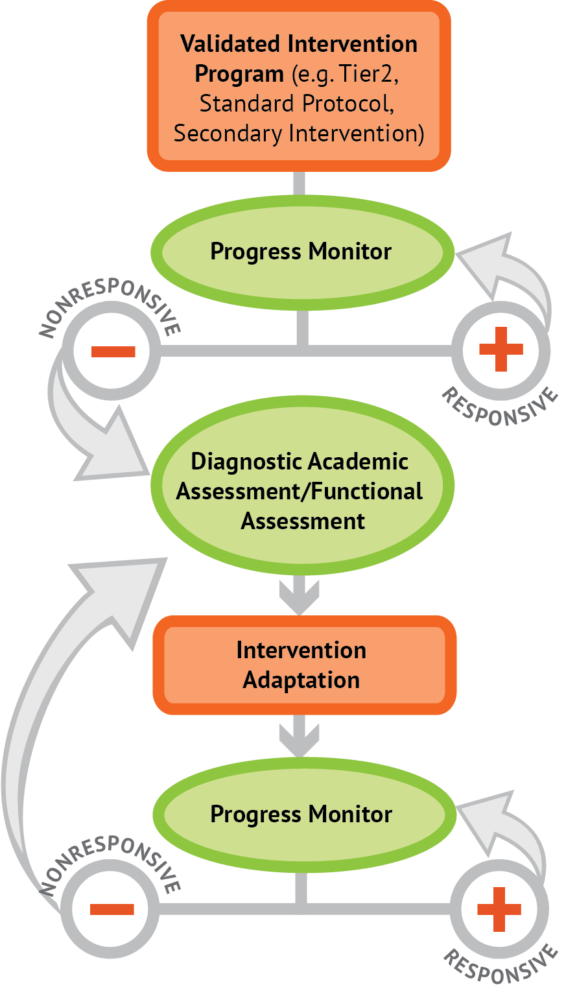
Intervention: Occurs frequently and with intensity
Assessment: Formative
Assessment: Diagnostic
Intervention adaptation: Content, dosage, explicit instruction, attention to transfer
Assessment: Formative

Slide 13
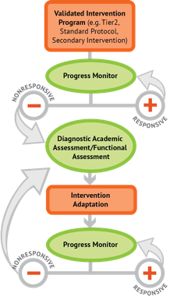
Where student IS
Where student NEEDS TO BE

Slide 14
Fluency

Slide 15
Fluently add and subtract within 5.

Slide 16
Fluently add and subtract within 5.
Add and subtract within 20, demonstrating fluency for addition and subtraction within 10.

Slide 17
Fluently add and subtract within 5.
Add and subtract within 20, demonstrating fluency for addition and subtraction within 10.
Fluently add and subtract within 100 using strategies based on place value, properties of operations, and/or relationships.

Slide 18
Fluently add and subtract within 5.
Add and subtract within 20, demonstrating fluency for addition and subtraction within 10.
Fluently add and subtract within 100 using strategies based on place value, properties of operations, and/or relationships.
Fluently multiply and divide within 100, using strategies such as the relationship between multiplication and division…

Slide 19
Fluently add and subtract within 5.
Add and subtract within 20, demonstrating fluency for addition and subtraction within 10.
Fluently add and subtract within 100 using strategies based on place value, properties of operations, and/or relationships.
Fluently multiply and divide within 100, using strategies such as the relationship between multiplication and division…
Fluently add and subtract multi-digit whole numbers using the standard algorithm.

Slide 20
Fluently add and subtract within 5.
Add and subtract within 20, demonstrating fluency for addition and subtraction within 10.
Fluently add and subtract within 100 using strategies based on place value, properties of operations, and/or relationships.
Fluently multiply and divide within 100, using strategies such as the relationship between multiplication and division…
Fluently add and subtract multi-digit whole numbers using the standard algorithm.
Fluently multiply multi-digit whole numbers using the standard algorithm.

Slide 21
Fluently add and subtract within 5.
Add and subtract within 20, demonstrating fluency for addition and subtraction within 10.
Fluently add and subtract within 100 using strategies based on place value, properties of operations, and/or relationships.
Fluently multiply and divide within 100, using strategies such as the relationship between multiplication and division…
Fluently add and subtract multi-digit whole numbers using the standard algorithm.
Fluently multiply multi-digit whole numbers using the standard algorithm.
Fluently add, subtract, multiply, and divide multi-digit decimals using the standard algorithm.

Slide 22
Where student NEEDS TO BE
Fluently add and subtract within 5.
Add and subtract within 20, demonstrating fluency for addition and subtraction within 10.
Fluently add and subtract within 100 using strategies based on place value, properties of operations, and/or relationships.
Fluently multiply and divide within 100, using strategies such as the relationship between multiplication and division…
Fluently add and subtract multi-digit whole numbers using the standard algorithm.
Fluently multiply multi-digit whole numbers using the standard algorithm.
Fluently add, subtract, multiply, and divide multi-digit decimals using the standard algorithm.

Slide 23
Where student IS
Where student NEEDS TO BE
Fluently add and subtract within 5.
Add and subtract within 20, demonstrating fluency for addition and subtraction within 10.
Fluently add and subtract within 100 using strategies based on place value, properties of operations, and/or relationships.
Fluently multiply and divide within 100, using strategies such as the relationship between multiplication and division…
Fluently add and subtract multi-digit whole numbers using the standard algorithm.
Fluently multiply multi-digit whole numbers using the standard algorithm.
Fluently add, subtract, multiply, and divide multi-digit decimals using the standard algorithm.

Slide 24
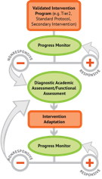
Where student IS
Where student NEEDS TO BE
Fluently add and subtract within 5.
Add and subtract within 20, demonstrating fluency for addition and subtraction within 10.
Fluently add and subtract within 100 using strategies based on place value, properties of operations, and/or relationships.
Fluently multiply and divide within 100, using strategies such as the relationship between multiplication and division…
Fluently add and subtract multi-digit whole numbers using the standard algorithm.
Fluently multiply multi-digit whole numbers using the standard algorithm.
Fluently add, subtract, multiply, and divide multi-digit decimals using the standard algorithm.

Slide 25
Place Value

Slide 26
Compose and decompose numbers from 11 to 19 into ten ones and some further ones…
Recognize that in a multi-digit number, a digit in one place represents 10 times as much as it represents in the place to its right and 1/10 of what it represents in the place to its left.
Use place value understanding to round whole numbers to the nearest 10 or 100.
Recognize that in a multi-digit number, a digit in one place represents ten times what it represents in the place to its right…
Understand that the two digits of a two-digit number represent amounts of tens and ones.
Understand that the three digits of a three-digit number represent amounts of hundreds, tens, and ones.

Slide 27
Compose and decompose numbers from 11 to 19 into ten ones and some further ones…

Slide 28
Compose and decompose numbers from 11 to 19 into ten ones and some further ones…
Understand that the two digits of a two-digit number represent amounts of tens and ones.

Slide 29
Compose and decompose numbers from 11 to 19 into ten ones and some further ones…
Understand that the two digits of a two-digit number represent amounts of tens and ones.
Understand that the three digits of a three-digit number represent amounts of hundreds, tens, and ones.

Slide 30
Compose and decompose numbers from 11 to 19 into ten ones and some further ones…
Understand that the two digits of a two-digit number represent amounts of tens and ones.
Understand that the three digits of a three-digit number represent amounts of hundreds, tens, and ones.
Use place value understanding to round whole numbers to the nearest 10 or 100.

Slide 31
Compose and decompose numbers from 11 to 19 into ten ones and some further ones…
Understand that the two digits of a two-digit number represent amounts of tens and ones.
Understand that the three digits of a three-digit number represent amounts of hundreds, tens, and ones.
Use place value understanding to round whole numbers to the nearest 10 or 100.
Recognize that in a multi-digit number, a digit in one place represents ten times what it represents in the place to its right…

Slide 32
Compose and decompose numbers from 11 to 19 into ten ones and some further ones…
Understand that the two digits of a two-digit number represent amounts of tens and ones.
Understand that the three digits of a three-digit number represent amounts of hundreds, tens, and ones.
Use place value understanding to round whole numbers to the nearest 10 or 100.
Recognize that in a multi-digit number, a digit in one place represents ten times what it represents in the place to its right…
Recognize that in a multi-digit number, a digit in one place represents 10 times as much as it represents in the place to its right and 1/10 of what it represents in the place to its left.

Slide 33
Problem Solving

Slide 34
Interpret and compute quotients of fractions, and solve word problems involving division of fractions by fractions…
Solve word problems that call for addition of three whole numbers whose sum is less than or equal to 20…
Solve real-world and mathematical problems involving the four operations with rational numbers.
Use addition and subtraction within 100 to solve one- and two-step word problems…
Use multiplication and division within 100 to solve word problems…
Solve real-world and mathematical problems leading to two linear equations in two variables.
Solve addition and subtraction word problems, and add and subtract within 10…
Solve multi-step word problems posed with whole numbers and having whole-number answers using the four operations…
Solve word problems involving addition and subtraction of fractions referring to the same whole, including cases of unlike denominators…

Slide 35
Solve addition and subtraction word problems, and add and subtract within 10…
Solve word problems that call for addition of three whole numbers whose sum is less than or equal to 20…
Use addition and subtraction within 100 to solve one- and two-step word problems…
Use multiplication and division within 100 to solve word problems…
Solve multi-step word problems posed with whole numbers and having whole-number answers using the four operations…
Solve word problems involving addition and subtraction of fractions referring to the same whole, including cases of unlike denominators…
Interpret and compute quotients of fractions, and solve word problems involving division of fractions by fractions…
Solve real-world and mathematical problems involving the four operations with rational numbers.
Solve real-world and mathematical problems leading to two linear equations in two variables.

Slide 36
Where student IS
Where student NEEDS TO BE
Solve addition and subtraction word problems, and add and subtract within 10…
Solve word problems that call for addition of three whole numbers whose sum is less than or equal to 20…
Use addition and subtraction within 100 to solve one- and two-step word problems…
Use multiplication and division within 100 to solve word problems…
Solve multi-step word problems posed with whole numbers and having whole-number answers using the four operations…
Solve word problems involving addition and subtraction of fractions referring to the same whole, including cases of unlike denominators…
Interpret and compute quotients of fractions, and solve word problems involving division of fractions by fractions…
Solve real-world and mathematical problems involving the four operations with rational numbers.
Solve real-world and mathematical problems leading to two linear equations in two variables.

Slide 37
Where student IS
Where student NEEDS TO BE
Use addition and subtraction within 100 to solve one- and two-step word problems…
Use multiplication and division within 100 to solve word problems…
Solve multi-step word problems posed with whole numbers and having whole-number answers using the four operations…

Slide 38
Where student IS
Where student NEEDS TO BE
Explain why addition and subtraction strategies work, using place value and the properties of operations.
Understand that the two digits of a two-digit number represent amounts of tens and ones.
Use addition and subtraction within 100 to solve one- and two-step word problems…
Fluently add and subtract within 100 using strategies based on place value, properties of operations, and/or relationships.
Apply properties of operations as strategies to multiply and divide….
Fluently multiply and divide within 100, using strategies such as the relationship between multiplication and division…
Use multiplication and division within 100 to solve word problems…
Fluently add and subtract multi-digit whole numbers using the standard algorithm.
Find whole number quotients and remainders with up to four-digit dividends and one-digit divisors, using strategies based on place value, the properties of operations, and/or the relationship between multiplication and division.
Solve multi-step word problems posed with whole numbers and having whole-number answers using the four operations…
Understand that the three digits of a three-digit number represent amounts of hundreds, tens, and ones.
Fluently multiply multi-digit whole numbers using the standard algorithm.

Slide 39
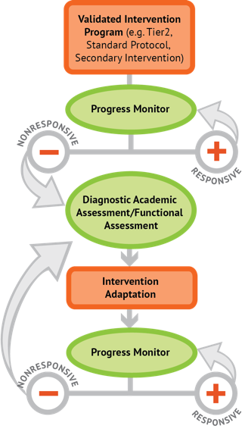
Instructional Platform
INSTRUCTIONAL DELIVERY
Explicit instruction
Precise language
Multiple representations
INSTRUCTIONAL STRATEGIES
Fluency building
Problem solving instruction
Motivation component

Slide 41
Explicit Instruction
Modeling
Practice
Clear Explanation
Guided
Practice
Planned
Examples
Independent Practice
Supporting Practices
Asking the right questions
Eliciting frequent responses
Providing immediate specific feedback
Maintaining a brisk pace

Slide 42
Goal and importance
“Today, we are learning about division. This is important because sometimes you have to share objects or things with your friends.”
Modeling
Practice
Clear Explanation
Guided
Practice
We Do
Planned
Examples
Independent Practice
“Let’s continue working with our three-dimensional shapes and volume. Understanding volume and calculating volume helps with measuring capacity.”
You Do
Supporting Practices
Asking the right questions
Eliciting frequent responses
Providing immediate specific feedback
Maintaining a brisk pace
Copyright 2018 Sarah R. Powell, Ph.D.

Slide 43
Goal and importance
Model steps
Modeling
Practice
Clear Explanation
Guided
Practice
“To solve 26 plus 79, I first decide about the operation. Do I add, subtract, multiply or divide?”
We Do
Planned
Examples
Independent Practice
“The plus sign tells me to add. So, I’ll add 26 plus 79. I’ll use the partial sums strategy. First, I add 20 plus 70. What’s 20 plus 70?”
You Do
Supporting Practices
“20 plus 70 is 90. I write 90 right here.”
Asking the right questions
Eliciting frequent responses
Providing immediate specific feedback
Maintaining a brisk pace
“Then I add 6 plus 9. What’s 6 plus 9?”
“6 plus 9 is 15. So, I write 15 here.”
“Finally, we add the partial sums: 90 and 15. 90 plus 15 is 105. So, 26 plus 79 equals 105.”
Copyright 2018 Sarah R. Powell, Ph.D.

Slide 44
Goal and importance
Model steps
Modeling
Practice
Clear Explanation
Concise language
Guided
Practice
We Do
Planned
Examples
Independent Practice
“To solve 26 plus 79, I first decide about the operation. Do I add, subtract, multiply, or divide?”
You Do
“The plus sign tells me to add. So, I’ll add 26 plus 79. I’ll use the partial sums strategy. First, I add 20 plus 70. What’s 20 plus 70?”
Supporting Practices
Asking the right questions
Eliciting frequent responses
Providing immediate specific feedback
Maintaining a brisk pace
“20 plus 70 is 90. I write 90 right here under the equal line.”
“Then I add 6 plus 9. What’s 6 plus 9?”
“6 plus 9 is 15. So, I write 15 here.”
“Finally, we add the partial sums: 90 and 15. 90 plus 15 is 105. So, 26 plus 79 equals 105.”
Copyright 2018 Sarah R. Powell, Ph.D.

Slide 45
Examples
“Today, we are learning about division. This is important because sometimes you have to share objects or things with your friends.”
Modeling
Practice
Clear Explanation
Guided
Practice
24 / 6
We Do
35 $)$ 5
28 $÷$ 7
Planned
Examples
Independent Practice
You Do
Supporting Practices
Asking the right questions
Eliciting frequent responses
Providing immediate specific feedback
Maintaining a brisk pace
Copyright 2018 Sarah R. Powell, Ph.D.

Slide 46
Examples
“Today, we are learning about division. This is important because sometimes you have to share objects or things with your friends.”
Modeling
Practice
Clear Explanation
Guided
Practice
24 / 6
We Do
35 $)$ 5
28 $÷$ 7
Planned
Examples
Independent Practice
You Do
With non-examples
Supporting Practices
Asking the right questions
Eliciting frequent responses
Providing immediate specific feedback
Maintaining a brisk pace
32 $÷$ 8
42 $÷$ 7
25 $−$ 5
Copyright 2018 Sarah R. Powell, Ph.D.

Slide 47
Modeling
Practice
Clear Explanation
Guided
Practice
Planned
Examples
Independent Practice
Supporting Practices
Asking the right questions
Eliciting frequent responses
Providing immediate specific feedback
Maintaining a brisk pace
Copyright 2018 Sarah R. Powell, Ph.D.

Slide 48
I Do
Modeling
Practice
Clear Explanation
Guided
Practice
Planned
Examples
Independent Practice
Supporting Practices
Asking the right questions
Eliciting frequent responses
Providing immediate specific feedback
Maintaining a brisk pace
Copyright 2018 Sarah R. Powell, Ph.D.

Slide 49
I Do
Modeling
Practice
Teacher and student practice together
Clear Explanation
Guided
Practice
Planned
Examples
Independent Practice
Supporting Practices
Asking the right questions
Eliciting frequent responses
Providing immediate specific feedback
Maintaining a brisk pace
Copyright 2018 Sarah R. Powell, Ph.D.

Slide 50
I Do
Modeling
Practice
Clear Explanation
Guided
Practice
Planned
Examples
Independent Practice
Student practices with teacher support
Supporting Practices
Asking the right questions
Eliciting frequent responses
Providing immediate specific feedback
Maintaining a brisk pace
Copyright 2018 Sarah R. Powell, Ph.D.

Slide 51
Modeling
Practice
Clear Explanation
Guided
Practice
Planned
Examples
Independent Practice
Supporting Practices
Asking the right questions
Eliciting frequent responses
Providing immediate specific feedback
Maintaining a brisk pace
Copyright 2018 Sarah R. Powell, Ph.D.

Slide 52
I Do
Modeling
Practice
Clear Explanation
Guided
Practice
We Do
Planned
Examples
Independent Practice
You Do
Supporting Practices
Asking the right questions
Eliciting frequent responses
Providing immediate specific feedback
Maintaining a brisk pace
Copyright 2018 Sarah R. Powell, Ph.D.

Slide 53
I Do
Modeling
Practice
Clear Explanation
Guided
Practice
Low-level and high-level
We Do
Planned
Examples
Independent Practice
You Do
“What is 7 times 9?”
“Which shape has 6 sides?”
“What do you do when you see a word problem?”
“Why do you have to regroup?”
“How would you solve this problem?”
“Why do you have to use zero pairs?”
Supporting Practices
Asking the right questions
Eliciting frequent responses
Providing immediate specific feedback
Maintaining a brisk pace
Copyright 2018 Sarah R. Powell, Ph.D.

Slide 54
I Do
Modeling
Practice
Clear Explanation
Guided
Practice
Low-level and high-level
We Do
Planned
Examples
Independent Practice
You Do
Classwide, individual, partner, write on paper, write on whiteboard, thumbs up, etc.
“Turn and discuss the formula for perimeter with your partner.”
“Write the multiplication problem on your whiteboard.”
Supporting Practices
Asking the right questions
Eliciting frequent responses
Providing immediate specific feedback
Maintaining a brisk pace
“In your math journal, draw a picture to help you remember to term parallelogram.”
Copyright 2018 Sarah R. Powell, Ph.D.

Slide 55
I Do
Modeling
Practice
Clear Explanation
Guided
Practice
Low-level and high-level
We Do
Planned
Examples
Independent Practice
You Do
Classwide, individual, partner, write on paper, write on whiteboard, thumbs up, etc.
Affirmative and corrective
Supporting Practices
“Good work using your word-problem attack strategy.”
Asking the right questions
Eliciting frequent responses
Providing immediate specific feedback
Maintaining a brisk pace
“Let’s look at that again. Tell me how you added in the hundreds column.”
Copyright 2018 Sarah R. Powell, Ph.D.

Slide 56
I Do
Modeling
Practice
Clear Explanation
Guided
Practice
Low-level and high-level
We Do
Planned
Examples
Independent Practice
You Do
Classwide, individual, partner, write on paper, write on whiteboard, thumbs up, etc.
Affirmative and corrective
Planned and organized
Supporting Practices
Asking the right questions
Eliciting frequent responses
Providing immediate specific feedback
Maintaining a brisk pace
Copyright 2018 Sarah R. Powell, Ph.D.

Slide 57
Modeling
Practice
Clear Explanation
Guided
Practice
Planned
Examples
Independent Practice
Supporting Practices
Asking the right questions
Eliciting frequent responses
Providing immediate specific feedback
Maintaining a brisk pace
Copyright 2018 Sarah R. Powell, Ph.D.

Slide 58
Modeling
Practice
Supporting Practices
Introduction of material
Review of material
Modeling
Practice
Modeling
Practice
Supporting Practices
Supporting Practices

Slide 59
How do you use explicit instruction within intensive intervention?
Model steps using concise language
Provide guided practice opportunities
Provide independent practice opportunities
Use supporting practices during modeling and practice
Ask the right questions
Elicit frequent responses
Provide feedback
Be planned and organized

Slide 60
Reflect upon your modeling and practice of something you taught recently. Describe your modeling, practice, and supporting practices.

Slide 61
Instructional Platform
INSTRUCTIONAL DELIVERY
Explicit instruction
Precise language
Multiple representations
INSTRUCTIONAL STRATEGIES
Fluency building
Problem solving instruction
Motivation component

Slide 63
degree

Slide 64
Vocabulary Across Grades

Slide 65
Language of Mathematics
Technical terms
Subtechnical terms
Symbolic terms
General terms
trapezoid
rhombus
numerator
addend
subtract
base
degrees
cube
plane
arc
plus
zero
twelve
dollars
and
above
measure
answer
longest
outside

Slide 66
Instead of…
Say…
“And the last one is 10.”
“8, 9, 10. We’ll stop counting there but we could count more.”
“What number is in the tens place?”
“What digit is in the tens place?”
“Six hundred and forty-eight”
“Six hundred forty-eight”
“Bigger number and smaller number”
“Number that is greater and the number that is less”
Hughes et al. (2016)

Slide 67
Instead of…
Say…
“Numbers in the fraction”
“This fraction is one number.”
“Top number and bottom number”
“Numerator and denominator”
“Reduce”
“Find an equivalent fraction”
“One point two nine”
“One and twenty-nine hundredths”
Hughes et al. (2016)

Slide 68
Instead of…
Say…
“Corner”
“Angle”
“Flips, slides, and turns”
“Reflections, translations, and rotations”
“Box or ball”
“Cube or sphere”
“Long hand and short hand”
“Minute hand and hour hand”
Hughes et al. (2016)

Slide 69
precise
“The denominator is the number of equal parts that make the whole.”
“A difference problem is two amounts compared for the difference.”
“To show the fraction, look at the denominator. A denominator of 5 means I need to break the whole into 5 equal parts.”
concise
“To use partial sums, add the hundreds, then add the tens, then add the ones. Finally, add all the partial sums.”

Slide 71
How do you attend to language within intensive intervention?
Understand why formal mathematical language is important
Plan for mathematical language to be precise
Plan for mathematical language to be concise

Slide 72
Instructional Platform
INSTRUCTIONAL DELIVERY
Explicit instruction
Precise language
Multiple representations
INSTRUCTIONAL STRATEGIES
Fluency building
Problem solving instruction
Motivation component

Slide 73
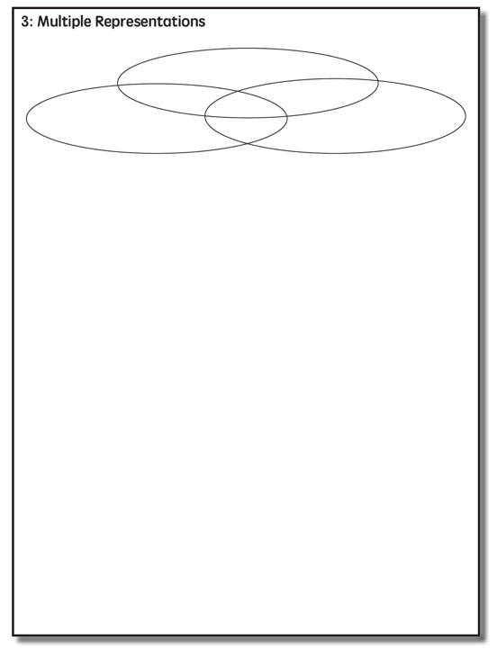

Slide 74
Multiple Representations
Abstract
Pictorial
Concrete

Slide 75
Abstract
Pictorial
Concrete
Three-dimensional objects

Slide 76
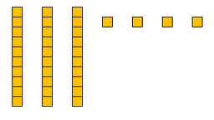
Abstract
Pictorial
Concrete
Two-dimensional images

Slide 77
Abstract
Pictorial
Concrete
Numerals and symbols
2 + 8 = 10
34 = 3 tens and 4 ones
x – 6 = 8
4,179
+ 569

Slide 78
How should multiple representations be used within intensive intervention?
Use three-dimensional concrete materials to teach concepts and procedures
Use two-dimensional representations to teach concepts and procedures
Ensure students understand mathematics with numbers and symbols (i.e., the abstract)

Slide 79
List 10 ways to use concrete representations and 10 ways to use pictorial representations.

Slide 80
Some examples of Multiple Representations

Slide 81
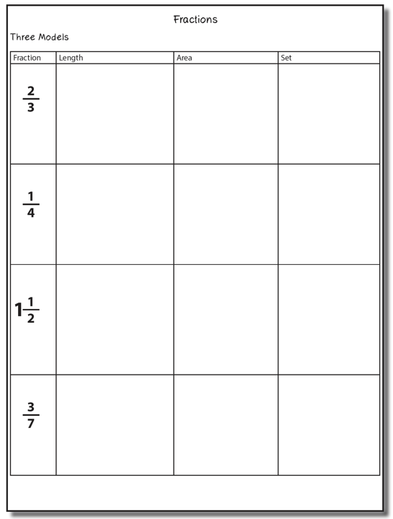

Slide 82
Fraction Models
Length
Area
Set

Slide 83
Length/Measurement
Fractions are appropriated by length
Fraction tiles/bars

Slide 84
Length/Measurement
Fractions are appropriated by length
Cuisenaire rods

Slide 85
Length/Measurement
Fractions are appropriated by length
Number line

Slide 86
Select a fraction and teach using the length model.
Explicit instruction
Multiple representations
Concise language

Slide 87
Area/Region
Shapes divided into equal sections
Fraction circles

Slide 88
Area/Region
Shapes divided into equal sections
Geoboards

Slide 89
Area/Region
Shapes divided into equal sections
Pattern blocks

Slide 90
Area/Region
Shapes divided into equal sections
Legos

Slide 91
Select a fraction and teach using the area model.
Explicit instruction
Multiple representations
Concise language

Slide 92
Set/Discrete
Individual shapes match the fraction
Two-color counters

Slide 93
Set/Discrete
Individual shapes match the fraction

Slide 94
Select a fraction and teach using the set model.
Explicit instruction
Multiple representations
Concise language

Slide 95
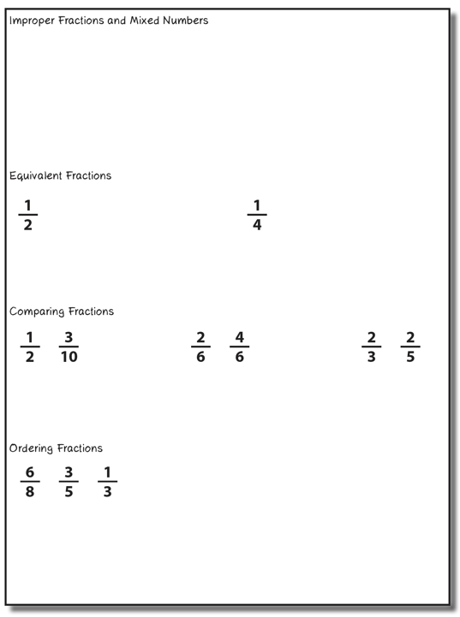
Select one of these concepts to teach. Use explicit instruction, strong mathematical language, and multiple representations.

Slide 96
Instructional Platform
INSTRUCTIONAL DELIVERY
Explicit instruction
Multiple representations
Precise language
INSTRUCTIONAL STRATEGIES
Fluency building
Problem solving instruction
Motivation component

Slide 97
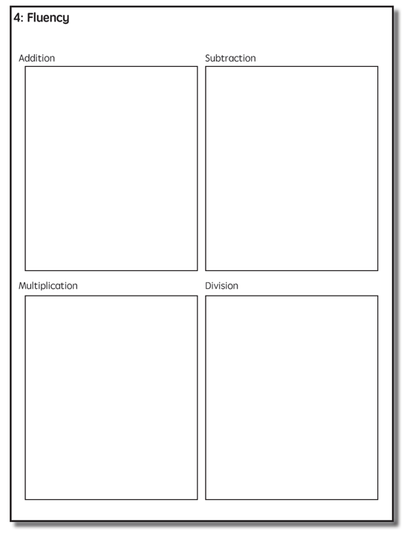

Slide 98
Addition Facts
100 addition basic facts
Single-digit addends sum to a single- or double-digit number
5 (addend)
+ 4 (addend)
9 (sum)

Slide 99
Addition: Part-Part-Whole (Total)
Count one set, count another set, put sets together, count sum
2 + 3 = 5

Slide 100
Addition: Join (Change Increase)
Start with a set, add the other set, count sum
2 + 3 = 5

Slide 101
Why is it important to understand addition in two separate ways?

Slide 102
Total
Parts put together into a total
Freddy saw 4 cardinals and 5 blue jays. How many birds did Freddy see?
4 + 5 = ?
Freddy saw 9 birds. If 4 of the birds were cardinals, how many were blue jays?
4 + ? = 9
Freddy saw 9 birds. 5 of the birds were blue jays, how many were cardinals?
5 + ? = 9

Slide 103
Change
An amount that increases or decreases
Lara had $4. Then she earned $3 for cleaning her room. How much money does Lara have now?
4 + 3 = ?
Lara has $4. Then she earned money for cleaning her room. Now Lara has $7. How much money did she earn?
4 + ? = 7
Lara had some money. Then she made $3 for cleaning her room. Now she has $7. How much money did Lara start with?
? + 3 = 7

Slide 104
Part-Part-Whole Versus Join
3 + 9 = __
7 + 4 = __
Determine a word problem for each schema.
Explicit instruction
Multiple representations
Concise language

Slide 105
Subtraction Facts
100 subtraction basic facts
Subtrahend and difference are single-digit numbers and minuend is single- or double-digit number
16 (minuend)
– 8 (subtrahend)
8 (difference)

Slide 106
Subtraction: Separate (Change Decrease)
Start with a set, take away from that set, count difference
5 – 3 = 2

Slide 107
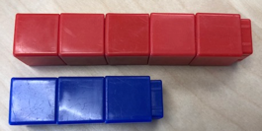
Subtraction: Compare (Difference)
Compare two sets, count difference
5 – 3 = 2

Slide 108
Why is it important to understand subtraction in two separate ways?

Slide 109
Change
An amount that increases or decreases
Melissa had 9 cookies. Then she ate 2 of the cookies. How many cookies does Melissa have now?
9 – 2 = ?
Melissa had 9 cookies. She ate some of the cookies. Now, she has 7 cookies. How many cookies did Melissa eat?
9 – ? = 7
Melissa had some cookies. Then, she ate 2 of the cookies. Now she has 7 cookies left. How many cookies did Melissa have to start with?
? – 2 = 7

Slide 110
Difference
Greater and less amounts compared for a difference
Pedro has 9 apples. Silvia has 4 apples. How many more apples does Pedro have? (How many fewer does Silvia have?)
9 – 4 = ?
Pedro has 5 more apples than Silvia. If Silvia has 4 apples, how many does Pedro have?
? – 4 = 5
Silvia has 5 fewer apples than Pedro. Pedro has 9 apples. How many apples does Silvia have?
9 – ? = 5

Slide 111
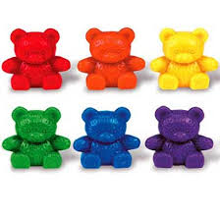
Separate Versus Compare
9 – 5 = __
8 – 3 = __
Determine a word problem for each schema.
Explicit instruction
Multiple representations
Concise language

Slide 112
Multiplication Facts
100 multiplication basic facts
Multiplication of single-digit factors results in a single- or double-digit product
2 (factor)
× 3 (factor)
6 (product)

Slide 113
Multiplication: Equal Groups
Show the groups, show the amount for each group, count product
3 × 2 = 6

Slide 114
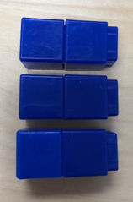
Multiplication: Array/Area
Make the array, count product
3 × 2 = 6

Slide 115
Multiplication: Comparison
Show a set, then multiply the set
3 × 2 = 6

Slide 116
Why is it important to understand multiplication in different ways?

Slide 117
Equal Groups
Groups multiplied by number in each group for a product
Haley has 2 bags of apples. There are 6 apples in each bag. How many apples does Haley have altogether?
2 × 6 = ?
Haley has 12 apples. She wants to share them equally among her 2 friends. How many apples will each friend receive?
2 × ? = 12
Haley has 12 apples. She put them into bags containing 6 apples each. How many bags did Haley use?
? × 6 = 12

Slide 118
Comparison
Set multiplied by a number of times for a product
Beth picked 6 apples. Marcie picked 2 times as many apples as Beth. How many apples did Marcie pick?
6 × 2 = ?

Slide 119
Equal Groups versus Comparison
3 × 4 = __
5 × 2 = __
Determine a word problem for each schema.
Explicit instruction
Multiple representations
Concise language

Slide 120
Division Facts
90 division basic facts
Divisor and quotient are single-digit numbers and dividend is single- or double-digit number
8 ÷ 4 = 2
(dividend) (divisor) (quotient)

Slide 121
Division: Equal Groups (Partitive Division)
Show the dividend, divide equally among divisor, count quotient
6 ÷ 3 = 2

Slide 122
Division: Equal Groups (Measurement Division)
Show the dividend, make groups of the divisor, count groups
6 ÷ 3 = 2

Slide 123
Why is it important to understand division in different ways?

Slide 124
Equal Groups
Groups multiplied by number in each group for a product
Haley has 2 bags of apples. There are 6 apples in each bag. How many apples does Haley have altogether?
2 × 6 = ?
Haley has 12 apples. He wants to share them equally among his 2 friends. How many apples will each friend receive?
2 × ? = 12
Haley has 12 apples. He put them into bags containing 6 apples each. How many bags did Mark use?
? × 6 = 12

Slide 125
Partitive versus Measurement
10 ÷ 5 = __
9 ÷ 3 = __
Teach this problem to a student.
Explicit instruction
Multiple representations
Concise language

Slide 127
Fluency Practice
Students should practice small sets of facts
These small sets should include known and unknown facts
BRIEF
(1-2 min)
DAILY
(everyday)

Slide 128
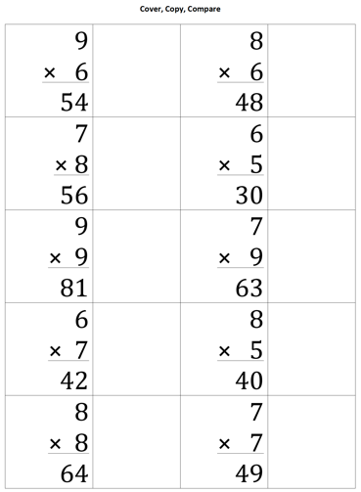
Cover, Copy, Compare
BEFORE
Create sheet with 10-12 answered problems and room to copy facts
DURING
Student reads entire fact
Student covers fact
Student rewrites entire fact
Student compares

Slide 129
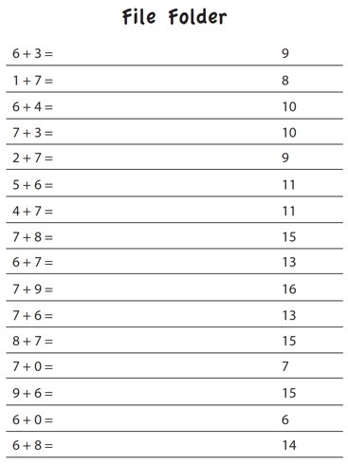
File Folder
BEFORE
Create sheet with 15-25 answered facts
DURING
Student folds answers over
Student writes answers to all facts
Student unfolds answers and compare

Slide 130
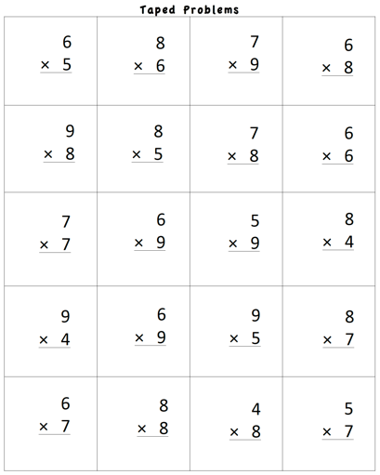
Taped Problems
BEFORE
Create worksheet with 15-25 facts
Make a recording:
Say fact (e.g., “6 times 5 equals…”)
Pause for 1-5 seconds
Say fact answer (e.g., “30”)
Continue with all facts on page
DURING
Student listens to recording
Student writes fact answer before the answer is stated on the recording

Slide 131
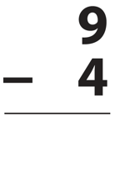
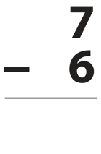
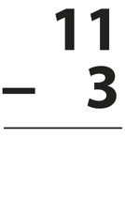
Flash Cards with Constant Time Delay
BEFORE
Collect small set of flash cards
DURING
Show student flash card for 3 seconds
Student answers
If correct, state correct answer and place back in pile
If incorrect, state correct answer and have student repeat it; place back in pile
Work through pile of cards for 1-2 minutes

Slide 132
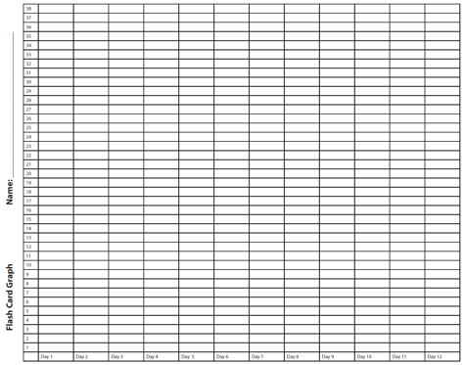
Flash Cards with Graphing
BEFORE
Collect small set of flash cards
DURING
Show student flash card
Student answers flash card
If correct, place in correct pile
If incorrect, review fact
Time for 1-2 minutes
Count total score
Graph total score
Could opt to try to beat score for another 1-2 minutes
Graph highest score

Slide 133
Flash Cards with Incremental Rehearsal
BEFORE
Select 1 unknown fact from a set of flash cards
Select 9 known facts from a set of flash cards
DURING
Read unknown fact aloud, provide answer, and ask student to read problem with you
Keep unknown fact flash card and combine with 1 known fact flash card
Show 2 flash cards to student
If student answer correctly, go to next flash card
If student answers incorrectly, read fact with answer and ask student to read with you
Work on cards until student answers correctly within 2 seconds
Add in 1 known fact flash card; continue with 3 cards
Keep adding in known fact flash cards until student achieves fluency with unknown card
Select new unknown fact and repeat process

Slide 134
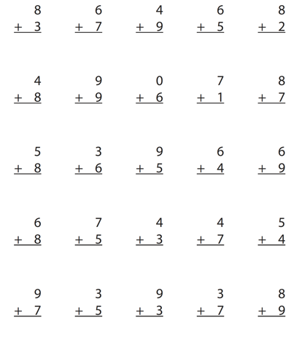
Worksheets
DURING
Students answer facts for 1-2 minutes
Students graph highest score of day or week
See graph on next slide.

Slide 135
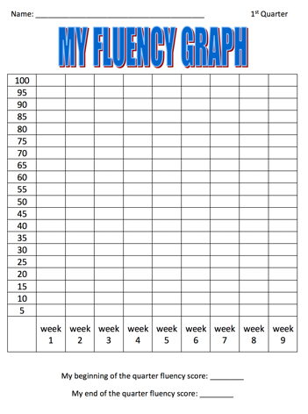
Worksheets with Graphing
DURING
Students answer facts for 1-2 minutes
Students graph highest score of day or week

Slide 136
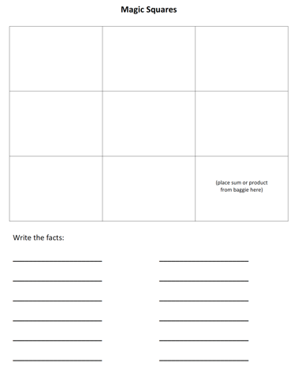
Magic Squares
BEFORE
Create sets of magic squares
See templates http://www.sarahpowellphd.com/presentations.html
DURING
Place sum or product in bottom right corner
In bottom row, create a fact with a sum or product of bottom right corner
In right column, create a fact with a sum or product of bottom right corner
Create two columns with a sum or product of bottom number
Create two rows with a sum or product of right column number
Write created facts
See demonstration on next slide.

Slide 137
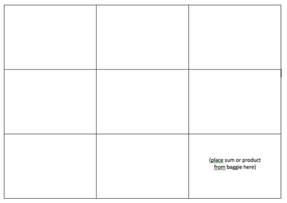
Magic Squares
5
4
12
8
6
1
3
3
6

Slide 138
Playing Cards
BEFORE
Select numbered playing cards from a deck of cards
DURING
Divide deck in half
Students place set of cards face down
Each student flips over top card
First student to add, subtract, or multiply the cards gets to keep both cards; cards go back in student’s set
Students continue until one student has all the cards
This game is similar to War.

Slide 139
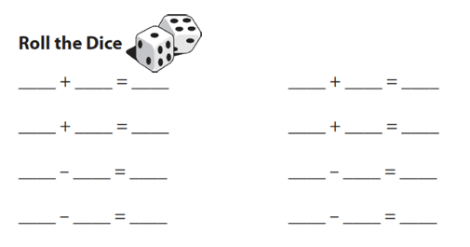
Dice Roll
DURING
Student rolls two die
Student adds, subtracts, or multiplies
Student writes facts

Slide 140
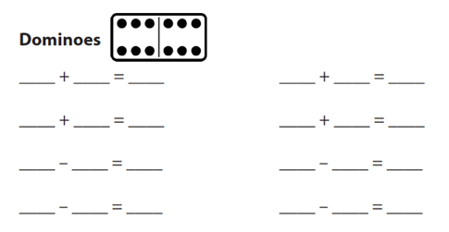
Dominoes
DURING
Student select domino
Student adds, subtracts, or multiplies
Student writes fact

Slide 141
Wrap-Ups
DURING
Student wraps string behind key and places around top left notch
Student answers fact by wrapping string in front of key and around to answer notch
Student brings string around the back to next left notch
Student continues
At end, student checks facts by comparing string to raised pattern on back of key

Slide 142
Mobi
DURING
Students begin with a specific number of blue tiles; the white tiles can be used at anytime
Students create a set of equations that build off of one another (each student makes their own set of equations)
Students draw more blue tiles after blue tiles are used; students rearrange and add to equation set
This game is similar to Bananagrams.

Slide 143
SMATH
DURING
Students use tiles to create equations on a game board
Students take turns and build off of one another’s tiles
This game is similar to Scrabble.

Slide 144
Technology
BEFORE
Select game that will practice small sets of facts
Select game that will track and monitor student progress
Select game that will provide feedback to student (especially when student makes mistake)

Slide 145
Other Ideas
Tic-Tac-Toe (with facts)
Connect Four (with numbers)
Chutes and Ladders (with numbers)
Add to this list!

Slide 146
Instructional Platform
INSTRUCTIONAL DELIVERY
Explicit instruction
Precise language
Multiple representations
INSTRUCTIONAL STRATEGIES
Fluency building
Problem solving instruction
Motivation component

Slide 148
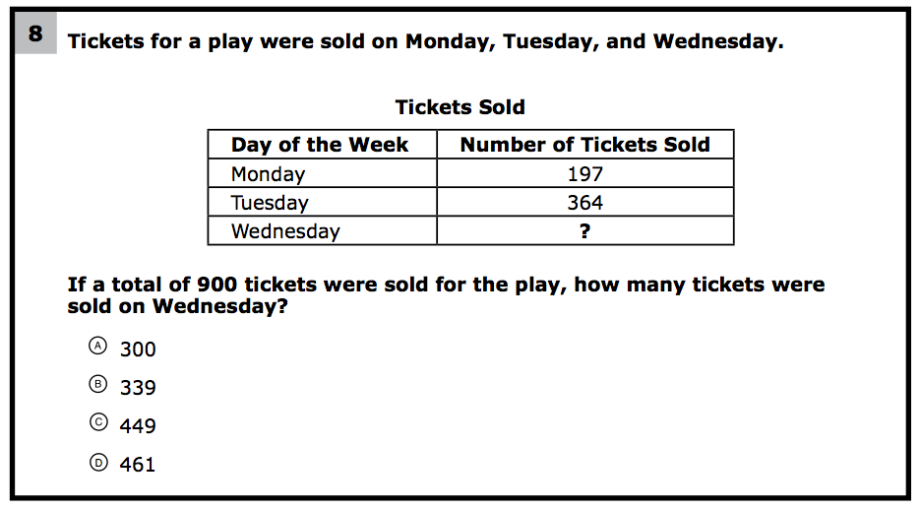
How would you teach this problem?
What do students need to know to solve this problem?
What might cause difficulty for students?

Slide 149
Problem Solving Difficulties
Reading problems
Understanding vocabulary
Identifying relevant information
Ignoring irrelevant information
Interpreting charts and graphs
Identifying appropriate operation(s)
Performing the computation(s)

Slide 150
Don’t tie key words to operations
Do have an attack strategy
Do teach word-problem schemas

Slide 151
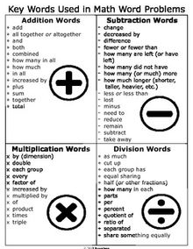
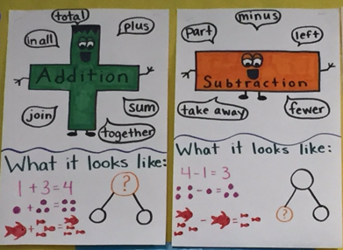

Slide 152
Kasey made $42, and Mandy made $37. How much money did they make in all?
Kasey and Mandy made $79 in all. If Kasey made $42, how much money did Mandy make?
Becky has $70 more than Perla. If Becky has $120, how much money does Perla have?
Becky has $70 more than Perla. If Perla has $50, how much money does Becky have?

Slide 153
Matt baked 18 cookies. His brother baked twice as many. How many cookies did his brother bake?
Matt’s brother baked twice as many cookies as Matt. If Matt’s brother baked 36 cookies, how many did Matt bake?
Rachel wants to share 36 brownies with 6 friends. How many cookies will each friend receive?
Rachel shared brownies with 6 friends. Each friend ate 6 brownies. How many brownies did Rachel have to start with?

Slide 154
Michelle made 17 paper airplanes. Dante made 24 paper airplanes. How many airplanes did they make altogether?
Michelle and Dante made 41 paper airplanes altogether. If Dante made 24 paper airplanes, how many did Michelle make?
Michelle made 4 paper airplanes using 2 pieces of paper for each airplane. How much paper did Michelle use altogether?
Dante and Michelle made 40 paper airplanes altogether. Dante made 24 of the paper airplanes. If Michelle gave 7 of her paper airplanes to her friend Nicole, how many planes does Michelle have now?

Slide 155
Students need to understand key words. But, key words should not be directly tied to operations.

Slide 156
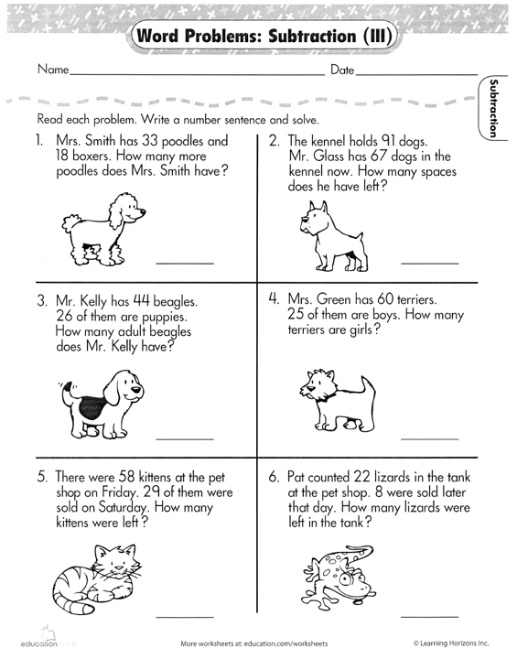

Slide 157
Don’t tie key words to operations
Do have an attack strategy
Do teach word-problem schemas

Slide 158
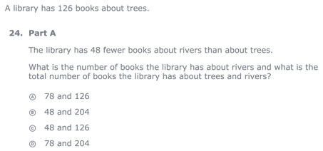
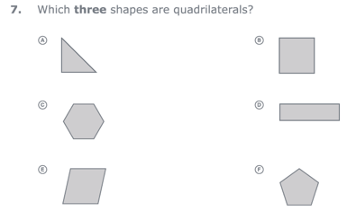
For every word problem
Regardless of problem type, students need an attack strategy for working through the problem
This strategy should work for any problem type
Routine Word Problems
Instructional Word Problems

Slide 159
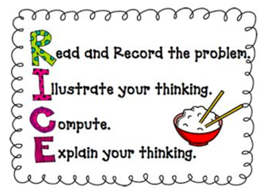
RIDGES
Read the problem.
I know statement.
Draw a picture.
Goal statement.
Equation development.
Solve the equation.
RIDE
Read the problem.
Identify the relevant information.
Determine the operation and unit for the answer.
Enter the correct numbers and calculate, then check the answer.

Slide 160
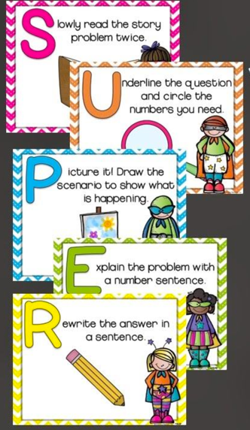

Slide 161
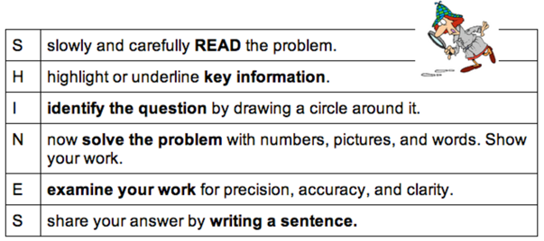
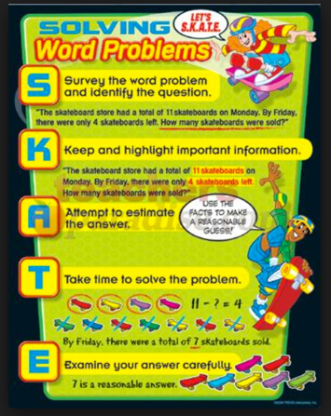
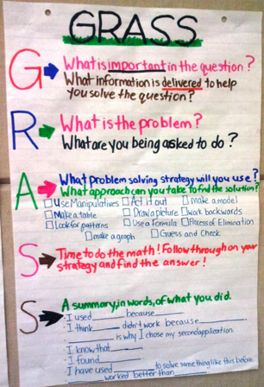

Slide 162
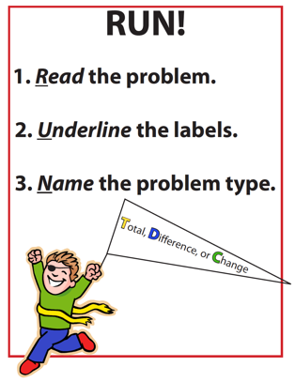
SIGNS
Survey questions
Identify key words
Graphically draw problem
Note operations
Solve and check
SOLVE
Study the problem.
Organize the facts.
Line up the plan.
Verify the plan with computation.
Examine the answer.

Slide 163
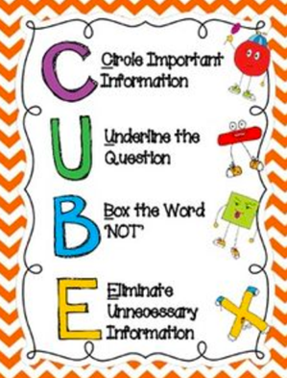
R-CUBES
Read the problem.
Circle key numbers.
Underline the question.
Box action words.
Evaluate steps.
Solve and check.

Slide 164
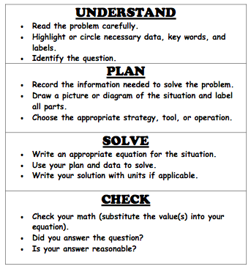

Slide 165
Don’t tie key words to operations
Do have an attack strategy
Do teach word-problem schemas

Slide 166
Additive Schemas

Slide 167
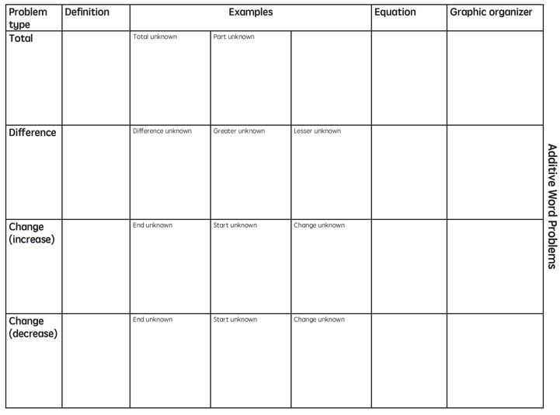

Slide 168
Instruction Using Schemas
A schema refers to the structure of the word problem
Total
Difference
Change

Slide 169
Total
Parts put together into a total
Jennifer saw 4 cardinals and 5 blue jays. How many birds did Jennifer see?
4 + 5 = ?
Jennifer saw 9 birds. If 4 of the birds were cardinals, how many were blue jays?
4 + ? = 9
Jennifer saw 9 birds. 5 of the birds were blue jays, how many were cardinals?
5 + ? = 9

Slide 170
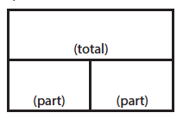
Total
P1 + P2 = T
Fuchs et al. (2008); Griffin & Jitendra (2009)

Slide 171
Total
“Are parts put together for a total?”

Slide 172
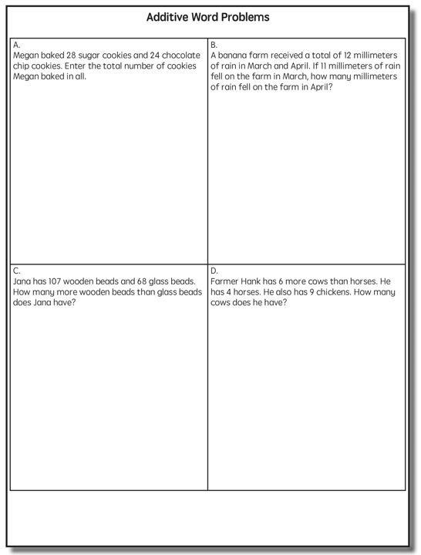
Total

Slide 173
Total
✔
✔
✔
P1 + P2 = T
U
P
S
✔
✔
28
+
24
=
?
✔
✔
28 + 24 = 52
X = 52 cookies
Grade 3 Smarter Balanced

Slide 174
Total
✔
✔
12
11
+ 1
12
12
- 11
1
✔
U
P
S
✔
✔
11
?
✔
✔
? = 1 millimeter
Grade 2 IXL

Slide 176
Difference
Greater and less amounts compared for a difference
Courtney has 9 apples. Silva has 4 apples. How many more apples does Courtney have? (How many fewer?)
9 – 4 = ?
Courtney has 5 more apples than Silva. If Silva has 4 apples, how many does Courtney have?
? – 4 = 5
Silva has 5 fewer apples than Courtney. Courtney has 9 apples. How many apples does Silva have?
9 – ? = 5

Slide 177
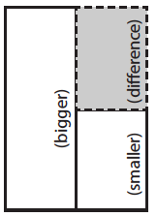
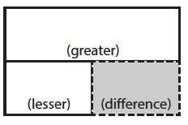
Difference
G – L = D
Fuchs et al. (2008); Griffin & Jitendra (2009)

Slide 178
Total
“Are parts put together for a total?”
Difference
“Are amounts compared for a difference?”

Slide 179
Difference

Slide 180
Difference
✔
✔
G – L = D
✔
U
P
S
✔
✔
107
-
68
=
B
107
68
68
+ ?
107
✔
✔
107 – 68 = 39
B = 39 more beads
Grade 3 Smarter Balanced

Slide 181
Difference

Slide 183
Change
An amount that increases or decreases
Sandra had $4. Then she earned $3 for cleaning her room. How much money does Sandra have now?
4 + 3 = ?
Sandra has $4. Then she earned money for cleaning her room. Now Sandra has $7. How much money did she earn?
4 + ? = 7
Sandra had some money. Then she made $3 for cleaning her room. Now she has $7. How much money did Sandra start with?
? + 3 = 7

Slide 184
Change
An amount that increases or decreases
Yolanda baked 9 cookies. Then, she ate 2 of the cookies. How many cookies does Yolanda have now?
9 – 2 = ?
Yolanda baked 9 cookies. Then, she ate some of the cookies. Now, she has 7 cookies. How many cookies did Yolanda eat?
9 – ? = 7
Yolanda baked some cookies. She ate 2 of the cookies and has 7 cookies left. How many cookies did Yolanda bake?
? – 2 = 7

Slide 185
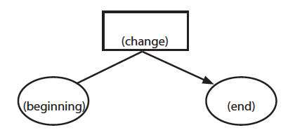
Change
ST +/– C = E
Fuchs et al. (2008); Griffin & Jitendra (2009)

Slide 186
Total
“Are parts put together for a total?”
Difference
“Are amounts compared for a difference?”
Change
“Does an amount increase or decrease?”

Slide 187
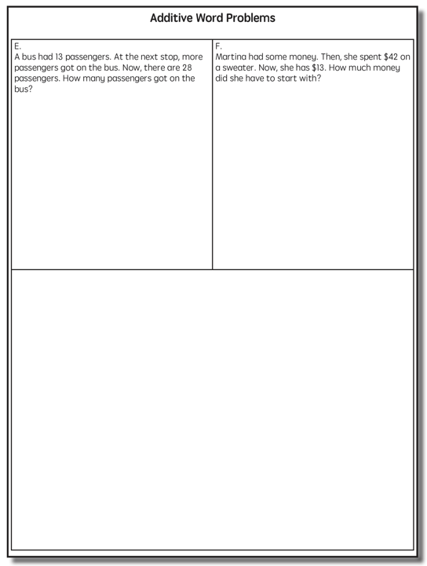
Change

Slide 188
Change
✔
A bus had 13 passengers. At the next stop, more passengers got on the bus. Now, there are 28 passengers. How many passengers got on the bus?
✔
✔
U
P
S
✔
ST + C = E
✔
13
+
?
=
28
✔
28
- 13
✔
13
+ ?
28
13 + 15 = 28
? = 15 passengers

Slide 189
Change

Slide 191
Total

Slide 192
Change

Slide 193
Difference

Slide 194
Total
P1 + P2 + P3 = T

Slide 195
Change
ST – C + C = E

Slide 196
Let’s Review
What’s a Total problem?
What’s a Difference problem?
What’s a Change problem?

Slide 197
Schema Quiz Time!

Slide 198
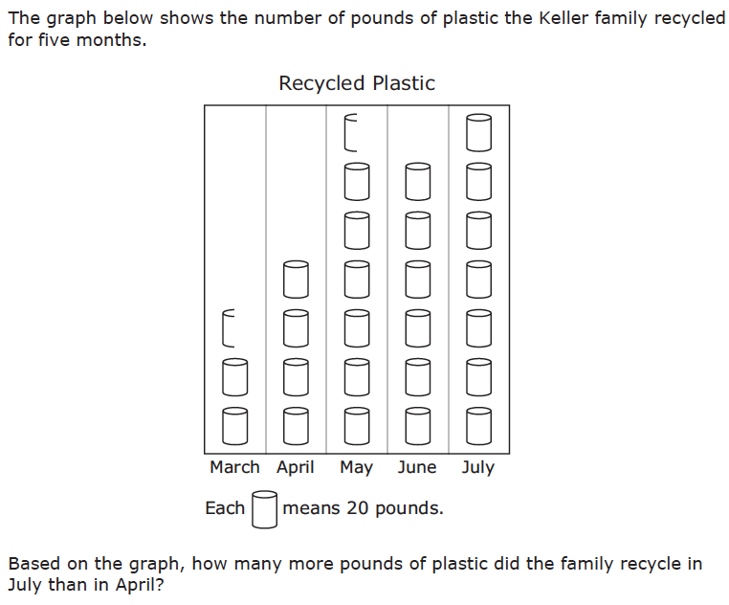
Difference
Grade 3 STAAR

Slide 199
Total
Grade 5 Smarter Balanced

Slide 200
Change
Grade 4 Smarted Balanced

Slide 201
Don’t tie key words to operations
Do have an attack strategy
Do teach word-problem schemas

Slide 202
Multiplicative Schemas

Slide 203
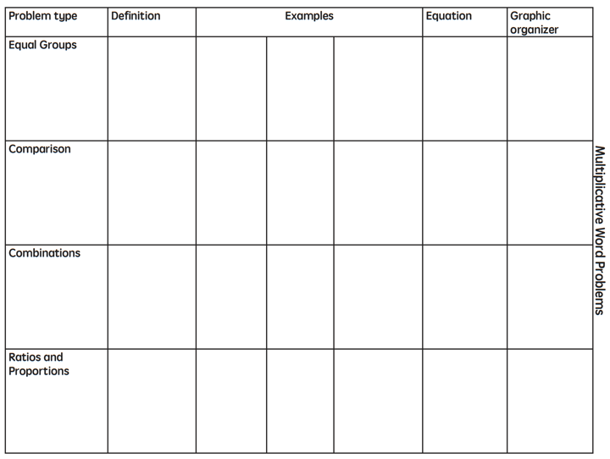

Slide 204
Equal Groups
Groups multiplied by number in each group for a product
Kristina has 2 bags of apples. There are 6 apples in each bag. How many apples does Kristina have altogether?
2 × 6 = ?
Kristina has 12 apples. She wants to share them equally among her 2 friends. How many apples will each friend receive?
2 × ? = 12
Kristina has 12 apples. She put them into bags containing 6 apples each. How many bags did Kristina use?
? × 6 = 12

Slide 205
Equal Groups
G × N = P

Slide 206
Equal Groups
“Are there groups with an equal number in each group?”

Slide 208
✔
✔
✔
G x N = P
U
P
S
✔
✔
x
=
6
25
?
✔
✔
6 x 25 = 150
? = 150 cherries

Slide 209
Equal Groups
✔
✔
✔
U
P
S
✔
✔
?
4
24
✔
✔
? x 4 = 24
4
4
Grade 3 STAAR
? = 6 packs

Slide 210
Comparison
Set multiplied by a number of times for a product
Marcie picked 6 apples. Lisa picked 2 times as many apples as Marcie. How many apples did Lisa pick?
6 × 2 = ?
Lisa picked 12 apples. She picked 2 times as many apples as Marcie. How many apples did Marcie pick?
? × 2 = 12
Lisa picked 12 apples, and Marcie picked 6 apples. How many times as many apples did Lisa pick as Marcie did?
6 × ? = 12

Slide 211
Comparison
S × T = P

Slide 212
Equal Groups
“Are there groups with an equal number in each group?”
Comparison
“Is a set compared a number of times?”

Slide 214
Comparison
✔
U
P
S
✔
6
2
?
✔
✔
✔
Grade 4 Smarter Balanced
? = 12 DVDs

Slide 215
Ratios/Proportions
Description of relationships among quantities
Xin et al. (2005)

Slide 216
Equal Groups
“Are there groups with an equal number in each group?”
Comparison
“Is a set compared a number of times?”
Ratios/Proportions
“Are there relationships among quantities - if this, then this?”

Slide 218
Ratios/Proportions
✔
✔
✔
✔
U
P
S
✔
✔
176
?
? = 110 slices
✔
✔
8
5

Slide 220
Ratios/Proportions

Slide 222
Equal Groups

Slide 223
Ratios/Proportions

Slide 224
Comparison
Grade 4 Smarter Balanced

Slide 225
Let’s Review
What’s an Equal Groups problem?
What’s a Comparison problem?
What’s a Ratios/Proportions problem?

Slide 230
Schema Quiz Time!

Slide 231
Ratios/Proportions
Grade 6 Smarter Balanced

Slide 232
Equal Groups
Grade 4 PARCC

Slide 233
Comparison
Grade 4 Smarter Balanced

Slide 237
Schemas
Total
Difference
Change
Equal Groups
Comparison
Ratios/Proportions

Slide 238
Don’t tie key words to operations
Do have an attack strategy
Do teach word-problem schemas

Slide 239
How do you incorporate effective problem-solving strategies within intensive intervention?
Don’t use key words tied to operations
Do teach students an attack strategy
Do teach students schemas
Do explicitly teach problem solving
Do provide problem-solving instruction regularly (i.e., several times a week)
Do practice schemas that students will encounter regularly

Slide 240
Instructional Platform
INSTRUCTIONAL DELIVERY
Explicit instruction
Precise language
Multiple representations
INSTRUCTIONAL STRATEGIES
Fluency building
Problem solving instruction
Motivation component

Slide 241
Motivation Component
on task
keep attention
regulate behavior

Slide 242
How do you incorporate a motivational component within intensive intervention?
Utilize a motivational component, when necessary

Slide 243
Instructional Platform
INSTRUCTIONAL DELIVERY
Explicit instruction
Precise language
Multiple representations
INSTRUCTIONAL STRATEGIES
Fluency building
Problem solving instruction
Motivation component

Slide 244
Contact Information
Sarah Powell, Ph.D.
The University of Texas at Austin
srpowell@austin.utexas.edu
@sarahpowellphd
119

