Slide 1
The Period of Purple Crying Program
Liz Kracht, RN, BSN
Injury Prevention Coordinator, MSJH

Slide 2
NAT (Non Accidental Trauma)
A leading cause of childhood traumatic injury and death in the United States
Abusive Head Trauma (AHT) accounts for 80% of NAT deaths
Nationally, It is estimated that a child is shaken every 6 hours. Of those, 20 to 30% die and of those who survive, 80% suffer permanent brain abnormalities.

Slide 3
NAT (Non Accidental Trauma)
2016 – 10.4 % (18 of 173) Pediatric trauma patients admitted for evaluation and treatment of NAT at MSJH.
Notes:
Get stats from Dr. Iniguez

Slide 4
Cost of Child Abuse
Average lifetime cost – Non-fatal maltreatment
  $210, 012
  Childhood healthcare - $32, 648
  Adult healthcare - $10, 530
  Productivity losses - $144, 360
  Child welfare costs - $7,728
  Criminal justice costs - $6,747
  Special Education - $7,999

Slide 5
Cost of Child Abuse
Average lifetime cost – Death due to maltreatment
        $1,272,900
        Health care - $14,100
        Productivity losses - $1,258,800

Slide 6
Abusive Head Trauma (AHT)
Formerly known as Shaken Baby Syndrome
CDC definition – An injury to the skull or intracranial contents of an infant or young child due to inflicted blunt impact and/or violent shaking
Can cause irreversible brain damage, paralysis, blindness, or even death.
Frustration with a child’s crying – number one reason why a person shakes or harms an infant

Slide 7
Period of Purple Crying
A prevention program developed by the National Center on Shaken Baby Syndrome
Take a normal child development approach to help parents and caregivers understand the frustrating features of crying in normal infants that can lead to shaking or abuse
10 page booklet, DVD with 10 minute PURPLE crying video and 17 minute Crying, Soothing, Coping: Doing What Comes Naturally video

Slide 8
Period of Purple Crying
Objectives
  Reduce the incidence of SBS/AHT
  Support caregivers in their understanding of early increased infant crying

Slide 9
Research
Barr et al, CMAJ 2009 - Receipt of PPC materials led to greater maternal score for knowledge about infant crying & protective behaviors ie. walking away
Reece et al, White Paper 2010 – Western NY, 16 regional hospitals implemented educational program; 47% reduction in cases of AHT

Slide 10
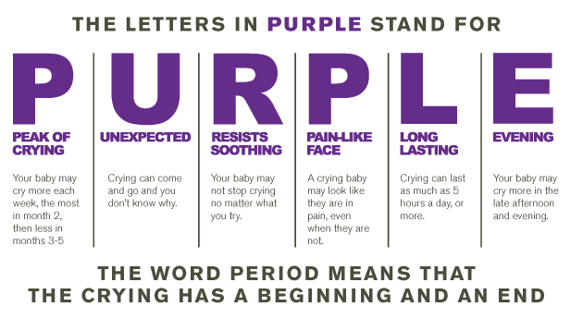

Slide 11
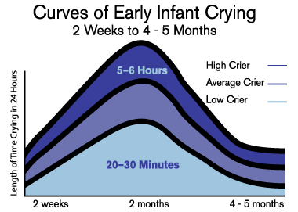

Slide 12
Period of Purple Crying
Dose One: Delivery of the PURPLE program materials to parents in Birth Center
Dose Two: Reinforcement of materials at well baby visit in Pediatric Clinic
Dose Three: Public media campaign
  Advertisements
  Coming together as a community
  Click for Babies

Slide 13

Period of Purple Crying

