Slide 1
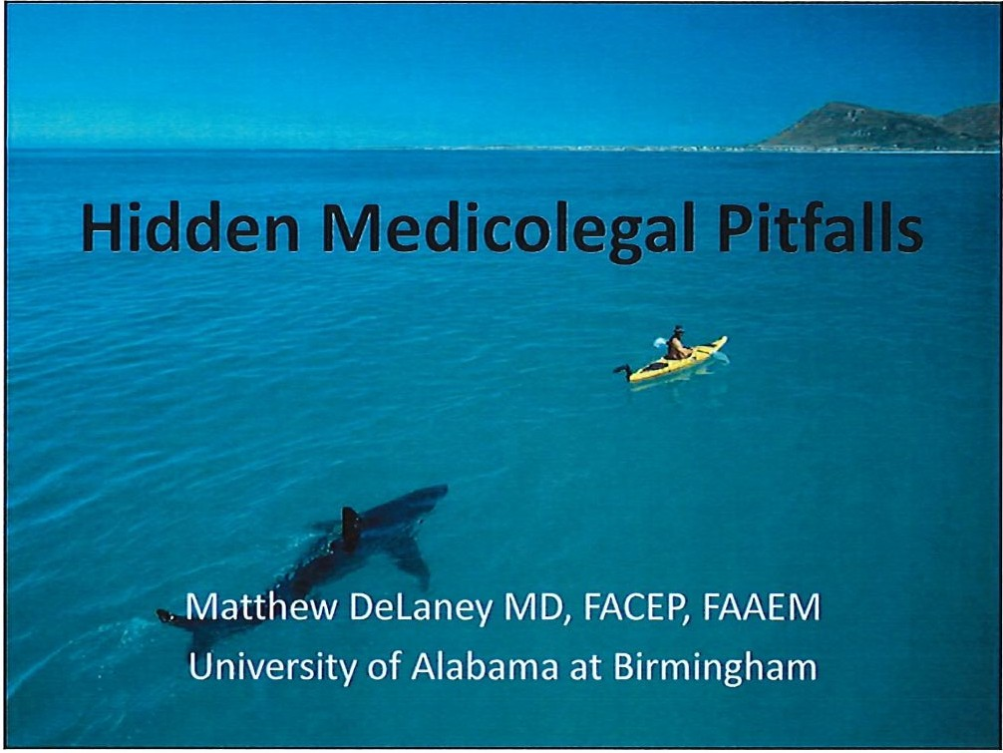
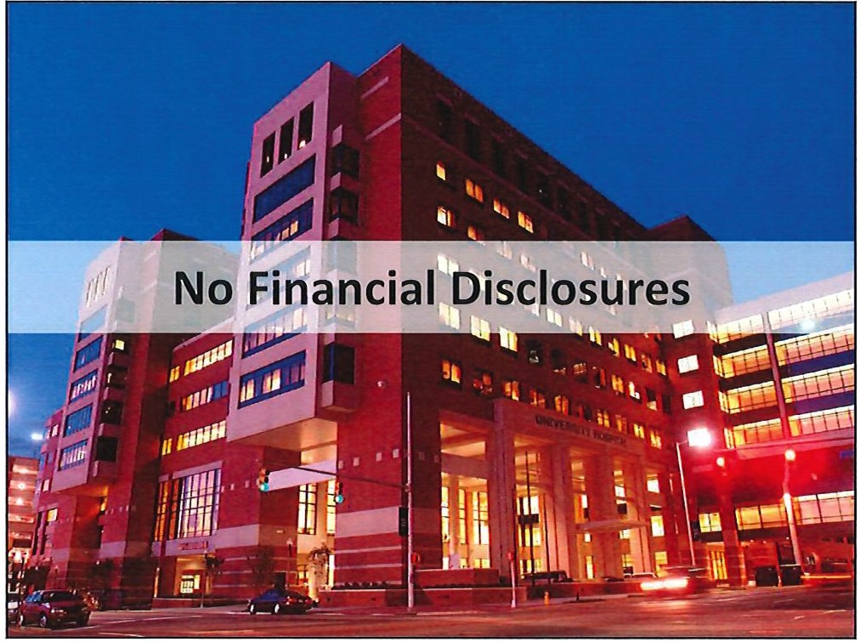
..^{I}....^{O}....
N 0 N 0

Slide 2
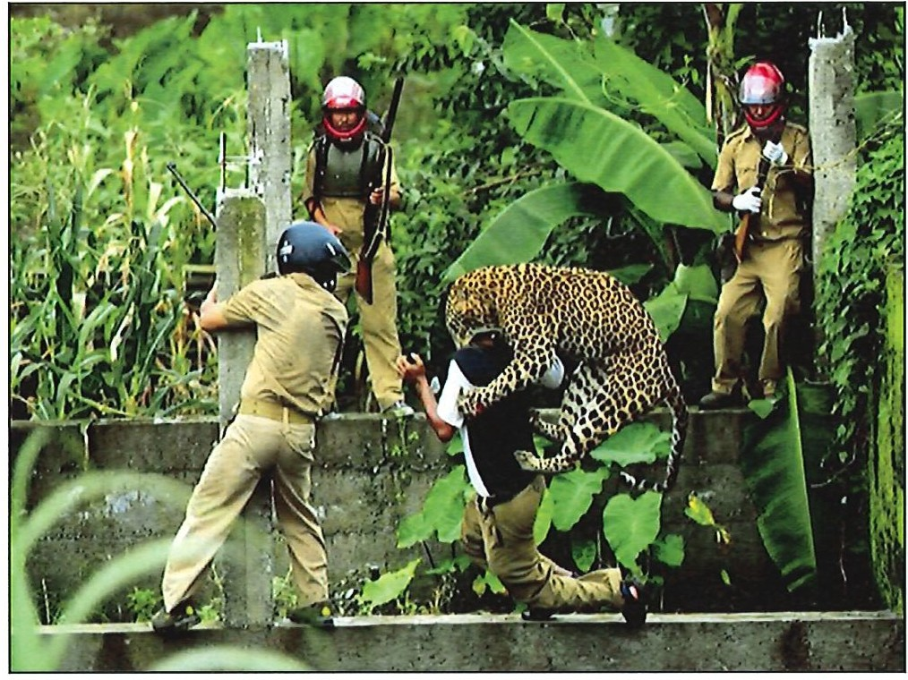
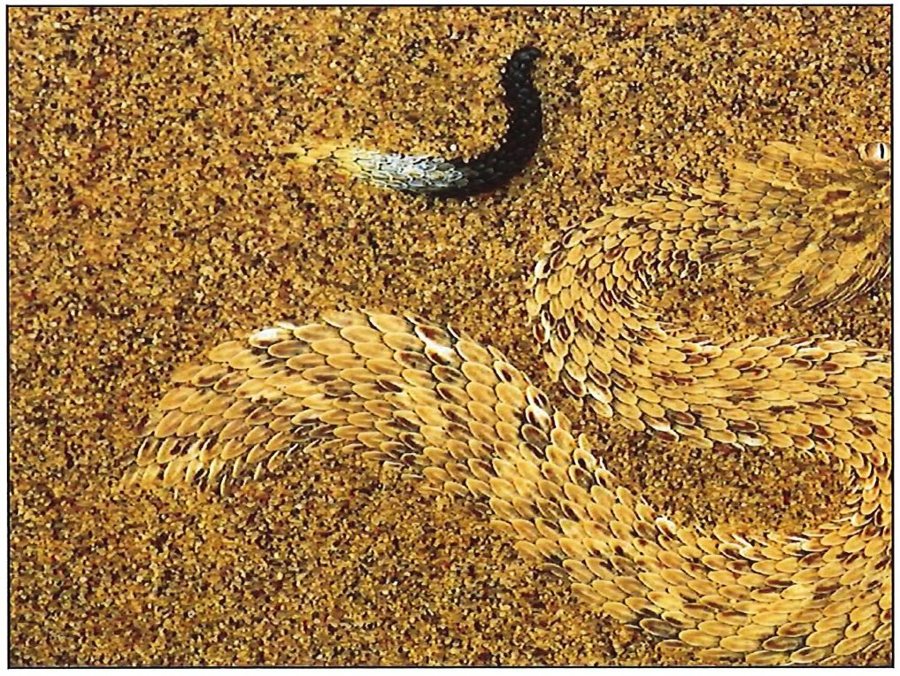
..^{C}...^{X}...^{l}.
N
0
N
0

Slide 3
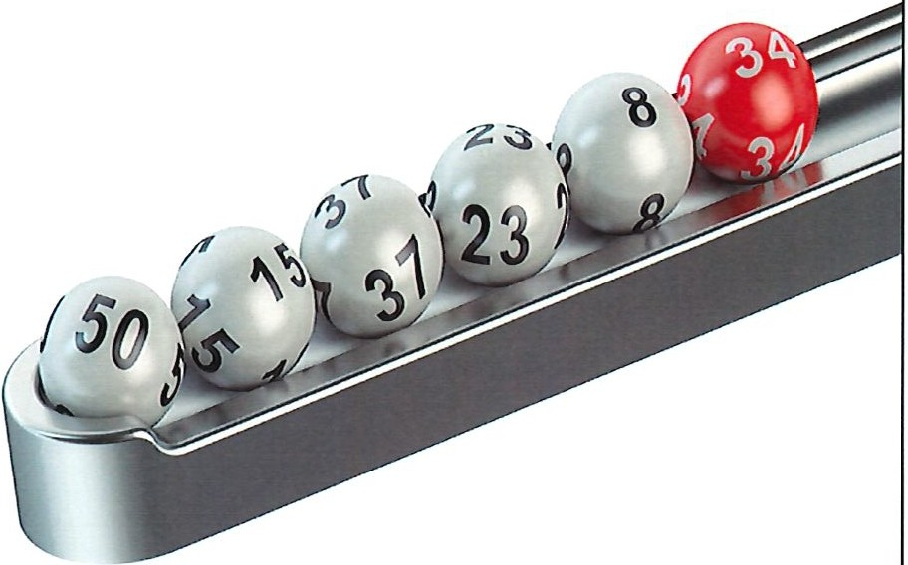
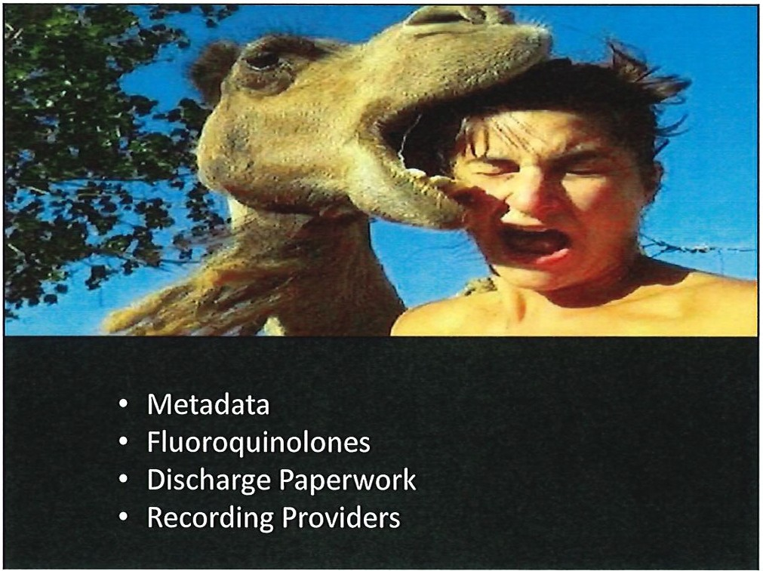
..⁰...⁰....
N
0
N
0

Slide 4
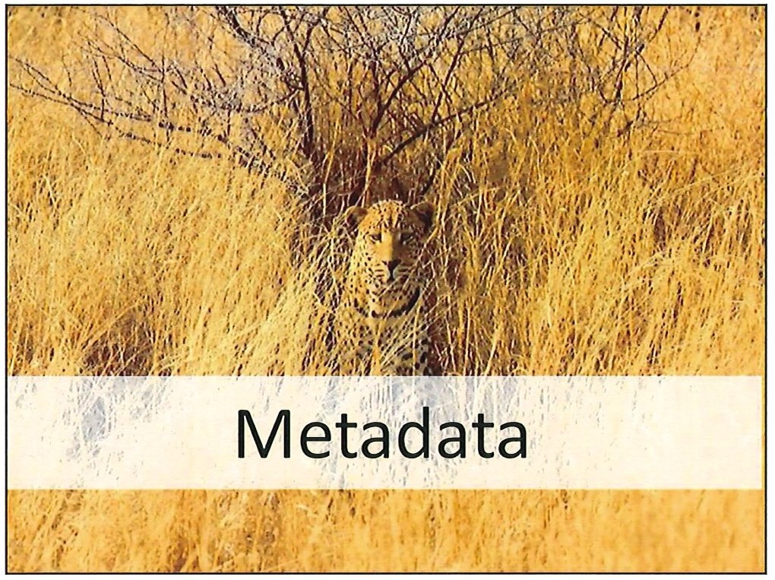

..^{I}.....^{D}
..⁽.^{X}..⁾.
N
0
N
0

Slide 5
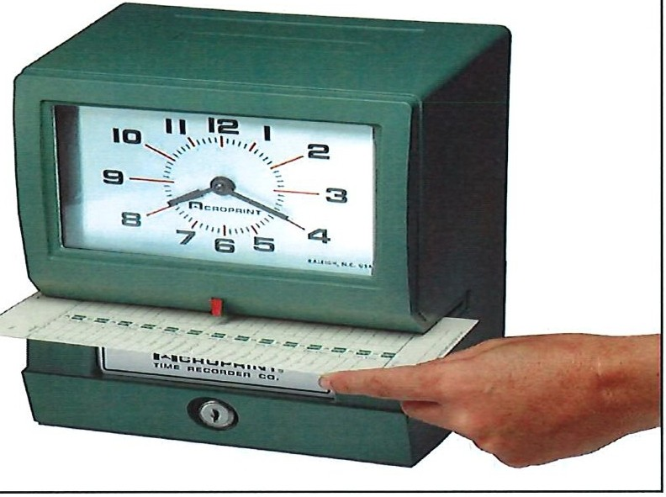
9 /8/2020
System Metadata
Application Metadata
.,
8 0 0
Um '1-!f. lt ⁰ t foq .,..pt:,lo?).& do(-
¹J'.l: fm ID 8 Iii ., .!>.,, o,,:. ·
0..-.1, = J a.nw. (
111 ,-. 1 o,_.' Do_< .. , a.- 7" T...,.., 'r'
t.' · tJ J! @Fl, • o
(Q.•( 'k uc"-h Doc:-, •1
1
AO•
?C I • t 12• • t;;r ta
, , 0.-.
&J
G3 Co·
J .. CC) , , _.._ . ....:
" ..........,uo;.
lb( l - • Oo<_ -t ,.,,_....,.
...•
' o.v_. ,,,..-.., ,..,, t,a.r1.. o.-tn l:1"'-W-" -q
No$!'! l, j,tn
-t
',i) - - .: • I. •••.• l ••••. ,
.
I I
12!1• snowy morningInAve nyn. Gothtnbur&. InSweden, J w.u convrrsln g In :1 fa'ihlon:1hle
. \ . t.£:e*." :!'f'l'c ·ID! F·i• ■ .,I·
fil, '+1 th a team ofJc. ,hockoy pla)•tr who play for the t t.am NorthernSprltu .
·
rce.... :-: .1u...z■11• ■- -1- ,
Skating Cir,lr..t wtlladdrt.uhowtht athlctcs and the glrl.s thc.v ct ach out to In
\, ·
,-
Cothtnburgcsbbllsh theirownInterpretations!!!,a nd Cor ed u cation proJ«l.S:. •
r ,!t* ,;,H.. f'ek'!Fi 1111\M X'
[
!
- - A-l ( l O.U,.t4",r-...)e1u -
_...,,.,,....•. •plqtf l M 0: 1 -- c.-,
w,&a' e. ln. walM • tMA tM l k .. »
n '-cby,&,.,..n t t1 • uh d "1 &.-..1M
, .-., - a , ,,,.l (tMth._. k • '- bt
p&,1Jff1atl • twory,. tt "\c1 loeocl "7 f'U11""'
.-....aM·• • 'J 'I
'
t!:.:,.,:: rlr6 iffl!I«MI'
''
M i?ik ·if1Uh ■: I J
!
rz, ;:- ,;; u lfP rlil ■ --13
['
t: .!:. ef zt •iff l llilSM-'I•}
f!7. -:,:_:H..,J,k'c·lff ¥1■4S_MJI
-
ra *.= ft1•iEU'■.14' ■,. -- ,
5

Slide 6
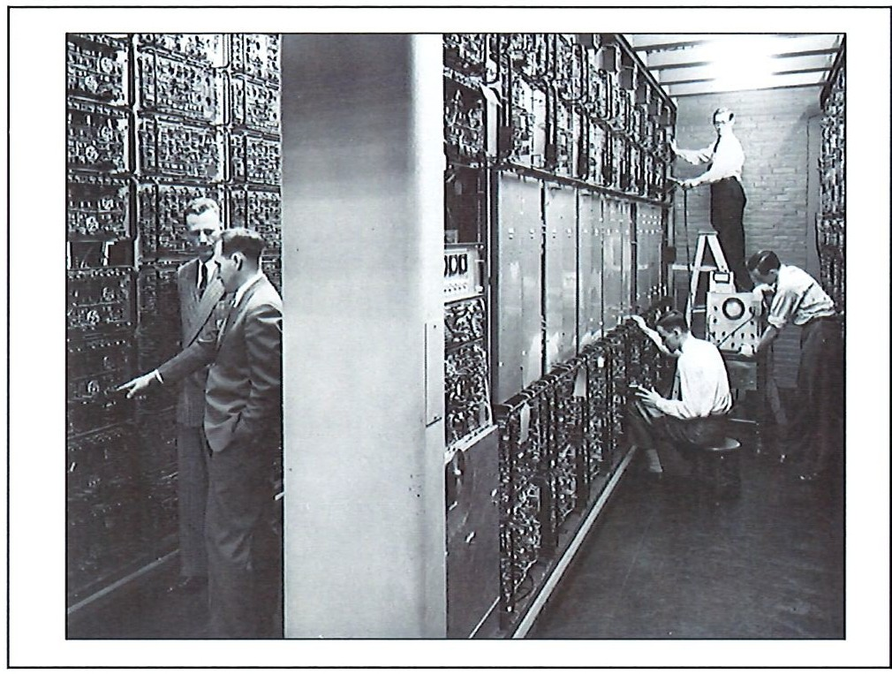
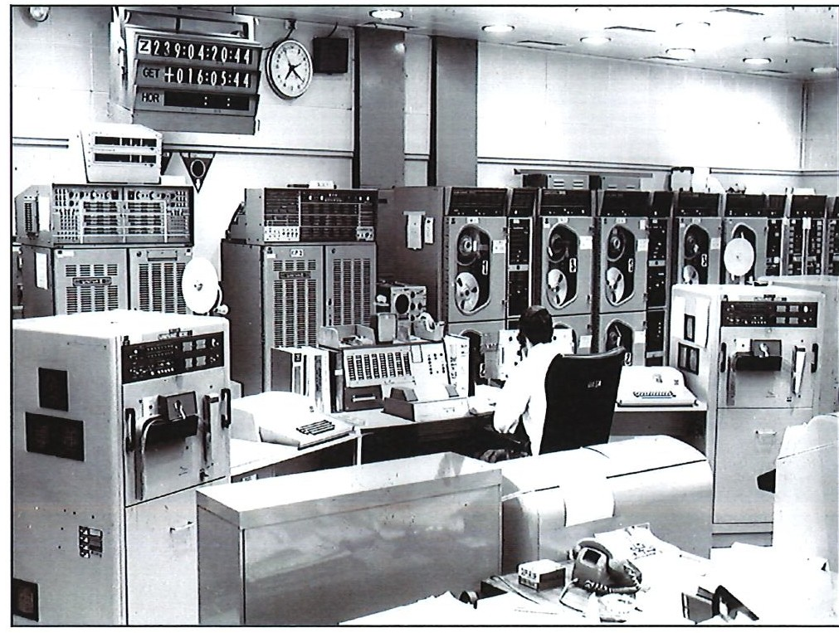
U)
N
0
N
0
-

Slide 7
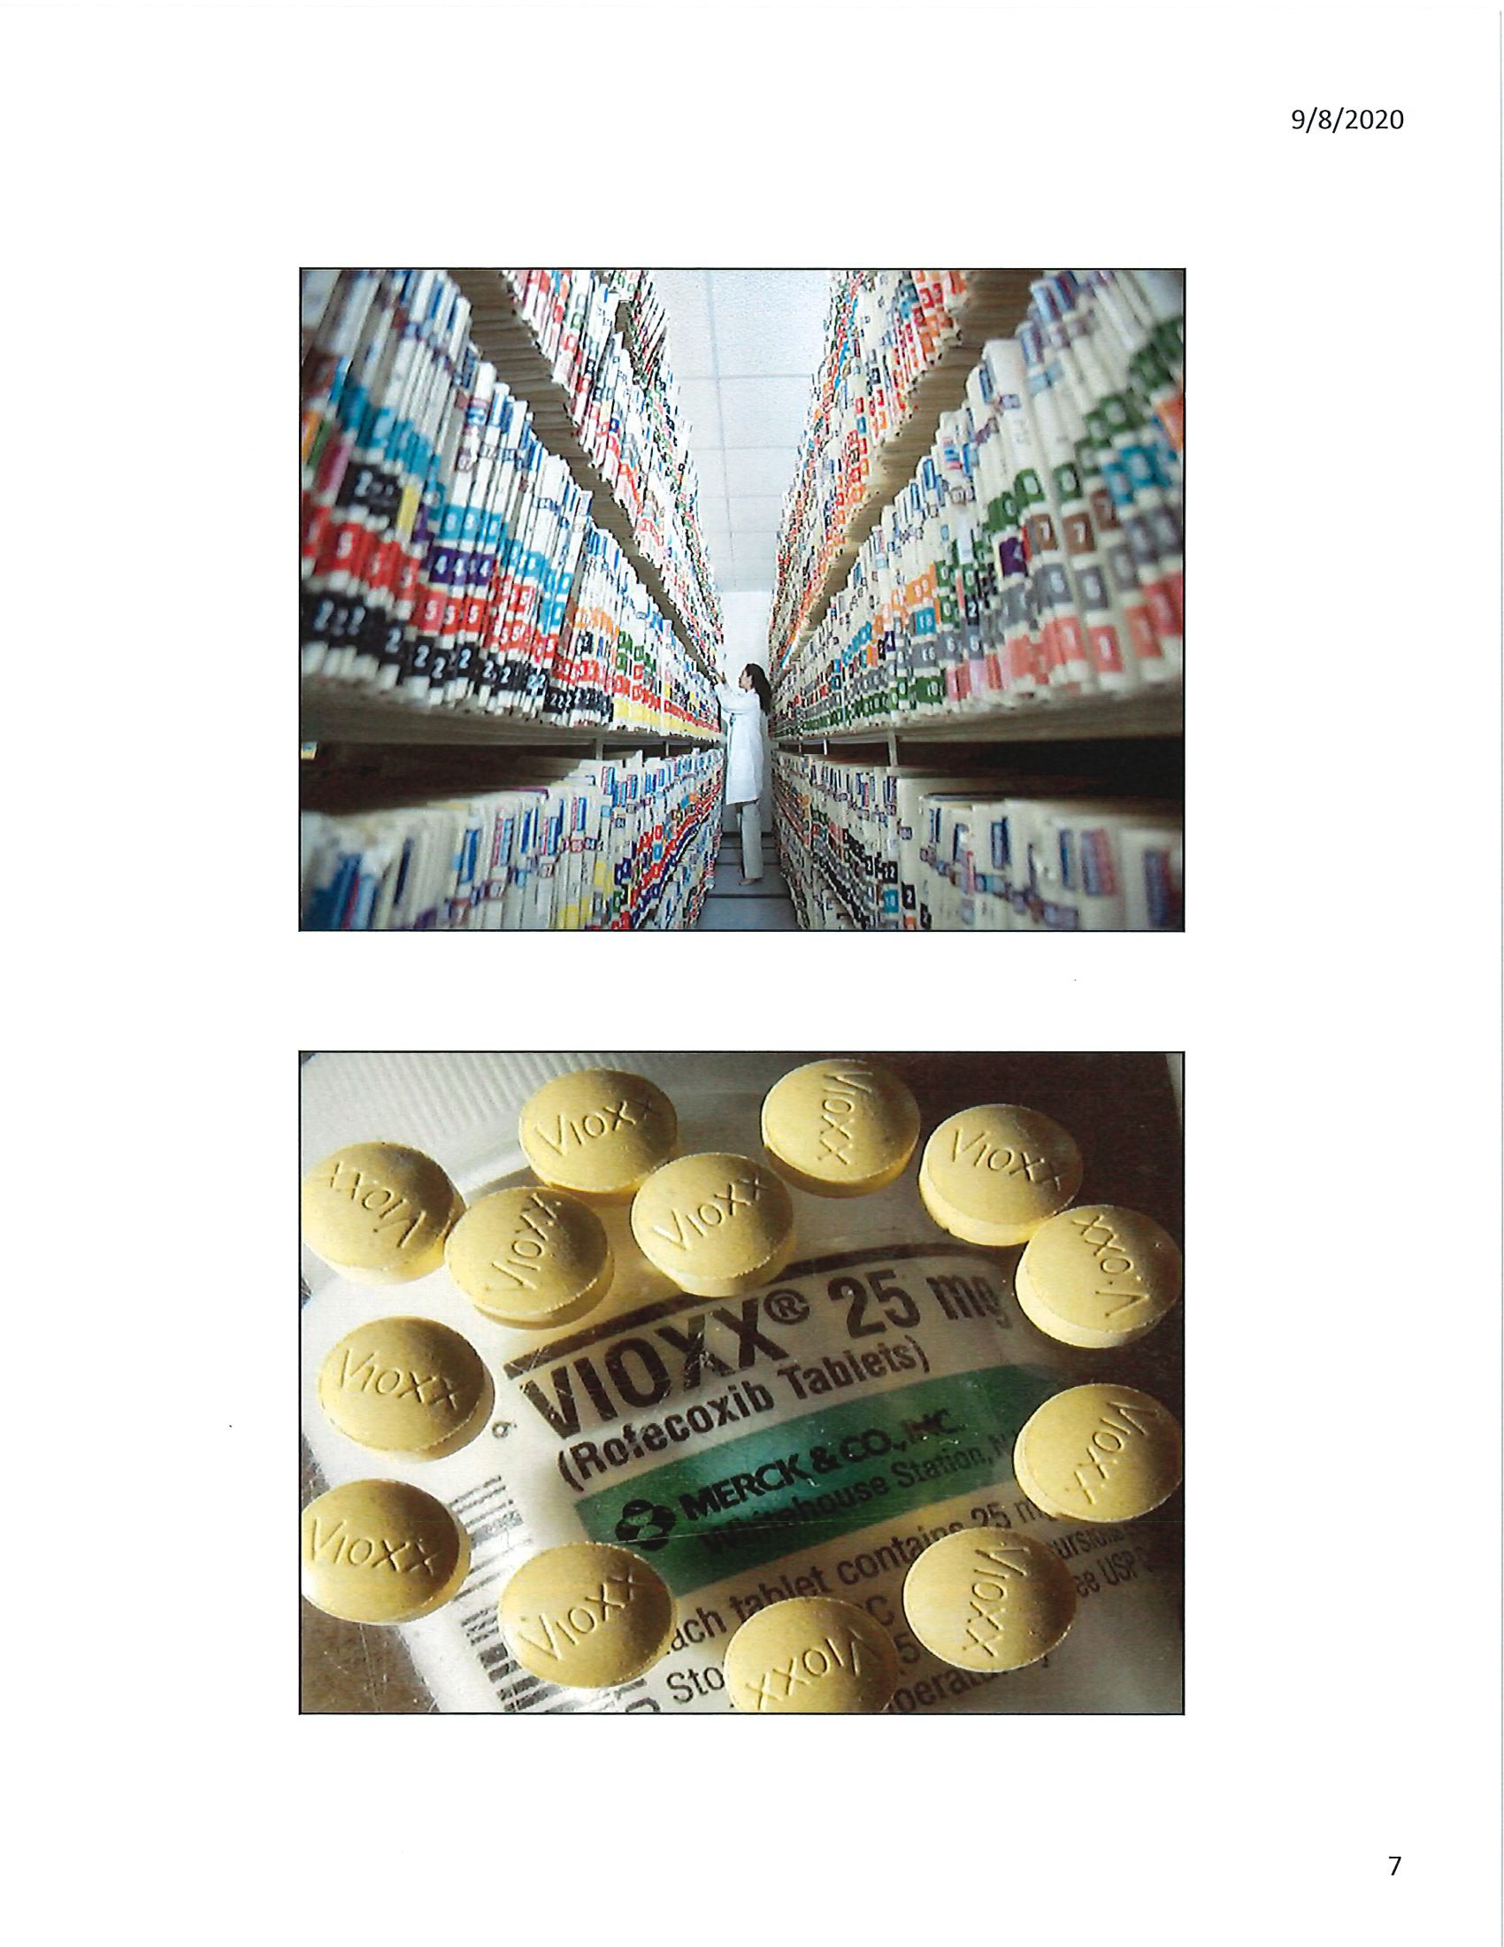

Slide 8
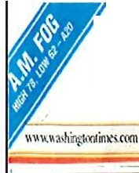
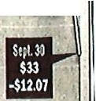
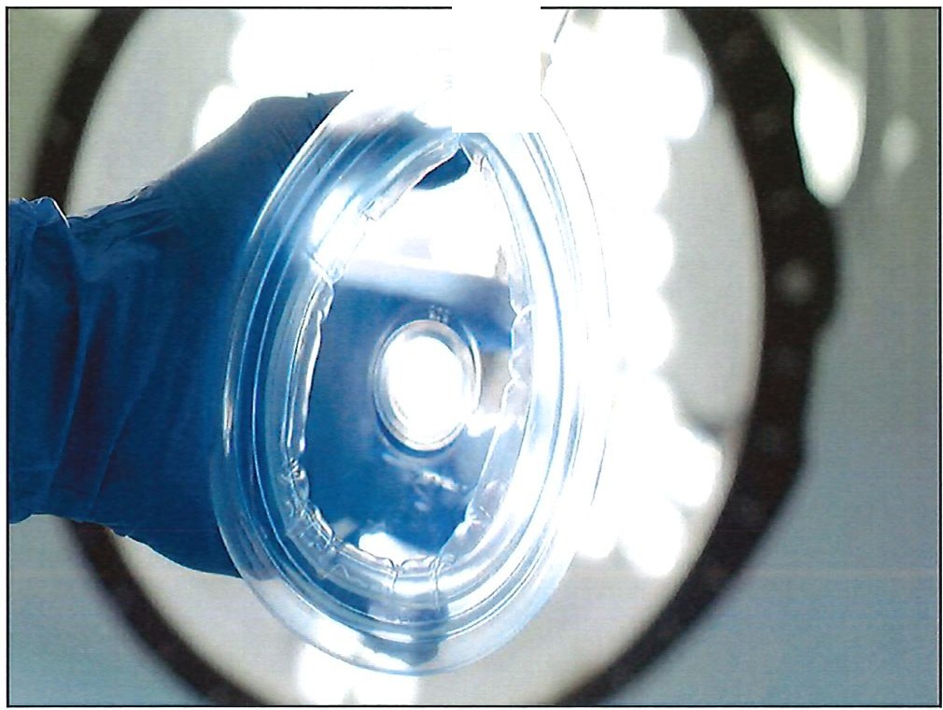
i cJ1t(J btgton mtmc(J
9/8/2020
ANAL
FRIDA) OBLHI, 2001
........ ..;'."i:!: 25CClifS
Merek . =
I Merci:!lock fell Sil.Of or 'Thii isll0(1101li surpr,aIe' Btiides po!libly' knowing
PAINFUL
ntarly 27pmtnloSll90in ' d Dr.SIC\'ffl G3llQC\ acltr« . boto the hannM effects and
I
hmylriding onlheliew\ ·mtoror n>A'1Cen cr(oc not actir.g qukki)'enwg Uie
I
Stoel: E change )'eiterJay.j ,ugEv3luauonandR.C$<, :u · Y is1llo wlnmb:e lo Mml:dragged w ,mthe ix,w V,oxxispartoCaciasicl6nll· h uei stllktn1nts b«awt lhc
COO'l)allysaldftwas
Jootsl00\lltrial w . t.kh 2Wu'biton!Nlhal betn,,a ::1"
; lalqft11111vttit dlUg
,
, infbnwalor)'d111gscalkJro:<· · · · s-canl:o1-asrol.arpioo-
recalls -4
and ltrdt-e a re debill•
, Yloxxolflhtnwktl
wasoffby56pomlt . . ily edbythephannac_( taling and co11ly, n id Mr.
Merci:\ l\'(111 of1ts VIO.'lt ini!ustrya.sbeqnm:tf!«b1i the iJ!fllk,rtreUC .
'1 ♦) F-== '
Iler su <cd phra 0-11 and haling ( tr !l&eff«l5.
or 1: M<.ooia: l ion or
c1tS III the UmltdS tales and particularly on 111( stomach, 1li.i1La· )ll'Io1Amtrka.
111Vioxx
Canada,I ming lilet? unpre• thanolder drug l'fizer\ Ctle· ' Onehoodredmillion \e
p.irtdlohandlequclllonSfrom bruand lk'<lrureallocox•l hai u.<cd Viffix and llierdore
lO
cooctmcd p.itknlnnd doctors inlu'bilOB. Buisofar11M1w the pOlenlial ror claimants Is
r or3lternatil'esandlrl'• bttn no c1idenu 1h11these •ht!aid.' \o'ualso
I OO' bulnuy0t 1<Jg,(I
20
i = l iruonr iationabolo rr• Olhcrdrugsposu nydangmlo hamiscr1oiV lllltarenc4
Heart riskfound
u1m1hrilis drug·
101 MfRC, K
1
Vioxx ich is.also pre• lhco11ais do not 1:now how injlJ
1<riool for aculep.1111and d - Vio.u may be ta the 111• roxuton.'<1.
. , '
oroe11 such a.so ru,v,el crusoorak.
AlalffirminO '.d!homa ifl , ·
. 1) ,is nm !Xl(tnlial Altematii'CStoVioxxinclilill / ifdtfnl3Jl& n1 .wd ll '
1
ia r•pm uonmtdici_ne}n m,eric l)3in rtlitl\'nsuch a.s hadfilcd1heliri!Lr• -s1n!sutlle·
. '
f r ·
' ' .
9

Slide 9
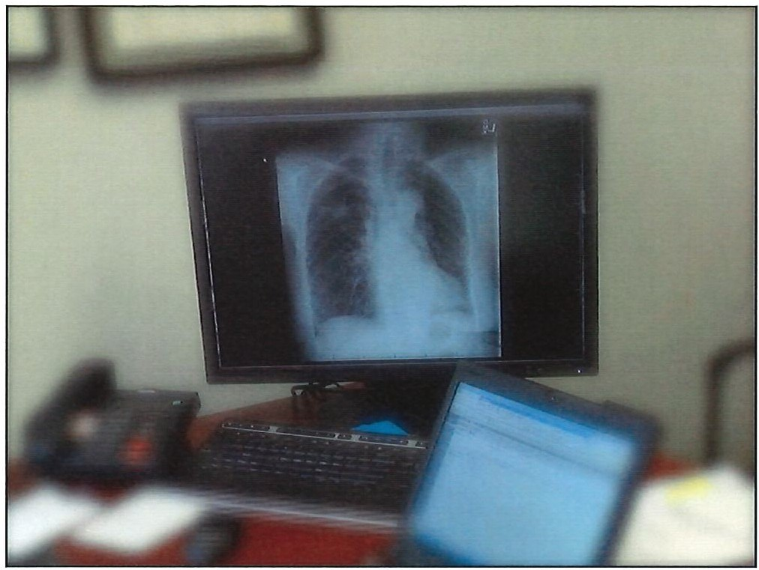


9/8/2020
AMERICAN 04'
I CAL \
A S SOC AT IO N
9

Slide 10
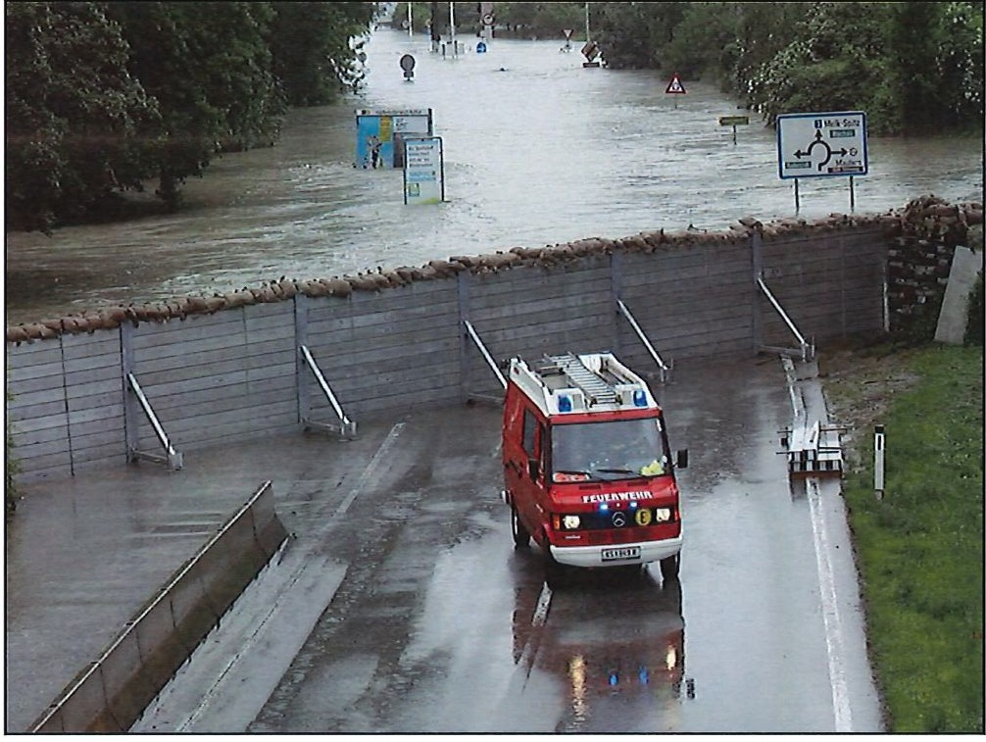
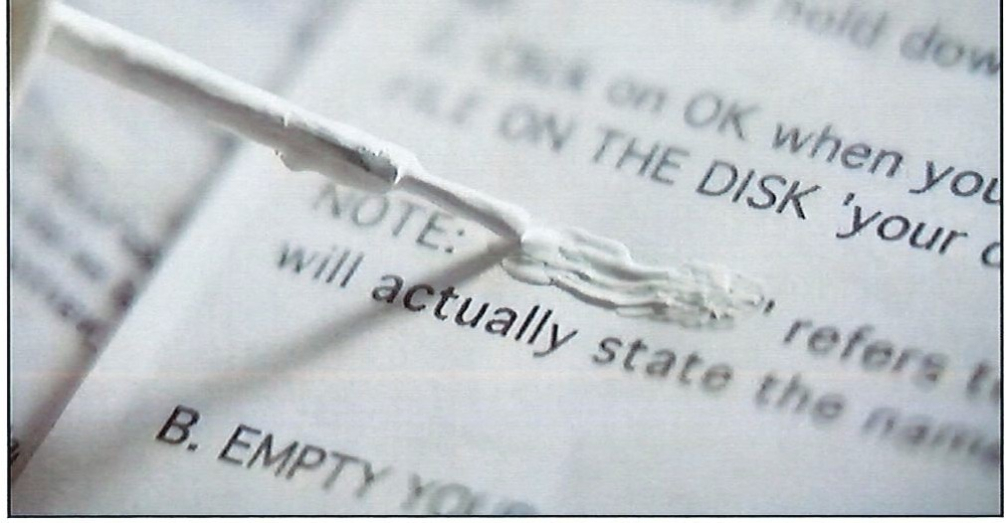
..'..°..._
..⁰..⁰..._
N
0
N
0
I->
0

Slide 11
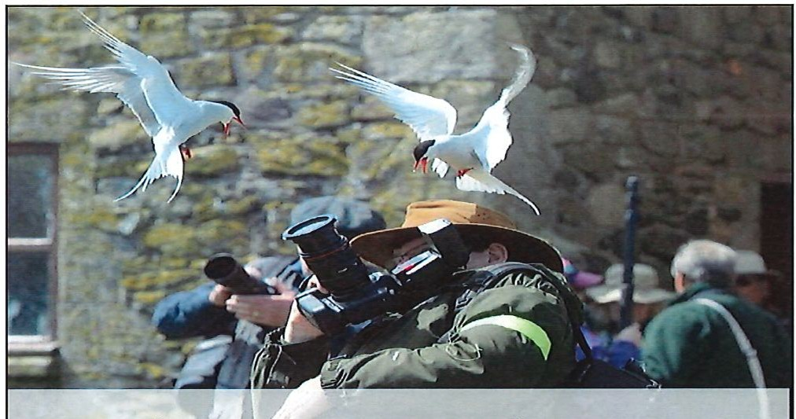
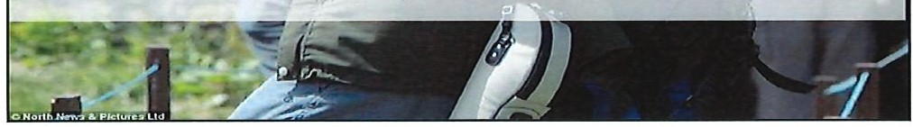

Flu;o·r,oquinolones
9/8/2020
300,000 prescriptions/year
Aerobic gram-negative coverage
Some pseudomonas
Some staph
Atypical pneumonias
Genital pathogens
Anaerobes
( NOC60505·1308·1
I: 'Clprofloxacln
,tt"I Tablets USP ;
- f I!
l
,,,
IP.P.l!'l!l!l"l!.il g
s I I
A.AJ>Orax CORP . 0
12

Slide 12
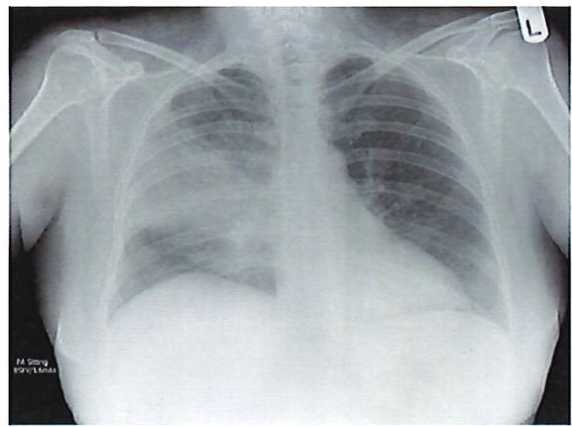
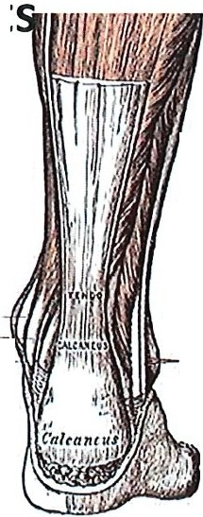

9/8/2020
Outpatient s with comorbidities*or A respiratory fluoroquinolone antibiotic use in past three monthst (levofloxacin [Levaquin],
gemifloxacin (Factive], or moxifloxacin [Avelox)),
Healthy Patient
-
t.•.":, i
J_{f}::..
_{r}t,":,- _- _\i'
c:;
T.-.itlons of
f'tr ot,Ut l«111!}UJ
tl hr1111J
'&
ll
1
12

Slide 13
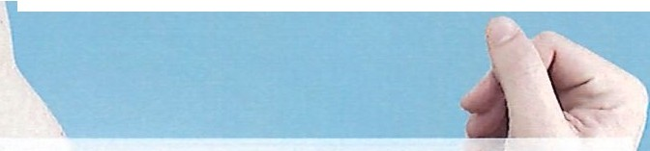
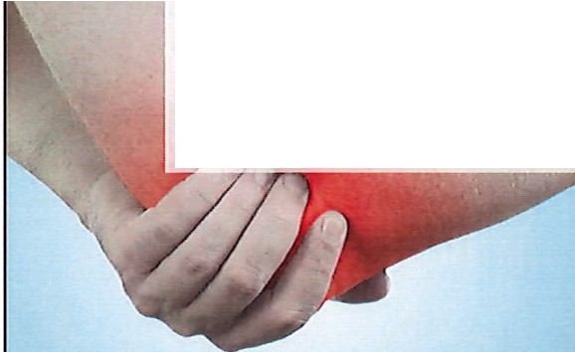
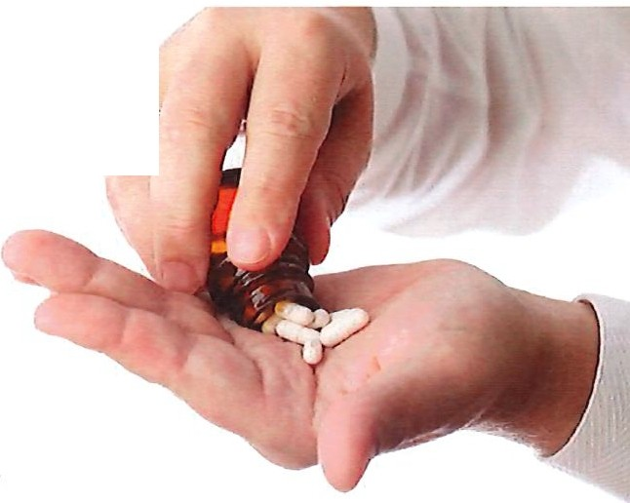


lracreased risk of rupture
9/8/2020
Men
Age> 60 years
Chronic renal disease
Prednisone
Tablet$ USP
,::::·
Watson⁰, 10001iti.u RAw ₁
46 X increase in tendon rupture
13

Slide 14
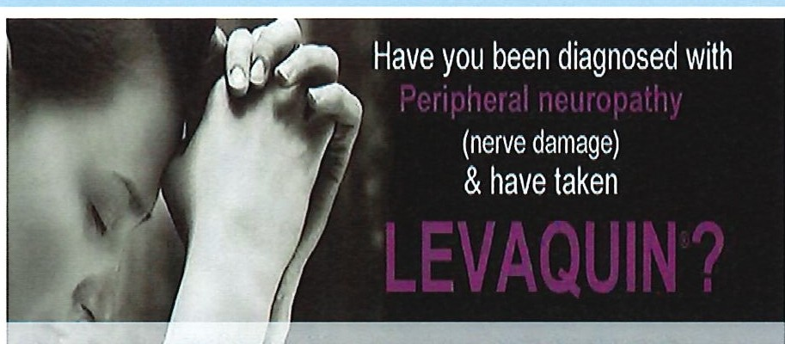
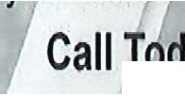
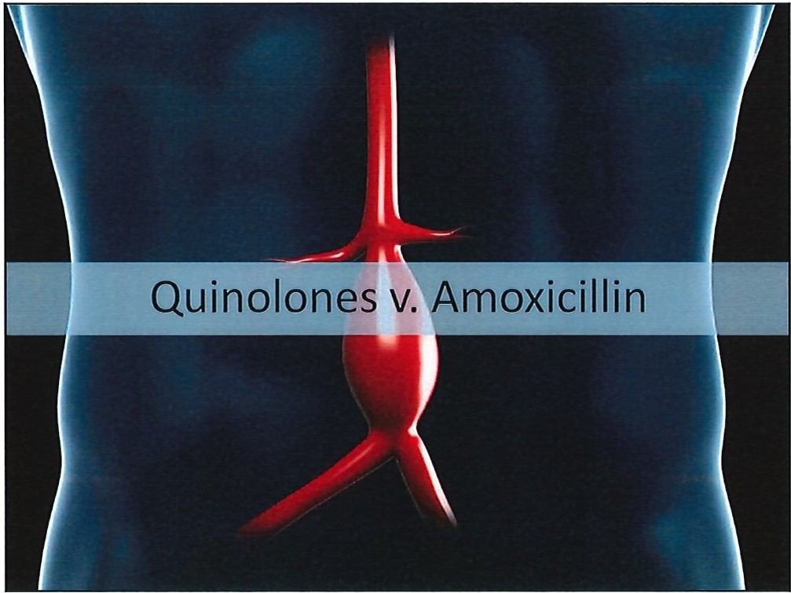
9/8/2020
Risk of Neuropathy
You Mav lie Entitleal o Compensation. WE CAN HELP!
. ,,day: (888) 245-3323

Slide 15
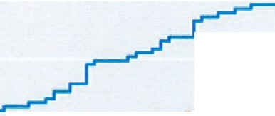

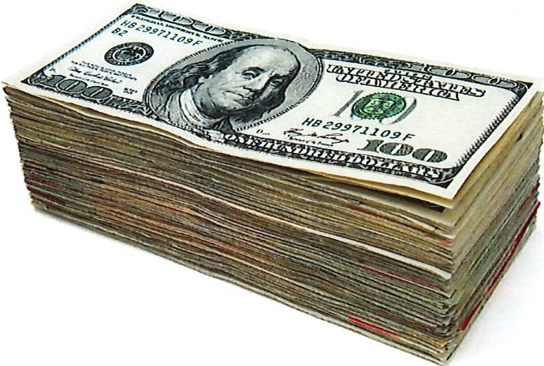
9/8/2020
Incidence of aort ic an eurysm/ dissect io n
2.5 ₋
fluoroqu inolones
2.0
- - - Amoxid llln
1.S
1.0
r-- -
r ..
_{--...}.,, _ _.r-1-
0.5 ,r
I_{..,...-} .,-
.,r J - .,
r---
₀ J- ...
o 10
20
30
'40
50
6 0
Days
Risk to the Provider

Slide 16
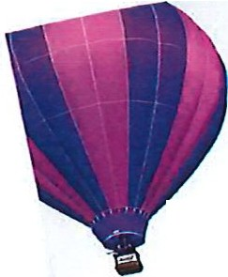
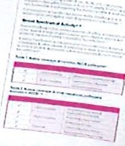

₋ .:s::.,.;..:.:..:..:.-.·.. ₋ua,,
9/8/2020
I "{\'\\0\<. aga\0,
consider "e\01t
7-
₁ trno)(.if\o)(.ac\n)
\
-
Ave@k
Floxie Hope A site to givehope for healing tothose adversely affected by fluoroquino!one antibiotics - Opro, Levaquln, Avelox andFloxln
Home | Recovery Stories | HelpAvailable | About | Umtact | Links& Resources

Slide 17
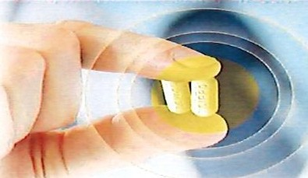

9/8/2020
HOW WE CAN HALT
THE ClPROAND
LEVAQUIN
CATASTROPHE
T he \ \'o rs t l\ lcd icntio n D is:1stcr in U.S. 1lsi tor y
I-low to Protect Younclf and Your F:u nily front the i\l:1sisvc
Overuse of the SixAnt..ib iot ic:sr· hat C a n D estro) ' Your Life
JAYS. COHEN, MD
<.- n k :.\U .VM X-.-.1 \1\ 11110, ,.rn ..-Vtt lt' l.h"' -n- D , ' l"h c C:ucAg .aln t he Dtug C...om p:rnks
"?>
s RVICEs.
U.,
( .ft_lFiD>A
<('.
o/
4'Vdaa
2008: Tendinitis and tendon rupture
2013: Peripheral Neuropathy
2016: Pain/ "adverse reactions"
2018: hypoglycemia / "Mental health issues"

Slide 18

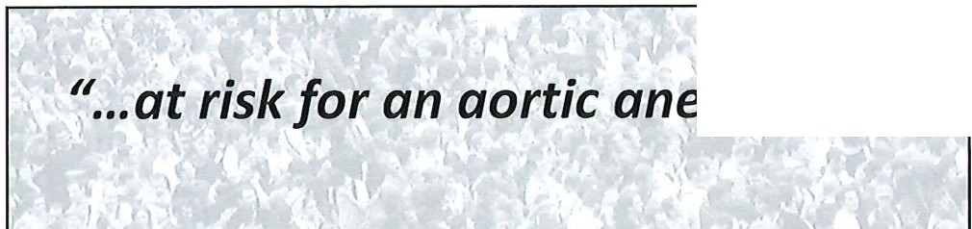
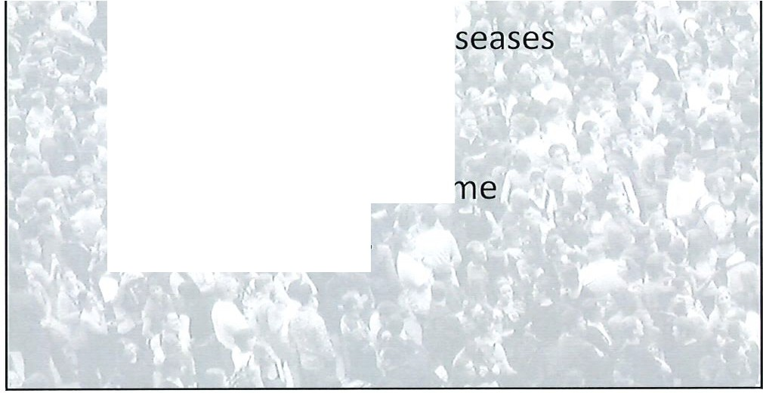
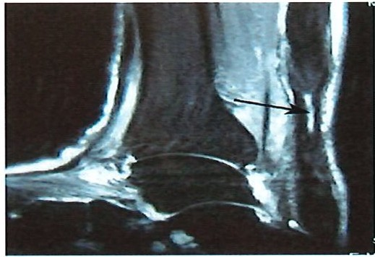
:t , �' •••at risk for an aortic aneurysm¹¹
9/8/2020
Peripheral vascular diseases
Hyper' tension,
Marfan syndrome
'
Ehlers-Danlos syndrome
Elderly patients.
I
2010: 82 y/o male
$1,800,000

Slide 19
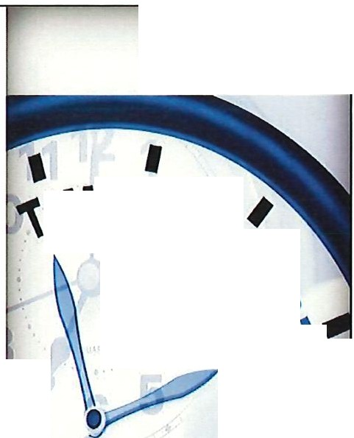
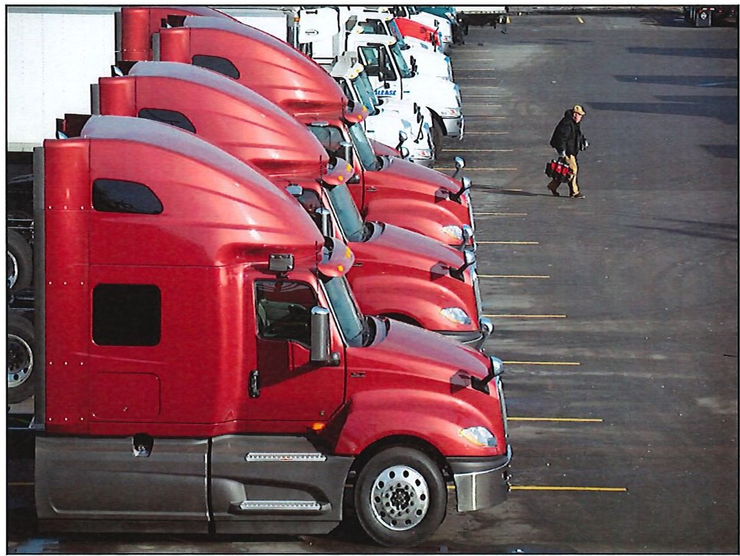
9/8/2020
Is It?
As of 2016:
\fflE Foll�
, / ,
rv5QQQ lawsuits
_{u} "
--
C)
'"
1www.TendonltlsExpetI.com
For The Victims Of Levaquin Side Effects?

Slide 20
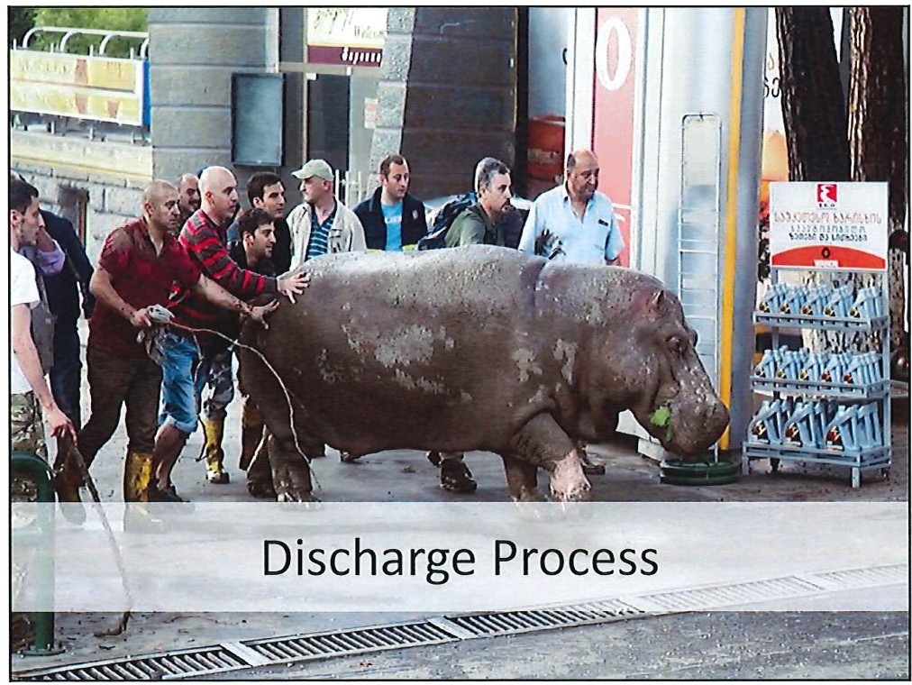
9/8/2020
Use your Macros:
I am prescribing a fluoroquinolone for the patient to treat . I have discussed the risks associated with this medication including risk of tendon rupture and neuropathy. I have considered other classes of antibiotics and I think this is the most appropriate choice of medication.
The patient has verbalized an understanding of these risks, has been advised to limit strenuous exercise while taking these medications, and will return immediately for any pain, swelling or if they develop any new or concerning symptoms.

Slide 21
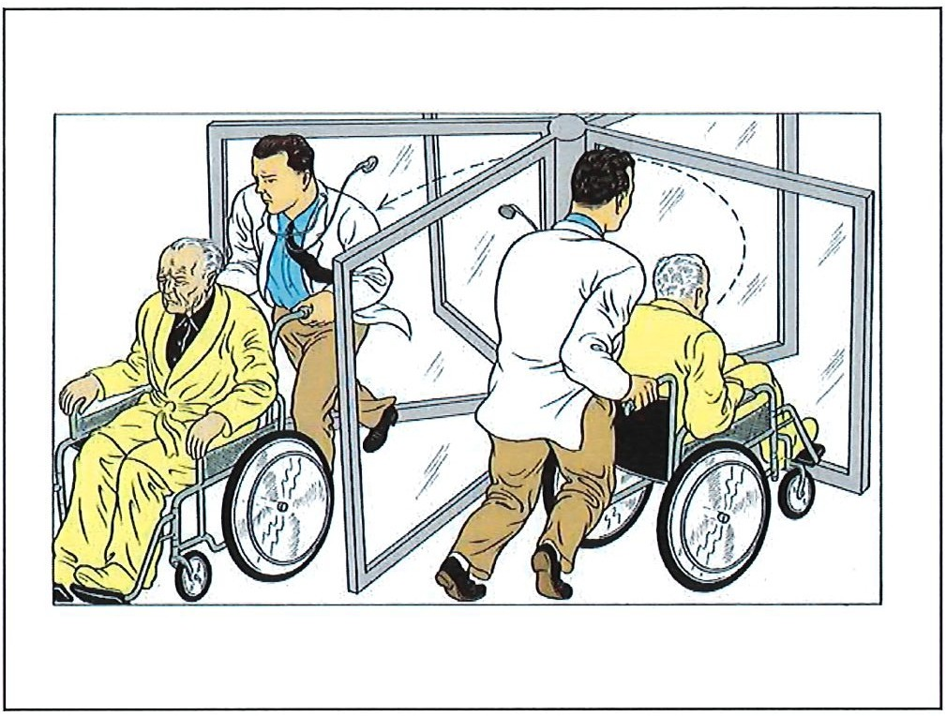
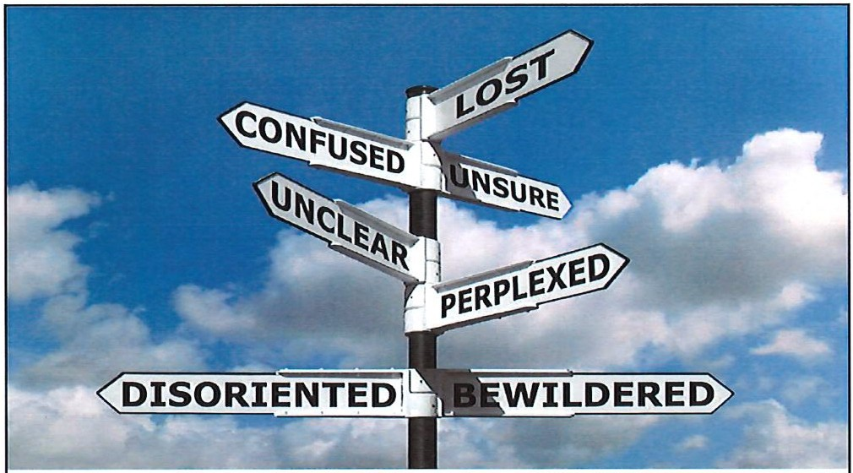
9/ 8/ 2020
22% of patients had difficulty understanding their discharge instructions.
Enge l et al. 2009

Slide 22
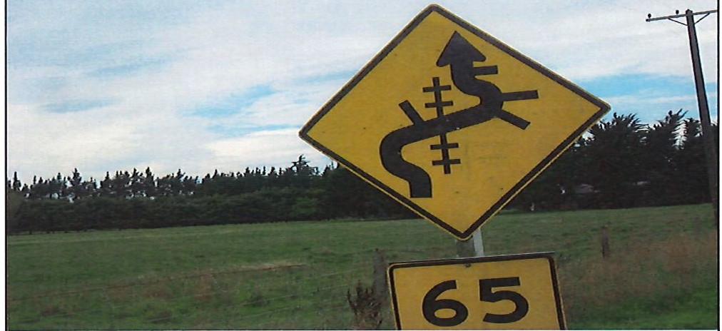

9/8/2020
Only 30% of patients recognized their deficiency in com prehension .
The above foll ow-up Instructions have been explained to me and follow the recommended Instruc tions. All of my questions haveb answered.I MAY RETURN TO THE EMERGENCY DEPARTMENT
TIME IF MY CONDITION WORSENS, DOES NOT IMPROVE, OR IF
A NEW PROBLEM.
k_ L0IE
Patient or Representative's Signature
L/
Date I Time

Slide 23
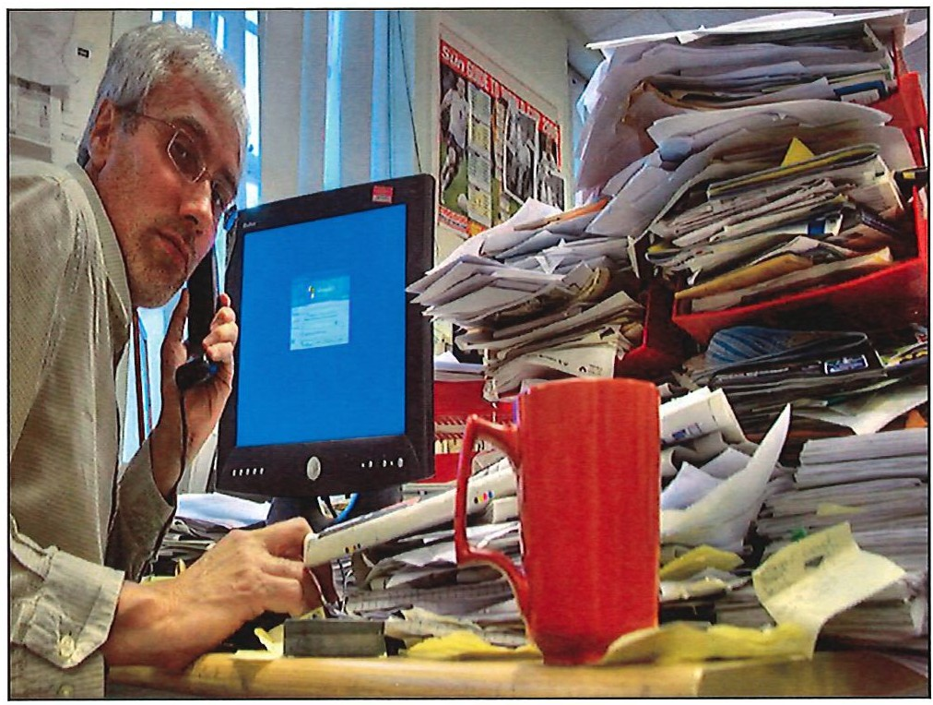
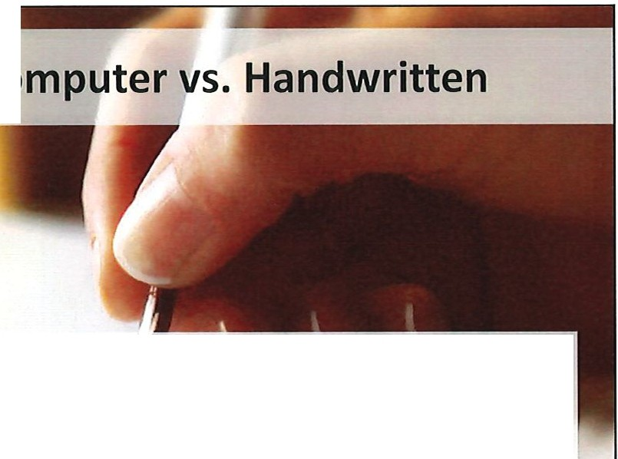

9/ 8/ 2020
Co
No association between the type of discharge instructions provided and the rat e of return visits over a 72 -hour period.
Lawrence et al. 2009

Slide 24

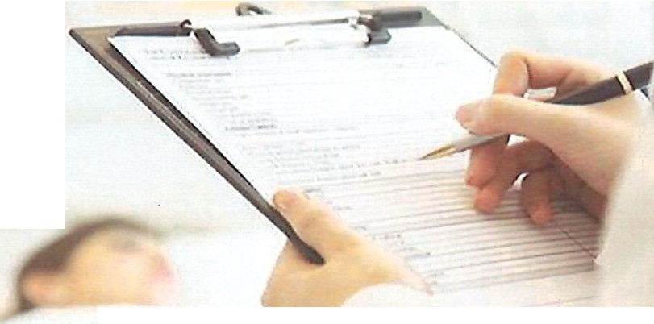
"gastroenteritisn
9/8/2020
,: < 3, , 2,, I
°'>- 5>,
� L I Ir I I
I f , I , I , 17
I , I I I I I \ : ; - :_; 2_
•••••
What matters in D/c instructions?
Time and Action Specific Written AND Verbal Get your own rebound

Slide 25
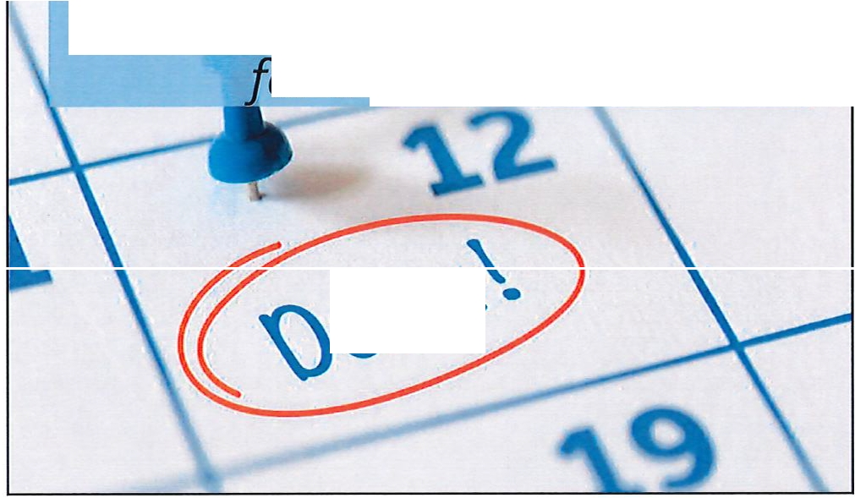
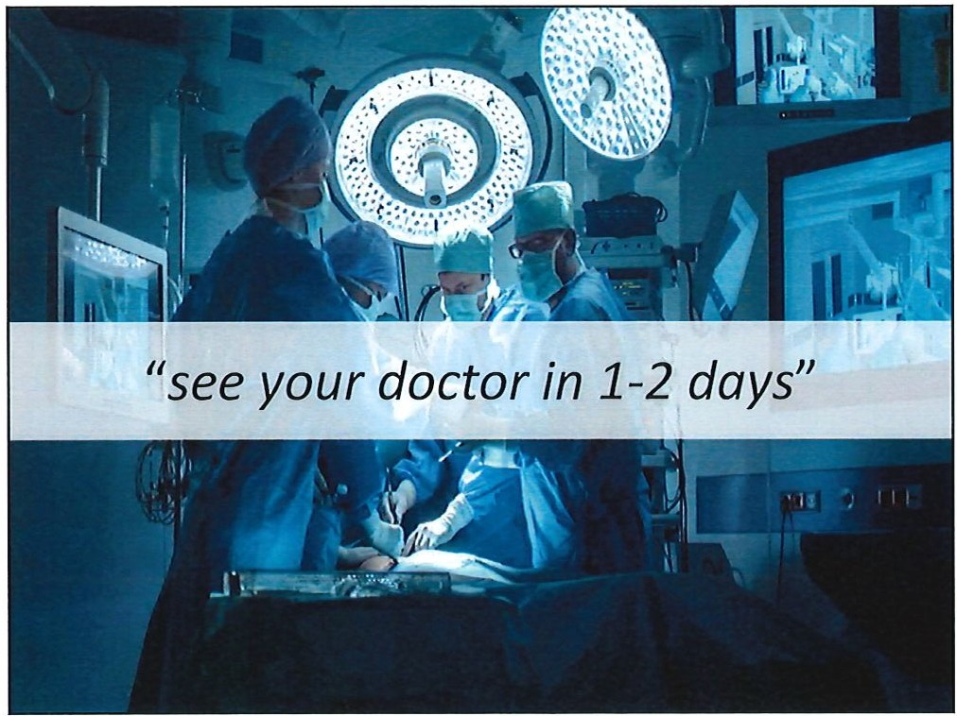
9/ 8/ 2020
"Make an appointment with a plastic surgeon when available
·or treatment."
1tl {$.

Slide 26


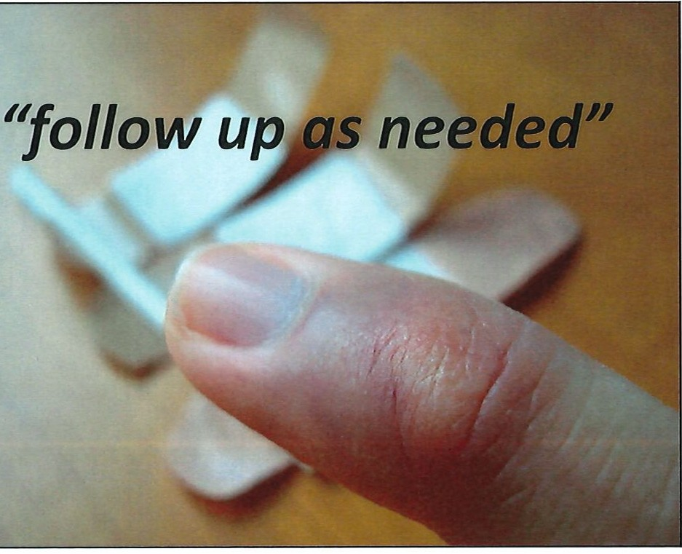
..........
..........
N 0 N 0
l.O
(X)
•
0
•
N
CJ)

Slide 27
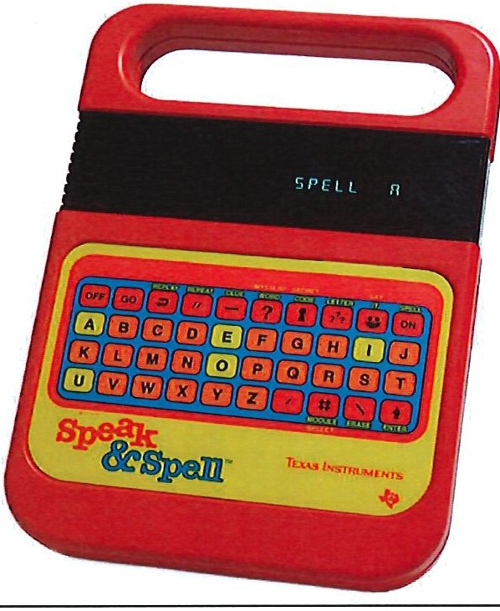

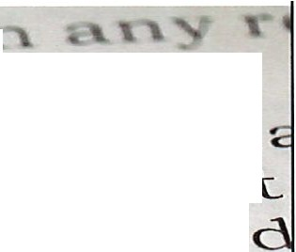


Written
and
Verbal
9/8/2020
Clelland V. Haas.
st,,1:
po-int of"-v-i V.v
1"'[a\pract.i_ce \m
-wr o n g d o i n g, tha..t
\" . cl.. 1), c >, - , µ. h t
t. o
i l "\ '
- - e ll \ ' " :--
" ...the discharge instructions as a whole did not fall below the applicable standard of care."
27

Slide 28
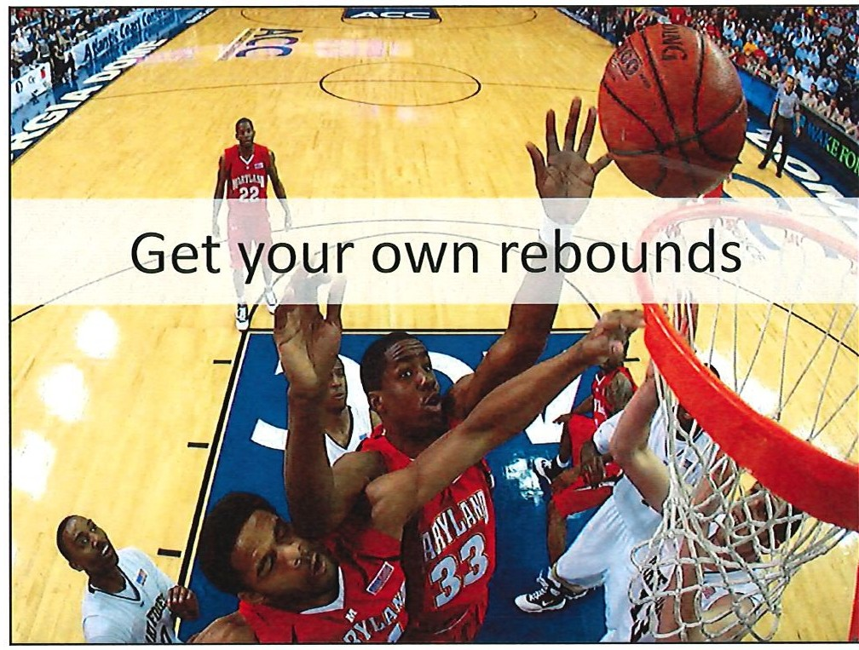
\.D
00
N
0
N
0
-
-
::::r
tD
-)C·
-·
_{t}-_{D}·
""'I
0.
:-:::s·
-I
V,
0.
""'Irt
V,
rt
0
V,
_{s}m
••
•
N 00

Slide 29







9/8/2020
_{i}\j
,
•
·
,:;J
¹¹ / f you get worse or develop any new symptoms return immediately to the emergency depart ment.
29

Slide 30


..........
..........
N 0 N 0
I.O
00
".. .,.
-_{a.}-.--
.(1,)
Vl
w
0

Slide 31


I.O
00
N
0
N
0
-
-
.^{w}...,.

Slide 32


I..D
00
N
0
N
0
-
-
w
N

Slide 33


l.O
00
N
0
N
0
-
-
w
w

Slide 34


..^{I}...^{O}.....
N 0 N 0

Slide 35





\.D
00
N
0
N
0
-
-
)> C C
0
:::c
-I
0
"tJ
0
w
(.J1

Slide 36


9/8/2020
Fluoroquinolones
Discharge Instructions
- CT.
Recording Providers
l wt.';
•ti ... ;.,;..,.....r:
m atthewcdelan e·y@gm ail.com
\
\_-
Twitter: mdelapeymd
·
•<46J,iw",,.._
36

