Slide 1
Environmental Sustainability
Craig Vincent Mitchell, PhD
Associate Professor of Christian Ethics
Southwestern Baptist Theological Seminary

Slide 2
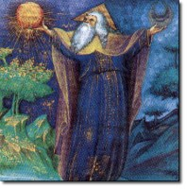
God and Creation
God is omnipotent, omniscient, omnipresent, and good.
God created everything to reflect His nature, will, and order
The world was created to serve His purposes.
God is separate from and greater than His created order

Slide 3
God and Creation
God has created the earth to support life in general, and human life in particular
God has given man authority over the earth
The earth cannot be destroyed by man because God made it to be strong and robust
The earth will exist and continue to support life until God “the Creator” brings all things to an end
Theo- centric Environmentalism
  Something is good only if it serves the purpose that God has for it.
  In God’s created order there is room for both man and his environment

Slide 4
Other Approaches to Environmentalism
Anthrop-centric
Eco-centric
There is no god, or objective morality so man can do whatever he wants
The earth and the environment are not important.
The mankind and the economy is all that matters
The environment is an end unto itself.
Deep ecology: morality is based on how things affect the environment
Mother Earth should be worshipped and protected at all costs
Man is a disease upon the earth

Slide 5
Overview: Part 1
Definition of Sustainability
Eco-centric Sustainability
Environmental Economics

Slide 6

Definition of Sustainability
“Sustainability … is intrinsically inexact… It is, at best, a general guide to policies that have to do with investment, conservation and resource use. And we shouldn’t pretend that it is anything other than that.”
Robert Solow, PhD

Slide 7

EPA Definition of Sustainability
Over the past 30 years, the concept of sustainability has evolved to reflect perspectives of both the public and private sectors.
Sustainable development reflects not the trade-off between business and the environment but the synergy between them

Slide 8
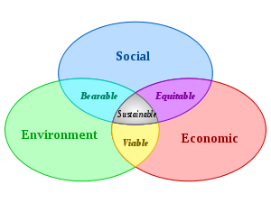
Definition of Sustainability
Weak sustainability can be viewed as an anthropocentic approach to environmentalism
It seeks to balance society’s economic needs with the environment

Slide 9
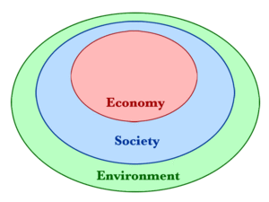
Environmental Sustainability
Strong Sustainability is an eco-centric approach to environmentalism. It is based around the concept of deep ecology.
Deep ecology is a ecological philosophy that recognizes an inherent worth of other beings, aside from their utility. The philosophy emphasizes the interdependent nature of human and non-human life as well as the importance of the ecosystem and has fostered a new system of environmental ethics.

Slide 10
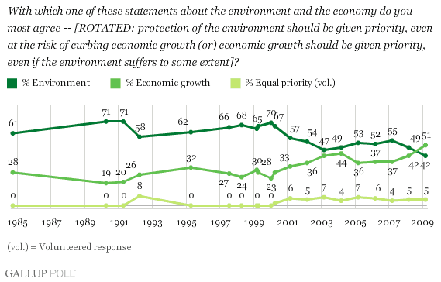
Gallop Poll

Slide 11
Overview: Part 2
Definition of Sustainability
Eco-centric
Sustainability
Environmental
Economics

Slide 12
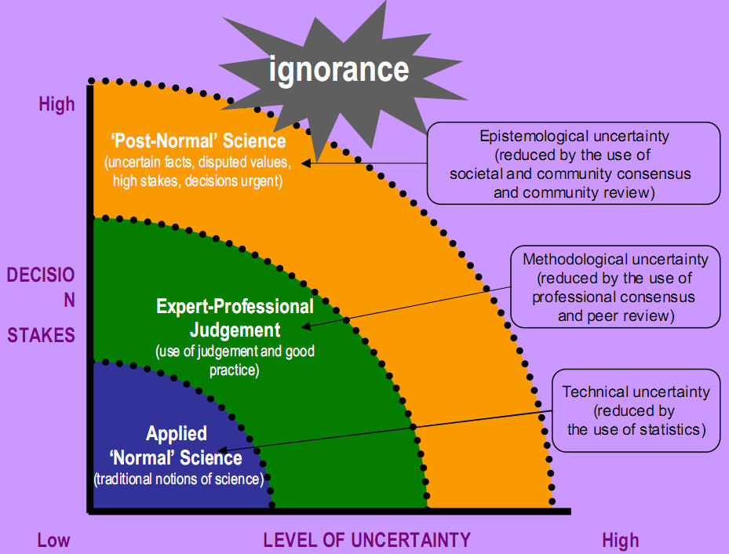
Post-normal Science

Slide 13
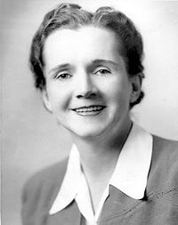

Rachel Carson’s
Silent Spring

Slide 14
Rachel Carson’s
Silent Spring
Carson's work had a powerful impact on the environmental movement. Silent Spring, in particular, was a rallying point for the fledgling social movement in the 1960s. According to environmental engineer and Carson scholar H. Patricia Hynes, "Silent Spring altered the balance of power in the world. No one since would be able to sell pollution as the necessary underside of progress so easily or uncritically." Carson's work, and the activism it inspired, are at least partly responsible for the deep ecology movement, and the overall strength of the grassroots environmental movement since the 1960s. It was also influential on the rise of eco-feminism and on many feminist scientists.

Slide 15
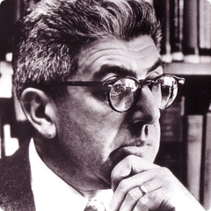
Barry Commoner
In his 1971 book The Closing Circle, Commoner suggested that the American economy should be restructured to conform to the unbending laws of ecology.
This book was one of the first to bring the idea of sustainability to a mass audience. Commoner suggested an eco-socialist response to the limits to growth thesis.
He had a long running debate with Paul Ehrlich, author of The Population Bomb and his followers, arguing that they were too focused on overpopulation as the source of environmental problems

Slide 16
Barry Commoner:
Four Laws of Ecology
1) Everything is connected to everything else - humans and other species are connected/dependant on a number of other species.
2) Everything must go somewhere - no matter what you do, and no matter what you use, it has to go somewhere. For example, when you burn wood, it doesn't disappear, it turns into smoke which rises into the air, and ash, which falls back down to the earth.
3) Nature knows best - Like it says, nature knows best. As much as you think it might help a place by repainting it, you are submitting the fumes into the air and into your lungs. Why not put siding on it?
4) There is no such thing as a free lunch - Everything you do, must have a reason behind it. For example, a class pizza party. In order to win the party, you have to fill out a survey, and submit it back to your teacher. This law basically means you have to do something in order to get something in return.

Slide 17
Barry Commoner
Commoner published another bestseller in 1976, The Poverty of Power. In that book, he addressed the "Three Es" that were plaguing the United States in the 1970s: "First there was the threat to environmental survival; then there was the apparent shortage of energy; and now there is the unexpected decline of the economy.“ He argued that the three issues were interconnected: the industries that used the most energy had the highest negative impact on the environment; the focus on non-renewable resources as sources of energy meant that those resources were growing scarce, thus pushing up the price of energy and hurting the economy. Towards the book's end, Commoner suggests that the problem of the Three Es is caused by the capitalistic system and can only be solved by replacing it with some sort of socialism.

Slide 18

Environmental Impact
“Almost all the rich nations are overpopulated because they are rapidly drawing down stocks of resources around the world. They don't live solely on the land in their own nations. Like the profligate son of our earlier analogy, they are spending their capital with no thought for the future.”
Paul Ehrlich, The Population Bomb

Slide 19
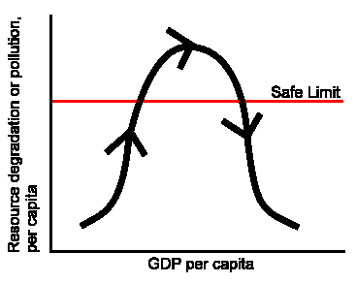
Environmental Impact
I = P × A × T
I = Environmental impact
P = Population
A = Affluence
T = Technology
Paul Ehrlich developed this equation.

Slide 20

Greenpeace International
Greenpeace began in 1970 in Canada. It is a non-governmental environmental organization[ with offices in over 40 countries and with an international coordinating body in Amsterdam, Netherlands. Greenpeace states its goal is to "ensure the ability of the Earth to nurture life in all its diversity“ and focuses its work on world wide issues such as global warming, deforestation, overfishing, commercial whaling and anti-nuclear issues. Greenpeace uses direct action, lobbying and research to achieve its goals.

Slide 21

Sustainability and
Global Governance
UNEP is the designated authority of the United Nations system in environmental issues at the global and regional level. Its mandate is to coordinate the development of environmental policy consensus by keeping the global environment under review and bringing emerging issues to the attention of governments and the international community for action.

Slide 22

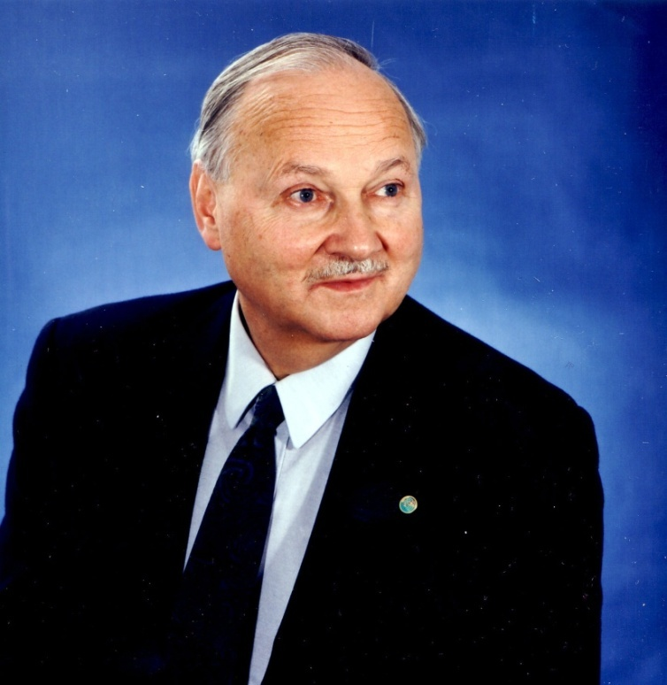
Sustainability and
Global Governance
Earth Council Alliance
Maurice Strong

Slide 23
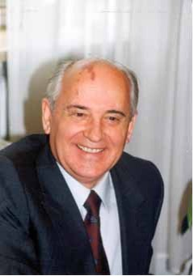

Sustainability and
Global Governance
Mikhail Gorbachev
Green Cross International

Slide 24
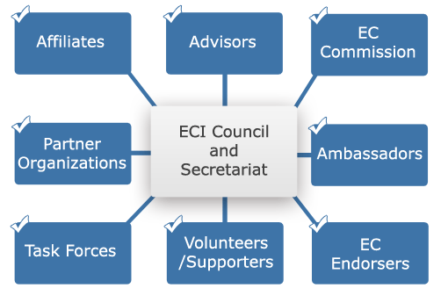
Earth Charter

Slide 25
Earth Charter
We stand at a critical moment in Earth's history, a time when humanity must choose its future. As the world becomes increasingly interdependent and fragile, the future at once holds great peril and great promise. To move forward we must recognize that in the midst of a magnificent diversity of cultures and life forms we are one human family and one Earth community with a common destiny. We must join together to bring forth a sustainable global society founded on respect for nature, universal human rights, economic justice, and a culture of peace. Towards this end, it is imperative that we, the peoples of Earth, declare our responsibility to one another, to the greater community of life, and to future generations.[

Slide 26

Earth Charter: Principles
I. Respect and Care for the Community of Life
II. Ecological Integrity
III. Social and Economic Justice
. IV. Democracy, Nonviolence, and Peace

Slide 27
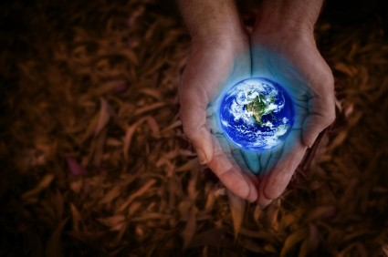
Earth Charter: Mission
The mission of the Earth Charter Initiative is to promote the transition to sustainable ways of living and a global society founded on a shared ethical framework that includes respect and care for the community of life, ecological integrity, universal human rights, respect for diversity, economic justice, democracy, and a culture of peace.

Slide 28

Earth Charter and Religion
In early 2009, as part of the ECI decentralization strategy, a Task Force on Religion, Spirituality and Ethics was formed. This Task Force aims to engage a broad range of individuals, institutions, and organizations concerned with religion, spirituality, ethics, to use the Earth Charter in their efforts toward creating a just, peaceful, and sustainable future for the Earth Community.

Slide 29
Earth Worshippers
Today's global warming zealots have neatly appropriated this enduring scriptural apologue. Those of them who have embraced the Gaia thesis are able to revere an almost living planet. And now, the timeless appeal of their narrative is attracting the devotees of conventional creeds, some of whom are trying to align their own theologies with the foxy faith of the hour. For example, in a forthcoming TV show, the former Dominican friar Mark Dowd aims to show that the religions of the book have goofed: all that stuff about humans having dominion over the Earth is entirely the wrong way round.
David Cox, Guardian Newspaper, Feb 8 2007.

Slide 30

Greenpeace and Sustainable Development
Greenpeace was one of the first parties to formulate a sustainable development scenario for climate change mitigation, which it did in 1993. According to sociologists Marc Mormont and Christine Dasnoy, Greenpeace played a significant role in raising public awareness of global warming in the 1990s. The organization has also focused on chloro flouro carbons, because of both their global warming potential and their effect on the ozone layer. Greenpeace was one of the leading participants advocating early phase-out of ozone depleting substances in the Montreal Protocol.

Slide 31
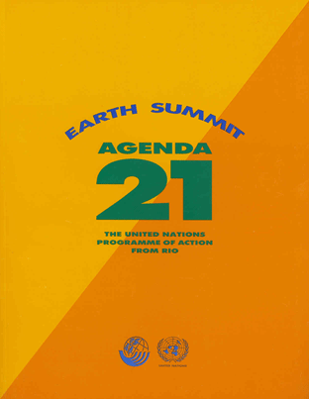
Sustainable Development
Agenda 21 is a comprehensive plan of action to be taken globally, nationally and locally by organizations of the United Nations System, Governments, and Major Groups in every area in which human impacts on the environment.
The full implementation of Agenda 21, the Program for Further Implementation of Agenda 21 and the Commitments to the Rio principles, were strongly reaffirmed at the World Summit on Sustainable Development held in Johannesburg, South Africa from 26 August to 4 September 2002.

Slide 32

Sustainability and Socialism
The dynamism and initiative of capitalism is something that would no longer be needed. The priority would be egalitarianism because in a steady state economy it would not be possible to justify inequality on the grounds that it leads to growth from which all benefit in the end. Instead, the lack of growth dynamic in a market socialist economy can be seen as a point in favor from a green perspective.
Simon Dresner, The Principles of Sustainability, 113.

Slide 33

Greenpeace and Socialism
Early Greenpeace member Canadian Ecologist Patrick Moore left the organization in 1986 when it, according to Moore, decided to support a universal ban on chlorine in drinking water. Moore has argued that Greenpeace today is motivated by politics rather than science and that none of his "fellow directors had any formal science education".[

Slide 34

Sustainability and Socialism
Clearly the Chinese, together with the rest of the over six billion people in the world, face a predicament that calls for a significant ecological, economic and social shift. The Sustainability Revolution presents an alternative that supports economic viability and healthy ecosystems by modifying consumption patterns and implementing a more equitable social framework.
Andres R. Edwards, The Sustainability Revolution, 3.

Slide 35
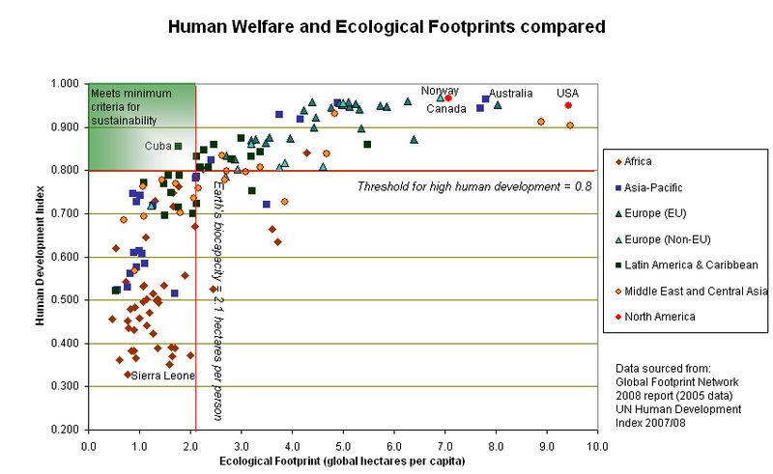
Human Welfare vs Ecological Welfare

Slide 36
Index of Sustainable Economic Welfare
GDP is not a good measure of the state of an economy
ISEW = personal consumption
+ public non-defensive expenditures
- private defensive expenditures
+ capital formation
+ services from domestic labor
- costs of environmental degradation
- depreciation of natural capital
James Tobin and Nordhaus

Slide 37
Net National Welfare
GDP is not a good measure of the state of an economy
Net National Welfare (NNW) should be used to measure sustainability, in place of GDP
NNW= GDP + NMO – Externality Costs
  Non Market Output- value of leisure, non- market work
  Externality costs- includes depreciation of created and natural capital, along with pollution cleanup costs
It is assumed that NNW rises over time to a maximum, known as Dynamic Efficiency

Slide 38
Green Jobs
A green job, also called a green-collar job is, according to the United Nations Environment Program, "work in agricultural, manufacturing, research and development (R&D), administrative, and service activities that contribute(s) substantially to preserving or restoring environmental quality. Specifically, but not exclusively, this includes jobs that help to protect ecosystems and biodiversity; reduce energy, materials, and water consumption through high efficiency strategies; de-carbonize the economy; and minimize or altogether avoid generation of all forms of waste and pollution."

Slide 39
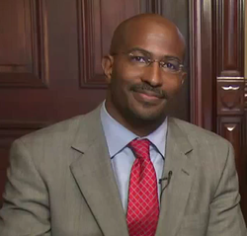
Green Jobs Czar
Van Jones is the former Green Jobs Czar under President Obama.
Jones is an attorney, civil rights activist, environmental advocate and avowed communist. He is currently a senior fellow at the Center for American Progress.
Jones views Green Jobs as a way that is consistent with Economic Justice.

Slide 40
Environment and Race
Environmental Racism
Environmental Justice
Environmental racism, an internationally recognized sociological term referring to the enactment of any policy or regulation that negatively affects the living conditions of low-income or minority communities at a rate disproportionate from affluent communities.
The phenomenon can be either intentional or unintentional, and the term is often used to describe specific events in which minority communities are targeted for the citing of polluting industries and factories
Environmental justice is "the fair treatment and meaningful involvement of all people regardless of race, color, sex, national origin, or income with respect to the development, implementation and enforcement of environmental laws, regulations, and policies.
Environmental justice emerged as a concept in the United States in the early 1980s; its proponents generally view the environment as encompassing "where we live, work, and play”).

Slide 41
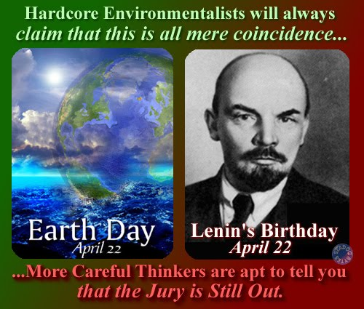
Sustainability and Socialism

Slide 42
Overview: Part 3
Definition of Sustainability
Eco-centric Sustainability
Environmental Economics

Slide 43
Types of Political/
Economic Systems
 |  | Resource Allocation
 |  | Private | Public
Resource Ownership | Private | Market Capitalism | Command Capitalism
 | Public | Market Socialism | Command Socialism

Slide 44
Types of Political/
Economic Systems
 | Liberty | Security
Efficiency | Market Capitalism | Command Capitalism
Equity | Market Socialism | Command Socialism

Slide 45
Types of Political/
Economic Systems
Market Capitalism- Free Market economics (provides economic growth)
Command Capitalism- (The Third Way) seeks a path between free market and socialist approaches to economic governance, but chiefly stresses technological development, education, and competitive mechanisms to pursue economic. (China?)
Market Socialism- economic systems where the means of production are publicly owned, managed and operated for a profit in a market economy. The profit generated in a market socialist system would be used to remunerate employees or go toward public finance. (France, Sweden)
Command Socialism- Communism (provides no economic growth)

Slide 46
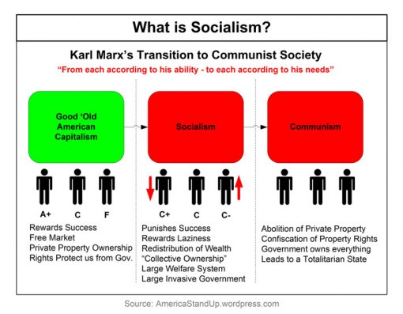
Types of
Economic Systems

Slide 47
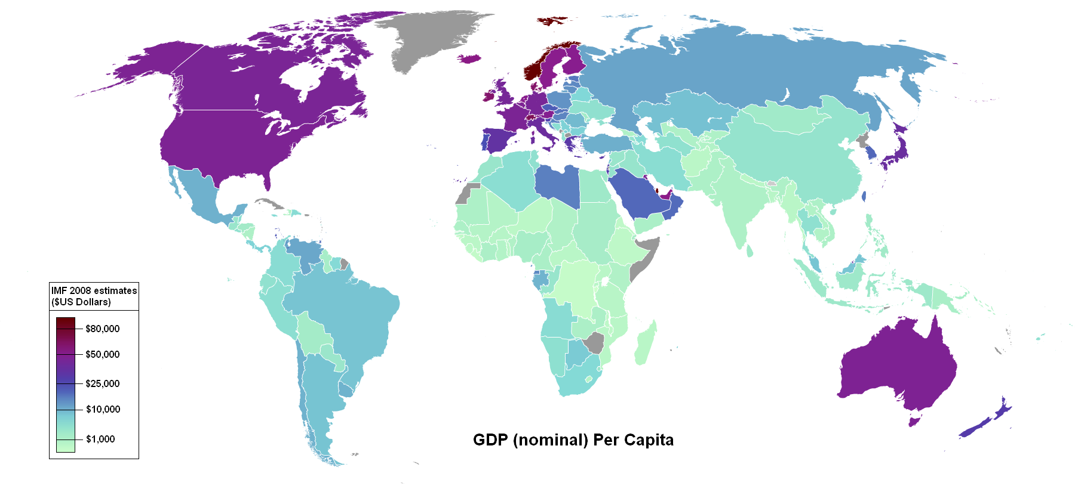
Wealth in GDP

Slide 48
Pollution and
Market Failure
Market Failure
Asymmetrical Information
Externalities

Slide 49
Pollution and
Market Failure
Environmental Pollution
Externalities
Public Goods

Slide 50
Types of Goods
 | Rival Goods | Non-Rival Goods
Excludable | Private Goods Your car | Cable television
Non- Excludable | outdoor concert | Public Goods Environmental protection

Slide 51
Externalities
The Social Optimum exists when there is market equilibrium (Supply= Demand) or no externalities.
An externality exists whenever one person’s actions affect someone else’s utility of some firms profits, other than through the price system
  Externalities can be positive or negative
  If an externality exists, then there are side effects on third parties, thus violating the perfect competition requirements

Slide 52
Externalities: Solutions
Solutions
Coasian/ bargaining
Pigouvian/ price
Regulation/ quantity

Slide 53

Externalities:
Coasian Solution
Coase Solution is named after Ronald Coase professor at the University of Chicago and Nobel prize winner
Establish property rights where they are missing and let people bargain over ownership of those rights
The theorem states that bargaining will lead to an efficient outcome regardless of the initial allocation of property rights.

Slide 54
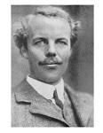
Externalities:
Pigouvian Solution
Pigouvian Tax (or subsidy) is a price approach named after Arthur Cecil Pigou
He originated the idea that governments can, via a mixture of taxes and subsidies, correct such perceived market failures — or "internalize the externalities".
Not always efficient (deadweight loss)

Slide 55
Externalities:
Regulatory Solution
Regulation is a quantity approach
Heterogeneity in the population of producers leads to different producers with different cost of reducing the negative externality
Set a target for reducing the externality, which may or may not be socially optimal
The social cost of externality reduction= private cost of externality reduction
Not always efficient (deadweight loss)

Slide 56
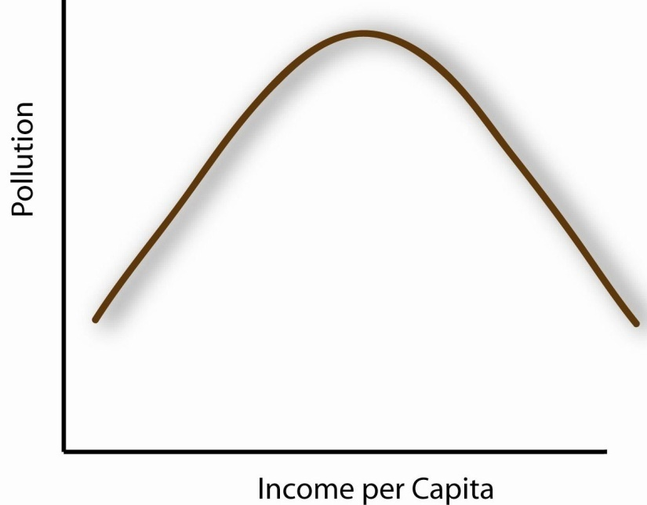
The Kuznet Curve
Simon Kuznet showed that as a country becomes industrialized economic growth comes with a growth in pollution.
Eventually the pollution levels out as economic growth continues
This shows that the environmental impact formula (IPAT) is wrong.

Slide 57

New Institutional Economics
Elinor Ostrom is a professor at the University of Indiana and a Nobel prize winner in Economic Sciences.
Ostrom cautions against global governmental units coordinating work against environmental destruction. Partly, this is due to their complexity, and partly to the diversity of actors involved.
She proposes that key management decisions should be made as close to the scene of events and the actors involved as possible

Slide 58

Entrepreneurial Environmentalism
PERC—the Property and Environment Research Center—is the nation’s oldest and largest institute dedicated to improving environmental quality through property rights and markets. Founded 30 years ago in Bozeman, Montana, it began as a think tank where scholars documented how government regulation and bureaucracy have led to environmental degradation. At the same time, they sought to explain how markets could be harnessed to improve environmental quality. From this work originated the idea of free market environmentalism.

Slide 59

Entrepreneurial Environmentalism
Our mission is to work with opinion leaders and decision makers to demonstrate how science and economics can effectively deal with contentious policy issues in ways consistent with a society of free and responsible individuals and America's founding ideals. Specifically, we provide constructive alternatives to the ever-present temptations to rely on centralized power when problems arise or new social goals are identified.

Slide 60

Entrepreneurial Environmentalism
Ducks Unlimited is an international non profit organization dedicated to the conservation of wetlands and associated upland habitats for waterfowl, other wildlife, and people. It currently has approximately 780,000 members, mostly in the United States and Canada.

Slide 61


Entrepreneurial Environmentalism

Slide 62


Entrepreneurial Environmentalism

Slide 63

Green Jobs
Gabriel Calzada Alvarez, PhD form King Juan Carlos University (Spain) argues against the Green job myth.
In a 2009 study, the government, Dr Calzada finds, is destroying 2.2 ordinary jobs for every green one it creates.

Slide 64

Green Jobs
Carlo Stagnaro, PhD from the Instituto Bruno Leoni (Italy) also argues that green jobs are more costly than real jobs
In a 2011 study, Dr Stagnaro found that one green job costs on average as much 4.8 jobs in the entire economy, or 6.9 jobs in the industrial sector.

Slide 65
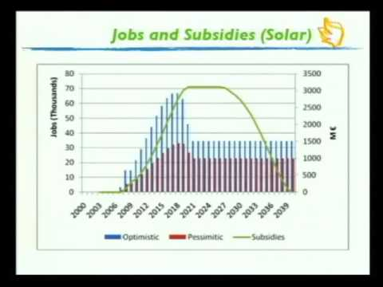
Green Jobs

Slide 66

Green Energy
Robert J. Michaels, PhD professor of economics at CSU Fullerton
Renewables (excluding hydroelectric dams) produce less than 3% of U.S. electricity, much of which is hardly clean. About two-thirds comes from burning scrap vegetation ('biomass') and garbage, which produce the same pollutants and carbon as coal. The real job is to produce fewer of them, rather than changing fuels from fossilized to non-fossilized vegetation."

Slide 67
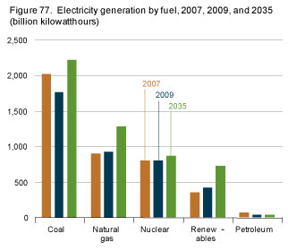
Green Energy
Renewables comprise a small part of electricity generation.
Renewables are projected to increase, but will not overtake coal, natural gas or nuclear power.
Renewables cannot and will not replace the major producers of energy

Slide 68
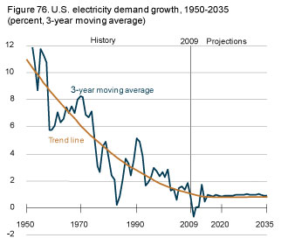
Electricity
Demand Growth
While the demand for electricity will increase, the rate of the growth will decrease.
The decreasing rate of demand growth is partially due to increases in efficiency
The rate of growth will also depend upon population (which is decreasing).

Slide 69
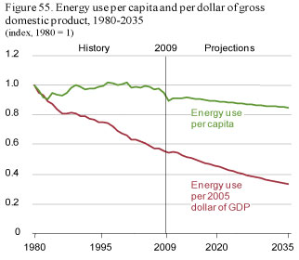
Energy Use
In real dollars, the price of energy use is decreasing
We are getting more efficient in our use of energy.
We are growing in the amount of energy
There are no good reasons for energy shortages in the US

Slide 70
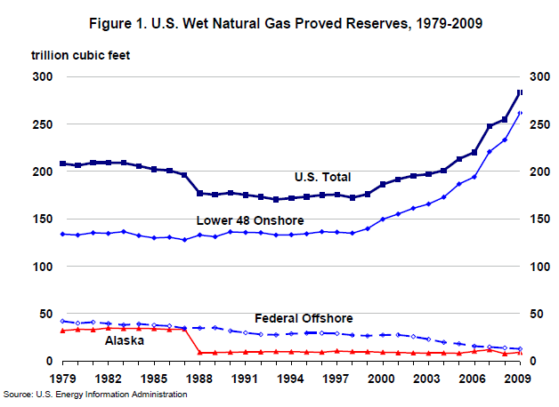
Natural Gas

Slide 71
Conclusions
Environmental Sustainability is a broad and not clearly defined topic
Environmental Sustainability can be good or bad
Some use Environmental Sustainability to pursue socialism and global governance (an anthropocentric approach)
Some use Environmental Sustainability for earth worship (an enviro- centric approach)
A theo-centric approach is the best way to approach Environmental Sustainability

