Slide 1

EPIC Immunization
2022 Update
Children, Adolescents, & Adults
®
September 2022
Notes:
Educating Physicians In their Communities is:
A peer-to-peer immunization education program presented in the practice setting for practitioners and staff or in a classroom for students.
Presented by a team of 2 professionals: physician or other primary care provider (nurse practitioner, physician's assistant) and a nurse or office manager.
Our Beginnings…
The first EPIC Immunization Education program was developed and implemented in Pennsylvania (a joint venture between public health and the PA chapter of the American Academy of Pediatrics). The program has been replicated in several states - Georgia most closely resembling the Pennsylvania program. Georgia was first to add adult vaccines to the program. In 2009 the Georgia Chapter created a separate Women’s Health Immunization Education program for obstetricians and gynecologists. Presentations are also available for students in healthcare training. Presentation on Coding are available to members of the Georgia Chapter of AAP.
EPIC programs are designed to meet Standard #10 of the Standards for Child and Adolescent Immunization Practices:
"Persons who administer vaccines and staff who manage or support vaccine administration are knowledgeable and receive on-going education"
And
Standard #8 of the Standards for Adult Immunization Practices: “Persons who administer vaccines are properly trained."

Slide 2
EPIC is presented by:
®
Georgia Chapter - American Academy of Pediatrics
Ga. Dept. of Public Health/Immunization Program
In Cooperation with:
Georgia Academy of Family Physicians
Georgia Chapter - American College of Physicians
Georgia OB/Gyn Society
EPIC® (Educating Physicians & Practices In their Communities) is a registered trademark of the Georgia Chapter of the American Academy of Pediatrics. All rights reserved.
Notes:
The EPIC immunization education program is developed and updated annually, and more frequently when necessary, by the Georgia Chapter of the American Academy of Pediatrics in partnership with the Georgia Immunization Program and in cooperation with the Georgia Academy of Family Physicians, the Georgia Chapter of the American College of Physicians/American Society of Internal Medicine, and the Georgia OB/GYN Society.
EPIC education programs utilize information from the Centers for Disease Control and Prevention, ACIP Recommendations, The Immunization Action Coalition and other reliable resources. When there is more than one vaccine manufacturer for a specific type of vaccine the presenter utilizes the generic name (i.e. Tdap, hepatitis b etc.)

Slide 3
Faculty Disclosure Information
In accordance with ACCME* and ANCC-COA* Standards, all faculty members are required to disclose to the program audience any real or apparent conflict of interest to the content of their presentation.
This presentation will include the most current ACIP recommendations for frequently used vaccines but is not a comprehensive review of all available vaccines.
Some ACIP recommendations for the use of vaccines have not currently been approved by the FDA.
Detailed information regarding all ACIP Recommendations is available at www.cdc.gov/vaccines/acip/recs/index.html
*Accreditation Council for Continuing Medical Education *American Nurses Credentialing Center Commission on Accreditation
Notes:
Presenters for the EPIC program do not discuss vaccines that are not licensed by the FDA or any pending vaccines that are still undergoing clinical trials. Sometimes an ACIP recommendation may not be listed as an indication for a specific vaccine or a specific age group on the manufacturers package insert. Therefore, the recommendation is considered “off label” use of the vaccine. The presenters will discuss the most recent ACIP recommendations during this presentation. All new ACIP Recommendations discussed have been published in MMWR.

Slide 4
Objectives
At the end of this presentation, you will be able to:
Recall the role vaccines have played in preventing diseases
Discuss the importance of vaccines for children, adolescents, and adults
Summarize the most recent CDC recommendations for storage and handling of vaccines
List at least 2 reliable sources for immunization information
Notes:
These are the objectives for this EPIC presentation.

Slide 5
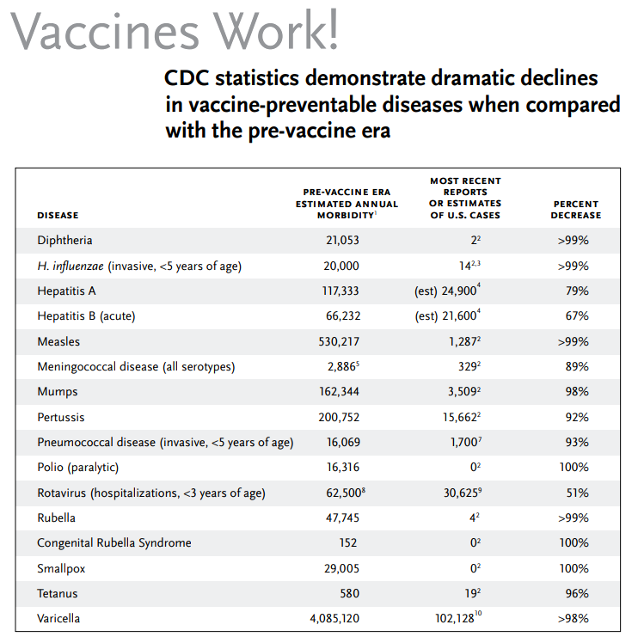
https://www.immunize.org/catg.d/p4037.pdf

Slide 6

Advisory Committee on Immunization Practices (ACIP)
15 voting members with expertise in one or more of the following:
Vaccinology
Immunology
Infectious diseases
Pediatrics
Internal Medicine
Preventive medicine
Public health
Consumer perspectives and/or social and community aspects of immunization programs
ACIP develops recommendations and schedules for the use of
licensed vaccines
Notes:
The dramatic reduction of vaccine preventable diseases in the United States can be attributed to the availability of vaccines, as well as recommendations and an organized vaccine schedule developed by the Advisory Committee on Immunization Practices (ACIP).
The overall goals of the ACIP are to provide advice which will assist the Department and the Nation in reducing the incidence of vaccine preventable diseases and to increase the safe usage of vaccines and related biological products.
For more information: http://www.cdc.gov/vaccines/acip/index.html
For more details about all the vaccine preventable diseases reviewed in this presentation, refer to: Epidemiology and Prevention of Vaccine-Preventable Diseases (The Pink Book), 13th edition. 2015. HHS, CDC.

Slide 7
Community Immunity
Formerly known as “Herd Immunity”*
Transmitting case
Immune
Immune
Immune
Immune
Immune
Susceptible
(Indirectly
Protected)
Immune
Susceptible
(Indirectly
Protected)
*Presentation from Immunize Georgia, September 9, 2016 by Walt A. Orenstein, MD, Professor of Medicine Global, Health, Epidemiology and Pediatrics
Emory Department of Medicine, Associate Director, Emory Vaccine Center Director, Vaccine Policy and Development, Emory University, Atlanta, GA
Notes:
It is probably unrealistic to believe we can immunize everyone appropriately. There will always be young infants who have not received all recommended vaccines because of age and there are a significant number of adults who are not adequately immunized. Herd immunity was the term used previously that refers to a situation in which a high percentage of a population is immune to a disease, essentially stopping the disease in its tracks because it cannot find new hosts.
The preferred term now is Community Immunity.
The threshold for community immunity varies, depending on the disease, with more virulent infectious agents requiring vaccination of a higher percentage of the population to create the desired community immunity. Most vaccination policies are focused on creating community immunity. The creation of community immunity is especially important in crowded environments which facilitate the spread of disease, like schools. It is also extremely important to receive regular boosters, as some vaccines lose their efficacy over time, leaving people vulnerable to an outbreak. Herd immunity led to the eradication of smallpox, and it explains why diseases such as polio and diphtheria are rare in developed nations with established vaccination policies.
EPIC 2021

Slide 8
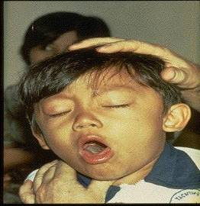
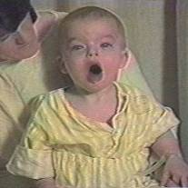

Diphtheria
©AAP
Tetanus
Pertussis
Notes:
Diphtheria, Tetanus and Pertussis (Whooping Cough) are all toxin mediated diseases. This means that the toxin or toxins produced by the bacteria are responsible for the symptoms of the disease.
DIPHTHERIA
Slide shows a child with diphtherial membrane in nasopharynx
Diphtheria is caused by a bacteria (Corynebacterium diphtheriae) that produces a toxin.
The bacterial growth and toxin cause local tissue destruction & membrane formation in nasopharynx & larynx & possible obstruction of respiratory tract.
Most common complications are myocarditis & neuritis (motor nerves).
TETANUS
Slide shows a child with muscle rigidity from tetanus.
Tetanus spores that are found everywhere in soil usually enter body through contaminated puncture wounds, lacerations or abrasions. Spores germinate and bacteria (Clostridium tetani) begin to multiply and produce an exotoxin. Toxin affects the neuromuscular junction and produces generalized rigidity and convulsive spasms of skeletal muscles, starting with the jaw and muscles of swallowing (lockjaw).
PERTUSSIS
Slide shows two children with pertussis (whooping cough) with paroxysmal coughing. (Sound is the typical pertussis cough and whoop. Pertussis, caused by a bacterium (Bordetella pertussis), produces multiple antigens and biologically active components that cause inflammation of the respiratory tract, paralysis of the cilia of the respiratory tract and lung damage resulting in pooling of secretions and characteristic cough lasting up to 12 weeks. Humans are the only reservoir. Transmission is by direct contact with respiratory droplets.
For more details about these 3 diseases refer to: Epidemiology and Prevention of Vaccine-Preventable Diseases, 13th edition. 2015 HHS, CDC.

Slide 9
Diphtheria, Tetanus and Pertussis Vaccines for Children, Adolescents, and Adults
ACIP Recommendations:
DTaP
  Administered at 2, 4, 6, 15-18 months and 4-6 years (Not given after age 6)
Tdap---can now be used any time Td is indicated
  Children and adolescents starting at 11 or 12 years of age
  Any adult who has not received a dose
  Routine decennial booster
  Tetanus prophylaxis for wound management
  Unvaccinated persons 7-18 yrs. of age
    3 doses of Td or Tdap given at appropriate intervals—see Catch-up Schedule*
2021 Childhood Schedule: Children 7-10 years of age who receive Tdap as part of the catch-up series should be given Tdap again at ages 11-12 years.*
  No minimum interval between doses of Td and Tdap**
*https://www.cdc.gov/vaccines/schedules/downloads/child/0-18yrs-child-combined-schedule.pdf*
**https://www.immunize.org/catg.d/p2055.pdf

Slide 10
Improving DTaP 4th Dose Coverage*
Prior research has identified the 4th dose of DTaP as one of the main contributors to non-completion of the primary series by age 2.
In years 2015-2016 Dose #3 coverage = 93.8%, but Dose #4 = 80.3%
Common Provider Challenges
  Provider confusion about when to administer the 4th dose
  When children are delayed in getting the 1st 3 doses, they may not be eligible to receive the 4th dose at the usual time (12-15 mos.)
  Failure of providers to administer all recommended doses at a visit
  Failure of providers to utilize reminder/recall functions of GRITS or their EMR
GRITS can be a valuable tool to help address all of these challenges.
*Human Vaccines & Immunotherapeutics https://doe.org/10.1080/21645515.2019.1699357

Slide 11

Tdap for Adults
For adults 65 years and older Boostrix should be used, when feasible. If only Adacel is available, the ACIP recommends giving it to adults aged ≥ 65 years.
Either Tdap or Td can be used for routine decennial booster.
Either can be used for tetanus prophylaxis for wound management.
  There is no minimum interval between doses of Td and Tdap.
**https://www.immunize.org/catg.d/p2055.pdf
*MMWR, January 24, 2020/ Vol.69/No. 3
Adult Immunization Schedule 2022
Notes:
MMWR, January 24, 2020/ Vol.69/No. 3
https://www.cdc.gov/vaccines/schedules/hcp/imz/adult.html

Slide 12
ADMINISTER THE RIGHT VACCINE!
PRODUCT | COMPONENT(S) | USE FOR AGES | USE FOR DTaP DOSES | ROUTE
Daptacel (SP) | DTaP | 6 wks. thru 6 yrs. | Doses 1 thru 5 | IM
Infanrix (GSK) | DTaP | 6 wks. thru 6 yrs. | Doses 1 thru 5 | IM
Pediarix (GSK) | DTaP-HepB-IPV | 6 wks. thru 6 yrs. | Doses 1 thru 3 | IM
Pentacel (SP) | DTaP-IPV/Hib | 6 wks. thru 4 yrs. | Doses 1 thru 4 | IM
Kinrix (GSK) | DTaP-IPV | 4 thru 6 yrs. | Dose 5 | IM
Quadracel (SP) | DTaP-IPV | 4 thru 6 yrs. | Dose 5 | IM
Vaxelis (Merck & SP) | DTaP-IPV-Hib-Hep B | 6 wks. thru Doses 1 thru 3 IM 4 yrs.

Slide 13
Tdap for Pregnant Women*
ACIP recommends:
One dose of Tdap during each pregnancy, regardless of a prior
history of receiving Tdap.
Optimal timing:
Between 27 and 36 weeks gestation.
Vaccinating earlier in the 27 through 36 week window will maximize passive antibody transfer to the infant.
This has been shown to be 80%-91% effective.
If Tdap is not given during pregnancy, administer Tdap immediately postpartum.
*MMWR, January 24, 2020/ Vol.69/No. 3
Notes:
Guidance on use of Tdap products for pregnant women:
All pregnant women should receive a dose of Tdap during each pregnancy, irrespective of prior history of receiving Tdap. Optimal timing for administration is between 27 and 36 weeks gestation. If a dose is given early in that same pregnancy, do NOT repeat it at 27-36 weeks. If not given during pregnancy, give Tdap immediately postpartum³.

Slide 14
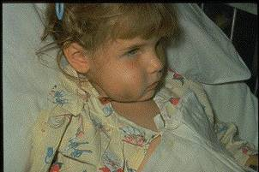
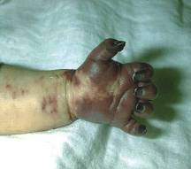
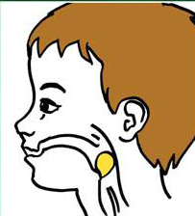
Haemophilus influenzae type b (Hib)
ACIP recommends:
3-4 doses of Hib (depending on brand)
  Dose 1 @ 2 months of age
  Dose 2 @ 4 months of age
  Dose 3 @ 6 months of age
  (Not required if Pedvax HIB® is administered at 2 and 4 months of age)
  Booster dose @ 12 through 15 months of age (Vaxelis® is NOT recommended for use as a booster dose.)
  One dose of Hib for unimmunized persons 5 through 18 years who have asplenia, sickle cell disease or HIV infection.
  One dose of Hib may be given to adults with immunocompromising conditions.
MMWR, February 28, 2014, Vol 63, #RR01
and https://www.cdc.gov/vaccines/schedules/hcp/imz/child-adolescent.html#note-hib 2022
Notes:
Slide shows a child with cellulitis of cheek and an infant with gangrenous fingers due to invasive Hib disease. The drawing shows a child with a markedly swollen epiglottis due to epiglottitis (croup) due to Hib infection.
Haemophilus influenza infection is caused by a bacteria which has 6 different polysaccharide serotypes and some non-typable strains
Type b (Hib) caused 95% of invasive disease in the past
Hib enters body through the nasopharynx, spreads via blood stream to other sites (meninges, joints, skin, epiglottis and/or bone)
Prior to licensure of a vaccine Hib was the leading cause of bacterial meningitis in young children with a case fatality rate of 2-5%. 15-30% of survivors had hearing impairment and neurologic sequelae.
Hib also causes cellulitis, septic arthritis, osteomyelitis, pneumonia and epiglottitis.
Peak age for infection is 6-7 months. Invasive Hib disease is uncommon beyond 5 years of age.
Before Hib vaccine was licensed there were about 20,000 cases of invasive Hib in the U.S. each year
By 5 years post licensure of Hib vaccine, the incidence decreased by > 99%.
From 2009-2018, 36 reports of Hib in patients younger than age 5 years were identified in the US.
Many physicians and nurses who were trained after the mid 1990s have never seen a case of invasive Hib
In the post–Hib vaccine era, the epidemiology of invasive H. influenzae disease in the United States has changed. The majority of invasive H. influenzae disease in all age groups is now caused by nontypeable H. influenzae.[
Schedule is shown on the slide. In the interest of time, I will not regurgitate the schedules as you can quickly pull up the childhood immunization schedule on your phone or in your clinic at any time.
For additional information refer to:
Epidemiology and Prevention of Vaccine-Preventable Diseases, 14th edition 2021. HHS, CDC. At https://www.cdc.gov/vaccines/pubs/pinkbook/hib.html
AND
Chapter 2: Haemophilus influenzae invasive disease
Manual for the Surveillance of Vaccine-Preventable Diseases
https://www.cdc.gov/vaccines/pubs/surv-manual/chpt02-hib.html

Slide 15
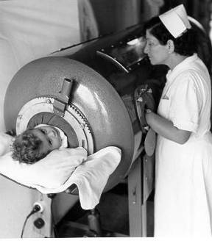
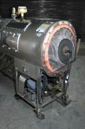
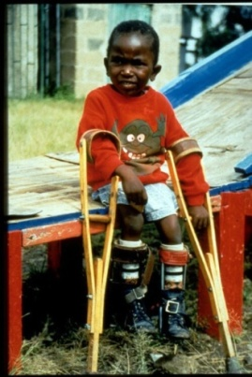
Polio
ACIP Recommendation:*
Four dose series of IPV at : 2, 4, 6 through 18 months and 4 through 6 years of age.
    Minimum interval from dose 3 to dose 4 is six mos.
    Final dose at 4 years of age or older regardless of the number of previous doses
    Only trivalent OPV (tOPV) given before 4/1/2016 counts toward U.S. vaccination requirements***
    If documentation not available (for persons ≤18 yrs.,)
    give routine IPV series.
    Travelers---A booster dose may be recommended, depending on destination and traveler’s history of polio vaccination. Go to: www.cdc.gov/vaccines/travel**
*MMWR, August 7, 2009, Vol 58, #30
**MMWR, July 11, 2014, Vol 63, # 27
**https://wwwnc.cdc.gov/travel/news-announcements/polio-guidance-new-requirements
***MMWR January 13, 2017 / 66(01);23–25
Source: World Health Organization
Notes:
Slide shows child in an iron lung due to weak respiratory muscles (common in polio era) and a child with muscle weakness, as a result of polio, requiring the assistance of braces and crutches in order to walk.
Polio, also called poliomyelitis and infantile paralysis is caused by an Enterovirus (Serotypes 1,2,3)
Infection acquired through mouth, virus replicates in pharynx and GI tract, then spreads to lymphatics and other tissues.
Clinical response to infection is varied:
Up to 95% of polio infections are inapparent and asymptomatic;
4-8% non specific illness; 1-2% cause aseptic meningitis - full recovery;
<1% of infections result in flaccid paralysis
Attacks motor neurons in spinal cord & brain stem
Persons with impaired muscles of respiration or involvement of respiratory center require a ventilator
(“Iron lung” used in the 1940s and 1950s)
Most persons with paralytic polio recover completely
Muscle weakness or paralysis for more than 12 months after acute infection is usually permanent
25-40% of people who had paralytic polio in childhood develop “Post-polio Syndrome” (new muscle
pain, exacerbation of existing weakness or new weakness) 30-40 years after the acute infection
Last endemic polio case in the US in 1979; last indigenous case in Western Hemisphere in 1991
Polio remain endemic in Pakistan and Afghanistan.
Types 2 and 3 polio virus declared eradicated.
80% of the world’s birth cohort will now start receiving IPV to boost their immunity.
If children under age 1 are given a travel dose, this dose must be repeated.
For additional information about polio refer to: Epidemiology and Prevention of Vaccine-Preventable Diseases, 13th edition 2015. HHS, CDC.

Slide 16
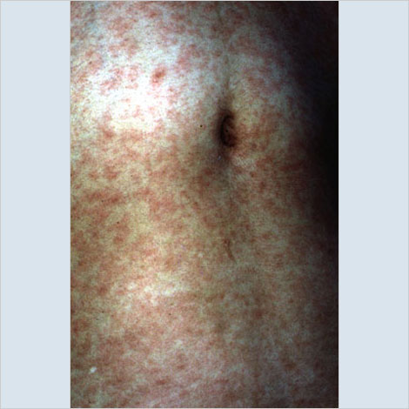
MEASLES*
Incubation period---8 to 14 days from exposure to onset of symptoms
Symptoms: fever, cough, coryza, conjunctivitis, maculopapular rash and Koplik spots
Complications: otitis media, pneumonia, croup, & diarrhea
Acute encephalitis occurs in 1 out of 1,000 cases.
Death occurs in 1 to 3 of every 1,000 cases.
Subacute sclerosing panencephalitis (SSPE) is a progressive neurological disorder that is rare but always fatal. It usually occurs 7-10 years after measles infection.**
Measles infection causes generalized immunosuppression that may make other infections more severe. ***
*AAP Red Book, 32nd edition, 2021-2024, published 2021
** https://www.ncbi.nlm.nih.gov/pmc/articles/PMC6027681 https://www.aappublications.org/news/2016/10/28/Measles102816/
*** Science, 1 November 2019 – Vol. 366, Issue 6465
Source: Immunization Action Coalition
Notes:
Measles:
Subacute Sclerosing Panencephalitis (SSPE) is a neurological disorder that can appear years after a person is infected with measles and is always fatal. It is characterized by behavioral and intellectual deterioration and seizures that occur usually 6-8 yrs. after measles infection. In rare cases the virus spreads to the brain, but then becomes dormant. Eventually it can lead to SSPE, resulting in deterioration and death. Researchers don’t know what causes the virus to reactivate.
There is no cure for SSPE and the only way to prevent it is to vaccinate everyone against measles.

Slide 17
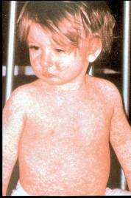
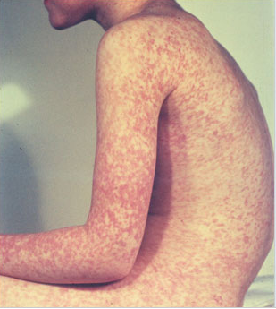
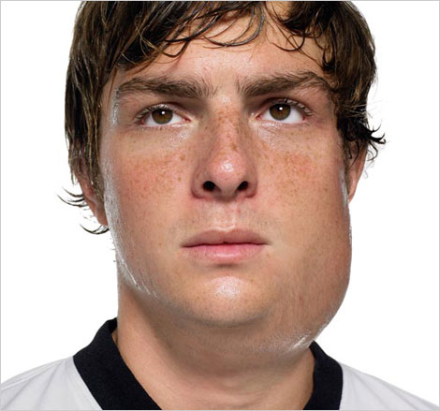
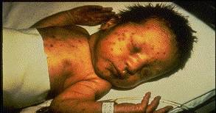
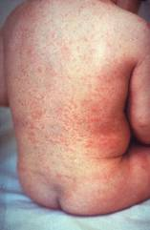
Measles, Mumps, Rubella
Measles (M)
Mumps (M)
Source: American Academy of Pediatrics
Red Book On Line Visual Library
Source: Creative Commons
Rubella (R)
Congenital Rubella (R)
Notes:
MEASLES (caused by paramyxovirus)
Slide shows two children with typical measles rash and conjunctivitis in younger child
Initial symptoms are runny nose, followed by increasing fever (103º-105º), cough, conjunctivitis, Koplik spots, and a maculopapular rash that lasts 5-6 days
Complications include otitis media (7%), pneumonia (6%), and acute encephalitis (0.1%) 1 in 1000 cases, death (0.2%) Although measles elimination was declared in the United States in 2000 , importation of measles cases continues to occur.
MUMPS (caused by paramyxovirus)
Slide shows an adolescent with parotitis due to mumps
Parotitis occurs in 30-40% of infected persons, 40-50% have only nonspecific or respiratory symptoms
Complications include aseptic meningitis, & deafness
Post pubertal individuals may have orchitis, ovarian inflammation, & pancreatitis
RUBELLA (Caused by togavirus)
In children, the rash may be the first manifestation of infection. Adults may have low-grade fever, malaise, URI, and lymphadenopathy prior to rash. Arthralgia and arthritis is common in adults, especially women. Complications include encephalitis and hemorrhagic manifestations
Rubella is no longer endemic in the U.S. However, it is still present in other countries and can be imported
CONGENITAL RUBELLA
Slide shows an adult and child with a typical rash from rubella and an infant with congenital rubella syndrome Infant was infected in utero and has “blueberry muffin spots” on skin due to petechial lesions, cataracts, hearing loss and congenital heart lesion and will most likely be developmentally delayed.
Also common: hearing loss, skin rash, enlarged neck lymph nodes, intellectual disability, malaise, neonatal jaundice, runny nose, or white pupil.
All woman of child bearing age should be certain they are immune to rubella.
For additional information refer to: Epidemiology and Prevention of Vaccine-Preventable Diseases, 13th edition 2015. HHS, CDC.

Slide 18
MMR Vaccine*
ACIP recommends 2 doses of MMR:
  Dose 1 @ 12 through 15 months of age
  Dose 2 @ 4 through 6 years of age
  Second dose can be given 28 days after first dose, if necessary.
  Other Recommendations:**
  Travelers to foreign countries should be appropriately immunized with MMR prior to leaving U.S.
  Infants 6-12 mos. of age traveling abroad should receive 1 dose of MMR. This dose must be repeated at age 12 -15 months of age and a second dose at least 4 weeks later.
  A 3rd MMR may be recommended in the instance of a public health-declared mumps outbreak.
Efficacy:
95% of people develop serum measles antibody after one dose. 99% after 2 doses.
5% or less may lose protection after several years.
Acceptable presumptive evidence of MMR immunity
Documentation of age-appropriate vaccination with MMR vaccine
Laboratory evidence of immunity
Laboratory confirmation of disease
Birth before 1957---except for evidence of rubella immunity in women who could become pregnant
*MMWR, June 14, 2013, Vol 62, #RR-04 ** MMWR, January 12, 2018, Vol 67(1);33–38
18
Notes:
MMR vaccine has been successful in reducing the cases of measles in the United States and many young physicians, physician’s assistants and nurse practitioners have never seen an acute case of measles. The symptoms of measles are more than a rash and include conjunctivitis, fever and white lesions (Koplik spots) on the buccal mucosa. Practitioners who have not seen a case of measles sometimes make a diagnosis solely on the basis of a rash. Serologic testing is now required to confirm a case of measles.
Infants 6-12 mos. of age travelling abroad should receive 1 dose of MMR. This dose must be repeated.
Measles antibodies develop in approximately 95% of children vaccinated at age 12 months. Seroconversion rates are similar for single-antigen measles, MMR vaccine, and MMRV vaccine. Approximately 2% to 7% of children who receive only 1 dose of MMR vaccine fail to respond to it, i.e., they experience primary vaccine failure. MMR vaccine failure can occur because of passive antibody in the vaccine recipient, immaturity of the immune system, damaged vaccine, or other reasons. Most persons who fail to respond to the first dose will respond to a second dose. Studies indicate that more than 99% of persons who receive 2 doses of measles vaccine (with the first dose administered no earlier than the first birthday) develop serologic evidence of measles immunity.
https://www.cdc.gov/vaccines/pubs/pinkbook/meas.html#vaccine

Slide 19
New MMR Vaccine: Priorix (June 2022 ACIP Meeting recommendations)
Priorix (GSK). FDA approved
First licensed in Germany in 1997 and approved in over 100 countries
Contains equivalent vaccine virus strains as MMR II (Merck)
No significant differences found in safety or side effects when comparing Priorix to MMR II.
June 2022, ACIP voted unanimously to approve the vaccine: “MMR vaccine (Priorix, GSK) is recommended according to currently recommended schedules and off-label uses as an option to prevent measles, mumps, and rubella.”
Notes:
From Immunize.org: https://www.immunize.org/express/issue1640.asp#IZX1
Measles-mumps-rubella (MMR) vaccine
ACIP concluded its review of a newly FDA-approved measles-mumps-rubella (MMR) vaccine, Priorix (GSK). Priorix was first licensed in Germany in 1997 and is approved in over 100 countries. Several countries consider it fully interchangeable with the long-standing U.S. product MMR II (Merck) because it contains equivalent vaccine virus strains. No significant differences in safety or side effects have been found and members noted that having a second manufacturer licensed and recommended would help ensure the stability of the supply of MMR in the United States. ACIP voted unanimously to approve the following policy statement:
“MMR vaccine (Priorix, GSK) is recommended according to currently recommended schedules and off-label uses as an option to prevent measles, mumps, and rubella.”

Slide 20
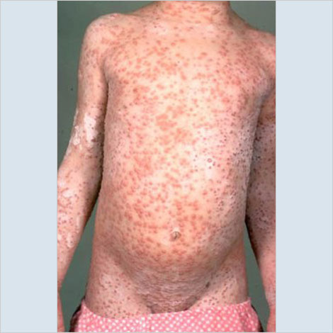
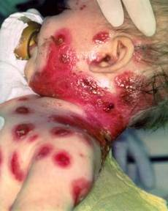
Varicella*
(Chickenpox)
© Copyright American Academy of Pediatrics
ACIP recommends 2 doses of Varicella Vaccine
Dose 1 @ 12 months through 15 months of age
Dose 2 @ 4 through 6 years of age**
Those 13 years of age or older without evidence of immunity should receive 2 doses separated by 4 to 8 weeks.
*MMWR, June 22, 2007, Vol 56, #RR-04
**Second dose can be administered at an earlier age, provided the interval between the first and second dose is at least 3 months.
Notes:
Slide shows a child with typical varicella rash and infant with secondary bacterial infected varicella lesions, probably due to staph or strep
Chicken pox or varicella is caused by the varicella zoster virus
Prior to licensure of varicella vaccine approximately 100 previously healthy children died from chicken pox each year
Newborns are in the highest risk group if maternal rash is 5 days before or 2 days after delivery
Adults are 25 times more likely to die than children
Varicella Vaccine:
Live attenuated virus vaccine licensed in Japan and Korea in 1988, and in U.S. in 1995
One dose of vaccine is 85% effective; two doses provide nearly 88-98% efficacy.
Breakthrough chicken pox may occur in individuals who have received the vaccine
All cases of breakthrough chicken pox have been mild
Vaccine may be effective in preventing illness if given within 3 days and possibly up to 5 days after exposure.
Children who were up-to-date with one dose of varicella vaccine prior to starting school may not have received the second dose, so should receive it as soon as possible.

Slide 21
Acceptable Evidence of
Varicella Immunity*
Written documentation of age-appropriate vaccination
Laboratory evidence of immunity or laboratory confirmation of varicella disease
U.S.-born before 1980
  Does not apply to healthcare personnel or pregnant women
Healthcare provider diagnosis or verification of varicella disease
History of herpes zoster based on healthcare provider diagnosis
*MMWR 2007;56(RR-4); 16-17

Slide 22
ACIP Recommendations for use of
MMRV (ProQuad )*
®
Licensed for ages 12 months through 12 years
Dose 1 at ages 12 through 47 months
Either separate MMR and varicella vaccines or MMRV vaccine can be used.
CDC recommends separate doses of MMR and varicella at early age
  Slightly increased risk of febrile seizures with combination vaccine
  Providers should discuss benefits and risks of both vaccination options with parents
Dose 1 or 2 given at ages 48 months and older
  MMRV vaccine generally is preferred over separate injections of its equivalent component vaccines (i.e., MMR and varicella vaccines).
*MMWR, May 7, 2010, Vol 59, #RR03
Notes:
Dose 1 at Ages 12 through 47 Months
Compared with use of MMR and varicella vaccines at the same visit, use of MMRV vaccine results in one fewer injection but is associated with a higher risk for fever and febrile seizures 5 through 12 days after the first dose among children aged 12 through 23 months* (about one extra febrile seizure for every 2,300–2,600 MMRV vaccine doses). Use of MMR and varicella vaccines avoids this increased risk for fever and febrile seizures following MMRV vaccine. Providers who face barriers to clearly communicating these benefits and risks for any reason (e.g., language barriers) should administer MMR and varicella vaccines.
Dose 1 at Ages 48 Months and Older and Dose 2 at any Age
For the first dose of measles, mumps, rubella, and varicella vaccines at ages 48 months and older and for dose 2 at any age (15 months through 12 years), use of MMRV vaccine generally is preferred over separate injections of its equivalent component vaccines (i.e., MMR and varicella vaccines). Considerations should include provider assessment†, patient preference, and the potential for adverse events.
Of note, the routinely recommended ages for measles, mumps, rubella and varicella vaccination continue to be 12 through 15 months of age for dose 1 and 4 through 6 years of age for dose 2.
Other MMRV Vaccine-related Guidance
New precaution for MMRV Vaccine Use
A personal or family (i.e., sibling, parent) history of seizures is a precaution for MMRV vaccination. Studies suggest that children who have a personal or family history of febrile seizures or family history of epilepsy are at increased risk for febrile seizures compared with children who do not have such histories. Children with a personal or family history of seizures generally should be vaccinated with MMR and varicella vaccines because the risks of using MMRV vaccine in this group of children generally outweigh the benefit of MMRV vaccine.
CDC has developed materials to help with the implementation of the updated recommendations for use of MMRV vaccine:
https://www.cdc.gov/vaccinesafety/vaccines/mmrv-vaccine.html
* The 47 month cut-off was chosen on the basis of the epidemiology of febrile seizures: first febrile seizures are uncommon after age 4 years, approximately 94% of febrile seizures occur in children aged less than 4 years.
† Provider assessment should include the number of injections, vaccine availability, likelihood of improved coverage, likelihood of patient return, and storage and cost consideration.

Slide 23
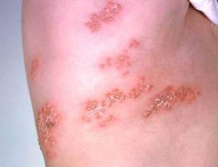
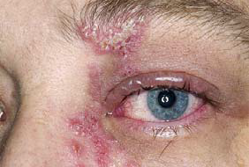
Herpes Zoster
Herpes zoster (HZ), or shingles, occurs through reactivation of latent varicella-zoster virus
Typically characterized by prodromal pain and an acute vesicular eruption (rash) accompanied by moderate to severe pain
One in three persons will develop zoster during their lifetime
Post-herpetic neuralgia (PHN) is a common consequence of zoster. PHN is defined as nerve pain persisting longer than 3 mos. after disappearance of the rash.
Risk for zoster and PHN increases with age
Photo courtesy of www.webmd.com
Notes:
The picture on left shows zoster (shingles) on the upper chest and back.
The picture on right shows zoster on the face involving one of the cranial nerves.

Slide 24
Shingrix (RZV) from GSK*
®
As of November 18, 2020, Zostavax (ZVL) is no longer available for use in the United States
Shingrix (RZV) is the only currently licensed Zoster vaccine in the United States
Efficacy
  > 91% in preventing zoster in all vaccinated persons in licensed age groups
  > 88% in preventing PHN
  At least 85% vaccine effectiveness >4 yrs. post vaccination in persons 70 years and older
ACIP Recommendations
RZV (recombinant zoster vaccine) is recommended by the ACIP for prevention of shingles and related complications.
RZV is recommended for immunocompetent adults 50 years and older who previously received ZVL and immunocompromised adults 19 years and older.
RZV may be given ≥2 months after receipt of ZVL
RZV may be administered to patients who previously received varicella vaccine.
RZV may be administered while patients are taking antiviral medications.
RZV Can be administered at same visit as other vaccines
*MMWR/January 26,2018/Vol. 67/No. 3
**https://www.cdc.gov/vaccines/hcp/acip-recs/general-recs/administration.html
Notes:
As of November 18, 2020, Zostavax (ZVL) is no longer available for use in the United States.
RZV may be used in adults aged ≥50 years, irrespective of prior receipt of varicella vaccine or ZVL, and does not require screening for a history of chickenpox (varicella).
Persons with a history of herpes zoster. Herpes zoster can recur. Adults with a history of herpes zoster should receive RZV. If a patient is experiencing an episode of herpes zoster, vaccination should be delayed until the acute stage of the illness is over and symptoms abate. Studies of safety and immunogenicity of RZV in this population are ongoing.
Persons with chronic medical conditions. Adults with chronic medical conditions (e.g., chronic renal failure, diabetes mellitus, rheumatoid arthritis, and chronic pulmonary disease) should receive RZV.
Persons known to be VZV negative. Screening for a history of varicella (either verbally or via laboratory serology) before vaccination for herpes zoster is not recommended. However, in persons known to be VZV negative via serologic testing, ACIP guidelines for varicella vaccination should be followed. RZV has not been evaluated in persons who are VZV seronegative and the vaccine is not indicated for the prevention of chickenpox (varicella).
Current herpes zoster infection. RZV is not a treatment for herpes zoster or postherpetic neuralgia and should not be administered during an acute episode of herpes zoster.

Slide 25
Shingrix (RZV) from GSK
Use in immunocompetent adults 50 years and older*
®
Licensed for adults ≥ 50 years of age
Store at appropriate refrigerator temperatures
2 doses given IM, 2-6 months apart
Give only 0.5 ml, not full contents of the vial.**
*MMWR/January 26,2018/Vol. 67/No. 3
**https://www.cdc.gov/vaccines/hcp/acip-recs/general-recs/administration.html
Notes:
As of November 18, 2020, Zostavax (ZVL) is no longer available for use in the United States.

Slide 26
Shingrix (RZV) from GSK
Use in immunocompromised adults 19 years and older
Two doses of recombinant zoster vaccine are recommended for the prevention of herpes zoster and its complications in adults aged 19 years or older who are or will be immunodeficient or immunosuppressed due to disease or therapy.
Dose 2 should be given 2-6 months after Dose 1.
For persons who are or will be immunodeficient or immunosuppressed, the second dose can be administered 1-2 months after the first
When possible, patients should be vaccinated before becoming immunosuppressed
MMWR/January 21, 2022/Vol.71(3)
Notes:
Recombinant zoster vaccine (RZV, Shingrix, GSK) has been recommended for immunocompetent adults age 50 years and older since January 2018. Compared to this population, people younger than 50 who are immunodeficient or immunosuppressed due to disease or therapy are at equal or greater risk of developing herpes zoster and its complications. Following its Evidence to Recommendation framework, ACIP reviewed available data and unanimously approved the following recommendation:Two doses of recombinant zoster vaccine are recommended for the prevention of herpes zoster and its complications in adults age 19 years or older who are or will be immunodeficient or immunosuppressed due to disease or therapy.
Dosing schedule. Two RZV doses are necessary, regardless of previous history of herpes zoster or previous receipt of zoster vaccine live. The second RZV dose should typically be given 2–6 months after the first; for persons who are or will be immunodeficient or immunosuppressed and who would benefit from a shorter vaccination schedule, the second dose can be administered 1–2 months after the first (2). If the second RZV dose is given sooner than 4 weeks after the first, a valid second dose should be repeated at least 4 weeks after the dose given too early. The vaccine series does not need to be restarted if more than 6 months have elapsed since the first dose.
Timing of vaccination. When possible, patients should be vaccinated before becoming immunosuppressed. Otherwise, providers should consider timing vaccination when the immune response is likely to be most robust (i.e., during periods of lower immunosuppression and stable disease). RZV may be administered to patients who previously received varicella vaccine. RZV is not a live virus vaccine; therefore, RZV may be administered while patients are taking antiviral medications.
Coadministration with other vaccines. Recombinant and adjuvanted vaccines, such as RZV, can be administered concomitantly, at different anatomic sites, with other adult vaccines, including COVID-19 vaccines (17). Concomitant administration of RZV with other adult vaccines¶¶¶¶ has been studied, and there was no evidence for interference in the immune response to either vaccine or of safety concerns (18–20). Coadministration of RZV with adjuvanted influenza vaccine (Fluad) and COVID-19 vaccines is being studied.
Counseling for reactogenicity. Before vaccination, providers should counsel patients about expected local and systemic reactogenicity, including grade 3 reactions. It is generally not recommended to take antipyretic or analgesic medications prophylactically before vaccination; however, antipyretic or analgesic medications may be taken for the treatment of postvaccination local or systemic symptoms. Patients should be encouraged to complete the series even if they experienced a (nonanaphylactic) grade 1–3 reaction after receipt of the first RZV dose.
Persons with a history of herpes zoster. Herpes zoster can recur. Persons with a history of herpes zoster should receive RZV.
Persons with no documented history of varicella, varicella vaccination, or herpes zoster. Persons who have neither experienced varicella nor received varicella vaccine are not at risk for herpes zoster. More than 99% of Americans born before 1980 have had varicella (21). Children and adolescents who have received live-attenuated varicella vaccines are at lower risk for herpes zoster than are those who experienced varicella (22,23). RZV is not indicated and has not been studied for the prevention of varicella. For immunocompromised persons, evidence of immunity to varicella (confirming need for RZV) includes documented receipt of 2 doses of varicella vaccine, laboratory evidence of immunity or laboratory confirmation of disease, or diagnosis or verification of a history of varicella or herpes zoster by a health care provider. For immunocompromised adults with no documented history of varicella, varicella vaccination, or herpes zoster, providers should refer to the ACIP varicella vaccine recommendations for further guidance, including postexposure prophylaxis guidance (24).
Pregnancy. There is currently no ACIP recommendation for RZV use in pregnancy; therefore, providers should consider delaying RZV until after pregnancy. There is no recommendation for pregnancy testing before vaccination.
Breastfeeding. Recombinant vaccines such as RZV pose no known risk to mothers who are breastfeeding or to their infants (17). Clinicians may consider vaccination without regard to breastfeeding status if RZV is otherwise indicated.
Evidence:
Prevention of herpes zoster and occurrence of SAEs were deemed critical outcomes by the work group. Five studies in four immunocompromised groups§§ evaluated herpes zoster as an outcome (9–13). Estimates of vaccine efficacy (VE) came from three studies, with VE of 68.2% (95% CI = 55.6%–77.5%) for autologous hematopoietic cell transplant recipients (11), and 87.2% (44.3%–98.6%) and 90.5% (73.5%–97.5%) in post hoc efficacy analyses for patients with hematologic malignancies (12) and potential immune-mediated diseases (13), respectively. SAEs were evaluated in seven studies (9–15) in six immunocompromised groups (2,541 RZV recipients).¶¶ Overall, rates of SAEs were comparable between RZV and placebo recipients (risk ratios ranged from 0.79 to 1.99). SAEs deemed to be related to vaccination by study investigators ranged from 0% to 1.6% in the RZV group and 0% to 0.76% in the placebo group. The level of certainty for prevention of herpes zoster and occurrence of SAEs was type 2 (moderate).***
In addition to the critical outcomes (prevention of herpes zoster and SAEs), the remaining outcomes were deemed important by the work group. One study among hematopoietic cell transplant recipients (11) reported VE of 89% (95% CI = 22%–100%) for prevention of postherpetic neuralgia and 85% (32%–97%) for prevention of herpes zoster-related hospitalization (certainty type 3 [low]). Immune-mediated diseases were evaluated in six studies (9,11–15) in five immunocompromised groups††† and were not increased among RZV recipients (certainty type 4 [very low]). One study in patients with hematologic malignancies (12) reported on graft-versus-host-disease among hematopoietic cell transplant recipients and did not identify an increased risk among RZV recipients (certainty type 4 [very low]). One study among renal transplant patients (15) reported on graft rejection and did not identify an increased risk among RZV recipients (certainty type 3). Local and systemic grade 3 reactions§§§ were evaluated in six studies (9–12,14,15) in five immunocompromised groups.¶¶¶ Local grade 3 reactions occurred in 10.7% to 14.2% of RZV recipients, and systemic grade 3 reactions occurred in 9.9% to 22.3% of RZV recipients, compared with 0% to 0.3% and 6.0% to 15.5%, respectively, among placebo recipients (certainty type 2).

Slide 27
Pneumococcal Conjugate Vaccine (PCV13)*
Children
All children 2 mos.- 4 yrs.
Children age 5 withincreased risk factors**
Children ages 6 - 18 yrs. with immunocompromising conditions, asplenia, cochlear or organ transplants
*MMWR, December 10, 2010, Vo1 59, #RR-11 **MMWR, June 28, 2013, Vol 62, #25 *** MMWR, Nov. 22, 2019, Vol. 68, No. 46

Slide 28
Pneumococcal Polysaccharide Vaccine (PPSV23)*
Children ≥2 yrs. with:
Underlying medical conditions
  Sickle cell, asplenia, immunocompromising conditions
  Should receive a 2nd dose 5 yrs. after first dose**
Immunocompetent children with chronic illness
  Heart or lung disease, diabetes, CSF leaks, cochlear implants
**MMWR, December 10, 2010, Vo1 59, #RR-11
*MMWR, September 3, 2010, Vol 59, #34

Slide 29
Pneumococcal Vaccines Recommended by ACIP October 2021
PCV15
PCV20
PPSV23
MMWR January 28, 2022; Vol. 71 (4)
Notes:
In 2021, 20-valent pneumococcal conjugate vaccine (PCV) (PCV20) (Wyeth Pharmaceuticals LLC, a subsidiary of Pfizer Inc.) and 15-valent PCV (PCV15) (Merck Sharp & Dohme Corp.) were licensed by the Food and Drug Administration for adults aged ≥18 years, based on studies that compared antibody responses to PCV20 and PCV15 with those to 13-valent PCV (PCV13) (Wyeth Pharmaceuticals LLC, a subsidiary of Pfizer Inc.). Antibody responses to two additional serotypes included in PCV15 were compared to corresponding responses after PCV13 vaccination, and antibody responses to seven additional serotypes included in PCV20 were compared with those to the 23-valent pneumococcal polysaccharide vaccine (PPSV23) (Merck Sharp & Dohme Corp.). On October 20, 2021, the Advisory Committee on Immunization Practices (ACIP) recommended use of either PCV20 alone or PCV15 in series with PPSV23 for all adults aged ≥65 years, and for adults aged 19–64 years with certain underlying medical conditions or other risk factors* who have not previously received a PCV or whose previous vaccination history is unknown.

Slide 30
PCV15 for children (June 2022 ACIP Meeting Recommendations)
PCV15 (Vaxneuvance), Merck. Licensed by FDA June 17, 2022 for use in children 6 weeks and older.
Includes all serotypes in PCV13 and 2 additional
Clinical trial data:
  PCV15 similar safety and side effects as PCV13
  PCV15 produced same or better immune response to vaccination compared to PCV13
ACIP voted unanimously “PCV15 may be used as an option to PCV13 for children aged <19 years according to currently recommended PCV13 dosing and schedules.”
NO preference for one vaccine over the other at this time.
Formal, official ACIP Recommendations are pending. Stay tuned.
Notes:
From Immunize.org (IAC): https://www.immunize.org/express/issue1640.asp#IZX1
PCV15 (Vaxneuvance, Merck) was licensed by the FDA on June 17 for use in children beginning at 6 weeks of age. PCV15 includes all serogroups in PCV13 (Prevnar 13, Pfizer), plus two additional serogroups. Its recommended schedule is the same as PCV13 and the cost per dose is estimated to be equivalent or slightly lower than PCV13, meaning that the potential additional disease prevention would come at no additional cost. PCV15 was shown to have similar safety and side effects as PCV13 in the clinical trial, with the possibility that it might produce higher fever in a small number of children. The assumptions of how well the vaccine will work are based on studies showing that PCV15 produced the same or better immune response to vaccination compared to PCV13; real-world evidence of PCV15 vaccine effectiveness is not yet available. For these reasons, ACIP members chose not to prefer PCV15 over PCV13, but to consider them equally acceptable options. No changes were made to recommendations for the use of 23-valent pneumococcal polysaccharide vaccine (PPSV23) in certain high-risk children age 2 through 18 years. ACIP voted unanimously to approve the following policy statement:

Slide 31
ACIP Recommendations Pneumococcal Vaccines 10/2021
Age-based: Adults aged 65 years or older who have not previously received PCV or whose previous vaccination history is unknown should receive 1 dose of PCV (either PCV20 or PCV15). When PCV15 is used, it should be followed by a dose of PPSV23.
Risk-based: Adults aged 19 -64 years with certain underlying medical conditions or other risk factors who have not previously received PCV or whose previous vaccination history is unknown should receive 1 dose of PCV (either PCV20 or PCV15). When PCV15 is used, this should be followed by a dose of PPSV23.
MMWR January 28, 2022; Vol. 71 (4)
Notes:
Use of PCV20 alone or PCV15 in series with PPSV23 is expected to reduce pneumococcal disease incidence in adults aged ≥65 years and in those aged 19–64 years with certain underlying conditions. Findings from studies suggested that the immunogenicity and safety of PCV20 alone or PCV15 in series with PPSV23 were comparable to PCV13 alone or PCV13 in series with PPSV23. Cost-effectiveness studies demonstrated that use of PCV20 alone or PCV15 in series with PPSV23 for adults at age 65 years was cost-saving. The new policy simplifies adult pneumococcal vaccine recommendations (Table 1 – see next slide) and is expected to improve vaccine coverage among adults and prevent more pneumococcal disease. An amendment to recommend PCV20 for all adults aged ≥50 years instead of age ≥65 years was considered but rejected. A summary of Work Group deliberations on use of either PCV20 alone or PCV15 in series with PPSV23 for all adults aged ≥65 years or adults aged 19–64 years with certain underlying conditions is available in the EtR tables.

Slide 32
Clinical Guidance Pneumococcal vaccines 10/2021
Dosing schedule: When PCV15 is used, the recommended interval between administration of PCV15 and PPSV23 is ≥1 year. (A minimum interval of 8 weeks can be considered for adults with an immunocompromising condition, cochlear implant, or cerebrospinal fluid leak)
Adults with previous PPSV23 only may receive a PCV (either PCV20 or PCV15) ≥1 year after their last PPSV23 dose. When PCV15 is used in those with history of PPSV23 receipt, it need NOT be followed by another dose of PPSV23.
Adults with previous PCV13. The incremental public health benefits of providing PCV15 or PCV20 to adults who have received PCV13 only or both PCV13 and PPSV23 have not been evaluated. These adults should complete the previously recommended PPSV23 series
Coadministration with other vaccines. PCV15, PCV20, or PPSV23 can be coadministered with QIV (quadrivalent influenza vaccine).
MMWR January 28, 2022; Vol. 71 (4)
Notes:
Dosing schedule. When PCV15 is used, the recommended interval between administration of PCV15 and PPSV23 is ≥1 year. A minimum interval of 8 weeks can be considered for adults with an immunocompromising condition, cochlear implant, or cerebrospinal fluid leak to minimize the risk for IPD caused by serotypes unique to PPSV23 in these vulnerable groups (31).
Adults with previous PPSV23 only. Adults who have only received PPSV23 may receive a PCV (either PCV20 or PCV15) ≥1 year after their last PPSV23 dose. When PCV15 is used in those with history of PPSV23 receipt, it need not be followed by another dose of PPSV23.
Adults with previous PCV13. The incremental public health benefits of providing PCV15 or PCV20 to adults who have received PCV13 only or both PCV13 and PPSV23 have not been evaluated. These adults should complete the previously recommended PPSV23††††† series (2,30).
Coadministration with other vaccines. PCV15, PCV20, or PPSV23 can be coadministered with QIV in an adult immunization program, as concomitant administration (PCV15 or PPSV23 and QIV [Fluarix], PCV20 and adjuvanted QIV [Fluad]) has been demonstrated to be immunogenic and safe. However, slightly lower pneumococcal serotype-specific OPA GMTs or geometric mean concentrations were reported when pneumococcal vaccines were coadministered with QIV compared with when pneumococcal vaccines were given alone (9,19,32,33). Currently, no data are available on coadministration with other vaccines (e.g., tetanus, diphtheria, acellular pertussis vaccine, hepatitis B, or zoster vaccine) among adults. Evaluation of coadministration of PCV15, PCV20, or PPSV23 with COVID-19 vaccines is ongoing (34,35).

Slide 33
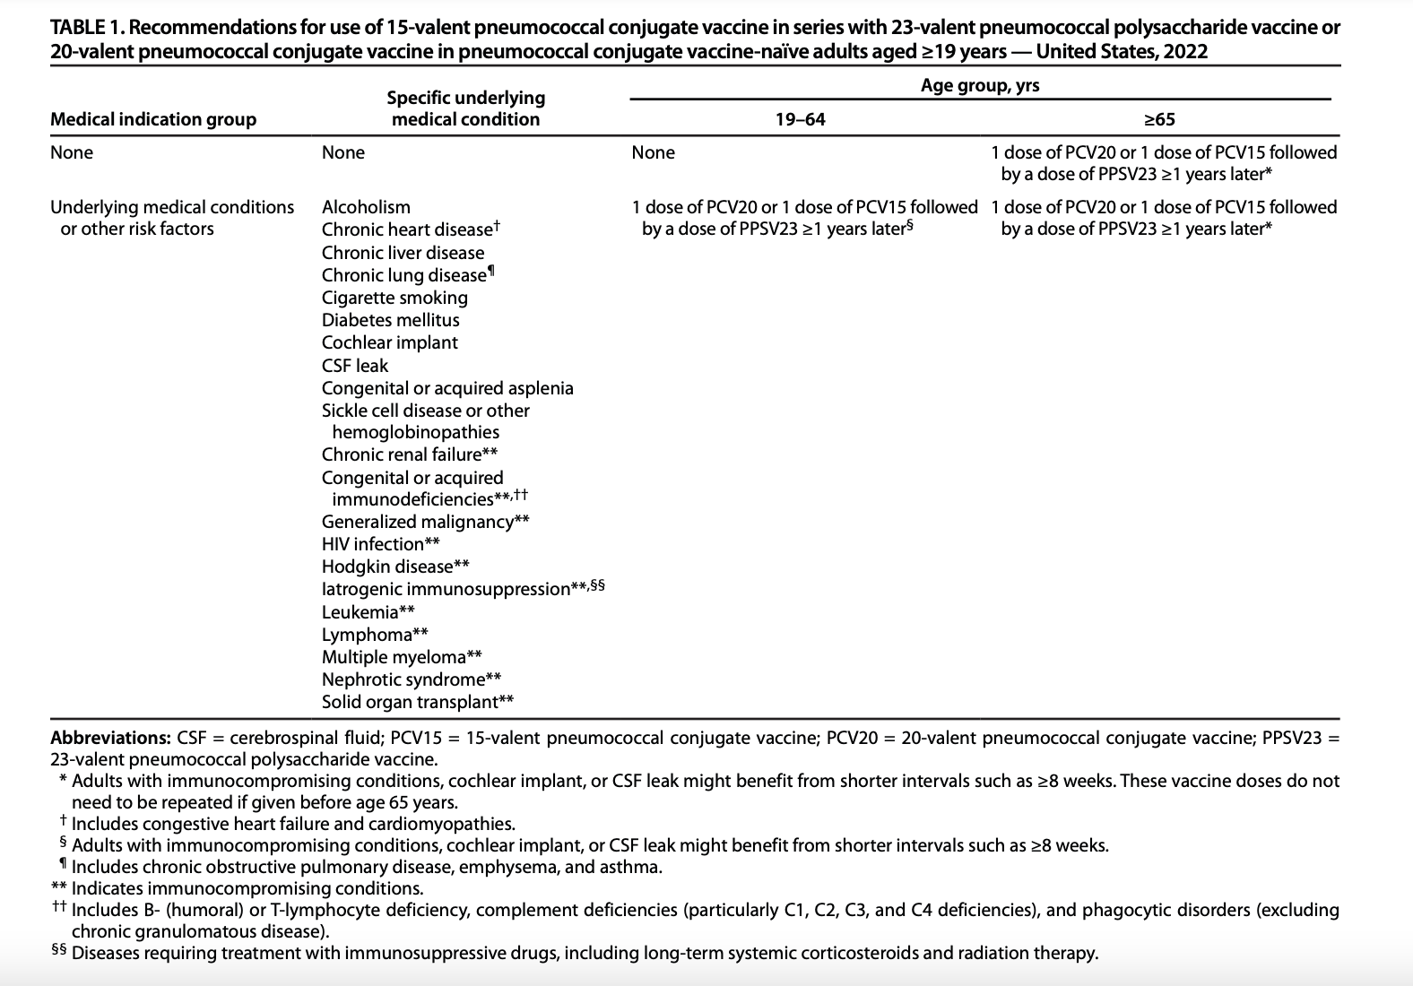
MMWR January 28, 2022; Vol. 71 (4)

Slide 34
FDA Recommended Influenza Antigens
for 2022-2032 Season in the U.S.
Egg-based influenza vaccines | Cell culture–based inactivated (ccIIV4) and recombinant (RIV4) influenza vaccines
an influenza A/Victoria/2570/2019 (H1N1)pdm09-like virus an influenza A/Darwin/9/2021 (H3N2)-like virus an influenza B/Austria/1359417/2021 (Victoria lineage)- like virus, and an influenza B/Phuket/3073/2013 (Yamagata lineage)-like virus | an influenza A/Wisconsin/588/2019 (H1N1)pdm09-like virus an influenza A/Darwin/6/2021 (H3N2)-like virus an influenza B/Austria/1359417/2021 (Victoria lineage)- like virus, an influenza B/Phuket/3073/2013 (Yamagata lineage)-like virus
ACIP recommends annual influenza vaccine for all persons 6 months of age and older who do not have contraindications.
SOURCE: MMWR CDC
Notes:
Routine annual influenza vaccination of all persons aged ≥6 months who do not have contraindications continues to be recommended. Primary updates in this report include the following:
The composition of the 2022–23 U.S. seasonal influenza vaccines includes updates to the influenza A(H3N2) and influenza B/Victoria components. For the 2022–23 season, U.S.-licensed influenza vaccines will contain hemagglutinin (HA) derived from an influenza A/Victoria/2570/2019 (H1N1)pdm09-like virus (for egg-based vaccines) or an influenza A/Wisconsin/588/2019 (H1N1)pdm09-like virus (for cell culture–based and recombinant vaccines); an influenza A/Darwin/9/2021 (H3N2)-like virus (for egg-based vaccines) or an influenza A/Darwin/6/2021 (H3N2)-like virus (for cell culture–based or recombinant vaccines); an influenza B/Austria/1359417/2021 (Victoria lineage)-like virus; and an influenza B/Phuket/3073/2013 (Yamagata lineage)-like virus.
Influenza vaccines expected to be available for the 2022–23 season, their age indications, and their presentations are described (Table 1). Afluria Quadrivalent is not expected to be available in a 0.25-mL prefilled syringe presentation. When using Afluria Quadrivalent for children aged 6 through 35 months (who require a 0.25-mL dose), the dose must be obtained from a multidose vial. One labeling change is described. In October 2021, FDA granted approval for the use of Flucelvax Quadrivalent (cell culture–based quadrivalent inactivated influenza vaccine [ccIIV4]) for children aged 6 months through <2 years. As of March 2021, Flucelvax Quadrivalent had been approved for persons aged ≥2 years. Approval for children aged 6 months through <2 years was based on results of a randomized, observer-blind study that compared immunogenicity and safety of Flucelvax Quadrivalent with that of a licensed comparator IIV4 among 2,402 children aged 6 through 47 months, of whom 894 were aged 6 through 23 months. Flucelvax Quadrivalent is now approved for persons aged ≥6 months.
On the basis of review of evidence concerning high-dose inactivated influenza vaccine (HD-IIV), recombinant influenza vaccine (RIV), and MF59-adjuvanted inactivated influenza vaccine (aIIV), recommendations for influenza vaccination of persons aged ≥65 years have been modified. ACIP recommends that adults aged ≥65 years preferentially receive any one of the following higher dose or adjuvanted influenza vaccines: quadrivalent high-dose inactivated influenza vaccine (HD-IIV4), quadrivalent recombinant influenza vaccine (RIV4), or quadrivalent adjuvanted inactivated influenza vaccine (aIIV4). If none of these three vaccines is available at an opportunity for vaccine administration, then any other age-appropriate influenza vaccine should be used. Higher dose vaccines include HD-IIV4 and RIV4, both of which contain a higher dose of HA antigen per virus than standard-dose vaccines (60 µg for HD-IIV4 and 45 µg for RIV4, compared with 15 µg for standard-dose inactivated vaccines). Adjuvanted inactivated influenza vaccine (aIIV4) contains MF59 adjuvant.

Slide 35
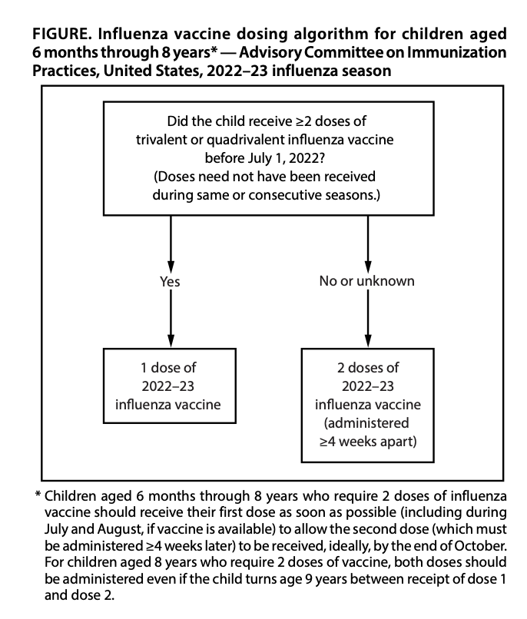
Dosing for children 6 months through 8 years of age
SOURCE: MMWR CDC
Notes:
For children aged 6 months through 8 years, the number of doses of influenza vaccine needed for the 2022–23 influenza season is determined as follows (Figure): ű Those who have previously received ≥2 total doses of trivalent or quadrivalent influenza vaccine ≥4 weeks apart before July 1, 2022, require only 1 dose for the 2022–23 season. The 2 previous doses of influenza vaccine do not need to have been received in the same season or consecutive seasons. ű Those who have not previously received ≥2 doses of trivalent or quadrivalent influenza vaccine ≥4 weeks apart before July 1, 2022, or whose previous influenza vaccination history is unknown, require 2 doses for the 2022–23 season. The interval between the 2 doses should be ≥4 weeks. Children aged 6 months through 8 years who require 2 doses of influenza vaccine should receive their first dose as soon as possible (including during July and August, if vaccine is available) to allow the second dose (which must be administered ≥4 weeks later) to be received, ideally, by the end of October. Two doses are recommended even if the child turns age 9 years between receipt of dose 1 and dose 2. • Adults and children aged ≥9 years need only 1 dose of influenza vaccine for the 2022–23 season

Slide 36
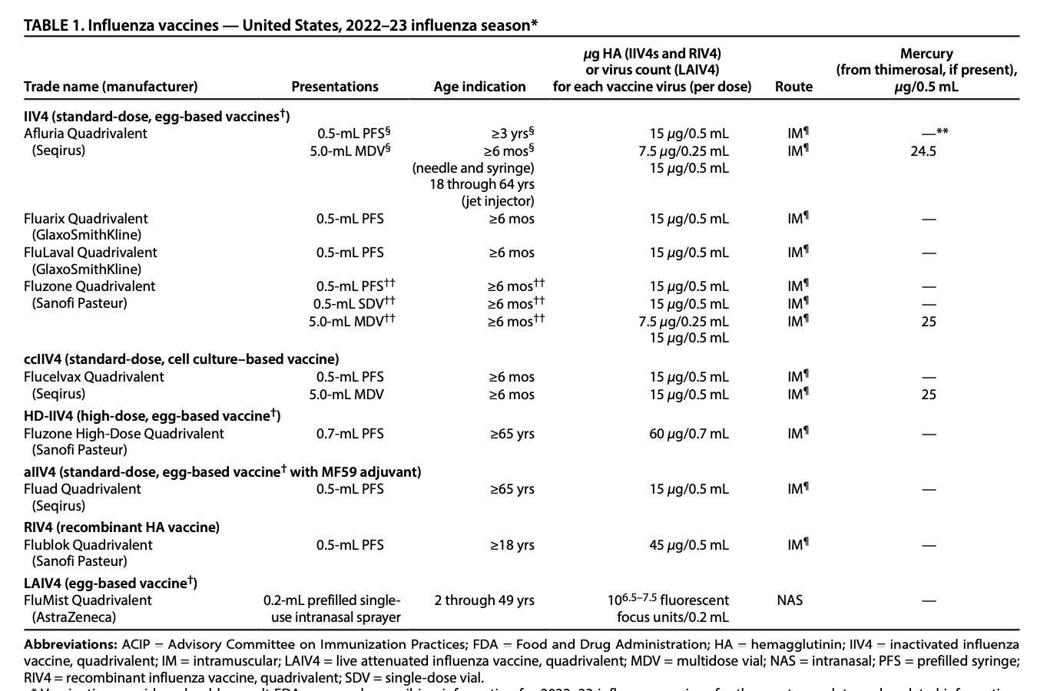
Influenza Vaccines for 2022-2023 Season
SOURCE: Available Influenza Vaccines 2022-23, CDC
Notes:
Flu vaccines for 2022-2023
Afluria Quadrivalent is not expected to be available in a 0.25-mL prefilled syringe presentation. When using Afluria Quadrivalent for children aged 6 through 35 months (who require a 0.25-mL dose), the dose must be obtained from a multidose vial.
One labeling change is described. In October 2021, FDA granted approval for the use of Flucelvax Quadrivalent (cell culture–based quadrivalent inactivated influenza vaccine [ccIIV4]) for children aged 6 months through <2 years. As of March 2021, Flucelvax Quadrivalent had been approved for persons aged ≥2 years. Approval for children aged 6 months through <2 years was based on results of a randomized, observer-blind study that compared immunogenicity and safety of Flucelvax Quadrivalent with that of a licensed comparator IIV4 among 2,402 children aged 6 through 47 months, of whom 894 were aged 6 through 23 months. Flucelvax Quadrivalent is now approved for persons aged ≥6 months..
Abbreviations: ACIP = Advisory Committee on Immunization Practices; FDA = Food and Drug Administration; HA = hemagglutinin; IIV4 = inactivated influenza vaccine, quadrivalent; IM = intramuscular; LAIV4 = live attenuated influenza vaccine, quadrivalent; MDV = multidose vial; mos = months; NAS = intranasal; PFS = prefilled syringe; RIV4 = recombinant influenza vaccine, quadrivalent; SDV = single-dose vial
Vaccination providers should consult FDA-approved prescribing information for 2021–22 influenza vaccines for the most complete and updated information, including (but not limited to) indications, contraindications, warnings, and precautions. Package inserts for U.S.-licensed vaccines are available at https://www.fda.gov/vaccines-blood-biologics/approved-products/vaccines-licensed-use-united-states

Slide 37
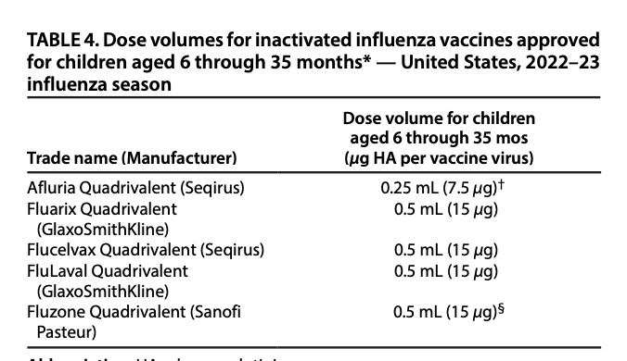
The cell-culture based inactivated influenza vaccine (ccIIV, Flucelvax Quadrivalent, Seqirus) is licensed and recommended for all people age 6 months and older. All standard dose IIVs are now approved for use beginning at age 6 months.

Slide 38
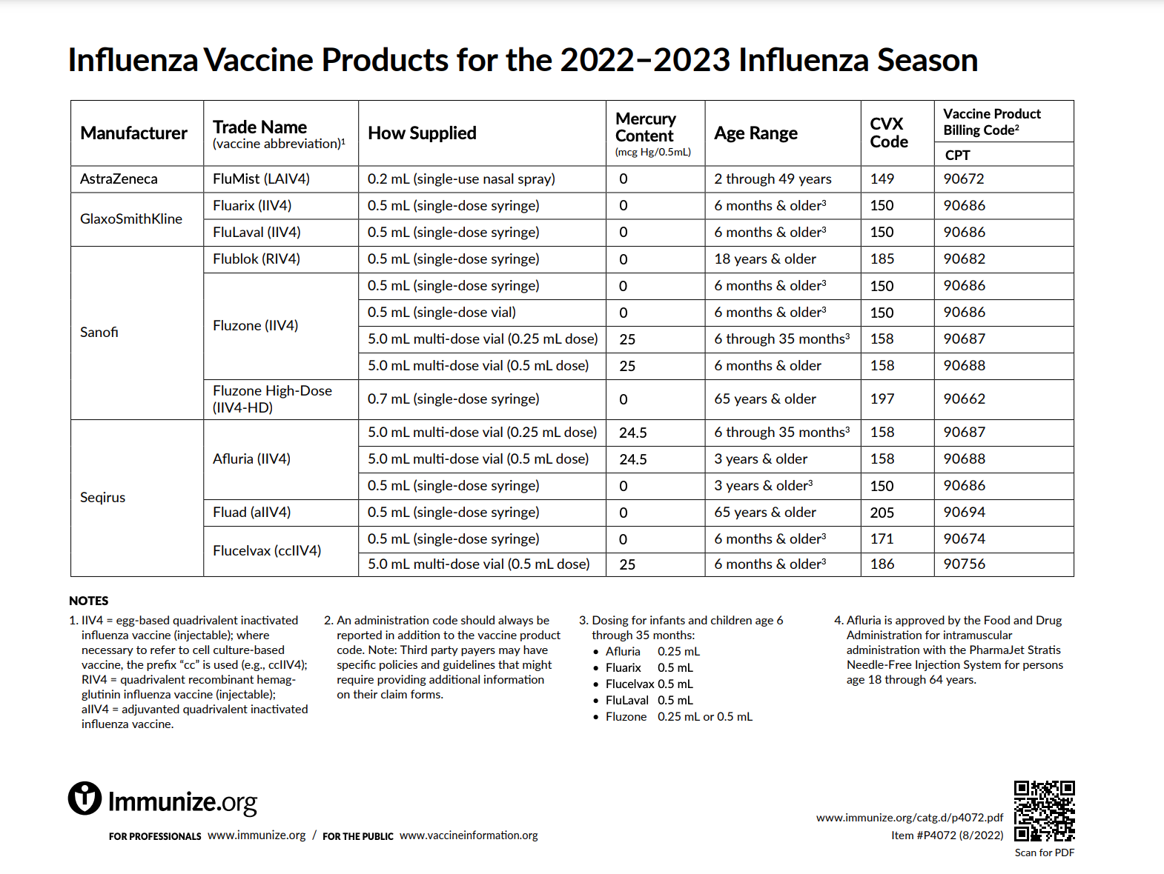
Notes:
Inactivated Influenza Vaccines (IIV4s) for Children 6 through 35 months ▪ Five IIV4s are now approved for this age group ▪ Dose volumes vary: – Fluarix Quadrivalent 0.5 mL/dose – FluLaval Quadrivalent 0.5 mL/dose – Flucelvax Quadrivalent 0.5 mL/dose – Afluria Quadrivalent 0.25 mL/dose – Fluzone Quadrivalent 0.25 mL/dose or 0.5 mL/dose

Slide 39
Live, Attenuated Influenza Vaccine (LAIV4)*
  FluMist® MedImmune (Nasal Spray)
  Licensed for healthy persons 2 through 49 years of age
LAIV4 MAY be used in the 2022-2023 season.
Contraindications to LAIV include:
  Children 2-4 yrs. of age with a diagnosis of asthma
  Persons receiving aspirin-containing medications – potential risk for Reye syndrome
  Persons who are immunocompromised, by medication or disease, have a CSF leak or cochlear implant, or asplenia
  Close contacts and caregivers of severely immunosuppressed persons
  Persons who have received influenza antiviral medications within the previous days (dependent on antiviral)
  Persons with a cranial CSF leak; people with cochlear implants
  Persons with a severe allergic reaction to any component of the vaccine or to a previous dose of any influenza vaccine (exception for allergy to egg)
  Pregnancy
SOURCE: MMWR CDC
Notes:
Available vaccines: One live attenuated influenza vaccine, FluMist Quadrivalent (LAIV4), is expected to be available during the 2022–23 influenza season. LAIV4 is approved for persons aged 2 through 49 years.
LAIV4 contains live attenuated influenza viruses that are propagated in eggs. These viruses are cold adapted (so that they replicate efficiently at 25°C) and temperature sensitive (so that their replication is restricted at higher temperatures, 39°C for influenza A viruses and 37°C for influenza B viruses). These viruses replicate in the nasopharynx, which is necessary to promote an immune response (101).
No preference is expressed for LAIV4 versus other influenza vaccines used within specified indications.
Dosage and administration: LAIV4 is administered intranasally using the supplied prefilled, single-use sprayer containing 0.2 mL of vaccine. Approximately 0.1 mL (i.e., half the total sprayer contents) is sprayed into the first nostril while the recipient is in the upright position. An attached dose-divider clip is removed from the sprayer to permit administration of the second half of the dose into the other nostril. If the recipient sneezes immediately after administration, the dose should not be repeated. However, if nasal congestion is present that might impede delivery of the vaccine to the nasopharyngeal mucosa, deferral of administration should be considered until resolution of the illness, or another appropriate vaccine should be administered instead. Each total dose of 0.2 mL contains 10^{6.5–7.5} fluorescent focus units of each vaccine virus
Contraindications to use of LAIV
• History of severe allergic reaction (e.g., anaphylaxis) to any component of the vaccine† or to a previous dose of any influenza vaccine (i.e., any egg-based IIV, ccIIV, RIV, or LAIV)§ • Concomitant aspirin- or salicylate-containing therapy in children and adolescents§ • Children aged 2 through 4 years who have received a diagnosis of asthma or whose parents or caregivers report that a health care provider has told them during the preceding 12 months that their child had wheezing or asthma or whose medical record indicates a wheezing episode has occurred during the preceding 12 months • Children and adults who are immunocompromised due to any cause, including but not limited to immunosuppression caused by medications, congenital or acquired immunodeficiency states, HIV infection, anatomic asplenia, or functional asplenia (e.g., due to sickle cell anemia) • Close contacts and caregivers of severely immunosuppressed persons who require a protected environment • Pregnancy • Persons with active communication between the CSF and the oropharynx, nasopharynx, nose, or ear or any other cranial CSF leak • Persons with cochlear implants** • Receipt of influenza antiviral medication within the previous 48 hours for oseltamivir and zanamivir, previous 5 days for peramivir, and previous 17 days for baloxavir††

Slide 40
History of egg allergy and egg-based Influenza vaccines
Persons with a history of egg allergy who have experienced only urticaria (hives) after exposure to egg should receive influenza vaccine.
Any licensed, recommended influenza vaccine (i.e., any IIV4, RIV4, or LAIV4) that is otherwise appropriate for the recipient’s age and health status can be used.
Persons who report having had reactions to egg involving symptoms other than urticaria (e.g., angioedema or swelling, respiratory distress, lightheadedness, or recurrent vomiting) or who required epinephrine or another emergency medical intervention can also receive any licensed, recommended influenza vaccine (i.e., any IIV4, RIV4, or LAIV4) that is otherwise appropriate for their age and health status.
If a vaccine other than ccIIV4 or RIV4 is used, the selected vaccine should be administered in an inpatient or outpatient medical setting, including but not necessarily limited to hospitals, clinics, health departments, and physician offices. Vaccine administration should be supervised by a health care provider who is able to recognize and manage severe allergic reactions.
SOURCE: MMWR CDC
Notes:
Most available influenza vaccines, with the exceptions of RIV4 (Flublok Quadrivalent, licensed for those aged ≥18 years) and ccIIV4 (Flucelvax Quadrivalent, licensed for those aged ≥6 months), are prepared by propagation of virus in embryonated eggs and might contain trace amounts of egg proteins, such as ovalbumin. For persons who report a history of egg allergy, ACIP recommends the following: • Persons with a history of egg allergy who have experienced only urticaria (hives) after exposure to egg should receive influenza vaccine. Any licensed, recommended influenza vaccine (i.e., any IIV4, RIV4, or LAIV4) that is otherwise appropriate for the recipient’s age and health status can be used. • Persons who report having had reactions to egg involving symptoms other than urticaria (e.g., angioedema or swelling, respiratory distress, lightheadedness, or recurrent vomiting) or who required epinephrine or another emergency medical intervention can similarly receive any licensed, recommended influenza vaccine (i.e., any IIV4, RIV4, or LAIV4) that is otherwise appropriate for their age and health status. If a vaccine other than ccIIV4 or RIV4 is used, the selected vaccine should be administered in an inpatient or outpatient medical setting, including but not necessarily limited to hospitals, clinics, health departments, and physician offices. Vaccine administration should be supervised by a health care provider who is able to recognize and manage severe allergic reactions. All vaccination providers should be familiar with their office emergency plan and be certified in cardiopulmonary resuscitation (42). No postvaccination observation period is recommended specifically for egg-allergic persons. However, ACIP recommends that vaccination providers consider observing patients (seated or supine) for 15 minutes after administration of any vaccine to decrease the risk for injury should syncope occur (42).

Slide 41
Co-administration
Inactivated influenza vaccines(IIV4s) and RIV4 may be administered simultaneously or sequentially with other inactivated vaccines or live vaccines. Injectable vaccines that are given concomitantly should be administered at separate anatomic sites.
LAIV4 can be administered simultaneously with other live or inactivated vaccines. However, if two live vaccines are not given simultaneously, then after administration of one live vaccine (such as LAIV4), at least 4 weeks should pass before another live vaccine is administered
Guidance concerning administration of COVID-19 vaccines with other vaccines indicates that these vaccines may be given with other vaccines, including influenza vaccines.
Providers should be aware of the potential for increased reactogenicity with coadministration and should consult the CDC guidance as more information becomes available. (This is more likely with the adjuvanted or high dose IIV4s which are recommended in persons 65 years and older.
SOURCE: MMWR CDC
Notes:
Providers should be aware of the potential for increased reactogenicity with coadministration and should consult the CDC guidance as more information becomes available. This is more likely with the adjuvanted or high dose IIV4s which are recommended in persons over the age of 65 years old.
If administered simultaneously, COVID-19 vaccines and influenza vaccines that might be more likely to cause a local reaction (e.g., aIIV4 or HD-IIV4) should be administered in different limbs, if possible.

Slide 42
Influenza Vaccines Preference 2022-23 for Older Adults and other changes for 2022-23 influenza vaccination recommendations
ACIP recommends that adults aged ≥65 years preferentially receive any one of the following higher dose or adjuvanted influenza vaccines:
  quadrivalent high-dose inactivated influenza vaccine (HD-IIV4),
  quadrivalent recombinant influenza vaccine (RIV4), or
  quadrivalent adjuvanted inactivated influenza vaccine (aIIV4).
If none of these three vaccines is available at an opportunity for vaccine administration, then any other age-appropriate influenza vaccine should be used.
No preference is expressed for any one of these three vaccines.
Notes:
Higher dose vaccines include HD-IIV4 and RIV4, both of which contain a higher dose of HA antigen per virus than standard-dose vaccines (60 µg for HD-IIV4 and 45 µg for RIV4, compared with 15 µg for standard-dose inactivated vaccines). Adjuvanted inactivated influenza vaccine (aIIV4) contains MF59 adjuvant.

Slide 43
Timing of Influenza Vaccination
Influenza vaccines might be available as early as July or August; however, vaccination during these months is not recommended for most groups because of the possible waning of immunity over the course of the influenza season
For most persons who need only 1 dose of influenza vaccine for the season, vaccination should ideally be offered during September or October.
However, vaccination should continue after October and throughout the influenza season as long as influenza viruses are circulating and unexpired vaccine is available.
Notes:
For most adults (particularly adults aged ≥65 years) and for pregnant persons in the first or second trimester: Vaccination during July and August should be avoided unless there is concern that vaccination later in the season might not be possible. • Children who require 2 doses: Certain children aged 6 months through 8 years require 2 doses of influenza vaccine for the season (see Children Aged 6 Months Through 8 Years: Number of Influenza Vaccine Doses) (Figure). These children should receive their first dose as soon as possible (including during July and August, if vaccine is available) to allow the second dose (which must be administered ≥4 weeks later) to be received, ideally, by the end of October. • Children who require only 1 dose: Vaccination during July and August can be considered for children of any age who need only 1 dose of influenza vaccine for the season. While waning of immunity after vaccination over the course of the season has been observed among all age groups (19–32), there are fewer published studies reporting results specifically among children (19–22). Moreover, children in this group might visit health care providers during the late summer months for medical examinations before the start of school. Vaccination can be considered at this time because it represents a vaccination opportunity. • Pregnant persons in the third trimester: Vaccination during July and August can be considered for pregnant persons who are in the third trimester because vaccination might reduce risk for influenza illness in their infants during the first months after birth, when they are too young to receive influenza vaccine (33–36). For pregnant persons in the first or second trimester during July and August, waiting to vaccinate until September or October is preferable, unless there is concern that later vaccination might not be possible. No recommendation is made for revaccination (i.e., providing a booster dose) later in the season of persons who have been fully vaccinated for the season, regardless of when the current season vaccine was received. During the 2022–23 influenza season, SARS-CoV-2 is expected to continue to circulate in the United States, and COVID-19 vaccinations are expected to continue. Current guidance for the administration of COVID-19 vaccines (“Coadministration of COVID-19 vaccines with other vaccines” at https://www.cdc.gov/vaccines/ covid-19/clinical-considerations/interim-considerations-us. html#recommendations) indicates that these vaccines can be administered with influenza vaccines; providers should consult this page for updated information. Guidance for vaccine planning during the COVID-19 pandemic is available at https://www.cdc.gov/vaccines/pandemic-guidance/index.html. Optimally, vaccination should occur before onset of influenza activity in the community. However, because timing of the onset, peak, and decline of influenza activity varies, the ideal time to start vaccinating cannot be predicted each season. Moreover, more than one outbreak might occur in a community in a single year. In the United States, localized outbreaks indicating the start of seasonal influenza activity can occur as early as October.

Slide 44
Hepatitis A Vaccine for Children and Adolescents*
ACIP recommends 2 doses of hepatitis A vaccine for:
All children 12 through 23 months of age (Separate the 2 doses by a minimum of 6 months)
Any child or adolescent 2 through 18 years, not previously vaccinated
All persons >1 year of age at increased risk for HAV infection or at increased risk for severe disease from HAV infection including persons experiencing homelessness, persons with chronic liver disease, persons living with HIV
Infants 6-11 mos. traveling outside the U.S. when protection against HAV is recommended. Revaccinate with 2 doses, separated by at least 6 months, between age 12-23 months.
*MMWR, May 19, 2006, Vol 55, #RR-07 **MMWR, Nov. 2, 2018, Vol. 67, No. 43 and https://www.cdc.gov/mmwr/volumes/69/rr/pdfs/rr6905a1-H.pdf, MMWR, July 3, 2020, Vol 69, #RR-05 https://www.cdc.gov/vaccines/schedules/hcp/imz/child-adolescent.html
Notes:
References:
Prevention of Hepatitis A Through Active or Passive Immunization - Recommendations of the Advisory Committee on Immunization Practices (ACIP) MMWR Vol. 55/No. RR-7 May 19, 2006
Hepatitis A occurs throughout the world. It is highly endemic in some areas, particularly Central and South America, Africa, the Middle East, Asia, and the Western Pacific.
Historically, children 2–18 had highest rates of hepatitis A (15 to 20 cases per 100,000)
Prior to 2000, incidence higher in Western states
Rates declined 95.5% since vaccination initiation in 1996 to 2011
From 2016-2021, over 37,000 outbreak-associated cases reported from 35 states
Humans are the only natural reservoir of the virus. There are no insect or animal vectors. A chronic HAV state has not been reported although infections may relapse or be prolonged.
The incubation period of hepatitis A is approximately 28 days (range 15 to 50 days). The clinical course of hepatitis A is indistinguishable from that of other types of acute viral hepatitis. The illness typically has an abrupt onset of fever, malaise, anorexia, nausea, abdominal discomfort, dark urine, and jaundice. Clinical illness usually does not last longer than 2 months, although 10% to 15% of persons have prolonged or relapsing signs and symptoms for up to 6 months. Virus may be excreted during a relapse or prolonged Illness.
The likelihood of symptomatic illness from HAV infection is directly related to age. In children younger than age 6 years, most (70%) infections are asymptomatic. In older children and adults, infection is usually symptomatic, with jaundice occurring in more than 70% of patients.
HAV infection is acquired primarily by the fecal-oral route by either ingestion of contaminated food or water or direct contact with an infectious person. Since the virus is present in blood during the illness prodrome, HAV has been transmitted on rare occasions by blood transfusion as well as solid organ transplantation. Although HAV may be present in saliva, transmission by saliva has not been demonstrated. Waterborne outbreaks are infrequent in the United States and are usually associated with sewage-contaminated or inadequately treated water.
Vaccination – same as MMR, remember 6-11 month old travelers to Hep A endemic areas.

Slide 45
Hepatitis A Vaccine Recommendations for Adults*
      All persons 1 year and older infected with HIV
      Vaccination of pregnant women identified to be at risk for HAV infection during pregnancy (e.g. international travelers, persons who use illegal drugs, etc.)
      During outbreaks of Hepatitis A in persons at risk for HAV infection
      Those traveling or working in countries with high or intermediate endemicity of infection
      Men who have sex with men
      Users of injecting and non-injecting drugs
      Persons with chronic liver disease or on dialysis
      Persons working with HAV positive primates or with HAV in research laboratory setting
      U. S. Adopters of adoptees from countries with high rates of hepatitis should receive the first dose of the 2-dose series as soon as adoption is planned.***
https://www.cdc.gov/mmwr/volumes/69/rr/pdfs/rr6905a1-H.pdf, MMWR, July 3, 2020, Vol 69, #RR-05
Notes:
Hepatitis A Transmission:
The hepatitis A virus (HAV) is transmitted via the fecaloral route, usually through direct person-to-person contact or consumption of contaminated food or water. HAV infection is clinically indistinguishable from other types of acute viral hepatitis, and the illness is usually mild and self limited when healthy persons are infected. Disease severity increases in persons who are older or immunocompromised, have chronic liver disease, or have other underlying health conditions. Infection with HAV has not been found to cause chronic infection, although prolonged or relapsing hepatitis A has been reported.
References:
1. Prevention of Hepatitis A Through Active or Passive Immunization - Recommendations of the Advisory Committee on Immunization Practices (ACIP) MMWR Vol. 55/No. RR-7 May 19, 2006
2. Notice to Readers: FDA Approval of an Alternate Dosing Schedule for a Combined Hepatitis A and B Vaccine (Twinrix®) MMWR 56(40);1057 October 12, 2007
3. Updated Recommendations from the Advisory Committee on Immunization Practices (ACIP) for Use of Hepatitis A Vaccine in Close Contacts of Newly Arriving International Adoptees MMWR 58(36);1006-1007 September 18, 2009
4. Epidemiology and Prevention of Vaccine-Preventable Diseases, 13th edition. 2015 HHS, CDC.
sons working with HAV positive primates or with HAV in research laboratory settings
Healthy persons through age 40 who have recently been exposed to Hepatitis A virus
5. MMWR, November 2, 2018, Vol. 67, No. 43

Slide 46
Hepatitis B*
Hepatitis B is an infectious liver disease caused by the hepatitis virus (HBV) that can lead to cirrhosis, liver cancer, and premature death.
Transmission:
  Percutaneous or mucosal exposure to infected blood or body fluids (e.g. skin puncture, sexual contact, contaminated surfaces)
  Vertical transmission from a HBsAg-positive mother to her newborn at birth
  Infected infants have 90% risk of developing chronic infection if not given HepB vaccine and HBIG at birth**
ACIP Hepatitis B vaccine recommendations (children and adolescents);
  Administer hepatitis B vaccine to all newborns within 24 hours of birth, using single antigen vaccine; Dose 2 at 1-2 mos. of age and Dose 3 at 6-18 mos. of age
  All children and adolescents less than 19 years of age who did not complete the
  series as an infant
*Recommended Immunization Schedule for Persons Age 0 Through 18 Years, United States, 2017
*MMWR, December 23, 2005, Vol 54, #RR16, Vol 60 ** https://www.cdc.gov/hepatitis/hbv/bfaq.htm
Notes:
Incubation period from time of infection to onset of symptoms is 45 to 160 days (average, 90 days)
Approximately 10% of acute hepatitis B infections progress to chronic Hepatitis B infection.
90% of infants and 30-50% of children 1-5 years of age with acute hepatitis B infection become carriers
Many with chronic infection are asymptomatic. Chronic infection may progress to cirrhosis, liver failure & hepatocellular carcinoma
Avoid this with vaccination!!! Begin in the prenatal period. All pregnant women should be tested routinely for HBsAg
Vaccinate in the nursery if at all possible, or at the 1 week or 1 month WCC visit.
Timing for Doses 2 and 3 of infant series added to 1st bullet.
All pregnant women should be tested routinely for HBsAg
90% of healthy adults & 95% of infants, children & adolescents develop adequate antibody response after a complete series
If no antibody response after 6 doses, person is a non-responder and is susceptible to hepatitis B
Booster doses NOT recommended for any age group
References:
1. A Comprehensive Immunization Strategy to Eliminate Transmission of Hepatitis B Virus Infection in the United States. Recommendations of the Advisory Committee on Immunization Practices (ACIP) Part 1: Immunization of Infants, Children and Adolescents MMWR Vol. 54/ No. RR-16 December 23, 2005
2. A Comprehensive Immunization Strategy to Eliminate Transmission of Hepatitis B Virus Infection in the United States. Recommendations of the Advisory Committee on Immunization Practices (ACIP) Part 2: Immunization of Adults MMWR Vol. 55/ No. RR-16 December 8, 2006

Slide 47
Hepatitis B-Exposed Infants and Children*
Postexposure Prophylaxis (PEP) for infants born to mothers who are HBsAg-positive,
  Administer hepatitis B immune globulin (HBIG) AND hepatitis B vaccine within 12 hours of birth
For infants born to mothers whose HBsAg status is unknown, administer the Hep B vaccine within 12 hours of birth.
  And administer HBIG within 12 hours of birth for infants who weigh less than 2000 grams,
  HBIG can be administered up to 7 days after birth for infants weighing at least 2000 grams if the mother’s hepatitis B surface antigen (HBsAg) lab result is unavailable at delivery and mother is determined to be HBsAg-positive during that time period
  For further details on dosing, please visit: https://www.cdc.gov/vaccines/pubs/pinkbook/hepb.html, Epidemiology and Prevention of Vaccine-Preventable Diseases, Hepatitis B chapter
*Prevention of Hepatitis B Virus Infection in the United States: Recommendations of the Advisory Committee on Immunization Practices. MMWR Recommendations and Reports 2018;67(No. RR-1):1–31.
Notes:
Only single-component vaccine should be used for the birth dose and doses administered before age 6 weeks
As with infants born to HBsAg-positive mothers, for infants weighing less than 2,000 grams, the birth dose should not be counted as part of the vaccine series because of potentially reduced immunogenicity; 3 additional doses of vaccine (for a total of 4 doses) should be administered beginning when the infant reaches age 1 month. Infants with mothers whose HBsAg status is unknown should receive the last dose by age 6 months but not before age 24 weeks.
Preterm infants weighing less than 2,000 grams have a decreased response to HepB vaccine administered before 1 month of age. However, by chronologic age 1-month preterm infants, regardless of initial birth weight or gestational age, are as likely to respond as adequately as full-term infants. Preterm infants of low birth weight whose mothers are HBsAg-negative can receive the first dose of HepB vaccine at chronologic age 1 month. Preterm infants discharged from the hospital before chronologic age 1 month can receive HepB vaccine at discharge if they are medically stable and have gained weight consistently, even if they are less than 2,000 grams.

Slide 48
Post-vaccination serologic testing (PVST)*
ACIP Recommendations re: PVST
  PVST recommended for infants born to HBsAg-positive and HBsAg-unknown mothers
  Testing is recommended at 9-12 months of age (not recommended before 9 mos. of age)
  PVST must include hepatitis B surface antigen (HBsAg) AND hepatitis B surface antibody (anti-HBs) tests
*Prevention of Hepatitis B Virus Infection in the United States: Recommendations of the Advisory Committee on Immunization Practices. MMWR Recommendations and Reports 2018;67(No. RR-1):1–31.

Slide 49
Hepatitis B Vaccine Recommendations for adults*
  Persons with history of or current drug use.
  Persons with chronic liver disease, including Hepatitis C infection, HIV infection
  Incarcerated persons
  All unvaccinated adults at risk for hepatitis B infection, including those aged 19- 59 yrs. with diabetes mellitus
  Persons of any age at risk for infection by sexual exposure.
  All other adults seeking protection from HBV infection.
  Post vaccination serologic testing (PVST) recommended for infants born to HBsAg-positive and mothers whose HBsAg status remains unknown
  Testing is recommended at 9-12 months of age (not recommended before 9 mos. of age)
  PVST must include hepatitis B surface antigen (HBsAg) AND hepatitis B surface antibody (anti-HBs) tests
MMWR, April 20, 2018, Vol 67(15) https://www.cdc.gov/mmwr/volumes/67/wr/mm6715a5.htm
MMWR, January 12, 2018, Vol 67 (1) https://www.cdc.gov/mmwr/volumes/67/rr/rr6701a1.htm
Notes:
Transmission:
Percutaneous or mucosal exposure to blood or body fluids including contaminated surfaces
Exposure by sexual contact
Incubation period from time of infection to onset of symptoms is 45 to 160 days (average, 90 days)
Approximately 10% of acute hepatitis B infections progress to chronic Hepatitis B infection.
90% of infants and 30-50% of children 1-5 years of age with acute hepatitis B infection become carriers
Many with chronic infection are asymptomatic. Chronic infection may progress to cirrhosis, liver failure & hepatocellular carcinoma
All pregnant women should be tested routinely for HBsAg
90% of healthy adults & 95% of infants, children & adolescents develop adequate antibody response after a complete series
If no antibody response after 6 doses, person is a non-responder and is susceptible to hepatitis B
Booster doses NOT recommended for any age group
Adults at Risk for HBV Infection
In 2015, CDC received 3,370 surveillance case-reports of acute HBV infection. Of 2,207 case-reports with risk information, 1,151 (52.2%) indicated no risk for HBV during the 6 weeks to 6 months prior to illness onset, and the remainder indicated at least one risk factor. Injection-drug use and multiple sex partners were the most common reported sources of HBV transmission (4).
Injection-drug use. Injection-drug use was reported by 30.3% of 1,657 new reported HBV cases that included information about injection-drug use (4). Since 2009, there has been an increase in acute HBV infection among non-Hispanic whites aged 30–39 years residing in nonurban areas reporting injection-drug use as a risk factor (16). Chronic HBV infection has been identified in 3.5%-20.0% (midpoint estimate: 11.8%) of persons who inject drugs (PWID) in a variety of settings (75) and 22.6% of PWID have evidence of past infection (75). The proportion of HBV cases reporting injection-drug use in three states (Kentucky, Tennessee, and West Virginia) increased significantly, from 53% during 2006–2009 to 75% during 2010–2013 (p<0.001, chi-square) (16).
Sexual (heterosexual and MSM) exposure. Among persons with case-reports of HBV infection with information about sexual exposure, 26.4% reported having two or more sexual partners, 3.3% reported sexual contact with an HBV-infected person, and 11.8% of males reported having had sex with another male (4). As many as 10%–40% of adults seeking treatment in STI clinics have evidence of current or past HBV infection. Among adults with acute HBV infection, 39% were screened or sought care for an STI prior to becoming infected with HBV (76).
Household contacts. An estimated 45% of persons living in households with others with chronic HBV infection have serologic evidence of past HBV infection, and 16% have evidence of current infection (CDC, unpublished data, 2017. Prior to universal infant vaccination, the risk for infection was greatest among unvaccinated children living with a person with chronic HBV infection in a household or in an extended family setting (67,77,78).
Developmentally disabled persons in long-term-care facilities. Developmentally disabled persons in residential and nonresidential facilities historically have had a chronic HBV infection prevalence as high as 20%. The prevalence of infection has declined substantially since the implementation of routine HepB vaccination in these settings (79–82).
Correctional facilities. The prevalence of chronic HBV infection has been higher among prison inmates (1.0%–3.7%) than among the general population (83,84), reflecting an overrepresentation of persons entering correctional facilities with risks for HBV infection (e.g., injection-drug use and histories of multiple sex partners).
Persons at risk for occupational exposure to HBV. Before HepB vaccination was widely implemented, HBV infection was recognized as a common occupational risk among HCP (85,86). Routine HepB vaccination of HCP and the use of standard precautions have resulted in a 98% decline in HBV infections from 1983 through 2010 among HCP (10). The Occupational Safety and Health Administration mandates that employers offer HepB vaccination to all employees who have occupational risk and that postexposure prophylaxis be available following an exposure (10,87).
Hemodialysis patients. Since the initiation of HepB vaccination and additional infection control precautions for hepatitis B in dialysis centers, the incidence of HBV infection among hemodialysis patients has declined approximately 95% (88,89). Since 1995, the annual incidence has been stable and HBsAg seroprevalence has remained at 1% (90). Receipt of dialysis was reported in <1% of acute HBV surveillance cases with information reported to CDC (4).
Persons with HCV infection. The number of reported HCV cases in four Appalachian states (Kentucky, Tennessee, Virginia, and West Virginia) increased 364% during 2006–2012 among persons aged ≤30 years, with injection-drug use as the most common reported risk factor (91). The increase in HCV infections occurred concomitantly with an increase in HBV infections among young adults in rural communities in Appalachian states.
Persons with chronic liver disease. Persons with chronic liver disease (e.g., cirrhosis, fatty liver disease, alcoholic liver disease, and autoimmune hepatitis) are not at increased risk for HBV infection unless they have percutaneous or mucosal exposure to blood or body fluids. However, concurrent chronic HBV infection might increase the risk for progressive chronic liver disease in these persons (92).
Travelers to countries where HBV is endemic. Short-term travelers to countries in which HBV infection is of high or intermediate endemicity (Box 3) typically are at risk for infection only through exposure to blood in medical or disaster-relief activities, receipt of medical care that involves parenteral exposures, sexual activity, or drug use. Monthly incidence of 25–420 per 100,000 travelers has been reported among long-term travelers to countries where the disease is endemic (93).
Persons with HIV. Approximately 10% of HIV-positive persons are coinfected with HBV (94–97). Chronic HBV infection has been identified in 6%–14% of HIV-positive persons, including in 9%–17% of MSM and in 7%–10% of PWID (98). Coinfected persons have increased rates of cirrhosis and liver-related mortality (99).
Persons with diabetes. Compared with adults without diabetes, adults with diabetes have a 60% higher prevalence of past or present HBV infection and twice the odds of acquiring acute HBV. Repeated outbreaks of HBV infection associated with assisted blood glucose monitoring underscore the continued risk for this population (100–102). Data also suggest the possibility of a higher case-fatality proportion among persons with diabetes acutely infected with HBV compared with those without diabetes (9).

Slide 50
ACIP Vote 11/2021 Hepatitis B
ACIP unanimously voted to recommend that hepatitis B vaccine should be given to:
  all adults 19 through 59 years
  All people aged 60 or older with any risk factor for hepatitis B infection.
ACIP also voted that any person aged 60 and older with NO known risk factor may be vaccinated.
*MMWR/April 1, 2022/Vol.71/No.13
Notes:
Hepatitis B vaccine – Hepatitis B vaccination rates among high-risk adults plateaued below 25 percent over the past decade, whereas incidence rates of acute hepatitis B infection have gradually increased among adults age 30 years and older. Only one-third of reported cases document a risk factor for contracting the infection. The current strategy of vaccinating adults according to a complex list of medical and behavioral risk factors is widely acknowledged as inadequate to meet national hepatitis B disease elimination goals, in contrast to the success of universal childhood hepatitis B vaccination.
To protect more adults against the potentially devastating consequences of hepatitis B infection, ACIP members agreed to broaden and simplify vaccination recommendations for most adults.

Slide 51
Meningococcal Disease (caused by N. meningitidis)*
Usually presents as meningitis, bacteremia or both
  Transmitted through direct contact with respiratory tract secretions from patients and asymptomatic carriers
  Nasopharyngeal carriage rate is highest in adolescents and young adults in the U.S.
  Disease Incidence
    Highest in infants <1 year
    Next highest in children 1 through 4 years of age
    A second peak is found in adolescents and young adults 17-21 years of age
Serogroups B and C are the major causes of meningococcal disease in the US.
  Each responsible for approximately 25 to 40% of cases
About 5% of all U.S. cases of meningococcal disease are outbreak-related
*https://www.cdc.gov/mmwr/volumes/69/rr/rr6909a1.htm
Notes:
https://www.cdc.gov/vaccines/pubs/pinkbook/mening.html
In the United States, incidence of meningococcal disease is highest among infants younger than age 1 year, followed by children age 1 through 4 years. A second peak of disease incidence is found in young adults 17 through 21 years of age. Incidence increases again in adults older than 85 years of age.
Meningococci are classified into serogroups based on the structure of the polysaccharide capsule. Twelve antigenically and chemically distinct polysaccharide capsules have been described and the polysaccharide capsule determines the serogroup labeling. Almost all reported cases of invasive disease worldwide are caused by one of six serogroups: A, B, C, W, X, and Y. The relative importance of each serogroup depends on factors such as geographic location and patient age. Some strains are nongroupable and do not express capsule; these strains are most commonly associated with asymptomatic nasopharyngeal carriage rather than invasive disease.
Serogroups B and C are the major causes of meningococcal disease in the United States, each being responsible for approximately 25% to 40% of cases; serogroups W and Y, along with nongroupable meningococci, are each responsible for another 5% to 15%. The proportion of cases caused by each serogroup varies by age group. Approximately 60% of disease among children and young adults under 24 years of age is caused by serogroup B. In particular, among individuals 18 to 24 years of age, college students have more than three times the risk of serogroup B meningococcal disease as similarly aged people not attending college. Meanwhile, serogroups C, W, or Y cause about 60% of all cases of meningococcal disease among persons 24 years of age and older.

Slide 52
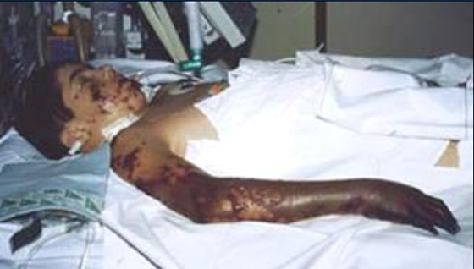
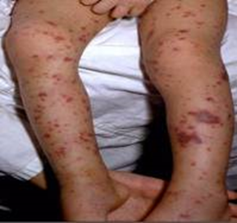
Signs and Symptoms of Meningococcal Disease
Risk factors
  Persistent complement component deficiencies
  Asplenia,
  HIV infection
  Exposure during an outbreak; Travel/residence in a country where disease is endemic/epidemic
  Household crowding, smoking,
  Unvaccinated college freshmen in dorms (particularly serogroup B)
  Military recruits
Symptoms of meningitis
    Sudden onset of fever
    Headache
    Stiff neck
    Photophobia
    Nausea and vomiting
Symptoms of meningococcemia
  All of the above are possible
  Cold hand and feet
  Pruritic rash
https://www.cdc.gov/mmwr/volumes/69/rr/rr6909a1.htm; MMWR, Sept 2020, Vol 69, RR 9
Notes:
Very scary:
The incubation period of meningococcal disease is typically 3 to 4 days, with a range of 1 to 10 days.
Meningitis is the most common presentation of invasive meningococcal disease and is found in about 50% of cases in the United States. Symptoms are similar to those seen in other forms of bacterial meningitis, and typically include sudden onset of fever, headache, and stiff neck, often accompanied by other symptoms, such as nausea, vomiting, photophobia (eye sensitivity to light), and altered mental status. Meningococci can be isolated from the blood in up to 75% of persons with meningitis.
Meningococcal septicemia (bloodstream infection or meningococcemia) occurs without meningitis in about 30% of invasive meningococcal infections. This condition is characterized by abrupt onset of fever; chills; cold hands and feet; severe aches or pain in the muscles, joints, chest, or abdomen; vomiting; diarrhea; and a petechial or purpuric rash, often associated with hypotension, shock, acute adrenal hemorrhage, and multiorgan failure.
An additional 15% of U.S. cases present with bacteremic pneumonia; this is the most common presentation in adults over 65 years of age. Other syndromes involving isolation of meningococci from normally sterile body sites, such as septic arthritis, can also occur.
Meningococci also occasionally cause noninvasive infections such as conjunctivitis or urethritis
Risk factors for the development of meningococcal disease include persistent complement component deficiencies (including use of a complement component inhibitor, eculizumab [Soliris®] or ravulizumab-cwvz [Ultomiris]), functional or anatomic asplenia, HIV infection, travel to or residence in a country where meningococcal disease is hyperendemic or epidemic, and exposure during an outbreak of meningococcal disease. Microbiologists who routinely work with isolates of N. meningitidis are also at risk. In addition, household crowding, active and passive smoking, and antecedent viral upper respiratory infection have been associated with meningococcal disease transmission.

Slide 53
Quadrivalent Meningococcal Conjugate Vaccine (MCV4)*
(Men A,C,W, Y)
Menactra™ licensed for 9 mos. through 55 years
Menveo® licensed for ages 2 mos. through 55 years
MenQuadfi® licensed for ages ≥ 2 yrs. of age
ACIP recommends:
  Dose 1---age 11-12 years preferred
  Booster dose---age 16 years
  Minimum interval between doses---8 weeks
  If 1st dose is received ≥16 years of age, a 2nd dose is not needed, unless they become at increased risk for meningococcal disease
  College students ≤21 years of age need 1 dose of MCV4 ≤5 years before enrollment.
Effective July 1, 2021, for the 2021-2022 school year, a meningococcal conjugate (MCV4/MenACWY) booster will be required for all high school students entering the 11th
grade and who are 16 years of age or older.**
**https://dph.georgia.gov/immunization-section
***https://dph.georgia.gov/public-health-regulations/regulationsrule-making
https://www.cdc.gov/mmwr/volumes/69/rr/rr6909a1.htm; MMWR, Sept 2020, Vol 69, RR 9
Notes:
ACIP recommends a single dose of MenACWY at age 11 or 12 years followed by a booster dose administered at age 16 years (Table 2). Children who received MenACWY at age 10 years do not need an additional dose at age 11–12 years but should receive the booster dose at age 16 years. Children who received MenACWY before age 10 years and with no ongoing risk for meningococcal disease for which boosters are recommended should still receive MenACWY according to the recommended adolescent schedule, with the first dose at age 11–12 years and a booster dose at age 16 years. For example, a healthy child who received MenACWY at age 9 years because of short-term travel to a country where meningococcal disease is hyperendemic or epidemic and who is not otherwise at increased risk should receive the MenACWY at age 11–12 years according to the recommended ACIP adolescent vaccination schedule. Children who received MenACWY before age 10 years and for whom boosters are recommended because of an ongoing increased risk for meningococcal disease (e.g., those with complement deficiency, HIV infection, or asplenia) should follow the booster schedule for persons at increased risk.
Adolescents who receive their first dose at age 13–15 years should receive a booster dose at age 16–18 years; the booster dose can be administered at any time, as long as a minimum interval of 8 weeks between doses is maintained. Adolescents who receive a first dose after their 16th birthday do not need a booster dose unless they become at increased risk for meningococcal disease. Persons aged 19–21 years who have not received a dose after their 16th birthday can receive a single MenACWY dose as part of catch-up vaccination. MenACWY vaccines are interchangeable; the same vaccine product is recommended, but not required, for all doses. MenACWY vaccines can be administered simultaneously with other vaccines indicated for this age group, but at a different anatomic site, if feasible. MenACWY-TT, which is conjugated to tetanus toxoid, is only licensed for the prevention of meningococcal disease; use of this vaccine does not replace doses or affect the dosing intervals of routinely recommended tetanus toxoid–containing vaccines in any age group.
First-year college students living in residence halls should receive at least 1 dose of MenACWY within 5 years before college entry. The preferred timing of the most recent dose is on or after their 16th birthday. If only 1 dose of vaccine was administered before the 16th birthday, a booster dose should be administered before enrollment. Adolescents who received a first dose after their 16th birthday do not need another dose before college entry unless >5 years have elapsed since the dose.
https://www.cdc.gov/vaccines/pubs/pinkbook/mening.html

Slide 54
Meningococcal Vaccines for High Risk
Persons 6 weeks – 55 years*
Menactra™ licensed for 9 mos. through 55 years
Menveo® licensed for ages 2 mos. through 55 years
MenQuadfi® licensed for ages ≥ 2 yrs. of age
Recommended for persons 6 weeks through 55 years**:
human immunodeficiency virus (HIV)***
complement component deficiency
functional or anatomic asplenia (sickle cell disease)
microbiologists exposed to isolates of N. meningitidis
part of a community outbreak due to vaccine serogroups
persons traveling internationally to regions with endemic meningococcal disease
For persons in any of these categories, consult the current ACIP Immunization Schedules for specific dosages and guidelines
*https://www.cdc.gov/mmwr/volumes/69/rr/rr6909a1.htm
Notes:
June 2016, ACIP recommended routine use of meningococcal conjugate vaccine for persons ages >2 months with human immunodeficiency virus infection. The majority of meningococcal disease among HIV-infected persons is caused by these four serogroups.
ACIP recommends HIV-infected infants 2 through 23 months should receive MenACWY-CRM (Menveo). HIV-infected children < 2 years should not receive MenACWY-D(Menactra) due to immune interference with PCV13.

Slide 55
Serogroup B Meningococcal Vaccine
Bexsero® licensed for ages 10 through 25 years (2 dose)
Trumenba® licensed for ages 10 through 25 years (2 or 3 dose)
ACIP recommends serogroup B meningococcal vaccine for*:
Persons with persistent complement component deficiencies
Persons with anatomic or functional asplenia
Persons receiving complement inhibitor
Microbiologists routinely exposed to isolates of Neisseria meningitidis
Persons considered at greater risk because of a serogroup B meningococcal disease outbreak**
The 2 vaccine products are not interchangeable.
Based on shared clinical decision making:
A Men B vaccine series may be administered to adolescents and young adults 16 through 23 years of age to provide short-term protection against most strains of Men B. Preferred age is 16-18 years.
*https://www.cdc.gov/mmwr/volumes/69/rr/rr6909a1.htm * https://www.cdc.gov/vaccines/hcp/acip-recs/vacc-specific/mening.html*
Notes:
“MenB vaccine should be administered as either a 2-dose series of MenB-4C or a 3-dose series of MenB-FHbp. The same vaccine product should be used for all doses.“
On February 26, 2015 the ACIP approved for MenB vaccines be recommended for the use among persons aged >10 years at increased risk for serogroup B meningococcal disease. The ACIP determined that insufficient evidence existed to routinely recommend that all adolescents be vaccinated with MenB vaccines. ACIP agreed that the information provided would allow each individual health care professional to use shared clinical decision making when recommending the vaccine. MenB vaccine series may be administered to young adults 16-23 years of age to provide short-term protection against most strains of MenB.

Slide 56
Serogroup B Meningococcal
Vaccine Administration
Bexsero® licensed for ages 10 through 25 years (2 dose)
Trumenba® licensed for ages 10 through 25 years (2 dose or 3 dose)
MenB-FHbp (Trumenba®)
  2 dose schedule – administered at 0, 6 months
  Given to healthy adolescents who are not at increased risk for meningococcal disease
  3 dose schedule – administered at 0, 1-2, 6 months
  Given to persons at increased risk for meningococcal disease and for use during serogroup B outbreaks
MenB-4C (Bexsero®)
  2 dose schedule – 0, 1-2 months
  Given to healthy adolescents who are not at increased risk for meningococcal disease
  Given to persons at increased risk for meningococcal disease and for use during serogroup B outbreaks
Notes:
For adolescents who are not otherwise at increased risk for meningococcal disease (e.g., due to complement deficiency or asplenia), a 2-dose series of MenB vaccine should be administered as follows: 2 doses of MenB-FHbp administered at 0 and 6 months or 2 doses of MenB-4C administered at 0 and ≥1 month.
For persons at increased risk for meningococcal disease (Box 1), including during serogroup B meningococcal disease outbreaks, either a 3-dose MenB-FHbp series or 2-dose MenB-4C primary series should be administered.
Primary series vaccination in persons aged ≥26 years and booster vaccination in persons at increased risk for meningococcal disease are not licensed in the United States and are considered off-label (Table 11).
https://www.cdc.gov/mmwr/volumes/69/rr/rr6909a1.htm

Slide 57
Meningococcal Vaccine
Booster Recommendations*
For persons at continued risk
  Meningococcal quadrivalent vaccine for persons who remain at increased risk
  Persons ≥10 years of age who previously received a MenB vaccine series
See *MMWR: Tables 2-11 https://www.cdc.gov/mmwr/volumes/69/rr/rr6909a1.htm#B1_down for further details.
https://www.cdc.gov/vaccines/hcp/acip-recs/vacc-specific/mening.html

Slide 58
Rotavirus Vaccines
RotaTeq® (Merck) and Rotarix® (GSK)*
RV 5, RotaTeq®: 3 doses; ages 2, 4, 6 months
RV 1,Rotarix®: 2 doses; ages 2 and 4 months
ACIP recommendation:
2-3 doses depending on brand
Administer either vaccine as directed below:
  Minimum age for first dose: 6 weeks
  Maximum age for first dose: 14 weeks 6 days
  Minimum interval between doses: 4 weeks
  Maximum age for any dose: 8 months 0 days
If any dose is Rotateq®, 3 doses are required
Use RotaTeq® if allergy to latex
*https://www.cdc.gov/vaccines/hcp/acip-recs/vacc-specific/rotavirus.html
MMWR, February 6, 2009, Vol 58, #RR-02; MMWR, June 11, 2010, Vol 59, # RR-22; MMWR, October 21, 2011, Vol 60, # RR-41
Notes:
Rotavirus infection in infants and young children can lead to severe diarrhea, dehydration, electrolyte imbalance, and metabolic acidosis. Treatment is supportive; feeding should be continued during the illness. Children who are immunocompromised because of congenital immunodeficiency or because of bone marrow or solid organ transplantation may experience severe or prolonged rotavirus gastroenteritis and may have evidence of resulting abnormalities in multiple organ systems, particularly the kidney and liver.
The routine use of Rotavirus vaccine has resulted in a dramatic decrease in hospitalizations for the management of dehydration. In the developing world the use of the vaccine has dramatically reduced deaths from rotavirus infection.
Schedule is shown. Beware of min and maximum ages and intervals. Always review this to avoid admin errors!
Rotateq® (Merck & Co) is a live, oral pentavalent vaccine that contains 5 live reassortant rotaviruses. (G1, G2, G3 and G4.) It is referred to as RV5 rotavirus vaccine.
Ref: Rotateq® Prescribing Information December 2009
Rotarix® (GSK) is a live, oral, monovalent attenuated rotavirus vaccine. It is referred to as RV1 rotavirus vaccine. Ref: Rotarix® Prescribing Information October 2008
ACIP does not express a preference for RV5 or RV1.
Interchangeability of Rotavirus Vaccines
ACIP recommends that the rotavirus vaccine series be completed with the same product whenever possible. However, vaccination should not be deferred if the product used for previous doses is not available or is unknown. In this situation, the provider should continue or complete the series with the product available. If any dose in the series was RV5 or the product is unknown for any dose in the series, a total of three doses of rotavirus vaccine should be given.
Contraindications
Latex rubber is contained in the RV1 oral applicator, so infants with a severe (anaphylactic) allergy to latex should not receive RV1. The RV5 dosing tube is latex-free.
A virus (or parts of a virus) called porcine circovirus is present in both vaccines. There is no evidence that this virus is a safety risk or causes illness in humans².
Some studies have shown a small increase in cases of intussusception within one week after the first dose of rotavirus vaccine. The estimated risk is 1 case per 100,000 infants receiving the vaccine². However, the benefits of the vaccine outweigh the risk. Rotavirus vaccination is now contraindicated for 1) infants with a history of severe allergic reaction (e.g., anaphylaxis) after a previous dose of rotavirus vaccine or exposure to a vaccine component, 2) infants diagnosed with severe combined immunodeficiency (SCID), and 3) infants with a history of intussusception.
Reference: 1. Prevention of Rotavirus Gastroenteritis Among Infants and Children - Recommendations of the Advisory Committee on Immunization Practices (ACIP) MMWR; February 6, 2009 / 58(RR02);1-25
2. Rotavirus Vaccine Information Statement 08/26/2013
3. MMWR, October 21, 2011 / 60(41);1427-1427

Slide 59
Types of Human Papilloma Virus (HPV)*
(More Than 200 Types Identified)
Mucosal/Genital
~40 types
Cutaneous
High risk types
16, 18, 31, 33, 45, 52, 58
(and others)
Low risk types
6, 11 and others
Cervical cancer
Anogenital cancer
Oropharyngeal Cancer
Cancer precursors
Low grade cervical disease
Genital Warts
Laryngeal Papillomas
Low grade cervical disease
Skin warts
Hands and Feet
*Epidemiology and Prevention of Vaccine Preventable Diseases 13th Edition, 2015
*Red Book – AAP 2018 Report of the Committee on Infectious Diseases
* MMWR, August 29, 2014, RR Vol. 63, No. 5
Notes:
More than 200 types have now been identified.
Virtually all cases of cervical cancer are caused by HPV viruses
Cervical cancer is the 2nd leading cause of cancer death in women in the world.

Slide 60
HPV Vaccine*
Gardasil 9® (9vHPV) HPV types 6, 11, 16, 18, 31, 33, 45, 52, 58
ACIP recommends HPV vaccine starting at age 11 or 12 years for:
  All males and females through 26 years of age
  Catch-up vaccination for persons through age 26 who are not adequately vaccinated
Gardasil 9 is now also licensed for all persons 9 through 45 yrs. of age**
  Use the 3-dose schedule for persons 15-45 years of age
  Based on shared clinical decision making, the series may be given to persons ages 27-45.
*https://www.merck.com/product/usa/pi_circulars/g/gardasil_9/gardasil_9_pi.pdf
* MMWR, August 29, 2014, RR Vol. 63, No. 5
**MMWR, August 16, 2019, Vo1 68, No. 32
Notes:
Recommendations for Use of HPV Vaccines
ACIP recommends that routine HPV vaccination be initiated at age 11 or 12 years. The vaccination series can be started beginning at age 9 years.
References:
1.2017 Supplement to Epidemiology and Prevention of Vaccine-Preventable Diseases, 13th Edition (the Pink Book)
2. MMWR, December 16, 2016, Vol 65, No. 49
3. https://www.merck.com/product/usa/pi_circulars/g/gardasil_9/gardasil_9_pi.pdf

Slide 61
2 Dose Schedule:
HPV vaccine initiated between 9-14 years can be given in two doses: 0, 6-12 months.
(If the 2nd dose is administered at least 5 months after 1st dose, it can be counted).
3 Dose Schedule:
HPV vaccine initiated after the 15th birthday or in persons with certain immunocompromising conditions should be vaccinated with the 3 dose schedule: 0, 1-2, 6 months
Dose 2 should be given at least 1 to 2 months after first dose (1 month minimum); Dose 3 should be given at least 6 months after the first dose
(minimum of 3 months between dose 2 and 3)
ACIP Recommendations and Schedule*
*MMWR, December 16, 2016, Vol 65, No. 49
Notes:
The ACIP meeting October 2016, approved the recommendation for a 2 dose vaccination schedule for HPV. The 2 dose schedule is only for adolescents that initiate the vaccine before the 15th birthday. If one-dose of the vaccine is administered before the 15th birthday and they turn 15 before receiving their 2nd dose, the two dose series can still be applied.
References:
2017 Supplement to Epidemiology and Prevention of Vaccine-Preventable Diseases, 13th Edition (the Pink Book)

Slide 62
Reasons to Immunize Against HPV at age 11-12 Years*
Higher antibody level attained when given to pre-teens rather than to older adolescents or women
At this age, more likely to be administered before onset of sexual activity
HPV can be transmitted by other skin-to-skin contact, not just sexual intercourse
There is no link between vaccine and riskier sexual behavior
Even those who abstain from sex until marriage can be infected by their marital partner
Individuals need to complete the series for full protection
This is an anti-cancer vaccine, and………….
Over 90% of HPV cancers are preventable through HPV vaccination.
Bottom line: NOT receiving a healthcare provider’s recommendation for HPV vaccine was one of the main reasons parents reported for not vaccinating their adolescent children.**
*Presented by Anne Schuchat, MD, RADM US Public Health Service, Asst. Surgeon General, Director NCIRD at Immunize Georgia Conference, Atlanta, GA, 9-11-14
Increasing HPV Vaccination Rates Among Adolescents: Challenges and Opportunities. PolicyLab: The Children’s Hospital of Philadelphia, 2016.
**http://www.immunize.org/askexperts/experts_hpv.asp
Notes:
Providers are less likely to recommend the HPV vaccine to their younger adolescent patients. They may be more comfortable reserving their recommendation for older teens, rather than for 11- and 12-year-olds. Providing clinicians with information about vaccine safety and efficacy to share with parents may increase endorsement of current HPV vaccine recommendations. ​
​
HPV vaccine should be recommended the same way other vaccines (Tdap, influenza and meningococcal) are recommended.​
Provide information about giving vaccine at a young age to increase immune response and protect before sexual activity begins​.
Cervical cancer is the only HPV-associated cancer for which screening is routinely recommended. MMWR/August 23, 2019/Vol. 68/No. 33
​
Reference: Gable, J.,Eder, J., Noonan, K. and Feemstar, K. Increasing HPV Vaccination Rates Among Adolescents: Challenges and Opportunities. PolicyLab: The Children’s Hospital of Philadelphia, 2016.​

Slide 63
Strategies to Avoid Missed Opportunities*
Provider Prompts
  Automatic pop-up alerts through your EHR system
  These can sometimes be pre-installed and then customized in your office
Family-friendly office hours
  Occasional evening or Saturday hours
  “No-appointment-required” if needing immunizations only
Immunization Champion in your practice
  Manage vaccine supply and schedule periodic updates
  Any member of the staff could fill this role
Include all recommended vaccines at each visit
Schedule periodic team meetings with all personnel to:
  Improve patient flow
  Improve quality of care
  Discuss problems within the framework of the practice
*https://www.aap.org/en-us/advocacy-and-policy/aap--health-initiatives/immunizations/Practice- Management/Pages/office- strategies.aspx

Slide 64
Other vaccine news discussed at June 2022 ACIP meeting
RSV – ACIP discussed the substantial burden of RSV disease in infants and in older adults and those with chronic health conditions. Several new products, including vaccines for adults and a long-acting (5 months or longer) single-dose monoclonal antibody (mAb) for newborns and infants are in late stages of clinical development and may be eligible for FDA licensure during 2023.
HPV - Information was provided about the recent decision by the World Health Organization’s Strategic Advisory Group of Experts (SAGE) to recommend 1-dose HPV vaccination as an option in settings where use of a single dose will allow countries to expand HPV vaccination programs to more age groups. Early evidence suggests that a single dose may be sufficient to provide a sustained, high level of protection from infection with HPV strains in the vaccine that may be close to the benefit of 2 doses; however, there is no plan at this time to consider a one-dose HPV vaccination schedule in the United States.
Monkeypox – The committee discussed the ongoing monkeypox outbreak in the United States. Two vaccines are available for post-exposure or pre-exposure prophylaxis when indicated: a live vaccine (ACAM2000, Emergent BioSolutions) and a replication-deficient live vaccine (Jynneos, Bavarian Nordic). Images in the presentation slides show how the skin lesions of monkeypox (deep-seated pustules or vesicles) in the current outbreak may differ from previous outbreaks. Clinicians who suspect monkeypox should contact their state or local public health department for consultation and assistance with specimen collection and testing. Commercial lab testing may be available. Visit https://www.cdc.gov/poxvirus/monkeypox/clinicians/index.html for further guidance.

Slide 65
*Place holder for COVID slides

Slide 66

Critical Elements for
Immunization Services

Slide 67
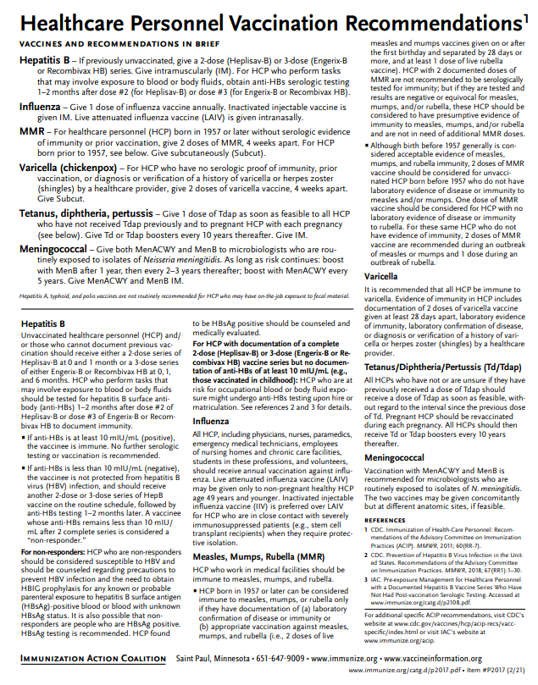
Recommended Healthcare Personnel Vaccinations
Hepatitis B (exposure risk) check immunity
Influenza (annual)
Measles, Mumps, Rubella (MMR)
Varicella (Chickenpox)
Tetanus, Diphtheria, Pertussis (Tdap)
Meningococcal (recommended for microbiologists who are routinely exposed to isolates of N. meningitidis).
COVID-19 vaccine
Are YOU up to date?
Available at www.immunize.org, P#2017
Notes:
Un-immunized HCP
Un-immunized healthcare workers are at risk of infecting patients, family members and community contacts
Immunized HCP
Protect patients from VPD’s
Help offices avoid potential liability cases. (The practice can be liable if an unimmunized HCP becomes infected with a vaccine preventable disease and infects a patient.)
Maintain productivity
Reduce illness and illness-related absenteeism
Evidence of Immunity to MMR
Documented administration of two doses of measles and mumps vaccine and one dose of rubella vaccine OR
Laboratory evidence of immunity or laboratory confirmation of disease (measles, mumps and rubella) OR
Born before 1957 (measles, mumps and rubella)
Because of their contact with patients or infective material from patients, many HCP are at risk for exposure to (and possible transmission of) vaccine-preventable diseases. Employers and HCP have a shared responsibility to prevent occupationally acquired infections and avoid causing harm to patients by taking reasonable precautions to prevent transmission of vaccine-preventable diseases.
Optimal use of recommended vaccines helps maintain immunity and safeguard HCP from infection, thereby helping protect patients from becoming infected. The recommendations for vaccination of HCP are presented in two categories: 1) those diseases for which routine vaccination or documentation of immunity is recommended for HCP because of risks to HCP in their work settings and, should HCP become infected, to the patients they serve and 2) those diseases for which vaccination of HCP might be indicated in certain circumstances. Vaccines recommended in the first category are hepatitis B, seasonal influenza, measles, mumps, and rubella, pertussis, and varicella vaccines. Vaccines in the second category are meningococcal, typhoid, and polio vaccines.

Slide 68

Hepatitis B Immunization Status for Previously Vaccinated HCP with No Post-vaccination Testing*
Positive antibody (anti-HBs) = ≥10 mIU/ml
Adequate
Yes
I dose vaccine—retest 4-6 wks.
Yes
Complete vaccine series—retest 4-6 wks.
Yes
Document positive antibody status
No need for Hepatitis B prophylaxis, regardless of source patient Hep B surface antigen status
NO
NO
NO
Document as “non-responder”
Test for HBsAg and anti-HBc (core antigen) to determine infection status
*MMWR, April 20, 2018/Vol. 67/No. 15

Slide 69
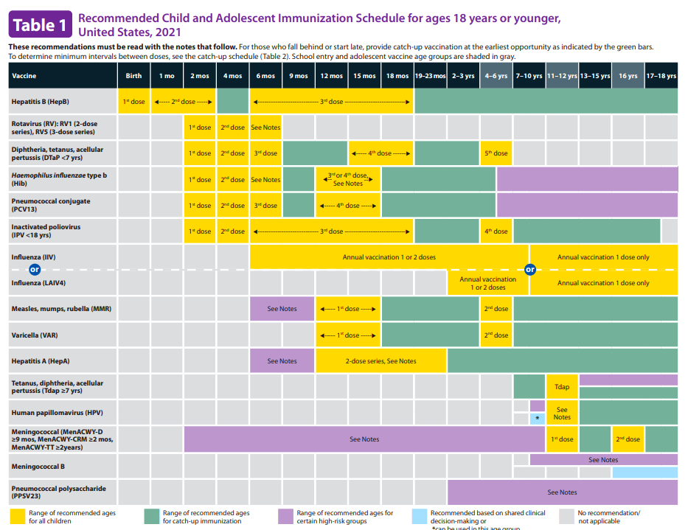
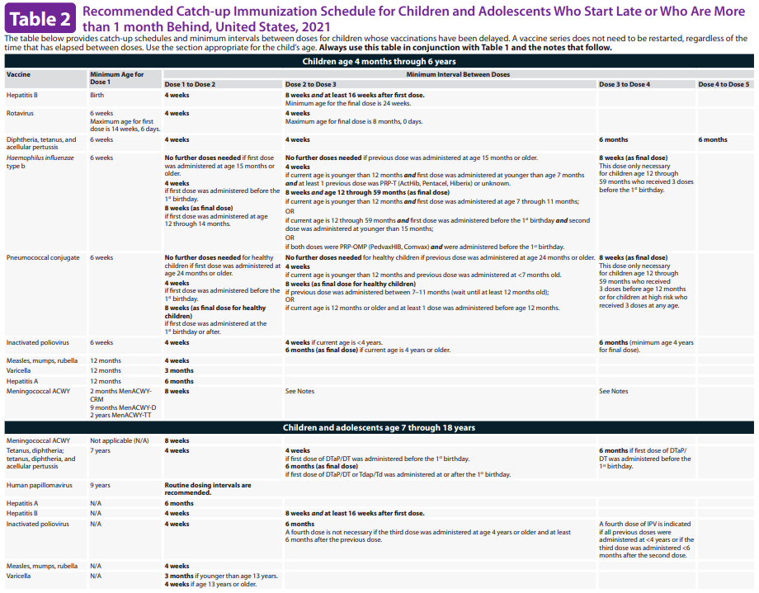
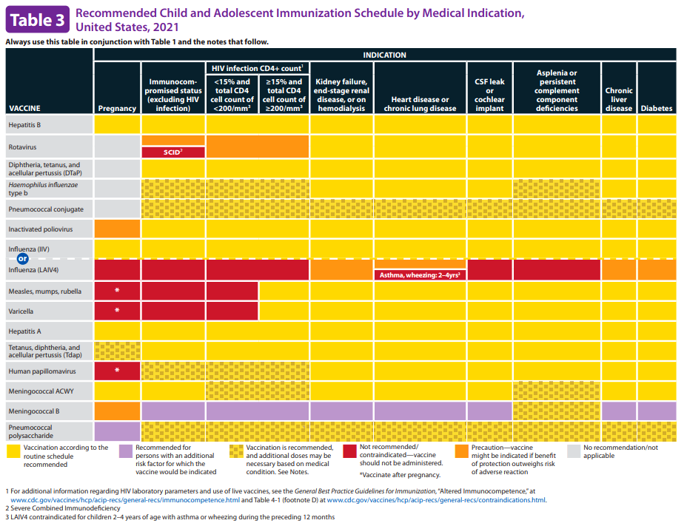
2022 Childhood and Adolescent Immunization Schedules*
Recommended Schedule for Children Ages 0-18 Years
Catch-up Schedule
Vaccines that might be indicated for children and adolescents aged 18 years or younger based on medical indications
Changes
Clarification of the charts
Additional information in the Notes section
READ THE FOOTNOTES TO ACCESS SPECIFIC VACCINE ADMINISTRATION DETAILS!
https://www.cdc.gov/vaccines/schedules/hcp/imz/child-adolescent.html

Slide 70
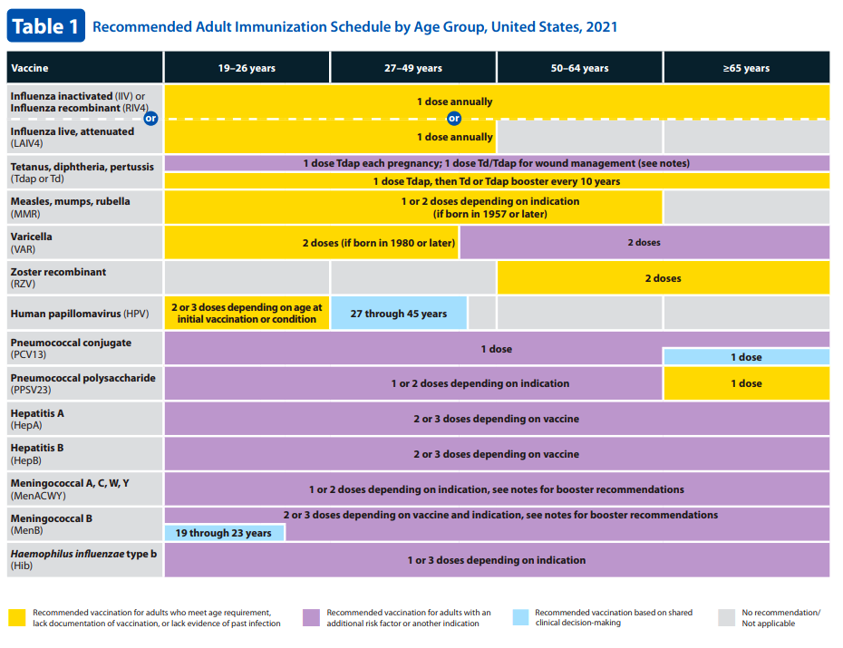
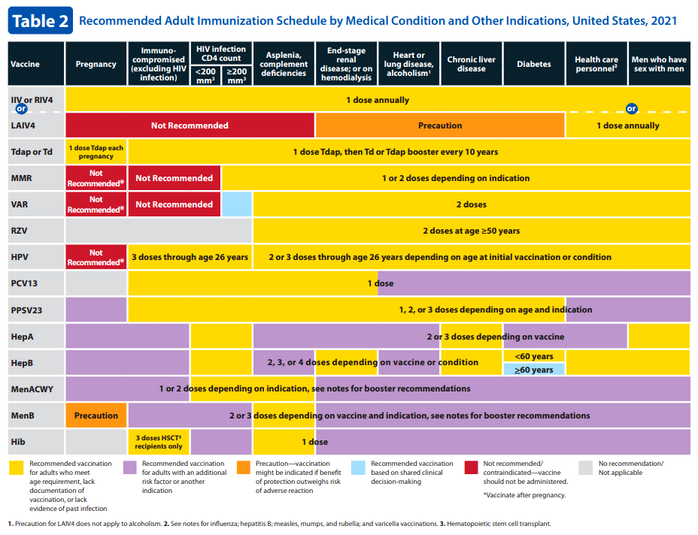
2022 Recommended Immunization Schedule for Adults Aged ≥19 Years*
Recommended adult schedule by age group
Recommended immunization schedule for adults aged 19 years or older by medical condition and other indications
Changes
Clarification of the charts
Additional information in the Notes section
READ THE FOOTNOTES TO ACCESS SPECIFIC VACCINE ADMINISTRATION DETAILS!
https://www.cdc.gov/vaccines/schedules/hcp/imz/adult.html

Slide 71


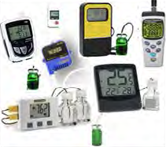
Updated Vaccine Storage and Handling Recommendations*
Use stand-alone refrigerator and stand-alone freezer units. If combined, use only refrigerator part.
Do not store any vaccine in a dormitory-style or bar-style combined refrigerator/freezer unit.
Use a bio-safe glycol-encased probe or a similar temperature buffered probe
Probes should be calibrated every 1-2 yrs. or according to manufacturers’ guidelines
Use digital data loggers.
Do not store ANYTHING ELSE in refrigerator.
Review vaccine expiration dates and rotate vaccine stock weekly.
*Vaccine Storage and Handling Toolkit, January, 2020
Notes:
It is estimated that 17-37% of immunization providers expose vaccines to improper storage temperatures. More commonly, refrigerators are kept too cold rather than too warm. The potency of vaccines stored at incorrect temperatures may be irreversibly reduced. A physical change in the vaccine may not be apparent.
Remember: if you find temperatures out of range, TAKE ACTION, DO SOMETHING ABOUT IT!

Slide 72
Maintaining Appropriate
Vaccine Storage & Handling*
Assign a primary and alternate vaccine coordinator.
Store all vaccines as recommended by manufacturer and IN ORIGINAL PACKAGING, WITH THE LID CLOSED.
Monitor and record temperatures of refrigerator and freezer twice daily.
Correct ranges: refrigerator 36° F to 46° F; freezer -58° F to +5° F
Maintain temperature log records for 3 years.
Take immediate action for all out-of-range temps.
Implement a vaccine emergency system.
If it is necessary to transport vaccine, do NOT use dry ice. See Vaccine Storage and Handling Toolkit, Section 6 for Transport System Recommendations.
For COVID-19 vaccine, see specific vaccine guidelines.
*Vaccine Storage and Handling Toolkit, January 2020
Notes:
Remember: if you find temperatures out of range, TAKE ACTION, DO SOMETHING ABOUT IT!

Slide 73
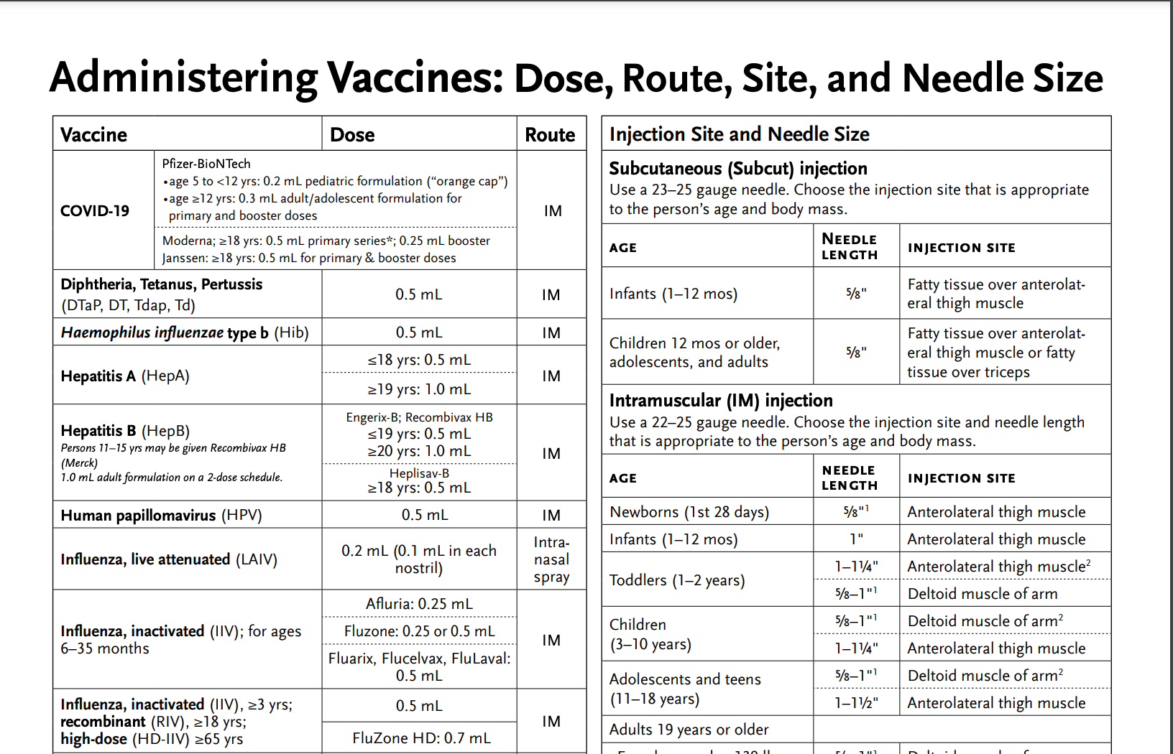
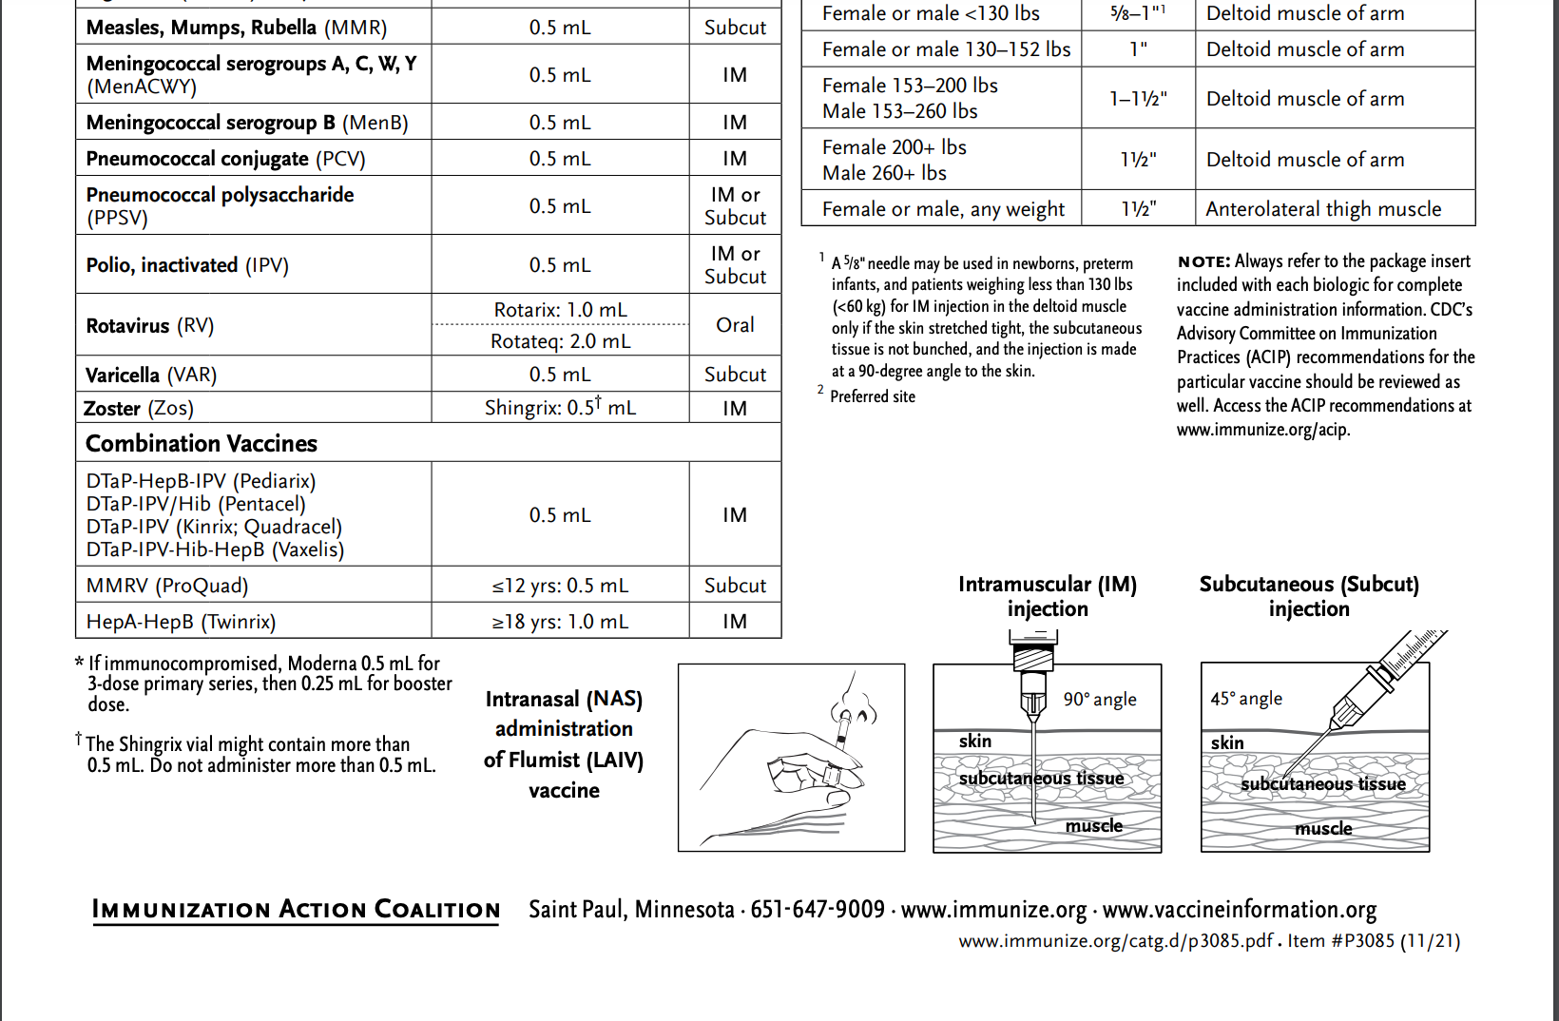
Vaccine Administration Best practices – Route, Dose, Site, Needle Size
https://www.immunize.org/catg.d/p3085.pdf
Notes:
Always verify the dose, route, site and needle size.

Slide 74
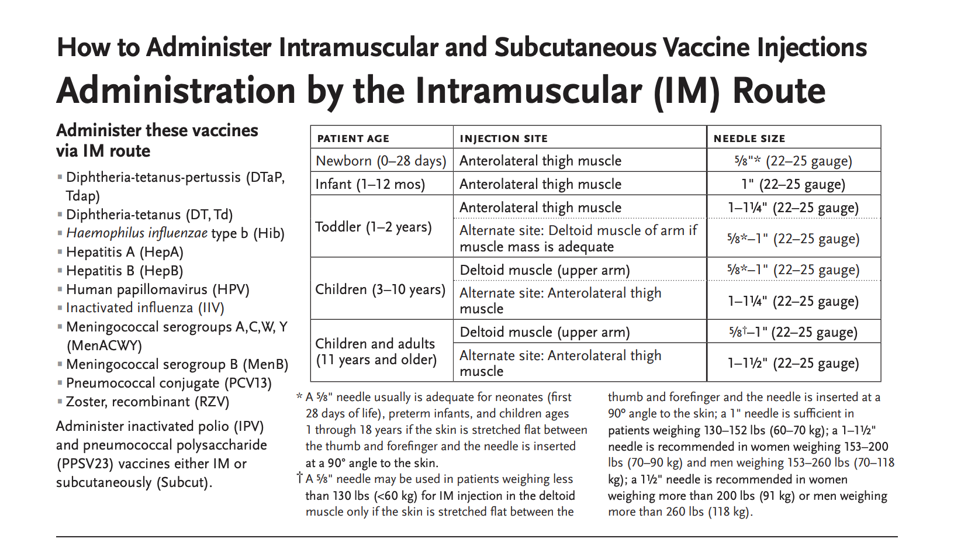
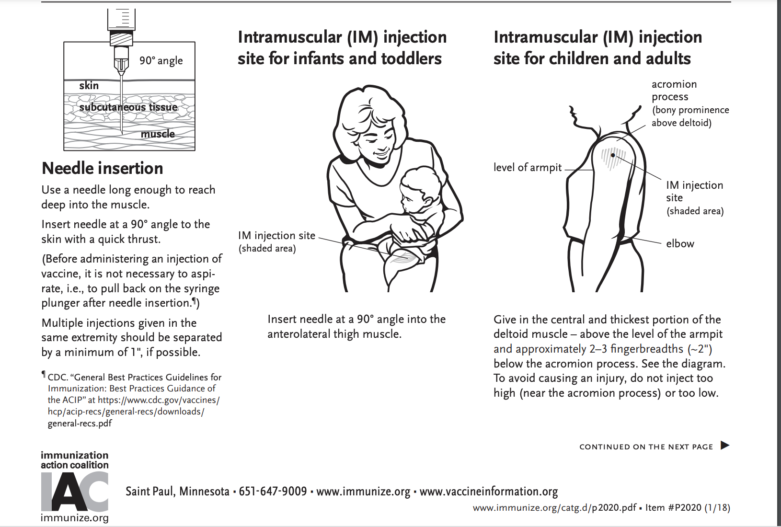
How to administer IM and SC vaccine injections
https://www.immunize.org/catg.d/p2020.pdf

Slide 75
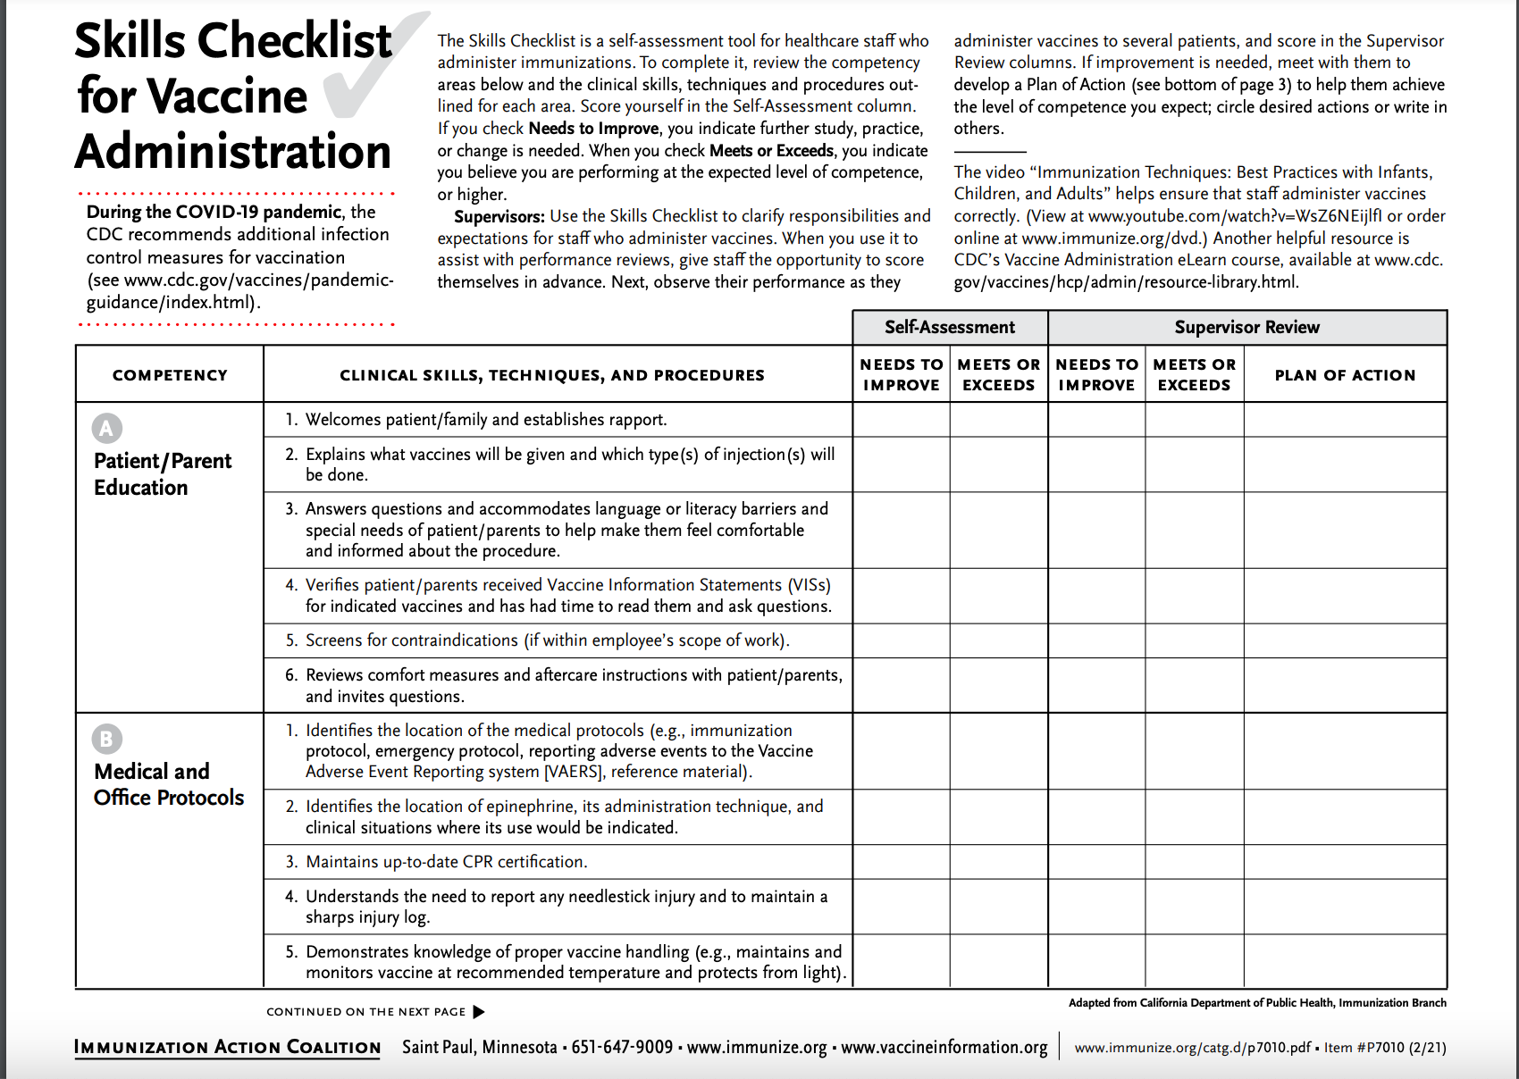
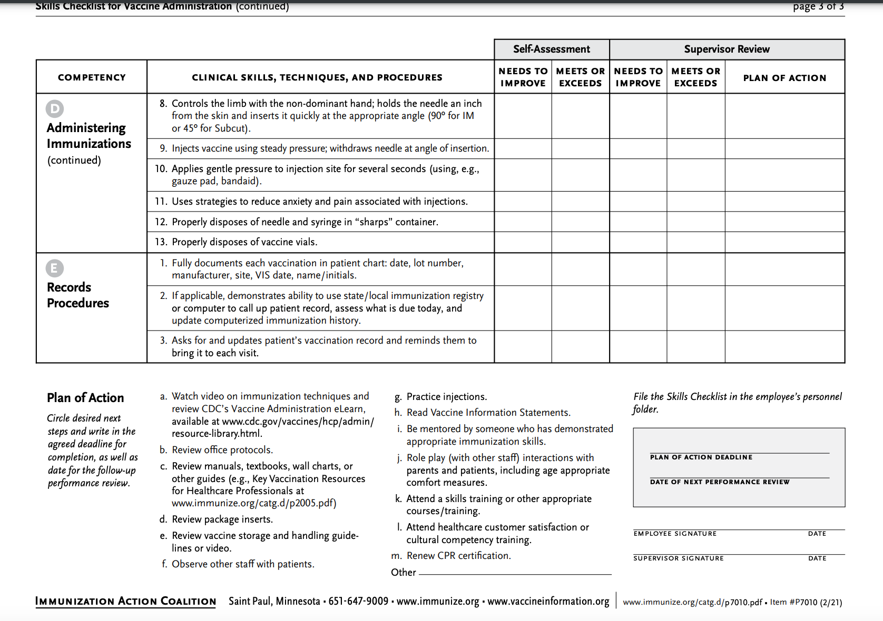
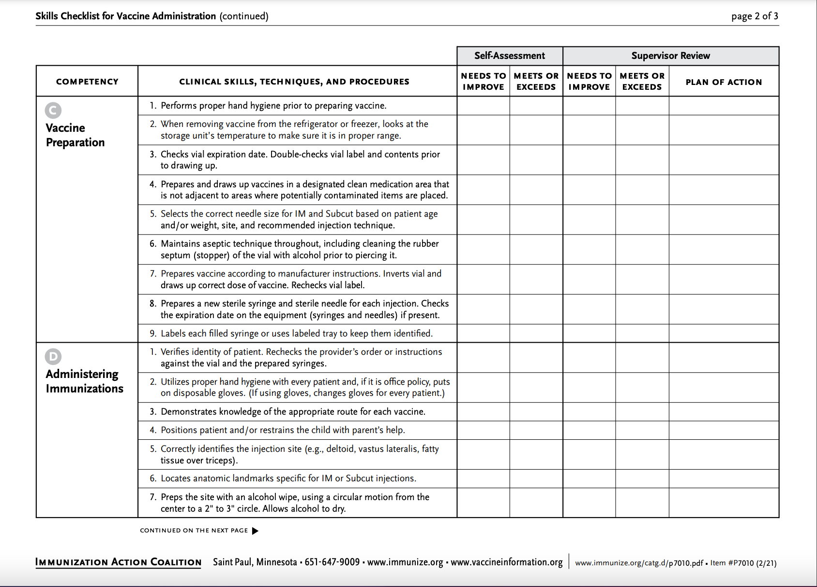
Training Tools: Skills Checklist for Vaccine Administration
https://www.immunize.org/catg.d/p7010.pdf

Slide 76
Improper Immunization Administration
Practices with Any Vaccine*
DO NOT re-use needles or syringes, due to the possibility of:
  Transmission of blood-borne viruses (HCV, HBV, HIV)
  Referral of providers to licensing boards for disciplinary action
  Malpractice suits filed by patients
Never use partial doses from 2 or more vials to obtain a dose of vaccine.**
Per OSHA and the CDC, you MAY use the same needle to withdraw a diluent, inject this into a lyophilized vaccine vial, and then administer to a patient, providing the needle or syringe has not otherwise been contaminated.**
*CDC, NCEZIZ, DHQP. Injection Safety Information for Providers: www.cdc.gov/injectionsafety/providers.html
**http://www.immunize.org/askexperts/administering-vaccines.asp
**Vaccine Storage and Handling Toolkit, January, 2020
Notes:
Per OSHA and the CDC, changing needles between drawing vaccine from a vial and injecting it into a recipient is not necessary unless the needle has been damaged or contaminated.

Slide 77
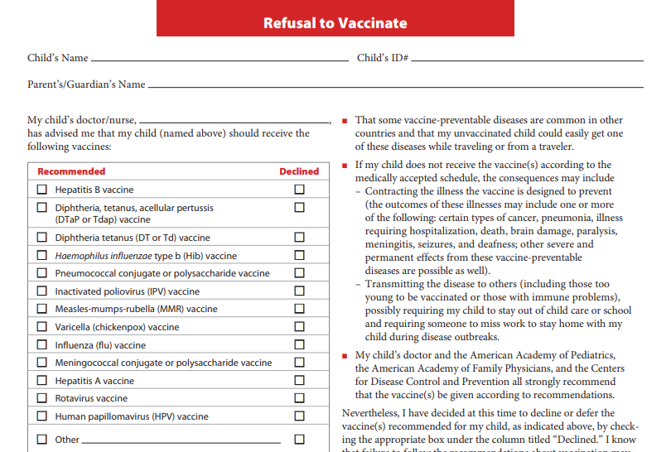
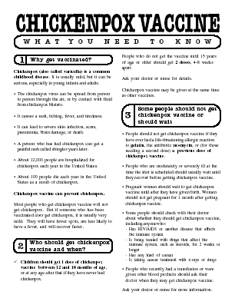
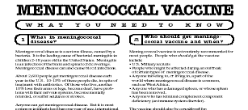
Always Document…
Accept only written documentation of prior immunizations
Provide VIS prior to administration of vaccine
After vaccine administration, document:
  Publication date of VIS & date VIS given
  Date, site, route, antigen(s), manufacturer, lot #
  Person administering vaccine, practice name and address
  Vaccine refusals with a signed “Refusal to Vaccinate Form”—see Online Resources slide for link to this form
  GA law does not require signed consent for immunizations
Notes:
Vaccine Information Sheets
VIS required by law for each vaccine given and each time that vaccine is given. The most current VIS must be used. For VIS statements in English and many other languages: www.immunize.org; www.cdc.gov/vaccines/ or call the National Immunization Program Information Hotline at 800-CDC-INFO (800-232-2522).
VIS can be provided at the same time or prior to allow time for questions and educate the parent/client about the vaccine.
Document all information listed on slide. Information will also be helpful if a specific lot of vaccine is recalled in the future.
Refusal to consent for an immunization should be documented for liability purposes and chart completeness. There is no way to document this in GRITS.
Georgia recognizes only medical and religious exemptions.
Medical exemptions must be documented in GRITS and be re-evaluated every year.
Georgia law does not require signed consent for immunization. Patients, parents or legal guardians may verbally consent to immunization. However, some practices may require written consent for all medical care.

Slide 78

A ‘Birth to Death’ Immunization Registry
Providers administering vaccines in Georgia must provide appropriate information to GRITS.
GRITS personnel can work with your EHR/EMR vendor to create an interface between your system and GRITS.
Use GRITS to generate reminders on medical records and/or notify patients when vaccines are needed.
Assess your immunization rates using GRITS to improve patient care, HEDIS scores, and identify problem areas.
Call the GRITS Training Coordinator (404) 463-0807 or e-mail : https://dph.georgia.gov/georgia-immunization-registry-grits
Notes:
In 2004, House Bill 1526 was passed making the Georgia Immunization Registry a birth to death registry mandating that providers of immunizations in Georgia report those immunizations into the registry database. Immunization data may now be shared by all providers of immunizations to Georgians of any age, and to schools, daycares, colleges and universities, and long term care facilities. The patient (age 18 or older) or parent or legal guardian may OPT-OUT of the registry.
Contact GRITS to enroll: 1-888-223-8644
Benefits of GRITS include: accurate immunization records, inventory tracking, reduction in missed opportunities or over-immunization, generation of school entrance forms/college immunization forms, reminder/recall notices for parents, assistance in generating reporting of immunizations to HEDIS/COCASA, and elimination of phone calls to providers for immunization records. The GRITS program is web-based. New users to the system will have to attend a training session and receive a password.
Advantages of a statewide registry are as follows:
Benefits to the Community
Enhance the overall health status by facilitating identification of inadequately immunized segments of the population
Decrease occurrence of over-immunization due to inability to locate past records
Assist in issuing reminders to patients for pending and overdue immunizations
Benefits to Healthcare Providers
Reduce staff time needed to obtain complete immunization history of patients
Provide printouts of school certificates
Provide vaccine information and simplify complex and dynamic immunization schedules
Streamline vaccine inventory process
Generate HEDIS and other reports
Reinforce the concept of a medical home
Benefits to Public Health Officials
Provide an accurate measure of immunization rates for districts, counties, and the state
Allow Georgia healthcare providers to update and exchange immunization information about their patients in a confidential manner
Facilitate community outreach programs
The Georgia Code 31-12-3.1, which took affect July 1, 1996 and House Bill 1526, which took affect July 1, 2004 states:
Any person who administers a vaccine or vaccines licensed for use by the United States Food and Drug Administration to a person shall, for each such vaccination, provide to the department such data as are deemed by the department to be necessary and appropriate for purposes of the vaccination registry established pursuant to subsection (a) of this Code section…

Slide 79
Exemptions From School/Day Care Requirements
Medical Exemption O.C.G.A. §20-2-771(d)
Used when a physical disability or medical condition contraindicates a particular vaccine.
Requires an annual review.
The medical exemption is documented in GRITS.
Religious Exemption O.C.G.A. §20-2-771(e)
Parent or guardian must be directed to http://dph.georgia.gov/immunization-section to obtain an Affidavit of Religious Objection to Immunization form.
This form must be signed and notarized and provided to the school.
Must be kept on file at school/facility in lieu of an immunization certificate.
Affidavit does not expire.
Georgia does NOT have a philosophical exemption.
Notes:
Medical exemptions should be entered in GRITS and will be listed on the immunization certificate. Medical exemptions must be reviewed on an annual basis.
Georgia now has an Affidavit of Religious Objection to Immunization form that must be filled out for if the parent is refusing immunizations due to a religious exemption. See URL on slide.
The form lists all vaccines that are required for admittance into childcare facilities or schools in Georgia. It confirms the safety of vaccines. The form also states that risks if a child is not vaccinated such as, contracting vaccine preventable diseases and spreading them to others. Lastly the form mentions the exclusion of the child from childcare or school during an epidemic or outbreak of a vaccine preventable disease.
The form must be signed and notarized. It does not expire and must be kept on file at the school or childcare facility.

Slide 80
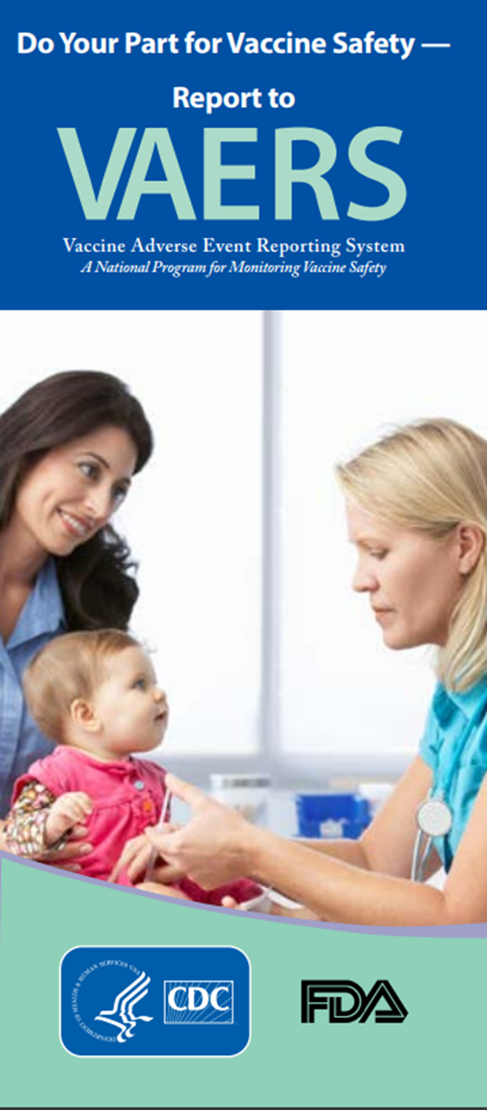
Monitoring Vaccine Safety
VAERS—Vaccine Adverse Event Reporting System
Option 1 - Report Online to VAERS (Preferred)
Submit a VAERS report online. The report must be completed online and submitted in one sitting and cannot be saved and returned to at a later time. Your information will be erased if you are inactive for 20 minutes; you will receive a warning after 15 minutes.
Option 2 - Report using a Writable PDF Form
Download the Writable PDF Form to a computer. Complete the VAERS report offline if you do not have time to complete it all at once. Return to this page to upload the completed Writable PDF form by clicking here.
If you need further assistance with reporting to VAERS, please email info@VAERS.org or call 1-800-822-7967.
FDA and Vaccine Data Link Safety Project
VERP: VACCINE ERROR REPORTING SYSTEM
  On line reporting at http://verp.ismp.org/
  Report even if no adverse events associated with incident
  Will help identify sources of errors to help develop prevention strategies
Notes:
Nothing is 100% risk free. Most reactions to vaccines are mild with very small risk of severe allergic reactions (anaphylaxis).
Systems in place to monitor safety include the FDA (pre and post licensure monitoring) and the Vaccine Safety Datalink (VSD) Project. This large project links 4 HMO's at 10 sites with the CDC to monitor adverse events possibly caused by vaccines.
FDA monitors vaccines for safety before issuing licenses - very stringent licensing involving laboratory and human testing; vaccine safety is also monitored after licensure to ensure each vaccine lot is effective and pure. Vaccine manufacturers also do post-licensure monitoring.
The Institute of Medicine reviews research related to vaccine safety and publishes a report periodically.
VAERS
Updated system. Two options for reporting are outlined in the gray box.
Passive reporting system to monitor vaccine adverse events established by the National Childhood Vaccine Injury Act 1986
Mandates patients/ parents are educated about risk of vaccines and compensated for any injury caused by vaccine.
Emphasize there is no penalty for reporting an “adverse event”. The healthcare provider is only reporting that a specific event occurred after administration of a specific vaccine and is not claiming that the event was caused by the vaccine.
VERP – There is relatively little data available on why vaccine administration errors occur. The Institute for Safe Medication Practice (ISMP) has launched a national patient safety reporting program to capture the unique causes and consequences of vaccine –related errors. The ISMP National Vaccine Error Reporting Program (ISMP VERP) allows healthcare practitioners to report errors and near misses in confidence.
Sources of Vaccine Safety Information:
https://www.cdc.gov/vaccines/hcp/vis/index.html www.cdc.gov/vaccinesafety/
www.idsociety.org www.vaccinesafety.edu
www.acponline.org www.aap.org
www.aafp.org www.immunize.org
www.vaccine.chop.edu www.vaers.hhs.gov

Slide 81
Invalid Contraindications to Vaccine*
Mild illness or injury
Antibiotic therapy
Disease exposure or convalescence
Pregnancy or immunosuppression in household
Family history of an adverse event to a vaccine
Breastfeeding
Prematurity
Allergies to products not in vaccine
Need for TB skin testing
Need for multiple vaccines
*https://www.cdc.gov/vaccines/hcp/acip-recs/general-recs/index.html
Notes:
ANTIBIOTIC THERAPY
Antibiotics do not have an effect on the immune response to a vaccine. [Exception: The growth of the live Ty21, a strain of typhoid vaccine, is inhibited in vitro by various antibacterial agents. Some antibacterial agents may interfere with efficacy of Ty21 vaccine. CDC Yellow Book (Health Information for Travelers) recommends delaying vaccine >72 hours after any antibacterial agent. The Typhoid VIS recommends a delay of >24 hours.]
DISEASE EXPOSURE OR CONVALESCENCE
There is no evidence that either disease exposure or convalescence will affect the response to a vaccine or increase the likelihood of an adverse event.
PREGNANCY OR IMMUNOSUPPRESSION IN THE HOUSEHOLD OR BREASTFEEDING
Most vaccines, including live vaccines (MMR, varicella, and yellow fever) can be given to infants or children with pregnant or immunosuppressed household contacts, as well as to breast-feeding infants. Breastfeeding does not decrease the response to routine childhood vaccines and does not extend or improve passive immunity to vaccine-preventable disease provided by maternal antibody.
PREMATURE BIRTH
Vaccines should be started on schedule based on the child's chronological age. Studies demonstrate that decreased seroconversion rates might occur among certain premature infants with low birth weights (i.e., <2,000 grams) after administration of hepatitis B vaccine at birth. However, by one month chronological age, all premature infants, regardless of initial birthweight or gestational age are as likely to respond as adequately as older and larger infants.
NEED OR REQUIREMENT FOR TUBERCULOSIS SKIN TEST (PPD)
All vaccines, including MMR, can be given on the same day as a TB skin test, or any time after a TB skin test is applied. MMR vaccine may decrease the response to a TB skin test, potentially causing a false negative response in someone who actually has an infection with tuberculosis. If MMR has been given and one or more days have elapsed, in most situations it is recommended to wait 4-6 weeks before giving a routine TB skin test. No information on the effect of varicella vaccine on a TB skin test is available. It is prudent to apply rules for spacing measles vaccine and TB skin testing to varicella vaccine."
ADMINISTERING VACCINES TO HOUSEHOLD MEMBERS OF IMMUNOCOMPROMISED PATIENTS
Immunocompetent individuals who live in a household with immunocompromised patients can safely receive inactivated vaccines. They may also receive live virus vaccines such as MMR, varicella, rotavirus, zoster, yellow fever, and oral typhoid vaccines if indicated. LAIV should be avoided in some instances. (See Footnote 3).

Slide 82
Vaccine Risk Perception
Many parents of young children are not familiar with vaccine-preventable diseases and perceive the risks of vaccines outweigh the benefits
Concerns
  Immune system overload
  Children get too many shots at one visit
  Vaccines have side effects (adverse reactions)
  Immunity from the disease is better than immunity from a vaccine (i.e. chicken pox)
  Vaccines cause autism
Notes:
Vaccine Concerns
-One quarter of parents mistakenly believe that vaccines weaken the immune system.
-One quarter of parents believe that children get more immunizations than are good for them.
-On the plus side, the child's health care provider is seen as the most important source for immunization information. (Gellin, B., et.al. "Do parents understand immunizations? A national telephone survey." Pediatrics, 106(5); 1097-1102).
Answers to common concerns about vaccines
Vaccines do not weaken the immune system (we give a small antigen load even at peak times/ages in the vaccine schedule)
Natural immunity is not better than vaccines (ex: shingles in those who have had chicken pox natural illness)
Vaccine-preventable diseases are serious illnesses with the possibility of complications and even death
Well controlled studies during the past 10 years have failed to show any association between MMR vaccine or thimerosal and autism. However, many anti-vaccine groups continue to promote the association of autism and MMR vaccine and the dangers of thimerosal.
For more information about these topics (and others of concern to parents/patients) visit http://www.cdc.gov/vaccinesafety/

Slide 83
Provider Strategies to Improve Vaccination Rates*
Strengthening vaccination recommendations
  Increased emphasis in the practice on training re: vaccine safety and efficacy for ALL employees having patient contact
  Having OB doctors begin the promotion of vaccines with expectant mothers, for themselves and for their newborn
  Be alert to avoid missed opportunities
  Decrease acceptance of alternative schedules
Strengthening vaccine mandates
  Eliminating nonmedical exemptions
  Increased enforcement of state mandates by schools and childcare facilities
*Children’s Hospital of Philadelphia, Vaccine Update for Healthcare Providers, “News & Views: Addressing Vaccine Hesitancy,” March 21, 2017

Slide 84
Provider Strategies* (cont’d)
Attention to requirements of “informed refusal”**
  Explain basic facts/uses of proposed vaccine
  Review risks of refusing the vaccine(s)
  Discuss anticipated outcomes with and without vaccination
  Parental/patient completion of Refusal to Vaccinate form each visit
Importance of documenting informed refusal to vaccinate**
  Claims of failure to warn of consequences of failing to vaccinate have resulted in successful lawsuits
  Documented informed refusal creates a record of interaction between parents/patients and providers
*Children’s Hospital of Philadelphia, Vaccine Update for Healthcare Providers, “News & Views: Addressing Vaccine Hesitancy,” March 21, 2017
**AAP Publications, “Document informed refusal just as you would informed consent,” James P. Scibilia, M.D. FAAP, October 30, 2018

Slide 85
Vaccine Schedules Varying From ACIP/AAP/AAFP Recommendations
Alternate Schedules
Dr. Bob’s Selective Vaccine Schedule
Dr. Bob’s Alternative Vaccine Schedule
Parent-derived schedules
Parent/caretaker refusal of all vaccines
Concerns re: alternate schedules
Alternate or delayed schedules have not been tested
No studies to prove they are safer
If any of these Alternate Schedules are requested, the health care provider and staff must spend additional time educating the parent/caretaker about the appropriate use of vaccines.
Notes:
Quote from:
The Problem With Dr Bob's Alternative Vaccine Schedule*
“For parents who are worried about vaccines, Sears offers 2 alternative schedules. One, titled “Dr Bob’s Selective Vaccine Schedule,” is for parents who want to decline or to delay vaccines. Children whose parents choose this schedule might not be receiving the measles, mumps, rubella, varicella, and hepatitis A vaccines and will not be receiving the polio and influenza vaccines or a booster dose of pertussis vaccine. The other schedule, titled “Dr Bob’s Alternative Vaccine Schedule,” is written for parents who worry that children are receiving too many vaccines too early. Children whose parents choose this schedule will not be receiving the influenza vaccine until 5 years of age (which is unfortunate, given that tens of thousands of children 4 years of age are hospitalized with complications resulting from influenza every year),(³⁴) will not be receiving the hepatitis B vaccine until 2.5 years of age, will not be receiving measles vaccine until 3 years of age, and, to space out vaccines so that children do not receive 2 shots at 1 visit, will be visiting the doctor for vaccines at 2, 3, 4, 5, 6, 7, 9, 12, 15, 18, 21, and 24 months and 2, 2.5, 3, 3.5, 4, 5, and 6 years of age. Increasing the number of vaccines, the number of office visits, and the ages at which vaccines are administered will likely decrease immunization rates. In addition to the logistic problem of requiring so many office visits, Sears’ recommendation might have another negative consequence; recent outbreaks of measles showed that several children acquired the disease while waiting in their pediatricians’ offices.⁽⁷⁾
At the heart of the problem with Sears’ schedules is the fact that, at the very least, they will increase the time during which children are susceptible to vaccine-preventable diseases. If more parents insist on Sears’ vaccine schedules, then fewer children will be protected, with the inevitable consequence of continued or worsening outbreaks of vaccine-preventable diseases. In an effort to protect children from harm, Sears’ book will likely put more in harm’s way.”

Slide 86




Anti-Vaccine Movement
Promotes the idea that there is less evidence of disease today and immunizations are no longer needed
Sends confusing & conflicting information
Uses stories, personal statements, and books to play on the emotional side of concerned parents
Encourage parents/patients to:
  Get the facts
  Consider the source
  Discuss their concerns with you
Global Vaccine Awareness League
Notes:
Anti-vaccine issues have been around since the early 1800's.
Most patients/parents haven't seen the diseases so are more concerned about vaccine risk
Media portrays tragedies with emotional appeal
Web sites with anti-immunization information are plentiful with little scientifically-based vaccine information
Address any concerns and questions your patients may have
Anti-Vaccine web sites:
This is just a small list of the many sites available on the internet for anti-vaccine promotion. Please be sure to check some of these locations so that you are aware of the type on information that can be obtained from these sites.
For “Evaluating Information on the Web”
go to http://www.vaccineinformation.org/internet-immunization-info/

Slide 87










Resources for Factual & Responsible
Vaccine Information
www.vaccinesafetynet.org
Notes:
These are sources for scientific and credible information
See information sheet in participant packet
https://www.cdc.gov/vaccinesafety/index.html
www.idsociety.org/Immunization/
www.who.int
www.gaaap.org
www.aap.org
www.cispimmunize.org
www.aafp.org
www.acponline.org
www.immunize.org/resources This site is a good resource for healthcare providers and for information written specifically for patient and parents.
www.nfid.org Great resources for immunization for healthcare professionals; Webinars
www.pkids.org (support and counseling for children with infectious diseases)
www.vaccine.org

Slide 88

Stay Current!
Sign up for listserv sites which provide timely information pertinent to your practice www.immunize.org/resources/emailnews.asp
  AAP Newsletter
  CDC immunization websites (32 in all)
  CHOP Parents Pack Newsletter
  IAC Express, Needle Tips and Vaccinate Adults
  Websites specific to particular vaccines

Slide 89

YOU ARE ALL PART OF THE TEAM THAT CAN
MAKE SURE YOUR PATIENTS RECEIVE THE
IMMUNIZATIONS THEY NEED!

Slide 90
Online Resources*
Current Childhood and Adult Immunization Schedules – www.cdc.gov/vaccines/schedules/index.html
Parent’s Guide to Childhood Immunizations – www.cdc.gov/vaccines/parents/tools/parents-guide/index.html
Order Information for Free CDC Immunization Materials for Providers and Patients – wwwn.cdc.gov/pubs/CDCInfoOnDemand.aspx
Vaccine Labels to Organize a Storage Unit – www.cdc.gov/vaccines/hcp/admin/storage/guide/vaccine-storage-labels.pdf
*Course Resource—Epidemiology & Prevention of Vaccine-Preventable Diseases—C296544-E

Slide 91
Vaccine Information Statements (VISs) –www.cdc.gov/vaccines/hcp/vis/current-vis.html
Refusal to Vaccinate Form –
https://www.aap.org/en-us/documents/immunization_refusaltovaccinate.pdf
Standing Orders (Explanation and Templates) – www.immunize.org/standing-orders/
Ask the Experts – www.immunize.org/askexperts/
General Best Practice Guidelines for Immunization – https://www.cdc.gov/vaccines/hcp/acip-recs/general-recs/index.html
*Course Resource—Epidemiology & Prevention of Vaccine-Preventable Diseases—C296544-E

Slide 92
Questions?
Contacts for more immunization information and resources!
National Center for Immunization and Respiratory Diseases, CDC
E-mail ► NIPInfo@cdc.gov
Hotline 800.CDC.INFO
Website http://www.cdc.gov/vaccines
Georgia Immunization Program
E-mail DPH-Immunization@dph.ga.gov
Hotline 404-657-3158
Website http://dph.georgia.gov/immunization-section
Immunization Action Coalition
E-mail admin@immunize.org
Phone 651.647.9009
Website www.immunize.org
Notes:
NIPInfo email site can provide answers to specific questions about immunizations. Experts from the CDC will respond to questions Monday through Fridays in 24 to 48 hours or sooner. It is not a practical source of information if the practitioner has a patient in an exam room waiting for an immunization. However, it a great source for information you can not find in the Pink Book or on the CDC web site.

Slide 93
Test Your Knowledge!
EPIC 2022

Slide 94
Test Your Knowledge!
Four month old Lucas was given Tdap instead of DTaP.
What should be done?

Slide 95
Test Your Knowledge!
Four month old Lucas was given Tdap instead of DTaP.
What should be done?*
If Tdap was inadvertently given to a child under age 7 years:
It should not be counted as either the first, second, or third dose of DTaP.
The dose should be repeated with DTaP. Continue vaccinating on schedule.
If the dose of Tdap was administered for the fourth or fifth DTaP dose, the Tdap dose can be counted as valid.
Please remind your staff to always check the vaccine vial at least 3 times before administering any vaccine.
*Immunization Action Coalition, Ask the Experts - Reviewed July 2014

Slide 96
Test Your Knowledge!
Five-year-old Tonia received her second MMR a week ago.
How long should she wait before receiving live varicella zoster vaccine?

Slide 97
Test Your Knowledge!
Five-year-old Tonia received her second MMR a week ago.
How long should she wait before receiving live varicella zoster vaccine?*
Live vaccines can be administered simultaneously with another live vaccine (for example MMR, varicella),but if not given at the same visit, ACIP recommends waiting 4 weeks before administering the second live vaccine.
*Immunization Action Coalition, Ask the Experts - Reviewed January 2017

Slide 98
Test Your Knowledge!
Logan is an 8 year old boy who has never had DTaP vaccine. His mother was hesitant to immunize him when he was younger. Now she is willing to have him immunized.
What vaccine would you use to immunize him against diphtheria, tetanus and pertussis?

Slide 99
Test Your Knowledge!
Logan is an 8 year old boy who has never had DTaP vaccine. His mother was hesitant to immunize him when he was younger. Now she is willing to have him immunized.
What vaccine would you use to immunize him against diphtheria, tetanus and pertussis?
Logan should receive the following (either Td or Tdap may be used for Dose 2 and/or 3)*:
Dose 1---Tdap
Dose 2 ---Td or Tdap 4 weeks after Dose 1
Dose 3 ---Td or Tdap 6 months after Dose 2
An additional Tdap should be given at age 11-12.
*MMWR, January 24, 2020/ Vol.69/No.

Slide 100
Test Your Knowledge!
Emily is 12 years old and comes to your office for a physical exam. Her immunizations were up-to-date when she started kindergarten.
What vaccines do you recommend for her?

Slide 101
Test Your Knowledge!
Emily is 12 years old and comes to your office for a physical exam. Her immunizations were up-to-date when she started kindergarten.
What vaccines do you recommend for her?*
Tdap, Meningococcal Conjugate, HPV
Influenza vaccine (in the fall)
*Current Child and Adolescent Immunization Schedule
Notes:
.

Slide 102
Test Your Knowledge!
Simon received MPSV4 at 5 years of age for international travel and a dose of MCV4 at age 11.
Does he need a booster dose of MCV4 vaccine at age 16?

Slide 103
Test Your Knowledge!
Simon received MPSV4 at 5 years of age for international travel and a dose of MCV4 at age 11.
Does he need a booster dose of MCV4 vaccine at age 16?*
Yes. Any meningococcal vaccination given prior to the tenth birthday (either with MCV4 or MPSV4) does NOT count toward routinely recommended doses.
*Immunization Action Coalition, Ask the Experts - Reviewed September 2013

Slide 104
Test Your Knowledge!
Ethan is 17 years old. After his second DTP vaccine at 4 months of age he cried persistently for 4 hours, had a fever of 104°F, and developed a severe local reaction at the injection site.
His pediatrician subsequently administered DT at 6 months, 18 months and 5 years of age. He received Td when he was 12 years old.
With this history of a severe reaction to pertussis vaccine, should he receive Tdap?

Slide 105
Test Your Knowledge!
Ethan is 17 years old. After his second DTP vaccine at 4 months of age he cried persistently for 4 hours, had a fever of 104°F, and developed a severe local reaction at the injection site.
His pediatrician subsequently administered DT at 6 months, 18 months and 5 years of age. He received Td when he was 12 years old.
With this history of a severe reaction to pertussis vaccine, should he receive Tdap?*
Yes, administer Tdap. These adverse reactions in infancy are not contraindications or precautions for Tdap vaccination in adolescents.
*Preventing Tetanus, Diphtheria, and Pertussis Among Adolescents: Use of Tetanus Toxoid, Reduced Diphtheria Toxoid and Acellular Pertussis Vaccines MMWR Recommendations and Reports March 24, 2006 / Vol. 55 / No. RR-3

Slide 106
Test Your Knowledge!
Dakota is an 18 year girl who will be starting her first year of college in August. She had her first dose of HPV vaccine on April 5 and her second dose on May 8. She will not be coming home again until late November.
Should you give her the third dose of HPV vaccine before she leaves home in mid August?

Slide 107
Test Your Knowledge!
Dakota is an 18 year girl who will be starting her first year of college in August. She had her first dose of HPV vaccine on April 5 and her second dose on May 8. She will not be coming home again until late November.
Should you give her the third dose of HPV vaccine before she leaves home in mid August?*
No! The minimum interval between the second and third doses of vaccine is 12 weeks. The minimum interval between the first and third doses is 24 weeks.
*Immunization Action Coalition, Ask the Experts, April 2012

Slide 108
Test Your Knowledge!
Ben is a 25-year-old plumber. Three months ago he had a motorcycle wreck causing multiple fractures, lacerations, and a ruptured spleen. His spleen was removed. He received Td in the ER.
He had chicken pox when he was 6 years old but has no idea if he ever had an MMR.
What vaccines do you recommend?

Slide 109
Test Your Knowledge!
Ben is a 25-year-old plumber. Three months ago he had a motorcycle wreck causing multiple fractures, lacerations, and a ruptured spleen. His spleen was removed. He received Td in the ER.
He had chicken pox when he was 6 years old but has no idea if he ever had an MMR.
What vaccines do you recommend?*
Tdap, MCV4, MenB, PCV13, PPSV23, MMR, and consider Hib
Influenza vaccine (in fall)
HPV?
(PCV13 and PPSV23 should be administered at least 8 weeks apart.)**
*Adult Immunization Schedule **Immunization Action Coalition, Ask the Experts- Needle Tips; September 2009
Notes:
Answer: Tdap. MCV4, MenB, PCV13, and PPSV23 because he is asplenic. He can be offered HPV (this is an ACIP permissive recommendation)
Excerpt from Ask the Experts
What vaccines are indicated for someone who has had a splenectomy, and is there concern that they may have a less than optimum response to vaccines?²
Regarding which vaccines are indicated: People who do not have a functioning spleen or who have had a splenectomy do not handle encapsulated bacteria well and, therefore, are at increased risk for infection with encapsulated bacteria, especially Neisseria meningitidis, Streptococcus pneumoniae, and Haemophilus influenzae type b. They should be vaccinated with age-appropriate pneumococcal, meningococcal, and possibly Hib vaccines. Regarding immune response to vaccines: Immunosuppression is not an issue unless the patient has other health issues or treatments that are suppressing the immune system. Their response to vaccination should not be affected by the lack of a functioning spleen. In addition to receiving their routine vaccinations, children and adults without a functioning spleen who are age 2 years and older should receive 1 dose of pneumococcal polysaccharide vaccine (PPSV) and 1 dose of meningococcal conjugate vaccine (MCV4). MPSV4 should be used for adults age 56 and older who have not previously received meningococcal vaccine and anticipate requiring a single dose, such as international travelers and persons at risk as a result of a community outbreak of meningococcal disease. ACIP recommends off-label use of MCV4 for persons age 56 years and older who were previously vaccinated with MCV4 and require revaccination or for whom multiple doses are anticipated, such as persons with asplenia and microbiologists. Men B is also recommended because he is asplenic. Although Haemophilus influenzae type b (Hib) vaccine generally is not recommended for people age 5 years and older, studies suggest good immunogenicity in patients who have had a splenectomy. Giving 1 pediatric dose of Hib vaccine to these patients who have not previously received Hib vaccine is not contraindicated. Ideally, PPSV, meningococcal, and Hib vaccines should be administered at least 2 weeks before a scheduled splenectomy, if possible. If vaccines are not administered before surgery, they should be administered as soon as the person’s condition stabilizes post-operatively.

Slide 110
Test Your Knowledge!
Paige is 24 years old. She has well controlled diabetes. She will be getting married in 3 months. Paige has received 2 doses of MMR and her last Td was 4 years ago. She denies ever having chicken pox but her 2 younger siblings had chicken pox.
What vaccines are recommended now?

Slide 111
Test Your Knowledge!
Paige is 24 years old. She has well controlled diabetes. She will be getting married in 3 months. Paige has received 2 doses of MMR and her last Td was 4 years ago. She denies ever having chicken pox but her 2 younger siblings had chicken pox.
What vaccines are recommended now?*
Tdap, PPSV23, hepatitis B, HPV, varicella
Influenza vaccine (in fall)
*Current Adult Immunization Schedule
Notes:
Tdap
Pneumococcal (PPSV23) and hepatitis B vaccine because of her diabetes.
HPV
Seasonal Influenza
Varicella
MMR? No.
Hepatitis A? No
Meningococcal? No
One point for discussion:
Before administering a two dose series of varicella vaccine the health-care provider should suggest that Paige ask her parent(s)/other relative if she had chicken pox as a child. If her two younger siblings had chicken pox and she did not develop chicken pox at the same time it is likely she had chicken pox previously. If her parents do not remember her having the disease or the history of chicken pox is not reliable or questionable she should be immunized with varicella vaccine.
The ACIP recommends Hepatitis B vaccine for unvaccinated adults with diabetes mellitus ages 19 through 59 years. Hepatitis B vaccine may be administered to those age 60 years and older at the discretion of the treating clinician. (MMWR/December 23, 2011/Vol.60/No. 50)

Slide 112
Test Your Knowledge!
Sam is a 32 year old carpenter. He punctured the palm of his hand with one of his tools at 6pm Friday. The injury caused minimal bleeding and he says it doesn’t need stitches.
Does he need tetanus vaccine tonight or can he wait until Monday when your office is open?

Slide 113
Test Your Knowledge!
Sam is a 32 year old carpenter. He punctured the palm of his hand with one of his tools at 6pm Friday. The injury caused minimal bleeding and he says it doesn’t need stitches.
Does he need tetanus vaccine tonight or can he wait until Monday when your office is open?*
The decision to delay a booster dose of tetanus toxoid following an injury should be based on the nature of the injury and likelihood that the injured person is susceptible to tetanus. If a tetanus booster is recommended he should receive Tdap if he has not received Tdap previously.
*Updated Recommendations for Use of Tetanus Toxoid, Reduced Diphtheria Toxoid and Acellular Pertussis (Tdap) Vaccine from the Advisory Committee on Immunization Practices, 2010 MMWR / January 14, 2011 / Vol. 60 / No. 1
Notes:
Answer:
ACIP has not addressed this issue specifically. Puncture wounds, however, should be attended to as soon as possible. The decision to delay a booster dose of tetanus toxoid-containing vaccine following an injury should be based on the nature of the injury and likelihood that the injured person is susceptible to tetanus. The more likely the person is to be susceptible, the more quickly that tetanus prophylaxis should be administered. A person with a tetanus-prone wound (e.g., punctures, wounds contaminated with soil or fecal material) and who has no history of tetanus immunization must be vaccinated with an age-appropriate dose of DTaP, Td, or Tdap and given tetanus immune globulin (TIG) as soon as possible. He should then complete the other doses of the vaccine series per schedule. A person with a documented series of at least three tetanus toxoid-containing products, with a booster dose within the previous 10 years ago is less likely to be susceptible to tetanus, and the need for a booster dose is not as urgent, particularly if the wound can be thoroughly cleaned. The more likely a person is to be completely susceptible to tetanus (i.e., unvaccinated or incompletely vaccinated), the sooner that TIG and Td/Tdap should be administered, even if it means a trip to the emergency department.
Ref: Immunization Action Coalition Ask the Experts (As of January 18, 2012)

Slide 114
Test Your Knowledge!
A 45-year-old patient will be traveling to Haiti for a mission trip. She doesn’t recall ever getting an MMR booster. She was immune to rubella when pregnant 20 years ago. Her measles titer is negative.
Would you recommend an MMR booster?

Slide 115
Test Your Knowledge!
A 45-year-old patient will be traveling to Haiti for a mission trip. She doesn't recall ever getting an MMR booster. She was immune to rubella when pregnant 20 years ago. Her measles titer is negative.
Would you recommend an MMR booster?*
ACIP recommends 2 doses of MMR given at least 4 weeks apart for any adult born in 1957 or later who plans to travel internationally. There is no harm in giving MMR vaccine to a person who may already be immune to one or more of the vaccine viruses.
*Immunization Action Coalition, Ask the Experts - Reviewed July 2014

Slide 116
Test Your Knowledge!
Lillian, a 50 year old grandmother, was given DTaP instead of Tdap.
Does she need to receive one dose of Tdap?

Slide 117
Test Your Knowledge!
Lillian, a 50 year old grandmother, was given DTaP instead of Tdap.
Does she need to receive one dose of Tdap?*
Lillian received the appropriate amount of tetanus toxoid and MORE diphtheria toxoid and pertussis antigen than is recommended. Count the dose as Tdap. The patient does not need a repeat dose of Tdap.
Take measures to prevent this error in the future.
*Immunization Action Coalition, Ask the Experts - Reviewed July 2014

Slide 118
Test Your Knowledge!
Morris is a 59 year old accountant. He is an alcoholic with chronic liver disease and smokes 1 pack of cigarettes per day. No other significant medical problems. His last tetanus booster was 12 years ago. He states he has never had measles or chicken pox.
What vaccines does he need?

Slide 119
Test Your Knowledge!
Morris is a 59 year old accountant. He is an alcoholic with chronic liver disease and smokes 1 pack of cigarettes per day. No other significant medical problems. His last tetanus booster was 12 years ago. He states he has never had measles or chicken pox.
What vaccines does he need?*
Tdap, hepatitis A, hepatitis B, PPSV23 (alcoholic, liver disease and smoker) , Shingrix® since he was born before 1980 and therefore could be presumed to have had or developed immunity to chickenpox
MMR (if he has no documentation of MMR)
Influenza vaccine (in fall)
*Current Adult Immunization Schedule

Slide 120
Test Your Knowledge!
Hazel is 61 years old. She had major surgery one month ago requiring a blood transfusion. During her visit to your office today she tells you she would like to get the shingles vaccine.
How would you respond to her request?

Slide 121
Test Your Knowledge!
Hazel is 61 years old. She had major surgery one month ago requiring a blood transfusion. During her visit to your office today she tells you she would like to get the shingles vaccine.
How would you respond to her request?*
Zoster vaccine can be given to persons who have recently received blood products. The amount of antigen in zoster vaccine is so substantial that it overpowers any antibody to herpes zoster that may be in the blood product.
*Immunization Action Coalition, Ask the Experts, September 2011

Slide 122
Test Your Knowledge!
Sixty five year old Nadine requests the shingles vaccine. In addition, she needs pneumococcal and influenza vaccine.
Should she receive all 3 vaccines on the same day?

Slide 123
Test Your Knowledge!
Sixty-five-year-old Nadine requests the shingles vaccine. In addition, she needs pneumococcal and influenza vaccine.
Should she receive all 3 vaccines on the same day?*
Yes.
ACIP states that either shingles vaccine may be given at the same visit along with other appropriate and recommended vaccines, such as pneumococcal and/or influenza.
*Immunization Action Coalition, Ask the Experts, February, 2018

Slide 124
Test Your Knowledge!
Varicella vaccine and MMR vaccine were administered to a 12 month old child. Before the child left the office the nurse noticed that the MMR vaccine expired at the end of the previous month (2 days ago).
What action should you take?

Slide 125
Test Your Knowledge!
Varicella vaccine and MMR vaccine were administered to a 12 month old child. Before the child left the office the nurse noticed that the MMR vaccine expired at the end of the previous month (2 days ago).
What action should you take?*
The dose must be repeated. Because MMR is a live virus vaccine you must wait at least 4 weeks after the expired dose was given before repeating the vaccine. If the expired dose was an inactivated vaccine, the dose should be repeated as soon as possible.
*Immunization Action Coalition, Ask the Experts IAC Express, Issue number 789: April 6, 2009

Slide 126
Test Your Knowledge!
Your office has a large supply of vaccine and space in the refrigerator is always an issue. Since the vaccines can not be stored in the vegetable drawers, the “vaccine manager” removed the bins and is storing some of the vaccines in the space occupied by the drawers.
Is this storage space appropriate?

Slide 127
Test Your Knowledge!
Your office has a large supply of vaccine and space in the refrigerator is always an issue. Since the vaccines can not be stored in the vegetable drawers, the “vaccine manager” removed the bins and is storing some of the vaccines in the space occupied by the drawers.
Is this storage space appropriate?*
No! The area is commonly closer to the motor of the refrigerator and temperature may be less stable.
*Immunization Action Coalition – Item #P3036 8/18
Notes:
Vaccines should not be stored in vegetable bins or the space occupied by vegetable bins because this area is commonly closer to the motor of the unit and temperatures may be less stable. The experts recommend that you remove the vegetable bins and put bottles of water in that space to help maintain a constant temperature in your refrigerator. Vaccines should be placed in the center of the refrigerator, away from the walls and floor of the unit in open containers so air can circulate around the vaccines. You also do not want the top shelf in the refrigerator too close to the vents that come from the freezer because this can expose your vaccines to freezing temperatures.
Reference: Ask the Experts (Immunization Action Coalition)

