Slide 1




Hylan Boulevard
Streetscape Improvement Project
Project ID: SANDR01
Bill de Blasio
Mayor
Lorraine Grillo
Commissioner
September 10, 2020

Slide 2

agenda
About the Project
Location
Construction Overview
During Construction
Community Impacts
Outreach and Notification
Sample Communications
Q & A
2

Slide 3

CLICK TO EDIT HEADLINE TEXT
Edit text
I. About the project
3
3

Slide 4
I. About the Project
How will this project benefit you?
New roadway, sidewalks, curbs, water main, sanitary/storm sewer, BMP (Best Management Practices), & landscaping.
New water main will upgrade aging infrastructure.
New roadway, storm sewers & catch basins will help resolve existing flooding issues.
New streetscape construction will help improve the surrounding areas.
Street lighting & traffic signal work will improve safety
4

Slide 5
CLICK TO EDIT HEADLINE TEXT
Edit text
Ii. location
5
5

Slide 6
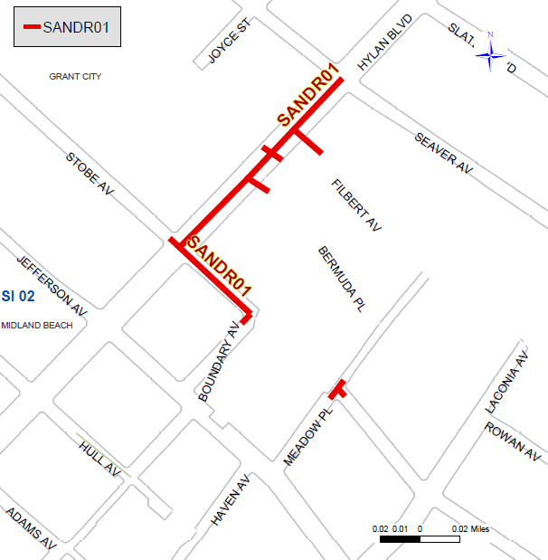
II. Location
Affected Areas
Hylan Blvd. between Stobe Ave. & Seaver Ave.
Stobe Ave. between Hylan Blvd. & Boundary Ave.
Meadow Pl. between Stobe Ave. & Dead End
What areas will be affected?
Project Location: Hylan Blvd. between Stobe Ave & Seaver Ave.

Slide 7
CLICK TO EDIT HEADLINE TEXT
Edit text
Iii. Construction overview
7
7

Slide 8
III. Construction Overview
Commencement: Summer 2020
Projected Completion: Early 2022
Project Estimated Cost: $ 26.5 Million
8

Slide 9
III. Construction Overview (cont.)
Preliminary Work
In the ground
Above ground
Utilities (by others)
Community Outreach
Permits and Scheduling
Staging and Storage of Materials
Street Tree Guards and Pruning
Preconstruction Photographs
Preconstruction Investigations
Saw Cutting
Water Main
Catch Basins
Fire Hydrants
Storm Sewer
Sanitary Sewer
Sidewalks, Curbs, Pedestrian Ramps
Full Roadway Reconstruction
Landscaping
Pavement Striping
BMP (Best Management Practices)
Street Lighting
Traffic Signal Improvements
9

Slide 10
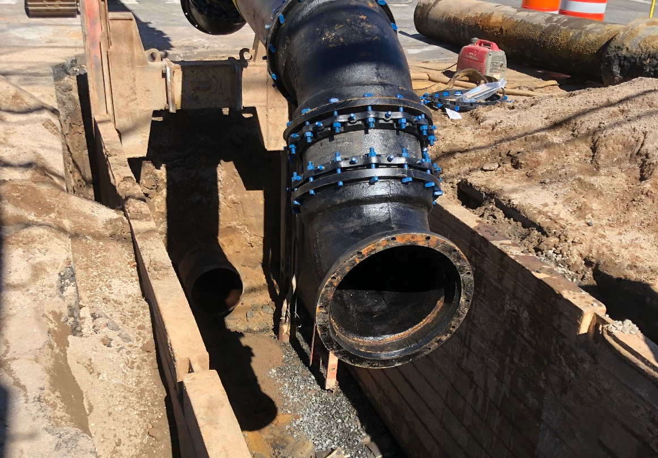
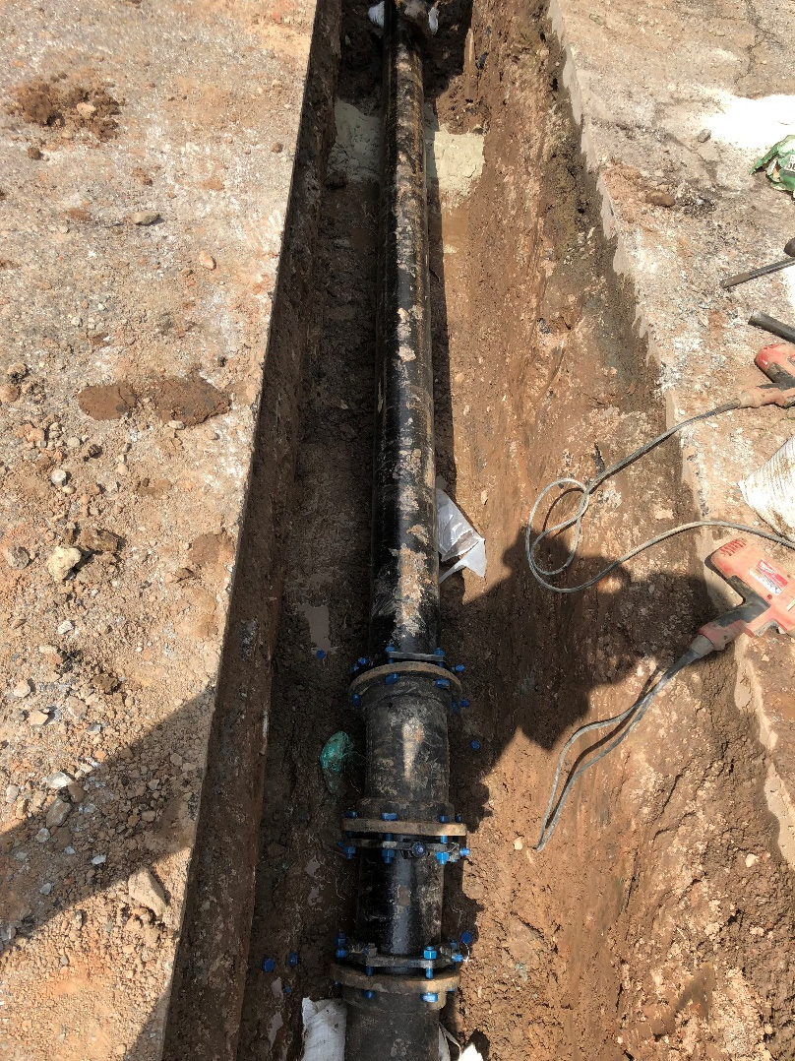
III. Construction Overview (cont.)
Water Main Work
Upgrading aging infrastructure
Improve drinking water quality
Improve delivery of drinking water
Additional upgraded fire hydrants
Why is this project necessary?

Slide 11
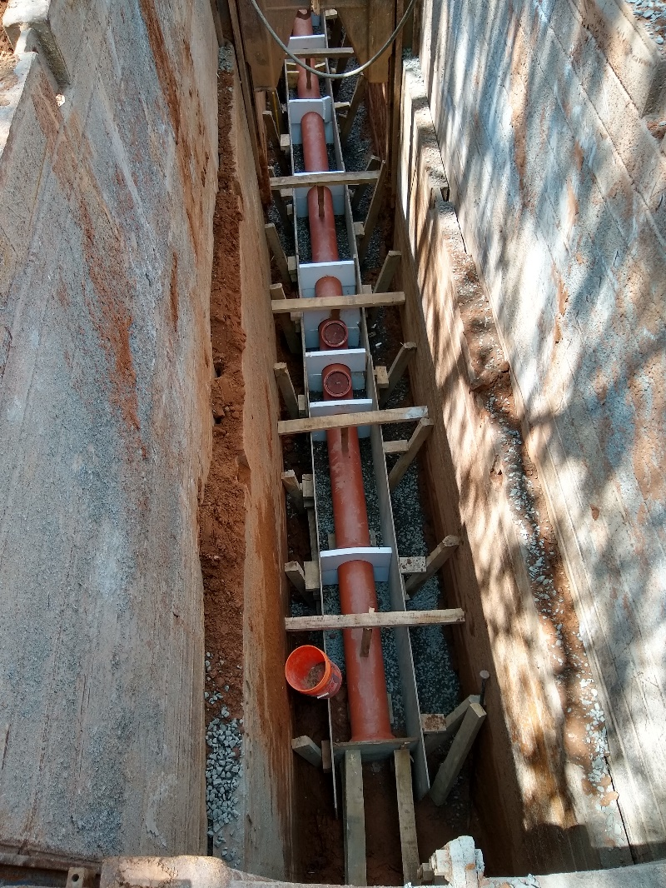
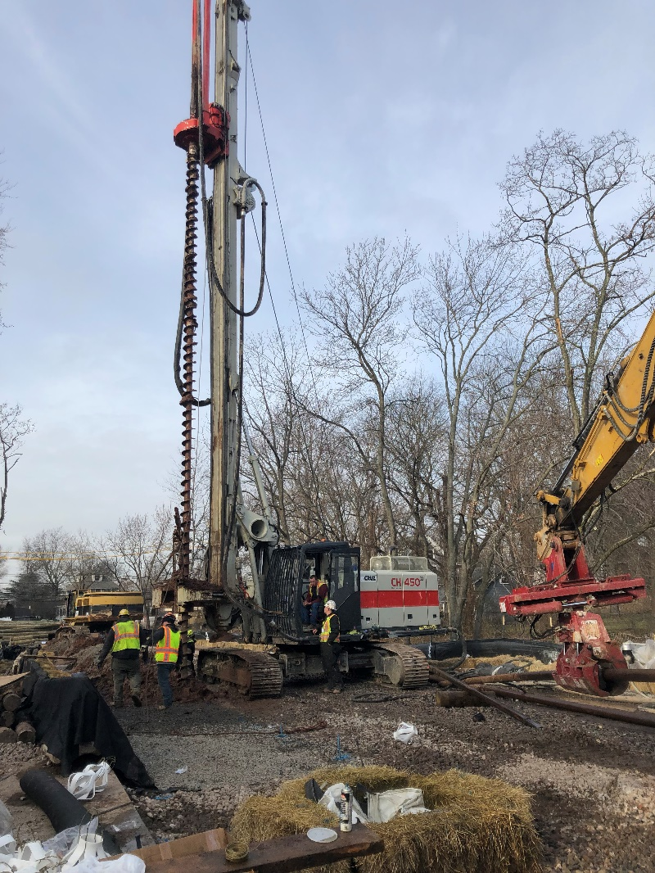
III. Construction Overview (cont.)
Storm and Sanitary Work
Upgrading aging infrastructure
Add new infrastructure
Alleviate flooding
Why is this project necessary?

Slide 12
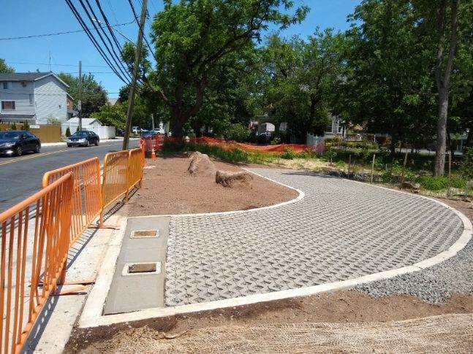
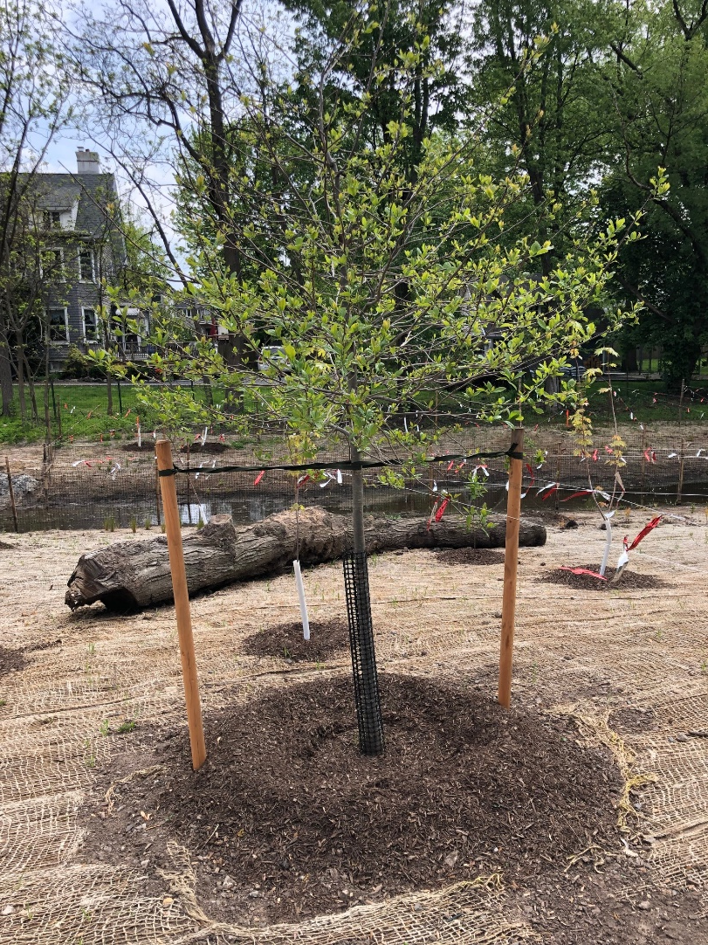
III. Construction Overview (cont.)
Streetscape, BMP, and Landscaping Work
Landscaping & BMP will improve on the surrounding areas
New trees planted
BMP work helps alleviate flooding
Why is this project necessary?

Slide 13
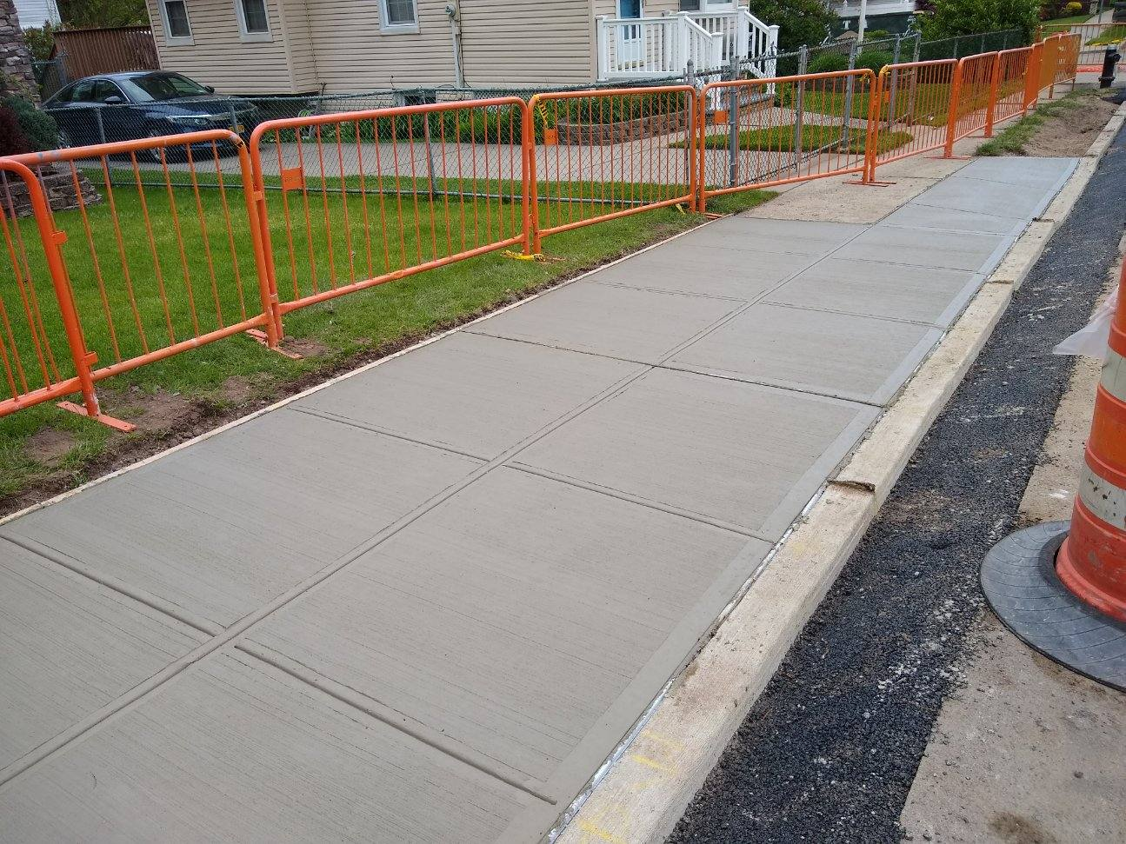
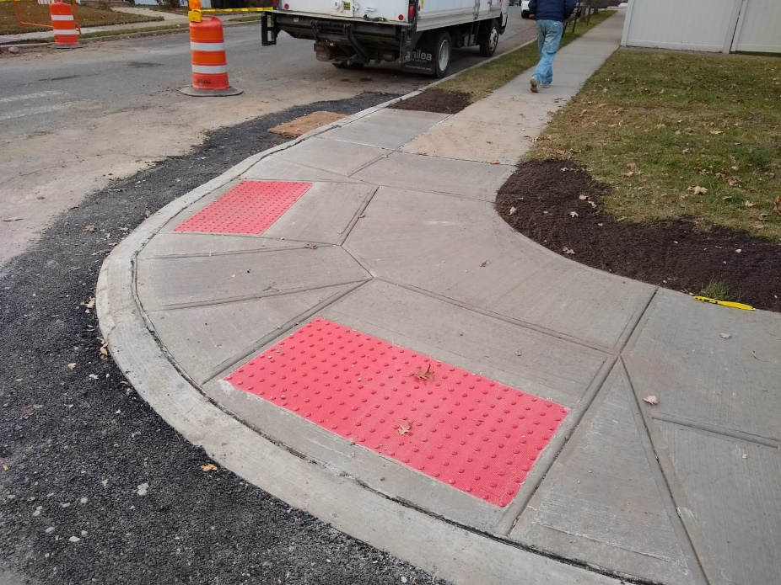
III. Construction Overview (cont.)
Sidewalk and Curb Improvements
Installation of new curb & sidewalk
New pedestrian ramps
Why is this project necessary?

Slide 14
CLICK TO EDIT HEADLINE TEXT
Edit text
Iv. During construction
14
14

Slide 15
IV. During Construction
DOT and SAPO Holiday Embargoes
Work on Hylan Blvd. may be affected by Holiday Embargo
Work will follow any special events restrictions
15

Slide 16
IV. During Construction (cont.)
Traffic Patterns During Construction
Roadway Traffic control devices (signage, concrete barriers, barrels, flaggers, etc.)
Pedestrian safety devices (pedestrian barricades, barrels, signage, etc.)
Pedestrian access to buildings and sidewalks.
Keep a minimum width of 5 feet for access to sidewalks and crosswalks.
Maintain 2 lanes of traffic each direction on Hylan Blvd. during the day
16

Slide 17
CLICK TO EDIT HEADLINE TEXT
Edit text
V. COMMUNITY Impacts
17
17

Slide 18
V. Community Impacts
Work within DEP Noise Code & Dust Control Regulations.
Weekly bulletins will be distributed to affected area.
Quarterly Newsletters will be distributed to affected area.
Advanced 72-hour notice of any upcoming work.
Additional 24-hour Contractor notice of any upcoming water shutdowns.
Keep storage site and MPT area clean & safe.
Professional rodent control inspector to monitor/maintain Rodent Control Station.
18

Slide 19
V. Community Impacts (cont.)
Driveway access may be temporarily restricted during work hours, but coordination is done case-by-case.
Temporarily, parking may be restricted when necessary;
“NO PARKING” signs will be posted in advance.
Garbage pick-up will be coordinated if necessary.
Anyone with special circumstances should notify the CCL.
DDC field staff will work to minimize any inconveniences.
19

Slide 20
CLICK TO EDIT HEADLINE TEXT
Edit text
VI. Outreach & Notifications
20
20

Slide 21
VI. Outreach & Notifications
DCC’s Office of Community Outreach + Notification (OCON)
OCON works with CB’s, BID’s, local businesses and other community stakeholders impacted by construction.
Community Construction Liaison (CCL)
DDC has assigned Nicole Chati as the dedicated on-site Community Construction Liaison (CCL). The CCL can be reached at:
SANDR01HylanBlvdCCL@gmail.com
(732) 500-2376
21

Slide 22
VI. Outreach & Notifications (cont.)
CCL responsibilities are as follows:
First point of contact, maintain on-site presence and communication.
Identify, resolve and/or proactively addressing issues and inquiries.
Distribute advisory updates/weekly construction activities newsletter.
Provide 72-hour and 24-hour (confirmation or cancellation) advisories for work impacts by email (if provided) and door to door.
22

Slide 23
CLICK TO EDIT HEADLINE TEXT
Edit text
VII. Sample Notifications
23
23

Slide 24
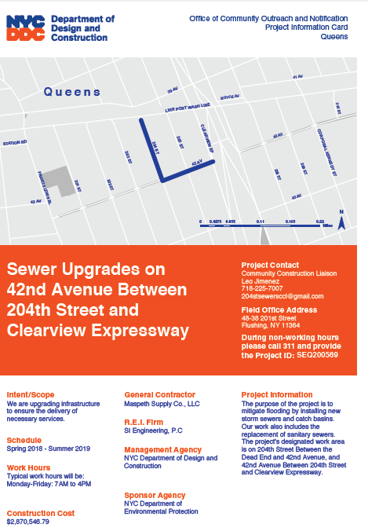
VII. Sample Communications
Project
information card
advisory
newsletters
Look ahead Weekly bulletin
24

Slide 25
CLICK TO EDIT HEADLINE TEXT
Edit text
VIII. Q & A
25
25

Slide 26
Thank you!
Project inquiries can be directed to the CCL at:
CCL: Nicole Chati
Phone Number: (732) 500-2376
Email: SANDR01HylanBlvdCCL@gmail.com

