Slide 1

Yuma Agriculture Water -
  Rights and Supply
Terry Fulp
Director, Lower Colorado Region
Yuma Agriculture Water Conference
January 13, 2016

Slide 2
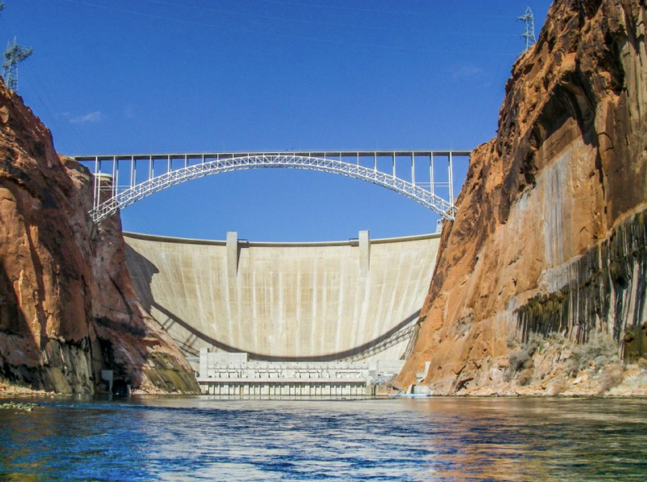
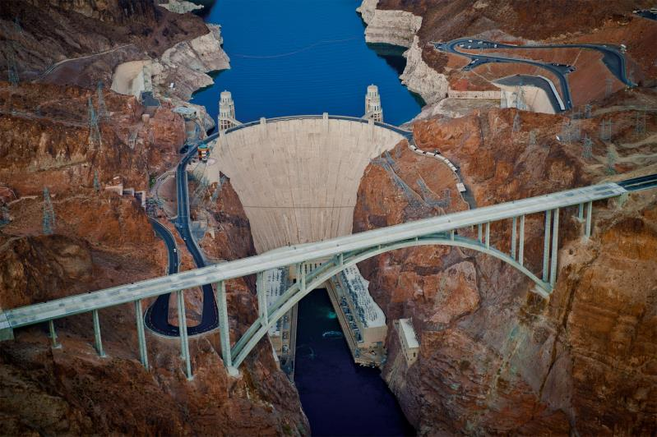
Topics
Overview of the Colorado River System
State of the System – Drought
2007 Interim Guidelines
Basin-wide Drought Response Activities
Future risk
2

Slide 3
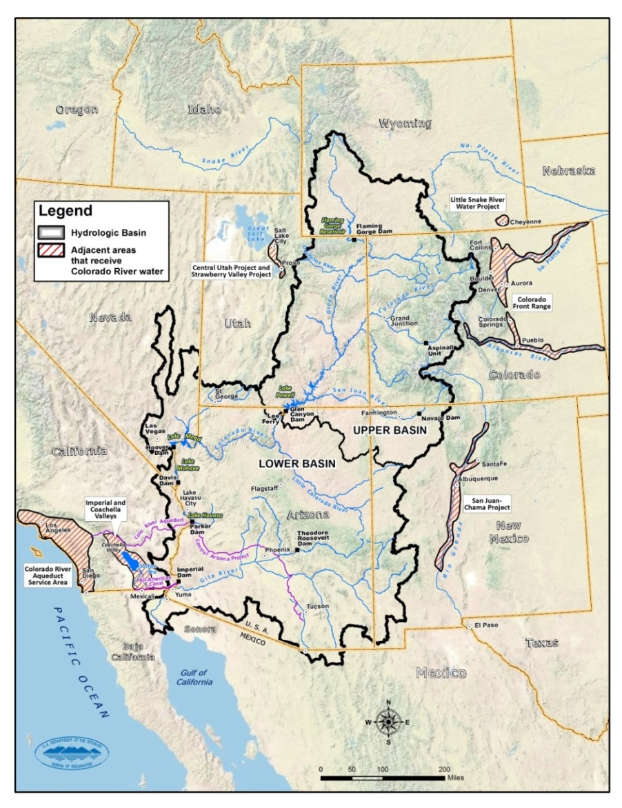
Overview of the Colorado River System
16.5 million acre-feet (maf) allocated annually
  7.5 maf each to Upper and Lower Basins
  1.5 maf to Mexico
~ 16 maf average annual “natural flow” (from historical record)
  14.8 maf in the Upper Basin and 1.3 maf in the Lower Basin
Inflows are highly variable year to year
60 maf of storage (~ 4X the annual inflow)
Operations and water deliveries governed by the “Law of the River”
3
Notes:
3

Slide 4
Natural Flow
Colorado River at Lees Ferry Gaging Station, Arizona
Water Year 1906 to 2015
Notes:
4
Points to make:
105-year (1906-2010) historical average is approximately 14.9 maf
2013-2015 are estimated values
Inflows are highly variable from year-to-year
2012-2013 was 4th driest 2-year period (2002-2003 was the driest)
Period from 2000-2009 was the lowest 10-year average inflow—there were two years with above average inflow during the period
Period from 1953-1964 was the lowest 12-year average inflow, but note there were a couple of good years in the period
Period from 2000-2014 is the lowest 14-year average inflow (at 12.4 maf, or 83% of the long-term average of 14.9 maf)

Slide 5
Current 16-year Drought (2000-2015*)
Natural Flow at Lees Ferry
Historical Long-term Average (1906-2015)
Current 16-year Drought Average (2000-2015)
Climate Projections (2016-2099) Approximately 25th-percentile of 16-year periods
Paleo Record (1200+ years)
Lowest 16-year period
5
*2013-2015 natural flows are provisional
Notes:
Historical long term average is 14.8 MaF
Current Drought Average is 12.4 MaF – this is the lowest 16 year period in the historical record
Paleo average 16 year period min is 12.2 MaF
Climate ensemble average 16 year period 25th% tile is 12.3 MaF
Stats on climate projections based on 2016-2099 period; 112 cmip3 and 97 cmip5 downloaded from archive and minor 2ndary bias corrected to Lees Ferry natural flow for 1950-1999 period

Slide 6
Water Year Snowpack and Precipitation as of January 11, 2016
Colorado River Basin above Lake Powell
Water Year 2016
Precipitation
(year-to-date)
98% of average¹
Current Snowpack
103% of average¹

Slide 7
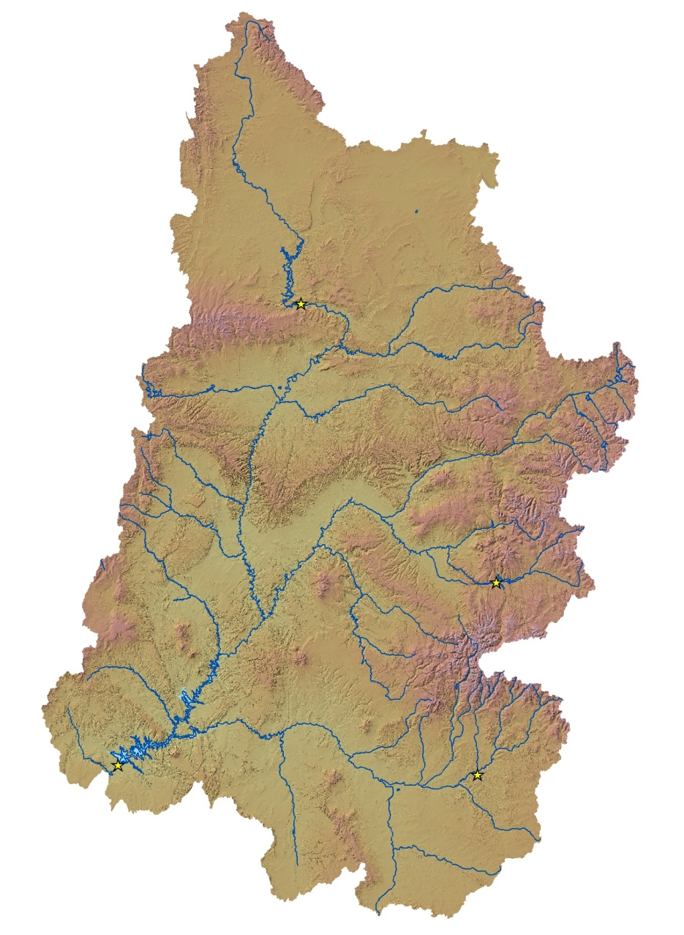

CBRFC Upper Colorado April-July Inflow Forecast dated January 5, 2016
Green River
Reservoir | 2016 April-July Inflow Forecast¹ (percent of average)
Flaming Gorge | 71
Blue Mesa | 90
Navajo | 105
Lake Powell | 89
Flaming Gorge
Little Snake
River
Duchesne River
Yampa River
White River
Colorado River
Green River
Blue Mesa
Dolores
River
Gunnison
River
Dirty Devil
River
San Juan River
Navajo
¹ Percent of average is based on the period of record from 1981-2010
Lake Powell

Slide 8
Colorado River Basin Storage
(as of January 10, 2016)
Reservoir | Percent Full | Storage (MAF) | Elevation (Feet)
Lake Powell | 48% | 11.69 | 3,599
Lake Mead | 39% | 10.15 | 1,082
Total System Storage* | 50% | 29.59 | NA
*Total system storage was 29.52 maf or 50% this time last year
Notes:
8

Slide 10
Water Budget at Lake Mead
Given basic apportionments in the Lower Basin, the allotment to Mexico, and an 8.23 maf release from Lake Powell, Lake Mead storage declines
  Inflow = 9.0 maf (release from Powell + side inflows)
  Outflow = - 9.6 maf
  (AZ, CA, NV, and Mexico delivery
  + downstream regulation and gains/losses)
  Mead evaporation loss = - 0.6 maf
  Balance = - 1.2 maf
Data based on long-term averages

Slide 11
State of the System (Water Years 1999-2016)^{1,2}
Notes:
11

Slide 12
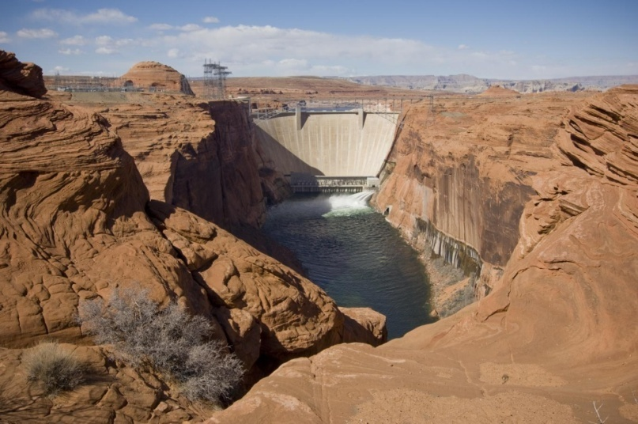
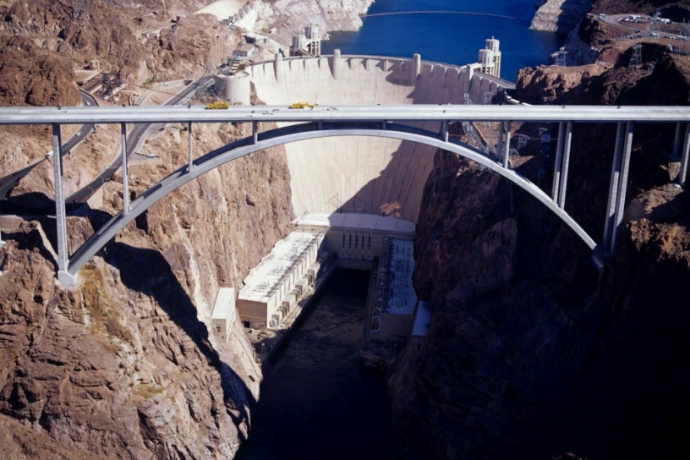
Interim Guidelines for Operation of Lake Powell and Lake Mead
Key provisions:
  Coordinated operation for Lake Powell and Lake Mead is specified throughout the full range of operation
  Strategy for shortages in the Lower Basin is specified, including a provision for additional shortages if warranted
  Mechanism (Intentionally Created Surplus or ICS) is established to encourage efficient and flexible water use in the Lower Basin
In place for an interim period (through 2026)
Do not include provisions for Mexico
Notes:
12

Slide 13
Lake Mead – Key Elevations¹
1,219.6 ft
26.1 maf, 100%
Flood Control or Surplus Conditions
1,145 ft
16.2 maf, 62%
Normal or ICS Surplus Conditions
1,082 ft*
10.2 maf, 39%
As of January 10, 2016
1,075 ft
9.6 maf, 37%
Level 1 Shortage Conditions
U.S. Lower Basin Shortage = 333 kaf
Mexico Reduction = 50 kaf
1,050 ft
7.7 maf, 29%
Level 2 Shortage Conditions
U.S. Lower Basin Shortage = 417 kaf
Mexico Reduction = 70 kaf
1,025 ft
6.0 maf, 23%
Level 3 Shortage Conditions
U.S. Lower Basin Shortage = 500 kaf
Mexico Reduction = 125 kaf
1,000 ft
4.5 maf, 17%
895 ft
0 maf, 0%
Not to scale
Dead Pool (2.5 maf)
¹ U.S. Lower Basin shortage volumes based on the 2007 Interim Guidelines; Mexico reductions based on Minute 319.
Notes:
13
Key points:
This teacup diagram shows more visually Lake Mead’s operating conditions under the 2007 Interim Guidelines and the key elevation triggers for each condition.
The diagram also notes the U.S. Lower Basin shortage volumes, under the three shortage levels, based on the 2007 Interim Guidelines.
Level 1: 333 kaf (411 mcm); Nevada 13 kaf (16.0 mcm), Arizona 320 kaf (395 mcm).
Level 2: 417 kaf (541 mcm); Nevada 17 kaf (21.0 mcm), Arizona 400 kaf (493 mcm).
Level 3: 500 kaf (617 mcm); Nevada 20 kaf (24.7 mcm), Arizona 480 kaf (592 mcm).
It could be noted that the 2007 Guidelines call for additional consultation with the Secretary if Lake Mead elevations are projected to decline below elevation 1,025 feet (312.4 meters).
The diagram also shows Mexico reductions based on Minute 319, in place for an interim period from 2013-2017, with reductions of 50 kaf (61.7 mcm), 70 kaf (86.3 mcm), and 125 kaf (154 mcm), respectively.

Slide 14

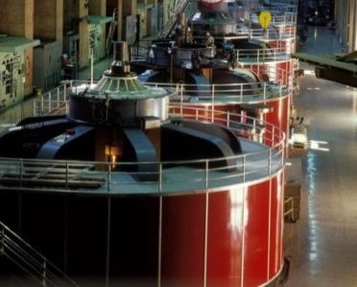
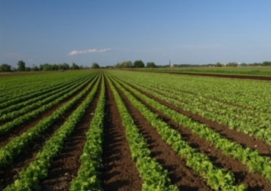
Impacts of Low Lake Mead Levels and Storage
Water Supply
  Increased potential for Lower Basin shortage
  Increased risk of reaching critically low elevations
Power Generation – reduced efficiency
  Each 1-ft decline in Mead elevation reduces Hoover Dam’s generating capacity by about 5.7 MW
  Due to loss in revenue and increased operational costs, power contractors funded the installation of five “wide-head” turbines to replace existing turbines
    Three wide-head turbines are already in operation
    A fourth has been installed by this summer and a fifth will be in 2016
Recreation
  For each 10-ft drop in Mead elevation, the National Park Service spends about $2.1 million to extend boat ramps*
  *Source: National Park Service Lake Mead National Recreation Area fact-sheet dated August 8, 2014
14
Notes:
At elevation 1,025 feet, only 6.0 maf remains in storage and at 1,000 feet, only 4.5 maf remains in storage

Slide 15
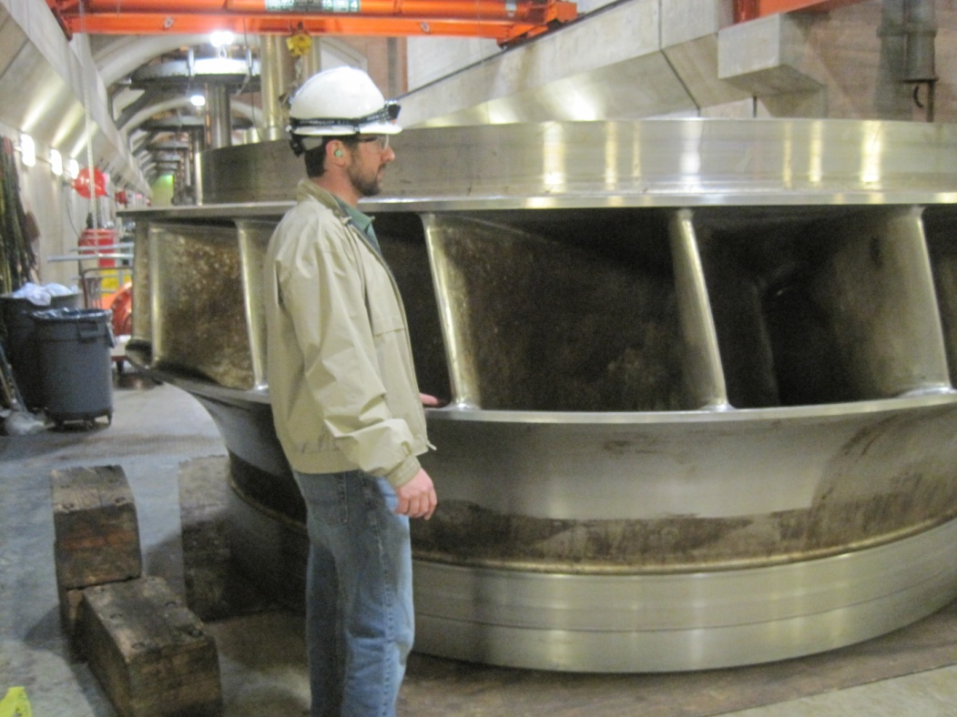
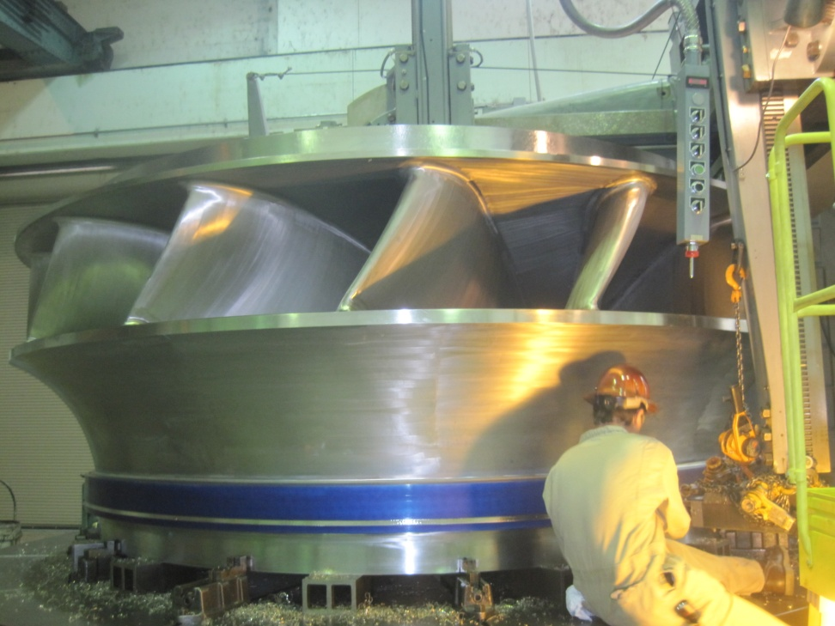
Unit N8 Runner Comparison
New Designed Head Range
  -Minimum 350 ft to Maximum 575 ft
  (~1000 – 1235 ft Lake Mead Elev)
Capacity/Output – 200,000 Hp
Designed for more stability and higher efficiencies across load range
Previous Designed Head Range
  -Minimum 400 to Maximum 585 ft
  (~1050 – 1245 ft Lake Mead Elev)
Capacity/Output – 178,000 Hp
Peaking Design, Unstable Across Operating Range (Large Rough Zones)

Slide 16
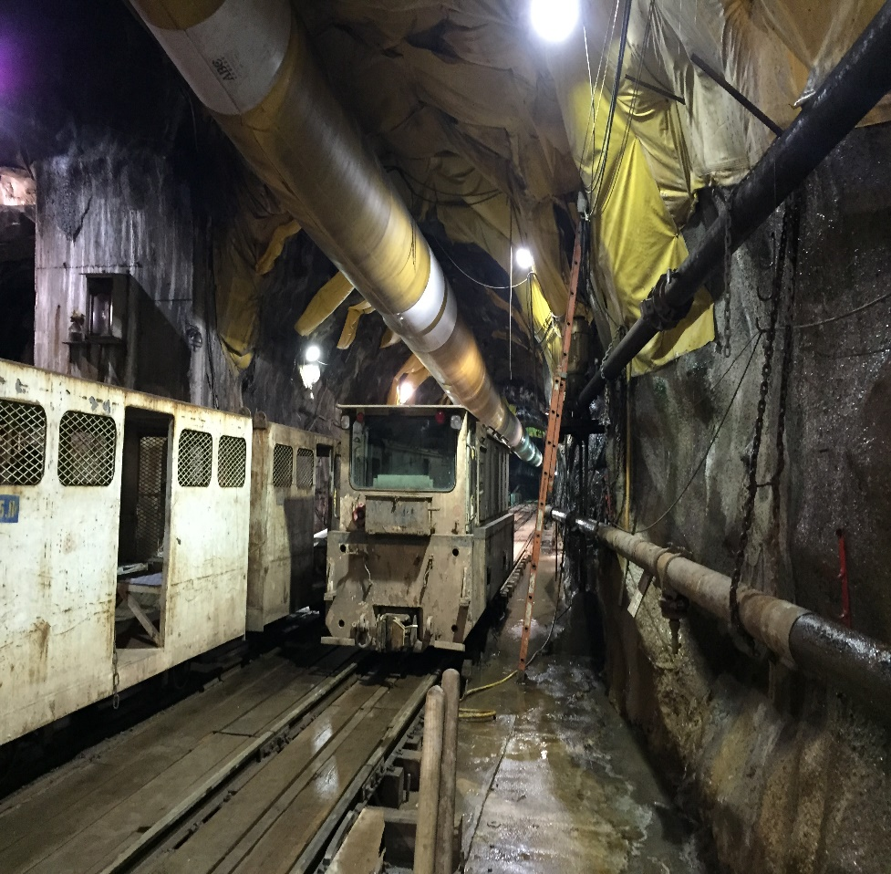
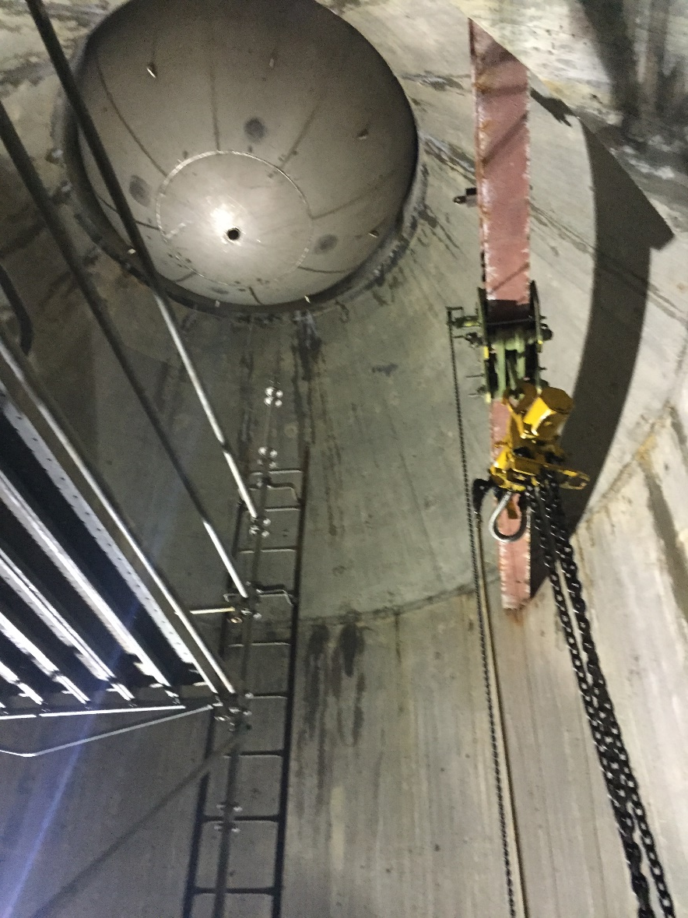
SNWA’s New Colorado River Intake

Slide 17
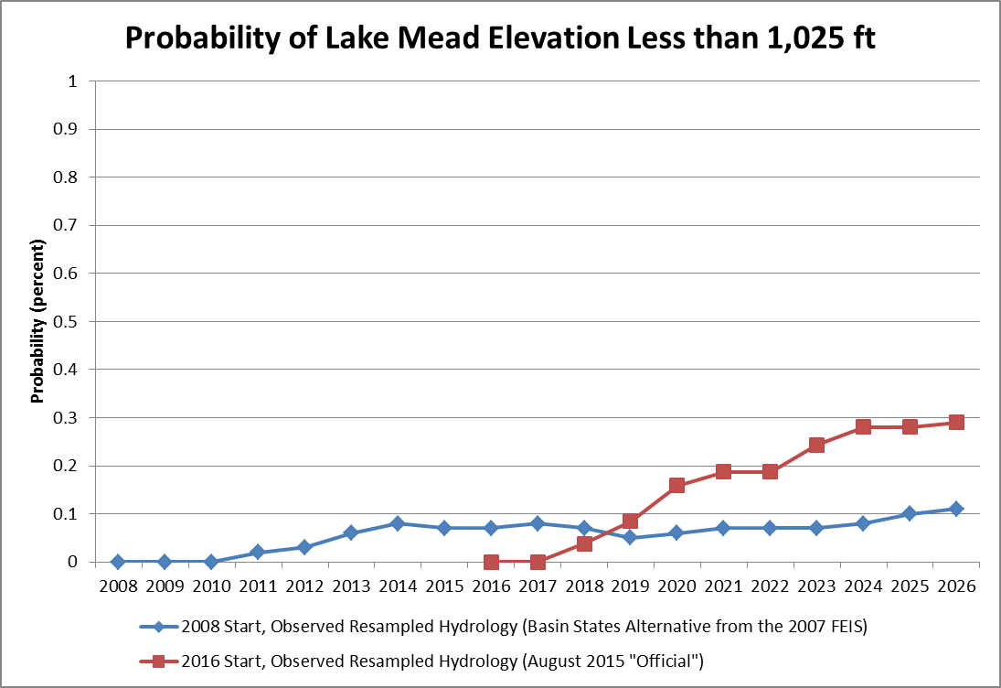

Slide 18
Basin-wide Drought Response Activities
Basin-wide Pilot System Conservation Program
  Funders: Reclamation, CAWCD, SNWA, MWD, and Denver Water
  Provides $11 million for voluntary pilot projects that create system water
  To date, six projects have been initially approved in the Lower Basin that will conserve ~ 60,000 acre-feet of water
Upper Basin Drought Contingency Planning
  Ongoing discussions:
    Augmentation (Weather modification)
    Extended Operations of CRSP Reservoirs
    Conservation (Upper Basin Demand Management)
18

Slide 19
Basin-wide Drought Response Activities (continued)
Lower Basin Agreement for Pilot Drought Response Actions
  Participants: CAWCD, MWD, SNWA, Lower Basin States, and Reclamation
  2014-2017 Goal: Generate 740,000 acre-feet of water to benefit Lake Mead elevation
  2014-2019 Goal: Generate 1.5 to 3.0 maf of water to benefit Lake Mead elevation
Lower Basin Drought Contingency Planning
On-going discussions:
  “overlay” to the Interim Guidelines of voluntary reductions to reduce risk of reaching critical elevations at Lake Mead
19

Slide 20
Protection Volume Analysis
Volumes¹ needed to “absolutely protect” Lake Mead elevations 1,000’ and 1,020’ through 2026
Hydrology | Lake Mead Elevation 1,020’ |  |  | Lake Mead Elevation 1,000’
 | Maximum in any year (MAF) | First Year that Maximum Occurs | Average through 2026 (MAF) | Maximum in any year (MAF) | First Year that Maximum Occurs | Average through 2026 (MAF)
Observed | 2.1 | 2019 | 0.74 | 1.9 | 2019 | 0.49
Climate Change | 6.1 | 2025 | 1.7 | 6.0 | 2025 | 1.8
Combined | 6.1 | 2025 | 1.5 | 6.0 | 2025 | 1.6
¹Volumes are in addition to Shortages per the 2007 Interim Guidelines
Notes:
We also looked at what kind of action would be needed to protect us a bit, to prevent us from getting into these conditions.
What this table summarizes is the additional volumes of water that would need to be saved in the system, above the amounts taken under the Interim Guidelines shortage tiers, in order to keep Lake Mead above 1,020 and 1,000 ft.
We recognize that climate change is a slow moving train, but if the hydrology doesn’t improve, this is just to show a possibility.
At 1,020 ft = Mead Storage is 5.67 maf

Slide 21
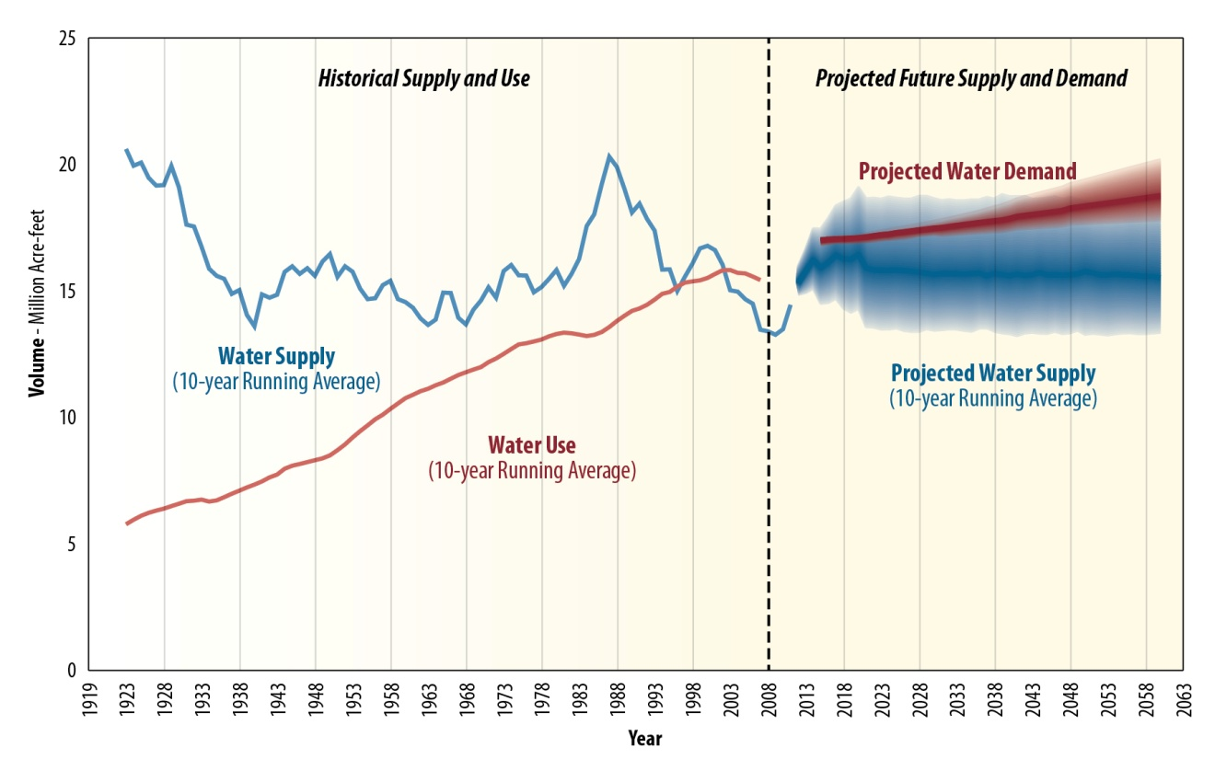
Projected Future Colorado River Basin Water Supply and Demand
Notes:
21

Slide 22
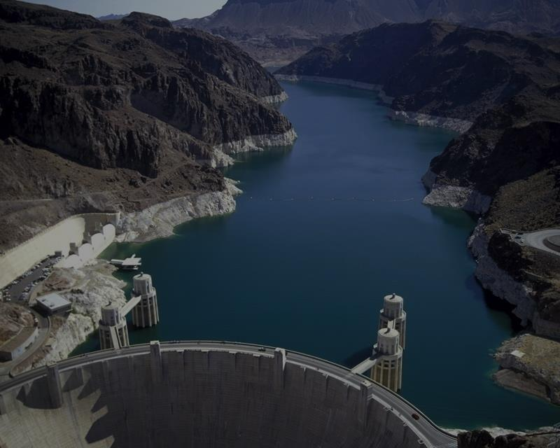
U.S. Bureau of Reclamation
Lower Colorado Region
For more information:
http://www.usbr.gov/lc/
Notes:
22

