Slide 1
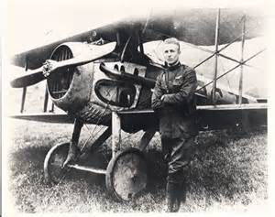
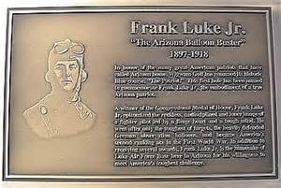
Discussion of Frank Luke Jr. Memorial Museum

Slide 2
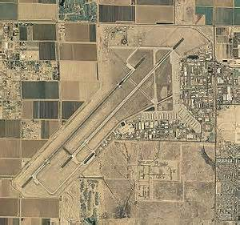
A legacy 40 acre project located adjacent to the south gate of Luke Air Force Base.

Slide 3
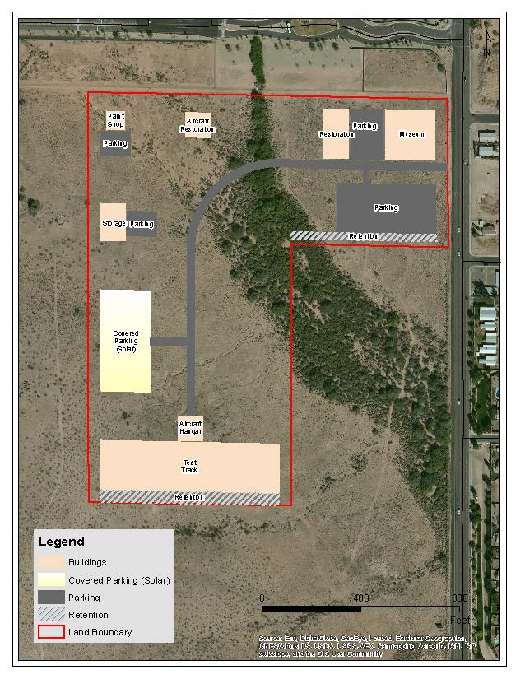

Slide 4
Construction of the Frank Luke Jr. Museum and Restoration Center employing PTSD/TBI veterans. Setting up a transitional training program for those transitioning from the military to the civilian workforce.

Slide 5
A Universal Technical Institute (UTI) type program would be used as a model with front end training input from local employers supporting our program.
Eventually all class room trainers will be veterans.
Primary income will come from restoration projects from other museums in other states.

Slide 6
We are looking to both the DAV and VA for guidance concerning screening veterans’ entrance into our program. We will begin with 25 students and anticipate to grow to 100 students per cycle.

Slide 7
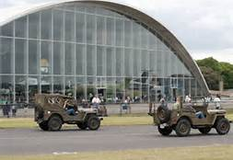
The museum will be an interactive facility we call a “Historeum”.
We will build this museum around nine small theaters that will accommodate elementary school children.
We will begin with WWI and incorporate the history of Medal of Honor recipient 1st Lt. Frank Luke Jr.
The history will progress up to our current conflict in Afghanistan.

Slide 8
Each theater will have a short video and an electric map to demonstrate where in the world this history took place.
We will be teaching accurate history and geography, as these subjects are not being adequately taught today in most of our schools.
Each theater will have a diorama with a vehicle and field items used during these conflicts.
There will be a small stage and a lectern for either veterans to tell their story or re-enactors to portray what life was like at this time in history.

Slide 9
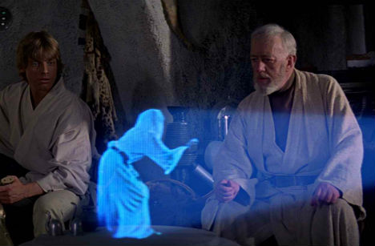
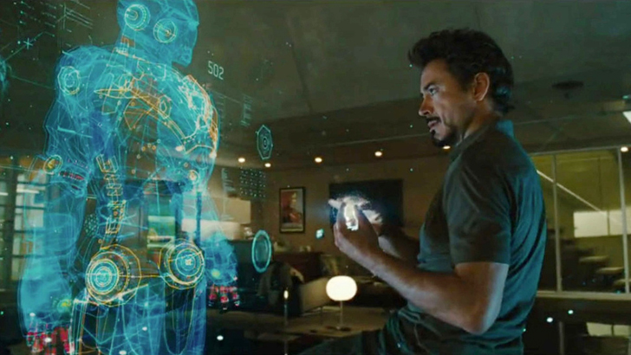
The “Historium” will have large military
emblems strategically located throughout, where
a 4 dimensional hologram image will appear –
similar to the hologram effects in both Star Wars and Iron Man movies which will let the participate feel like they are part of
the experience.

Slide 10
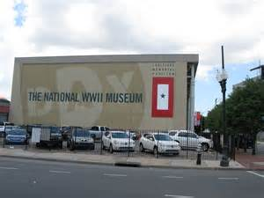
With the help of Tom Hanks, we would like to duplicate the WWII 4-D theater in New Orleans.

Slide 11
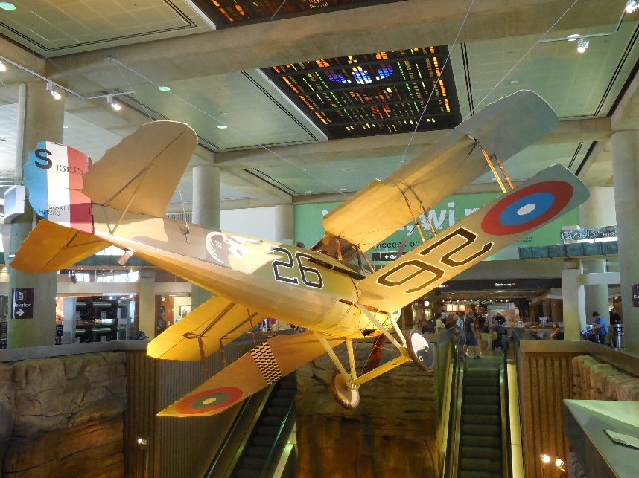
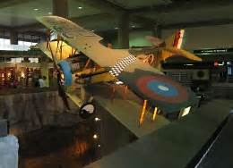
We would also like to move the Spad VIII from Sky Harbor’s terminal #3 and properly mount it at the inside entrance to our museum. Lt. Luke would be flying toward a German balloon. When you press a button the display comes to life showing both Frank’s thoughts and German observers about to be shot down.

Slide 12
We have the support of an Air Force collector who has 13 semi-trailers of museum quality displays.
Luke has several different displays throughout the base documenting their history that could be incorporated into our museum on a loaned basis.

Slide 13
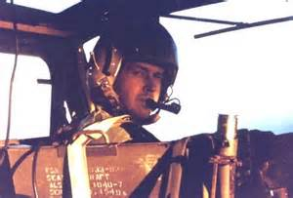
We have located a Huey aircraft flown by Medal of Honor recipient and Arizona resident Major Frederick Ferguson, US Army during the Vietnam war, which could be relocated to our museum.

Slide 14
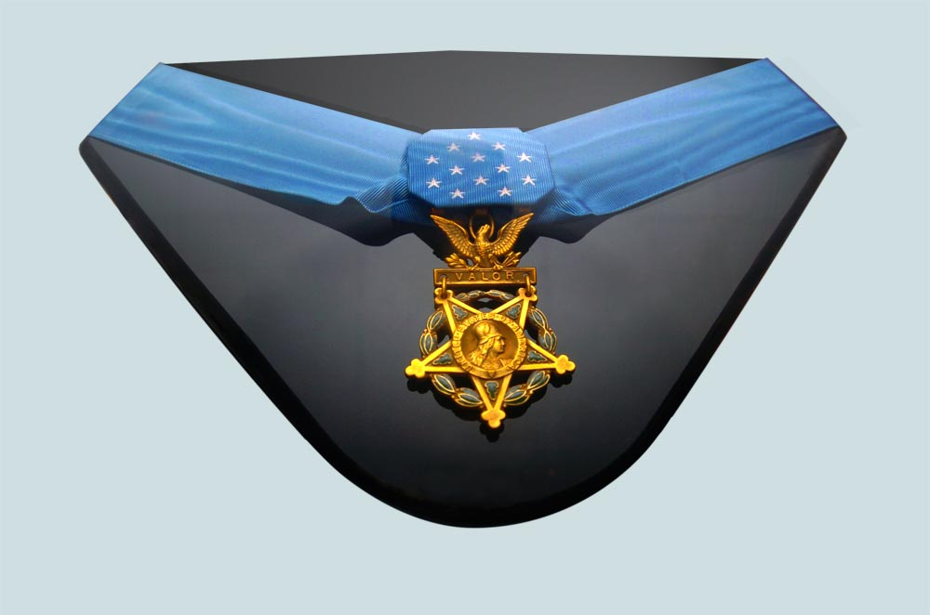
Don Luke has told us he will retrieve the Medal of Honor of his uncle Frank Luke Jr. from Wright Patterson AFB per a letter of agreement, and have it on display in the museum.

Slide 15
Representative Trent Franks is a strong supporter of this museum and restoration center.
Former Secretary of State Ken Bennett, Mayor Jerry Weiers (honorary board member), County Supervisor Clint Hickman and Business Owner Don Mellon all have expressed interest in seeing this project completed.

Slide 16
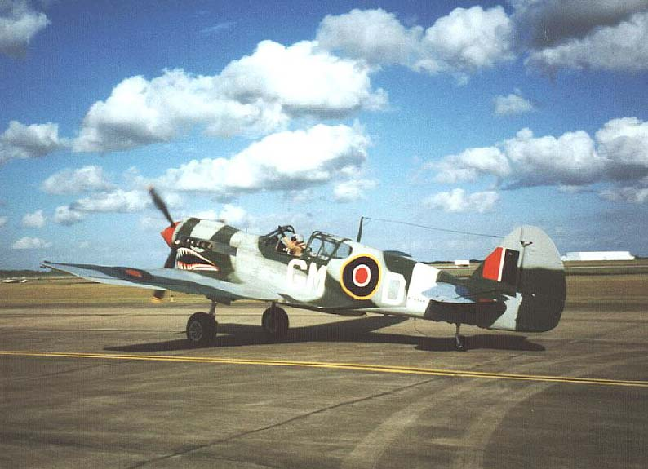
We have been told Luke AFB might consider moving their historic aircraft to the south gate fence line so that the museum visitors can see the aircraft.

Slide 17
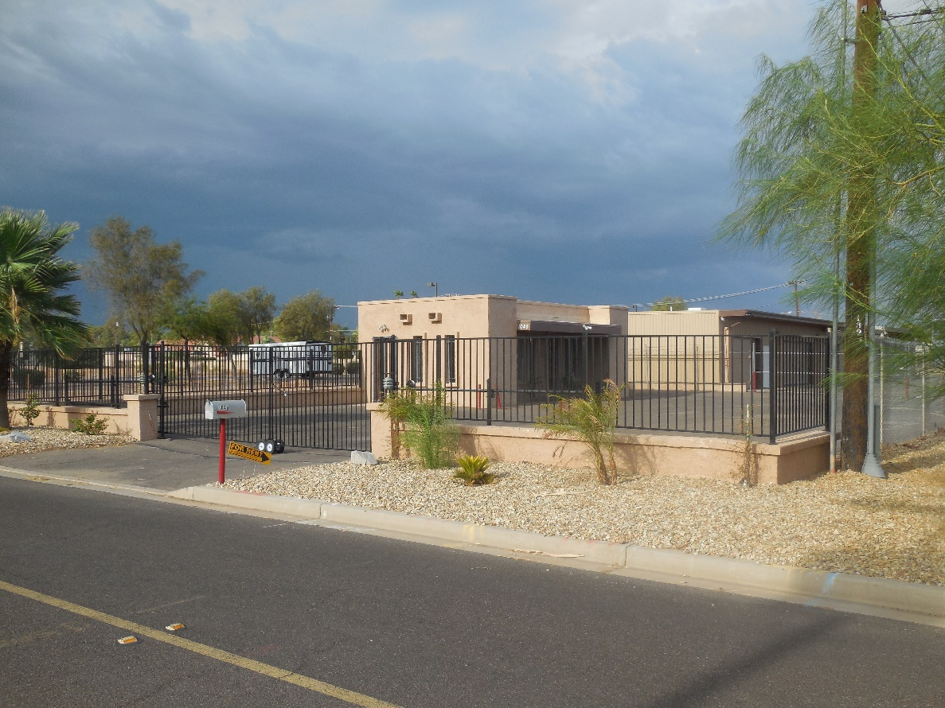
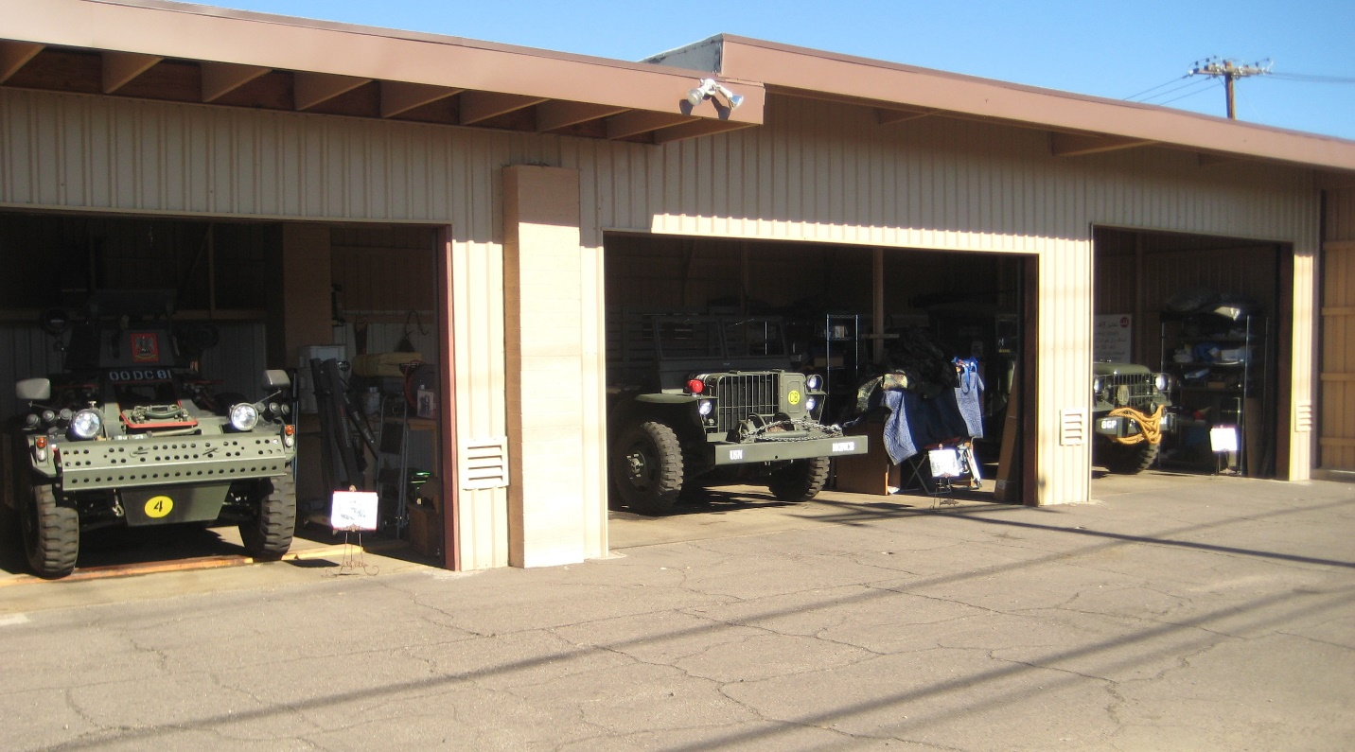
Current location
1045 S. Camino Oro
Goodyear, AZ 85338

Slide 18
Five Year Plan
Year One:
Purchase 40-acre site adjacent to Luke Air Force Base’s south gate entrance. Obtain corporate letters of intent to sponsor buildings and Hollywood contacts for museum development.
Year Two:
Complete Maricopa County and City of Glendale development requirements, final architectural drawings and storm drain installation.

Slide 19
Year Three:
Complete construction of first major building. Probably the restoration/veteran training center along with the storage facility and paint center.
Year Four:
Complete solar energy fields and museum facilities including large hangar for President Eisenhower’s Air Force One.
Year Five:
Complete final aircraft restoration hangar and vehicle test track. Final grand opening.

Slide 20
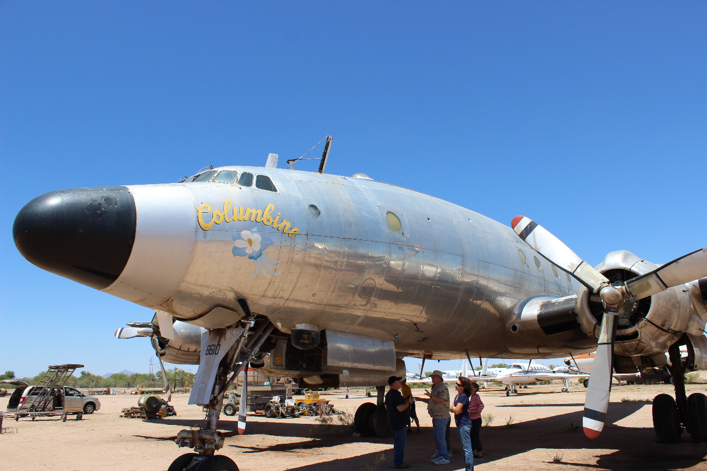
Special Plans
We have a unique opportunity to acquire President Eisenhower’s Columbine II located at the Marana airport. This is the only presidential aircraft in private hands seeking a permanent museum home.

Slide 21
Our museum is the place to have this historic aircraft.
We would build a special 1950’s vintage hangar just for Ike’s Air Force One and park his Chrysler limousine next to the stairs leading up to the aircraft.
We would have special lighting, and Ike and Mamie re-enactors along with 1950’s dressed pilots & crews around the aircraft to tell about its history.
In the fall and spring we can host “Black Tie” gatherings with the east side hangar doors open for all to see this beautiful aircraft on a hill just off Litchfield Rd.

Slide 22
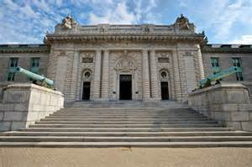
Future Plans
There are future plans for a Military Preparatory Academy near the museum.
Grades 8-12
This would be the starting point for many future military leaders, heads of companies, great organizers in their communities and positive parental role models.

