Slide 1
The Children’s MTC Experience
Dr Tina Newton
ED Consultant and Trust Major Trauma Lead
Birmingham Children’s Hospital

Slide 2
BCH
This Photo by Unknown Author is licensed under CC BY

Slide 3
Emergency Department
2013 we saw 46 000 children per year
2018 that number had risen to 60 000
Number of consultants has increased
Shop floor cover at senior level has increased
Acuity has increased
ED performance has worsened (if judged by breaches)

Slide 4
I joined the team in 2013, 1 year after BCH became an MTC
Steady increase in the number of TARN eligible patients seen
Consistently the Children’s MTC with the highest number of ISS>15 patients
Year on year increase in the number of stabbings and gang related incidents

Slide 5
What have been the challenges?
Initially a ‘Corporate Service’
Small number of patients
No co-located CT scanner
Incomplete service for the management of rarer emergencies (vascular surgery, IR, pelvic fractures)
Maintaining skills

Slide 6
Strength in numbers
In 2014 we hosted the first meeting of the 5 stand-alone Children’s MTCs
Now we have become the Children’s Major Trauma National Network
Meet twice a year
Information sharing

Slide 7
What have we learned from experience?
This Photo by Unknown Author is licensed under CC BY-NC-ND

Slide 8
NAI
Ffion Davies et al published a paper EMJ – Major Trauma from suspected child abuse; a profile of patient pathways.
7.3% of children with Major Trauma will be as a result of NAI. 98% of these will be 0-5 year olds with 76% <1 year old. Median age of 3.6 months

Slide 9
Safeguarding is high on the agenda for the children’s MTCs
Children’s Major Trauma National Network subgroup
Safeguarding team involvement in all MT patients to be a standard (BPT) going forward
Member of the safeguarding team attends our weekly MDT

Slide 10
So is safeguarding a prominent issue in our MTC patients?
YES!
A small number of NAI cases come in as RTD alerts
Significant number picked up in ED
90% of our MT patients have safeguarding or social problems

Slide 11
Features of children with NAI
These patients have high ISS and 3x higher mortality
Less likely to call emergency services
Less likely to present to MTC or trigger pre hospital response to send direct to MTC as an alerted trauma patient
Often present with non specific history (not of trauma) and do not prompt a major trauma response

Slide 12
A recent MDT…….
13 patients
2 NAI
2 No concerns
9 safeguarding concerns

Slide 13
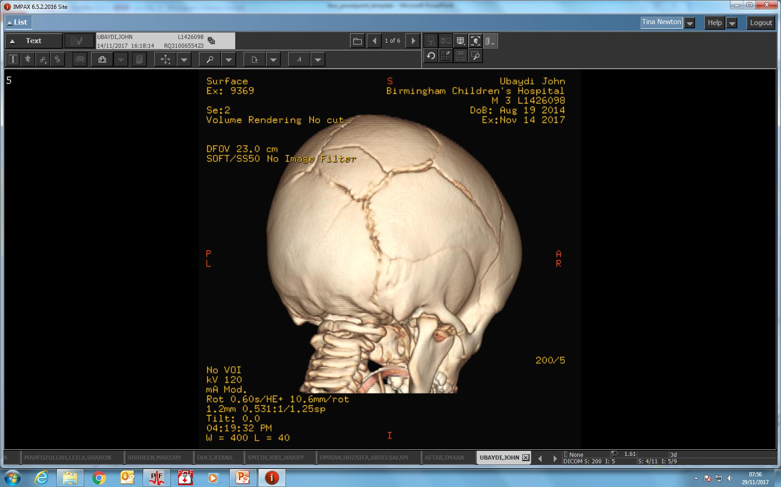

Slide 14
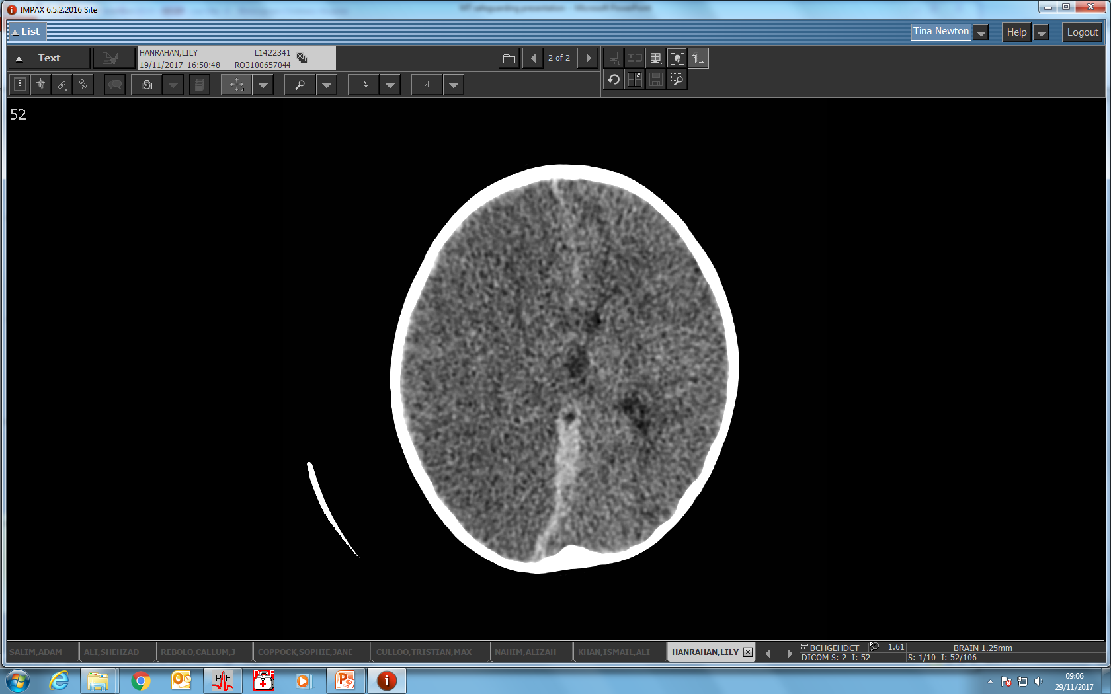

Slide 15
6 week old
Rear seat passenger in a car
Driver uninsured
Baby in a car seat facing forward and not strapped in
Head on collision
Baby landed in footwell
CT/MRI spinal cord injury C4-7

Slide 16
SA
15 year old boy
Stab wound to the head and neck
Right hemiplegia
Pre morbid CAMHS issues
Suicidal ideation
Gangs

Slide 17
AJ
3 year old boy
Accidental suffocation in a pool in Spain
Severe hypoxic brain injury
‘Tragic accident’

Slide 18
BM
1 year old
Fell out of a shopping trolley
Parietal skull fracture
Possible elbow fracture sustained in hospital
Section 47 open

Slide 19
RR
Toddler
Accidental suffocation when Mum had a seizure
Severe hypoxic brain injury
History of domestic violence
Can Mum keep child safe?

Slide 20
RG 13 years old
Parents IVDU
ADD, autism, multiple failed foster placements
In care
Suicide attempt (ran in front of car)
Tibial fracture, occipital skull fracture, temporal contusion

Slide 21
RM 13 year old bike vs car
Head injury, thalamic bleed, occipital condyle fracture, DAI
Agitated and impulsive
Supportive family

Slide 22
But…
Previous suicide attempt
‘Managed move’ to a new school
Previous suicide attempt…….

Slide 23
LT
Jumped off a bridge
Spinal cord injury. Mobile but neuropathic bladder and bowel
In care
Further suicide attempt since

Slide 24
KK
Unrestrained front seat passenger
Lower limb fractures
Car driven by uncle fled the scene
Dad in prison
Domestic violence
Mum in London
Living with grandparents

Slide 25
IS (no safeguarding issues)
13 years old
Ped vs car
Leg trapped
Blood loss at the scene

Slide 26
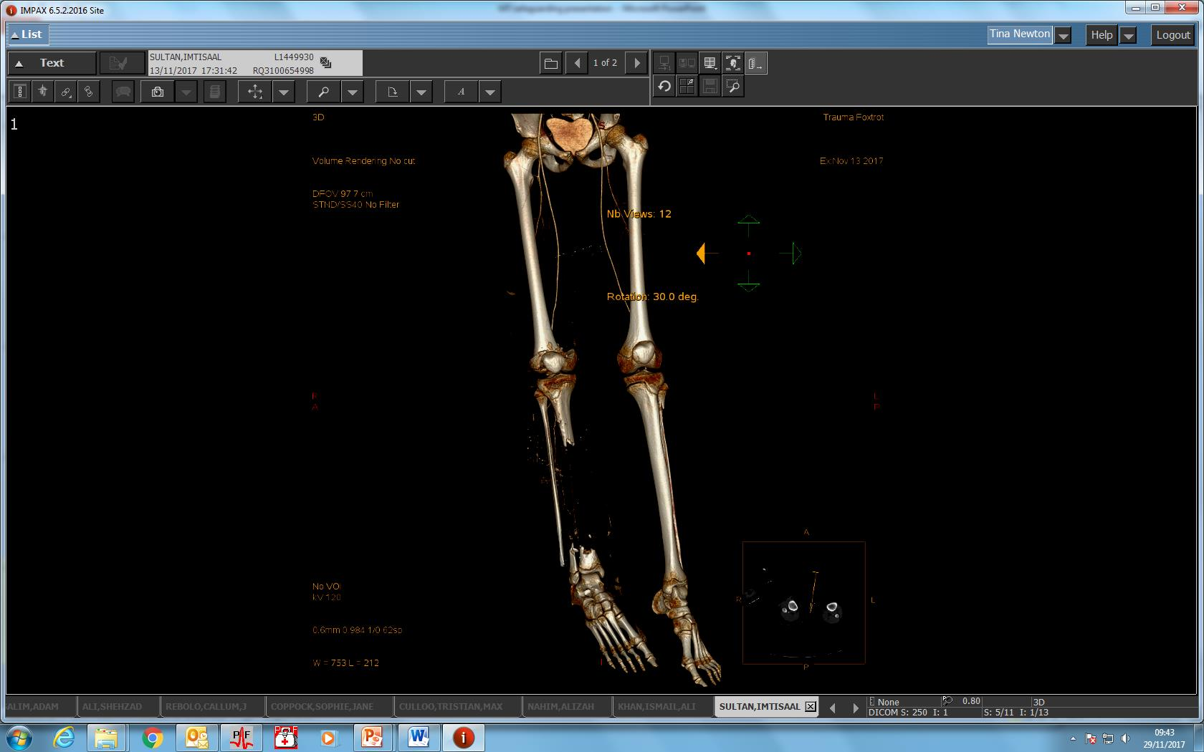

Slide 27
Safeguarding issues are prevalent
But what about after the major trauma has been dealt with?
These children leave hospital with more complex needs than they had before their accident (housing, psychological needs, education challenges)
We have seen that the majority of our patients were already vulnerable before their accident
Where does our responsibility end?

Slide 28
We have learned that kids will often tolerate injury with little initial change in physiology

Slide 29
Drumstick boy

Slide 32
Research
BCH ED has an active research profile
Trauma related research has included the GRIP study looking at handlebar injuries
It’s all in the history

Slide 33
12 year old fell off a scooter……..

Slide 34
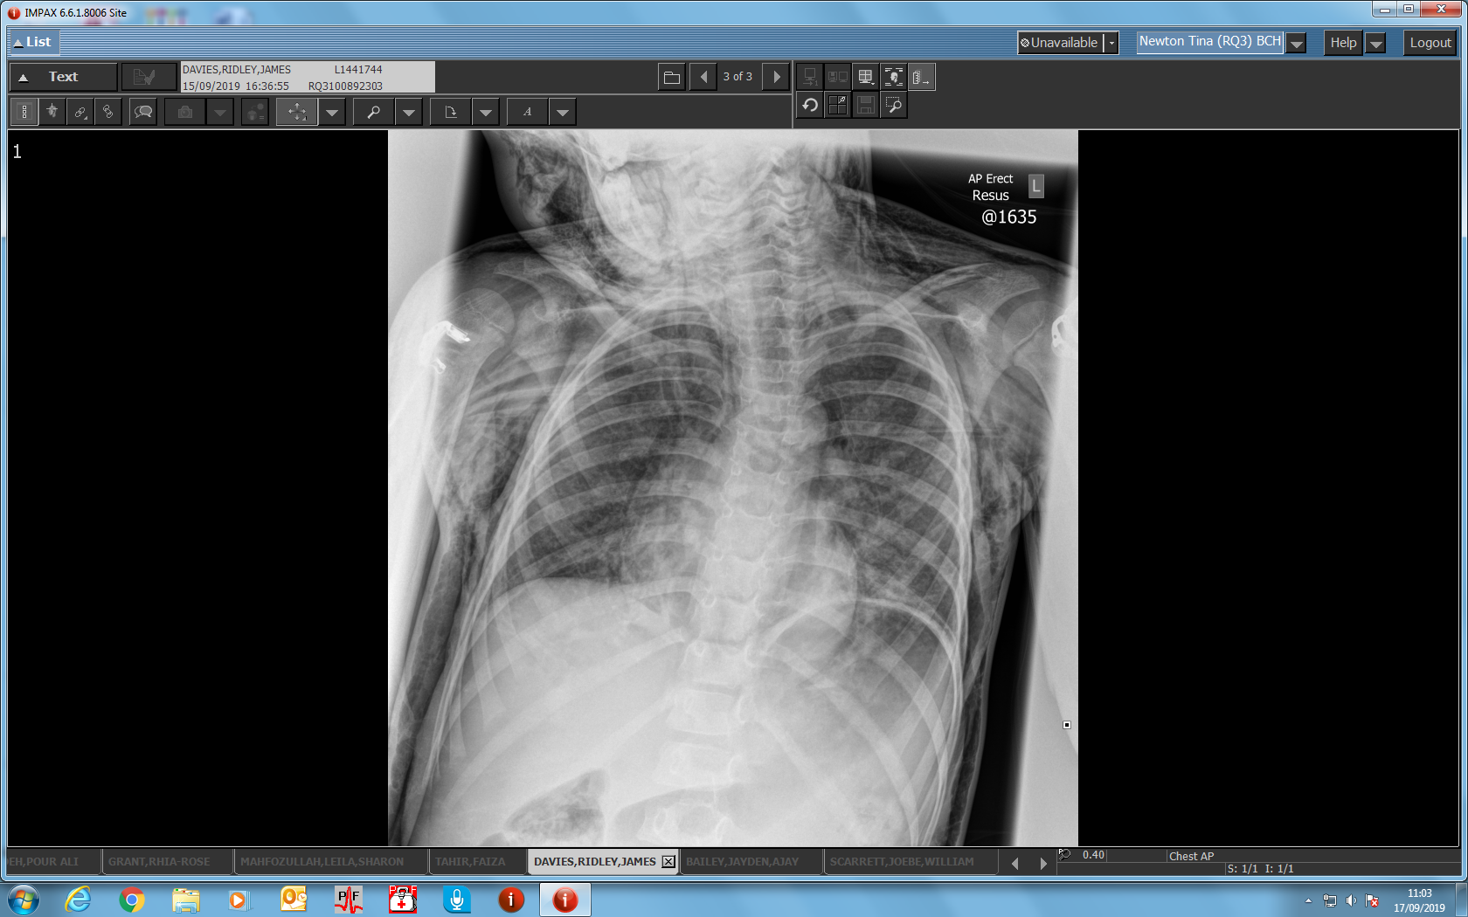

Slide 35
And a final reminder…….
0300 200 1100

Slide 36
Take home messages
In children’s trauma think safeguarding
Children will often compensate well; the devil is in the detail of the mechanism of injury.

Slide 37
