Slide 1
Chapter 15
The Nation Breaking Apart

Slide 2
Economic Differences
North
Many small farms
Industry
Commerce (Trade)
Immigrants
Opposed slavery
South
Plantation farming
Small class of wealthy planters
Cash crops (cotton)
Slave labor

Slide 3
Compromise of 1850
California admitted as a free state
Slave trade abolished in D.C.
Congress promised not prevent slavery in the other territories gained from Mexico
Congress promised to pass a stronger law to benefit slaveholders
Fugitive Slave Act
Suspected run-away slaves could be arrested without a warrant
Required northerners to help recapture and return run-away slaves

Slide 4
Compromise of 1850

Slide 5
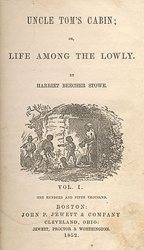
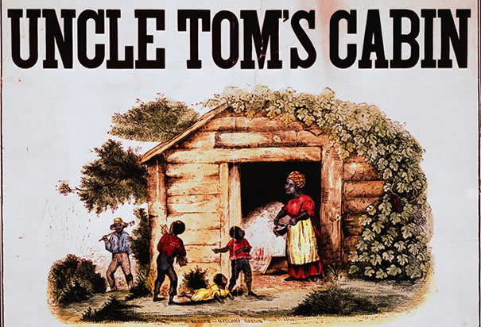
Uncle Tom’s Cabin
Novel by Harriet Beecher Stowe
1852
Presented the cruelty of slavery
Popular in North
Created more tension

Slide 6
Kansas Nebraska Act (1854)
Bill drafted by Sen. Stephen Douglas
Divided Nebraska Territory into two parts
Kansas & Nebraska
Residents of territories vote on slavery
Popular sovereignty
Went against the Missouri Compromise
“Bleeding Kansas” & “Bleeding Sumner”

