Slide 1
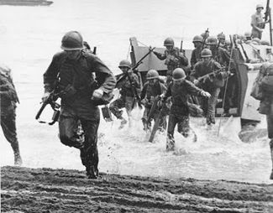
World war II and Lubbock
http://www.wbellauthor.com/single-post/2015/06/07/Reprise-A-Day-That-Changed-The-World

Slide 2
Credits:
Sponsored by The Knowledge Center, Inc. - Lubbock, Texas
This project was made possible through the generous support of:
The CH Foundation
The Knowledge Center, Inc.
The Lubbock Christian University School of Education
Lubbock Independent School District
All photographs are printed with permission from:
Southwest Collection/Special Collections Library at Texas Tech University
Lubbock Independent School District
Prepared by Samuel Ayers, Ed. D., Katie Dunn, and Claudia Sanchez
Copyright 2017

Slide 3
U.S. Presidents
http://totallyhistory.com/franklin-roosevelt/
https://en.wikipedia.org/wiki/Harry_S._Truman
Franklin D. Roosevelt
1933 -1945
Harry S. Truman
1945 - 1953

Slide 4
Texas Governors
https://en.wikipedia.org/wiki/W._Lee_O%27Daniel
https://en.wikipedia.org/wiki/Coke_R._Stevenson
W. Lee O’Daniel
1939 - 1941
Coke R. Stevenson
1941 - 1947

Slide 5
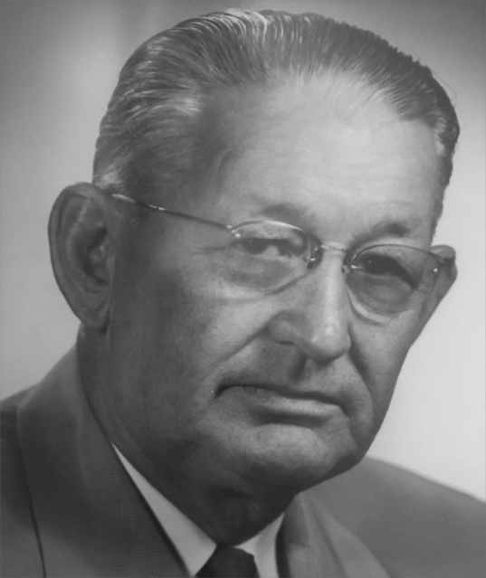
Lubbock Mayors
City of Lubbock
City of Lubbock
Mayor Carl E. Slaton
1938-1944
Mayor O.W. Ribble
1944-1945

Slide 6
World War II
1939-1945

Slide 7
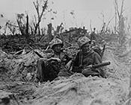
World War II - 1939
September 1:
Germany invades Poland
WWII begins
September 3:
France and Great Britain declare war on Germany
https://www.archives.gov/research/military/ww2/photos

Slide 8
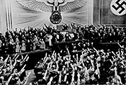
World War II - 1940
May 30:
Winston Churchill becomes leader of British government
July 10:
Germany launches an air attack on Great Britain
Attacks last until the end of October and are known as the Battle of Britain
September 22:
Germany, Italy, and Japan sign the Tripartite Pact creating Axis Alliance
https://www.archives.gov/research/military/ww2/photos

Slide 9
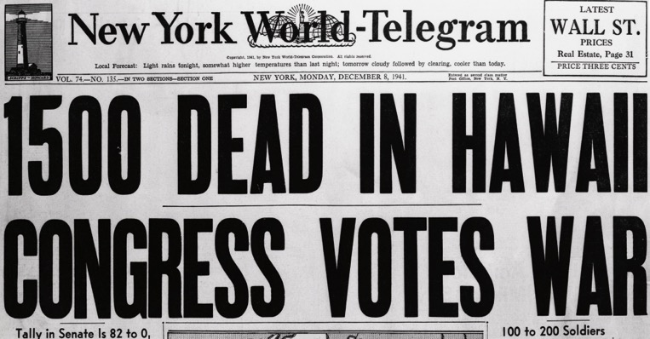
World War II - 1941
June 22:
Germany and the Axis Powers attack Russia with a force of over 4,000,000 troops.
December 7:
The Japanese attack the US Navy at Pearl Harbor.
The next day the United States joined the Allies in WWII .
http://www.history.com/topics/world-war-ii/world-war-ii-history/pictures/pearl-harbor/on-war-fatalities-in-hawaii

Slide 10
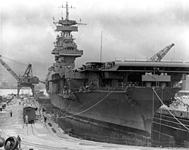
World War II - 1942
June 4:
The U.S Navy defeats the Japanese at the Battle of Midway
https://en.wikipedia.org/wiki/Battle_of_Midway

Slide 11
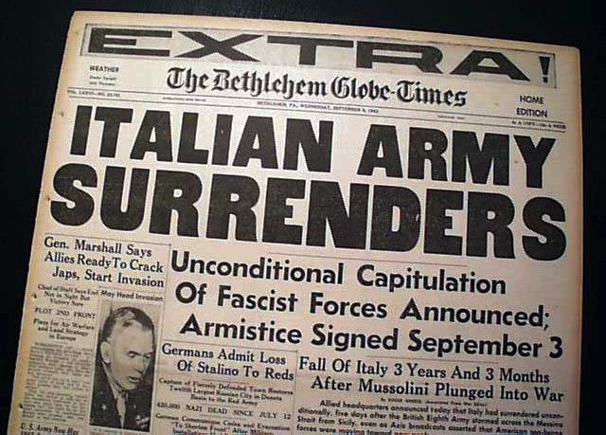
World War II - 1943
September 3:
Italy surrenders to the Allies
Germany helps Mussolini escape and set up government in Northern Italy
April 13:
The Jefferson Memorial in Washington, D.C. dedicated on Thomas Jefferson's 200th birthday by President Franklin D. Roosevelt
http://www.rarenewspapers.com/view/595210

Slide 12
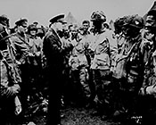
World War II - 1944
June 6:
D-Day and invasion of Normandy
Allied forces invade France and push back the Germans
June 22:
The G.I Bill of Rights is signed into law (provides benefits to veterans)
August 25:
Paris is liberated from German control
December 16:
The Germans launch a large attack in the Battle of the Bulge
Lose to the Allies sealing the fate of German army
December 18:
The U.S Supreme Court rules that internment of Japanese Americans on the West Coast was valid during times of war. (Korematsu vs. U.S.)
https://www.archives.gov/research/military/ww2/photos

Slide 13
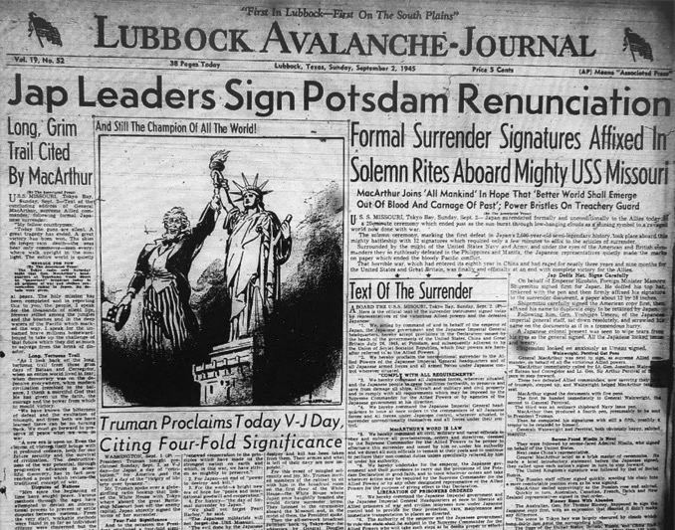
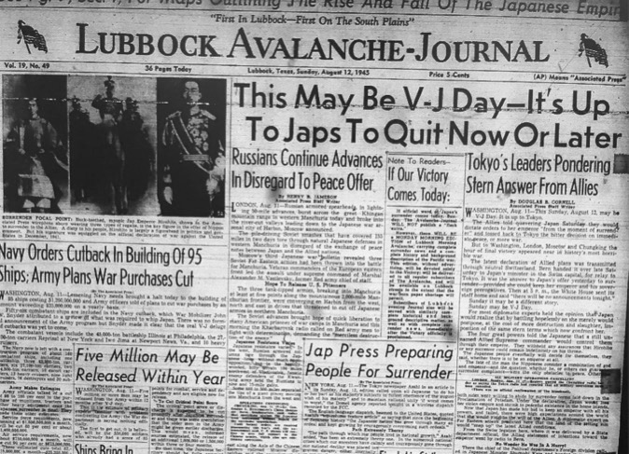
World War II - 1945
February 19:
US Marines invade the island of Iwo Jima, capturing it after a fierce battle
March 22:
US Third Army under General Patton crosses the Rhine River
April 12:
President Roosevelt dies unexpectedly
Vice President Harry S. Truman becomes president
April 30:
Adolf Hitler commits suicide as he knows Germany has lost the war

Slide 14
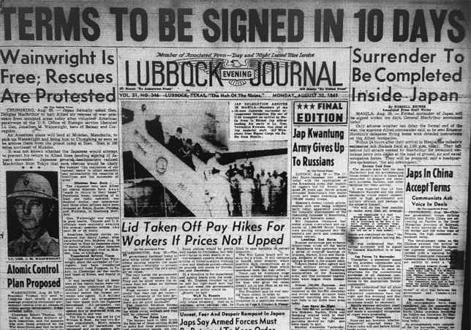
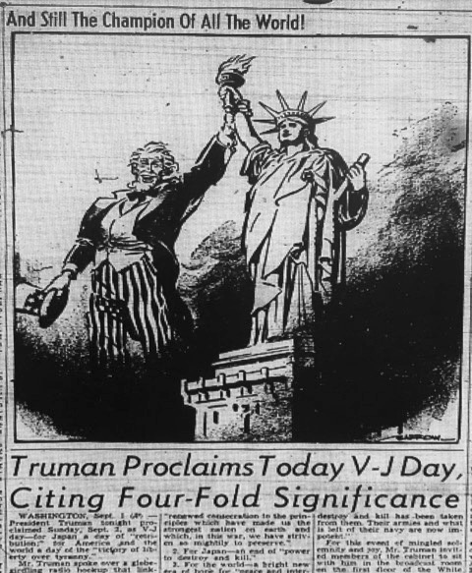
World War II - 1945
May 7:
Germany surrenders to the Allies
August 6:
The US drops an atomic bomb on Hiroshima, Japan, devastating the city
August 9:
Another atomic bomb is dropped on Nagasaki, Japan
September 2:
Japan surrenders to US General Douglass MacArthur and the Allies

Slide 15
Lubbock on the rise
Life in 1940s

Slide 16
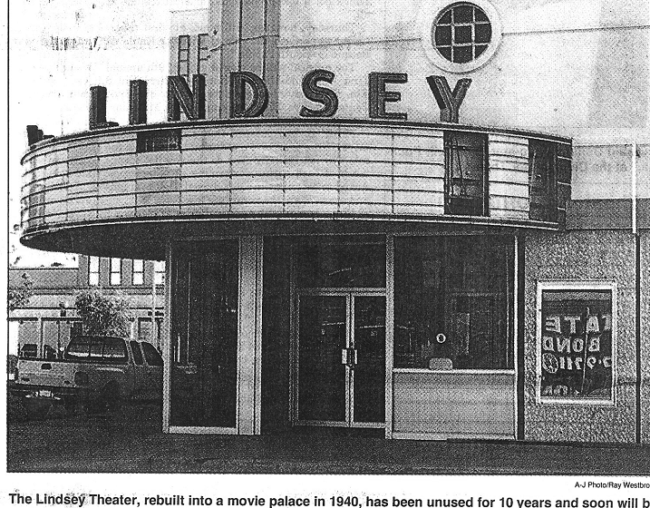
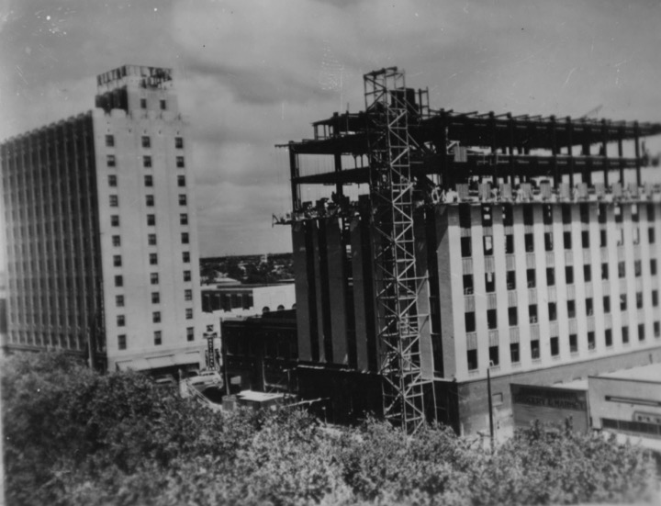
Lubbock on The Rise -Life in1940s
1940:
Population rises to 31,853
New Lindsey Theatre built
Lubbock National Bank construction begins
http://www.lhs54.org/Hi-D-Ho.htm
Lubbock National Bank
Southwest Collection at Texas Tech University

Slide 17
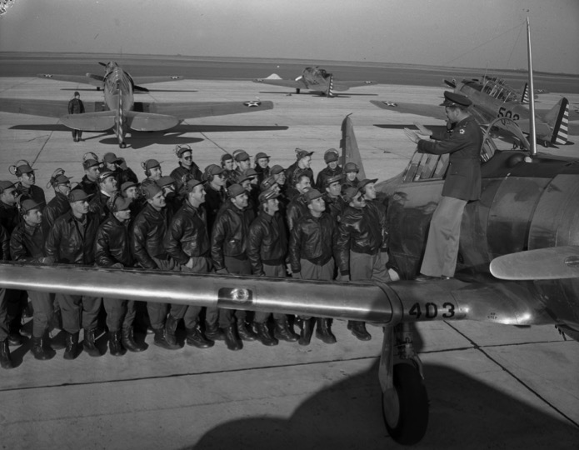
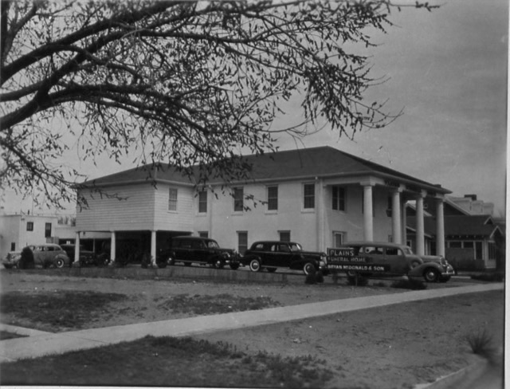
Lubbock on The Rise -Life in1940s
1941:
U.S. Army Flying School established near city
Lubbock Women’s Club established
Cadets at Flying School in Lubbock
Southwest Collection at Texas Tech University
Lubbock Women’s Club
Southwest Collection at Texas Tech University

Slide 18
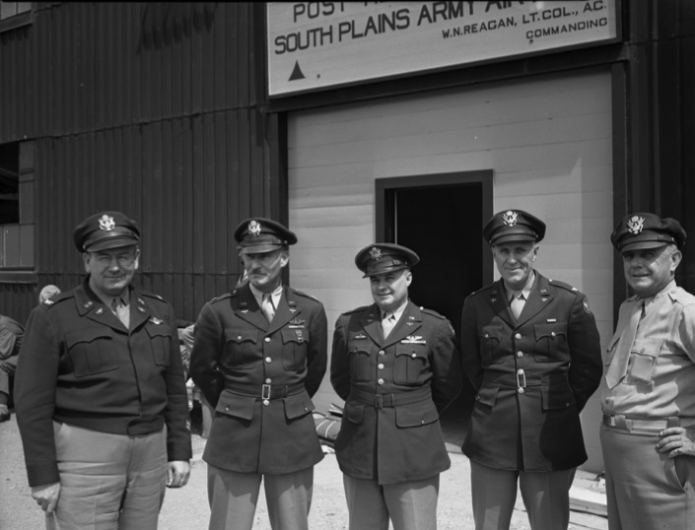
Lubbock on The Rise -Life in1940s
1942:
U.S. Army South Plains Flying School established
Officers at South Plains Army Airfield
Southwest Collection at Texas Tech University

Slide 19
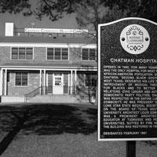
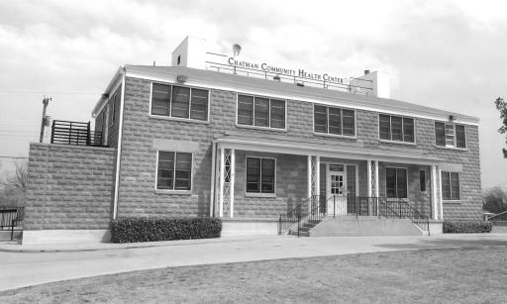
Lubbock on The Rise -Life in1940s
1945:
Chatman Hospital opens
Became a Historical Landmark in February 1981
http://texasplainstrail.com/plan-your-adventure/historic-sites-and-cities/sites/chatman-hospital
Chatman Hospital suffered a fire in 1987, but was restored in 1993.
http://lubbockonline.com/stories/041308/loc_268018088.shtml#.WZiTn8Z5A_U

Slide 20
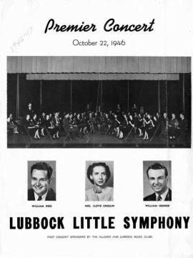
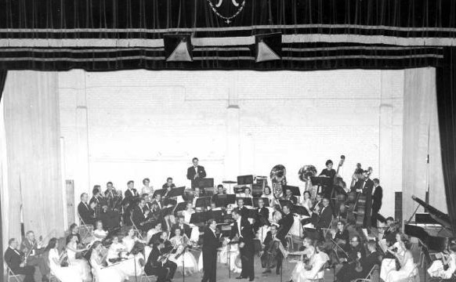
Lubbock on The Rise -Life in1940s
Lubbock Little Symphony became Lubbock Symphony Orchestra
1946:
Lubbock Symphony Orchestra is formed
http://lubbockonline.com/filed-online/2016-10-15/caprock-chronicles-harrod-instrumental-forming-lubbock-little-symphony
An early concert of the Lubbock Symphony held at Lubbock High School

Slide 21
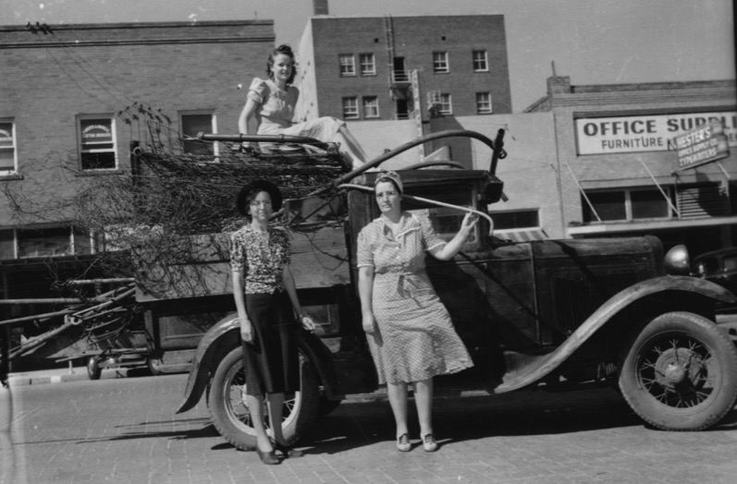
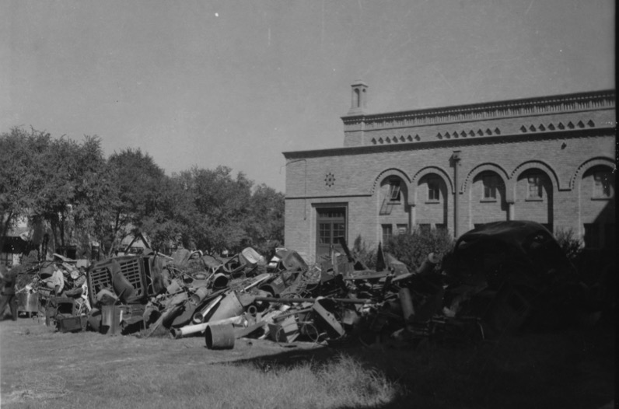
Lubbock on The Rise -Life in1940s
Lubbock scrap metal drive during WWII
Scrap Metal Drive at Lubbock High
Women bringing scrap metal to a collection site.
Southwest Collection at Texas Tech University

Slide 22
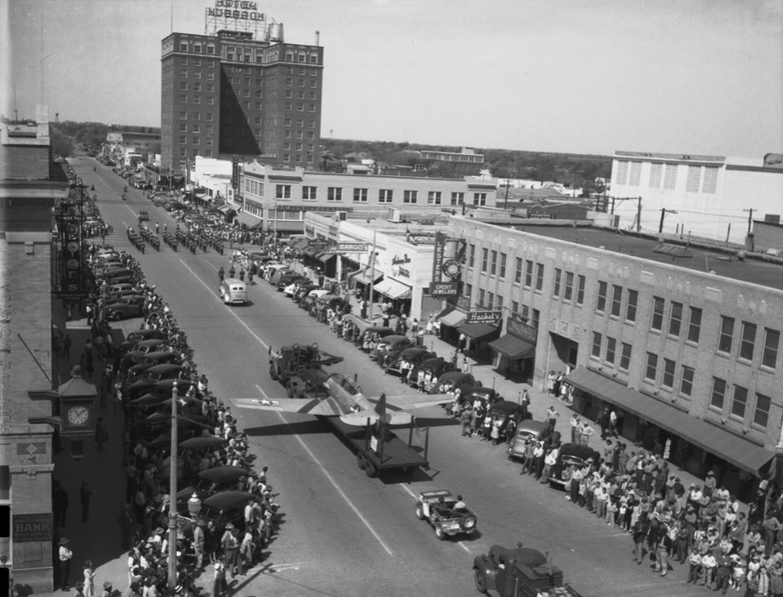
Lubbock on The Rise -Life in the 1940’s
Lubbock Military parade on Broadway street.
Military personnel march in downtown Lubbock
Southwest Collection at Texas Tech University

Slide 23
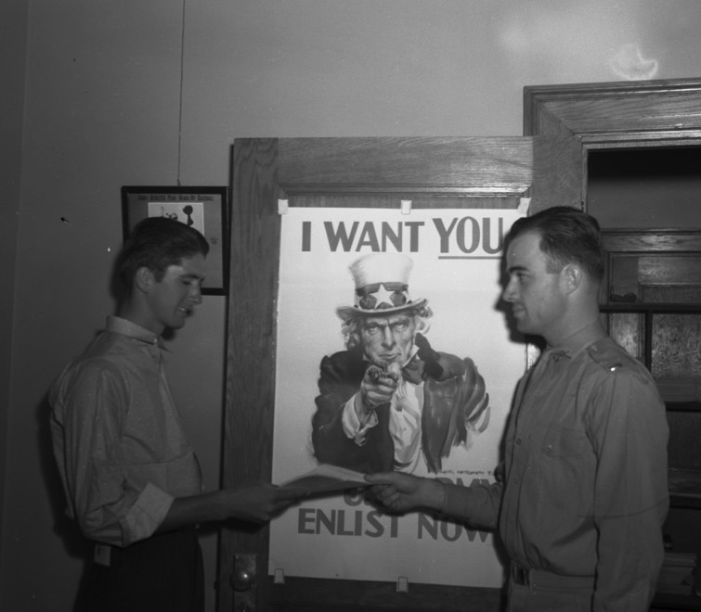
Lubbock on The Rise -Life in the 1940’s
Increased Military Recruitment
“I want YOU…” sign on the door
Brave men pledging their oath to serve.
Southwest Collection at Texas Tech University

Slide 24
Lubbock schools in the 1940s
1939-1944

Slide 25
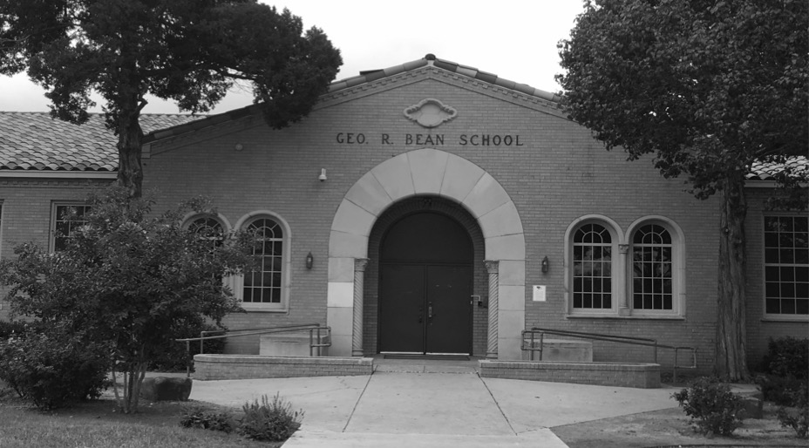
Lubbock Schools in the 1940s
Bean Elementary School – 1939
Named after George R. Bean (1874-1962)
Served many years as County Judge
President of the School Board (1907-09)
First Principal:
Kary Mathis (1940-50)
Southwest Collection at Texas Tech University

Slide 26
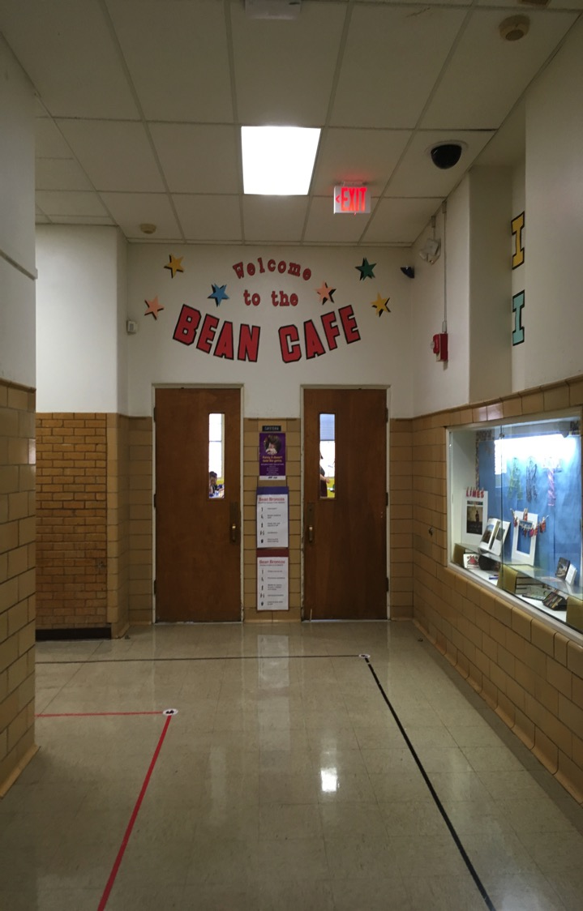
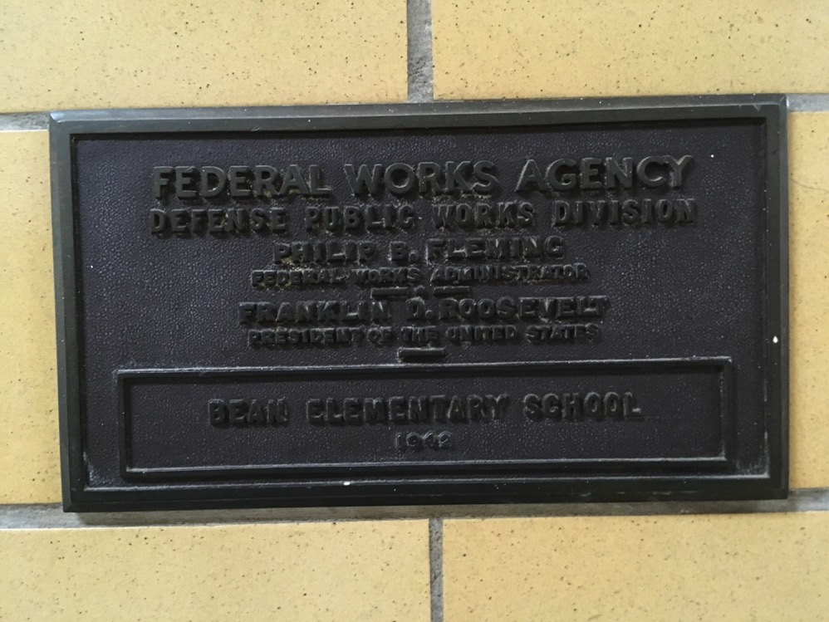
Bean Elementary Cafeteria Addition, 1942

Slide 27
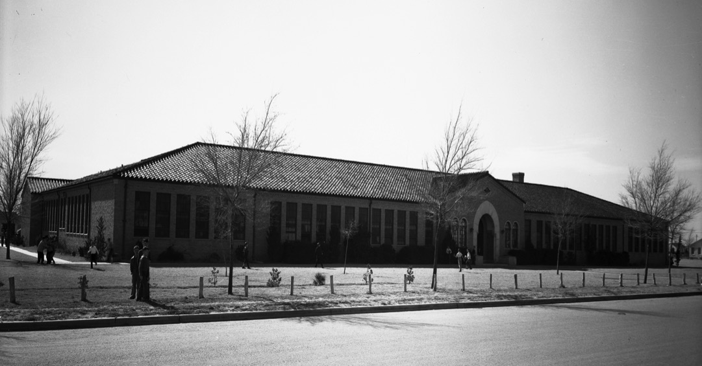
Lubbock Schools in the 1940s
Roscoe Wilson Elementary School – 1940
Named after Roscoe Wilson (1881-1936)
First president of the Lubbock Chamber of Commerce – 1913
Served as an LISD Trustee
First Principal:
Ivy Savage (1940-65)
Roscoe Wilson Elementary during the early 1940s

Slide 28
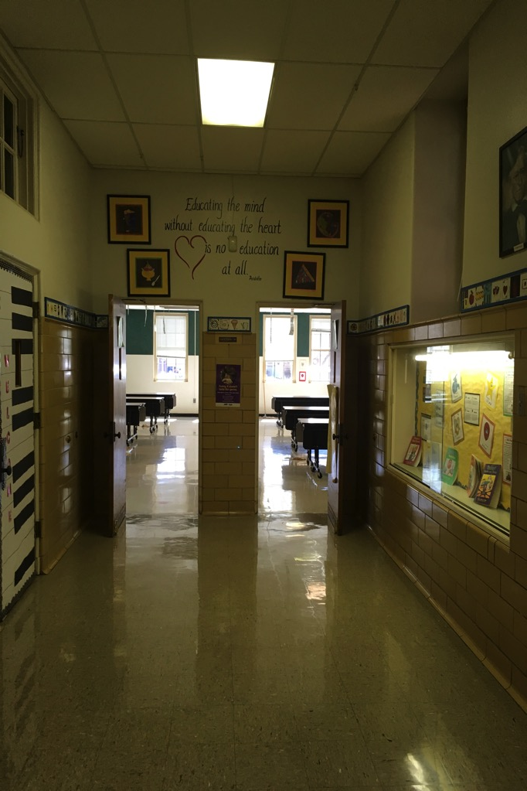
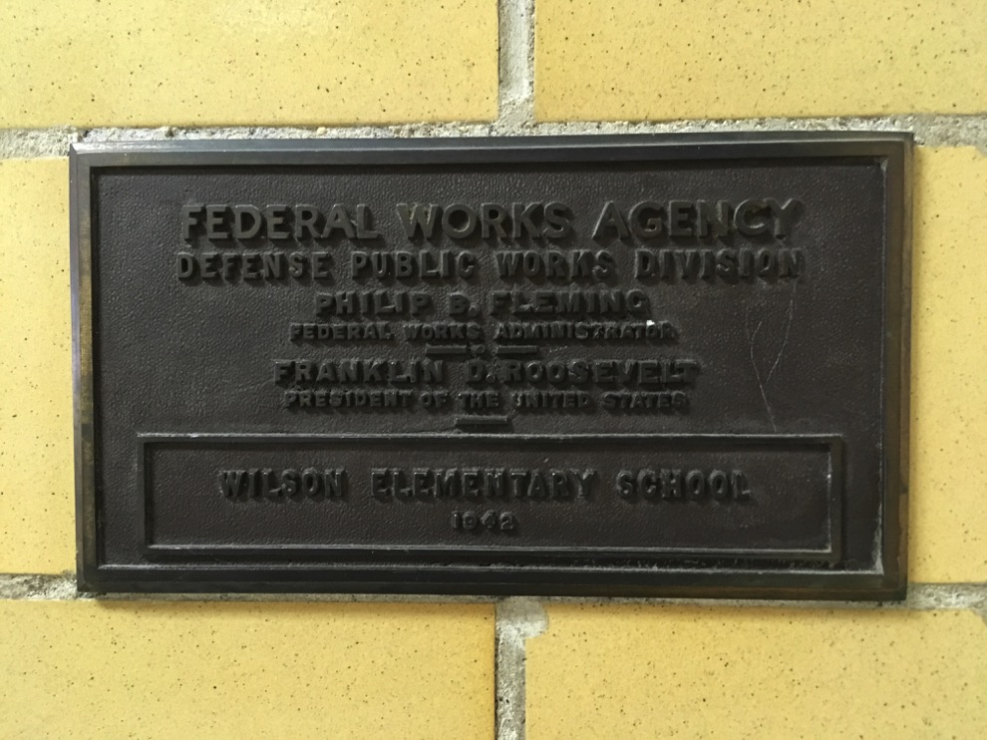
Roscoe Wilson Elementary Cafeteria Addition, 1942

Slide 29
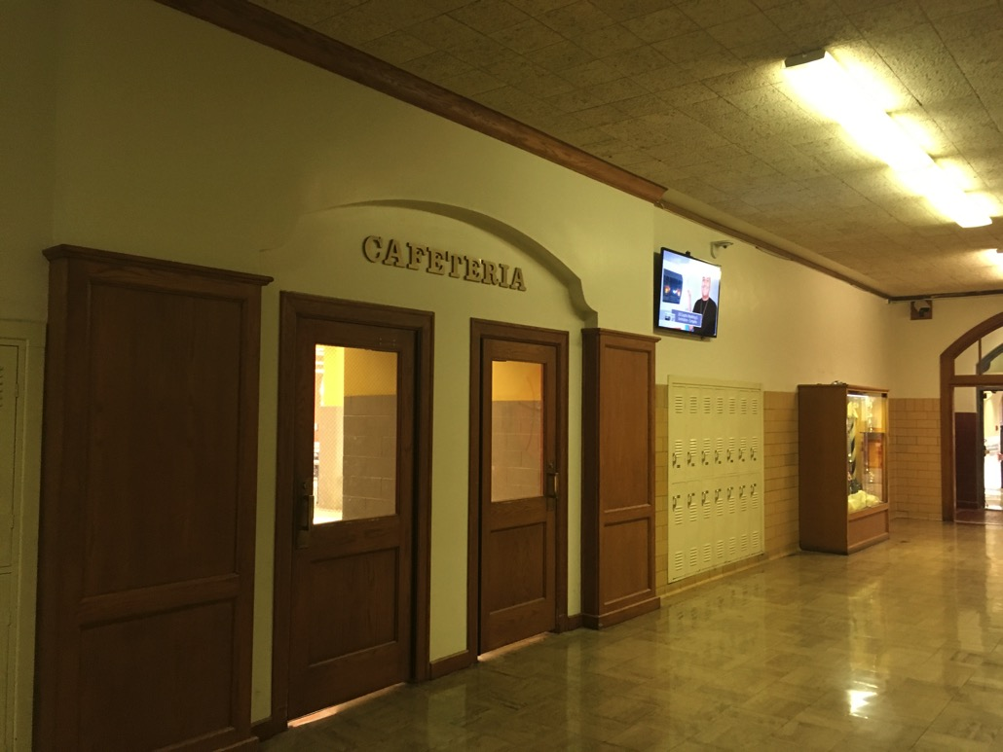
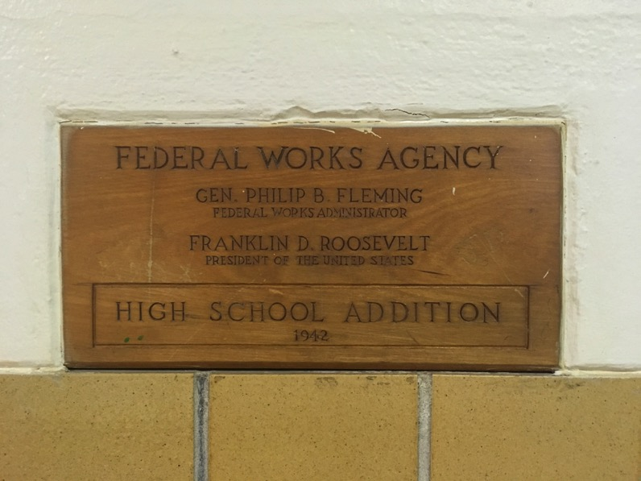
Lubbock Schools in the 1940s
Cafeteria Addition – 1942

Slide 30
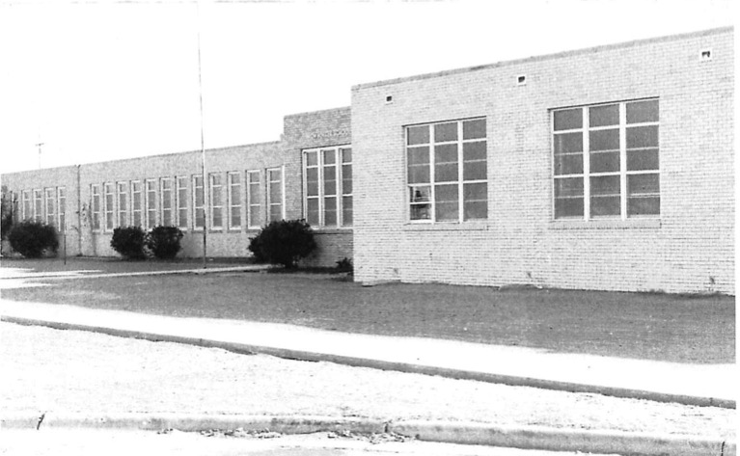
Lubbock Schools in the 1940s
McWhorter Elementary School – 1944
Named after Burton Owen McWhorter (1867-1940)
Invested in first ice plant and electric plant in Lubbock
Served on the City Council (1910-14)
Served on the Lubbock Chamber of Commerce
Leader in securing property for a new school building in 1909
First Principal:
Reuby S. Rhodes (1944-52)
Lubbock Independent School District

Slide 31
Lubbock High Yearbook Pictures
“The Westerner”
during
WWII

Slide 32
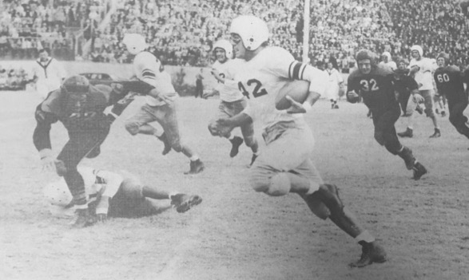
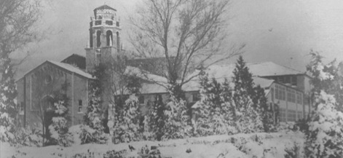
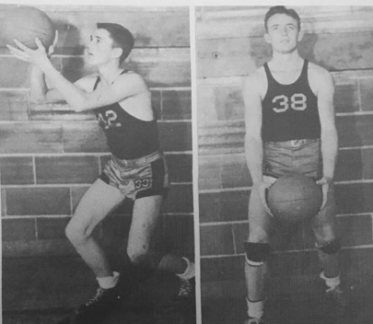
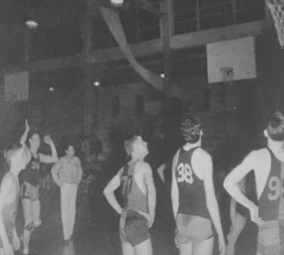
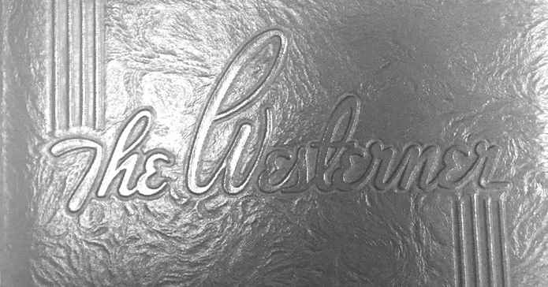
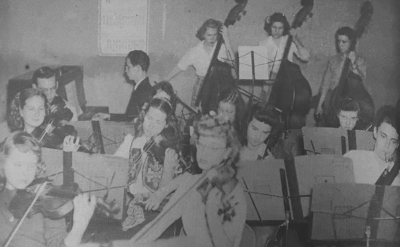
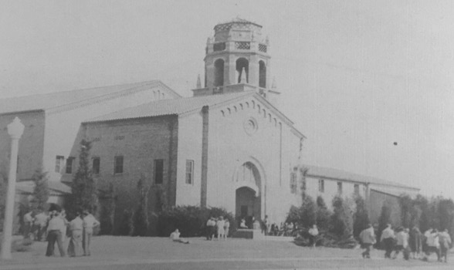
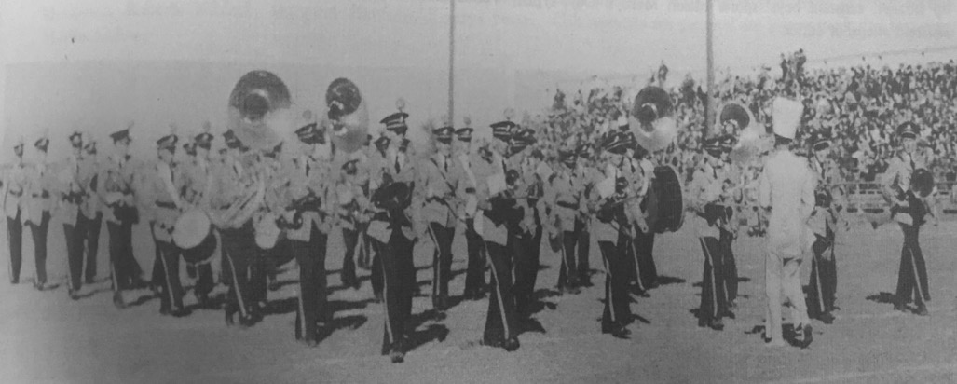
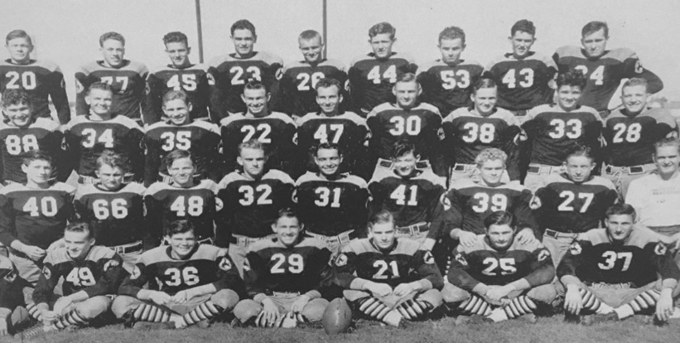
“The Westerner” – 1942

Slide 33
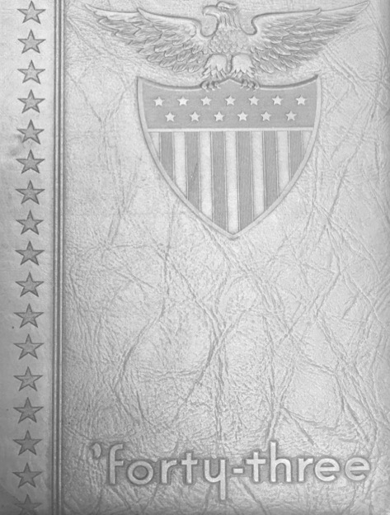
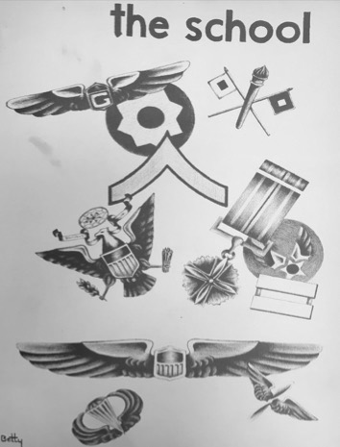
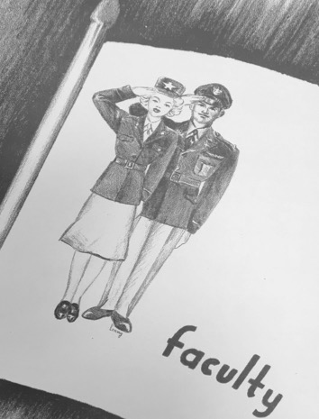
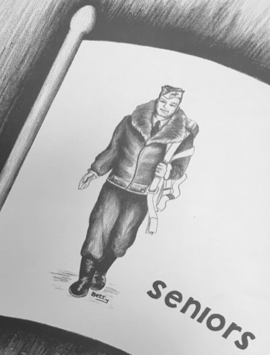
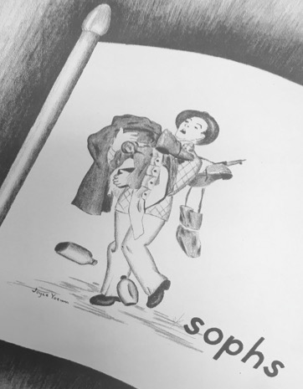
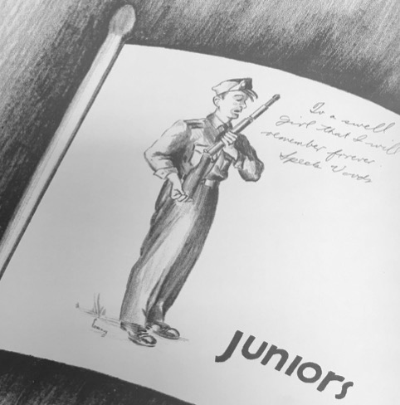
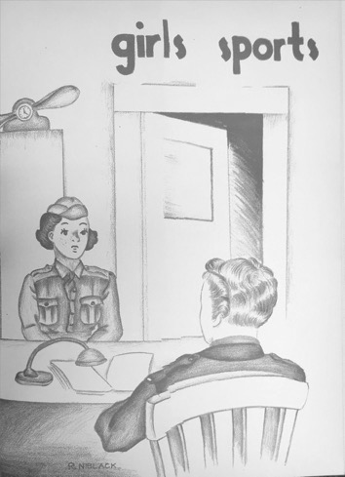
“The Westerner” – 1943

Slide 34
“The Westerner” – 1944

Slide 35
Meet the people of Lubbock
1940-1946

Slide 36
Ross Ayers (1910-2001)
Schools and Honors:
Texas Tech University – 1934
TTU Letterman - 1930-32
TTU Football Captain – 1932
Texas Tech Athletic Hall of Fame – 1966
Armed Services
National Guard – 1932
U.S. Army Officer – 1938
WWII Veteran
Awarded Silver Star for Gallantry in Action – WWII
Appointed by Governor Preston Smith as Adjunct General-Texas National Guard – 1969-73
Commander-Texas National Guard

Slide 37
Ross Ayers (1910-2001)
Career:
Teacher/Assistant Coach at Lubbock HS
Principal at Harwell Elementary School – 1946
Counselor to Disabled Veterans – Veterans Administration
Farmer

Slide 38
Hubert Edwin “Hub” “Big Boy” “Beck” Bechtol (1926-2004)
Schools and Honors:
Lubbock High School – 1943
LHS Three Sport Letterman
LHS Basketball Captain – 1943
Texas Tech University – 1943-44
TTU Two Sport Letterman
Little All-American – 1944
Three-time All-American – 1944-46
1st Round Draft Pick – Pittsburg Steelers – 1963
National College Football Hall of Fame – 1991

Slide 39
Hubert Edwin “Hub” “Big Boy” “Beck” Bechtol (1926-2004)
Armed Services:
U.S. Navy V-12 Program
Career:
NFL Baltimore Colts – 1947-50
Insurance Agent & Relator-Austin
Founding Member-West Austin Youth Sports Programs
Boy Scouts of America Silver Beaver & Silver Antelope Awards
Appointed to Texas Board of Pardons and Paroles
Land Acquisition-Lower Colorado Authority

Slide 40
Kathryn Black – (1919- 1989)
Schools and Honors:
Lubbock High School – 1937
Played in Lubbock HS Orchestra
Texas Technological College – 1941 (now Texas Tech University)
Trapogan School of Fashion Design- New York City – 1946
War Years:
Worked for the U.S. Navy in Corpus Christi – 1942-45
Married U.S. Navy Pilot, Vernon C. Bragg, in New York City – 1945
Career:
Moved with military husband to bases in Washington State; San Francisco, California; Pensacola, Florida; and Norfolk, Virginia
Retired in San Antonio, Texas

Slide 41
Henrietta Bowlin McElroy – (1919-2006)
Schools and Honors:
Lubbock High School – 1937
Participated in theatre productions
Texas Technological School – 1937-39 (now Texas Tech University)
Nursing school in Lubbock after the war
Earned LVN
War Years:
Married Orville McElroy – 1940
Traveled with husband, who constructed air bases, Army bases, and POW Camps, throughout Texas, New Mexico, and Oklahoma
Career:
Worked as a nurse at West Texas Hospital in Lubbock

Slide 42
James Thomas “J.T.” Braxton, Jr. – (1919- )
Schools and Honors:
Booker T. Washington HS (Tulsa OK)
Attended Tuskegee Institute, Tyler College, University of Colorado
Wylie College and University of Nebraska
War Years:
- U.S. Army – Military Band (1943-46)
Career:
Toured the country playing in jazz bands and attending different colleges
Taught band and orchestra in Tulsa and El Paso Schools
Taught band and orchestra at Dunbar, Alderson, Atkins & Struggs

Slide 43
Robert E. Brewer (1925-1944)
Schools and Honors:
Lubbock High School – 1943
LHS Letterman
All-District
2nd Team All-State
Track State Qualifier
100 Yard Dash State Runner-Up – 1943
Texas Technological College – 1943-44 (now Texas Tech University)
TTU Letterman
Armed Services:
U.S. Air Force-Corporal
Killed in Action – WWII

Slide 44
James Chase, Jr. (1918- )
Schools and Honors:
Lubbock High School – 1937
Northern Illinois College of Optometry – 1949
Armed Services:
U.S. Navy
Served in Fighting Squadrons in Philippines Campaign, South China Sea, French Indo China, Formosa, Okinawa, and Iwo Jima
Retired as Lt. Commander – 1945
Career:
Optometrist in Pampa, Texas – 1949-86

Slide 45
Jim Bill Clark (1919-1989)
Schools and Honors:
Lubbock High School – 1937
Armed Services:
U.S. Army Air Corps
Flew 43 missions over enemy Europe
Plane shot down over France- escaped back to England
Discharged – 1945
Career:
Worked in automobile business – 1945-83

Slide 46
Bill Cope (1926- )
Schools and Honors:
Lubbock High School – 1944
LHS Three Sport Letterman
Basketball Co-Captain – 1944
Basketball District Champions – 1944
Two-Time Track Discuss State Qualifier – 1943, 1944
Texas Technological College (Texas Tech University) – 1949
TTC Basketball Letterman
Armed Services:
U.S. Army Air Corp – WWII

Slide 47
Bill Cope (1926- )
Career:
Semi-Pro Baseball- Seagraves-Oil Belt League – 1948-50
Chemical Plant – Denver City
Public Health Service
Business Manager- Knox & Stone Medical Clinic – Brownfield
Basketball & Football Referee - 25 years

Slide 48
Pat “Old Folks” Farris (1921- )
Schools and Honors:
Lubbock High School – 1940
LHS Two Sport Letterman
Football District Champions – 1939
State Champions – 1939
All-State – 1939
Texas Technological College – 1944 (now Texas Tech University)
TTC Letterman
Armed Services:
U.S. Army Air Corps – 1942
Career:
Teacher/Coach: Lubbock HS and Midland HS

Slide 49
Glenna Faye Grant Frame (1907-2000)
Schools and Honors:
Lubbock High School – 1923
LHS Two Sport Letterman
Basketball Captain
Simmons University – 1927 (now Hardin Simmons University)
SU Letterman
Basketball Captain – 1925

Slide 50
Glenna Faye Grant Frame (1907-2000)
Armed Services:
Captain & Physical Education Director– U.S. Women’s Army Corp – 1942-45
Career:
Athletic Director for Women-Simmons University – 1927-35
Director of Physical Education– Abilene HS – 1935-42
Director– Abilene City Recreation Department – 1950s & 1960s

Slide 51
Berl Huffman (1907-1990)
Armed Services:
U.S. Army Air Corps – 1942-46
Career:
Teacher/Head Basketball & Assistant Football Coach– Lubbock HS – 1932-35
Head College Coach for three sports:
Football: Texas Tech Assistant – 1936-42
Basketball: Texas Tech – 1936-42 and 1946-47
Baseball: Texas Tech – 1961-67
Honors:
Texas Tech Basketball Coach: NAIA Tournament – 1942
Texas Tech Hall of Honor – 1972
Berl Huffman Athletic Complex in Lubbock named in his honor

Slide 52
Edwin H. “Ed” Irons (1920-1995)
Schools and Honors:
Texas Technological College – 1943 (now Texas Tech University)
Texas Tech Letterman: Football & Basketball – 1940-42
Texas Tech Hall of Fame – 1973
Lubbock Christian University– Honorary
Irons MS named in his honor – 1989
Armed Services:
U.S. Navy – WWII
Career:
Teacher/Coach– Tyler HS
Principal– Tyler – 1952-63
Superintendent: Tyler (1963-69), Irving (1969-70), Lubbock (1970-83)

Slide 53
Albert Leete "Jug" "Rosie" Jackson Jr. (1922 - 2012)
School and Honors:
Lubbock High School – 1940
LHS Varsity Football: Co-Captain
Football State Champions - 1939
Two-time All-State
Texas Technological College – 1948 (now Texas Tech University)
Texas Tech Football Letterman
Border Conference Champions (1947)
Peach Bowl
Texas High School Football Hall of Fame(1972)
Texas Tech Hall of Honor (1975)

Slide 54
Albert Leete "Jug" "Rosie" Jackson Jr. (1922 - 2012)
Armed Services:
U.S Marine Corp Torpedo Bomber Pilot in "Red Devils" Squadron in WWII
Career:
Radio Station
Executive Vice-President- Red Raider Club – 1951-86
Public relations- Lubbock Power & Light

Slide 55
J.G "Goober" Keyes (1908-1994)
Armed Services:
U.S. Army Air Corps (Lieutenant) – WWII- 1942-45
Career:
Teacher/Assistant coach/Head Track Coach-Lubbock HS.
LHS Track District Champions– 1937-39
LHS Football State Champions
Owner- Sports Center Inc.

Slide 56
Ernest P. Mallory (1917-2005)
Armed Services:
Corporal- U.S. Army- 1942-45
Career:
Bellman
Teacher/Head Basketball Coach- Dunbar HS- 1950-62
Honors:
Dunbar HS Coach:
DHS Team Played Exhibition Game Against Harlem Globetrotters in the Panther Gym- 1951
Five-time District Champions
Four-time PVIL Basketball State Champions- 1953, 1957, 1960, 1962
PVIL Coach of the Year- 1962
Lubbock ISD Athletic Hall of Honor- 2012

Slide 57
Marion Cheshire "Mandy" Manderson (1926-1999)
Schools and Honors:
Lubbock High School – 1944
LHS Letterman – 1944
Co-Captain – 1944
District Champions – 1944
Texas Tech University – 1944
TTU Basketball – 1944
U.S. Maritime Academy – 1945-46
USMA Basketball & Crew

Slide 58
Marion Cheshire "Mandy" Manderson (1926-1999)
Armed Services:
Cadet Midshipman- U.S. Merchant Marines– WWII – 1945
Naval Reserve Officer
U.S. Navy
Career:
Engineer- Arthur D. Little Management Consulting (Boston)

Slide 59
Lonnie Dean "Primo" McCurry- (1919-2010)
Schools and Honors:
Lubbock High School – 1936
LHS Varsity Football
Texas Tech University – 1941
Three-Time TTU Letterman (1938-40)
Cotton Bowl (1938)
All- American 1940)
TTU Basketball (1944)
Drafted NFL Brooklyn Dodgers
Texas Tech Hall of Fame (2000)
Armed Services:
U.S. Marines Corp WWII
Purple Heart at Guam
Retired Lieutenant Colonel – 1960
Career:
Real Estate Broker

Slide 60
Rage Nabors (1920-2003)
Schools and Honors:
Lubbock High School - 1937
Three year letterman in football, basketball, and track
Texas Tech University - 1942
Offered NFL contract with Detroit Lions but joined military
Armed Services:
Enlisted June 12, 1942 - played football for U.S. Army at Lubbock Army Air Field, Randolph Air Field (San Antonio) and Nashville, TN, discharged 1945

Slide 61
Rage Nabors (1920-2003)
Career:
Played in Canadian Football League for Montreal Allouttes - 1946
Teacher/Coach
Tulia - 1947-49
Matador, TX - 1949-51
Dallastown, PA - 1951-80

Slide 62
Catherine Royalty (1915-)
Schools and Honors:
Lubbock High School - 1932
Texas Tech University - 1936
Texas Tech University - 1949
Vocation:
_ Post High School Teacher – English and School Newspaper Sponsor (1936-41)
Lubbock Junior High School Teacher, English (1941-44)
_ Served in WAVES (1945-47)
_ Lubbock Junior High School Teacher, English and started newspapers at all four campuses
Armed Services:
_ Served in WAVES - Women Accepted for Volunteer Emergency Service (1945-47)
(Trained in New York, worked in San Francisco Fleet Post Office)

Slide 63
Walter E. "Jumbo" Webster (1920-1945)
Schools and Honors:
Lubbock High School – 1939
LHS Letterman – 1936-1938
Honorable Mention All State – 1938
District Champions – 1938
State Champions – 1938
Texas Tech University – 1939-42
Texas Softball League's Jumbo Webster Softball Field (Former Lubbock Hubbers Ballpark) named in his honor
Armed Services:
Civilian Pilot Instructor- Fort Stockton Army Air Field – 1943
U.S. Army Air Corp- WWII- Kill-In-Action – 1945

Slide 64
Then and Now
Today in Lubbock

Slide 65
Lubbock National Bank
Southwest Collection at Texas Tech University
Then – 1940
Now

Slide 66
McWhorter Tire
Southwest Collection at Texas Tech University
Storing cars in garage while men at war
Then – 1940s
Now

Slide 67
Lubbock Women’s Club
Southwest Collection at Texas Tech University
Then – 1941
Now

Slide 68
Bean Elementary
Southwest Collection at Texas Tech University
Then – 1940
Now

Slide 69
Bean Elementary
Southwest Collection at Texas Tech University
Then – 1940

Slide 70
Roscoe Wilson Elementary
Now
Then – 1940

Slide 71
McWhorter Elementary
Then
Now
Lubbock Independent School District

Slide 72
Downtown Lubbock
Military parade area
Southwest Collection at Texas Tech University
Now
Then- 1940s

Slide 73
Scrap Metal Drive
Outside of what was then a movie theatre and now law office
Southwest Collection at Texas Tech University
Then – 1940s
Now

Slide 74
Scrap Metal Drive
Outside of Lubbock High School
Southwest Collection at Texas Tech University

Slide 75
Mail Delivery at Railroad Depot
Southwest Collection at Texas Tech University

Slide 76
War Bonds Drive Event
Downtown Lubbock near courthouse
Southwest Collection at Texas Tech University

Slide 77
Scrap Metal Drive
Downtown Lubbock
Southwest Collection at Texas Tech University

Slide 78
Military Recruitment
Southwest Collection at Texas Tech University

Slide 79
Resources:
Ayers, Samuel J. (2016). Lubbock Sports: A Century of Champions 1916-2016.
Lubbock, Texas: The Knowledge Center, Inc.
Randy Vance, Southwest Collection/Special Collections Library, Texas Tech University
Michael Stewart, Lubbock High School
Michele Campbell, Lubbock High School
Lubbock High Westerner (yearbook)– 1942, 1943, 1944
Lubbock Independent School District
City of Lubbock
Websites:
https://en.wikipedia.org/wiki/List_of_mayors_of_Lubbock,_Texas
http://totallyhistory.com/franklin-roosevelt/
https://en.wikipedia.org/wiki/Harry_S._Truman
https://en.wikipedia.org/wiki/W._Lee_O%27Daniel
https://en.wikipedia.org/wiki/Coke_R._Stevenson
https://www.archives.gov/research/military/ww2/photos
https://www.archives.gov/research/military/ww2/photos
http://americasbesthistory.com/abhtimeline1940.html%20U.S http://lubbockonline.com/discover-lubbock/2016-03-25/then-and-now-lubbocks-timeline
http://lubbockheritagesociety.bravehost.com/historicLubbock.html
http://lubbockonline.com
https://www.archives.gov/research/military/ww2/photos
http://www.rarenewspapers.com/view/595210
https://en.wikipedia.org/wiki/Battle_of_Midway
http://www.history.com/topics/world-war-ii/world-war-ii-history/pictures/pearl-harbor/on-war-fatalities-in-hawaii

