Slide 1
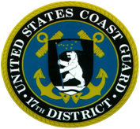
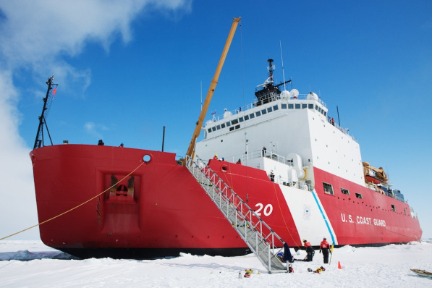
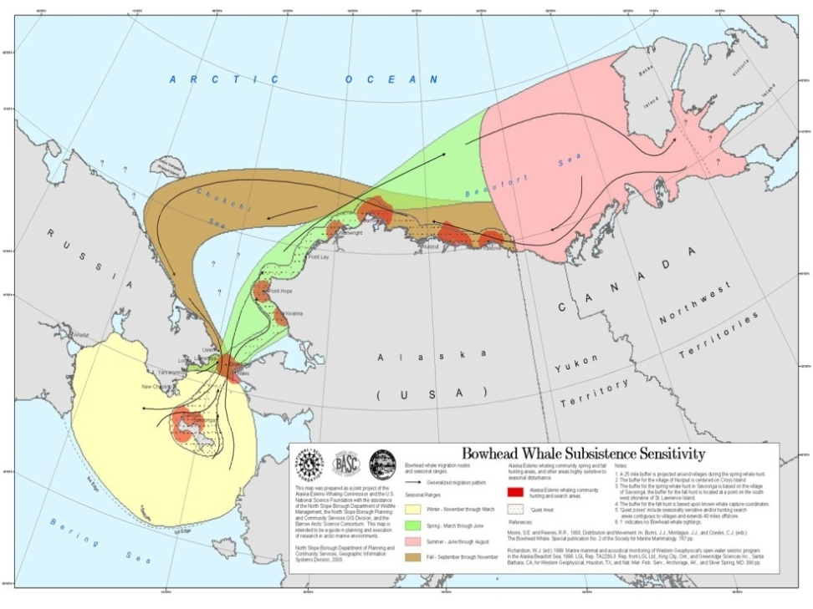
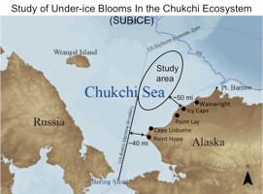
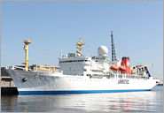
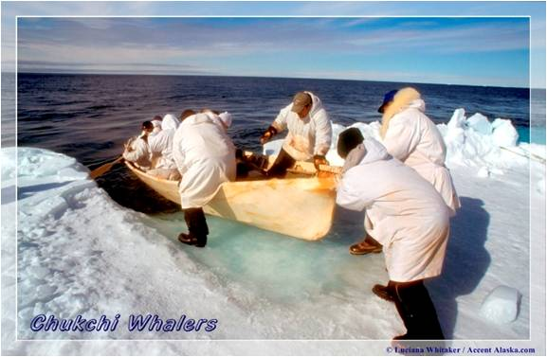
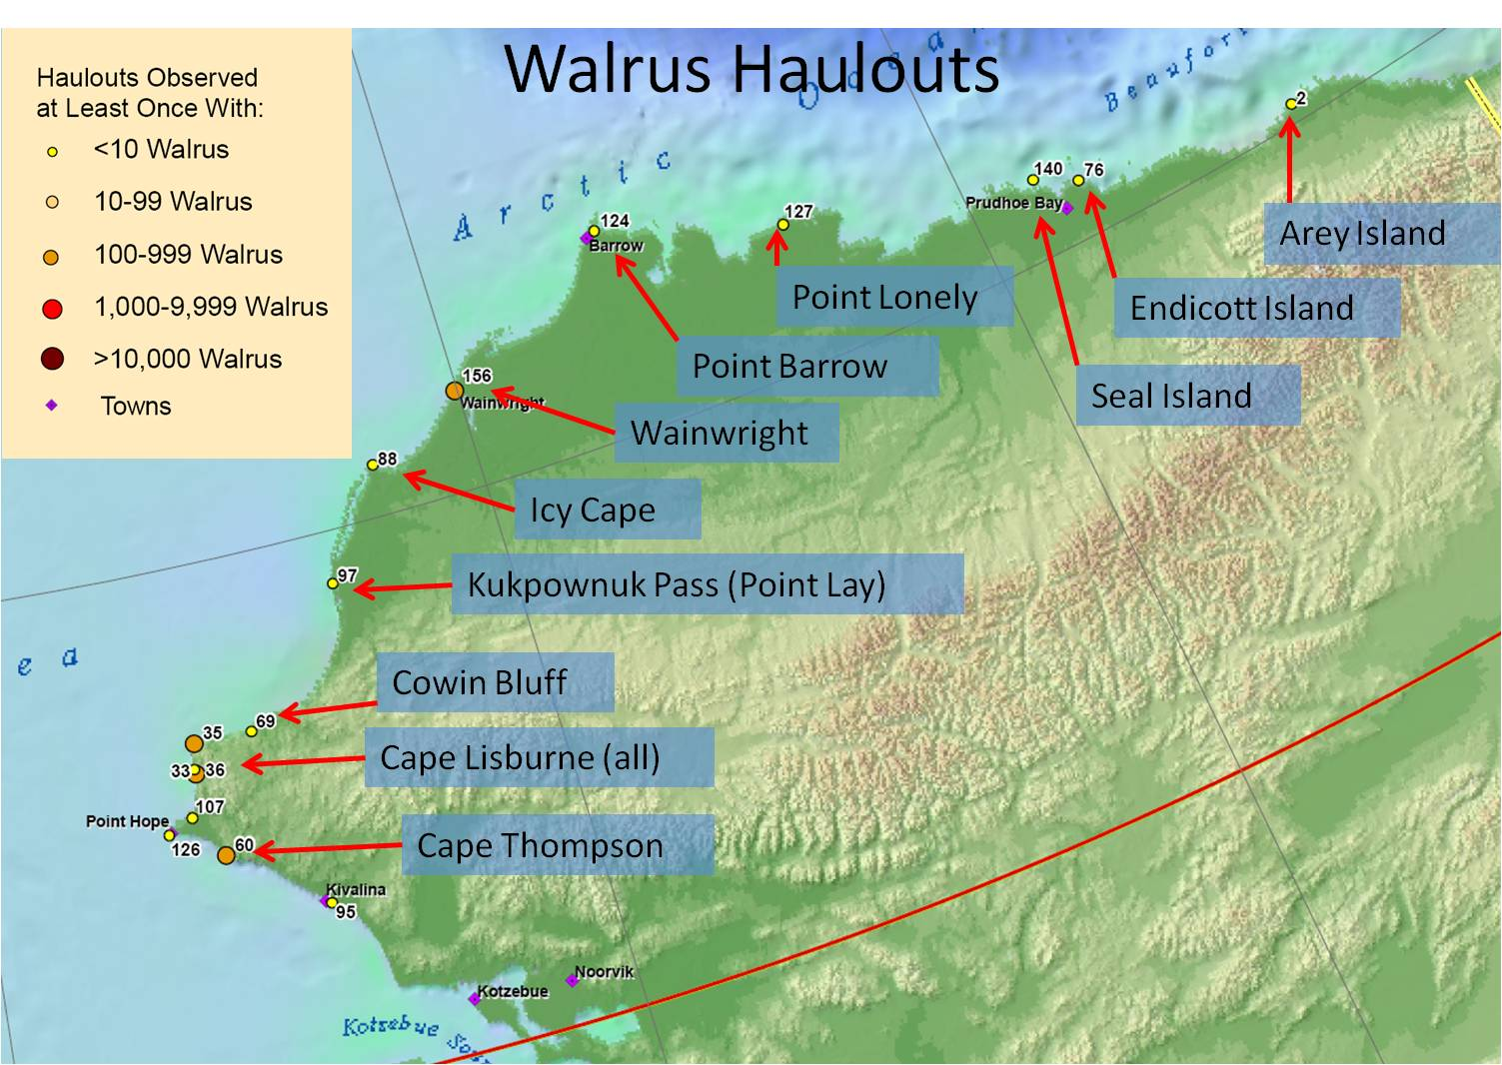
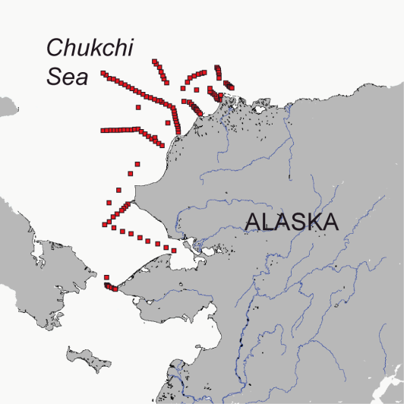
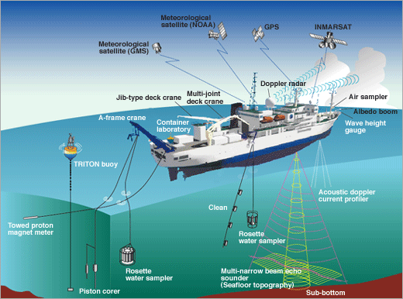
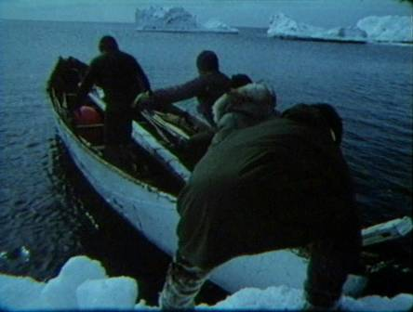
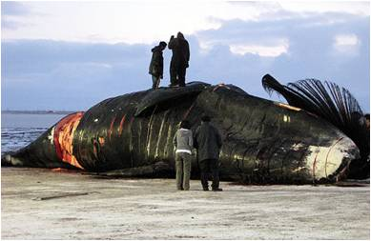
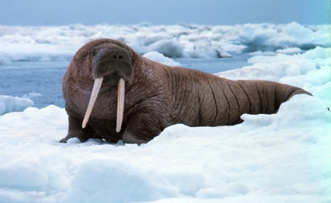
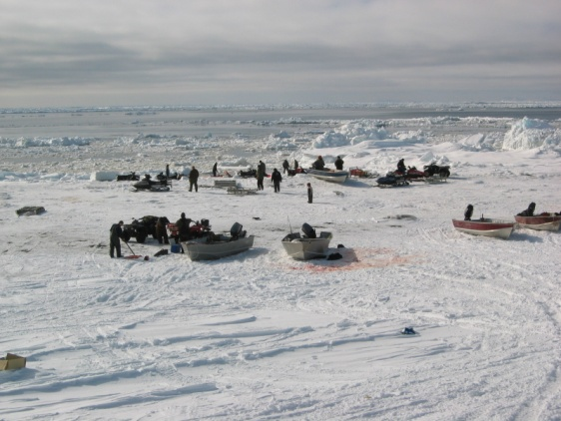
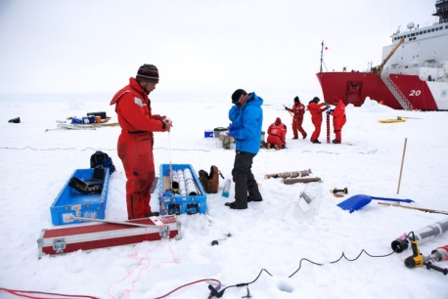
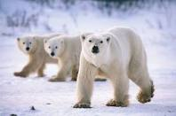
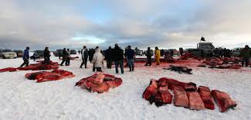
Overview of Sources: Research-Related Conflicts
12/10/2015

Slide 2
Vessel Voyage Info Resources
University-National Oceanographic Laboratory System (UNOLS):
UNOLS Ship Scheduling Committee (Univ-Natl Oceanographic Lab System): https://www.unols.org/committee/ship-scheduling-committee-ssc
Research Vessel Operators Committee: https://www.unols.org/committee/research-vessel-operators-committee-rvoc
Arctic Icebreaker Coordinating Committee (AICC): https://www.unols.org/committee/arctic-icebreaker-coordinating-committee-aicc
Cruise Planning Information for Scientists: https://www.unols.org/ship-schedules/cruise-planning-information-scientists
Ship Schedules: http://strs.unols.org/public/Search/diu_all_schedules.aspx
NOAA Arctic Research:
Distributed Biological Obervatories (DBO): http://www.arctic.noaa.gov/dbo/
USCG Icebreakers:
Cruise Planning: http://icefloe.net/cruise-planning-overview
Marine Exchange of Alaska (Active “Real-Time” Tracking Resource):
Vessel Tracking Information: http://www.mxak.org/

Slide 3
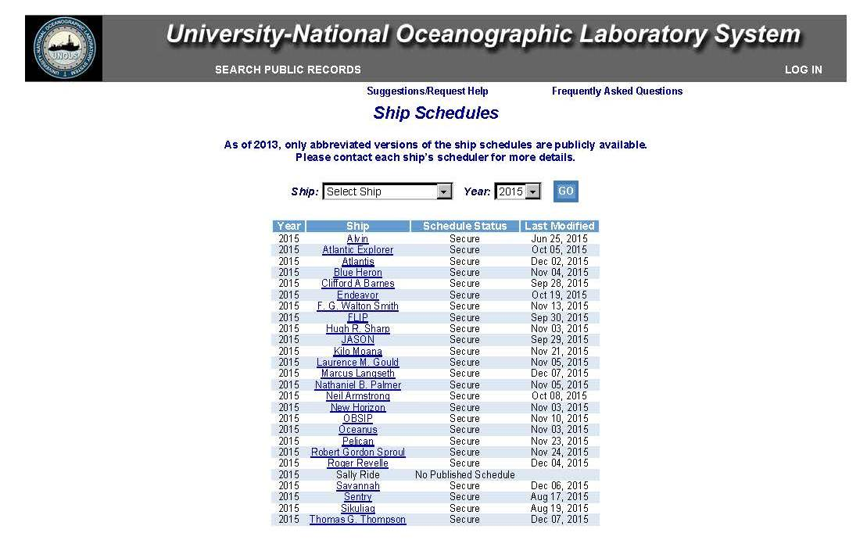
UNOLS Ship Schedules
https://www.unols.org/ship-schedules

Slide 4
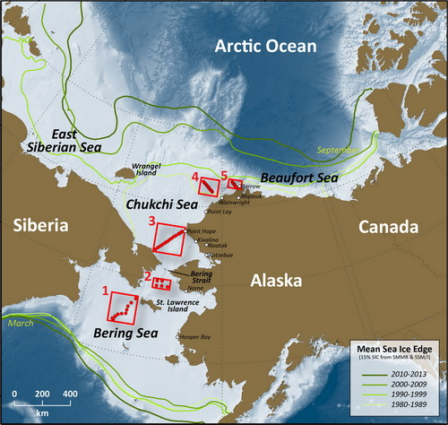
NOAA Arctic Research: Distributed Biological Observatories (DBO)
DBO sites (red boxes) are:
Regional "hotspot" transect lines and stations located along a latitudinal gradient
Considered to exhibit high productivity, biodiversity, and overall rates of change
DBO sites will:
Serve as a change detection array for the identification and consistent monitoring of biophysical responses
Be occupied by national and international entities with shared data plan
http://www.arctic.noaa.gov/dbo/

Slide 5
2015 DBO Cruise Data (Example)
Dates (Port calls) | Ship |  | DBO Region | Projects | PAG contact | Chief Scientist
July 2-8 (Nome-Nome) | Norseman II | 3 |  | Bering Strait Mooring Project/AON | Rebecca Woodgate woodgate@apl.washington.edu
July 11-22 (Nome-Nome) | Norseman II | 2,3,4 |  | USGS | Jackie Grebmeier jgrebmei@umces.edu
July 4-25 (Victoria, BC-Barrow) | Sir Wilfrid Laurier | 1,2,3,4,5 |  | C30/DBO | Jackie Grebmeier jgrebmei@umces.edu
July 27-14 Aug | Fairweather | 2, 3 |  | CTD sampling | Sue Moore sue.moore@noaa.gov
July 30-Aug 5 (Prudhoe-Prudhoe) | Norseman II | DBO6,7 |  | ANIMIDA | Jackie Grebmeier jgrebmei@umces.edu
August-Sept (Dutch-Barrow) | Healy | - |  | GEOTRACERS | Jackie Grebmeier jgrebmei@umces.edu
Aug 6-Sept 2 | Araon | 3 |  | Korean Expedition (KOPRI) | Sung-Ho Khang shkang@kopri.re.kr
Aug 9-Sept 2 (Prudhoe-Wainwright) | Norseman II | 3, 4 |  | AMBON | Jackie Grebmeier jgrebmei@umces.edu
Aug 18-Sept 7 (Barrow-Barrow) | Annika Marie | 5 |  | AON | Carin Ashjian cashjian@whoi.edu
Aug 6-Sept 4 (Kodiak-Dutch Harbor) | Brown | 3,4,5 |  | NOAA/PMEL | Phyllis Stabeno Phyllis.Stabeno@noaa.gov
Aug 25-Oct 6 (Hachinohe, Japan-Dutch Harbor) | Mirai | 3,5 |  | JAMSTEC; DBO moorings 3 and 5 | Takashi Kikuchi takashik@jamstec.go.jp
6-24 Sep (Nome-Dutch Harbor) | Aquila | 3, 4, 5 |  | ARC West/CHAOZ-X | Phyllis Stabeno Phyllis.Stabeno@noaa.gov
mid-October (Anadyr-Anadyr) | Viktor Buynitsky | 3 |  | RUSALCA Bering Strait mooring | Kathy Crane Kathy.Crane@noaa.gov Phyllis.Stabeno@noaa.gov
Sept 4-12 (Wainwright-Wainwright) | Norseman II | 4 |  | Winsor gliders | Jackie Grebmeier jgrebmei@umces.edu
Sept-Oct | Louis S St- Laurent | - |  | JOIS | Bill Williams Bill.Williams@dfo-mpo.gc.ca
Sept-Oct | Sir Wilfrid Laurier | 4, 8 |  | C30/DBO | Bill Williams Bill.Williams@dfo-mpo.gc.ca

Slide 6
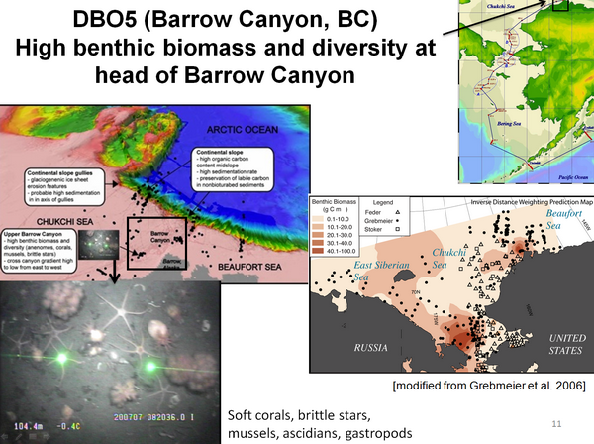
DBO Cruise Data Products & Website Info
Research Info/Findings:
DBO concept can work
6 Cruises/4 Nations (2010-2011)
“Requires Coordination and Commitment”
Repeat testing captures variations
DBO Website Info/Links:
Workshop Products
Cruise Data/Vessel Info
Publications
Contacts

Slide 7
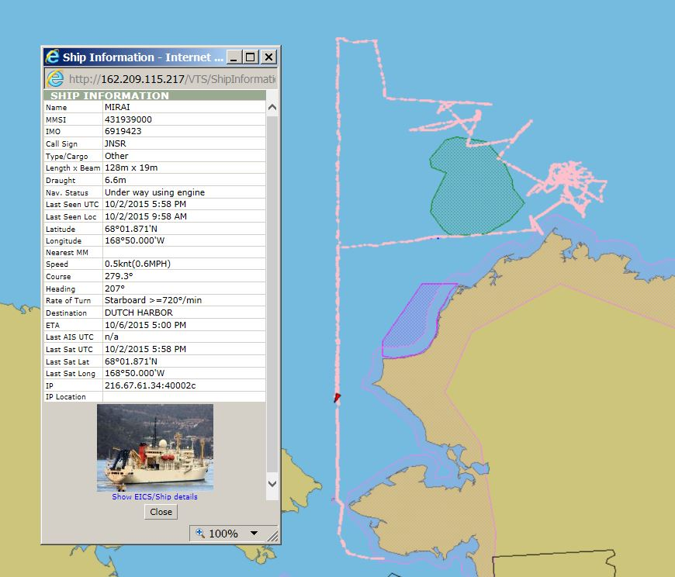
R/V MIRAI

Slide 8
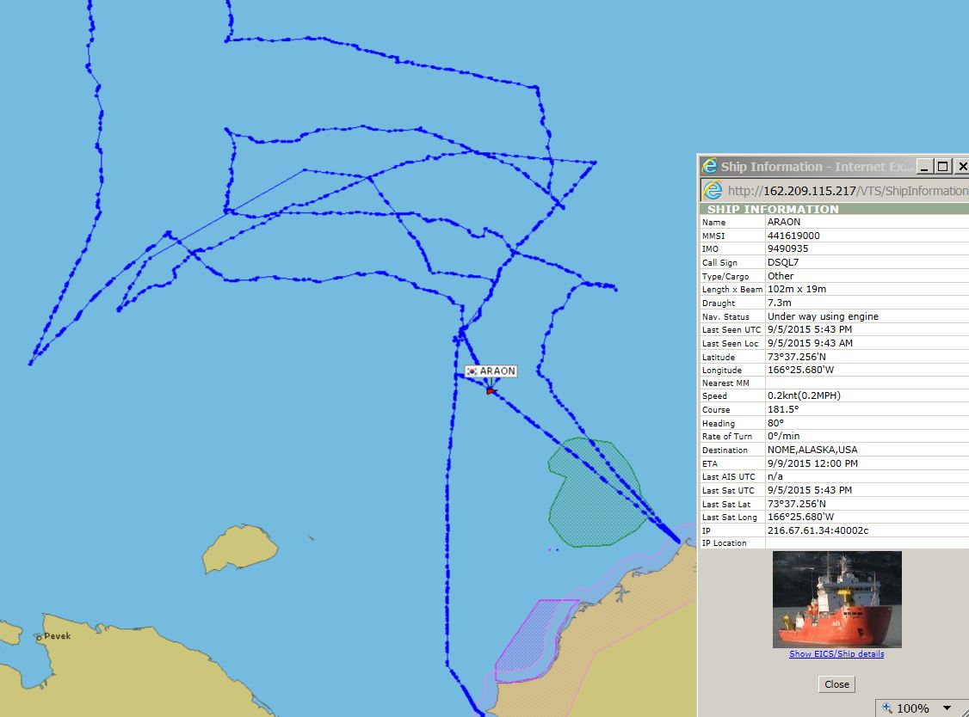
R/V AROAN

Slide 9
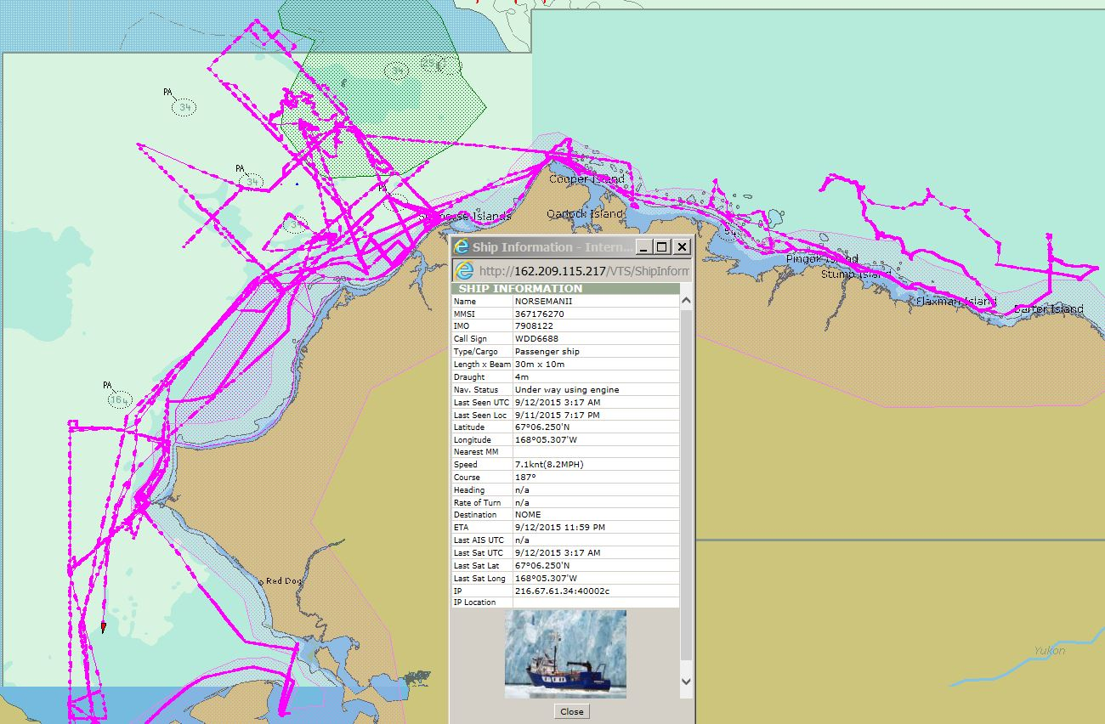
R/V NORSEMAN II

Slide 10
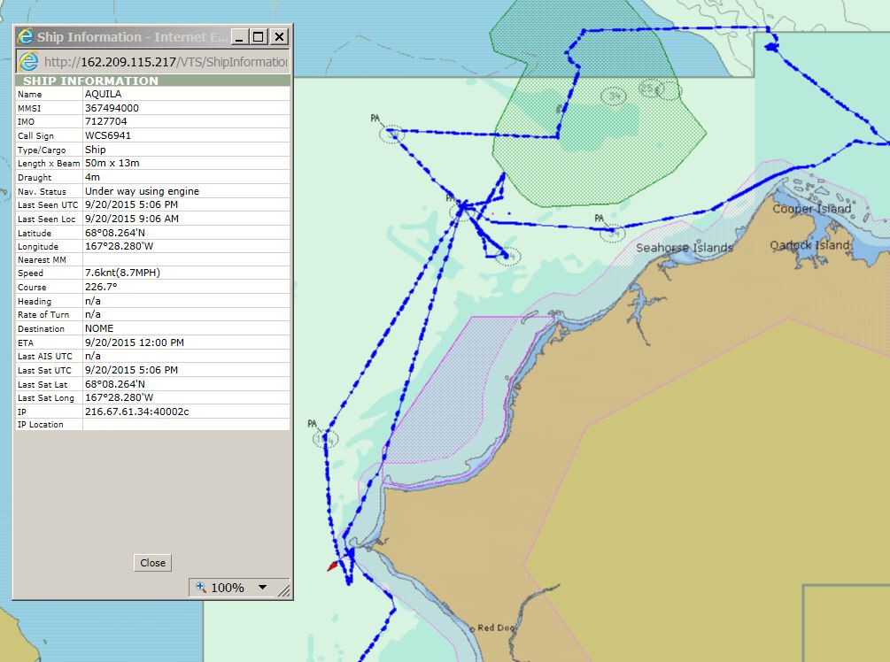
M/V AQUILA

Slide 11
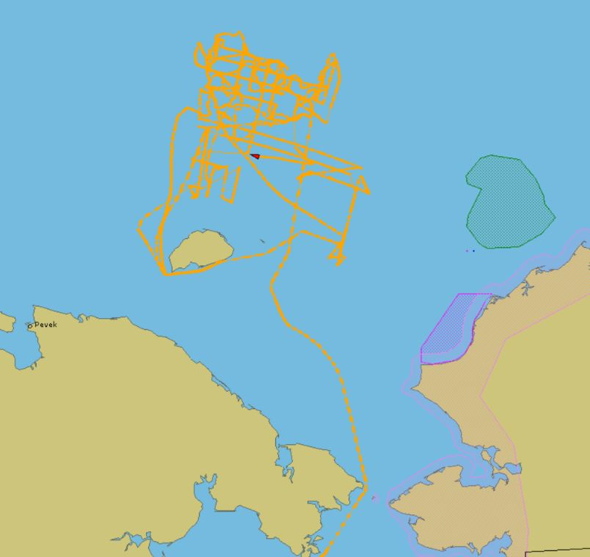
M/V OTTO SHMIDT

Slide 12
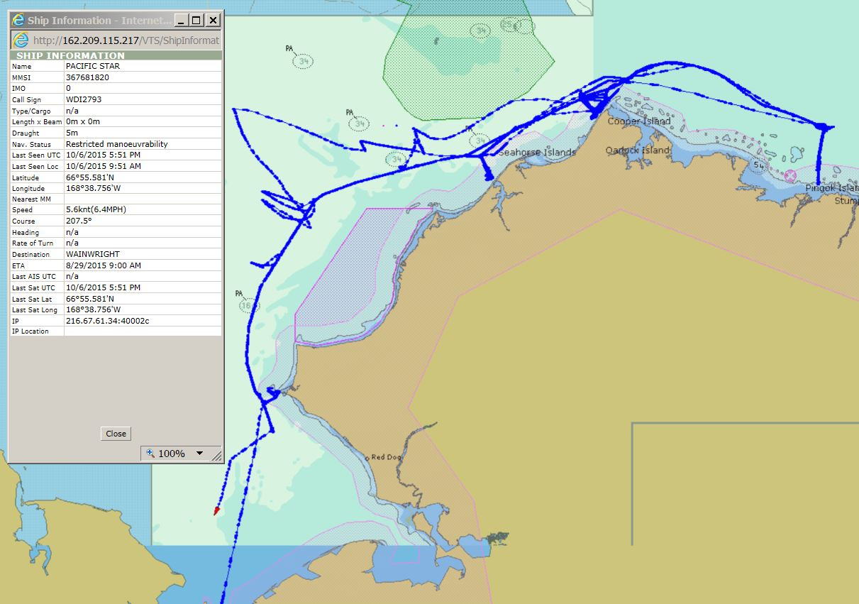
M/V PACIFIC STAR

Slide 13
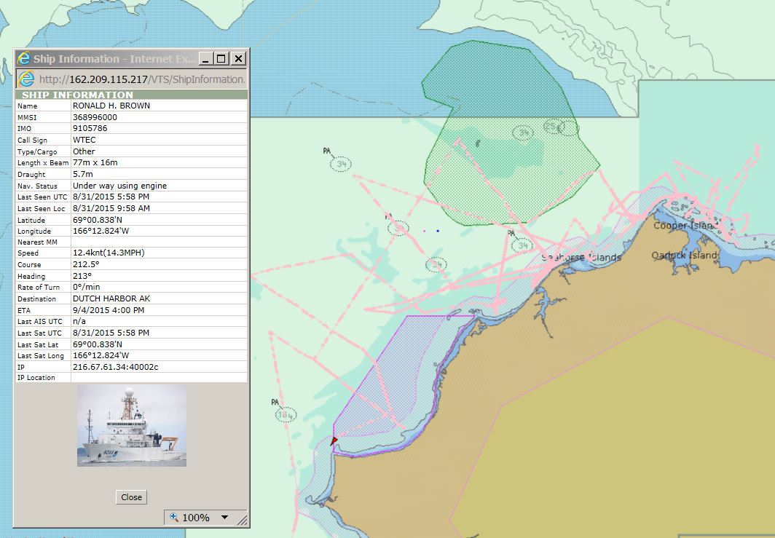
NOAA SHIP RONALD H. BROWN

Slide 14
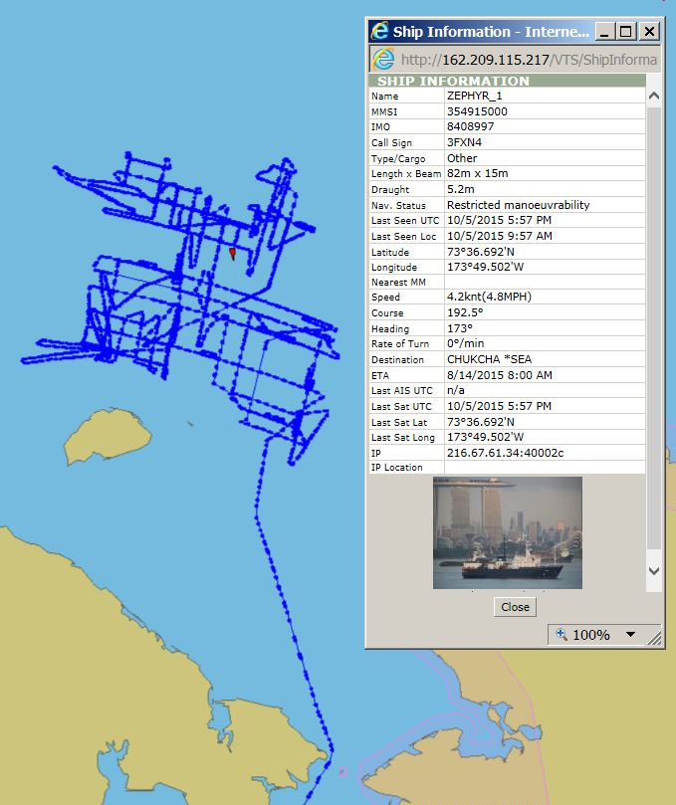
M/V ZEPHYR (Seismic)

Slide 15
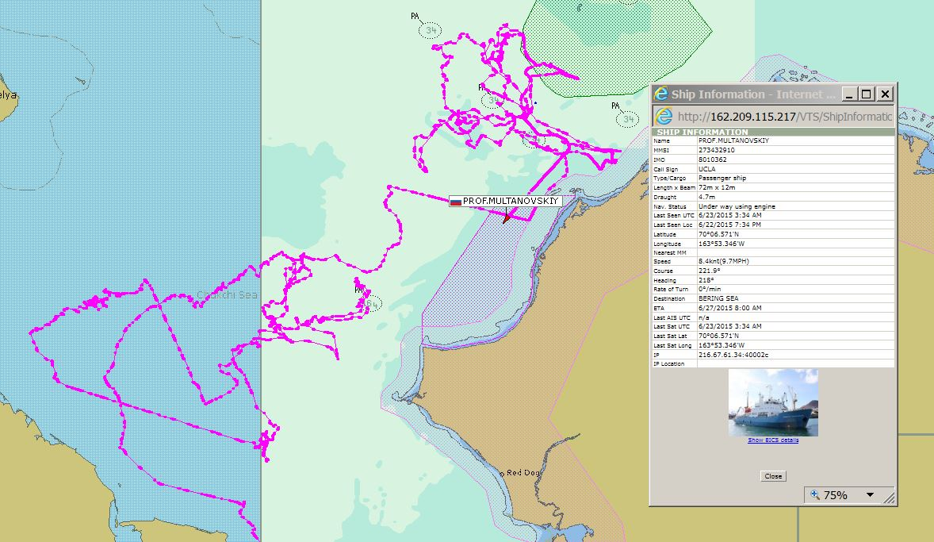
R/V PROFESSOR MULTANOVSKIY

Slide 16
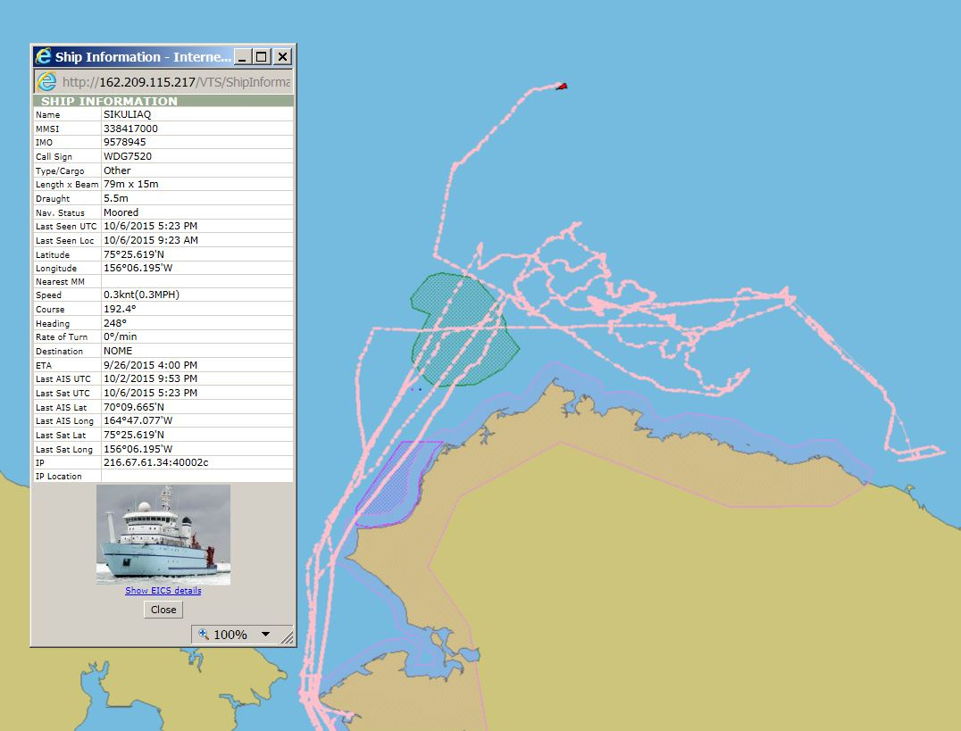
R/V SIKULIAQ (Univ of Alaska)

Slide 17
Composite of Previous Slide Vessel Tracks

Slide 18
Vessel Voyage Info Resources
University-National Oceanographic Laboratory System (UNOLS):
UNOLS Ship Scheduling Committee (Univ-Natl Oceanographic Lab System): https://www.unols.org/committee/ship-scheduling-committee-ssc
Research Vessel Operators Committee: https://www.unols.org/committee/research-vessel-operators-committee-rvoc
Arctic Icebreaker Coordinating Committee (AICC): https://www.unols.org/committee/arctic-icebreaker-coordinating-committee-aicc
Cruise Planning Information for Scientists: https://www.unols.org/ship-schedules/cruise-planning-information-scientists
Ship Schedules: http://strs.unols.org/public/Search/diu_all_schedules.aspx
NOAA Arctic Research:
Distributed Biological Obervatories (DBO): http://www.arctic.noaa.gov/dbo/
USCG Icebreakers:
Cruise Planning: http://icefloe.net/cruise-planning-overview
Marine Exchange of Alaska (Active “Real-Time” Tracking Resource):
Vessel Tracking Information: http://www.mxak.org/

Slide 19
Questions/Discussion
12/10/2015

