Slide 1
Marlene Lieb Harford County Department of Social Services Advisory Board Member

Slide 2
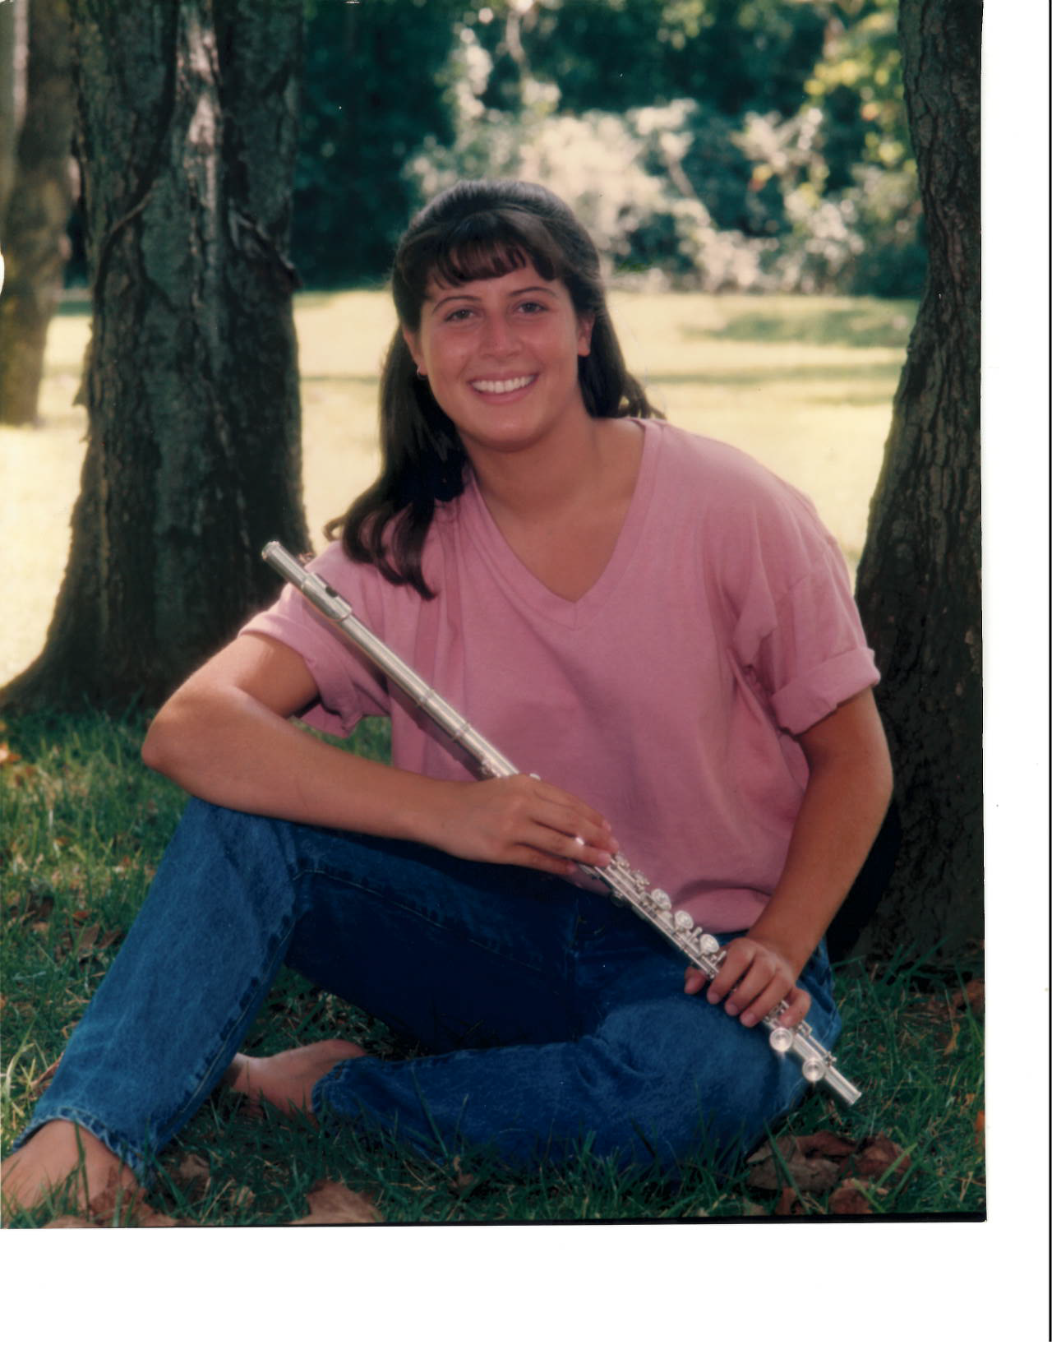
Cheryl in High School

Slide 3
Proud Father walking his Daughter down the aisle!

Slide 4
Mother and Father of the Bride

Slide 5
Cheryl’s Immediate Family

Slide 6
The Lieb Family

