Slide 1
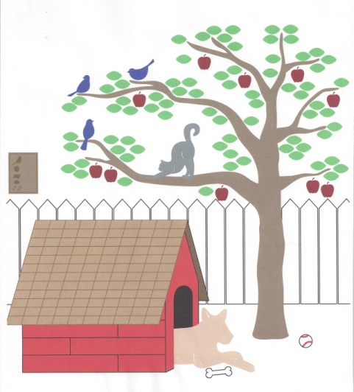

Happy Tails Humane Society
Let It Grow!
Serving the Community and Saving Lives for Over 25 Years

Slide 2
Who we are
Limited-intake, no-kill, nonprofit organization — 501(c)(3)
Funded by private donations
Founded in 1987
Notes:
We are a limited-intake, no-kill nonprofit. We receive no public funding—everything is from private donations. This year we’re celebrating our 25th year saving animal lives and serving the community.

Slide 3
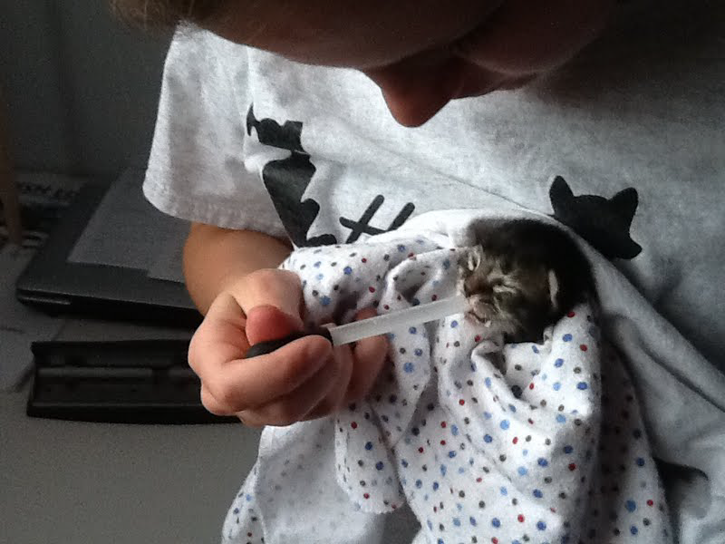
What we do
Pet rescue and adoption
Humane education
Community outreach
Notes:
Our mission is to rescue stray and abandoned dogs and cats and find them loving, permanent homes, and to teach compassion and respect related to animal welfare.
Our mission:
Happy Tails' mission is to help sick, injured, abandoned and unwanted animals within the limits of our available resources; to seek suitable homes for animals without owners and to reunite lost animals with their owners; and to educate the community in the humane treatment of animals and prevent cruelty that may be inflicted upon them.

Slide 4
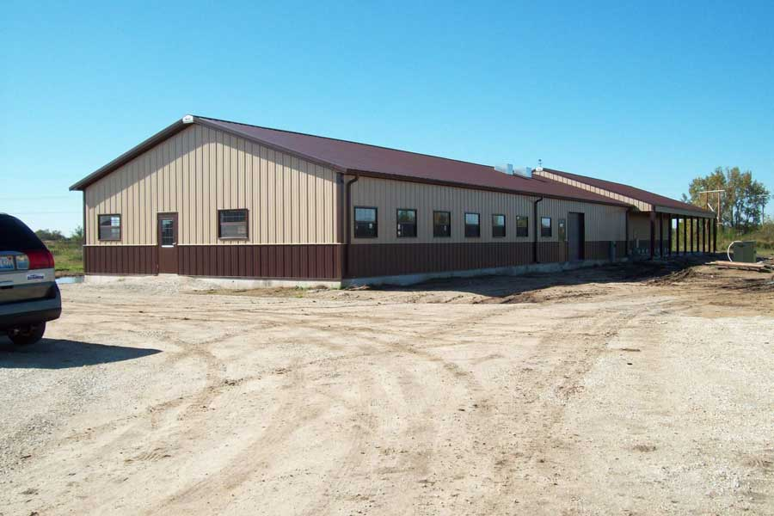
Our shelter
High-quality ventilation
In-floor heating
“Meet” room
Large dog exercise yards
Rooms for
  Quarantine, treatment
  Maternity, kittens
  Pet food preparation
  Laundry and grooming
  Storage/utilities
Our animals and property are protected 24/7 by a security system. We have life safety measures in place to monitor room and kennel tempera-tures and we receive alarms if temperatures rise or drop rapidly.
Notes:
We operate Whiteside County’s only animal shelter. Our facility was built in 2011 after many years of donations by the community. The building is state-of-the-art, with hospital-quality ventilation, in-floor heating and rooms to meet a range of needs. Our cats live in small groups, in open rooms and are never caged except for medical necessity.

Slide 5
We have been growing!
Programs to reduce animal intake
Programs to promote adoption
Partnerships with kill shelters to rescue animals
Training for volunteers and shelter staff
  Animal safety
  Animal first aid
  Emergency response

Slide 6
We’re at the leading edge
We practice humane capacity of care (intake limited to ability to provide humane care and housing)
We follow guidelines of the Association of Shelter Veterinarians
We provide enrichment for our animals
  Music designed to calm
  Toys designed to stimulate
  Lots of volunteer interaction
Notes:
We want the animals who come to Happy Tails to have the best care we can give them, not just medically but in every way. We did our homework. We follow principles established by leaders in the fields of animal rescue, starting with humane capacity of care, meaning we take in only as many animals as we can give quality care to based on our resources.
We provide enrichment to our animals. We’ve set up a sound system that pipes music and calming sounds throughout the shelter. We can see the difference. We make sure all the animals have toys designed to interest them, and our volunteers play with them and give them as much love and attention as they can. Many of our volunteers come to the shelter specifically to socialize our dogs and cats, and take our dogs for walks.
We’re continuing to learn more about shelter animal care, which is a growing field that now has its own veterinary association. The ASPCA and other humane groups are a rich source of guidance.

Slide 7

Meet Your Match
Developed by ASPCA
Matches adopters with pets based on preferences and lifestyle
Adopters can take brief survey; available online
Notes:
Meet Your Match helps adopters find the best pet based on preferences and lifestyle.
Paw It Forward lets donors pay the adoption fee for a particular Happy Tails animal. When the animal is adopted, the adopter is informed that the adoption fee has already been paid and is given the opportunity to "paw it forward" and donate the adoption fee to another animal waiting for a home.
The SAFER dog evaluation program
Pets for Life Community Outreach

Slide 8
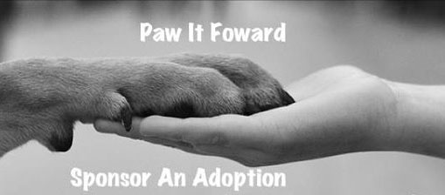
Paw It Forward
Donor pays the adoption fee for an animal.
When the animal is adopted, the adopter can choose to "paw it forward" and donate the adoption fee to another animal waiting for a home.

Slide 9
SAFER® Aggression Assessment
ASPCA’s SAFER® is a predictive, consistent method for evaluating the probability of canine aggression in individual dogs.

Slide 10

Pets for Life Community Outreach
Microchip database (no cost)
Pet food pantry for owners in need
Reduced-cost spay/neuter program
Reduced-cost wellness clinics
Notes:
Our Pets for Life program offers several programs to Whiteside County residents. We have a microchip registry that can help reunite lost pets with their owners efficiently. We offer a pet food pantry for owners who need a little help, and we offer spay and neuter services and vaccinations at a reduced cost for pet owners enrolled in a public assistance program.

Slide 11
Adoptions continue to increase
*Projected
Notes:
Pet adoptions have been rising steadily. We attribute this to an increased presence in the community, more use of news and social media, and mobile adoption events.

Slide 12
Shelter time continues to decrease
*Projected

Slide 13
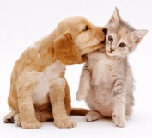
But that’s not the whole story
In the first half of 2014
Rehomed without coming to the shelter | 21
Reunited with owner | 10
Assisted through food pantry | 713

Slide 14
Healthcare is our top priority
Limited intake affords higher quality of care
Short stays in the shelter means lower costs
Notes:
Our highest priority and biggest budget item is medical care for our animals. That involves routine medical care and spay or neuter for all the animals, as well as occasional emergency care that may require surgery or other relatively costly procedures. We’ve worked with our veterinarian, shelter staff, and volunteers to make animal health our top priority. Animal health is up and veterinary costs are down.

Slide 15
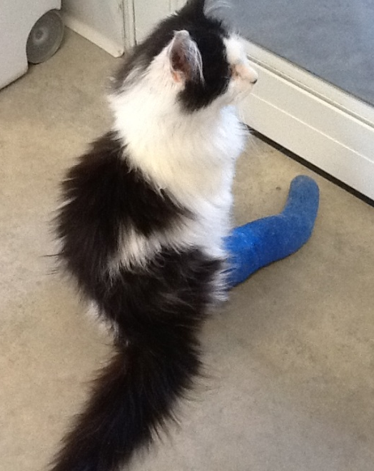
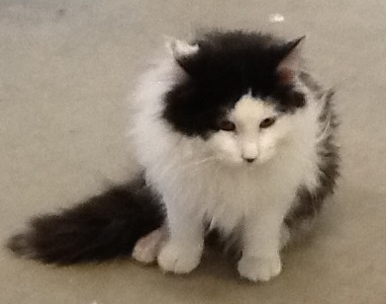
Zeus
Critically injured by car
Good citizen paid for veterinary care and Zeus came to Happy Tails to recover
After 3 casts and rehab, made full recovery
Now in a loving new home
Notes:
Zeus was found with a badly broken leg from being hit by a car. The good samaritan who found him generously paid for his medical care. Zeus came to Happy Tails to recover. It was touch and go, but finally after 3 casts, he kept his leg and made a full recovery. Zeus now lives with a loving new family.

Slide 16
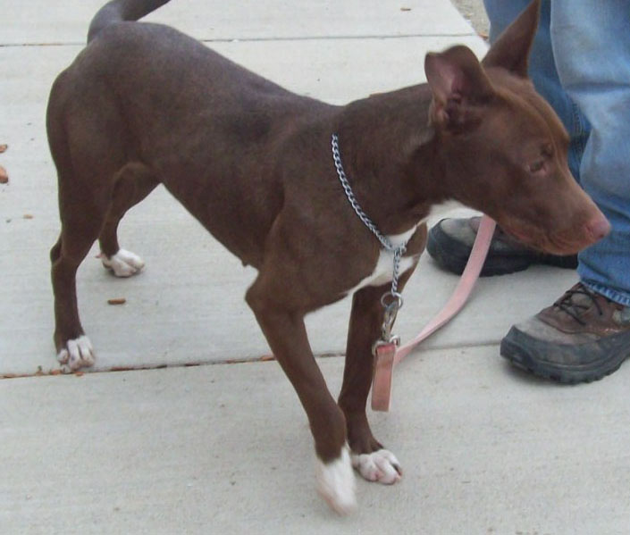
Cinnamon
Found abused in small cage at a garage sale
Volunteer brought her to shelter, thin and scared
Safe and secure, she gained weight and was no longer traumatized or stressed
Now in a loving forever home
Notes:
Cinnamon was found at a garage sale, in a small cage with a sign on it saying “Free dog.” A kind volunteer brought her to Happy Tails. When she came in she was dangerously underweight and so scared that every time she was petted she would urinate. In a safe, secure environment she began to gain weight and realize she was among friends. It wasn’t long before she relaxed and was able to be the sweet, outgoing girl she really was. She was recently adopted and is now in a safe and loving home.

Slide 17
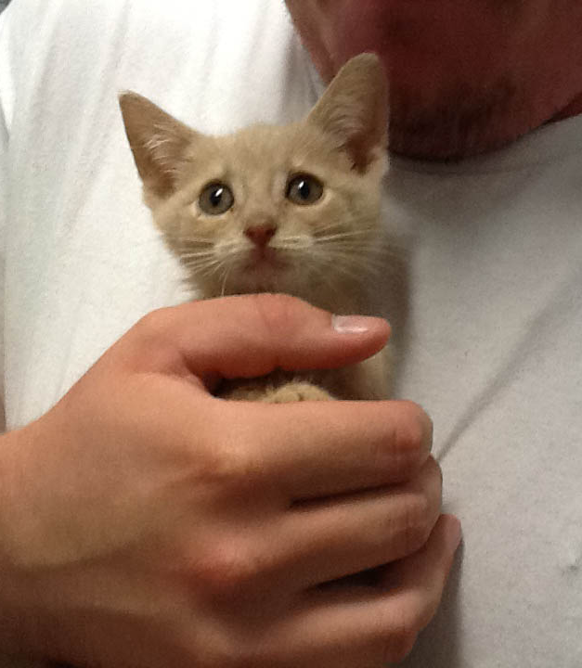
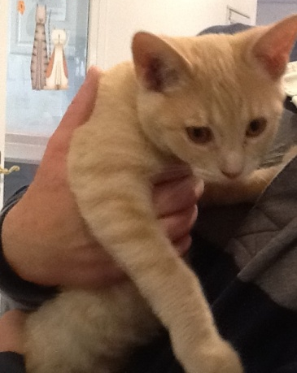
Charlie
Came to us clinging to life
Veterinary care and TLC from a special volunteer brought him back
He thrived and was adopted
Notes:
Charlie was in very bad shape when he came to us, suffering from “failure to thrive.” He received veterinary care but maybe more important, care from a very special volunteer, who took Charlie home for feeding and cuddling every night. It took a while, but eventually Charlie Tuna (as the volunteers called him) began to thrive. He became a shelter favorite and we all were so happy when his new family found him.

Slide 18
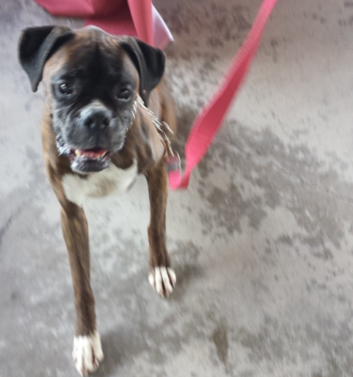
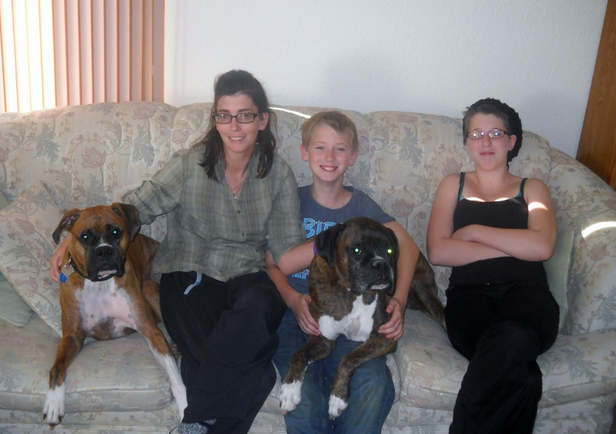
Tyson
Found running loose
Skin and bones, scared
Special diet, volunteer TLC
Now with his loving new family
Notes:
A good samaritan rushed into our shelter one day, concerned about a dog she had seen running loose on Route 30. She was concerned he would be hit by a car. A Happy Tails volunteer went to the place where she had seen the dog, and there he was, thin and scared. The dog was skittish at first, but finally let our volunteer approach him and lead him to our van. We named the boxer Tyson. It was clear he’d been on his own for some time; he was severely underweight and had several scars and lesions. But with some time and care, Tyson blossomed. He was adopted into a loving family and continued recovering to be the beautiful boy he is today.

Slide 19
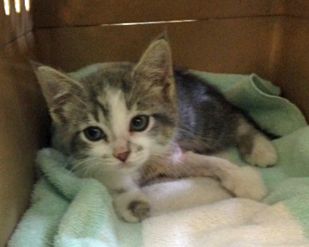
Daniel
Came to us at age 6 weeks with broken leg from dog attack
Volunteers took him to a veterinary specialist
His leg was saved and he was adopted, along with his kitten friend Roxie

Slide 20
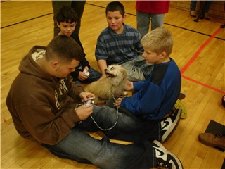
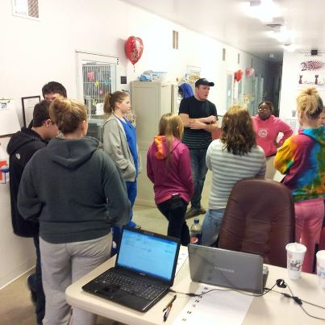
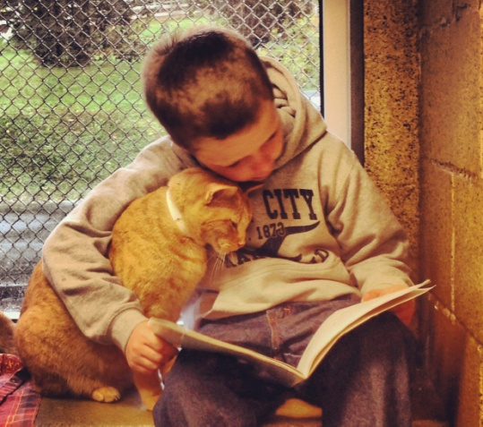
Humane Education
Visit schools and talk with students K-12 about pets, pet care, and animal shelters
Host field trips to the shelter
Read to the Cats program
Notes:
Another part of our mission is humane education, which the ASPCA describes as programs intended to establish a sense of responsibility in participants and foster respect, kindness, and empathy towards animals and other humans. Happy Tails visits schools to talk with kids from kindergarten through high school about pet care, the role of animal shelters, and humane behavior toward all animals. We also host visits from children who read to our cats; this helps build reading skills and confidence in the kids and gives our cats more “people” time.

Slide 21
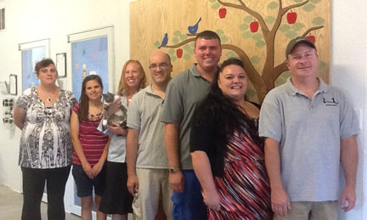
No wonder we’re “a model shelter”!
The Humane Society of the United States visited us and said we are a model shelter, on the road to longevity!
“You are doing so many things right!”
Notes:
Each year the staff of the Humane Society of the United States visits selected shelters that they think are doing good things—using practices that could benefit other shelters. Last year the Society visited Happy Tails and found many good things to say about us. They gave us the ultimate compliment when they asked if they could refer other shelters to us. We said yes!

Slide 22
What we see in our future
More lives saved, more lives touched
  Mobile adoption unit
More educational outreach
Broader service to the community
  Larger low-cost spay/neuter program
Notes:
Our number one goal is to save more lives. Using the tools we’ve begun to develop and based on the results we’ve seen, we believe that this year we can rescue and adopt out more pets than ever before. Our teens are an amazing group of young people who love what they do and are capable of doing even more. We want to establish groups for younger kids, as well. Youth groups are our key to the future. And we want to give more back to the community that has invested in us.

Slide 23

Please Let It Grow!
Dog bone $5,000
Baseball $5,000
Bluejay $2,500
Apple $1,500
Shingle $1,000
Leaf $ 850
As little as $5 per month toward a leaf
Notes:
We’ve created a tree on our shelter wall to help grow the great things we’ve planted. We can save more animal lives and be an even greater resource for the community. Please be part of it. Pledge a donation of as little as $5 a month and let it grow!

Slide 24
The power of $5
Approximately 10,000 households in Sterling and Rock Falls
Number of Households Donating per Month | Total Annual Donation
10 percent (1,000) | $60,000
25 percent (2,500) | $150,000
50 percent (5,000) | $300,000
100 percent (10,000) | $600,000

Slide 25

Stay in touch!
happytailsanimalshelter.org
Follow us!

