Slide 1
Chapter Sexual Expression

Slide 2
Celibacy
Types of celibacy
Complete celibacy
Partial celibacy

Slide 3
Reasons for or Benefits of Celibacy
Religious, moral beliefs
Waiting for the appropriate person
Learning about other aspects of self
Health considerations
During substance abuse recovery

Slide 4
Erotic Dreams
Expression and exploration of desires taking place within the mind
Nocturnal orgasm

Slide 5
Erotic Fantasy
Can occur during daydreams, masturbation, or during sexual encounters
95% of women and men fantasize
Fantasy content among heterosexual, bisexual, and homosexual individuals are similar, except for sex of imagined partner

Slide 6
Sexual Fantasy
Function of sexual fantasies
Source of pleasure and arousal
Overcome sexual anxiety
Acceptable expression of socially unacceptable behavior
Impact of personal religious views on fantasy
Gender similarities and differences
Fantasies: Help or hindrance?
Most research points to helpful

Slide 7
Perspectives on Masturbation
Traditional condemnation
Viewed as non-procreational
Erroneous health concerns
Freud considered it immature
Contemporary research has established that it is not harmful

Slide 8
Purposes for Masturbation
Relieves sexual tension
Means of self-exploration
Assists in physical relaxation

Slide 9
Kissing and Touching
Kissing
Cross-cultural practices and attitudes toward kissing
Touching
Cornerstone of human sexuality
Whole body is responsive
Personal preferences
Specific erogenous zones
Tribadism (a sex act in which a woman rubs her vulva against her partner's body for sexual stimulation, especially for ample stimulation of the clitoris. )

Slide 10
Manual Stimulation of Genitals
Individual differences with regard to manual stimulation
Most women need consistent touching through orgasm
Men may not like to be touched just after orgasm

Slide 11
Oral-Genital Stimulation
Types: cunnilingus and fellatio
Acceptance varies
More unmarried people engaging in oral sex now than reported in Kinsey’s survey

Slide 12
Anal Stimulation
Prevalence is lower than other forms of sexual activity, but the number of people who have engaged in anal sex is increasing
Health risk (HIV, other infections)
Lubricants and gentle insertion needed
Anilingus/rimming

Slide 13
Coitus and Coital Positions
Position variations
Man or woman above
Face to face
Side-lying
Rear entry

Slide 14
What Is Your Favorite Intercourse Position?

Slide 15
Tantric Intercourse
Eastern path to spiritual enlightenment
Sexual expression considered a form of spiritual meditation
Involves control and delay of male orgasm with focus on harmony with partner

Slide 16
Sexual Variation
sexual variation is behavior in which less than the majority of individuals engage in. Not abnormal, as it varies widely by culture.

Slide 17
Paraphilia
Paraphilia - recurring intense sexually arousing fantasies, urges or behaviors involving nonhuman objects, suffering or humiliation, or children or other nonconsenting individuals or animals. Tend to be injurious, compulsive, long-standing and may be consenting or nonconsenting.
Para (prefix): A prefix with many meanings, including: alongside of, beside, near, resembling, beyond, apart from, and abnormal.

Slide 18
Domination and Submission
Form of consensual fantasy sex involving no pain with perceived power as the central element.
Used to be called officially sadomasochism (S&M)

Slide 19
Noncoercive Paraphilias
Fetishism is sexual attraction to objects. Object is desired or preferred for sexual arousal.
Transvestism is the wearing of clothes of the other sex, usually for sexual arousal.

Slide 20
Coercive Paraphilias
Zoophilia involves animals as the preferred sexual outlet even when other outlets are available.
Voyeurism is the nonconsensual and secret observation of others for the purpose of sexual arousal.
Exhibitionism exposure of the genitals to a nonconsenting stranger.

Slide 21
Coercive Paraphilias
Telephone scatologia nonconsensual telephoning of strangers and often involves obscene language.
Frotteurism involves touching or rubbing against a nonconsenting person for the purpose of sexual arousal.
Necrophilia is sexual activity with a corpse.

Slide 22
Coercive Paraphilias
Pedophilia refers to sexual arousal and contact with children aged 13 or younger by adults. Person must be at least 16 and at least 5 years older than the child. Illegal in all states.
For people with pedophilia the youth of the child is more important than gender. Heterosexual and gay men may be periodically attracted to boys; gay men with pedophilia are less attracted to girls.

Slide 23
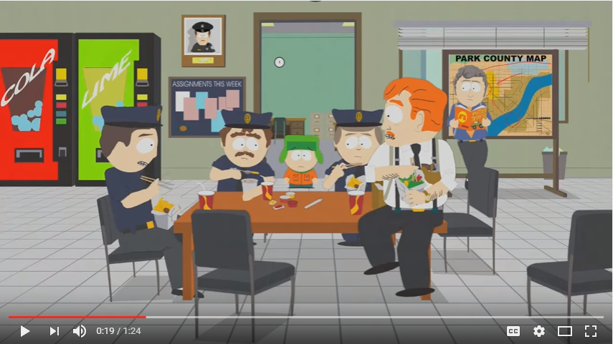
Pedophilia
The majority of people who act on pedophilia know their victim.
About half have been married. Fondling and masturbation are the most common activities.
Few reported females with pedophilia; underreported for two reasons: 1)stereotypes of nurturance and 2)pedophilic activities may not be recognized as such or viewed positively.
Notes:
https://www.youtube.com/watch?v=h7SpXGz-XOc

Slide 24
Coercive Paraphilias
Sexual sadism sexual urges or fantasies of intentionally inflicting real physical or psychological pain or suffering on a person.
Sexual masochism urge or fantasy of being humiliated or made to suffer through real behaviors, not simulated ones.

Slide 25
Coercive Paraphilias
BDSM bondage, discipline, sadism, and masochism.
Autoerotic asphyxia a form of sexual masochism linking strangulation with masturbatory activities.

Slide 26
Origins and Treatment of Paraphilias
Paraphilias likely result of social/environmental, psychological and biological factors.
They are difficult to treat and relapses occur.
Prevention programs may be the most effective way to address paraphilias.

